Slide 1

Tbilisi State University
School of Exact and Natural Sciences:
Department of Chemistry
Research Topic:
SYNTHESIS AND ENANTIOSEPERATION OF NEW CHIRAL HYDANTOINE DERIVATIVES IN HIGH PERFORMANCE LIQUID CHROMATOGRAPHY USING NORMAL MOBILE PHASES
Speaker: Ana Rakviashvili
Supervisors:
Bezhan Chankvetadze
Rusudan Kakava

Slide 2
Hydantoins
The analyte molecules used in this experiment – hydantoin derivatives were synthesized by Prof. Alessandro Volonterio and his scientific group at Politecnico di Milano,
Hydantoin derivatives are interesting compounds in terms of their pharmacological activity. Different studies have demonstrated their antiepileptic, antiarrhythmic, antidiabetic and other properties

Slide 3
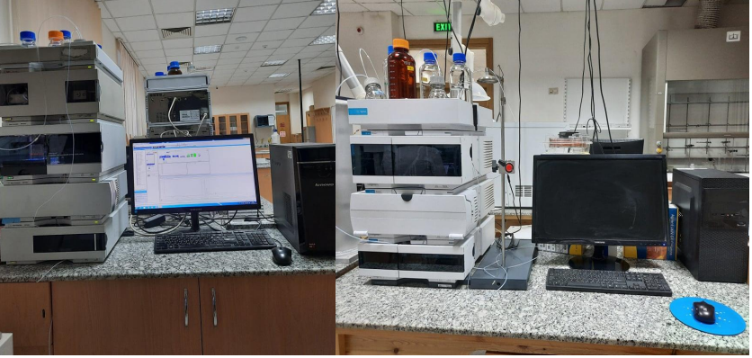
Used Equipment
Agilent Techs High Performance Liquid Chromatography (HPLC) 1200 series. | Agilent Techs High Performance Liquid Chromatography (HPLC) 1260 series.

Slide 4
The list of hyndatoins with names and structures
N | Name | Structure
1 | benzyl 2-(3-(2-((tert-butoxycarbonyl)amino)ethyl)-1-(tert-butyl)-2,5-dioxoimidazolidin-4-yl)acetate
2 | 2-(3-(2-acetamidoethyl)-1-(tert-butyl)-2,5-dioxoimidazolidin-4-yl)-N-cyclohexylacetamide
3 | 2-(3-(2-acetamidoethyl)-1-((3s,5s,7s)-adamantan-1-yl)-2,5-dioxoimidazolidin-4-yl)-N cyclohexylacetamide
4 | benzyl 2-(3-(2-(tert-butoxy)-2-oxoethyl)-1-(tert-butyl)-2,5-dioxoimidazolidin-4-yl)acetate
5 | 2-(1-(tert-butyl)-3-(2-((2-(methylamino)-2-oxoethyl)amino)-2-oxoethyl)-2,5-dioxoimidazolidin-4- yl)-N-(4-methoxybenzyl)acetamide
6 | 2-acetamido-N-(2-(3-(tert-butyl)-5-(2-((4-chlorobenzyl)amino)-2-oxoethyl)-2,4-dioxoimidazolidin 1-yl)ethyl)acetamide

Slide 5
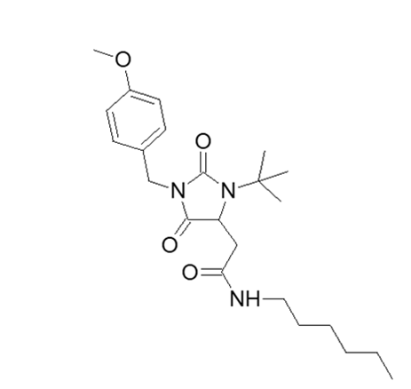
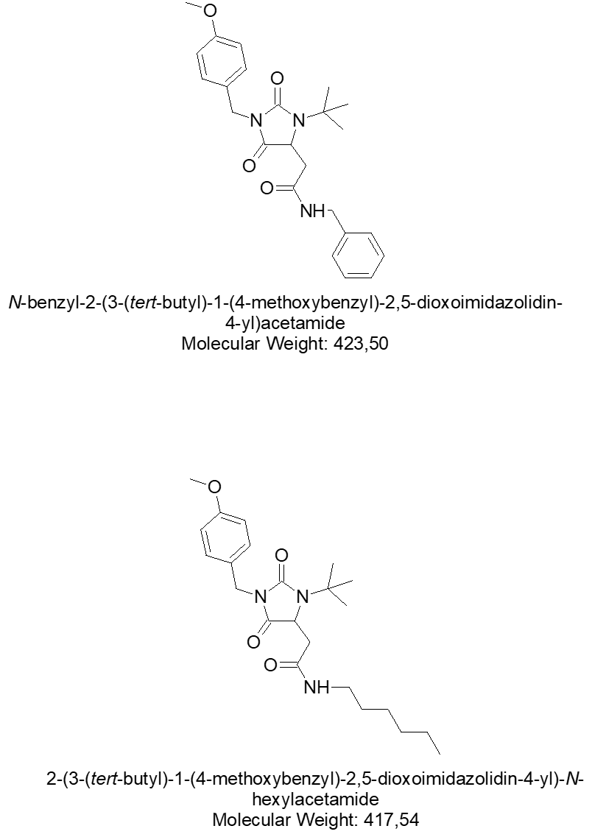
The list of hyndatoins with names and structures
9 | (1-((3s,5s,7s)-adamantan-1-yl)-3-(2-((2-((4-chlorobenzyl)amino)-2-oxoethyl)amino)-2-oxoethyl)- 2,5-dioxoimidazolidin-4-yl)-N-(2-(isobutylamino)-2-oxoethyl)acetamide
12 | 2-acetamido-N-(2-(3-(tert-butyl)-5-(2-((2-((4-methoxybenzyl)amino)-2-oxoethyl)amino)-2- oxoethyl)-2,4-dioxoimidazolidin-1-yl)ethyl)acetamide
15 | 1-(4-(2-(benzhydrylamino)-2-oxoethyl)-3-benzyl-2-oxoimidazolidin-1-yl)-N-(2-(3a,7a-dihydro-1H-indol-3-yl)ethyl)cyclobutanecarboxamide
16 | ethyl 2-(3-(1-((2-(1H-indol-3-yl)ethyl)carbamoyl)cyclobutyl)-5-((2,2-diphenylethyl)amino)-2,4-dioxoimidazolidin-1-yl)acetate
19 | 2-(3-(tert-butyl)-1-(4-methoxybenzyl)-2,5-dioxoimidazolidin-4-yl)-N-hexylacetamide
20 | N-benzyl-2-(3-(tert-butyl)-1-(4-methoxybenzyl)-2,5-dioxoimidazolidin-4-yl)acetamide

Slide 6

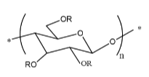
The list of used stationary and mobile phases:
As mobile phases mixtures of n-hexane and isopropanol with various ratios were used
1:1 7:3 9:1
Chiral Selectors:
Cellulose derivates and amylose derivates were used as stationary phases:
Cellulose derivates
Amylose derivates

Slide 7





Cellulose based stationary phases :
N | Column | Name | Structure
1 | Cellulose-1 | Cellulose tris(3,5-dimethylphenylcarbamate)
2 | Cellulose-2 | Cellolose tris(3-chloro,4-methylphenylcarbamate)
3 | Cellulose-3 | Cellulose trus(4-methylbenzoate)
4 | Cellulose-4 | Cellulose tris(4-chloro,3-methylphenylcarbamate)
5 | i-Cellulose-5 | Cellulose tris(3,5-dichlorophenylcarbamate)

Slide 8





Amylose based stationary phases :
N | Column | Name | Structure
1 | Amylose-1 (SP6) | Amylose tris(3.5- dimethylphenylcarbamate)
2 | i-Amylose-1 (SP9) | Amylose(3.5- dimethylphenylcarbamate) immobilized
3 | Amylose-2 | Amylose tris(5-chloro-2-methylphenylcarbamate)
4 | i-Amylose-3 (SP10) | Amylose tris (3-chloro-5-methylphenylcarbamate) immobilized
5 | - | Amylose tris(3-chloro-4-dimethylphenylcarbamate)

Slide 9
The process of the experiment :
On the first step of the experiment, 12 chiral hydantoin derivatives were evaluated in high-performance liquid chromatography using normal mobile phases.
Afterwards, enantiomers have been fractionated and spiked samples with the enantiomers’ ratio of 1:1.5 to 1:2 have been prepared;
Spiked samples have been investigated using 10 polysaccharide stationary phases, cellulose and amylose derivatives, as mobile phases mixture of n-hexane and isopropanol with various ratios were used.
Statistical analysis about retention and separation parameters of enantiomers have been performed;
Correlation between the structure and retention / separation parameters have been estimated.

Slide 10
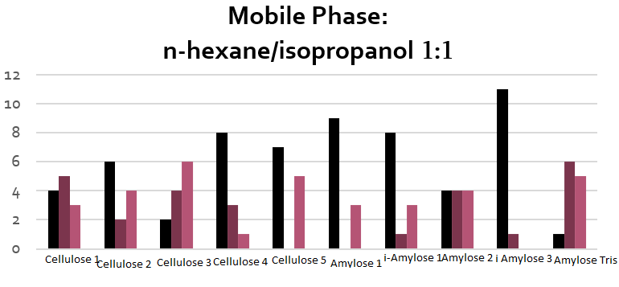
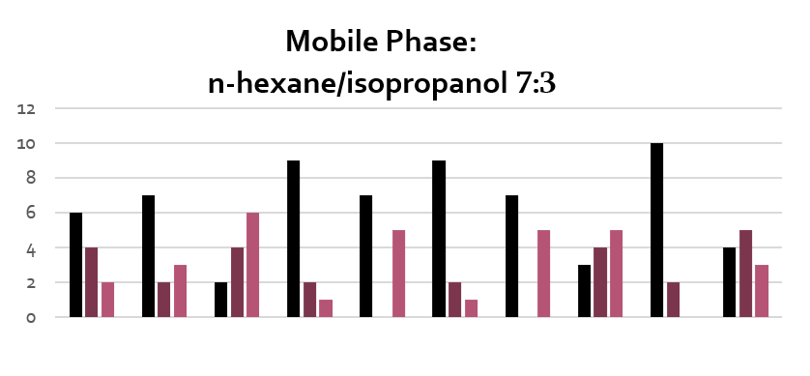
Structure of chiral selectors
As we can see from the results of separation of chiral hydantoins it is optimal to analyze the substance in the n-hexane/isopropanol phase using Amylose tris (3-chloro-5-methylphenylcarbamate).

Slide 11
Effect of mobile phase on enantiomer separation
Chiral hydantoins are separated better by hexane isopropanol(7:3) phase while using Amylose 1 chiral selector.

Slide 12
Effect of mobile phase on enantiomer separation
For Amylose tris chloro-4-methylphenylcarbamate, Amylose 2 and i-Amylose 1 we had the worst separation rate in hexane isopropanol (9:1) phase.

Slide 13
Effect of mobile phase on enantiomer separation
In the case of Cellulose 1 and Cellolose 2, we had the best separation indicator in hexane isopropanol phase with the ratio of 7:3.

Slide 14
Effect of mobile phase on enantiomer separation
For Cellulose 3 we had the best separation indicator in hexane isopropanol phase with the ratio of 7:3 and 1:1.

Slide 15
Effect of mobile phase on enantiomer separation
In the case of Cellulose 4 and i-Cellulose 5, the best separation indicator was shown in the hexane isopropanol phase with a ratio of 7:3.

Slide 16

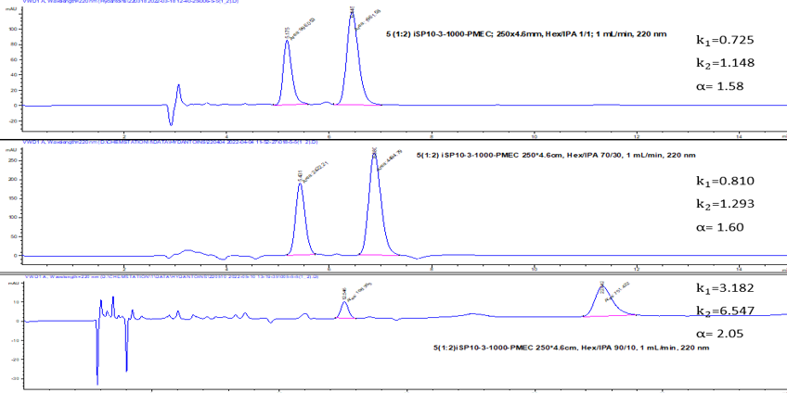
Effect of mobile phase composition on retention and separation parameters
Following chromatograms show the effect of increasing the proportion of hexane in the mobile phase, on the retention parameters on the i-amylose tris column

Slide 17

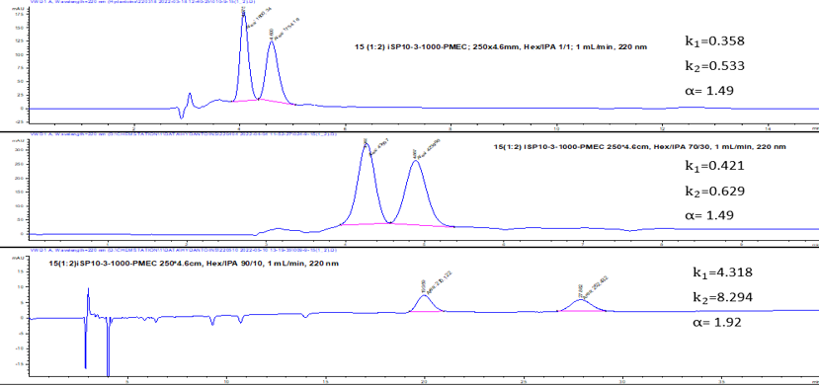
Effect of mobile phase composition on retention and separation parameters
Following chromatograms show the effect of increasing the proportion of hexane in the mobile phase, on the retention parameters on the i-amylose tris column

Slide 18
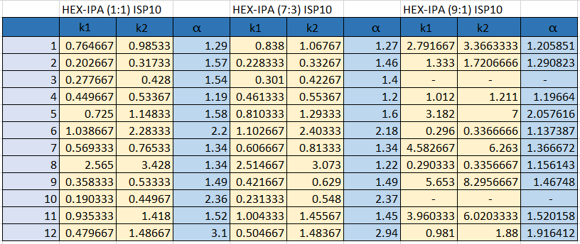
The numerical values of the retention factor and selectivity of enantiomers of chiral hydantoins are given in the table.

Slide 19
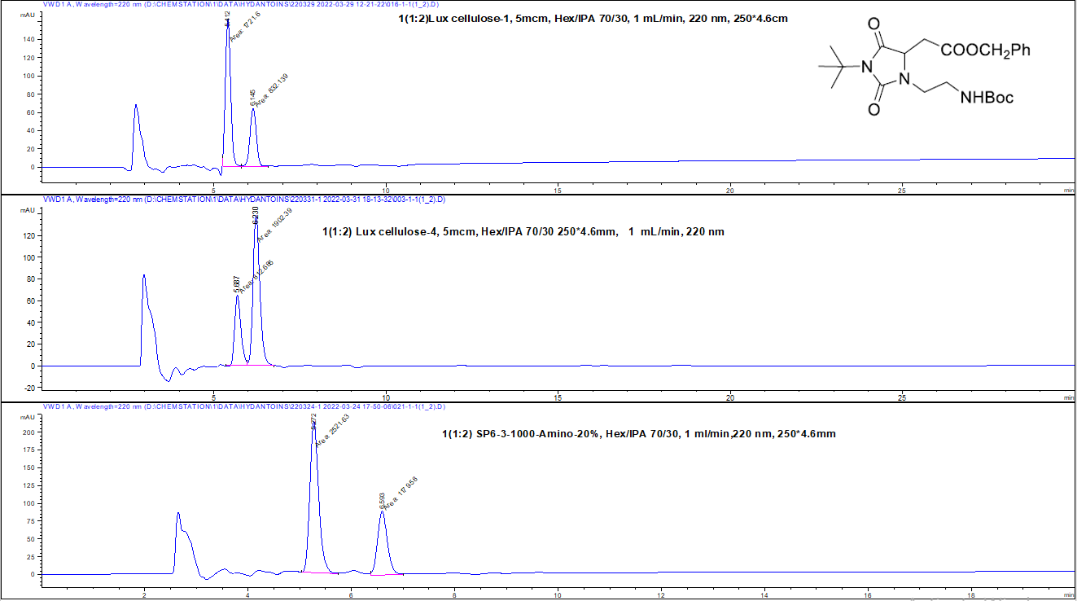
Reversal of elution order of enantiomers
The reversal of elution order of enantiomers was observed in different stationary phases, especially when the chiral selector was changed from cellulose to amylose derivative. Following example was obtained in the n-hexane and isopropanol (7:3) mobile phase.

Slide 20
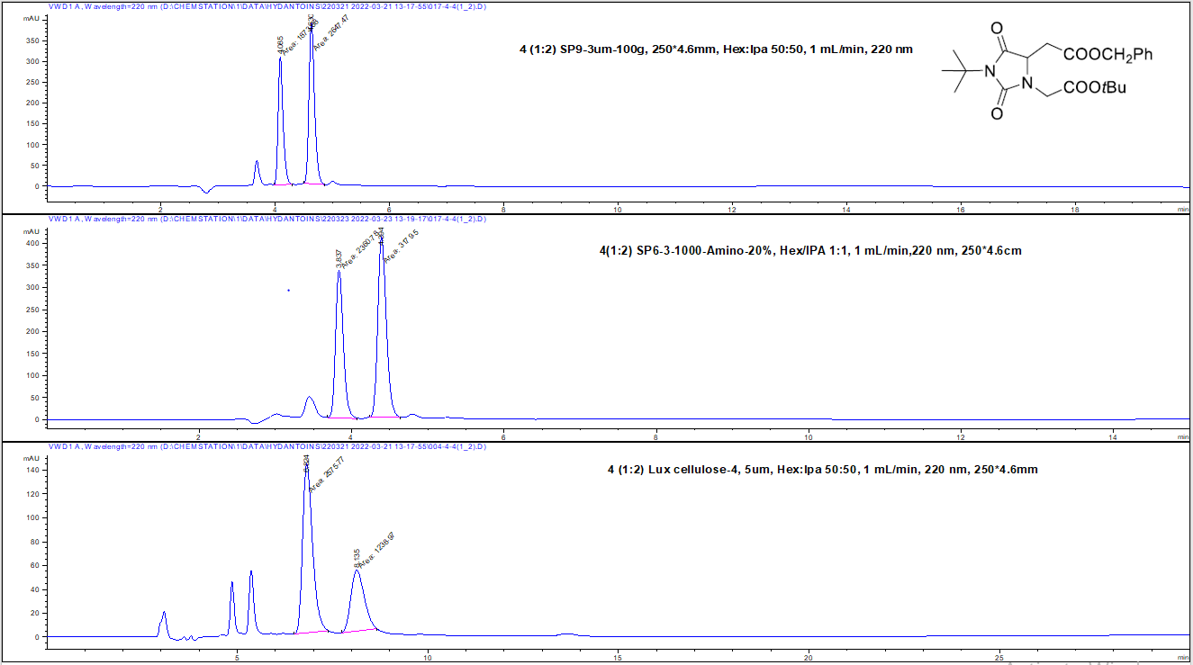
Reversal of elution order of enantiomers
Following example was obtained in the n-hexane and isopropanol (1:1) mobile phase.

Slide 21
Conclusion
From chiral selectors, the highest ability to separate enantiomers was shown by the amylose-based stationary phase -amylose tris (3-chloro-5-methylphenylcarbamate).
The retention and separation parameters characteristics of enantiomers of chiral hydantoins increase with the increase of the non-polar component (n-hexane) in the mobile phase.
A reversal of the elution order of enantiomers was detected for all twelve analytical samples.

Slide 22
Thanks for your attention!

