Slide 1
Environment hazard studies using machine learning approach
Ana Palavandishvili Master student of Engineering Physics
Supervisor Prof. Tamar Bzhalava
Department of Engineering Physics Georgian Technical University Tbilisi, Georgia
email: palavandishvili.ana21@gtu.ge
2022, September 16

Slide 2
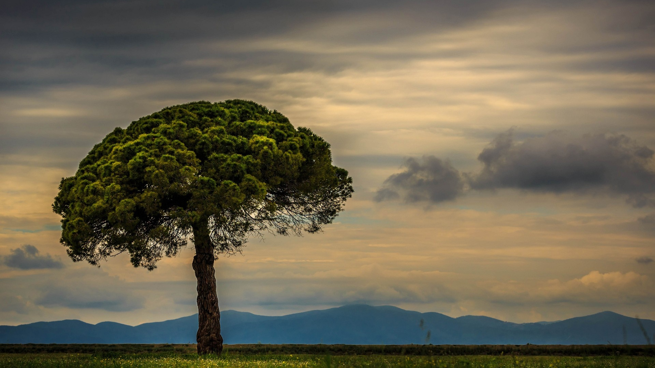
Aim of the Project
Study some drought related processes and other natural hazards
Estimation and analyze the distribution of precipitation over the territory of Georgia
Evaluation the possibility of environment hazard detection at the early stage, monitor and prediction.

Slide 3
Main topics
Types of data collection
Method of environment data analysis
Modern approach
Summary

Slide 4
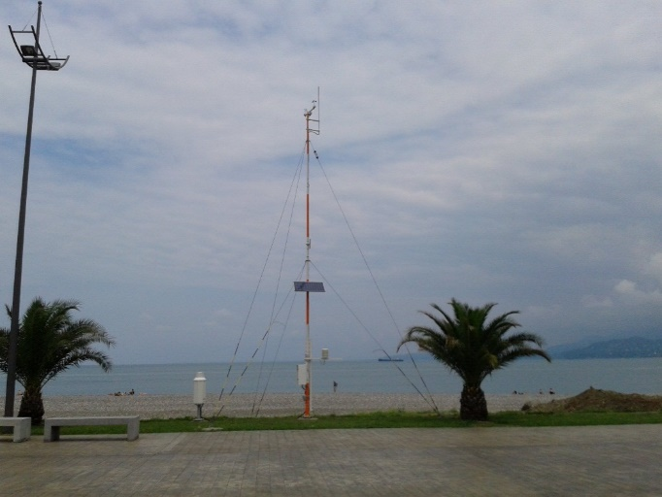
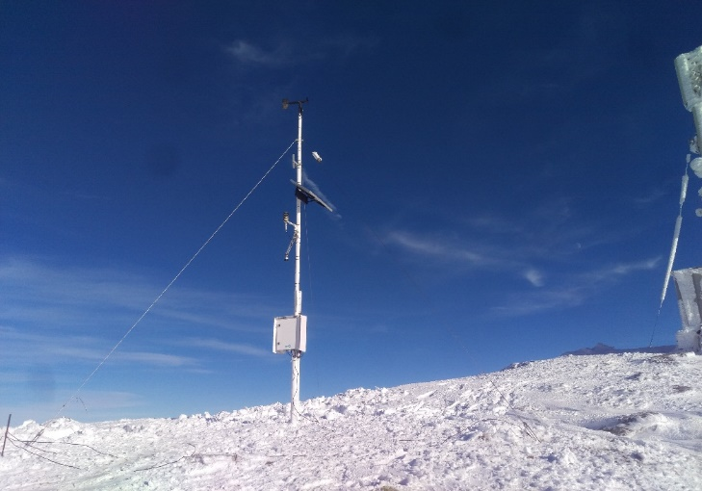
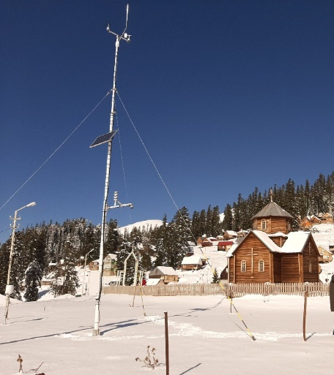
Types of data collection
Satellite
Ground base
National Environmental Agency

Slide 5
Types of data collection In 1979 NOAA’s first polar-orbiting environmental satellite was launched

Slide 6
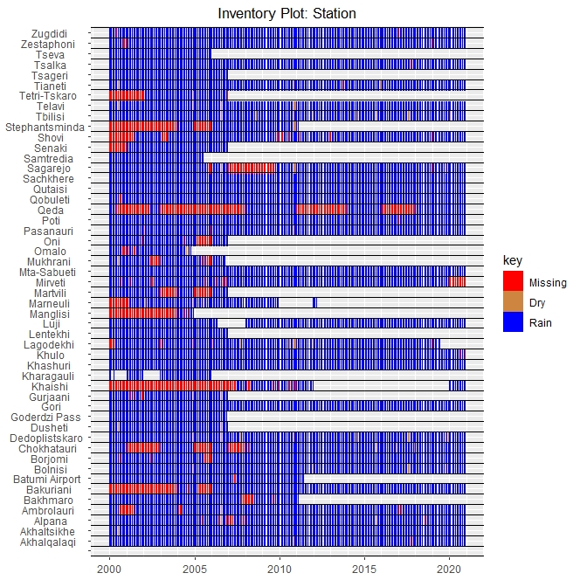
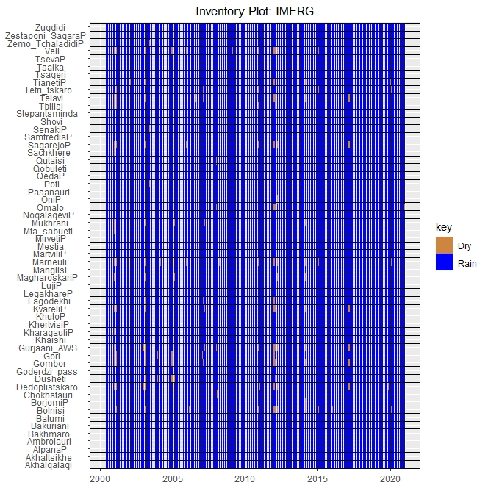
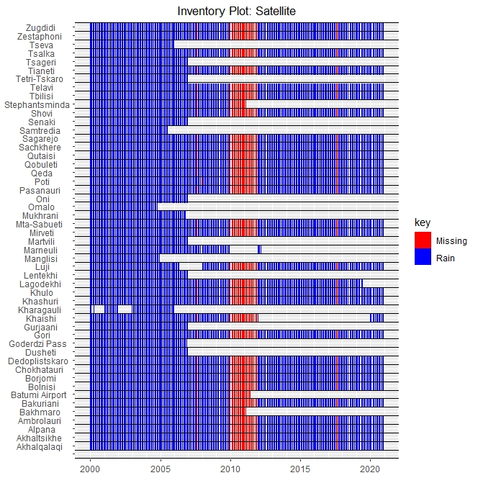
Inventory of Station and Satellite Data (territory of Georgia)
Inventory of Stations
Inventory of IMERG satellite
Inventory of CHIRPS satellite

Slide 7
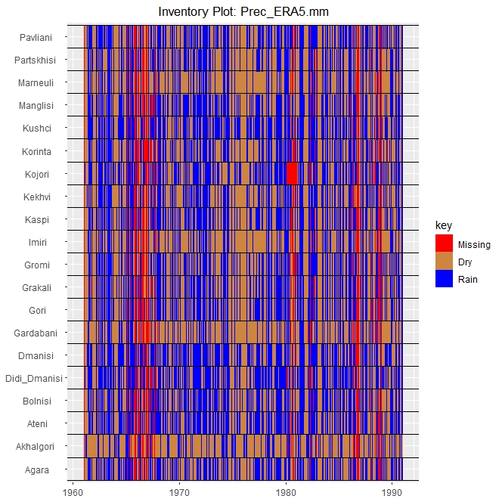
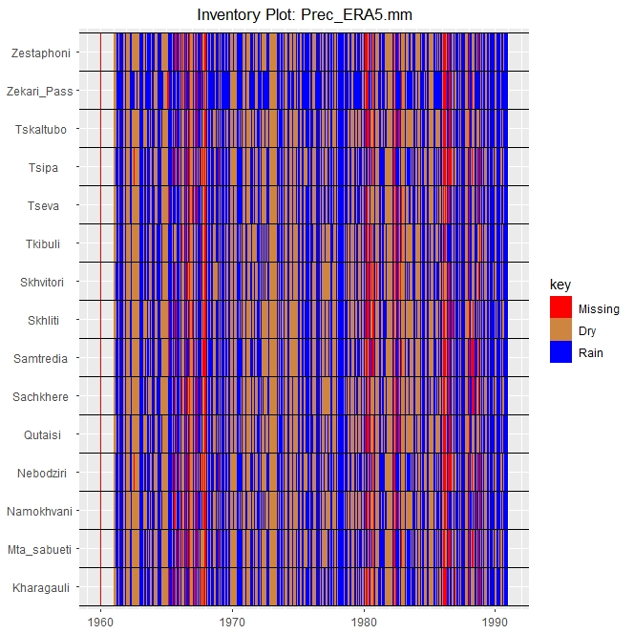
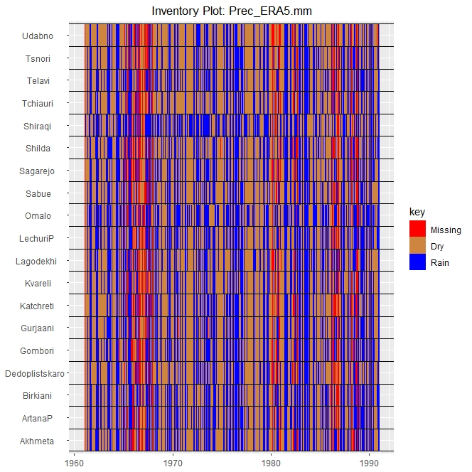
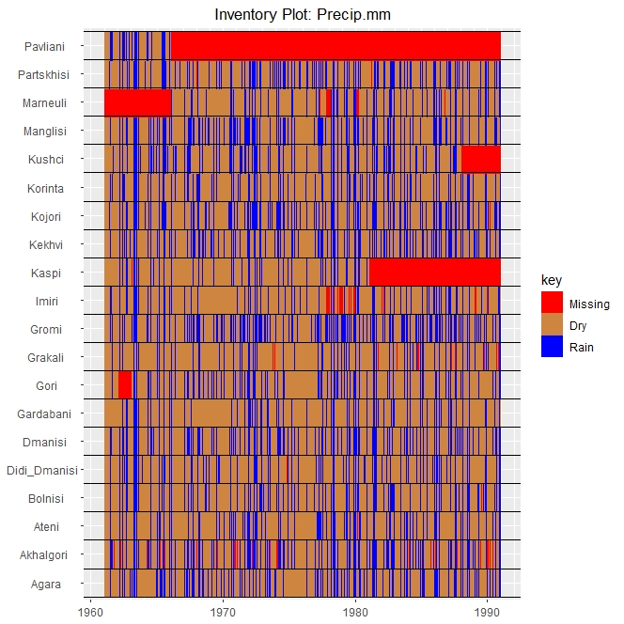
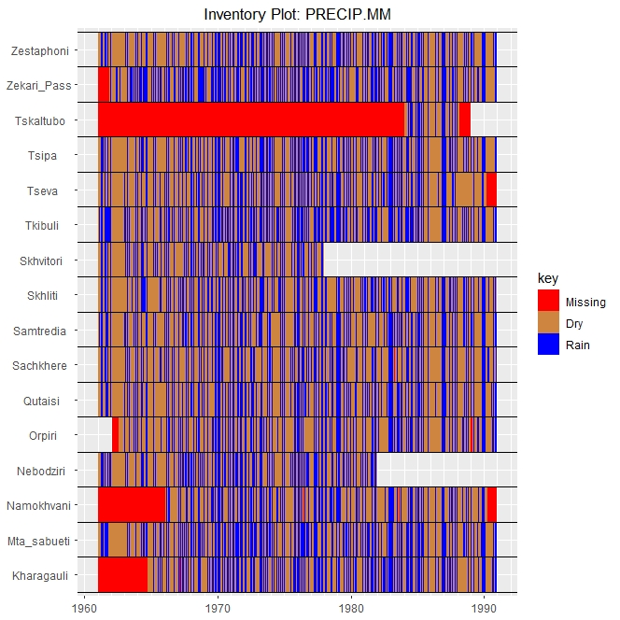
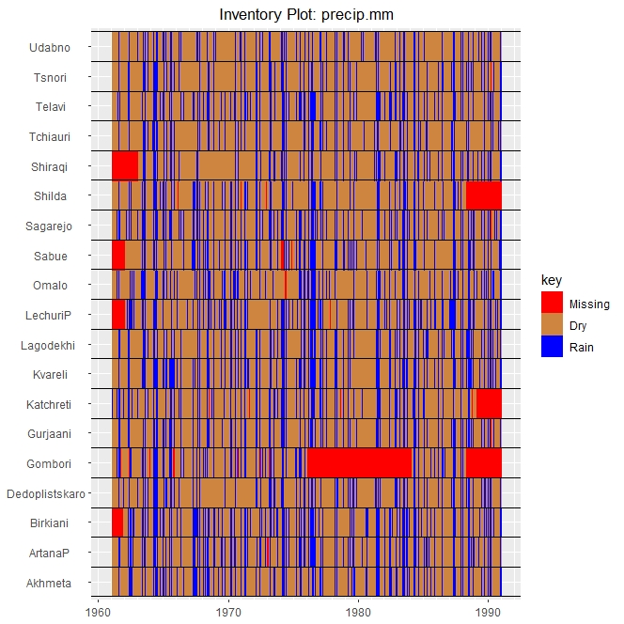
1961-1991 years
Imereti region
Qartli region
Kakheti region

Slide 8
Statistical Method of Environment Data Analysis
Station | correlation | Mean absolute error | Standard deviation
Akhalqalaqi | 0.66759 | 28.7 | 26.84318
Alpana | 0.587625 | 41.8 | 46.65444
Ambrolauri | 0.64799 | 27.6 | 35.83004
Goderdzi Pass | 0.491516 | 46.3 | 45.11875
Gori | 0.600696 | 18.8 | 23.40047
Gurjaani | 0.68528 | 29.1 | 38.4494
Khaishi | - | - | -
Kharagauli | - | - | -
Khashuri | 0.602859 | 20.7 | 25.35372
Khulo | 0.668731 | 49.2 | 58.73967
Lagodekhi | 0.597565 | 56.8 | 60.23253
Lentekhi | 0.553973 | 44.3 | 53.99864
Luji | 0.590198 | 42.4 | 54.02934
Mukhrani | 0.670568 | 22.5 | 24.8989
Omalo | - | - | -
Oni | 0.520496 | 36.2 | 39.74461
Shovi | 0.717298 | 30.0 | 36.37001
Stephantsminda | - | - | -
Tbilisi | 0.678032 | 21.1 | 28.35372
Telavi | 0.693299 | 26.0 | 35.45118
Tetri-Tskaro | - | - | -
Tseva | 0.607114 | 39.7 | 41.05641
Zestaphoni | 0.462851 | 41.3 | 54.92459
Zugdidi | 0.603897 | 51.9 | 62.13524
Standard deviation
Pearson‘s correlation

Slide 9
Statistical Method of Environment Data Analysis
stations | Standart deviation | correlation | Mean absolute error
Akhmeta | 5.76054943 | 0.5936142 | 2.22960019
ArtanaP | 6.81349292 | 0.58776933 | 2.34396992
Birkiani | 7.62295759 | 0.63601722 | 2.50106601
Dedoplistskaro | 5.177286 | 0.57295248 | 2.34935663
Gombori | 5.48090201 | 0.57076494 | 2.1249113
Gurjaani | 6.29609913 | 0.61040494 | 2.13628114
Katchreti | 5.37111452 | 0.5144723 | 2.64170272
Kvareli | 7.51038719 | 0.58870058 | 2.30064283
Lagodekhi | 7.62411052 | 0.55838778 | 2.39522353
LechuriP | 7.26083196 | 0.48469664 | 2.65489445
Omalo | 5.06645709 | 0.65703807 | 2.28134972
Sabue | 7.18089762 | 0.5644877 | 2.44340144
Sagarejo | 6.09202268 | 0.60668778 | 2.295695
Shilda | 6.35923532 | 0.48506866 | 3.04148853
Shiraqi | 5.45504798 | 0.30906783 | 2.58658036
Tchiauri | 4.83284442 | 0.5361194 | 1.87135863
Telavi | 6.16741437 | 0.61484533 | 2.13956842
Tsnori | 5.19081531 | 0.62222577 | 1.96229826
Udabno | 4.04739384 | 0.51336395 | 1.66217209
station | Standart Deviation | Correlation | Mean Absolute error
Kharagauli | 7.85930832 | 0.61063712 | 3.31114145
Mta_sabueti | 6.88256598 | 0.65681824 | 2.65379103
Namokhvani | 10.5177843 | 0.73813568 | 3.421992
Nebodziri | 7.06226709 | 0.65174843 | 2.71054412
Qutaisi | 8.7846531 | 0.76485803 | 2.72882069
Sachkhere | 6.01472966 | 0.67014331 | 2.5321416
Samtredia | 9.62344858 | 0.7375074 | 3.07922543
Skhliti | 7.86647971 | 0.53210015 | 3.66301178
Skhvitori | 5.67140504 | 0.58267192 | 2.88446565
Tkibuli | 12.9105271 | 0.73570879 | 4.06044635
Tseva | 7.90024533 | 0.63358707 | 3.20507421
Tsipa | 6.42174731 | 0.64022233 | 2.59371872
Tskaltubo | 10.0703208 | 0.74756599 | 2.7428573
Zekari_Pass | 4.44321397 | 0.61712942 | 3.48213517
Zestaphoni | 7.8866575 | 0.69193727 | 3.1577992
station | Standart Deviation | Correlation | Mean Absolute error
Agara | 4.34064066 | 0.58355007 | 2.43601228
Akhalgori | 5.0941847 | -0.0089408 | 3.4325895
Ateni | 3.95641096 | 0.52940393 | 2.82058328
Bolnisi | 4.2644068 | 0.58644153 | 1.93865252
Didi_Dmanisi | 4.05124893 | 0.16584897 | 6.1042853
Dmanisi | 5.30128815 | 0.4970841 | 2.86838572
Gardabani | 3.70630001 | 0.56144094 | 1.11040474
Gori | 4.06196228 | 0.56405872 | 2.60095974
Grakali | 3.70204951 | 0.457096 | 3.0927464
Gromi | 11.3475678 | 0.43562028 | 4.36446711
Imiri | 3.65207064 | 0.48340695 | 1.45448837
Kaspi | 4.54757394 | 0.49518841 | 2.63855558
Kekhvi | 5.01821433 | 0.56496095 | 2.13203837
Kojori | 5.9384272 | 0.21912997 | 5.82093385
Korinta | 5.13819303 | 0.59169276 | 2.09317305
Kushci | 4.60339906 | 0.50054488 | 2.40327777
Manglisi | 5.16603452 | 0.61160976 | 2.25850565
Marneuli | 3.77876657 | 0.51204977 | 1.41856537
Partskhisi | 4.22970369 | 0.51318882 | 1.8966853
Pavliani | 7.33075493 | 0.61901554 | 2.71989133

Slide 10
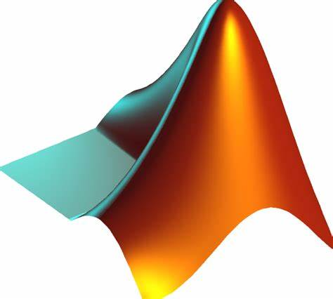
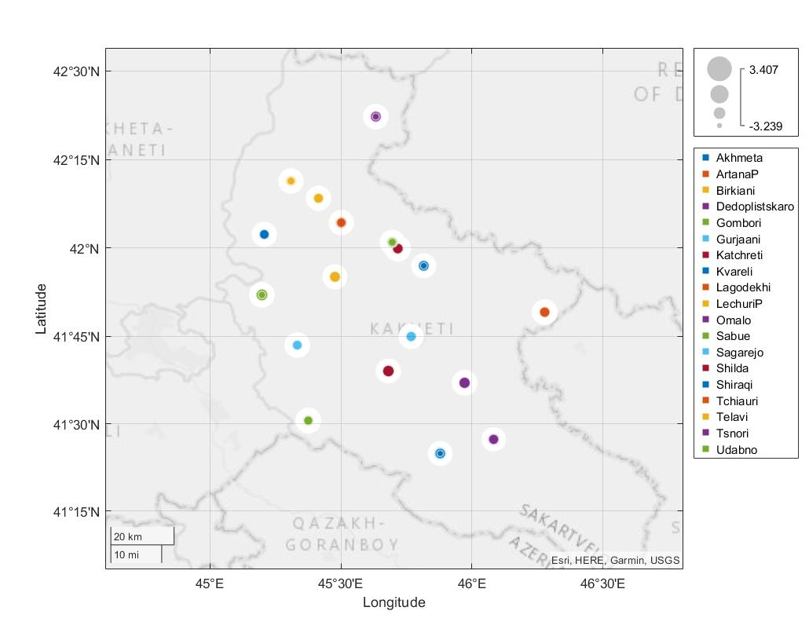
Modern Approach based on Machine Learning

Slide 11
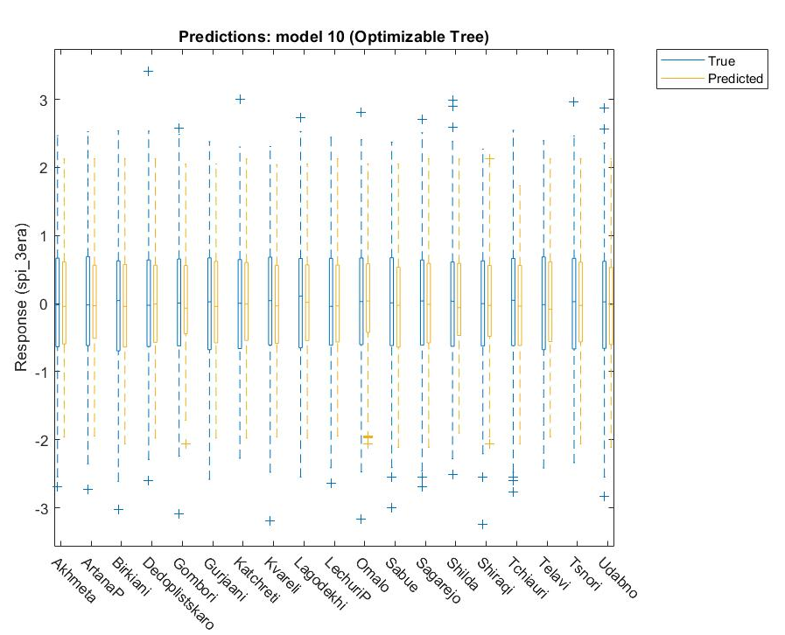
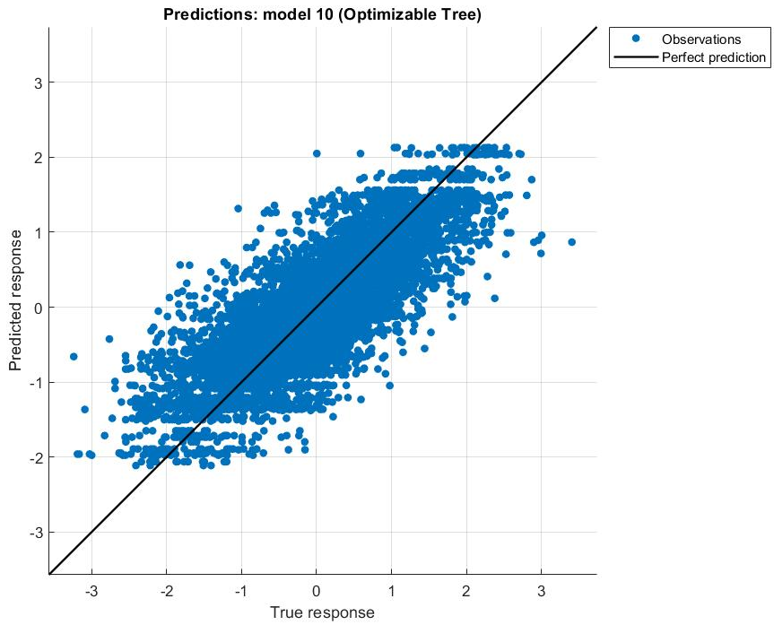
Modern Approach based on Machine Learning
3 month SPI (Standard Precipitation Index)

Slide 12
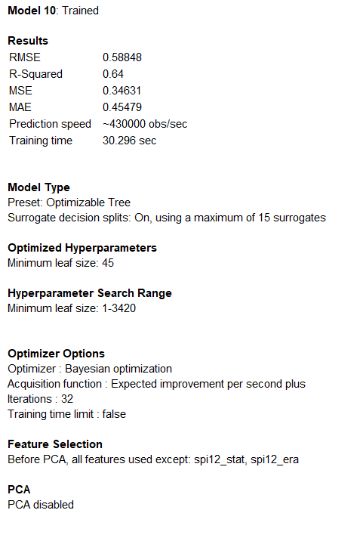
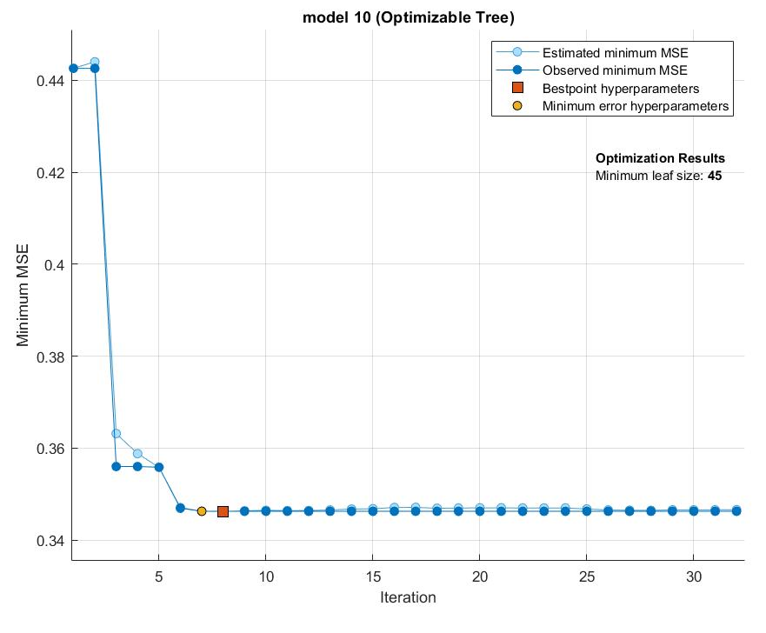
Modern Approach - Machine Learning

Slide 13
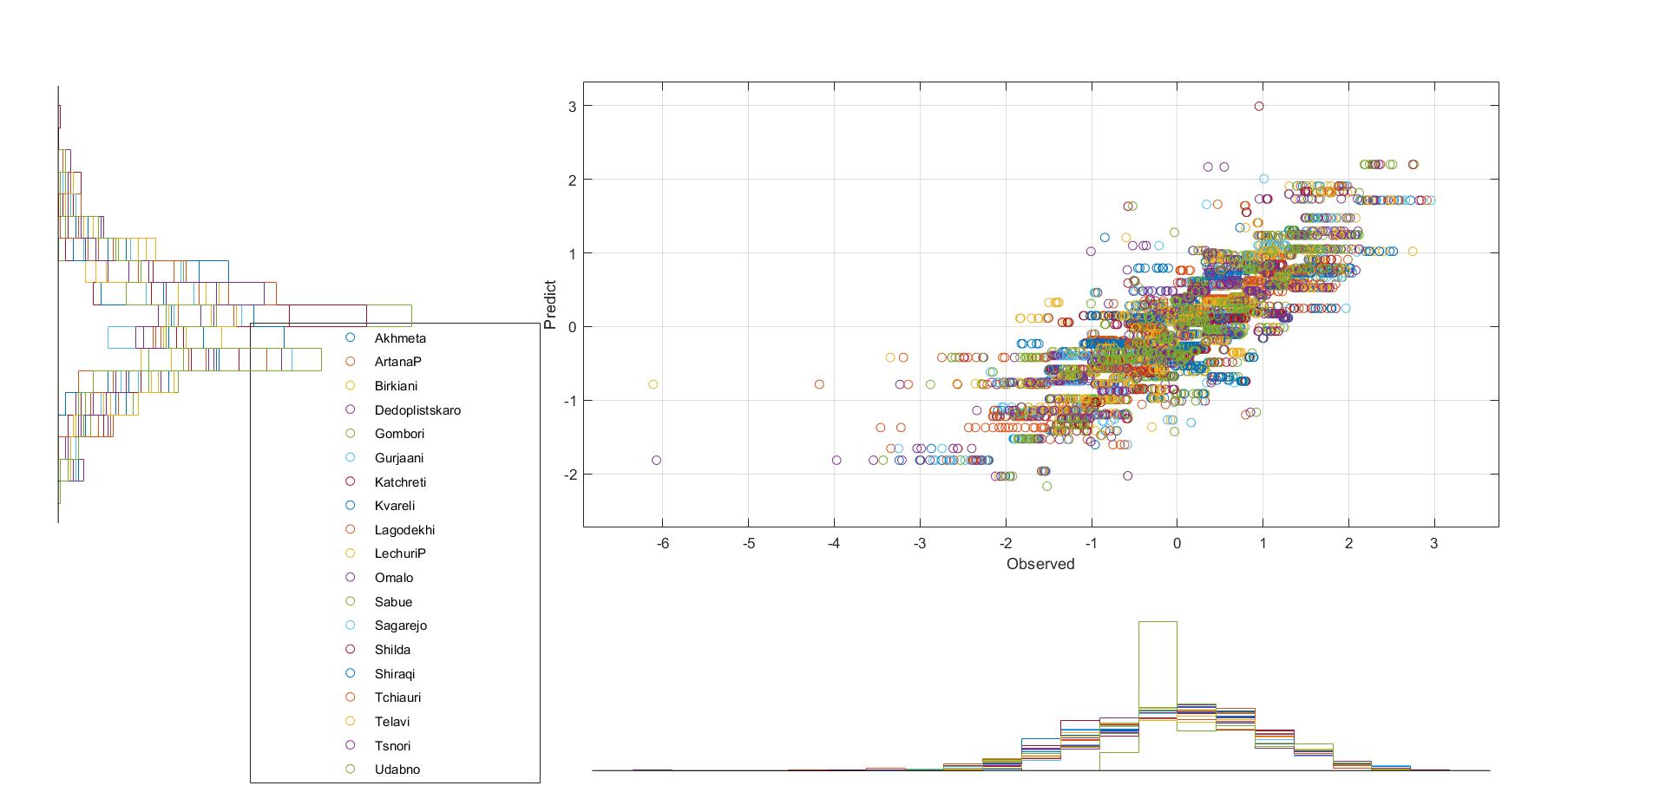
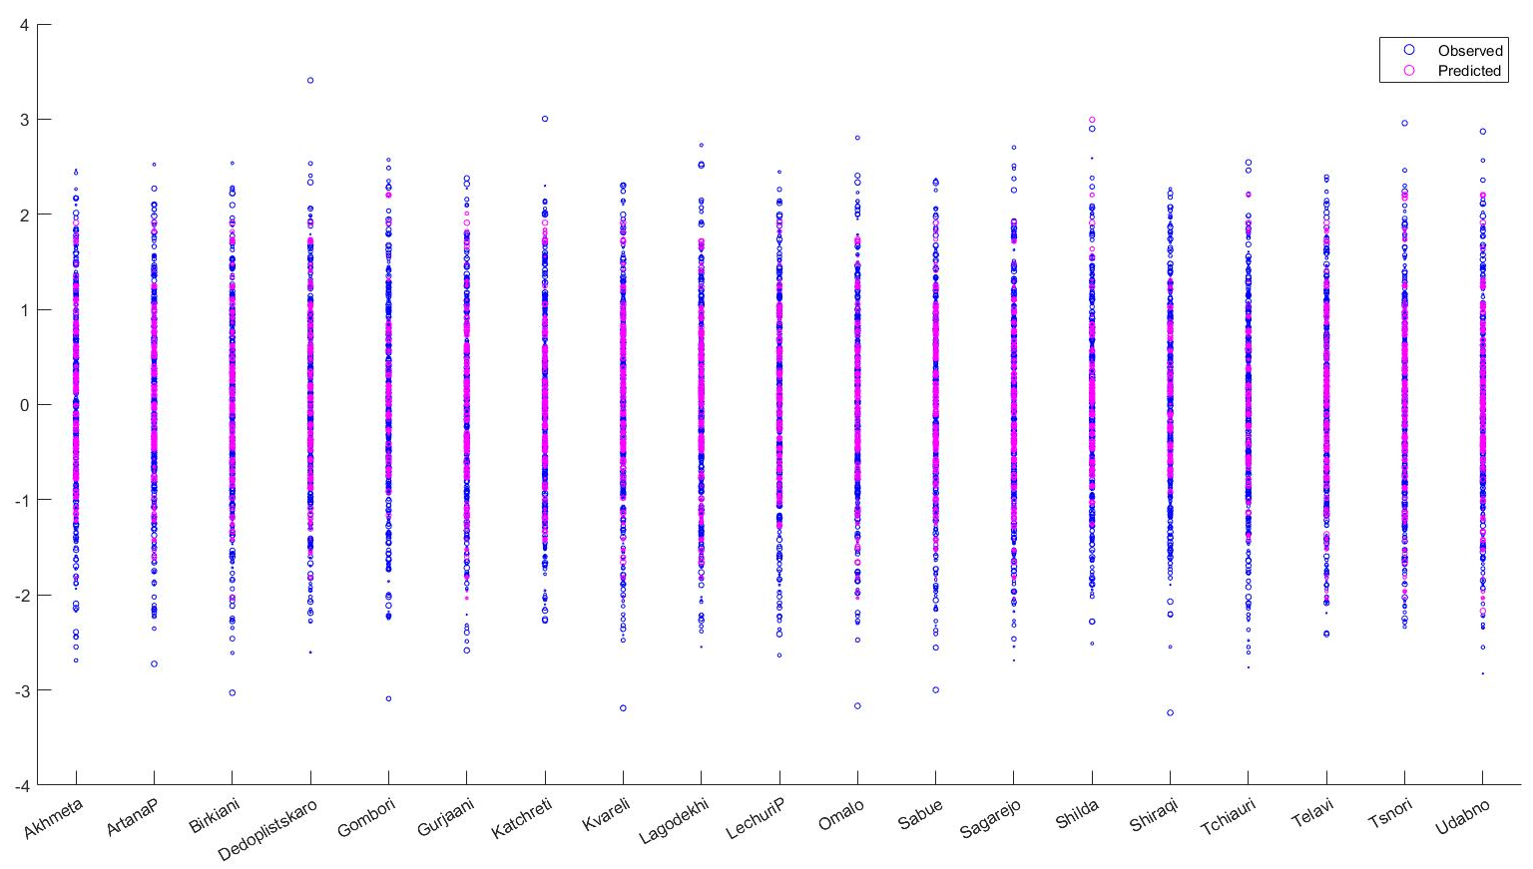
3 month SPI for Kakheti Region
Scatter histogram

Slide 14
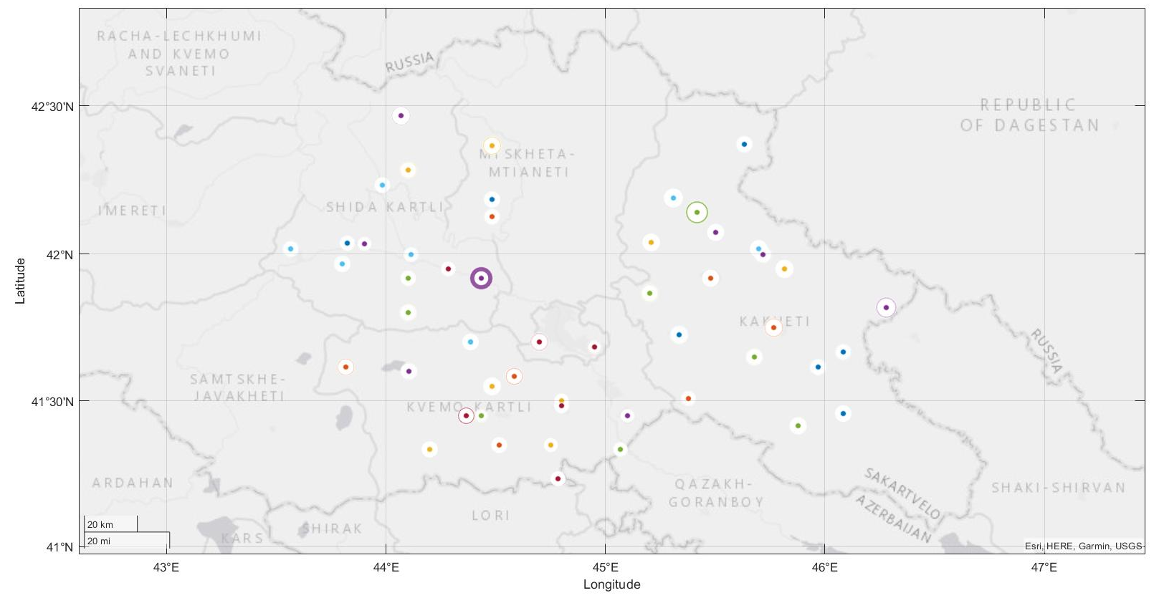
Summary
stations | sd(station/model) | cor(sation/model) | mae(sation/model) | sd(era/model) | cor(era/model) | mae(era/model)
Agara | 31.268 | 0.563 | 53.411 | 48.965 | 0.307 | 96.408
Akhalgori | 36.180 | 0.545 | 56.086 | 48.419 | 0.115 | 60.226
Akhmeta | 46.266 | 0.535 | 62.997 | 47.134 | 0.425 | 80.971
ArtanaP | 49.355 | 0.464 | 73.397 | 34.036 | 0.370 | 66.903
Ateni | 30.787 | 0.488 | 39.000 | 58.116 | 0.235 | 100.961
Birkiani | 60.732 | 0.499 | 90.043 | 36.671 | 0.343 | 71.052
Bolnisi | 33.641 | 0.545 | 42.823 | 38.624 | 0.389 | 73.535
Dedoplistskaro | 41.480 | 0.510 | 50.498 | 62.384 | 0.344 | 87.463
Didi_Dmanisi | 38.152 | 0.467 | 43.804 | 78.424 | 0.132 | 186.393
Dmanisi | 41.052 | 0.483 | 58.047 | 59.700 | 0.250 | 99.331
Gardabani | 26.249 | 0.567 | 33.560 | 20.601 | 0.496 | 33.841
Gombori | 47.162 | 0.682 | 36.954 | 50.114 | 0.168 | 80.993
Gori | 28.111 | 0.598 | 42.281 | 58.330 | 0.291 | 99.359
Grakali | 27.825 | 0.585 | 31.406 | 64.761 | 0.287 | 102.463
Gromi | 103.659 | 0.687 | 142.316 | 35.434 | 0.149 | 72.893
Gurjaani | 48.145 | 0.534 | 65.336 | 44.589 | 0.356 | 77.029
Imiri | 27.290 | 0.612 | 34.371 | 23.206 | 0.431 | 40.378
Kaspi | 39.868 | 0.599 | 26.187 | 58.579 | 0.107 | 94.727
Katchreti | 44.301 | 0.577 | 50.331 | 59.082 | 0.291 | 89.901
Increase number of dataset
Increase of time period
Find nearest points of observations
Model #10
Input data
Dependence on microclimate
Dependence on network frequency
Long time series
stations | sd(station/model) | cor(sation/model) | mae(sation/model) | sd(era/model) | cor(era/model) | mae(era/model)
Shilda | 49.532 | 0.646 | 59.488 | 64.554 | 0.207 | 94.865
Shiraqi | 41.794 | 0.609 | 47.159 | 34.587 | 0.189 | 67.388
Surami | 35.666 | 0.534 | 60.109 | 46.732 | 0.339 | 100.914
Tbilisi | 25.255 | 0.786 | 13.244 | 40.394 | 0.144 | 59.314
Tchiauri | 36.887 | 0.542 | 45.303 | 32.609 | 0.395 | 57.887
Telavi | 48.513 | 0.468 | 64.658 | 44.433 | 0.377 | 76.672
Tetri-tskaro | 45.530 | 0.497 | 63.083 | 38.366 | 0.372 | 69.576
Tsalka | 44.201 | 0.413 | 58.924 | 51.942 | 0.251 | 93.541
Tsiteli_Khidi | 28.240 | 0.590 | 32.204 | 25.558 | 0.407 | 42.725
Tskhinvali | 32.622 | 0.574 | 54.081 | 34.434 | 0.423 | 75.475
Tskneti | 41.399 | 0.486 | 48.798 | 37.921 | 0.347 | 59.141
Tsnori | 38.920 | 0.529 | 49.688 | 45.351 | 0.367 | 72.835
Udabno | 31.578 | 0.543 | 37.731 | 36.015 | 0.373 | 51.383
Vanati | 39.249 | 0.664 | 50.248 | 31.006 | 0.285 | 62.541
Vaneli | 55.931 | 0.585 | 79.232 | 37.400 | 0.315 | 82.903
Zemo_Akhalsopeli | 41.677 | 0.692 | 28.393 | 59.413 | 0.145 | 102.608
Zghuderi | 41.695 | 0.799 | 39.439 | 48.965 | 0.116 | 96.194
Sd-standard deviation
Mae-mean absolute error
Corr-Pearson’s correlation

Slide 15
Thank you for attention
Ana Palavandishvili Master student of Engineering Physics
Supervisor Prof. Tamar Bzhalava
Department of Engineering Physics Georgian Technical University Tbilisi, Georgia
email: palavandishvili.ana21@gtu.ge
2022, September 16

