Slide 1
The University Proton Therapy Dresden: A Facility Dedicated to Medical, Radiobiology, Medical Physics and Technology Research Workshop of the Georgian-German Science Bridge Kutaisi, September 12, 2022
Wolfgang Enghardt
Technische Universität Dresden, Faculty of Medicine Carl Gustav Carus
OncoRay – National Center for Radiation Research in Oncology

Slide 2
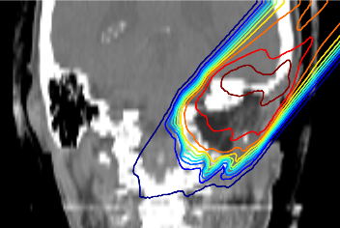
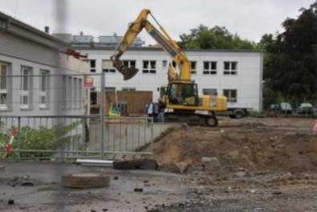
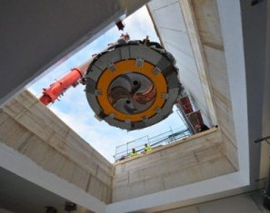
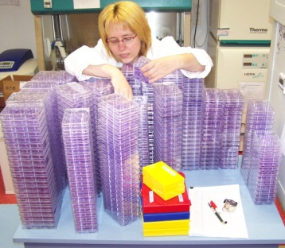
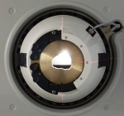
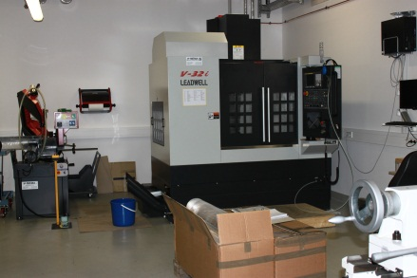
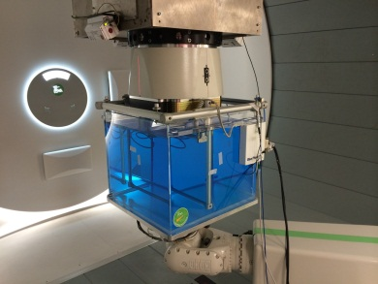
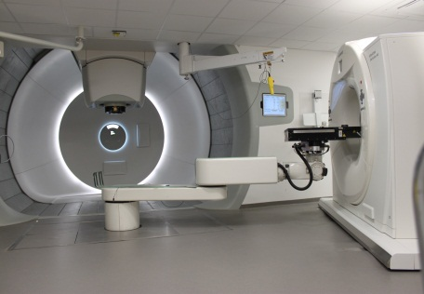
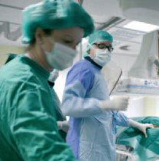
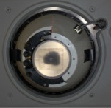
Gliederung
1. The Development of UPTD
2. The Proton Facility
3. Treatment and Clinical Research
4. Radiobiology experiments
5. Medical Physics and Technology
Notes:
2

Slide 3
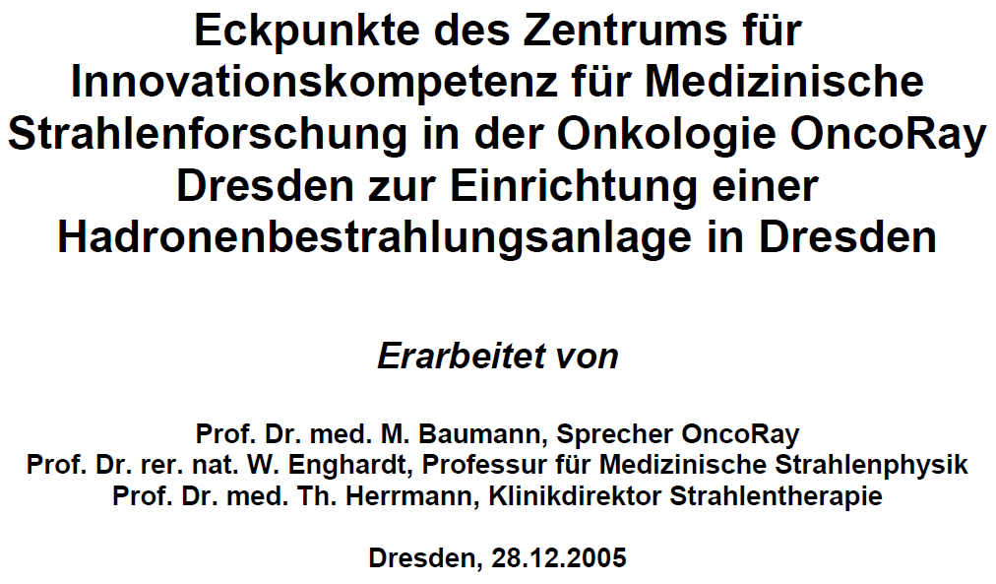
1. The Development of UPTD Initial considerations: The starting point
On request of the Saxon State Ministry for Science and the Arts :
PT: Not clinical routine → Clinical trials
PT-Technology: Suboptimal → Technology development
→ A PT-facility has to be integrated into a university hospital
M. Baumann, W. Enghardt, T. Herrmann: Positionspapier zur Errichtung einer Partikeltherapie in Dresden, 2005, unpublished
Notes:
3

Slide 4
1. The Development of UPTD Initial considerations: Capacity and layout
Analysis of time for:
• Treatment fraction
• Maintenance
• Machine QA
• Patient-specific QA
Prognosis of patient referral in Germany:
• Highly fragmented RT landscape
• Recruitment solely from own clinic
• 10-15% of patient benefit from PT
One PT treatment room:
≈ 8000 fractions p.a.
≈ 250 patients p.a. (fully fractionated)
Typical German academic radiation oncology department:
≈ 2000 curative treatments p.a.
200-300 PT-patients p.a.
Conclusion: For an adequate development of proton therapy:
Integration of single room systems into university hospitals
☹
☺
2005: 2022:
Notes:
4

Slide 5
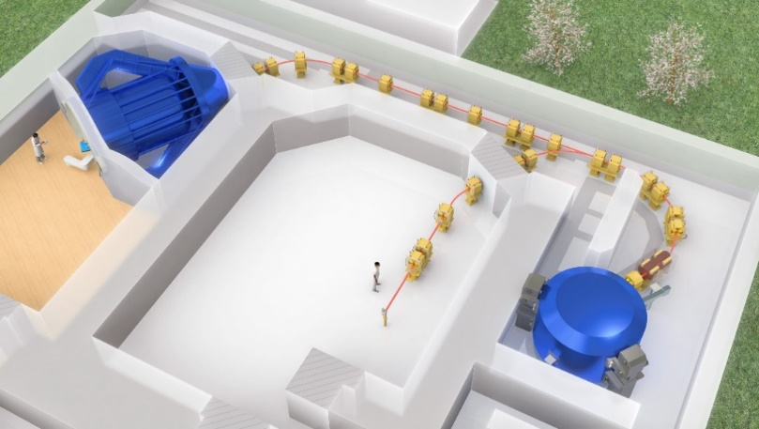
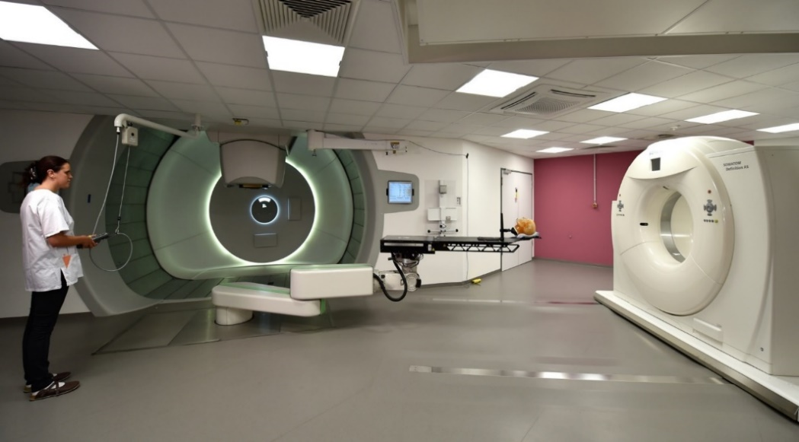
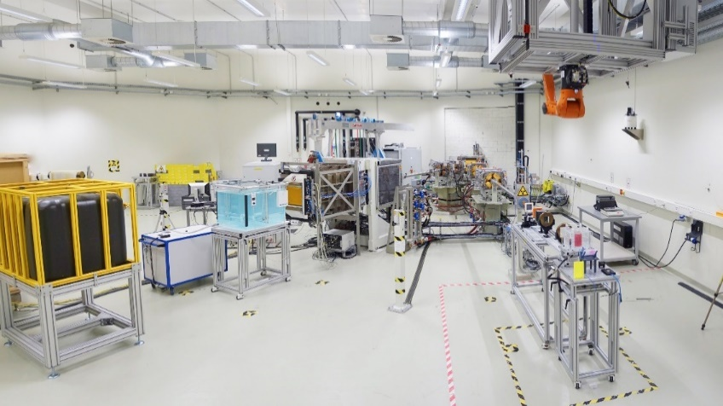
2. The Proton Facility
Overview
• Clinical room
• Experimental room
• Start groundbreaking: May 2011
• Start physics experiments: 23.03.2014
• Start therapy: 12.12.2014
Treatment, clinical research
Physics, biology, technology research
Notes:
5

Slide 6
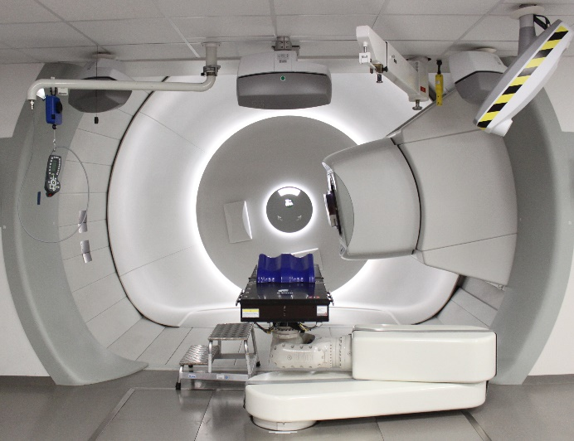
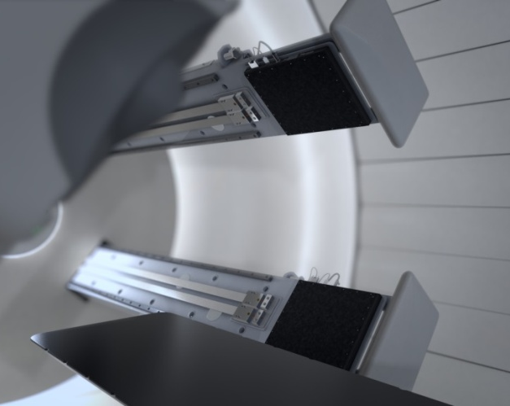
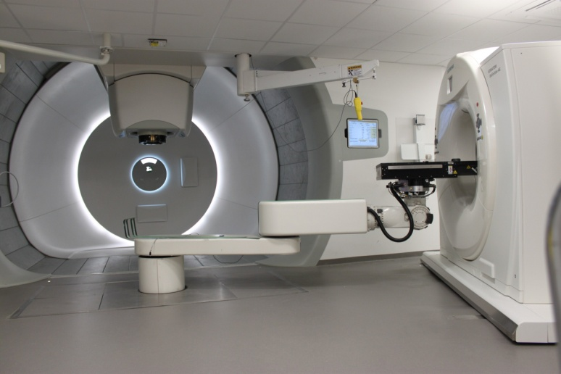
19
2. The Proton Facility
The clinical room
Clinical room (100 m²):
• Isocentric Gantry
• Universal Nozzle (DS, PBS)
• Robotic patient table
• Planar radiography
• CT on rails
• Opt. surface scanning system
Notes:
6

Slide 7
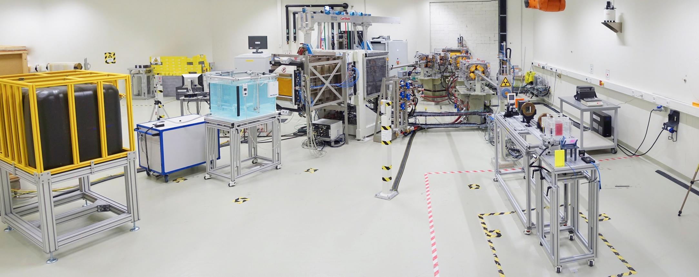
20
2. The Proton Facility
The experimental area
Experimental room (250 m²):
• Horizontal beam line
▪ Diameter: 10 mm
▪ Energy: (70-226) MeV
▪ Current: (0.001-300) nA
▪ Flexible timing (100 µs … min)
• Pencil beam scanning beam line
▪ Field size: 30 × 40 cm²
▪ Energy: (70-230) MeV
▪ Current: < 2 nA
Notes:
7

Slide 8
3. Treatment and Clinical Research
Reality check: Patients treated at UPTD
• 95% of patients treated in clinical trials or registries
• Ramp up over 4 years
• More than 100 patients in year 1:
▪ Intensive training program
▪ Physicians and physicists: HIT, MGH since 2009
▪ RTT: Plenty time in treatment room
• 13 h clinical treatment p. day
• Case mix: →
→ The predictions of 2005 have been proven to be correct:
• For Germany
• Different in countries with higher regulated health care systems, e.g. NL, DK, SE
• Analysis of 90 PT-facilities: Number of patients treated per room: Rank 8 for UPTD
https://ptcog.ch
Notes:
8

Slide 9
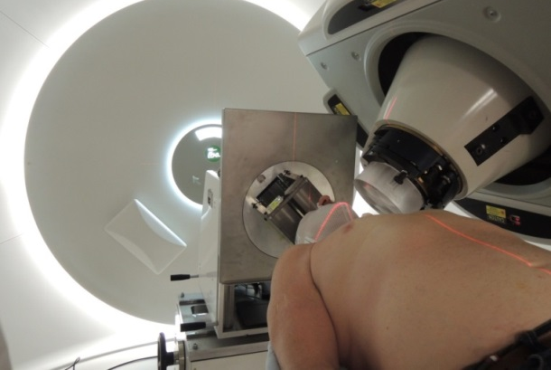
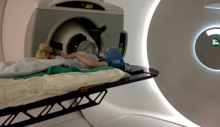
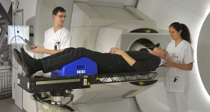
3. Treatment and Clinical Research
Clinical trials
Comparative trials
Randomized, Photons vs. Protons
• Non small cell lung cancer
• Oesophagus (European trial)
• Prostate, after surgery (in cooperation with HIT)
Non-randomized, patient or insurer choice
• Brain
• Prostate, primary
Single arm trials with acquiring data on QoL:
• Head and neck squamous cell carcinoma
• Skull base
• Children
• Lymphoma (in cooperation with HIT)
Courtesy: Mechthild Krause, Esther Troost
Notes:
9

Slide 10
3. Treatments and Clinical Research
European Particle Therapy Network (EPTN)
• Facilitated by ESTRO
• Organizers: C. Grau, Aarhus; D. Weber, Villigen, D. Georg, Vienna
• Founding members: Aarhus, Dresden, Essen, Groningen, Heidelberg, Pavia, Trento, Uppsala, Villigen, Wiener Neustadt
• Open for all European facilities
• Workpackages:
1. Clinical (H. Langendijk, R. Orecchia, K. Hausterman, D. Zips, J. Balosso, E. Troost)
2. Dose assessment, quality assurance, dummy runs, technology inventory (O. Jäkel, S. Safai, S. Lorentini)
3. Education (M. Høyer, M. Schwarz)
4. Image guidance in particle therapy (A. Hoffmann, A. Bolsi)
5. TPS in particle therapy (H. Nyström, T. Lomax, C. Richter)
6. Radiobiology, RBE (M. Dosanjh, B. Jones, A. Lühr, J. Pawelke, M. Pruschy, B. Sørensen)
7. Health economy (Y. Lievens)
Courtesy: Jörg Pawelke
Notes:
10

Slide 11
4. Radiobiology experiments
Irradiation facility
• Double-scattering field shaping device, E = 150 MeV
• 10 × 10 cm² field, 20-32 mm SOBP width, dose rate: ≤ 15 Gy/min
• Collimation down to ∅ = 1 mm for irradiation of mouse brain substructures
• Flash irradiation: Ultra-high (300 Gy/s) and conventional (5 Gy/min) dose rate
Protons
Protons
1st scatterer
2nd scatterer
Collimator
11
Helmbrecht et al.: J Instrum 11 (2016) T11001, Beyreuther et al.: Int J Particle Ther 5 (2018) 172
Courtesy: Jörg Pawelke
Notes:
11

Slide 12
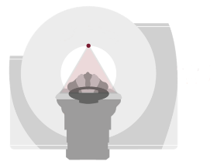
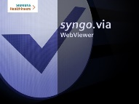
5. Medical Physics and Technology
Dual energy CT for proton treatment planning (I)
DirectSPR
Treatment plan on
stopping power map
Scan 1
Scan 2
2 scans: More information:
ρ_{e}, Z
Universal Studios
Wohlfahrt et al. IJROBP 2017
Möhler et al. PMB 2017
Wohlfahrt et al. Radiother Onccol 2017
Wohlfahrt et al. IJROBP 2018
Wohlfahrt et al. IJROBP 2019
Wohlfahrt & Richter BJR 2020
Peters et al. Radiother Oncol 2021
Berthold et al. IJROBP 2021
Richter & Wohlfahrt Springer 2022
• Reduction of safety margins downbeam by 35%
• In clinical routine at UPTD since 2019
→ Most accurate proton treatment planning worldwide
Courtesy: Christian Richter
Notes:
12

Slide 13
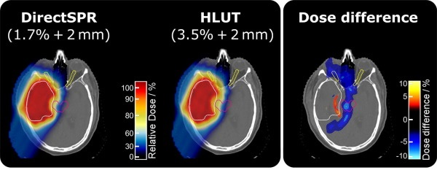
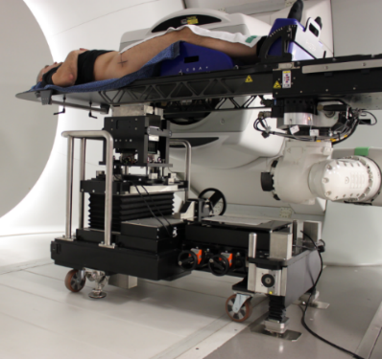
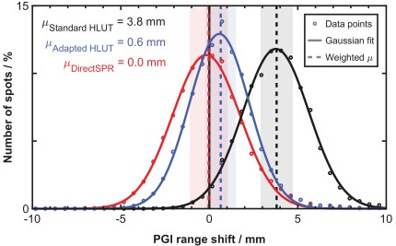
5. Medical Physics and Technology
Dual energy CT for proton treatment planning (II)
• Improvement of
TP quality by
DECT based
DirectSPR
• Safety margin reduction
Peters et al.
Radiother Oncol 2022
In-human
validation of
accuracy by
prompt γ-ray
imaging
Berthold et al.
IJROBP 2021
Notes:
13

Slide 14
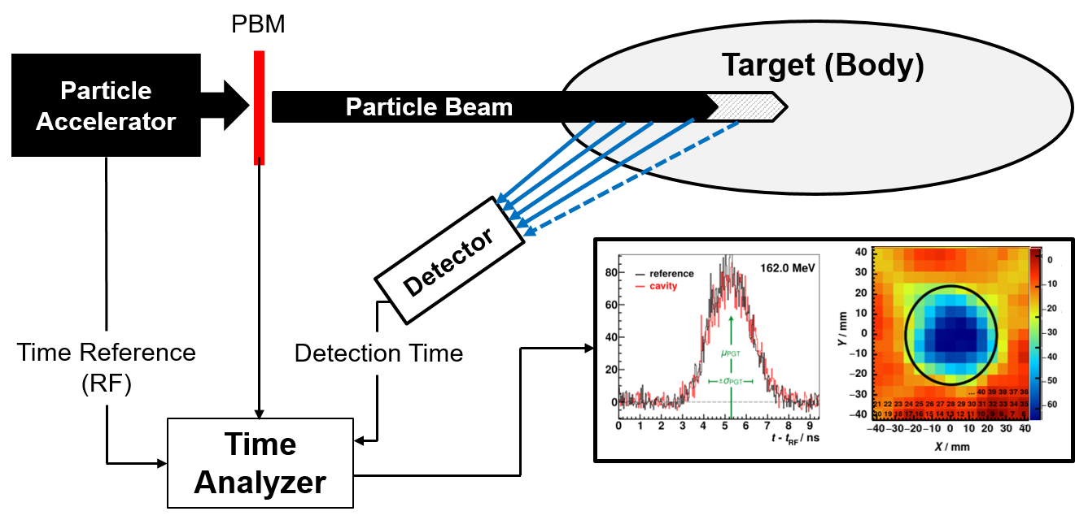
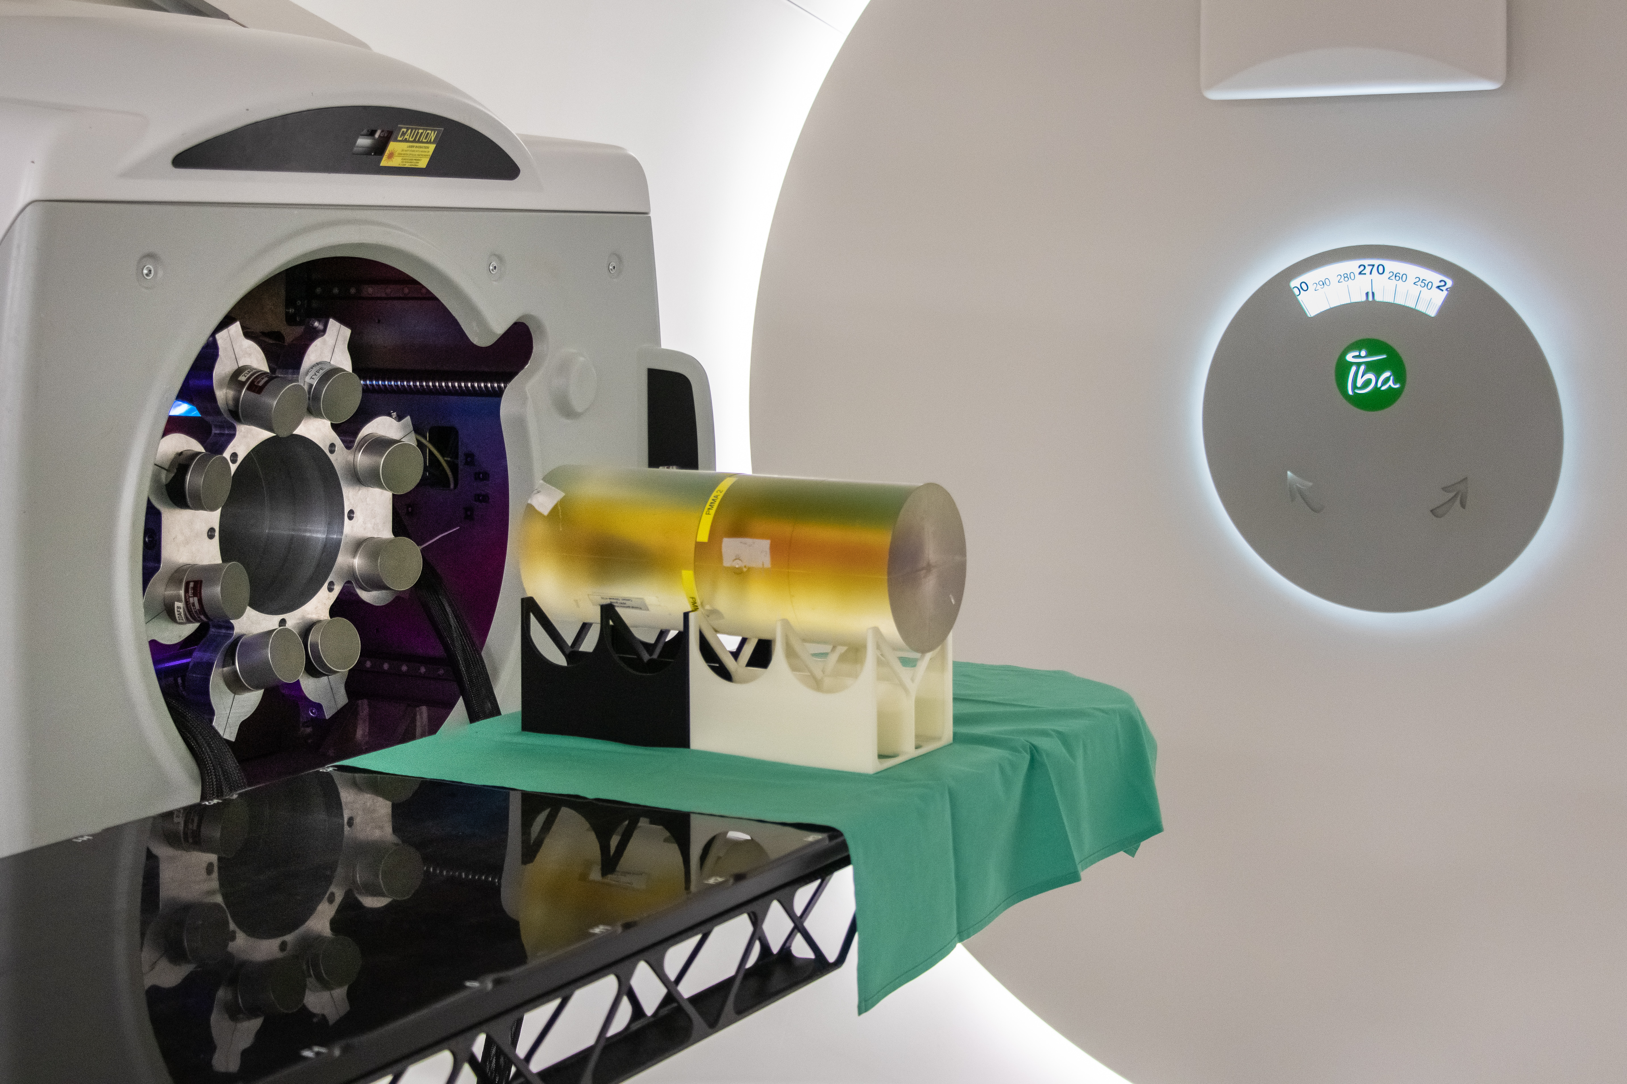
5. Medical Physics and Technology
Nuclear range measurements: Prompt γ-ray timing
Proton bunch monitor
+ Simple, compact, light-weight
+ Direct integration into the therapy nozzle feasible
+ Low interference with clinical workflow
- Cutting edge detectors and DAQ ($τ, \dot{N}$)
Courtesy: Toni Kögler
Golnik et al., PMB 59 (2014); Pausch et al., IEEE TNS 63 (2016); Werner et al., PMB (2020)
Notes:
14

Slide 15
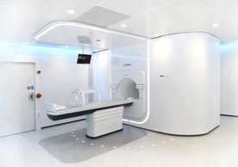
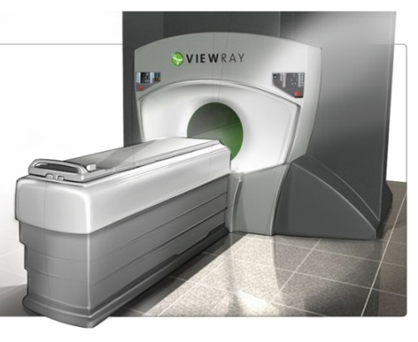
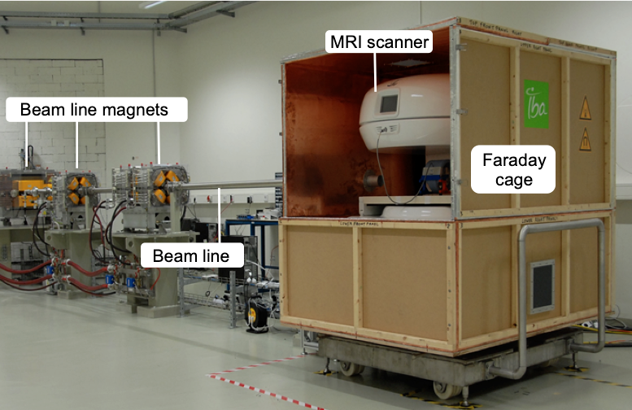
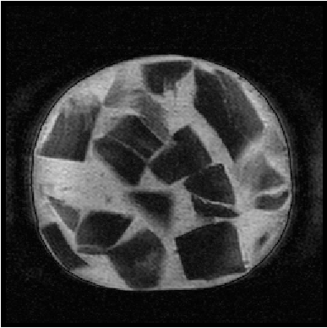
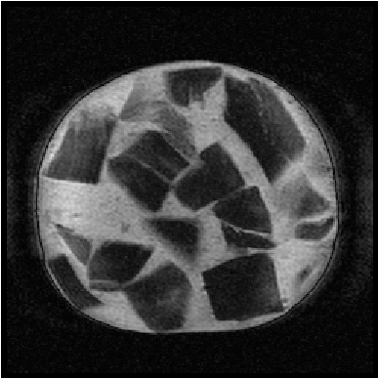
5. Medical Physics and Technology
Towards (I)
To hit accurately in 2D (photons), a high-
precision telescope is necessary.
Why this is not available for the much more
challenging to hit in 3D (particles)?
Because it is much more difficult.
2015: Strategic decision: Development of at OncoRay
1. Step: A 0,22 T MRT-scanner at the horizontal fixed experimental beam line at UPTD
MR-Linac
MRIdian
Beam OFF
0,22 T MRT
p-beam: E_{p} = 125 MeV, 5.4 nA
Beam line magnets
OFF
T2 DE
ON
Faraday-
cage
Beam line
Dresden Fleischwurst
Courtesy: Aswin Hoffmann
S. Schellhammer et al. PMB 63 (2018) 23LT01
Notes:
15

Slide 16
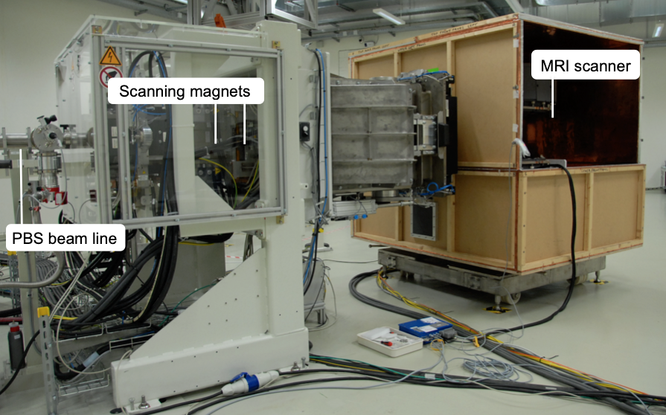
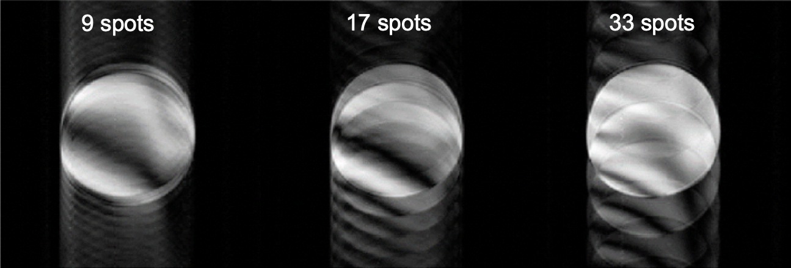
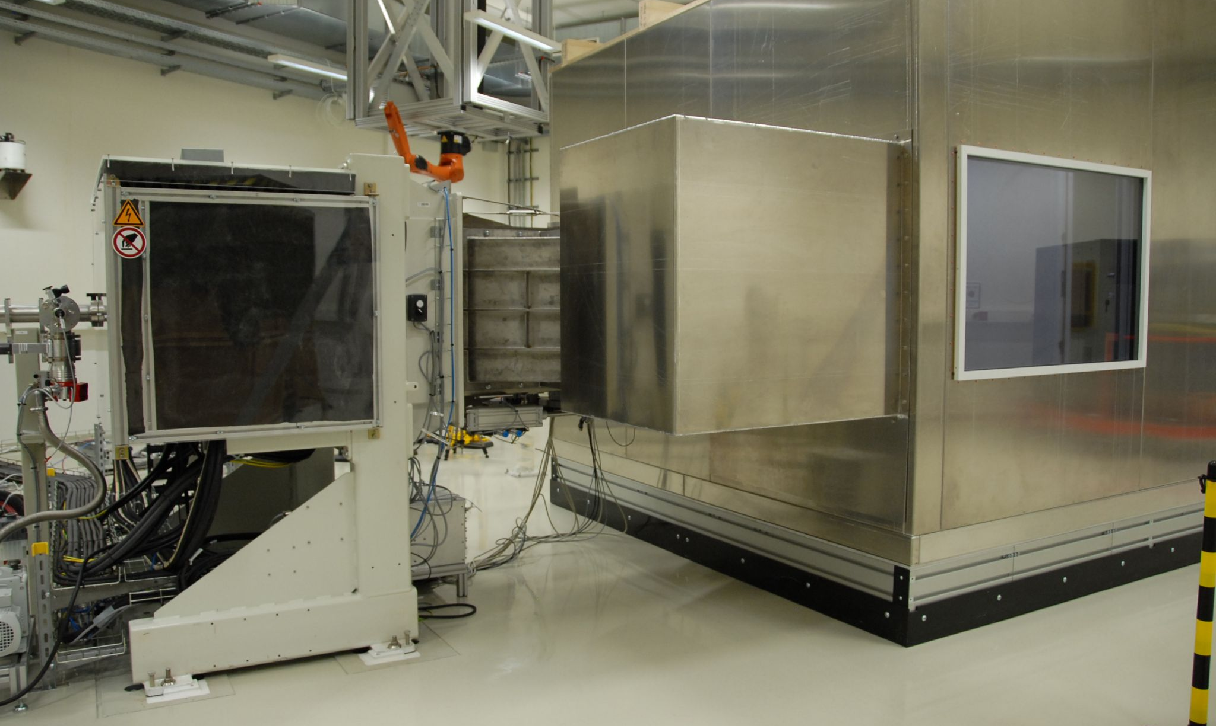
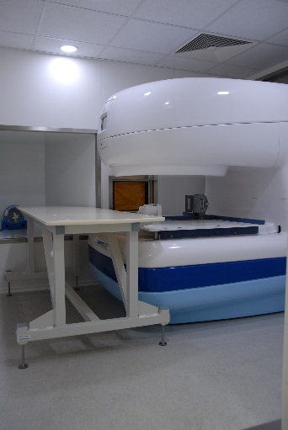
5. Medical Physics and Technology
Towards (II)
2. Step: A 0,22 T MRT-scanner at the horizontal PBS beam line of UPTD
3. Step: A 0,33 T MRT-scanner at the horizontal PBS beam line of UPTD
0,22 T MRT
Scanning magnets
Pencil beam scanning
MR-images of a homogeneous cylinder phantom during pencil beam scanning irradiation
PBS beam line
2020: Installation of the MRT
2021: Magnetic fringe field mapping
2021: Beam commissioning
2022: Image quality and workflow optimization
→ First in human (static targets)
Faraday cage
on air cushion
0,33 T MRT
Courtesy: Aswin Hoffmann S. Gantz et al. PMB 65 (2018) 215014; B. Gebauer et al. Dreiländertagung 2021, ePoster ID 93
Notes:
16

Slide 17
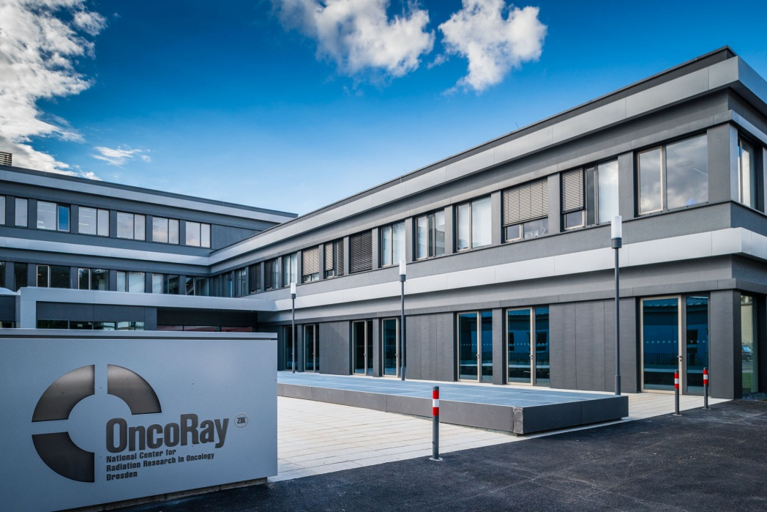
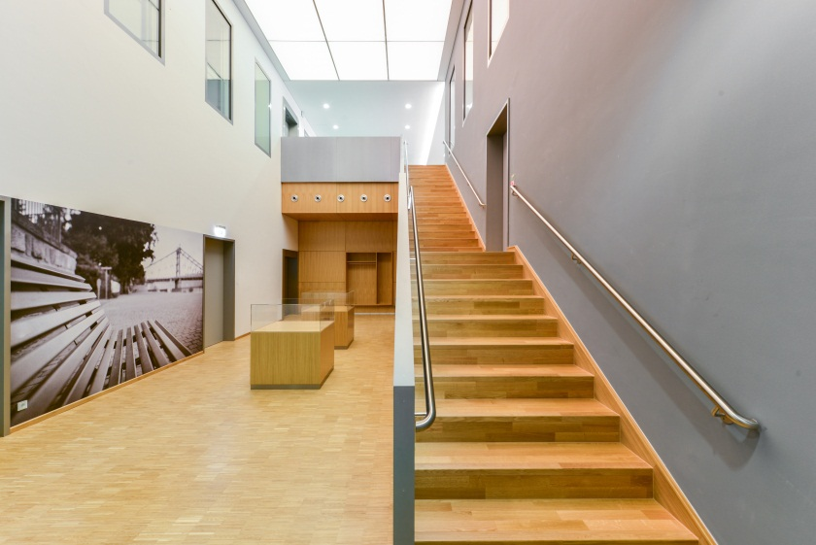
Thank you
Elke Beyreuther Sebastian Makocki
Aswin Hoffmann Jörg Pawelke
Julia Hytry Christian Richter
Toni Kögler Esther Troost
Mechthild Krause
Notes:
17

Slide 18
2. The Proton Facility
Overview
Energy selection system:
70 – 230 MeV
High energy beamline : 25 m
Gantry:
d = 11 m
m = 120 t
Clinical room:
≈ 100 m²
Experimental room: ≈ 250 m²
31 m
43 m
Isochronous cyclotron: 230 MeV
Notes:
18

Slide 19
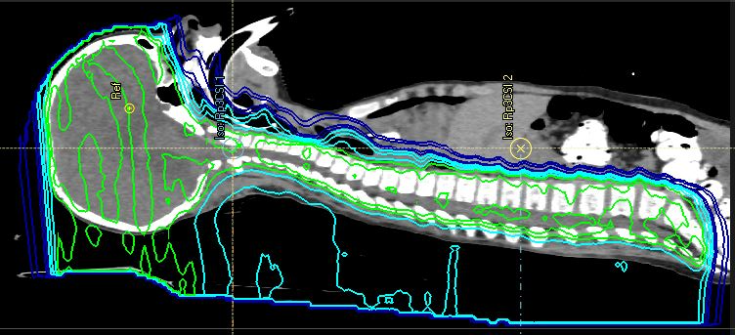
statutory health insurance
3. Treatment and Clinical Research
Indications
Indications accepted by the German statutory health insurances:
• Paediatric Tumours
• Tumours close to brain and spinal cord
• Tumours not treatable by conventianal techniques
Indications treated under agreements with German statutory health insurances:
• Brain tumours
• Tumours in pre-irradiated areas
• Tumours of the pelvis, e.g. prostate
• Tumours of the chest
• Head and neck tumours
• Soft tissue tumours
Irradiation,
Craniospinal
axis,
7-years old
child under
anaesthesia
Percentage of dose
2.
1.
2.
1.
2. Photons 1. Photons
2. Protons 1. Photons
Courtesy: Mechthild Krause, Esther Troost Julia Hytry, Sebastian Makocki
Notes:
19

Slide 20
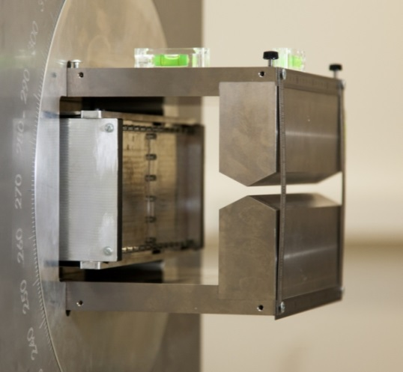
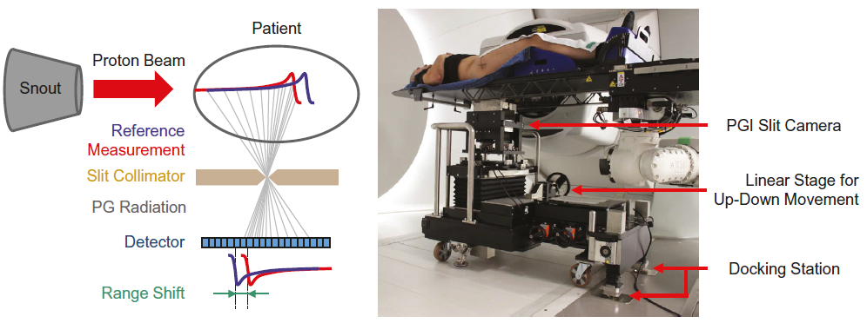
5. Medical Physics and Technology
Nuclear range measurements: The IBA slit camera (I)
• Prototype in Dresden since Oct. 2014
• Detector calibration and -optimization
• 1. clinical application: Aug. 2015
• Clinical trial for validation of benefit
• 2. prototype since Oct. 2018
J. Smeets et al. PMB 57 (2012) 3371; C. Richter et al. Radiother. Oncol. 118 (2016) 232; J. Berthold et al. IJROBP (2021) (in press)
Notes:
20

Slide 21
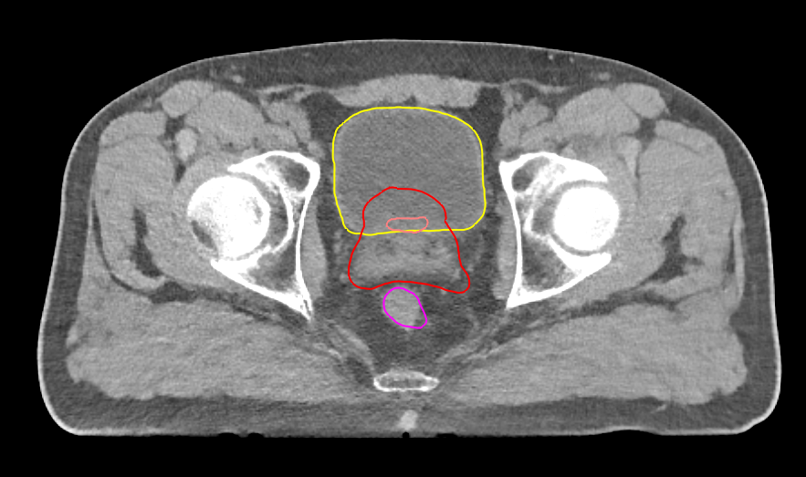
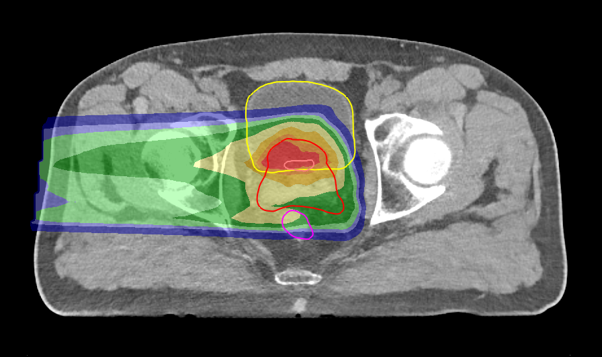
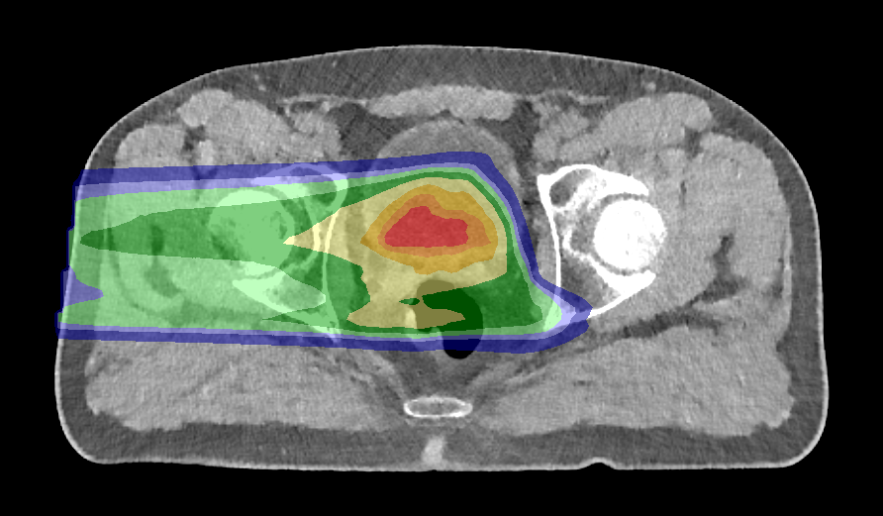
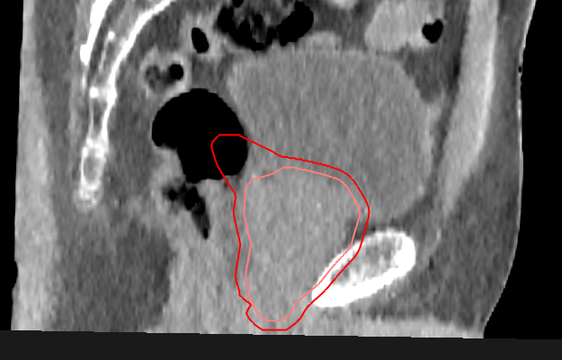
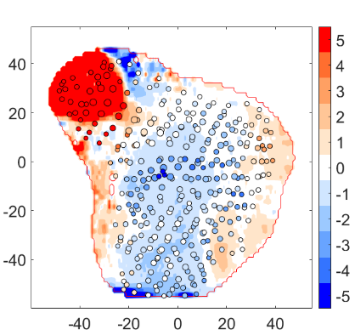
5. Medical Physics and Technology
Nuclear range measurements: The IBA slit camera (II)
Verification of anatomical changes during fractionated proton therapy
Planned treatment
Dose Difference
Fraction 2 (after 14 days)
PG Range Shifts (BEV)
PG range shifts / mm
J. Berthold et al. IJROBP (2021) (in press)
Courtesy: Christian Richter
Notes:
21

Slide 22
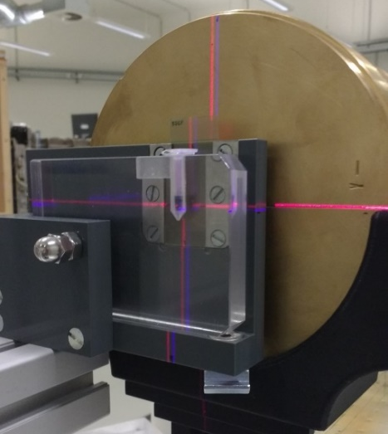
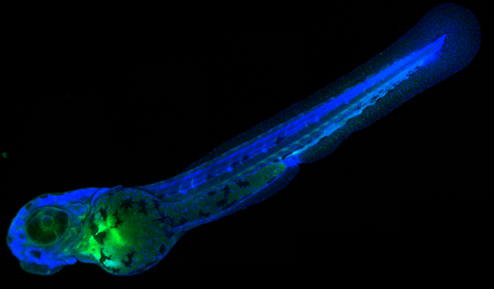
4. Radiobiology
Experiments
Proton FLASH experiment
• Ultra-high (300 Gy/s) and conventional (5 Gy/min) dose rate
• Single pulse (Δt = 100 ms) and continuous beam
• I = 150 nA and I = 0.05 nA
• Model: Zebrafish embryo
• Endpoint: γH2AX-fluorescence (DSB)
Segmented IC Bragg peak IC RC film Markus IC
50 embryos
in a well
Protons
15 Gy
LMF@MPICBG
Beyreuther et al.: Radiother Oncol 139 (2019) 46
Courtesy: Elke Beyreuther
Notes:
22

