Slide 1
KIU2020
Hadron Therapy Center
2022

Slide 2
KIU Campus Map

Slide 3
KIU Hadron Therapy Center
Hadron Therapy Center (HTC) to be opened in KIU
HTC will serve two objectives:
Research facility in the directions of:
Medical and Experimental Physics
Radiation Biophysics
Medical treatment facility
Proton Therapy Center

Slide 4
KIU Hadron Therapy Center
CARTU Foundation has signed a contract with IBA to install Georgia’s first proton therapy center at KIU.
The project is funded by CARTU with up to 40 million EURO.
The contract entails delivery and commissioning of 2 cyclotrons at KIU.
CARTU Foundation completing procurement
of design & supervision services for HTC.
Notes:
KIU development plans include establishment of the Hadron Therapy Center. This research center will offer its facilities for the scientific research in particle physics, radiation physics and biophysics, as well as support operations of the Proton Therapy Center, coupled with the faculty of Medicine at KIU. At the beginning of this year, KIU has signed a contract with IBA (Ion Beam Applications S.A., EURONEXT), the world’s leading provider of proton therapy solutions for the treatment of cancer to install Georgia’s first proton therapy center. The project is funded by Cartu with up to Euro 35 million investment. As a result, KIU will in a few years open the first Proton Therapy Center in the region providing medical treatment as well as research opportunities.

Slide 5
KIU HTC – E2E design
CARTU Foundation has signed a contract with IDOM to elaborate E2E design studies & works
IDOM scope - Architecture, Structural design, Engineering & IT
IDOM scope – Construction supervision
Architecture, Engineering, Structural & IT
Notes:
KIU development plans include establishment of the Hadron Therapy Center. This research center will offer its facilities for the scientific research in particle physics, radiation physics and biophysics, as well as support operations of the Proton Therapy Center, coupled with the faculty of Medicine at KIU. At the beginning of this year, KIU has signed a contract with IBA (Ion Beam Applications S.A., EURONEXT), the world’s leading provider of proton therapy solutions for the treatment of cancer to install Georgia’s first proton therapy center. The project is funded by Cartu with up to Euro 35 million investment. As a result, KIU will in a few years open the first Proton Therapy Center in the region providing medical treatment as well as research opportunities.

Slide 6
KIU HTC – BUILDING CONCEPTS Two Separate Bunkers
Kutaisi Proton Therapy Clinic
Bunker 1 – Radiation Shielding Bunker for IBA ProteusONE Cyclotron (500-600 m2);
Building 1 – Connected to the Bunker 1 - Proton Therapy Clinic for proton therapy treatment and all necessary equipment (1,500-2,000 m2);
Kutaisi Cyclotron Lab
Bunker 2 – Radiation Shielding Bunker for IBA S2C2 Cyclotron research facility (500-600 m2);
Building 2 – Connected to the Bunker 2 - Building for research facility (1,500-2,000 m2);

Slide 7
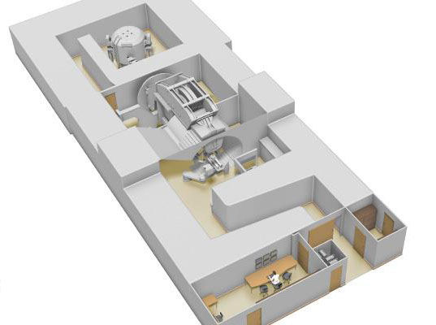
KIU HTC – IBA FACILITIES
KIU Proton Therapy Clinic
IBA Proteus®ONE
Kutaisi IBA Cyclotron Lab
IBA S2C2 Cyclotron

Slide 8
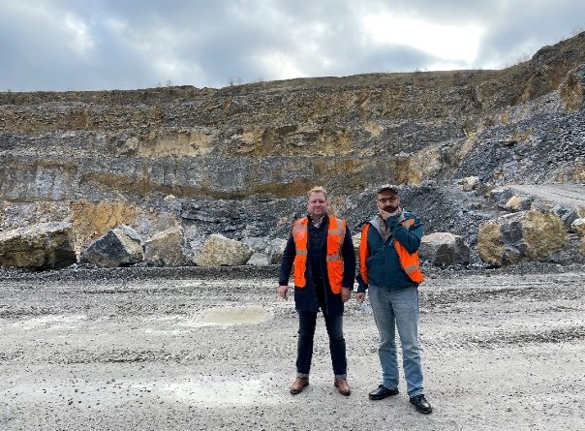
KIU HTC – LAC (Low Activation Concrete)
LAC requirements
Aisemont, Fosses-la-Ville, Belgium

Slide 9
Particle Therapy Co-Operative Group (PTCOG)

Slide 10
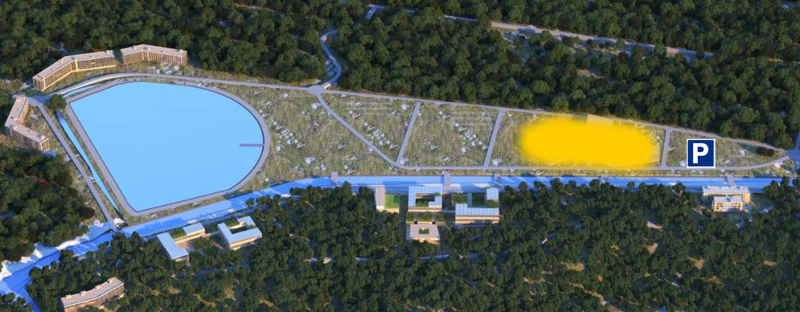
KIU HTC - SITE

Slide 11
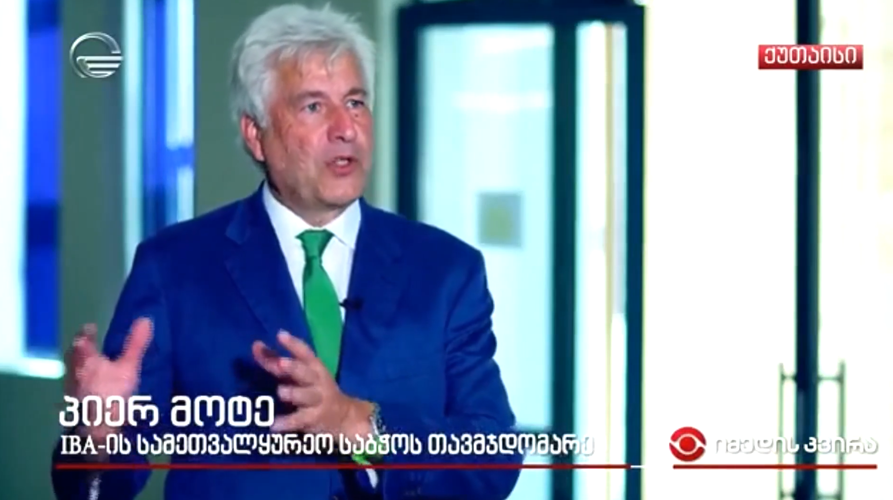
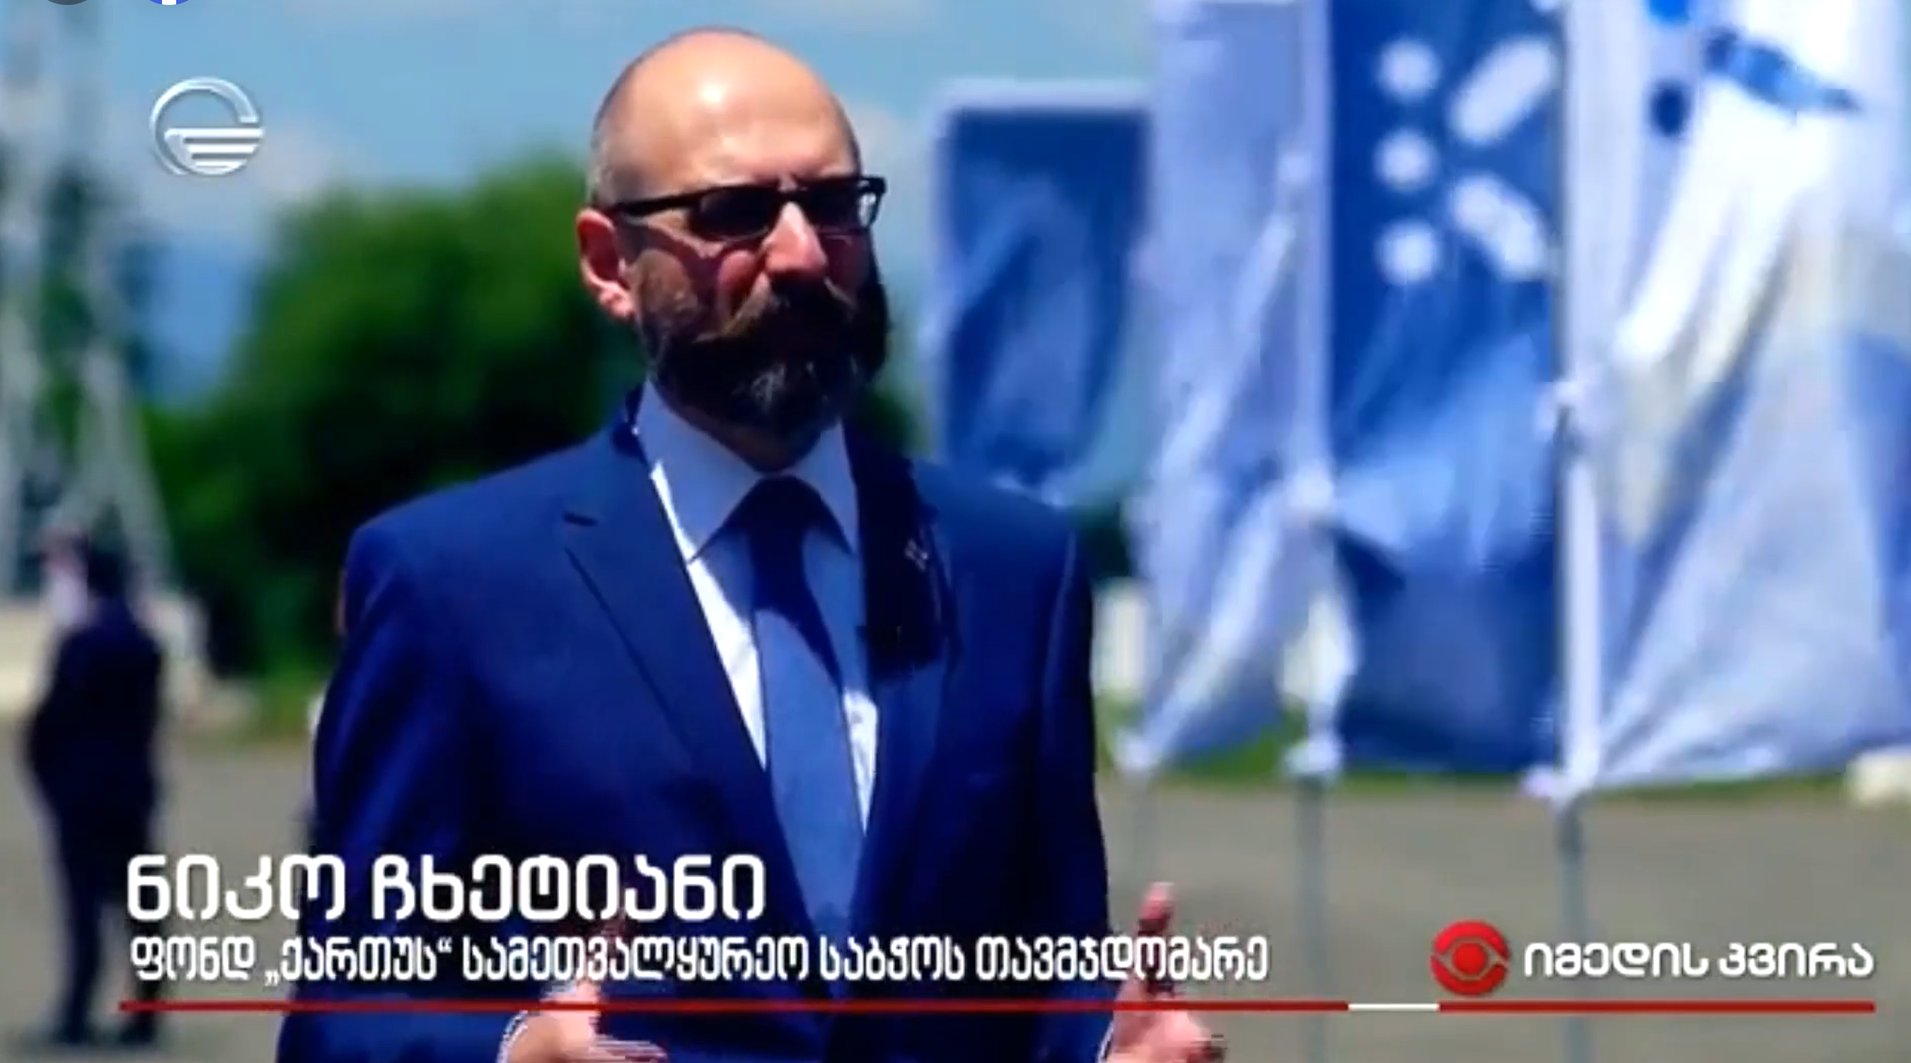
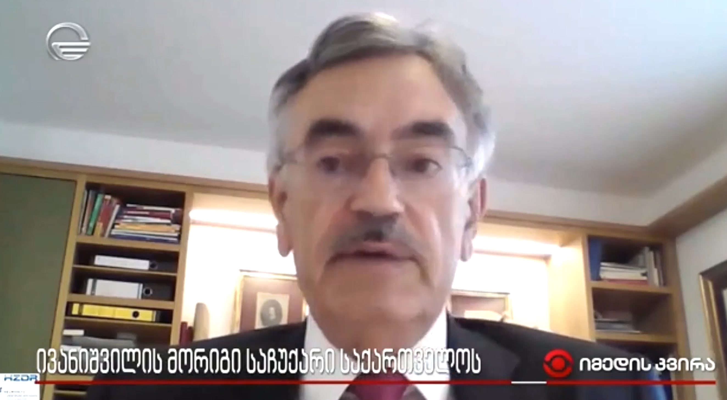
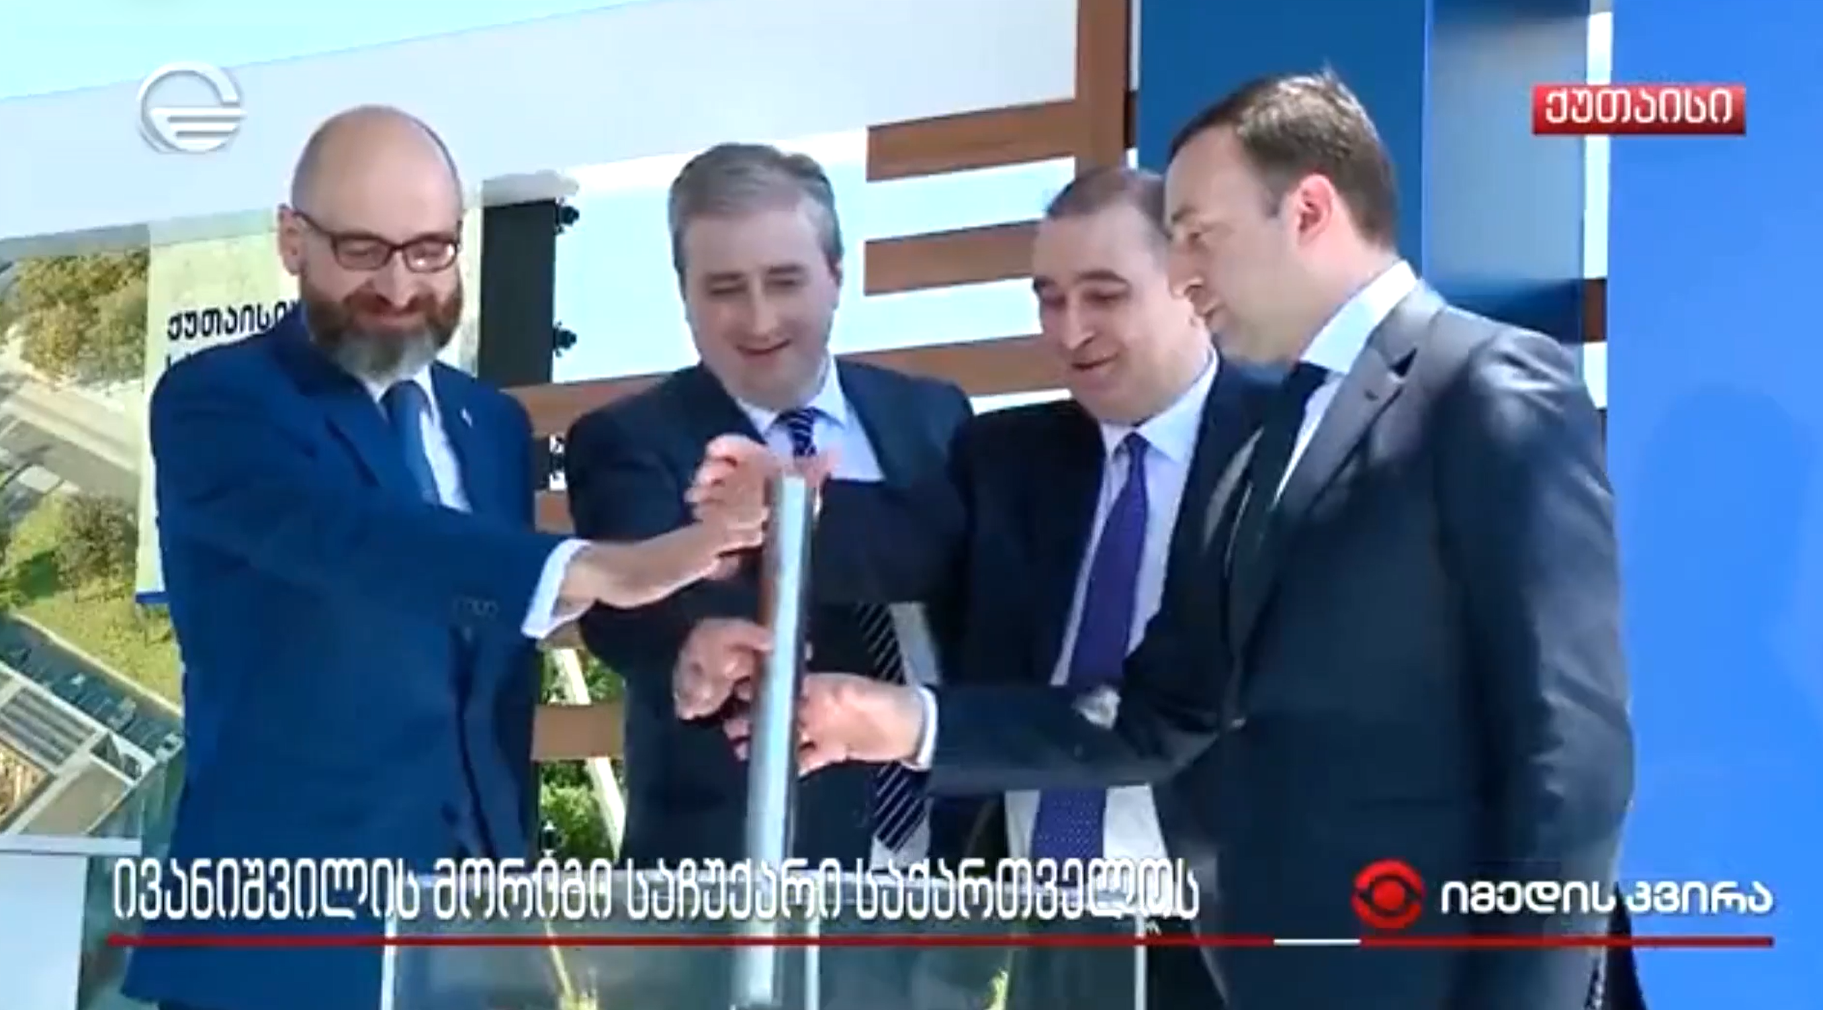
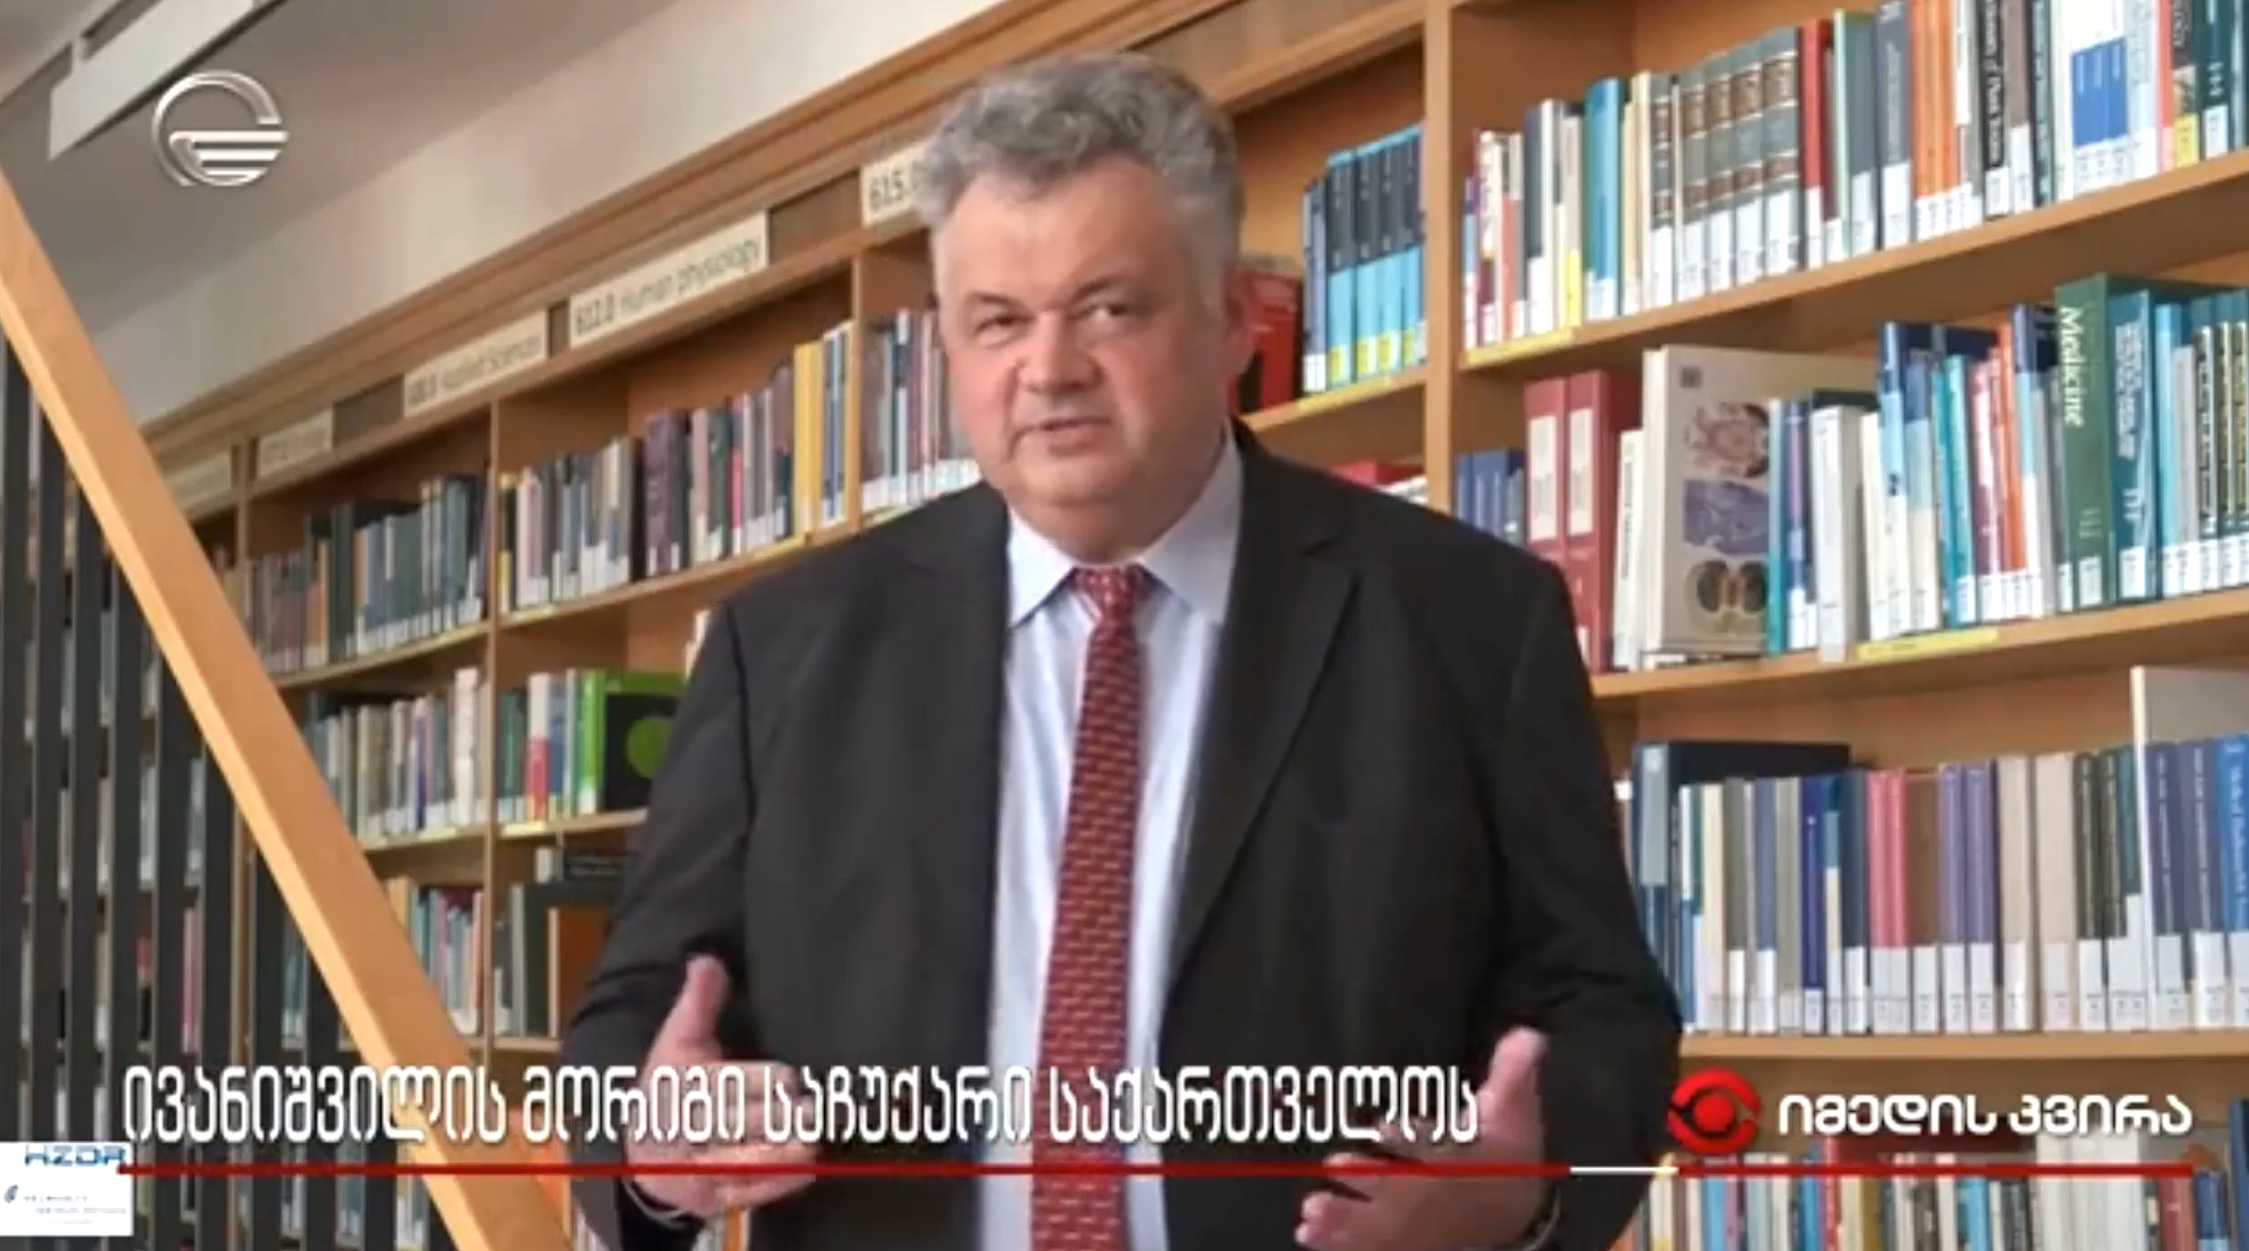
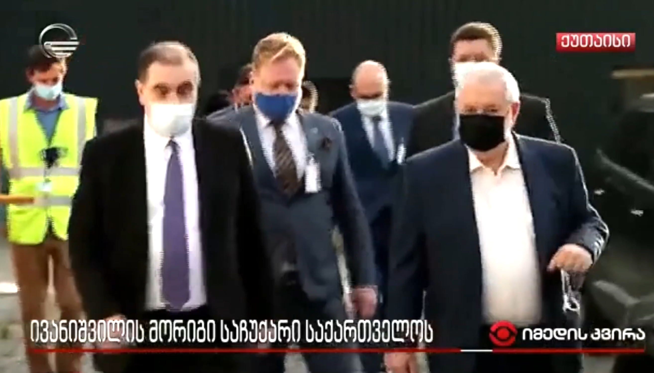
July 11 – Groundbreaking Event

Slide 12
KIU HTC - PROJECT

Slide 13
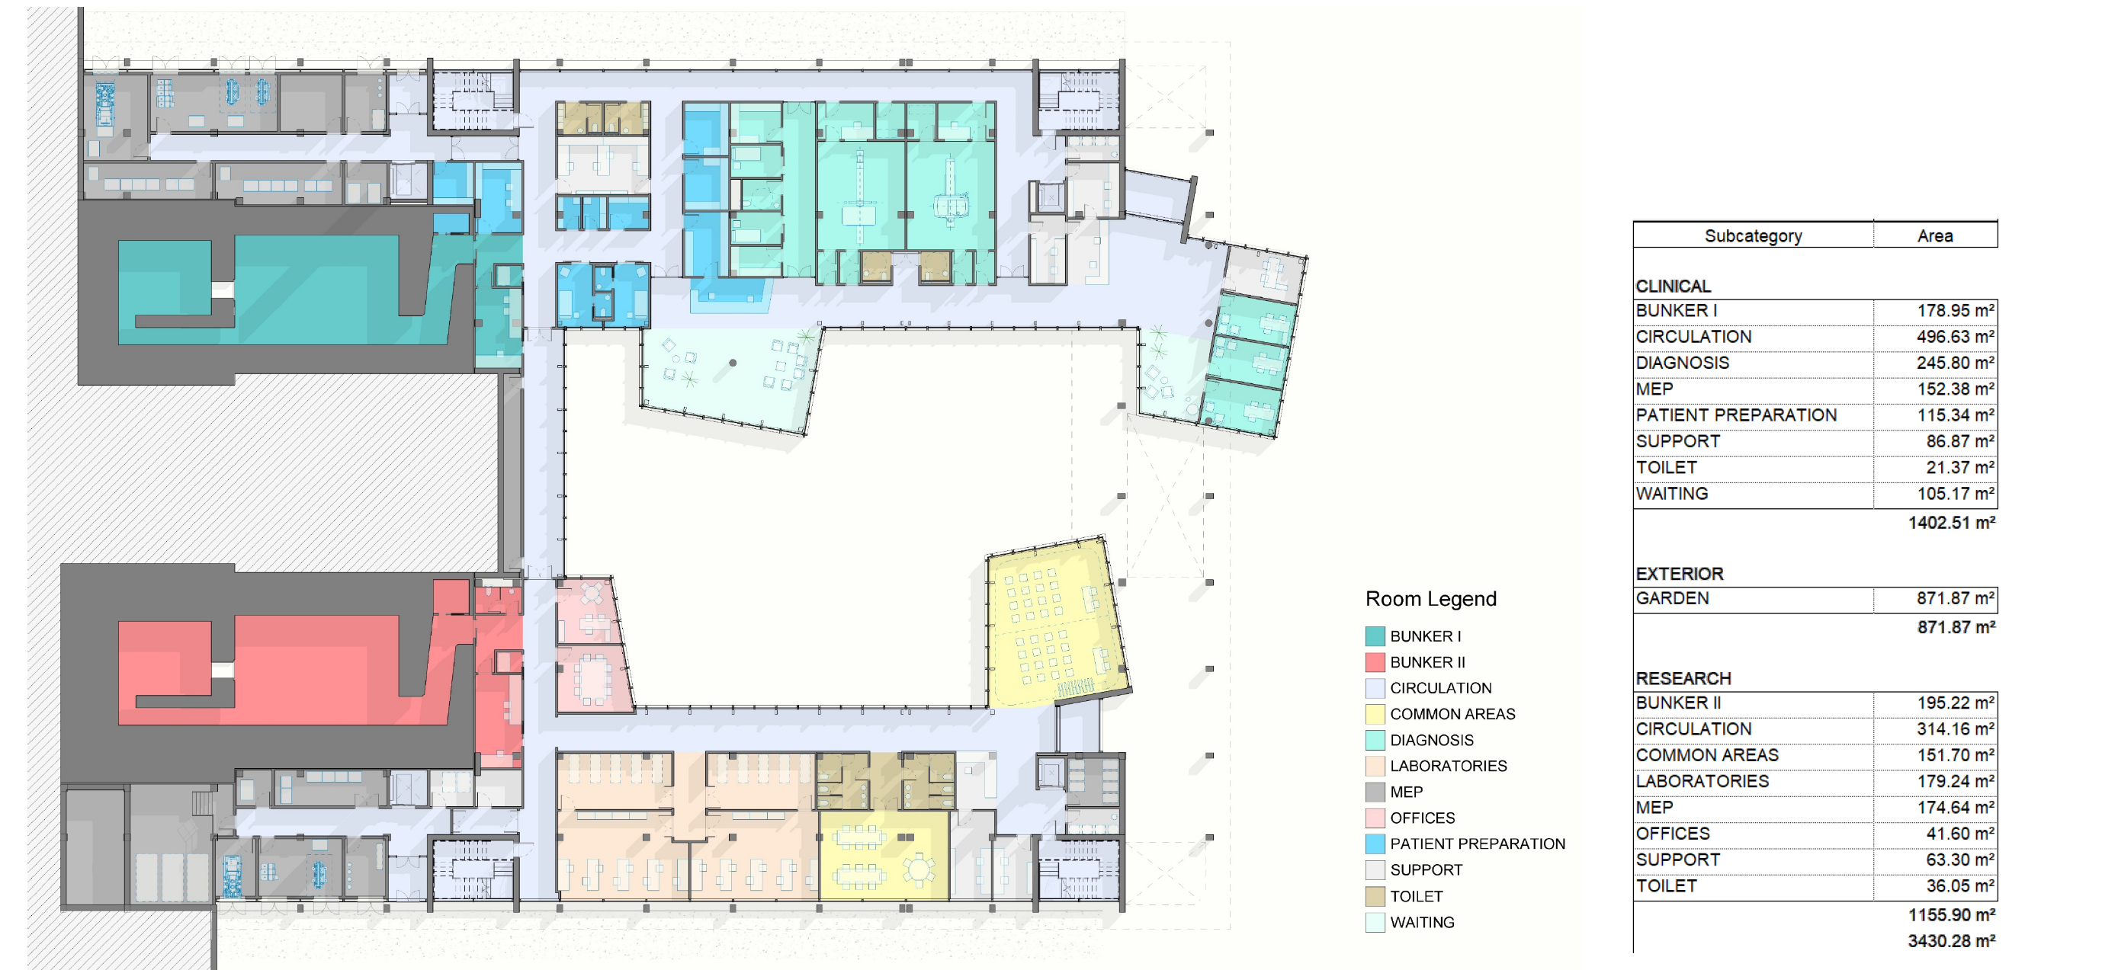
KIU HTC - PROJECT

Slide 14
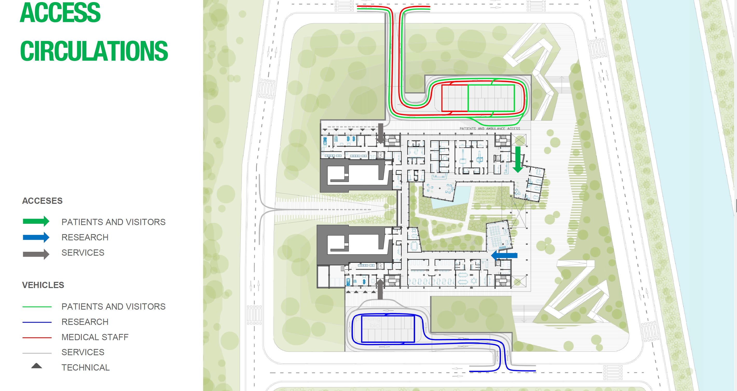
KIU HTC - PROJECT

Slide 15
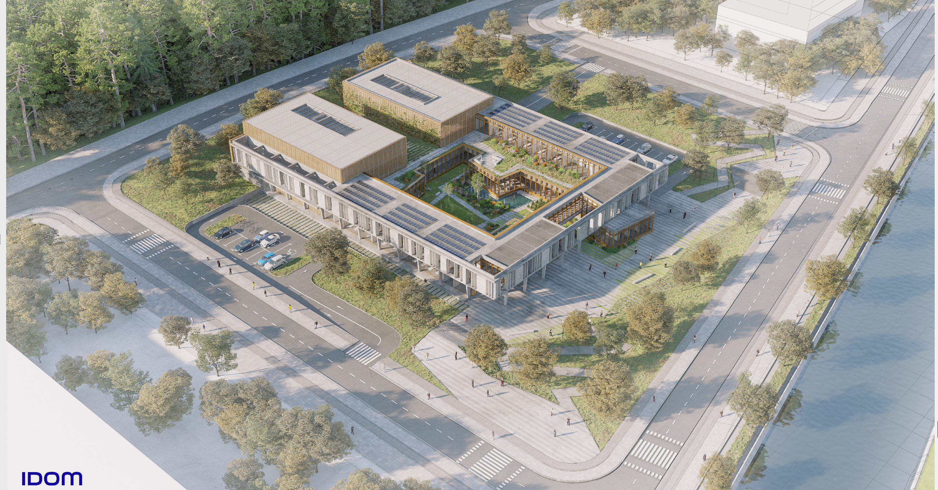
KIU HTC - PROJECT

Slide 16
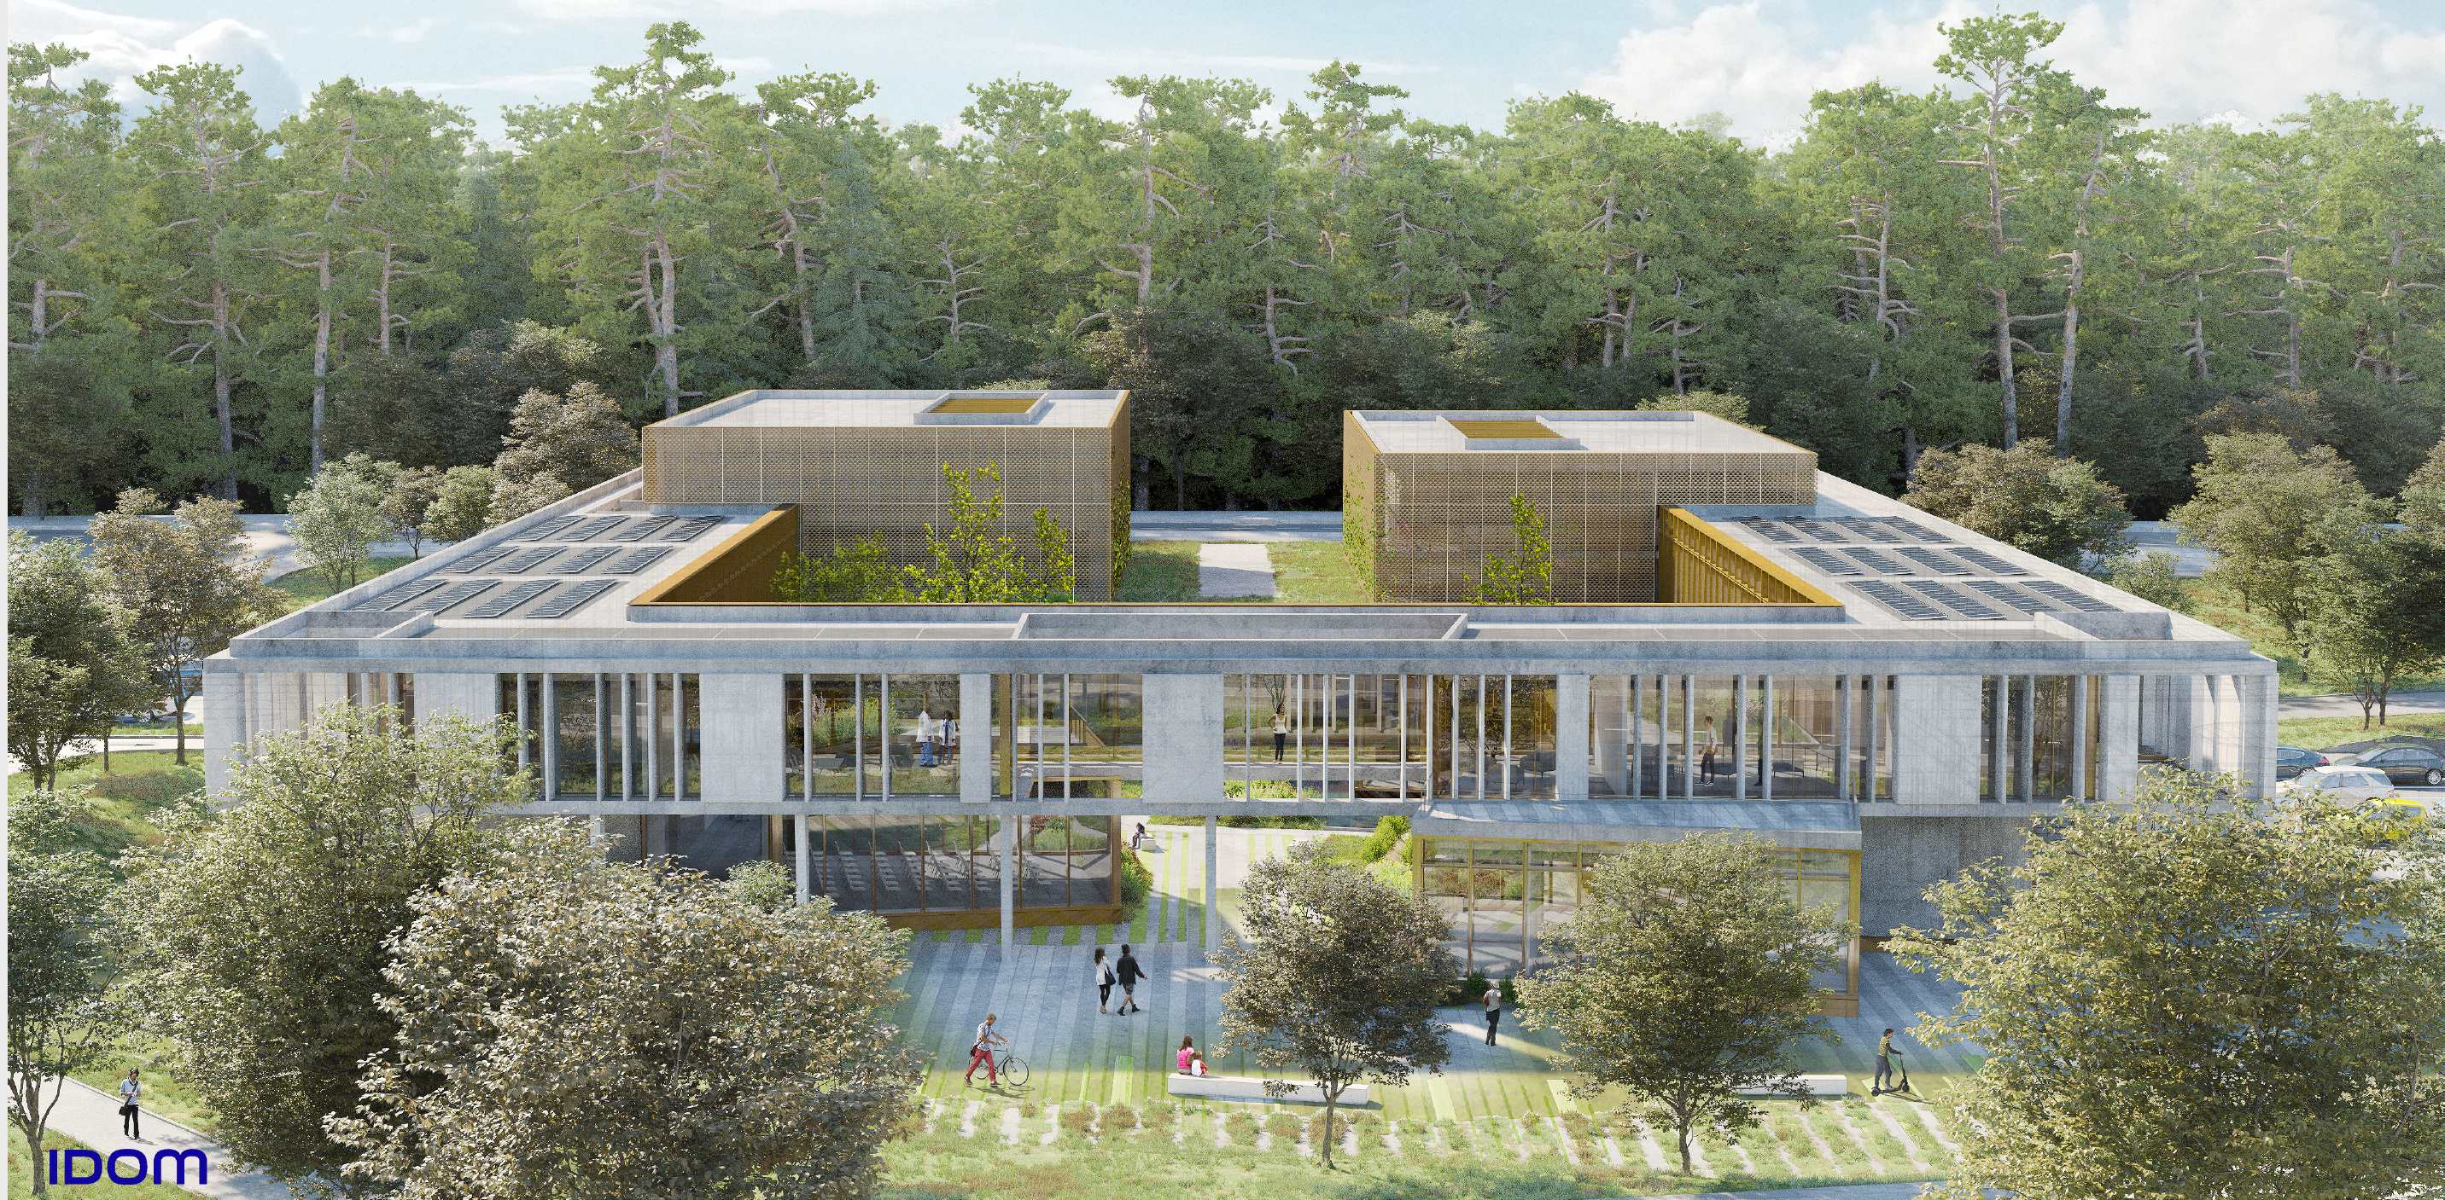
KIU HTC - PROJECT

Slide 17
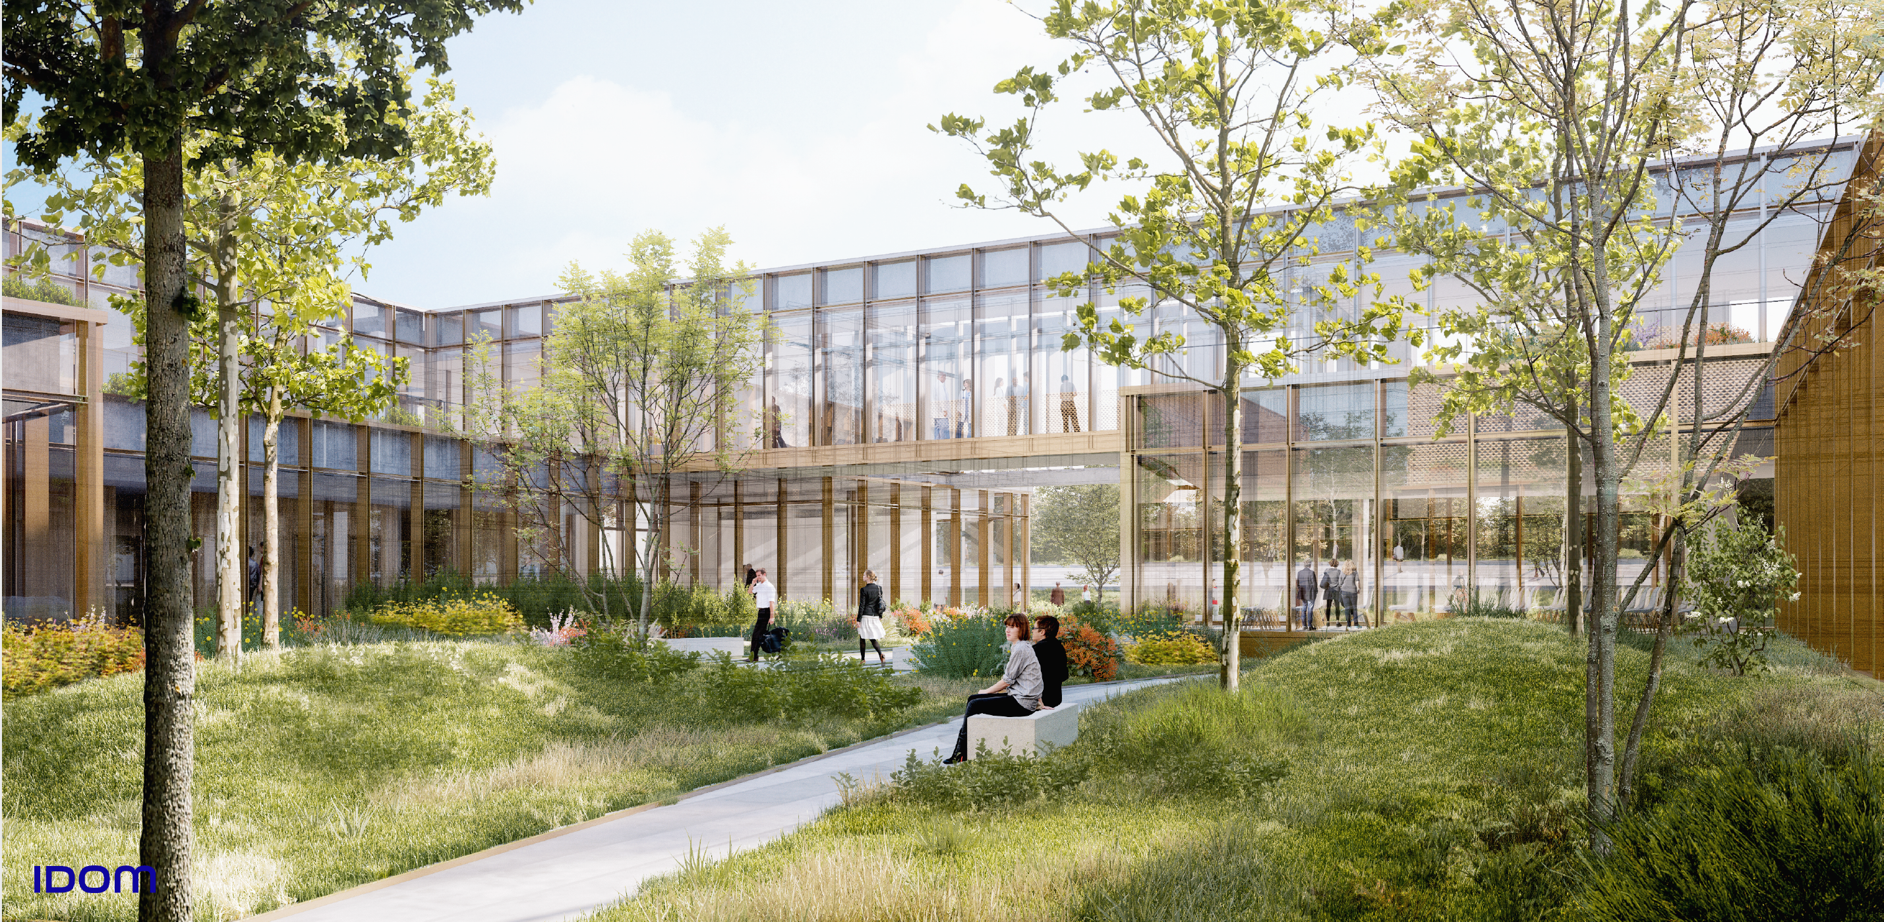
KIU HTC - PROJECT

Slide 18
KIU HTC - Roadmap
Q3
2024
Q4
2024
Q1
2025
Q2
2025
Construction
Permissions
T & C
First Patient
Construction process will be finished by Q3, 2024
The operation and radiation safety permissions will be acquired from the national authorities
Testing and commissioning will be finished by Q1. 2025
Fist patient will be received by Q2, 2025

Slide 19
