Slide 1
Partner GSI:
Physics highlights and perspectives of FAIR
September 5th – 9th, 2022
Thomas Stöhlker (GSI, HI-Jena)

Slide 2
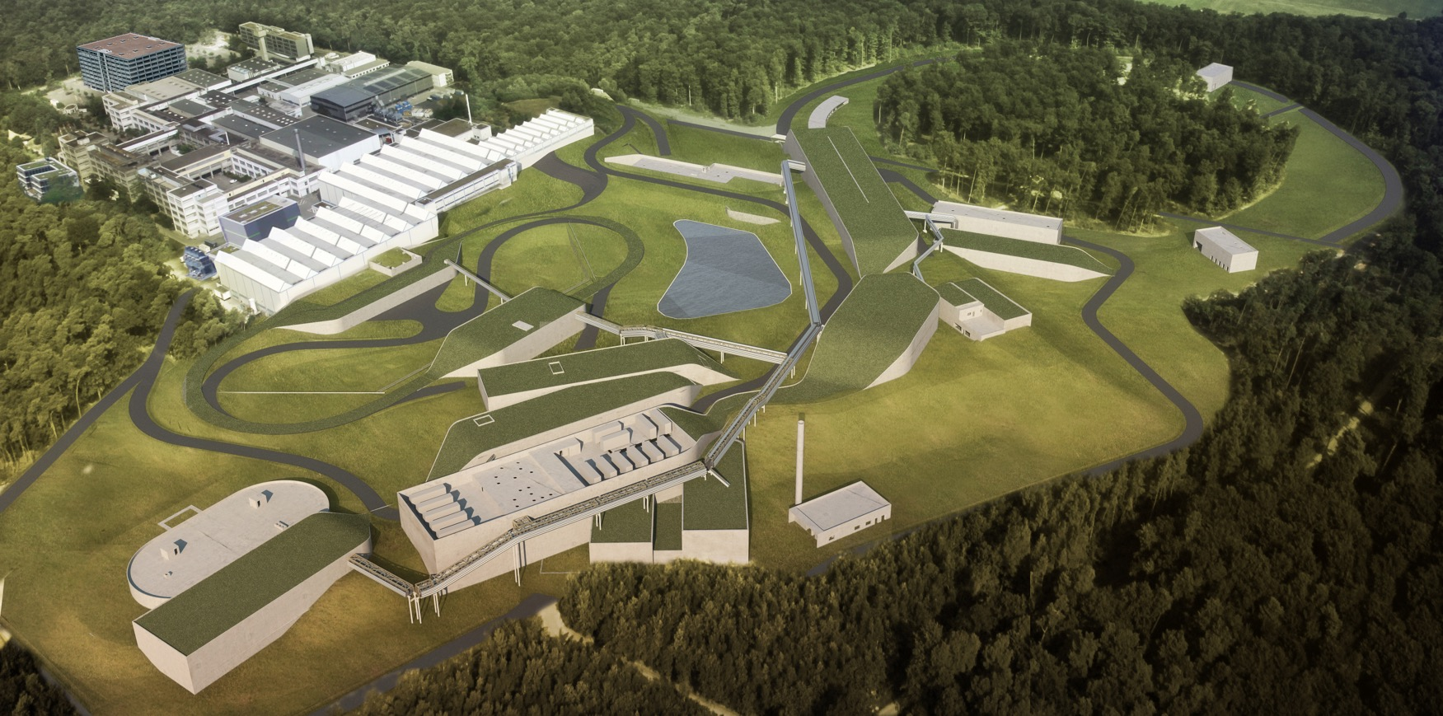
FAIR – Facility for Antiproton and Ion Research
Offering a broad spectrum of different research topics
Covering many different facets in physics but also in applications
Milestone of the European Research Infrastructure Roadmap (ESFRI)
Top-priority of the nuclear physics community

Slide 3
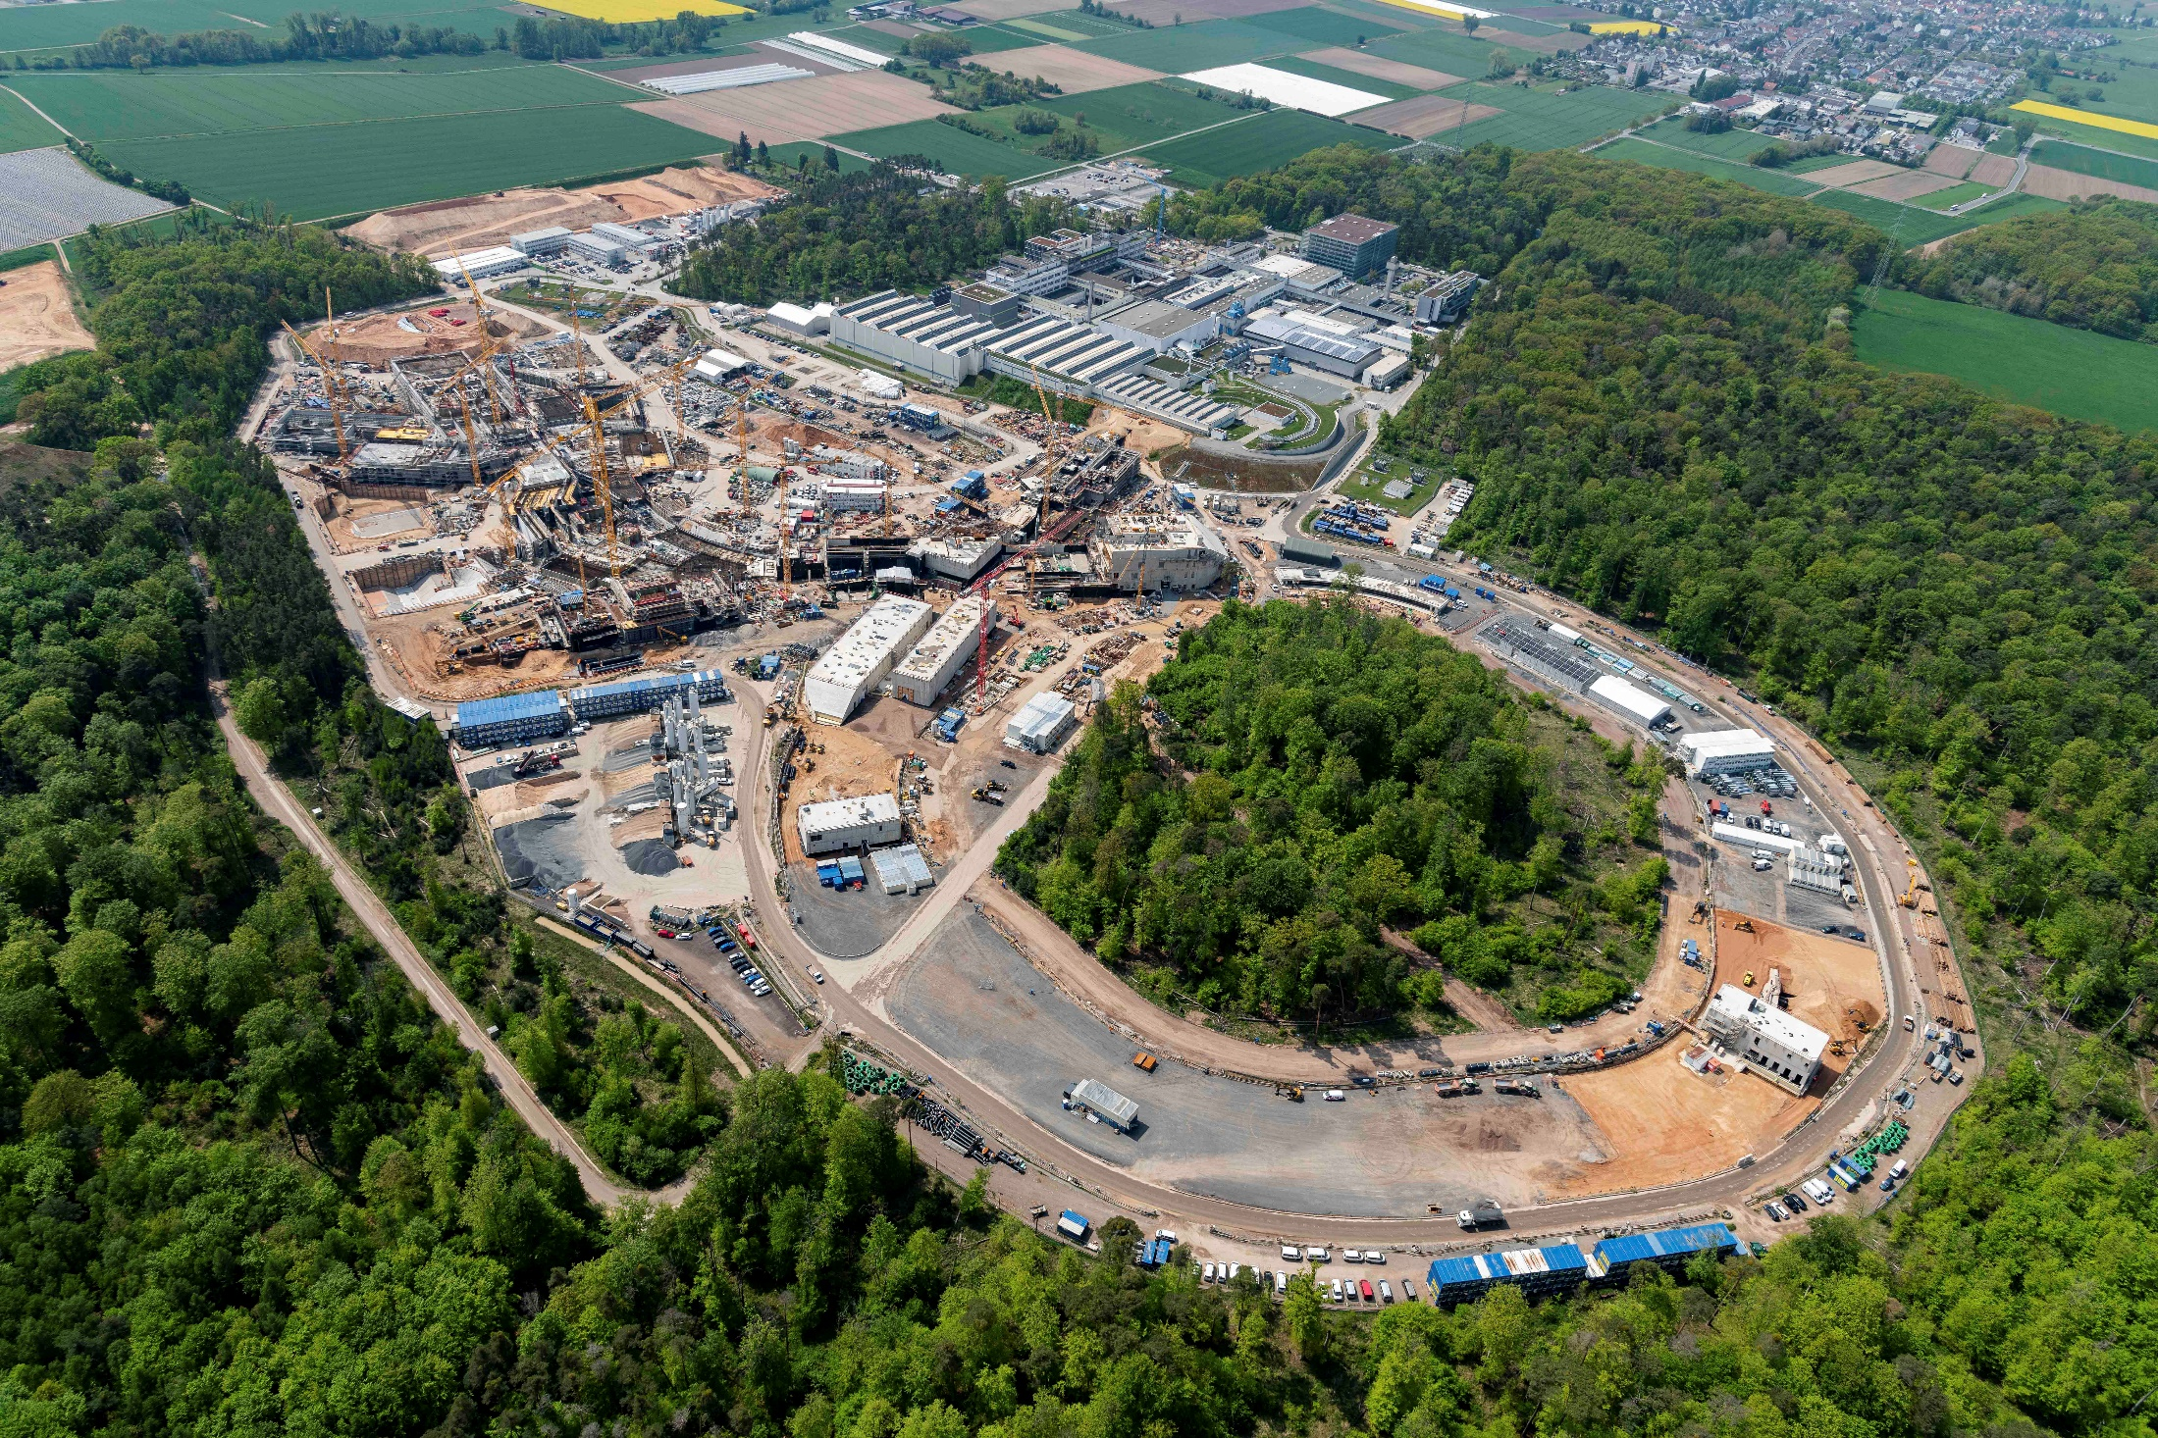
FAIR civil construction progressing well
May 2022
Drone videos available via www.gsi.de

Slide 4
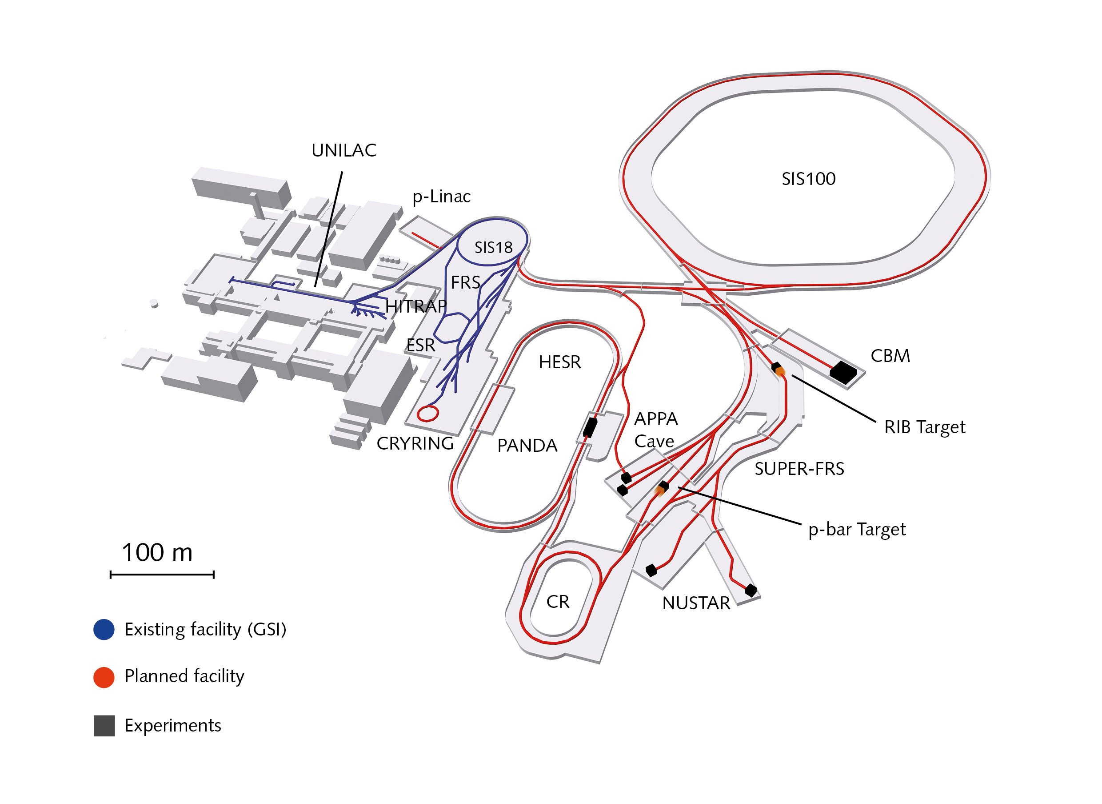
GSI, existing (upgraded to integrate with FAIR)
FAIR,
under construction
FAIR key features
intensity for wide range of ions
storage rings
antiproton beams
ESR, CRYRING, & HITRAP are part of FAIR

Slide 5
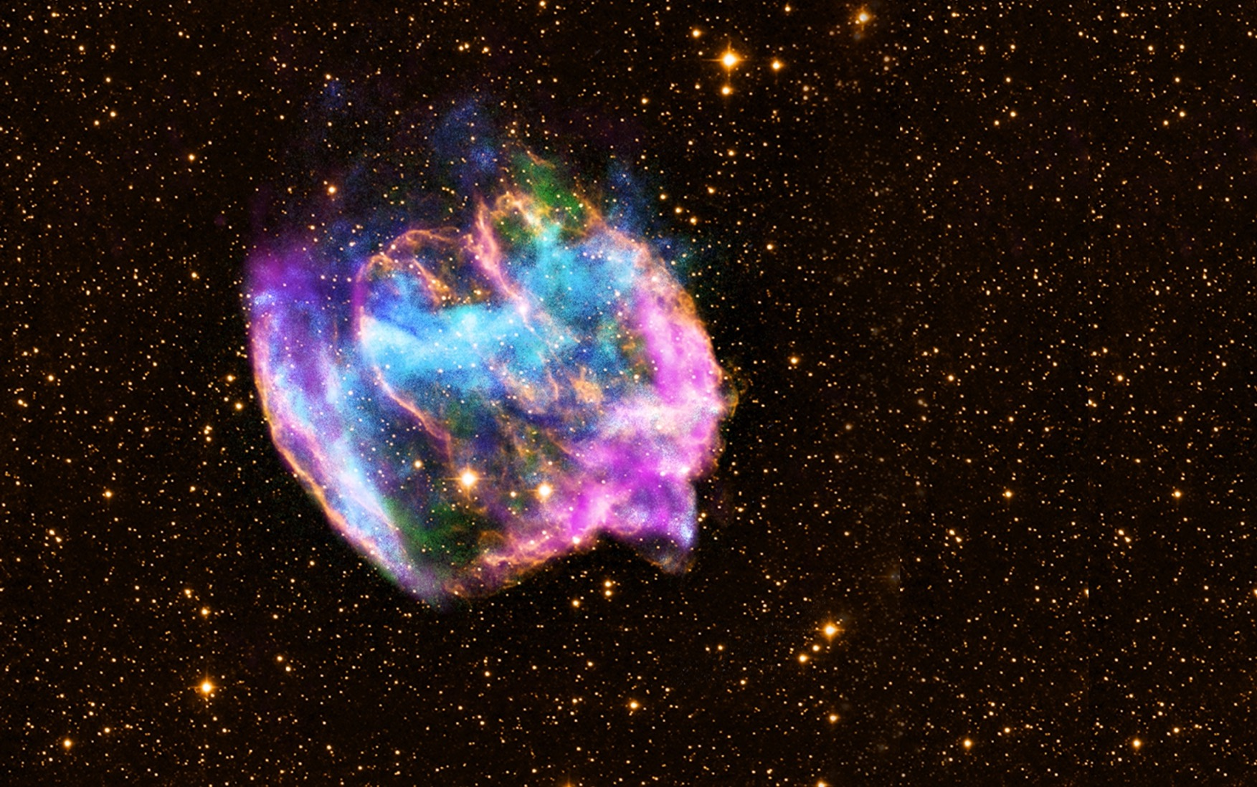
Creating extreme conditions existing in universe with heavy-ion accelerators

Slide 6

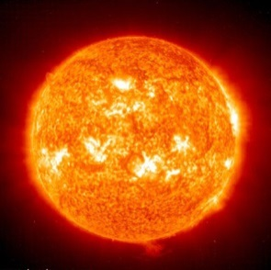
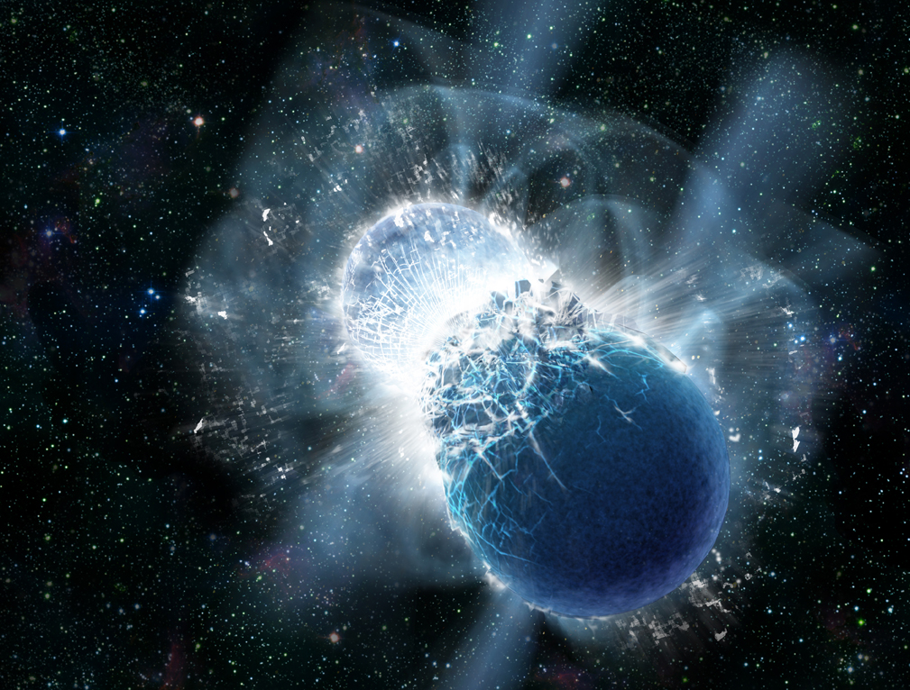
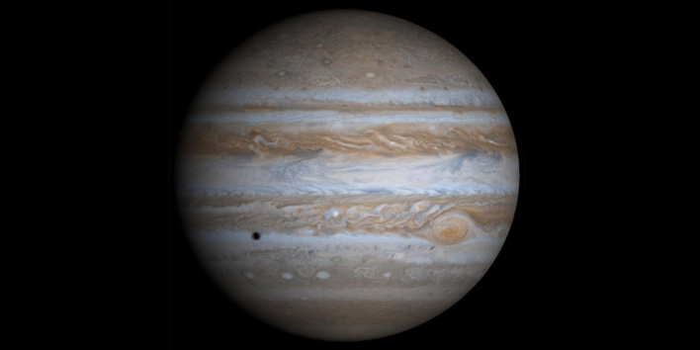
Synthesis of chemical elements in the cosmos
Building blocks of life: Production of carbon and oxygen in stars
Neutron star mergers: equation of state, strong force, neutron rich nuclei
Matter in the interior of Earth and of large planets

Slide 7
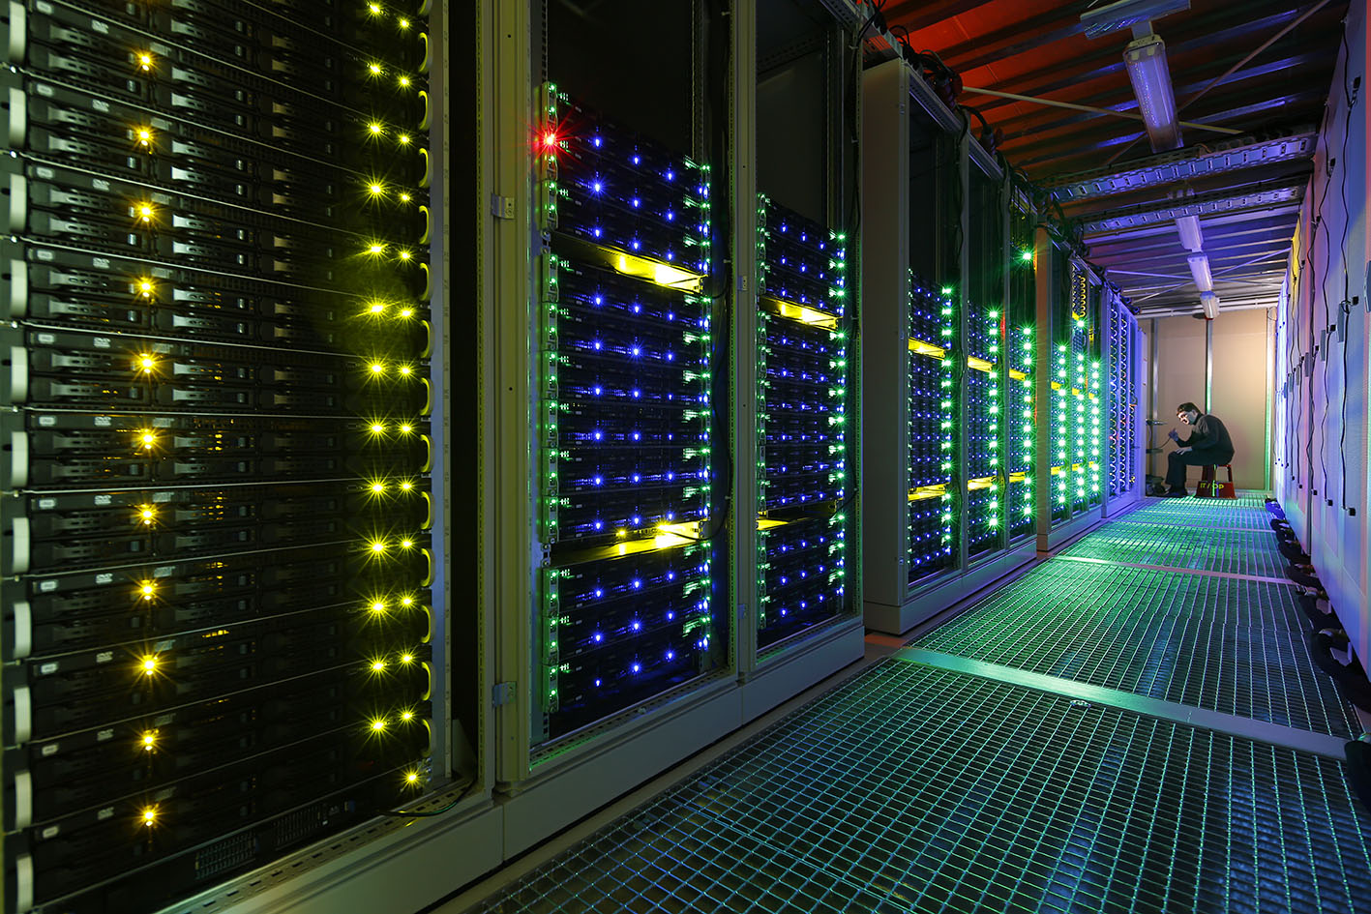
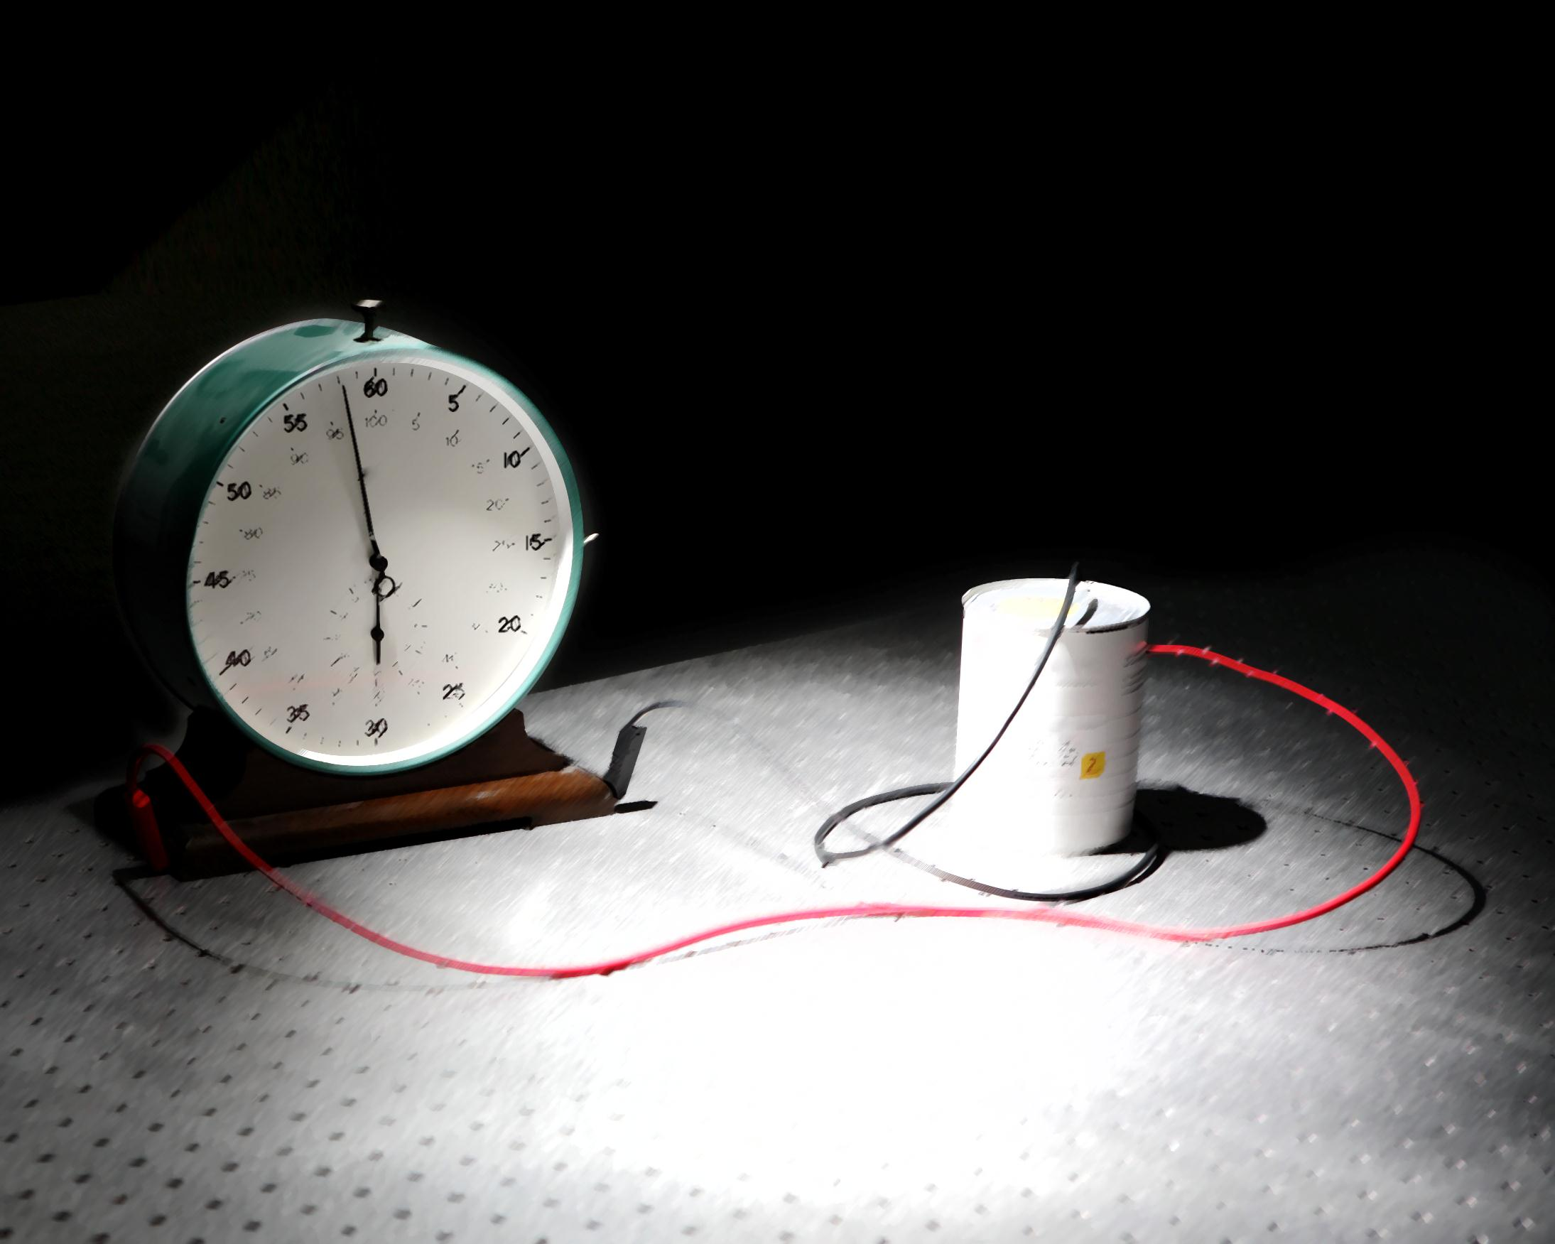
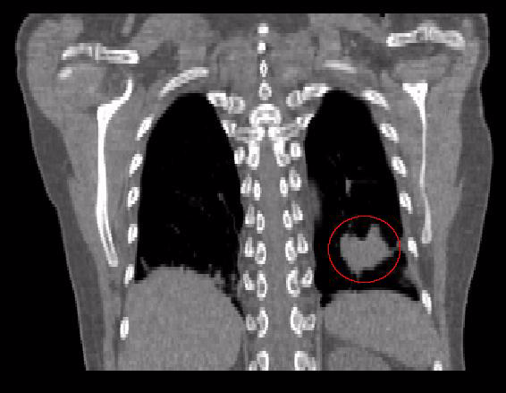
High-performance and scientific computing, big data, green IT
Space radiation protection, unique facility for simulation, collaboration with ESA
Development of nuclear clock:
Promising candidate thorium-229
Novel applications for tumor and non-tumor diseases

Slide 8
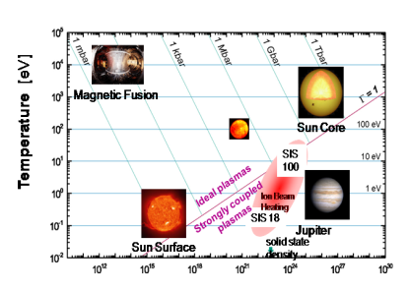
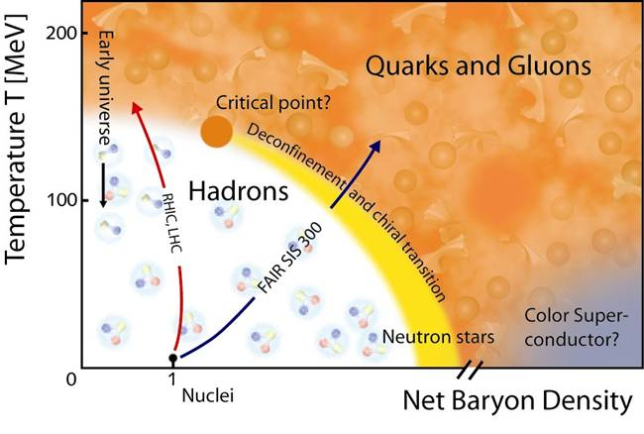
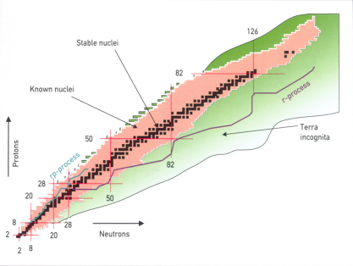
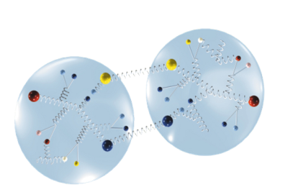
FAIR research is organized in four pillars
atomic physics, biophysics, plasma physics, materials research
APPA
nuclear- and quark-matter
C.B.M
nuclear structure and
nuclear astrophysics
NuSTAR
PANDA
hadron structure and dynamics

Slide 9
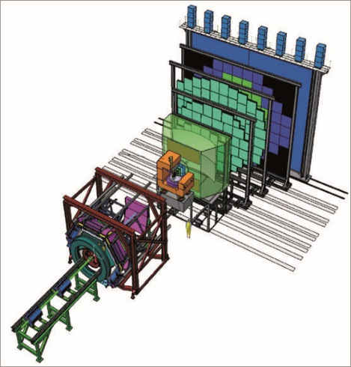
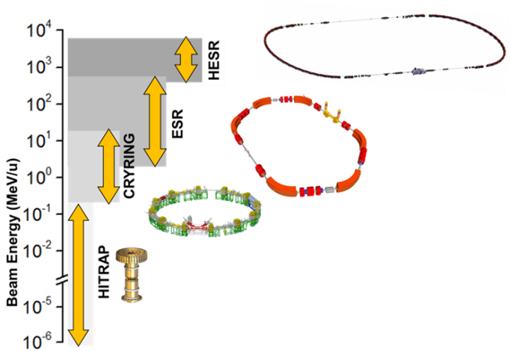
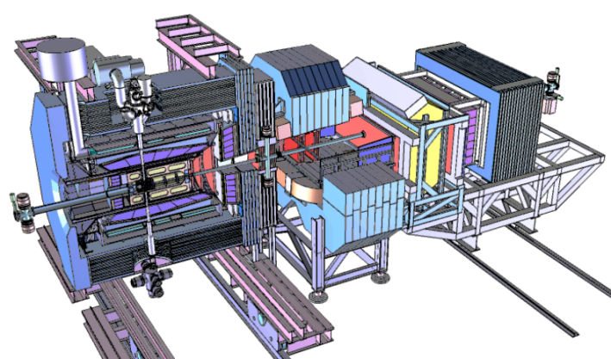
FAIR facility
HADES
+ CBM
APPA
NUSTAR
Super-FRS
PANDA

Slide 10

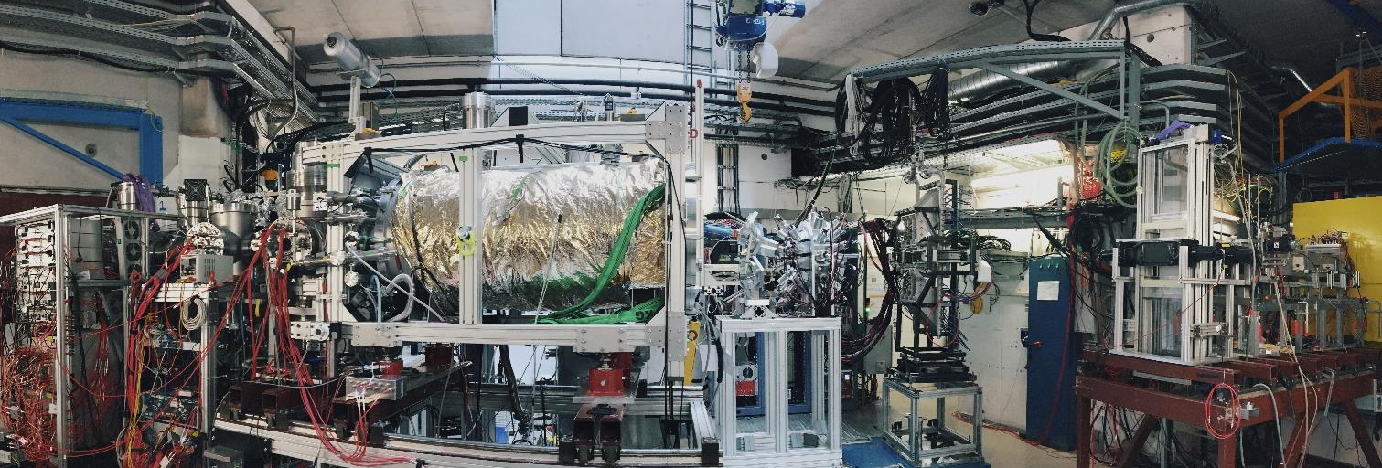
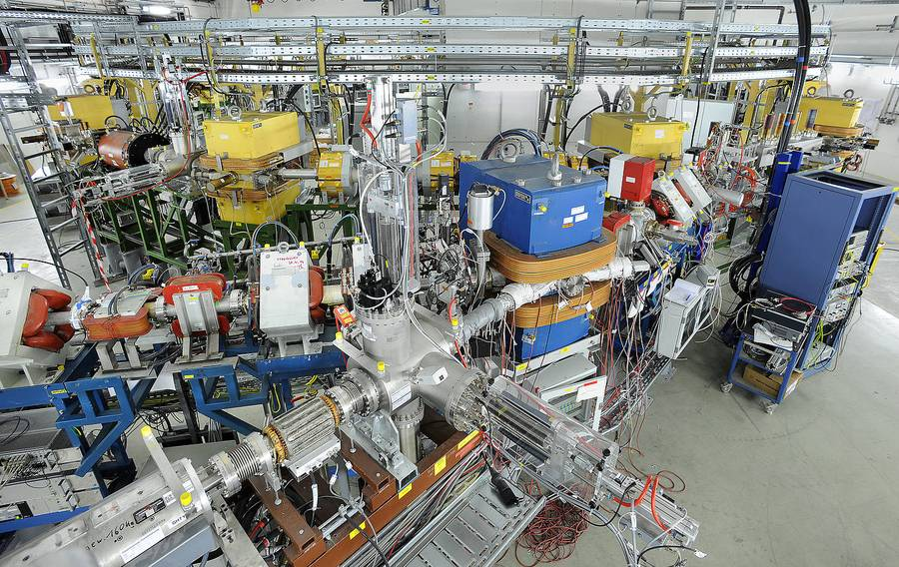
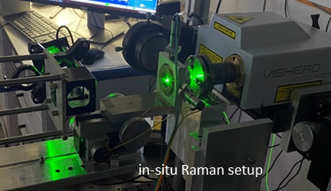

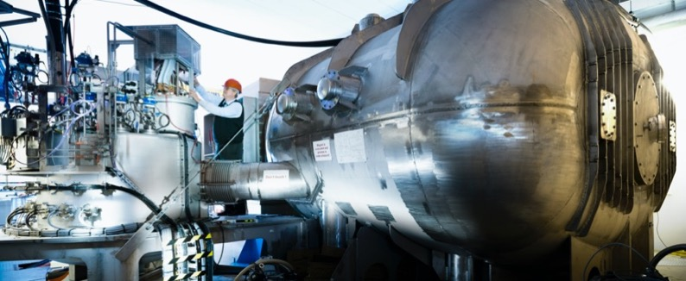
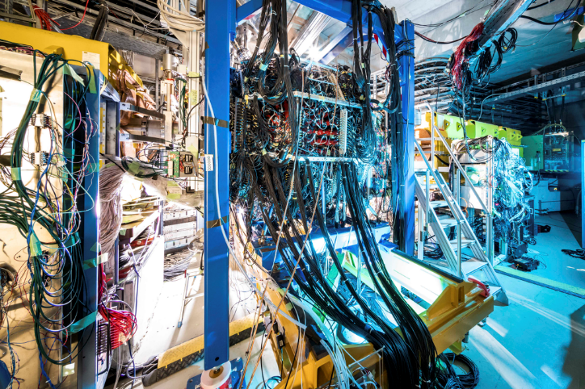
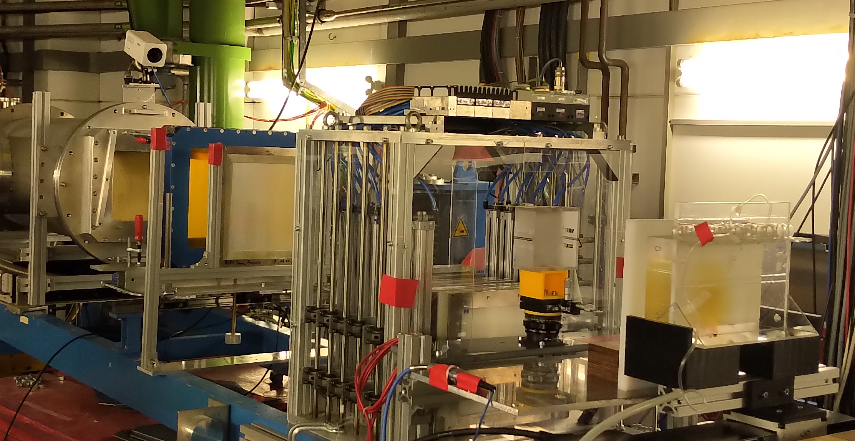
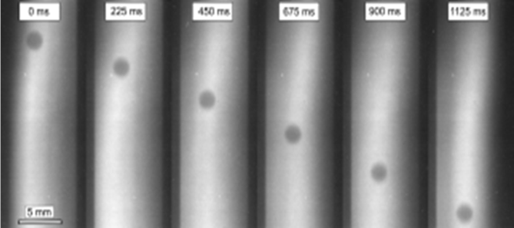
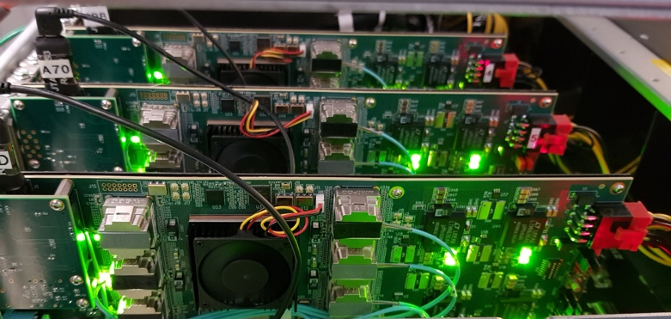
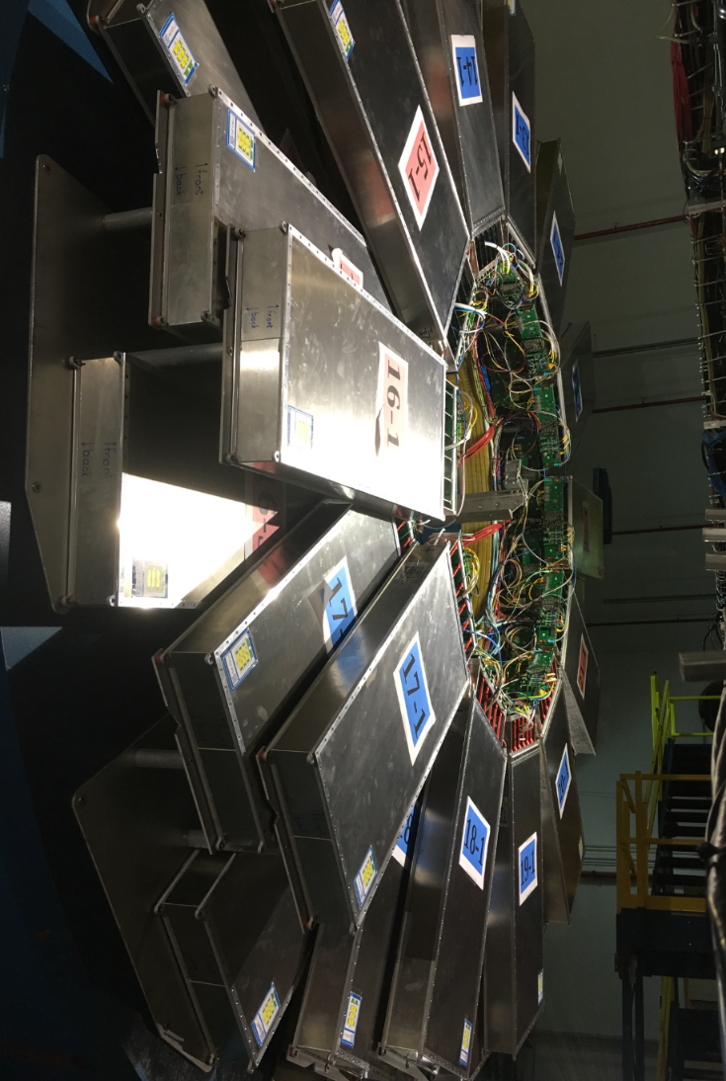
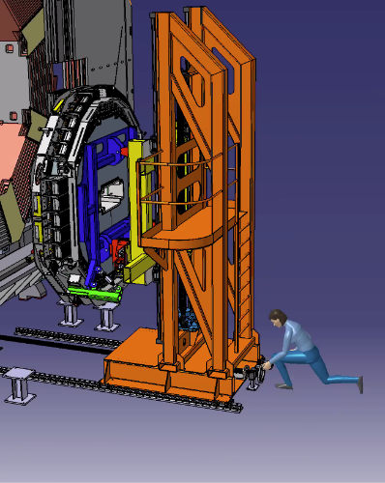


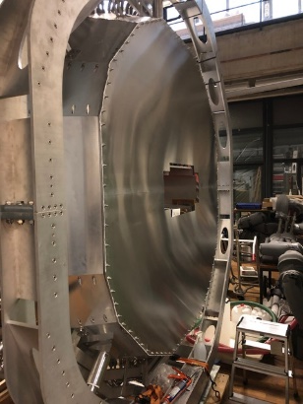
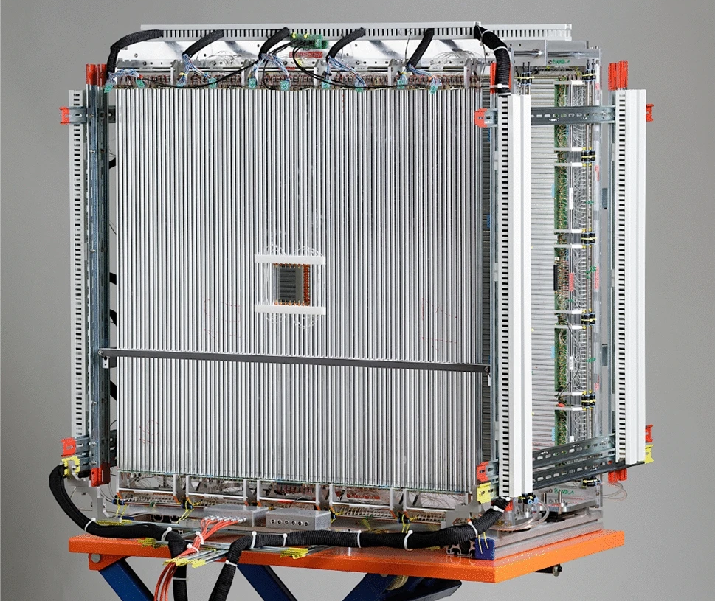
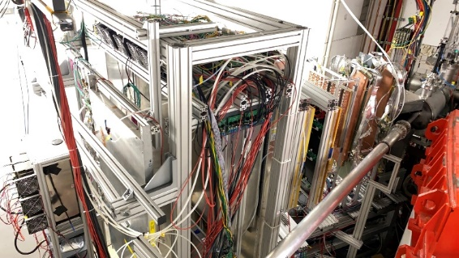
FAIR experiments

Slide 11
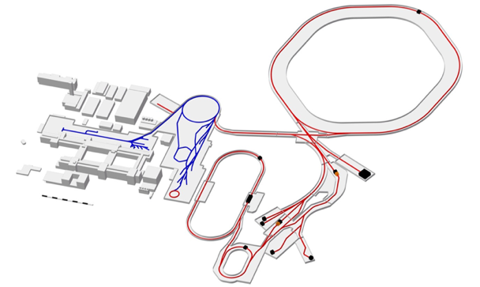
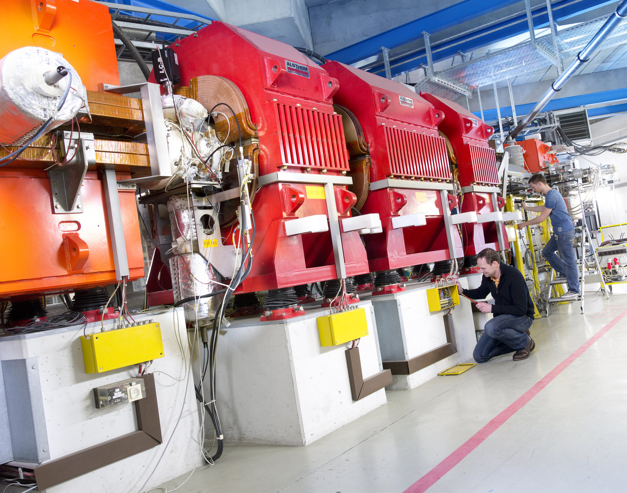
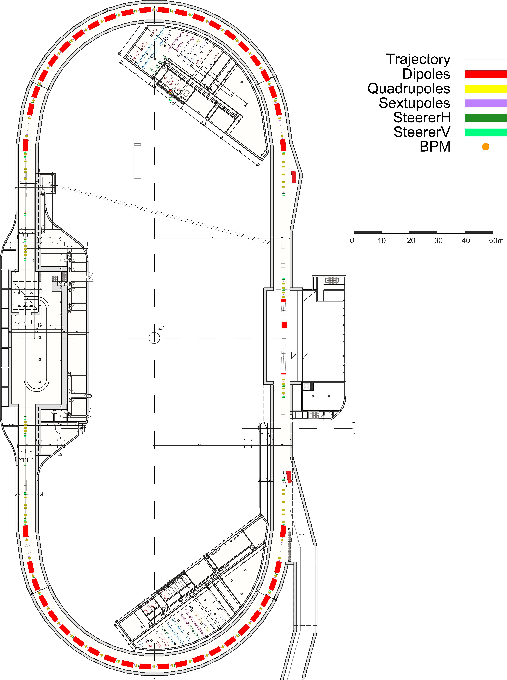
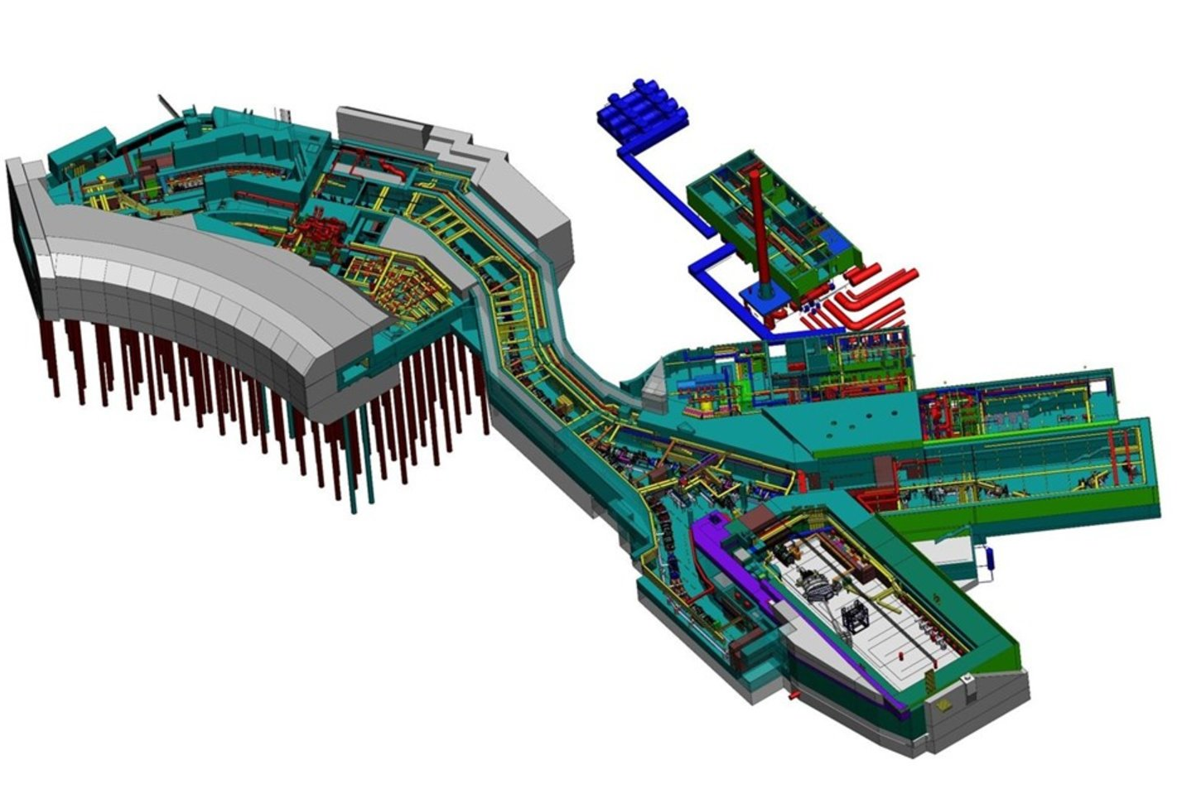
FAIR accelerators
SIS100
rigidity: 100 Tm
super-conducting
accelerating intermediate charge states of HIC
cryogenic UHV system
protons: 2.5 × 10¹³/cy, 29 GeV
U²⁸⁺ : 5 × 10¹¹ /cy, 2.7 GeV/u
U⁹²⁺ : 4 × 10¹⁰ /cy, 10 GeV/u
ESR – CRYRING
ESR
rigidity: upto 10 Tm
electron cooling
typical energies ~ 300 MeV/u
CRYRING
rigidity 0.04 – 1.44 Tm
ion source for stand alone operation
CR
max. rigidity 13 Tm
fast bunch rotation, coasting beam
stochastic cooling
HESR
rigidity: 5-50 Tm
accelerating p, anti-p and highly charged ions
stochastic (and electron) cooling
Super-FRS
CR - HESR
ACCEPTANCE
horizontal Φ_{x} = ±40 mrad
vertical Φ_{y} = ±20 mrad
momentum ΔP/P = ±2.5 %
magnetic rigidity 2 - 20 Tm
MOMENTUM RESOLUTION
first stage = 750
second stage = 1500
Target spot size (for slow extarction)
horizontal σ_{x} = 1 mm
vertical σ_{y} = 2 mm
Projectile
Elements from p - U
Energies up to 1500 MeV/nucleon
Intensities up to 10¹² /s (depending on element)
DC or pulsed operation
Features
Fast (sub-microseconds)
Two separation stages - Pre-Separator and Main-Separator
Mono-isotopic or coctail beams
Multi-branch system (HEB, LEB, RB)
Large phase-space acceptance utilizing SC magnets
Handling concepts for high radiation area

Slide 12
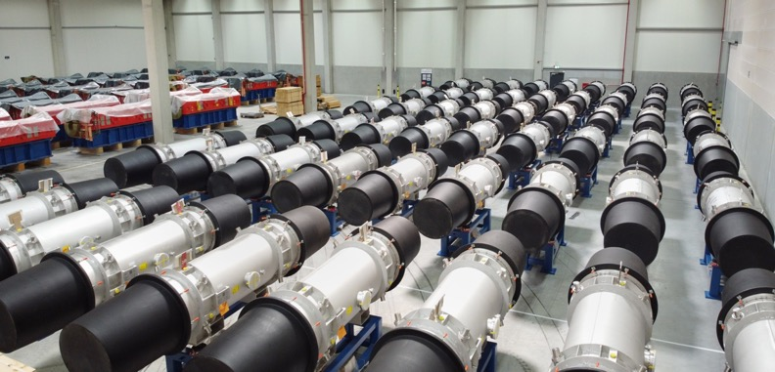
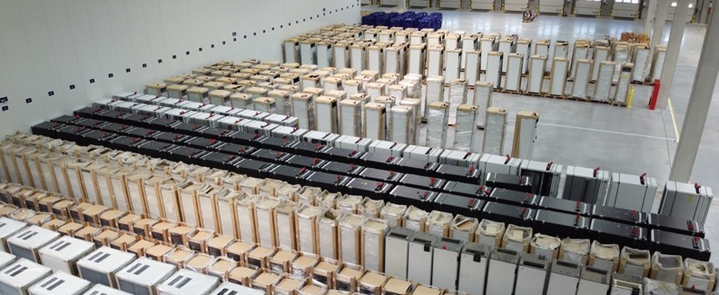
FAIR accelerators
SIS100 – Pumping chambers
SIS100 – Dipole magnets
Power supplies | India
SIS100 sc quadrupole testing facility / Salerno

Slide 13
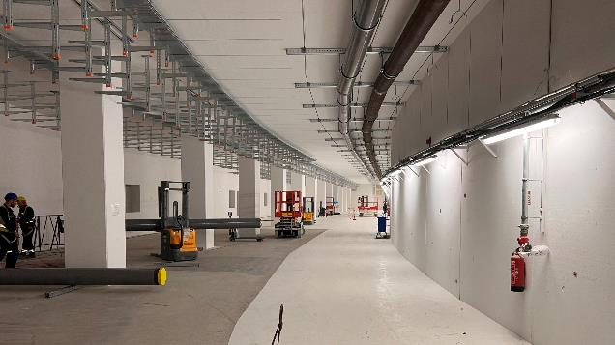
FAIR civil construction
CBM cave
Some examples
building hosting cryogenics completed
coating and TBI installation for SIS100 tunnel ongoing
concrete works for CBM cave completed, crane installation started
Cryogenic building
SIS 100 tunnel

Slide 14

FAIR Phase-0 at (but not only) the GSI facilities
Staged approach to FAIR science started in 2019
working towards start of FAIR
progressive commissioning of GSI accelerators and already existing FAIR detectors
3 months user beamtime/year at GSI
2021 and 2022 runs completed as planned
defined in consultation with the community
following call for 2023/24 beam time, the individual PACs will evaluate the proposals in Sep 2022
up to 90 % speed of light
Ion species: H⁺,..., U⁹²⁺
heavy-ion synchrotron
SIS 18
linear accelerator
UNILAC
PHELIX
M-branch
Z6
Fragment
Separator
HHT
storage
ring ESR
8 % - 15 % speed of light
SHE
X0
HITRAP
HADES
Cave A
miniCBM
R3B
CRYRING

Slide 15
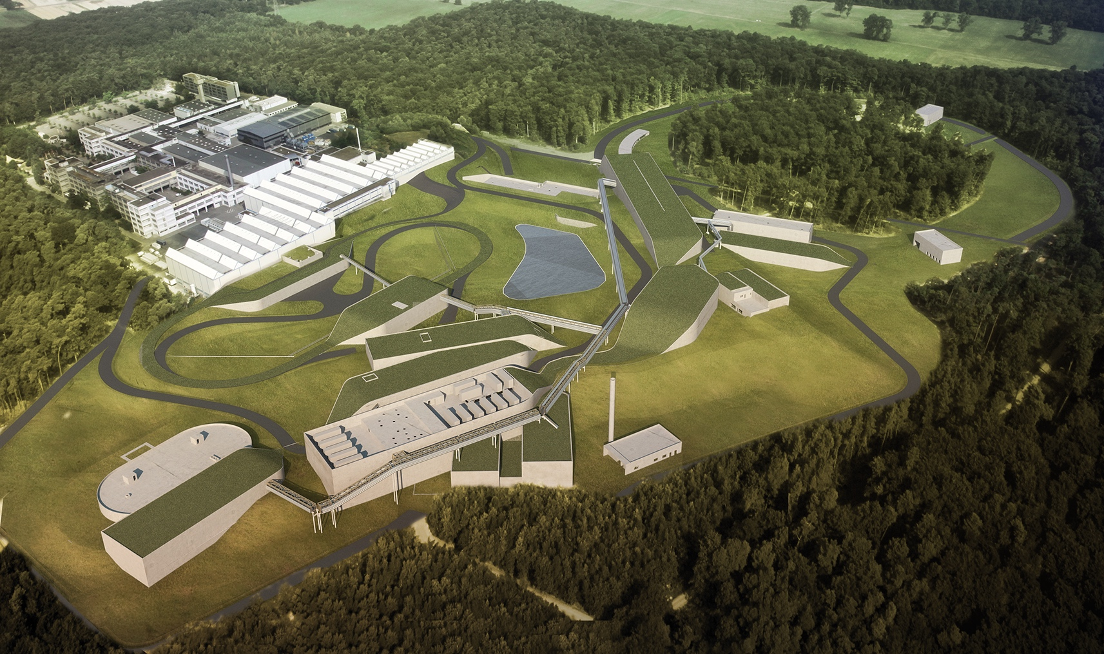
Summary and Conclusion
FAIR Phase-0 at GSI
Staged approach to FAIR science which allows smooth transition from GSI to FAIR operation
    education of young scientists and engineers
    maintaining expertise and skills
    commissioning of accelerator and detector equipment
  Fostering a close collaboration between experiment and theory
Start of FAIR
Stepwise process
Major revision necessary because of the sanction against Russia after the invasion in Ukraine
  freezing of all ongoing projects with Russia
  important Russian in-kind contributions are on hold
  working group consisting out of people from accelerator and experiments evaluating the consequences of the sanctions and potential Russian failure to deliver components
  scientific review ongoing
  several scenarios are being evaluated
Notes:
Risk of resource shortage due to parallel operation and construction

Slide 16
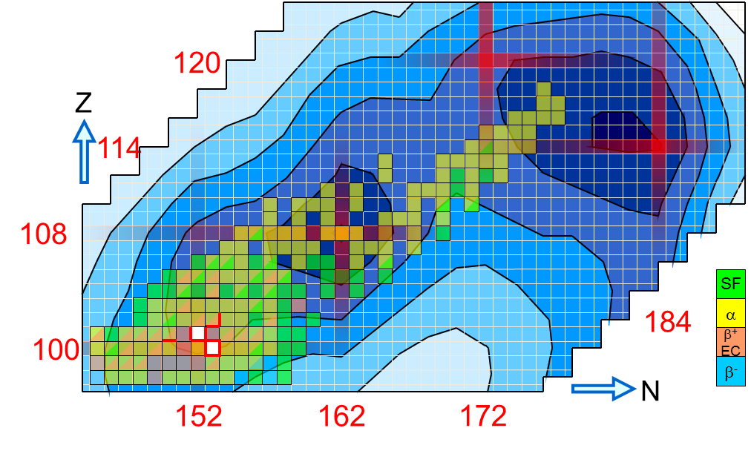
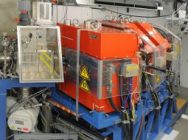
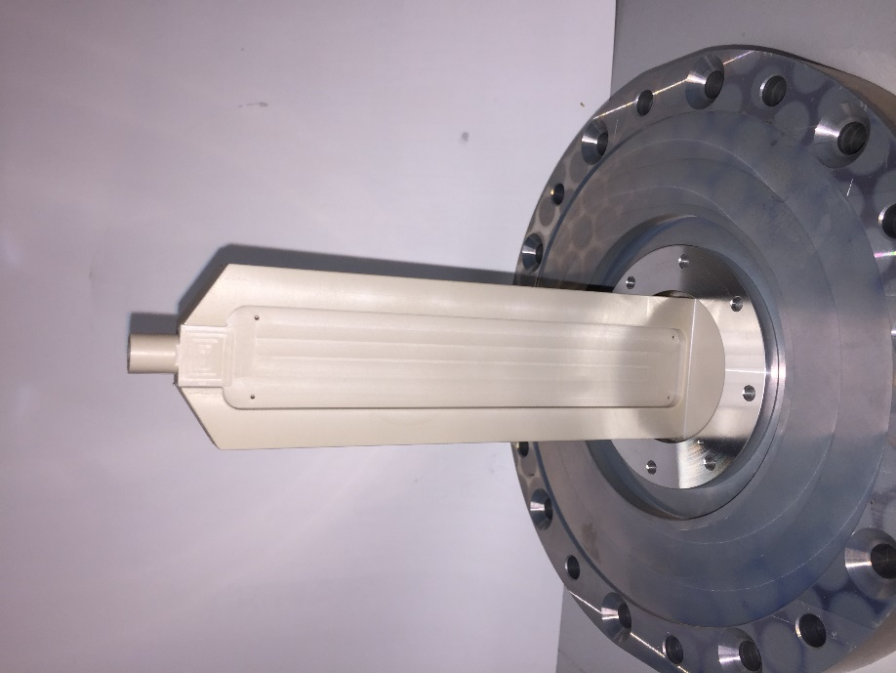
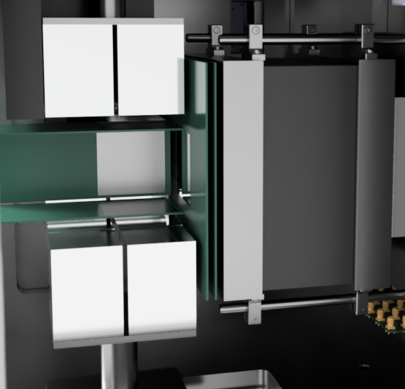
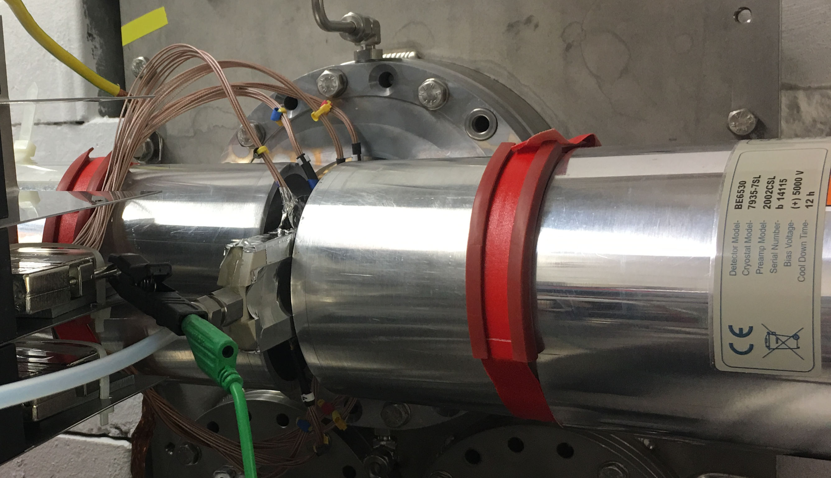
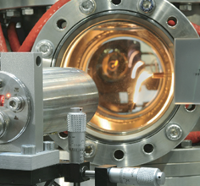
NUSTAR – Superheavy Elements
Perspectives of superheavy element research
SHIP
FAIR Phase-0:
With novel experimental setups around SHIP and TASCA study production and atomic, chemical and nuclear properties of elements Z ~ 100 – 118
TASCA
Production and Nuclear Structure of SHE:
decay spectroscopy: Z ~ 100-118
mass measurements: Z ~ 100-106
Chemical Properties
of Transactinides
Z ~ 113-116
Beyond FAIR Phase-0:
novel cw linac HELIAC
might allow studies of elements up to Z = 118 and beyond
SHIPTRAP
miniCOMPACT
Laser Spectroscopy
Z ~ 100-103
ANSWERS
LUNDIUM
RADRIS
UniCELL
Notes:
During FAIR Phase-0:
Each individual experiment does not exceed four weeks of main beamtime.
As in past years, intense beam sharing between the SHIP and TASCA will allow us to make best use of the available beamtime and to also commission new and advanced equipment in parallel to high-impact science runs.
Beams:
The program will continue to rely heavily on the ⁴⁸Ca and ⁵⁰Ti beams
Individual proposals will request other beams, e.g., ²²Ne, ⁴⁰Ar, ⁵⁴Cr, ⁶⁴Ni
Access to molecular chemical SHE systems
Mass measurements in ²⁶³Sg
ANSWERS studies of n-rich Rf isotopes
…

Slide 17
See you at FAIR!
Photo: C. Betz

Slide 18
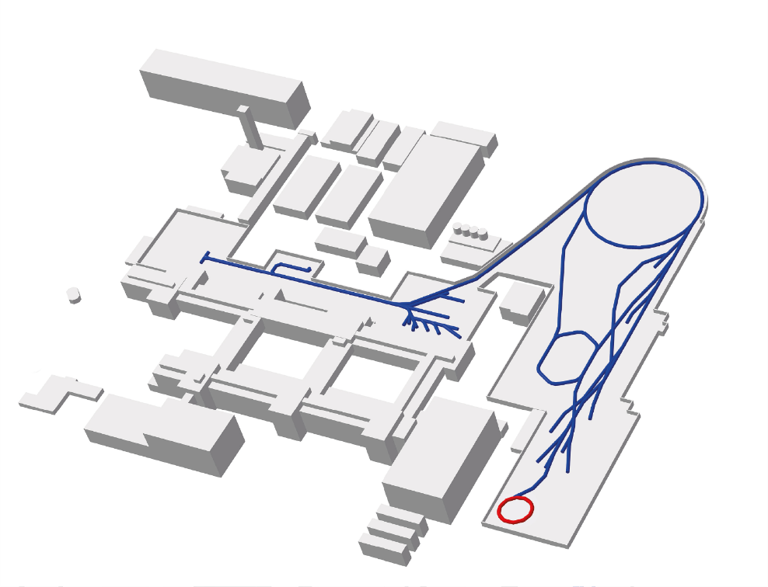
U²⁸⁺ 1.4 MeV/u
UNILAC – accl.
U⁷³⁺ 11.4 MeV/u
High current injector
High charge injector
FRS
SIS18 – accl.
UNILAC
Low energy
experimental area
U⁹⁰⁺ 400 MeV/u
ESR
ESR– decel.
Green
IT Cube
U⁹⁰⁺ 10 MeV/u
High energy
experimental area
CRYRING@ESR

Slide 19
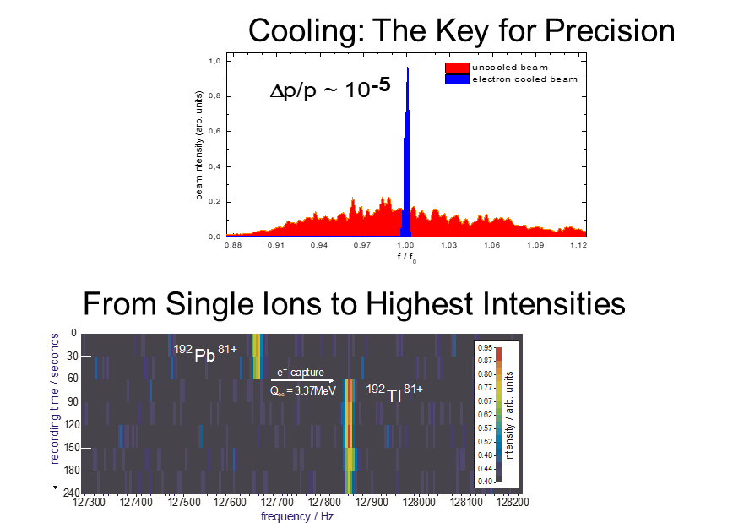
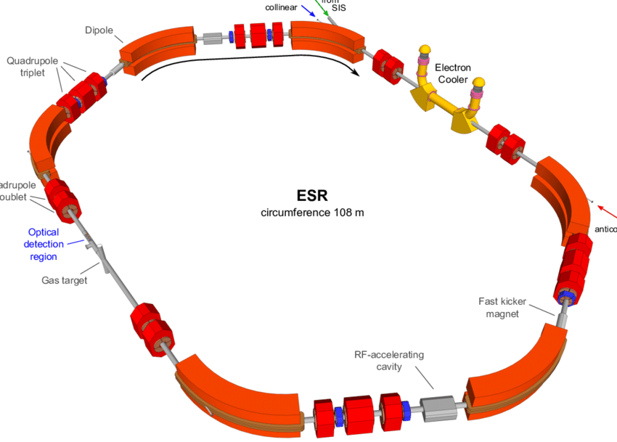
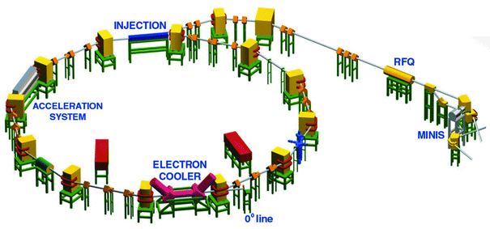
APPA: Atomic Physics, Plasma physics, and Applied science
SPARC Precision physics by trapping and storage
10⁴
HESR
FAIR Phase-0 (2018 …)
10³
10²
ESR
research, employing FAIR instrumentation
focus on storage and trapping
first experiments at CRYING & HITRAP
preparation of Phase-1
FAIR Phase-1
(2025…)
…
making use of full MSV
10¹
10⁰
CRYRING
Ion Energy (MeV/u)
10⁻¹
H
I
T
R
A
P
10⁻²
10⁻¹⁰
10⁻¹¹
10⁻¹²
10⁻¹³

Slide 20
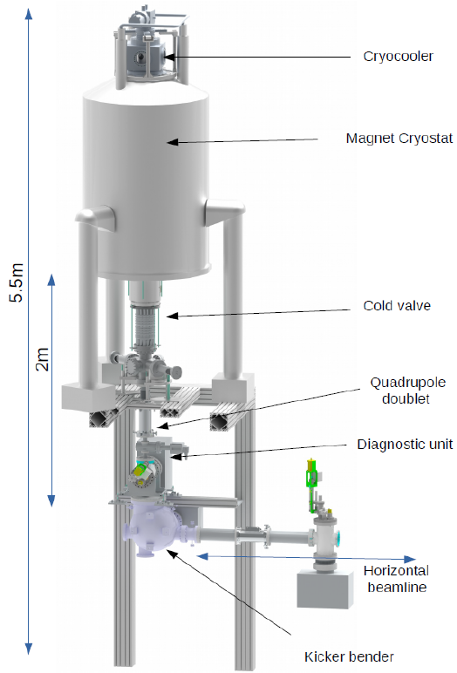
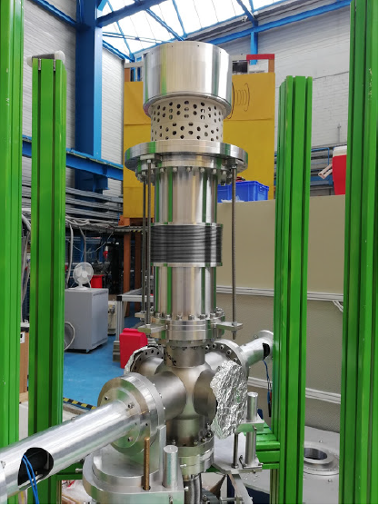




HITRAP Experiments
Connecting ARTEMIS to Low Energy beam line
Test setup with cold valve
Preparation for beam time in May 2022
Commissioning of LEBT with
EBIT ion source
Detection of highly charged argon ions in vertical beamline
Next step: installation of cold valve between LEBT and ARTEMIS
Detection of Ar^{X+} ions in diagnostic unit
J. Klimes, K. Anjum, M. Horst, S. Rausch,
K. Kanika, M. Chambath, M. Vogel, W. Quint

Slide 21
APPA: Atomic Physics, Plasma physics, and Applied science
SPARC Precision physics by trapping and storage
10⁴
HESR
10³
10²
ESR
10¹
10⁰
CRYRING
Ion Energy (MeV/u)
10⁻¹
H
I
T
R
A
P
10⁻²
10⁻¹⁰
10⁻¹¹
10⁻¹²
10⁻¹³

Slide 22



















