Slide 1
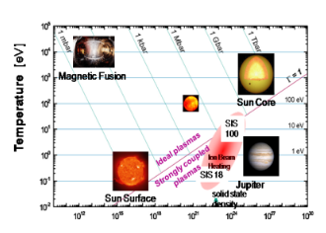
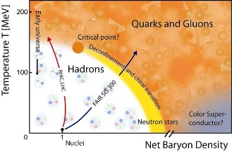
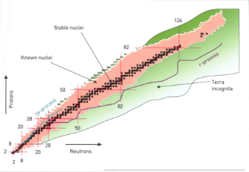
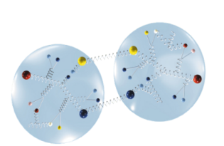
FAIR research is organized in four pillars
atomic physics, biophysics, plasma physics, materials research
APPA
nuclear- and quark-matter
C.B.M
nuclear structure and
nuclear astrophysics
NuSTAR
PANDA
hadron structure and dynamics

Slide 2
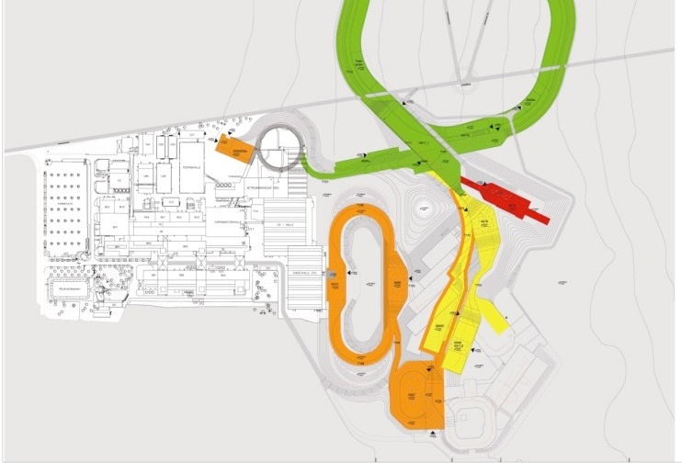
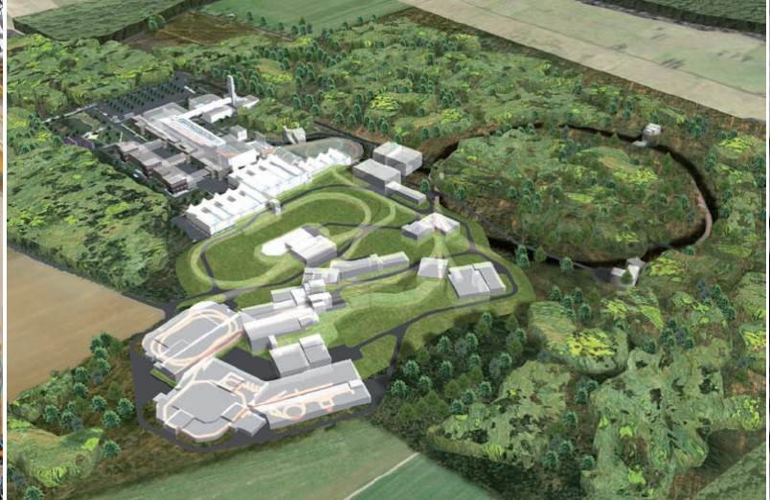
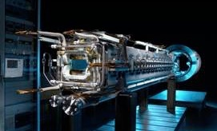

APPA and NUSTAR
at GSI & FAIR
Thomas Stöhlker
GSI, Helmholtz Institute Jena, Friedrich-Schiller Universität Jena

Slide 3

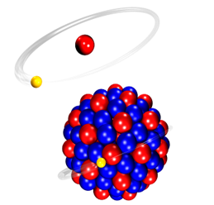
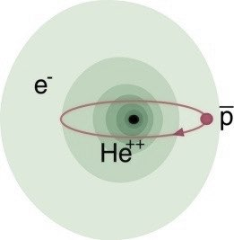
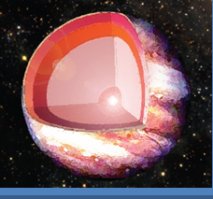

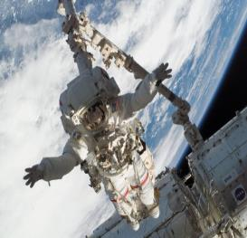
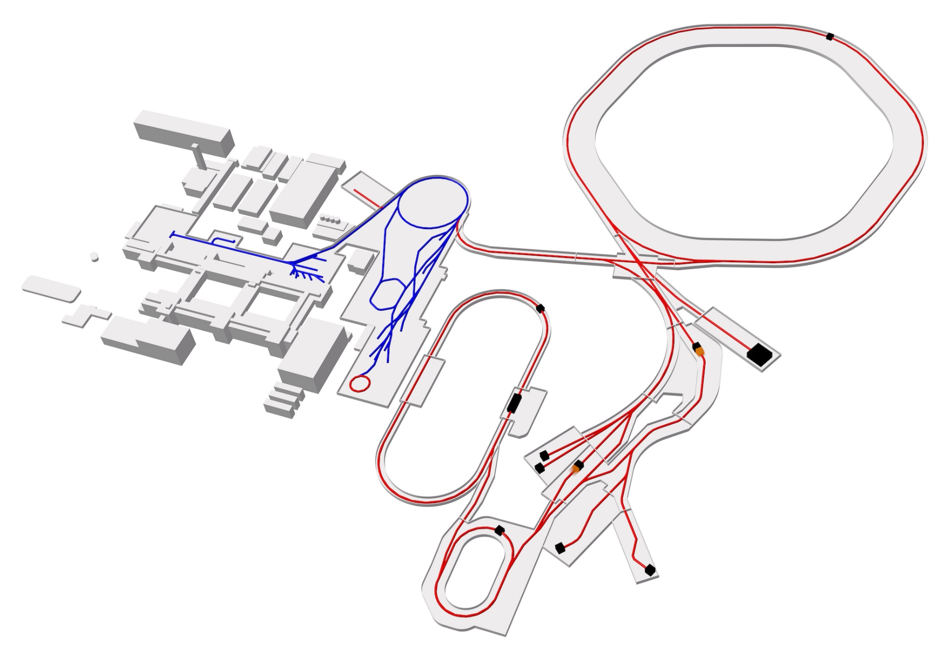
Atomic Physics, Plasma Physics, and Applied Sciences
Atomic Physics
Plasma Physics
Materials Science
Biophysics
SPARC
FLAIR
HED@FAIR
MAT/BIOMAT
BIO/BIOMAT
SIS100
strong field research
... probing fundamental laws of physics
antimatter
... matter / anti-matter symmetry
(not in MSV)
extreme states of matter
... common in astrophysical objects
radiation effects
... materials degradation and nanostructuring
space travel & therapy
... cosmic radiation risk and theranostics
PHELIX
UNILAC
HHT
Laser
HITRAP
ESR
caves A,M
HESR
FACILITY CAPABILITY
SCIENTIFIC CAPABILITY
Highest Charge States
Relativistic Energies
High Intensities
High Charge at Low Velocity
Low-Energy Anti-Protons
Extreme Static Fields
Extreme Dynamical Fields and Ultrashort Pulses
Very High Energy Densities and Pressures
Large Energy Deposition
Antimatter Research
CRYRING
APPA cave

Slide 4

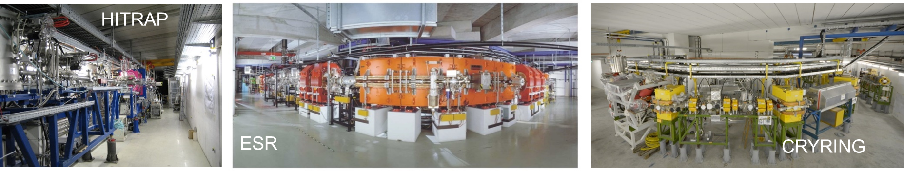
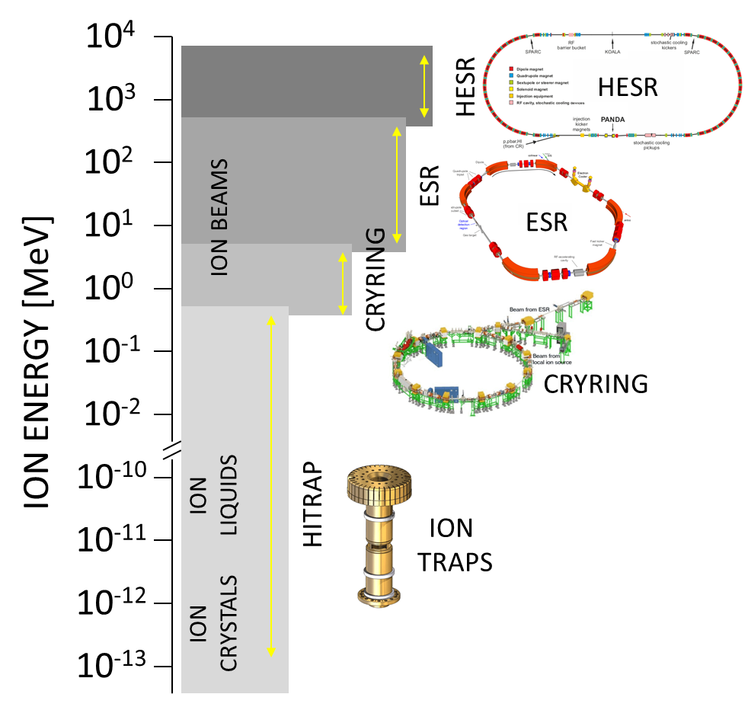
Precision Domain of FAIR: Trapping & Storage of HCI
Atomic, Quantum, and Fundamental Physics
HITRAP, CRYRING@ESR, ESR
From rest to relativistic energies (up to 4.9 GeV/u)
From single ions to highest intensities
Cooling is the key for precision
Storage rings: High luminosity due to typical revolution frequency of MHz

Slide 5
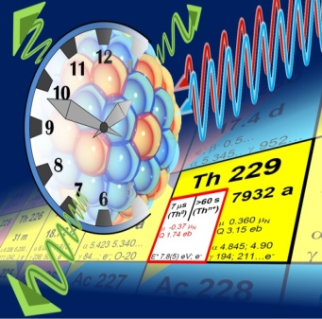
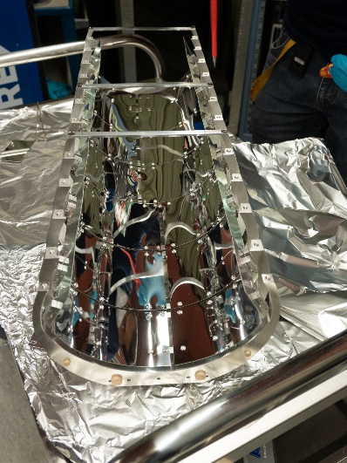
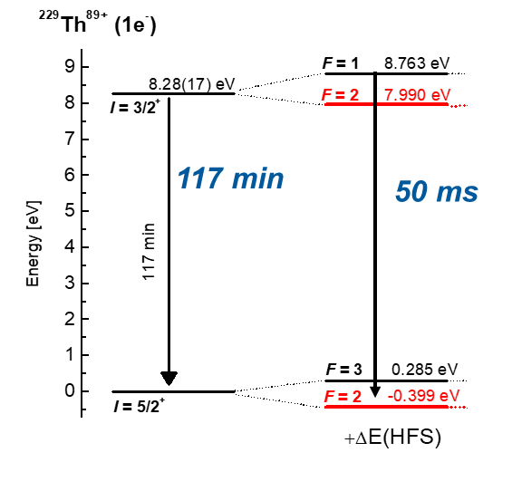
^{229(m)}Th: Nuclear, Optical Frequency Standard (nuclear clock)
Hyperfine spectroscopy of stored ^{229m}Th⁸⁹⁺ ions
In flight production of ^{229m}Th⁸⁹⁺ ions from ²³⁸U⁹²⁺
H-like ²²⁹Th⁸⁹⁺: Acceleration of nuclear decay by coupling of electrons to nuclear spin (hyperfine interaction).
Achievements
at ESR in 2022
2 • 10⁴ bunched ²²⁹Th⁸⁹⁺ in ESR
per 10⁹ ²³⁸U ions in SIS.
Intense „10 eV“-laser exploiting the Doppler Shift.
neutral
1e- oder 3e-
[GS]
²²⁹Th⁸⁹⁺
Foto: C. Brandau
Novel in-ring VUV fluorescense detection system
MgF₂-coated Al-mirrors for the detection of photons bellow 115nm
(Collaboration Fraunhofer IOF, Jena)
ΔE_{HFS}
Feasibility of the measurement method demonstrated
(but due to restrictions only 15-20% of targeted scan range covered)
V. M. Shabaev et al., PRL. 128, 043001 (2022)
C. Brandau et al,.

Slide 6

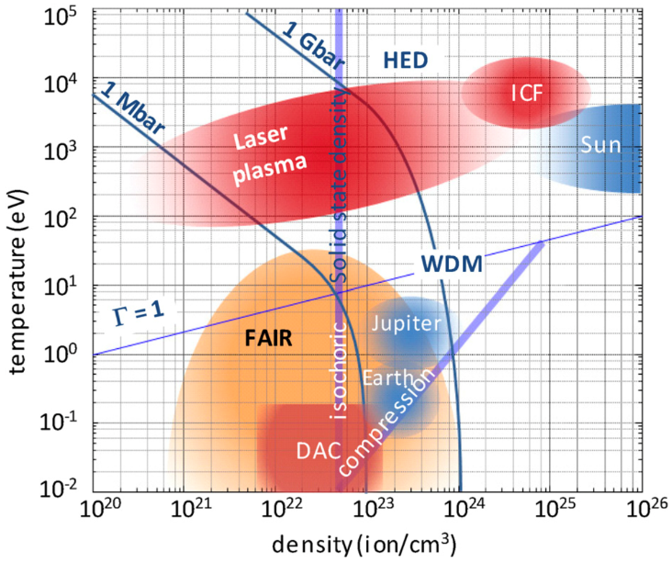
High Energy Density Science at FAIR
HED
@
Intense, focused, bunched heavy ions
    → volumetric heating, isentropic compression
HED@FAIR research topics:
Planetary science
Compressing materials to extreme conditions relevant to planetary science (e.g. interior of giant planets)
Basic properties of strongly coupled plasmas created with heavy-ion beams and lasers
Equation-of-state studies, transport properties, particle stopping
Proton microscopy of samples created with secondary drivers
Shocked matter, equation-of-state studies
Nuclear photonics
Excitation of nuclear processes in plasmas, laser-driven particle acceleration and neutron production, also as diagnostics for HED samples
      FAIR will produce the largest volumes of matter at uniform HED conditions worldwide
  High-energy intense protons
  → proton microscopy
  FAIR will allow accurate fast imaging of large dynamical evolution of HED matter
Warm dense matter (WDM)
∼1 - 100 Mbar
∼1 - 10 eV
Strongly coupled (Γ=E_{pot}/E_{th} ≳1)
Partially degenerate (E_{F}~E_{th})
Collisions (conductivity, heat transport): Λ_{C}<0
Partial ionization
Continuum lowering/pressure ionization
Phys. Plasmas 27, 043103 (2020)

Slide 7

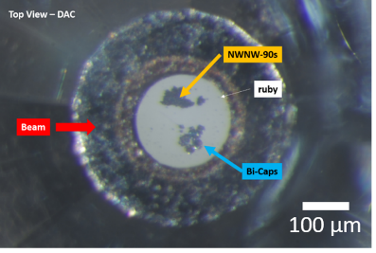
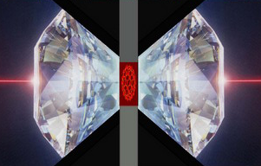
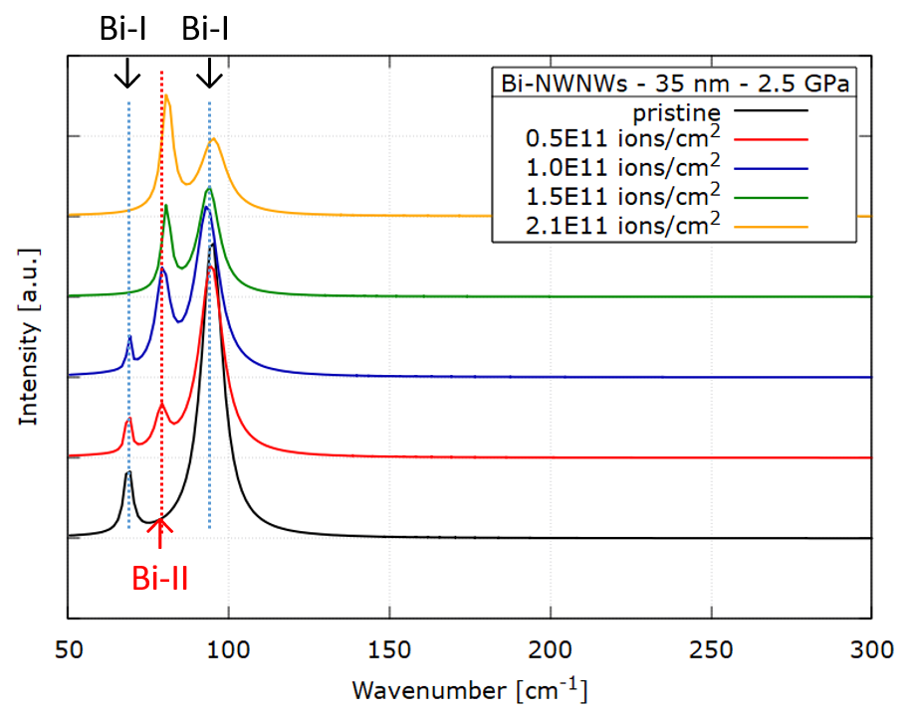
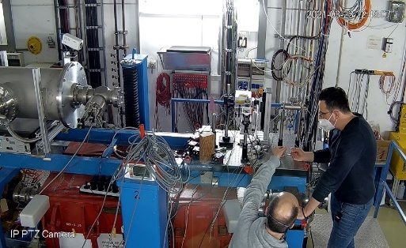

Progress: Materials under extreme conditions
April 2022, Cave A
Raman spectrometer
laser
Bi nanowires
beam
collimator
250 µm aperture
265 MeV/u U ions
2 mm
goniometer
goniometer
microscope
unpublished data from April 2022

Slide 8

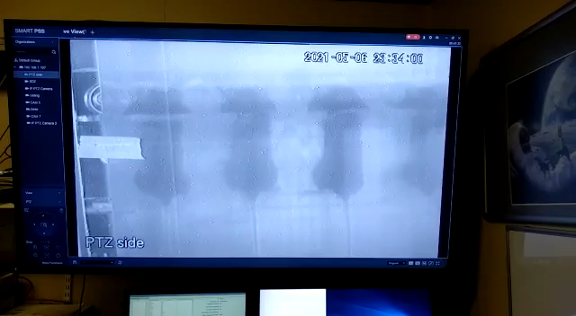
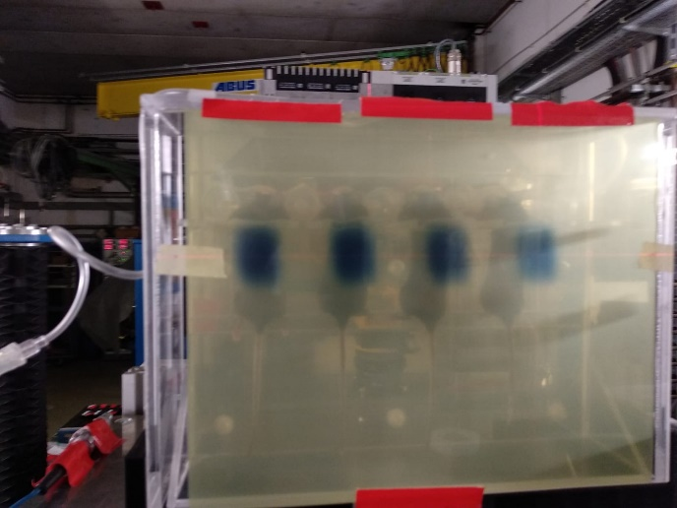
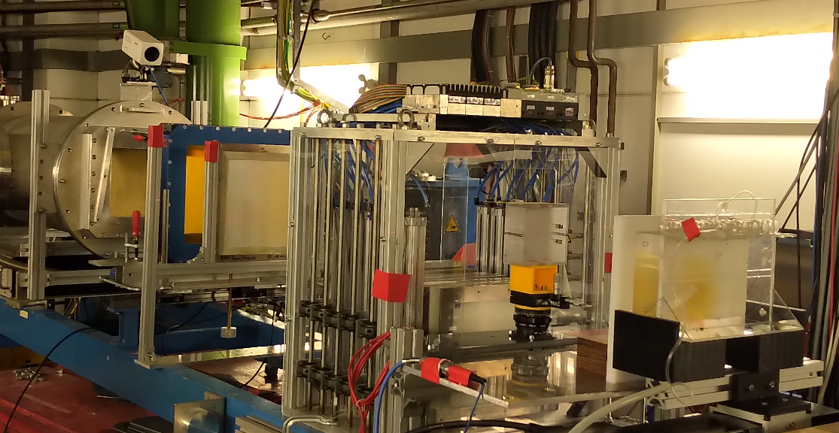


FLASH in FAIR-phase-0: 1st example of heavy ion FLASH @synchrotrons
vacuum window
3D printed
range
modulator
beam
monitors
(He-CO₂ filled )
ripple
filter
mice holder box
for thorax irrad.
(with inlet for anesthetic gas)
range
shifter
absorber
Scanned ion beam
HIT ≈ 5×10⁸ ions per spill
⇨ 8 Gy | 50 Gy/s for 10 × 10 mm²
FAIR-phase-0 > 5× 10⁹ ions per spill (reliable)
⇨ 18 Gy | 100 Gy/s for 20 × 20 mm²
D= 18 Gy
Tinganelli et al., Int. J. Radiat. Oncol. Biol. Phys. 2022
Weber et al., Med. Phys. 2022

Slide 9
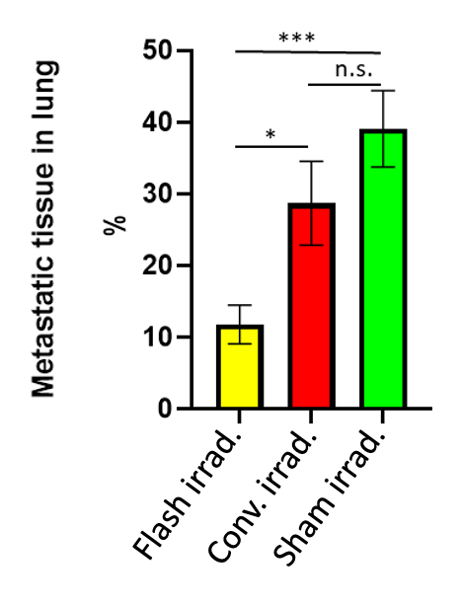
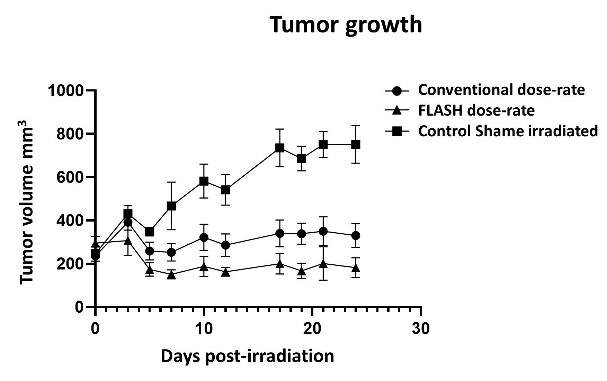
Impact on tumor control and metastasis
Tinganelli et al., Radiother. Oncol. , 2022

Slide 10
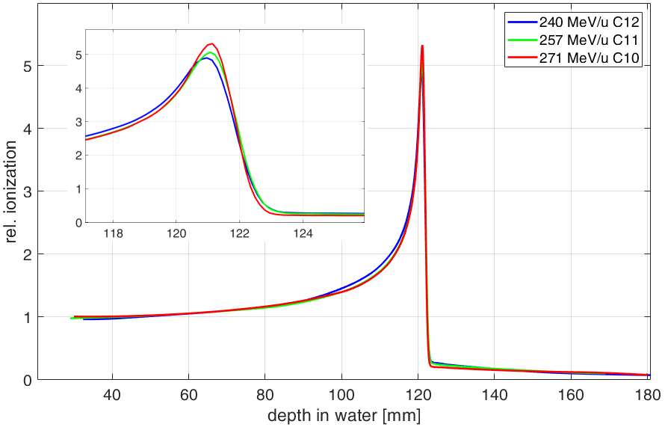
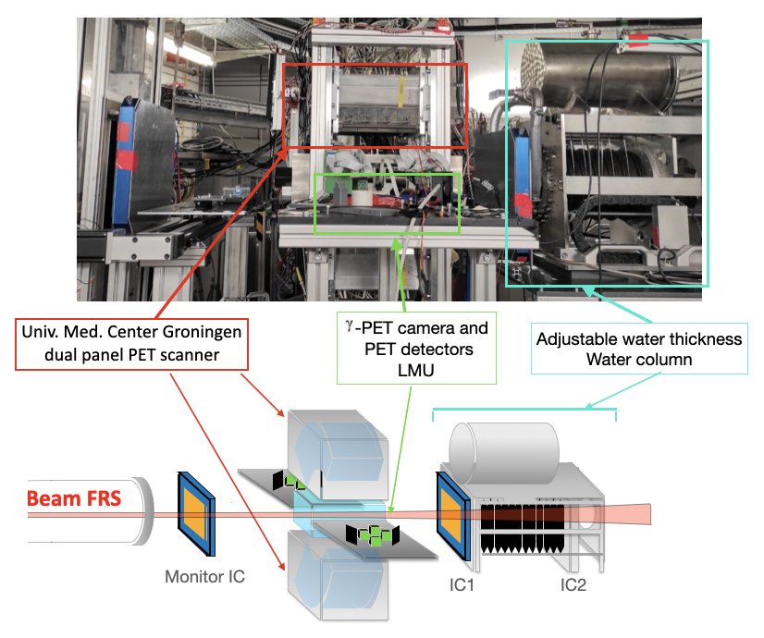







Biophysics
BARB: first experimental tests in 2021
Boscolo et al., Front. Oncol. 2021
Isotopes: | 10C | 11C | 12C
Half-life (min): | 0.322 | 20.36 | stable
Intensities: | ~10⁶ pp/s | ~10⁷ pp/s | ~10⁸ pp/s
Energy: | ~270 MeV/u and ~135 MeV/u
Imaging phantoms: | PE and PMMA
FRS ion optical modes | Monochromatic and achromatic
PET image
Notes:
This was shown last time also!!!

Slide 11
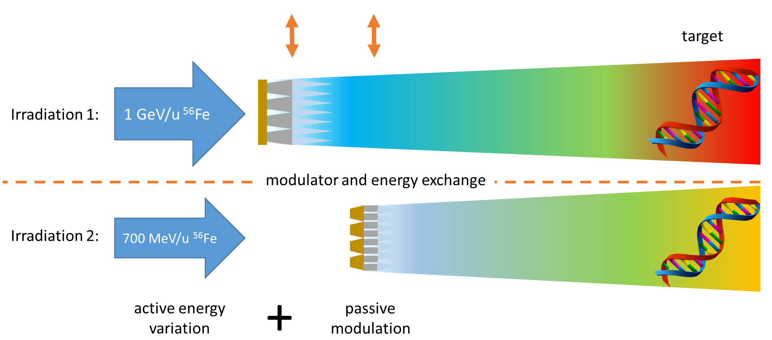
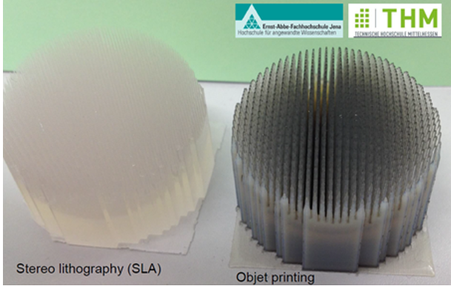

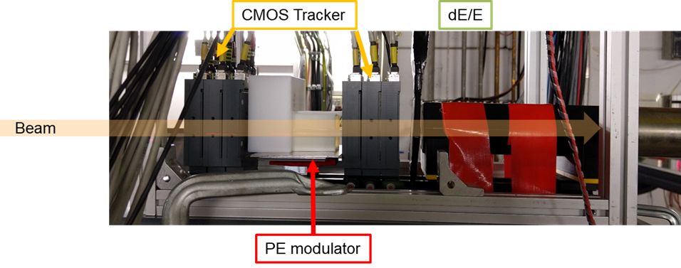
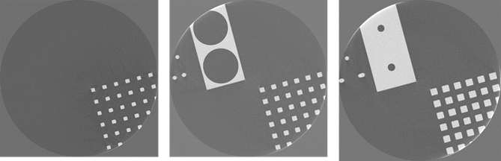
New infrastructures for FAIR tested in FAIR-phase-0 (April 2022)
GCR simulator
Schuy et al., Front. Phys. 2020

Slide 12
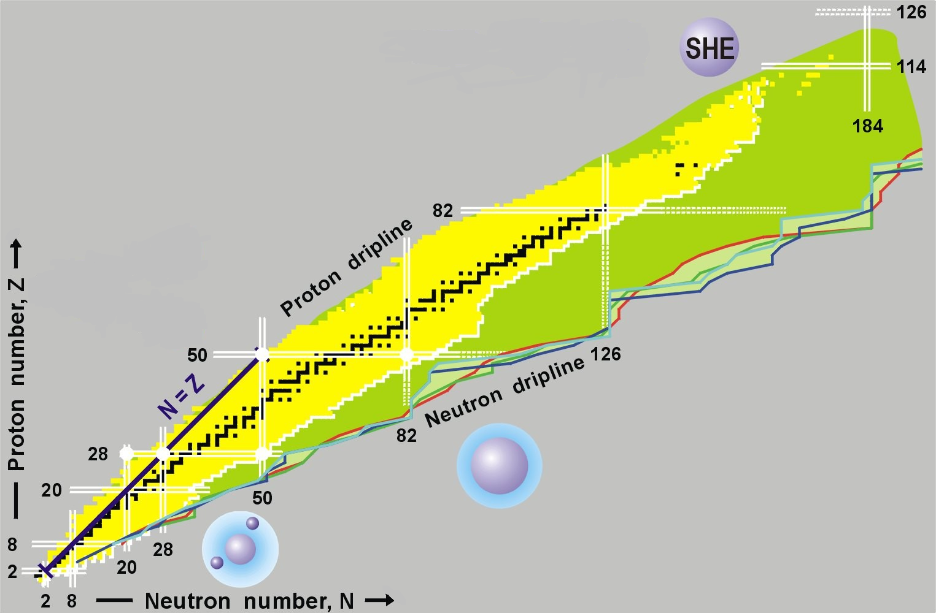
The NUSTAR collaboration at FAIR
NUclear STructure Astrophysics and Reactions
The limits of nuclear existence (lifetimes, decays, …)
Ground state properties (masses, radii, …)
Structure of excited states (shell structure, shapes, …)
Origin of the elements and nuclei in astrophysical events
Unbound and other exotic system (halo, skin, hypernuclei, …)
Nuclear equation of state
Notes:
NUSTAR stands for Nuclear Structure Astrophysics and Reactions and comprises all experiments related to the study of atomic nuclei at FAIR. Our playing ground is the nuclear chart, from the lightest elements to the SHE. We aim at finding the limits of nuclear existence, the so-called driplines and to study nuclei even beyond those limits as short lived “resonance states”. For all nuclei we want to determine first their basic properties, such as their lifetime and decay modes, but also their ground state properties (masses, radii) but also their structure, as exhibited for example by the evolution of the nuclear shell structure and shapes. In nuclei close to and beyond the drip lines we have found very exotic properties such as neutron halos, neutron skins, which we need to study (and understand) in more detail and we expect many more surprises when going further and further from stability. Finally, we plan to produce new exotic systems, such as nuclei containing hyperons or nucleon resonances, and to determine the properties of the nuclear equation of state.

Slide 13
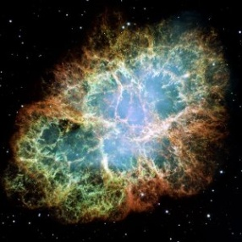
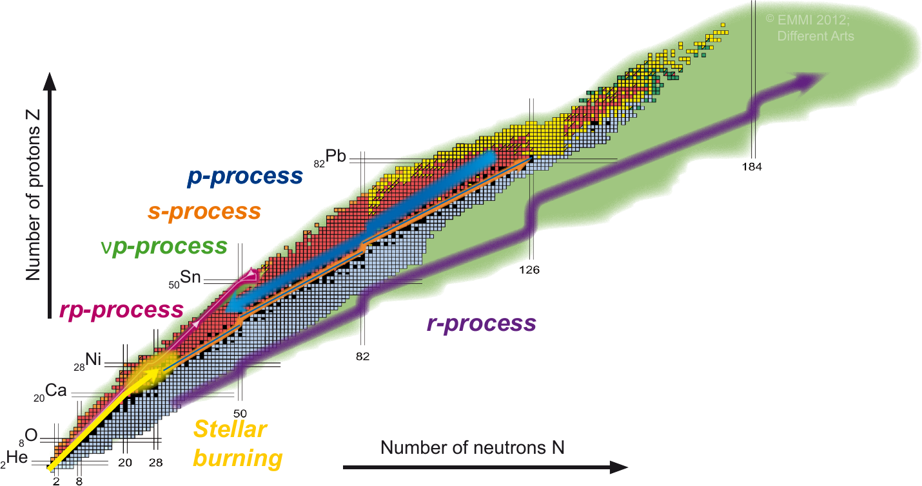
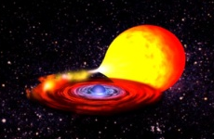
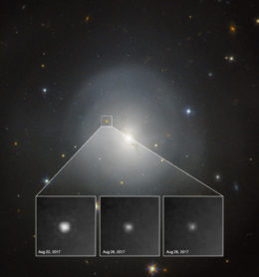
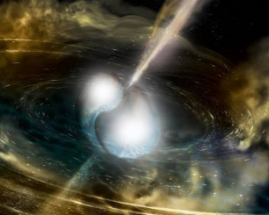
Nuclear astrophysics: Origin of the elements and the role of nuclei in astrophysical events
Supernova
remnant
X-ray binary
Kilonova from GW170817
Neutron star merger
Notes:
In nuclear astrophysics the main challenges are to determine the origin of the elements and to understand the rile of nuclei in different astrophysical events, such the ones depicted on this slide together with some of the principal processes relevant for the production of heavy nuclei beyond stellar burning both on the proton-rich and neutron-rich side of the valley of stability.

Slide 14
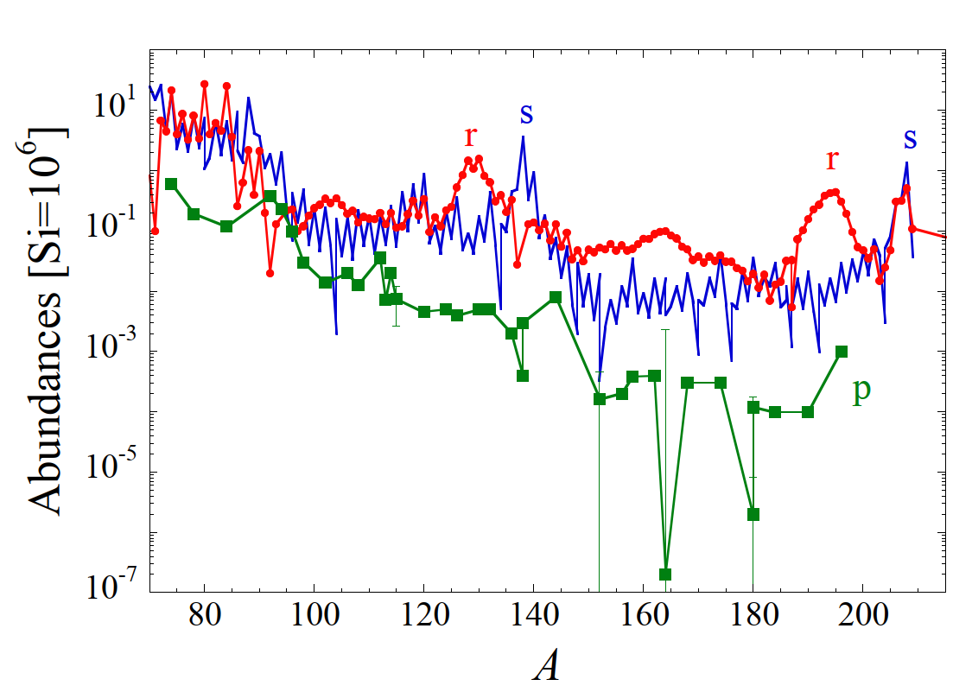
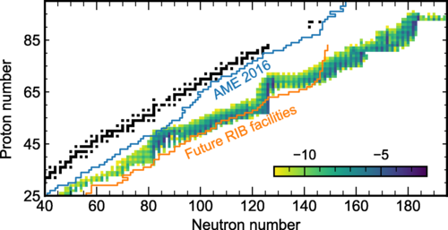
Nuclear astrophysics: the origin of heavy elements?
Rapid neutron capture process
(r-process) produces around half of heavy-element abundances
The r-process proceeds far from stability along largely unknown nuclei
M. Arnould & S. Goriely,
PPNP 112 (2020) 103766
J. Cowan et al.,
Rev. Mod. Phys. 93 (2021) 015002
Need experimental data on exotic nuclei:
Masses, lifetimes, decay channels, structure of exotic nuclei far from the valley of stability
Notes:
As we will see in the following is particularly well adapted to contribute to the understanding of the rapid-neutron capture or r-process path, which is responsible for the abundance of about half of the heavy elements. Since the r-process proceeds very far on the neutron-rich side of the valley of stability along largely unknown nuclei, more and more powerful radioactive beam facilities are needed to obtain experimental data on these very exotic nuclei, such as their masses, lifetimes decay channels and even the structure of excited states.

Slide 15
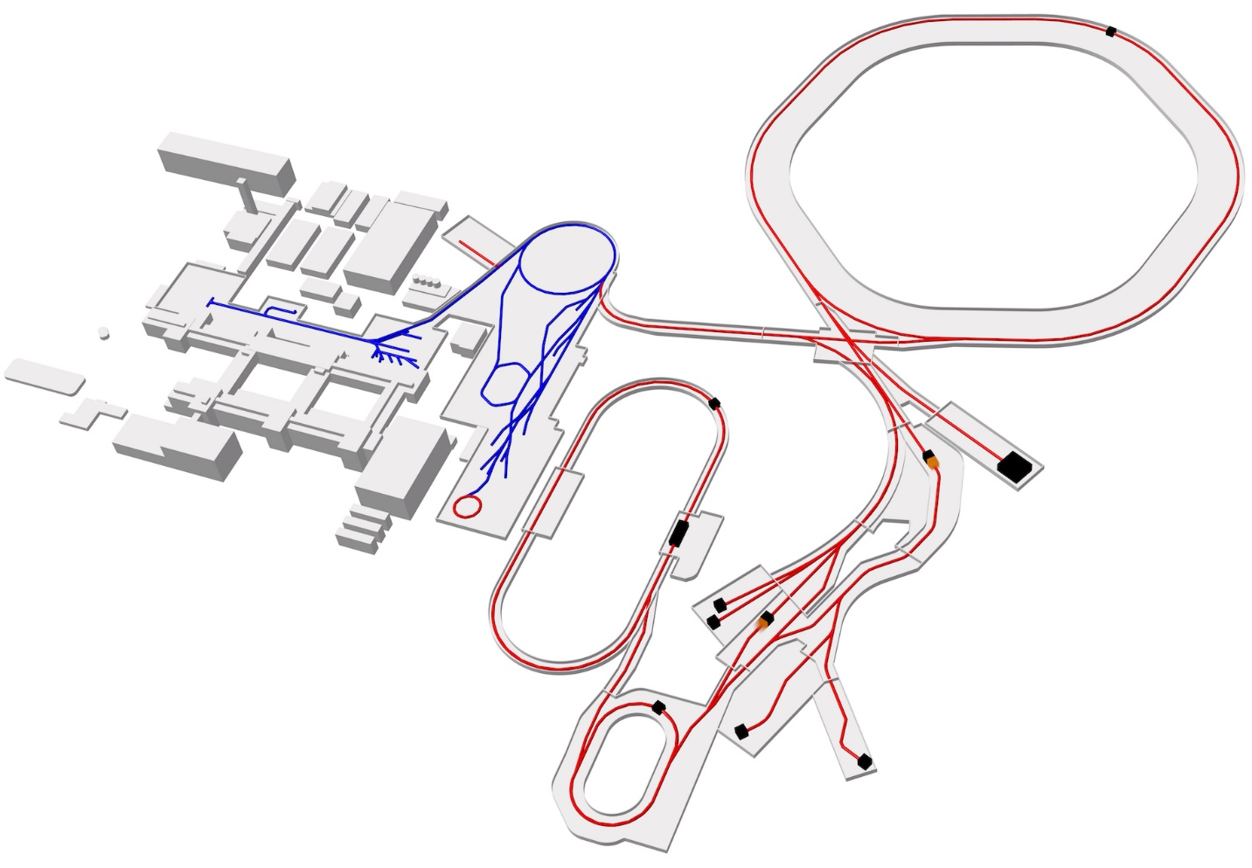
Implementation of the NUSTAR experiments
SIS 100
p-LINAC
SIS 18
UNILAC
ESR
CRYRING
Rare Isotope
Production Target
Super-FRS EC
ILIMA & EXL
(Phase-0 and IO)
HESR
Super-FRS
HISPEC
DESPEC
MATS
LaSPEC
CR
HEB
ILIMA & EXL
(MSV)
LEB
R³B
Notes:
The NUSTAR experiments are implemented at several different sites, but use as a common machine the Super-Fragment Separator or Super-FRS. The R3B experiment operates in the high energy cave, HISPEC-DESPEC, MATS and LaSPEC in different areas of the Low-energy cave, the Super-FRS Experiment Collaboration used the Super-FRS itself as spectrometer. ILIMA and EXL operate in phase-0 und during the IO still at the ESR, and should move to the CR and HESR once the full MSV will have been constructed.

Slide 16
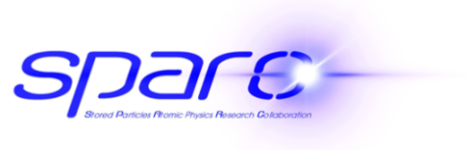
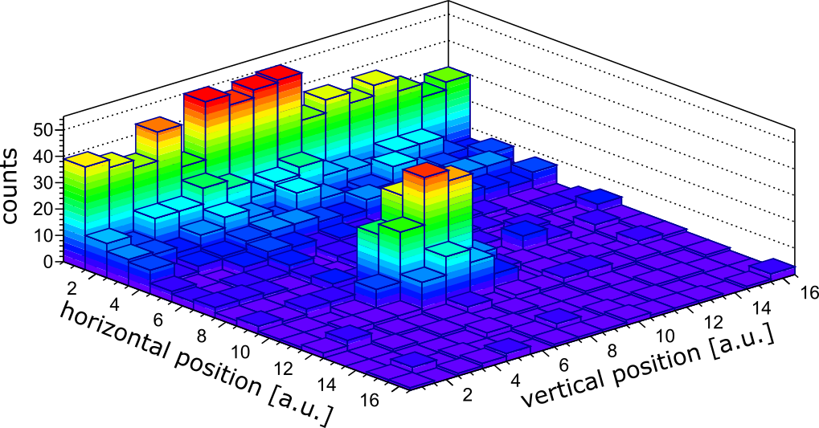
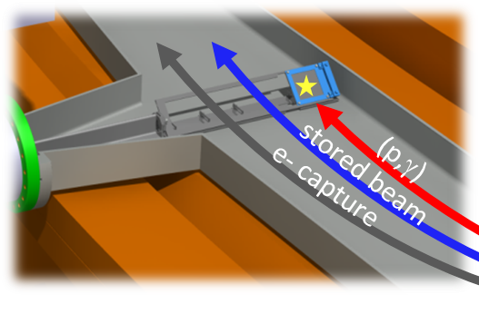







Proton-capture rates for nuclear astrophysics:
First reaction study on stored exotic beam at low energies
study of radioactive ¹¹⁸Te (6 days half-life)
  production, storage, accumulation and deceleration
  of ¹¹⁸Te in FRS-ESR
  proton-capture measurements
  realized at 7 MeV/u and 6 MeV/u
  clear signatures with good statistics
new background-free detection method
  maximized sensitivity for detection of
  proton-capture reactions
future prospects:
  full access to Gamow window energies in CRYRING
¹¹⁸Te(p,γ)
Jan Glorius et al.

Slide 17


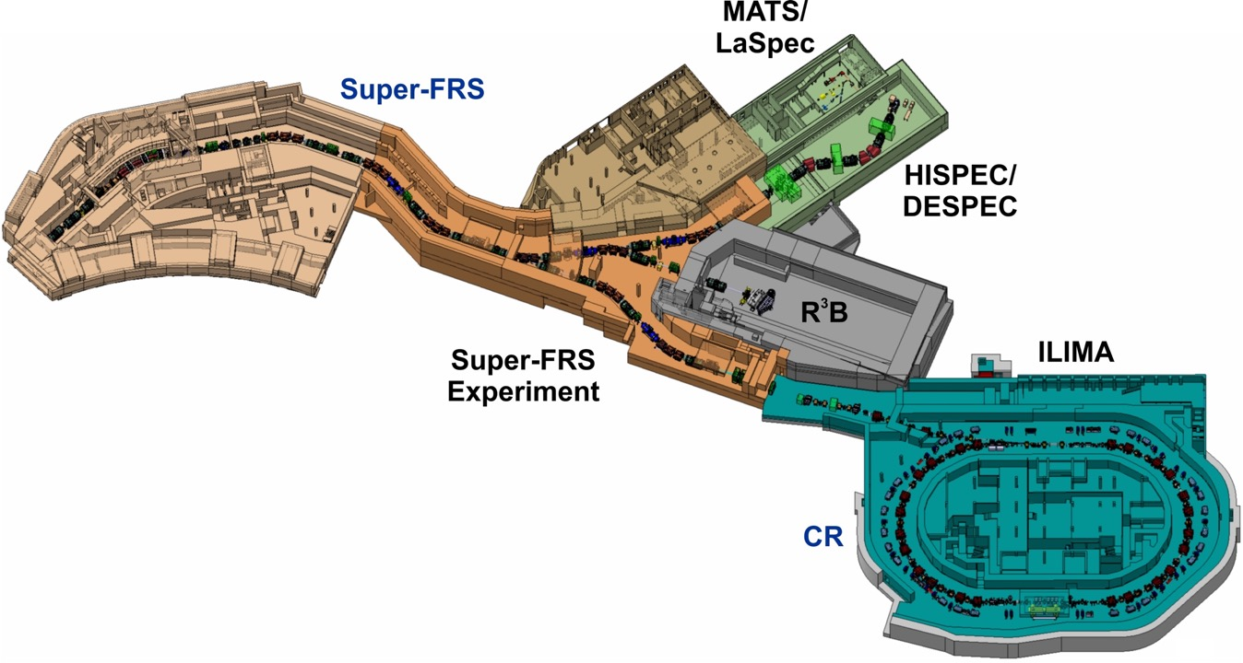
The Super-FRS facility for NUSTAR@FAIR
3
2
1
Start of Experiments
Early Physics: S-FRS Exp., DESPEC, R3
Phase 1a: + HISPEC (AGATA)
Phase 1b(α): + MATS/LASPEC
Phase 1b(β): + ILIMA
4
17
Notes:
The next phase will be the physics start-up at FAIR: As pointed out previously we plan early physics at the high-energy branch of the Super-FRS (corresponding to 2/3 completion) with the R3B set-up and detectors from the DeSEPC and the S-FRS Exp. Coll. in front of the high-energy cave. In the my presentation I am concentrating on the physics opportunities in this phase.
For completeness let me add that we expect to operate in the front part of the low-energy cave from 2026, possibly with AGATA, and from 2027 with MATS and LASPEC behind the energy buncher and with ILIMA in the CR.

Slide 18
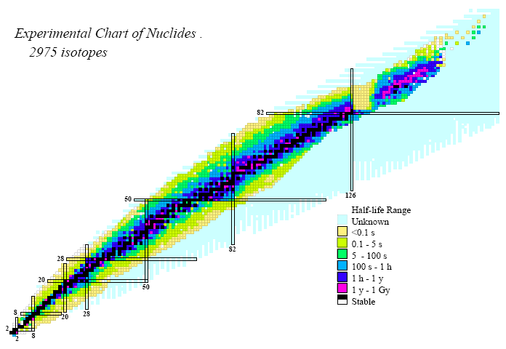
Production and selection of Radioactive Isotopes from the Super-FRS at FAIR
Projectile fragmentation and fission of primary beams with E<1.5 GeV/u
Super-FRS will provide
high production rates at highest energies
thicker targets and higher transmission
access to very short-lived nuclei (ns-μs)
access to new excitation modes
Unique place to study
(bare) heavy nuclei !
- high-energy RIBs
- high-Z beams
- isomeric beams
- isotopically pure beams
- fully-stripped beams
Vast
Terra Incognita
Notes:
In this way the Super-FRS will provide the highest energy RIB in the wold, up to the highest Z. Due to the short time-of-flight the Super-FRS will also be capable to produce isomeric beams. These are isotopically pure due to the excellent performance of the Super-FRS and fully stripped of their electrons (up to U).

Slide 19
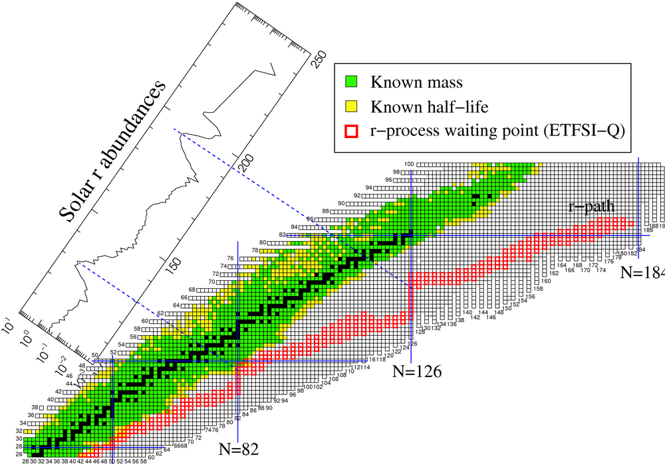
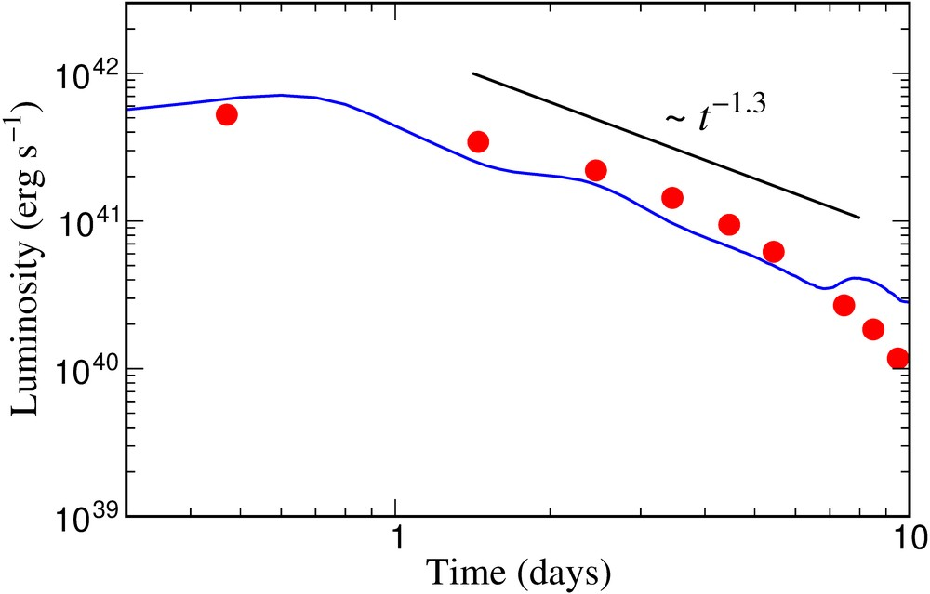
Search for new isotopes and their properties
Identification of new neutron rich isotopes
Measurement of production cross sections and longitudinal momentum distributions
Mass and half-life measurements after implantation
Electromagnetic “Kilonova” Signal from GW170817
Metzger, Martinez-Pinedo, Arcones et al. (2010)
Cowperthwaite, et al. (2017)
Kilonova observations
Ground-state properties (halflife, mass, radius) and spectroscopic studies (β-decay, isomers)
First spectroscopic information for the nucleosynthesis of heavy nuclei
Evolution of the shell structure and exotic nuclear shapes near the limits of nuclear existence
Notes:
The ground state properties of very exotic isotopes are important to test nuclear models far from stability, for example to verify the evolution of the nuclear shell structure near the limits of nuclear stability. However, these are also important ingredients for the calculation of the nucleosynthesis of heavy elements and to understand the Solar abundances, in particular of the so-called 3rd r-process peaks. This topic has become even more relevant today, due to the observation of the electromagnetic signal from the Kilonova following the neutron star merger observed as GW170817. Since for many of these isotopes their properties are today extrapolated from measurements much closer to stability as we will seen on the next slide, it is quite impressive how well the time dependence of the luminosity has been predicted. Exact astrophysical location of the r-process path depends on parameters such as number of available neutrons and lifetimes.

