Slide 1
Bioimaging_Lab: Chemistry part
Rusudan Kakava
Institute of Physical and Analytical Chemistry,
Tbilisi State University, Tbilisi, Georgia
1
GGSB2022 – Kutaisi and Tbilisi
September 14, 2022, Tbilisi, Georgia
1

Slide 2
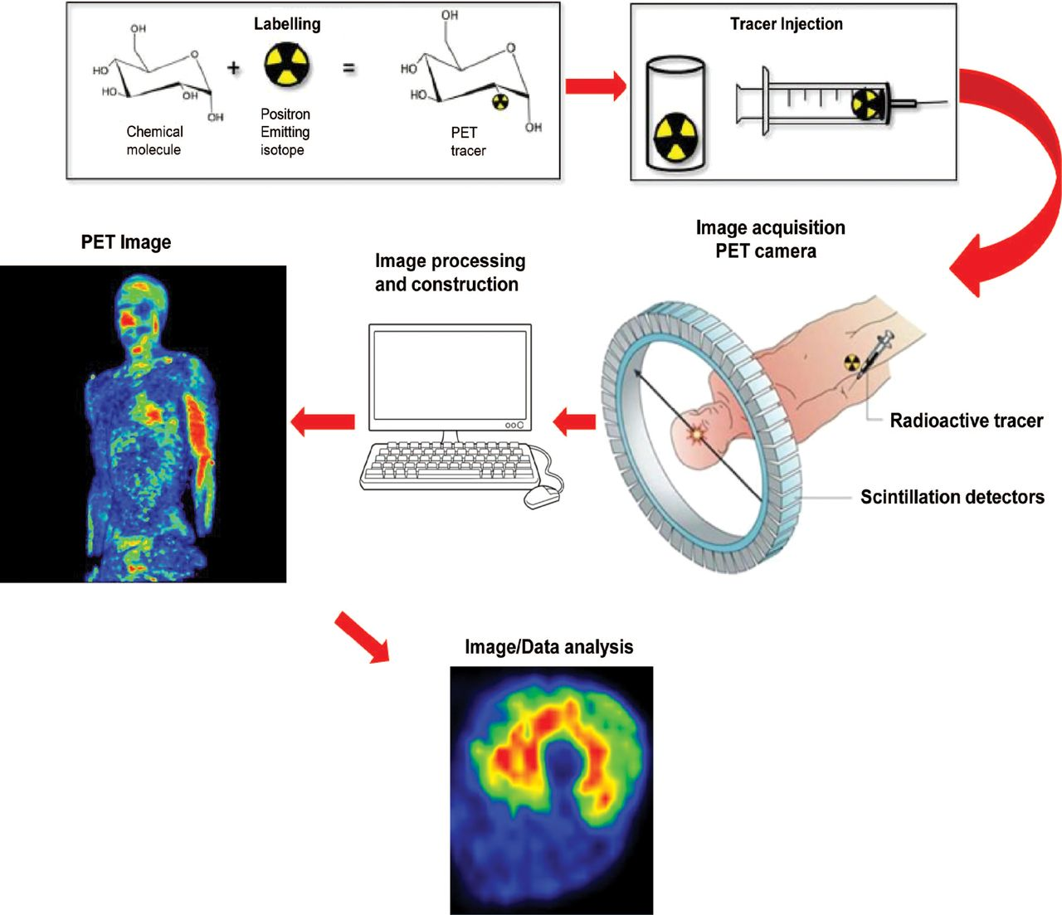
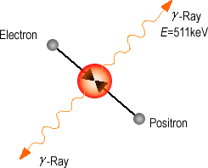
Positron Emission Tomography (PET) - The most common imaging modality in nuclear medicine
2
From: Journal of Applied Physiology, Thorsten Rudroff, John H. Kindred, Kari K. Kalliokoski, Published 15 May 2015, Vol. 118 no. 10, 1181 1190 DOI: 10.1152/japplphysiol.01070.2014

Slide 3
Our contribution to Bioimaging_Lab - Chemistry part:
The synthesis of interesting radiotracer precursors at TSU. 2nd Step is the radiolabeling of synthesized biomolecules at INM 5, Julich Research Center.
Application of chiral chromatography for enantioseparation and purification.
3

Slide 4
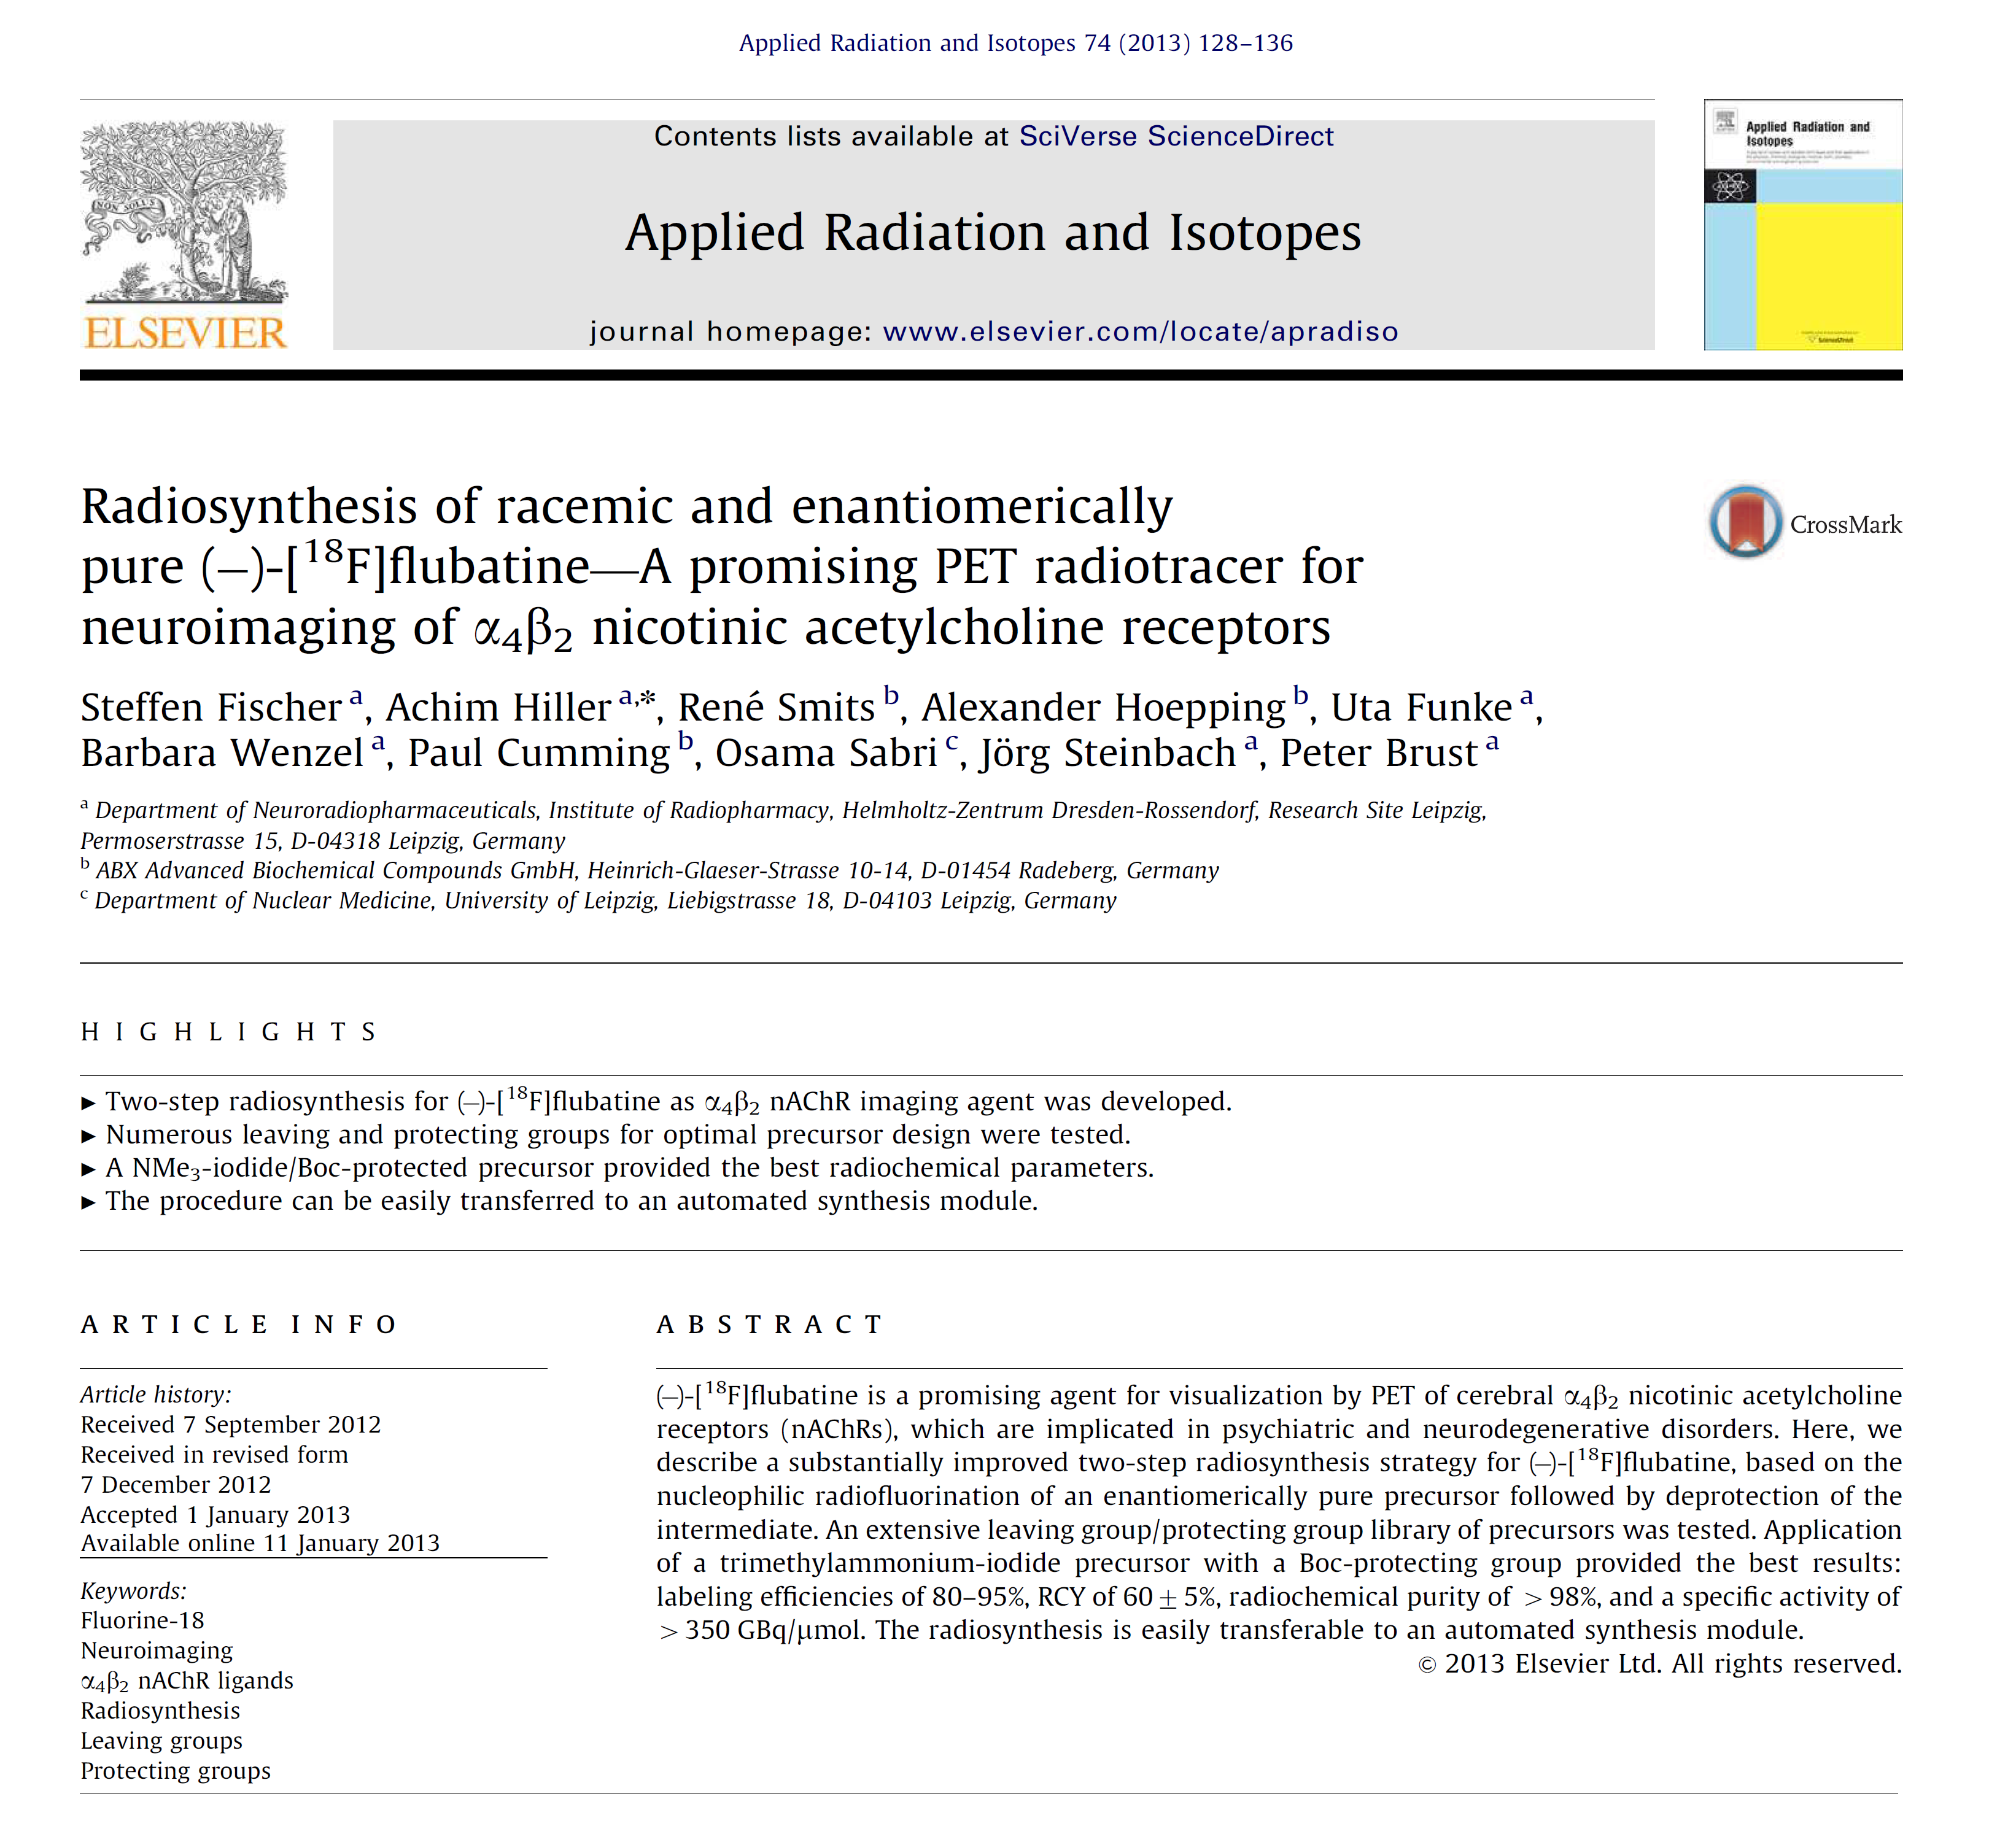

Slide 5
Non-radioactive syntheses
Radiosyntheses

Slide 6
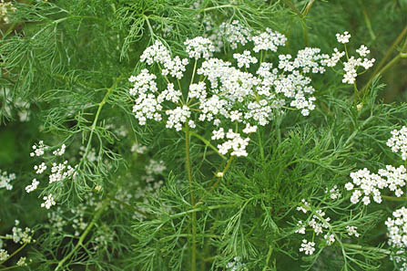
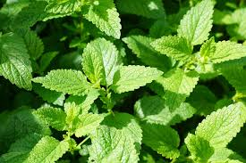
Enantiomers – same physical and chemical properties:
Same structure
Same shape
Same molecular weight
Same melting point
Same boiling point
Same density
Same solubility
Same polarity
Same refractive index
Same energy
Same rate of reaction with achiral reagents
etc..
Except optical activity.
(+)-Carvone
(from oil of caraway)
(-)-Carvone
(from oil of spearmint)
6
Stereochemistry in odor recognition

Slide 7
Different biological activity
Different Pharmacokinetics
Different Absorption
Different Distribution
Different Metabolism
Different Excretion
Different Pharmacodynamics
Different Mechanism of action
Different Mode of action
Different Toxicity
Different Dose–response relationship
Different Therapeutic index
Enantiomers are different in chiral environment:
Biological systems
7

Slide 8
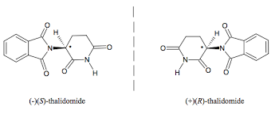
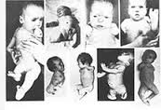
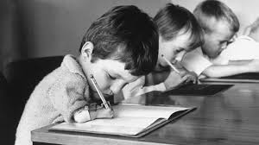
Thalidomide
Teratogen

Slide 9
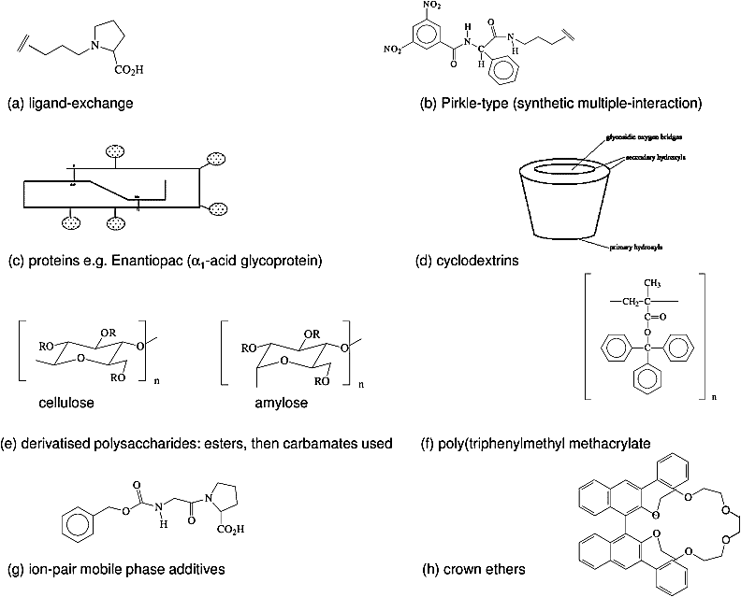
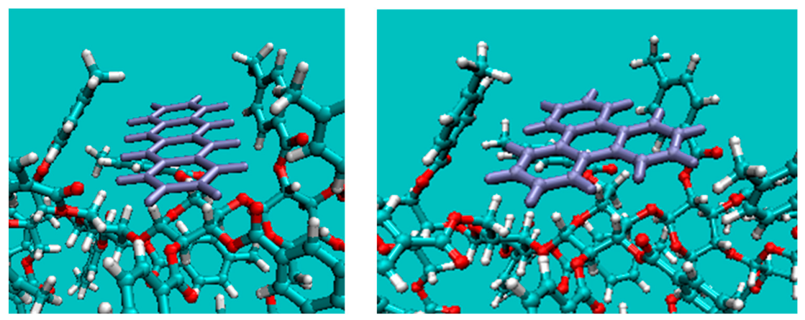
Chiral stationary phases
W.J. Lough, Classification of LC chiral stationary phases: Wainer Types I–V revisited, J. Chr. B, 2014, 1-7
Effective binding can be achieved if there is:
steric fit
electrostatic fit (functional fit)
hydrophobic fit
dynamic fit and induced fit
mutual saturation of extended molecular surfaces by each other.
9

Slide 10
Thank you!
10

