Slide 1


Progress and Achievements of the Last Decade and Quality Assurance of Radiotherapy in Georgia
Nugzar Kalandarishvili
Radiation Oncologist
Radiotherapy Department
Academician F. Todua Medical Center-
Research Institute of Clinical Medicine

Slide 2
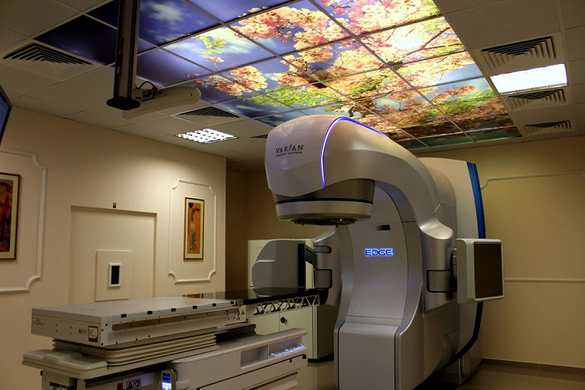
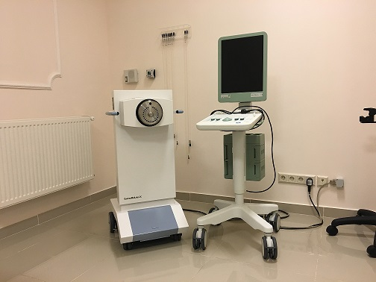
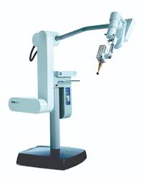
Available Radiotherapy Services
External Beam Radiotherapy
Brachytherapy
Intra-operative Radiotherapy

Slide 3
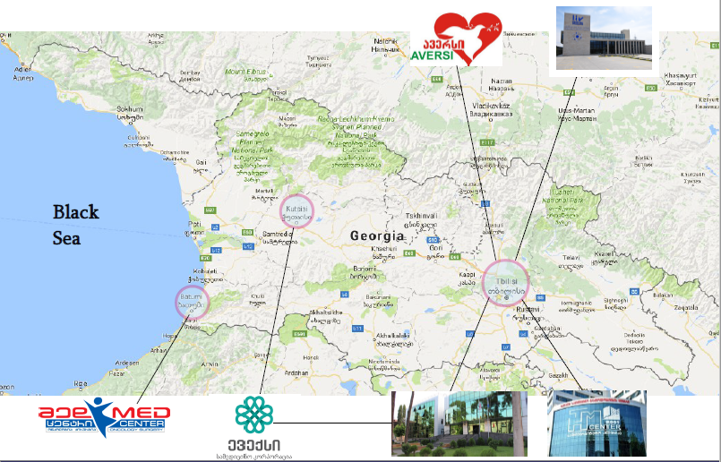
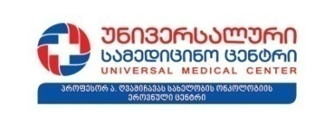



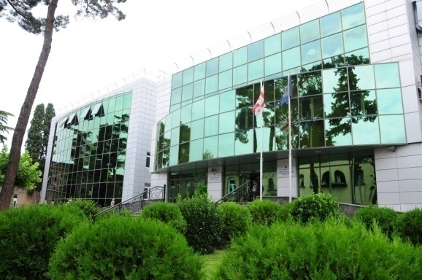
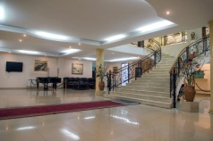

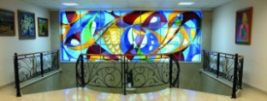
Radiotherapy Centers in Georgia
Kutaisi
Tbilisi
Batumi

Slide 4
Short Historical review
  First Patient Treated with HDR Brachytherapy Equipment using 2D planning System– 2007
  First patient treated with Co-60 Unit using 2.5D Planning Software- 2007
  First patient treated with Linear Accelerator using 3D Planning system and Image guidance- 2009
  First Patient Treated with HDR Brachytherapy Equipment using 3D planning System– 2012
  First Patient Treated with Intra-operative Radiotherapy– 2012
  First patient treated with IMRT Technique- 2012
  First patient treated with VMAT Technique- 2015
  First patient treated with SRS/SBRT Technique- 2016
  First patient treated using Respiratory Gating System- 2017
  First patient treated using Auto Beam Hold Technique for Intra-fractional verification of patient position - 2018
  Number of X-rays Units - 1904
  Number of Digital X-rays Units – N/A
  Number of Mammography Units - 40
  Number of Fluoroscopy Units - N/A
  Number of Dental X-rays Units - 423
  Number of X-ray Units used for interventional diagnostic procedures-84
  Number of CT systems – 162
  Number of SPECT/CTs-5
  Number of MRI systems – 25
  Number of PET-CTs – 2
  Availability of PACS, electronic requesting systems-Yes

Slide 5
Equipments
  Number of Linear Accelerators- 13
  Number of Cyber-Knife- 1
  Number of Co-60 Units – 2
  Number of Intra-operative Radiotherapy
  Equipments – 3
  Number of HDR Brachytherapy Equipments – 3
  Number of LDR Brachytherapy Equipments – 1
  For Information:
  Number of SPECT/CTs-5
  Number of PET/CTs-3
  Number of X-rays Units - 1904
  Number of Digital X-rays Units – N/A
  Number of Mammography Units - 40
  Number of Fluoroscopy Units - N/A
  Number of Dental X-rays Units - 423
  Number of X-ray Units used for interventional diagnostic procedures-84
  Number of CT systems – 162
  Number of SPECT/CTs-5
  Number of MRI systems – 25
  Number of PET-CTs – 2
  Availability of PACS, electronic requesting systems-Yes

Slide 6
Staffing
  Number of Radiation Oncologists-21
  Number of Nuclear Medicine Physicians-6
  Number of Medical Physicists -18
  Number of Radiotherapy Technicians-40
  Acknowledgement
  During last than 10 years under the frame of IAEA Technical co-operation projects many fellowships, training courses and scientific visits has been executed for local staff to improve their qualification in the field of radiotherapy

Slide 7
Educational Programs in the Field of Radiotherapy
  Radiation Oncologist-4 Years Residency Program
  Tbilisi State Medical University
  Academician F. Todua Medical Center, Research Institute of Clinical Medicine
  High Technology Medical Center-University Clinic
  Radiotherapy Medical Physicist -2 Years Master’s Program (active from the Winter Semester of 2017/2018)
  I. Javakhishvili Tbilisi State University
  Academician F. Todua Medical Center, Research Institute of Clinical Medicine
  Radiotherapy Technician – N/A
  CPE (RO, MP, RTT)-not established

Slide 8
Advanced Radiotherapy Techniques Available in Georgia
3D Conformal Radiotherapy
IMRT (DMLC) and RapidArc/VMAT
SRS/SBRT Techniques
Imaging Modalities
Image Guided Radiotherapy
Respiratory Gated Radiotherapy
Techniques for Intra-fractional Patient Position Verification
Brachytherapy
Intraoperative Radiotherapy

Slide 9
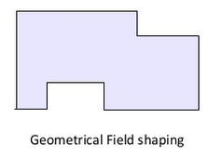
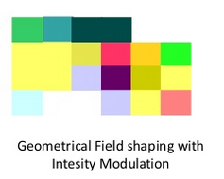
Conformal Radiotherapy
Radiotherapy Treatment, that creates a high dose volume, shaped to “conform” to the desired target volumes as closely as possible, while minimizing the dose to critical structures
2 broad subtypes of Conformal Radiotherapy:
Techniques aiming to employ geometric field shaping alone (3DCRT)
Techniques to modulate the intensity of the fluence across the geometrically-shaped field (IMRT/VMAT)

Slide 10
Rationale of Modulated Beam Intensity
More Conformal than 3D CRT
Dose Distribution more homogeneous within PTV
A sharp fall off PTV Boundary
Reduction of normal tissue dose
Possibility to create concave isodose surfaces or low-dose areas surrounded by high dose
Lower rate of complications
Large fields and boosts can be integrated in the same single treatment plan (Simultaneously Integrated Boost SIB)

Slide 11
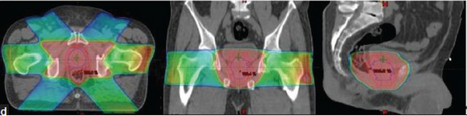
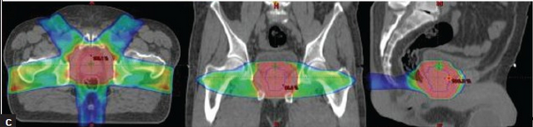
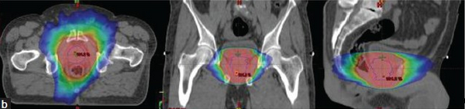
3DCRT, IMRT (DMLC/S&S), RapidArc/VMAT
3DCRT
IMRT
VMAT

Slide 12
Stereotactic Radiotherapy/Radiosurgery
Stereotactic Radiotherapy dates back more than 50 years, however form of this treatment became domain of radiation oncology only in the past 10-15 years;
Stereotaxy (stereo+taxis – Greek meaning orientation in the space) means the method, which defines a point in the patient’s body by using external 3D coordinate system, which is rigidly attached to the patient.
The result of this method is highly precise delivery of the radiation dose to an exactly defined target volume
High degree of anatomic targeting accuracy and reproducibility and precisely delivered radiation
Maximize cell-killing effect
Minimize Radiation induced injury in related normal structures

Slide 13
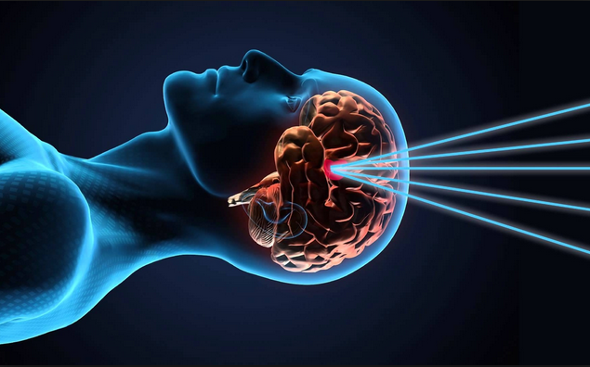
Stereotactic Approach
Stereotactic Radiotherapy
Delivery of multiple fractionated doses of radiation to the definitive target volume with normal structure sparing (both intra as well as extracranial);
Stereotactic Radiosurgery
Delivery of a single, high dose of irradiation to a small and critically located volume, sparing normal structures;
The main goal of both techniques:
To encompass the target volume in the high dose area with remarkably steep dose gradient, to spare surrounding normal structures;

Slide 14
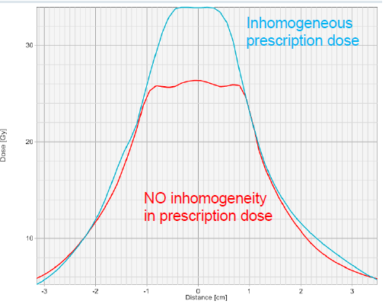
Differences Between Conventional and Stereotactic
Conventional Approach
-Homogeneous dose prescription
-PD encompasses the PTV
-Max dose 115%
Stereotactic Ablative Intent
-Heterogeneous dose prescription
-PD encompasses 95+% of PTV
-Max dose should approach 150%
Ablative intent may afford steeper dose gradients

Slide 15
Imaging Modalities
No single imaging modality produces all the information, needed for the accurate identification and delination of the target volume and critical organs.
Treatment Planning Software has opportunity to use various imaging modalities:
CT
MRI
PET-CT

Slide 16
Aim for Image Registration
Identifying the volume of a tumor on a preoperative scan and transferring it to the postoperative treatment planning scan to define the target volume;
Registration allows use of complementary features of different scan types;
Visualizing CNS structures more clearly seen on MRI and mapping them to CT image for planning-fusion
Combining functional or biochemical signals from emission tomography onto CT scans for planning purposes
For organ motion studies
Image Guidance
For follow-up studies
4D CT
Image registration allows computation of cumulative doses from multiple plans done on different image sets for the same patient

Slide 17
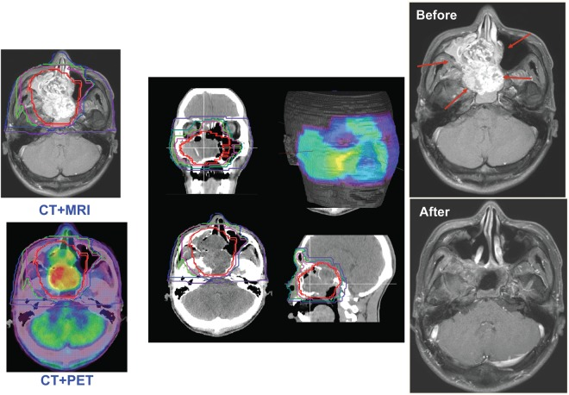
Image Registration

Slide 18
Image-Guided Radiotherapy
IGRT
The process of frequent imaging (2D/3D) before and during treatment session of radiotherapy
Why IGRT
Internal anatomy is not always well correlated with the surface anatomy
Goal of IGRT is to target tumors more accurately while better sparing the normal structures
Decreases side effects
IGRT is highly accurate and precise treatment

Slide 19
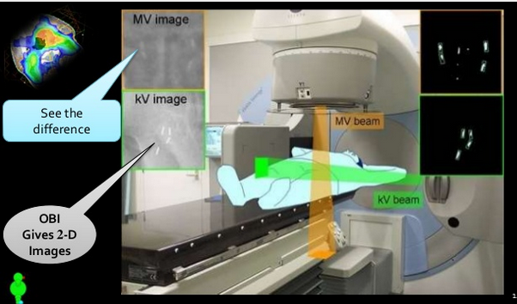
2D Planar Images
kV images have better contrast than the MV images

Slide 20
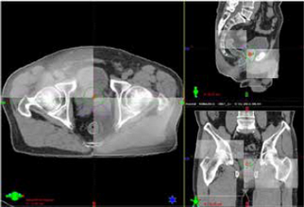
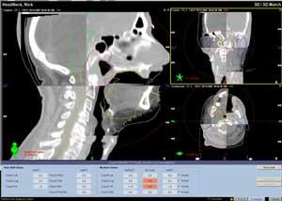
3D Image-Cone Beam Computed Tomography
Integrated CT imaging with a LINAC
Visualization of exact tumor location
Acquiring multiple planar images produced by kV or MV Cone beam rotating 360⁰ around the patient
Algorithm to reconstruct the volumetric images of the target volume

Slide 21
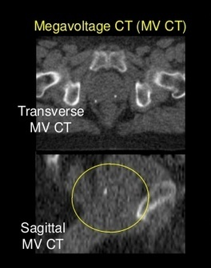
Advantages of MV CBCT over kV CBCT
Less susceptibility to imaging artifacts due to metallic objects such as hip implants, dental filings and surgical clips
There is no need for extrapolating attenuation coefficients from diagnostic beams to the therapeutic beam, CT numbers in MV-CBCT correlate directly with electron density
The known dose distribution characteristics of the therapeutic beam allow more accurate calculation of imaging dose in the MV-CBCT acquisition process

Slide 22
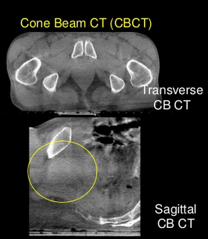
Advantages of kV CBCT over MV CBCT
Better contrast and Spatial resolution
Better soft tissue visibility at much lower doses
Compatibility of kV images with the reference treatment plan images for setup verification and correction
Combination of radiography, fluoroscopy and CBCT capabilities from the same source and detector provides great flexibility in implementing the goals of IGRT

Slide 23
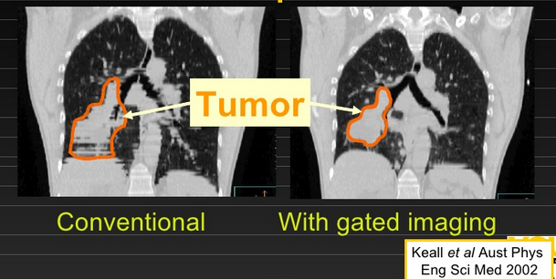
Imaging Tool for Tumor Motion Management
Tumor motion in lung or other sites can not be predicted with any degree of accuracy
Real-Time tumor tracking or gating process is required to manage target motion in radiotherapy
Methodologies are available for real time tumor tracking and respiratory management

Slide 24
4D Computed Tomography
Obtain images of the patients during individual phases of the breathing cycle
These data used to develop treatment plans for the patients with reduced CTV and PTV margins
Typically the breathing cycles is divided into 8-10 respiratory phases and multiple CT volumes are taken at each phase
Real-Time Management RPM gating system is computer-controlled video based system in which a box with infrared reflectors is placed on the patient’s surface and the motion of the box is tracked by IR camera
These images are used to design individualized treatment plan, where radiation is administered only at the optimum moment of the breathing cycle

Slide 25
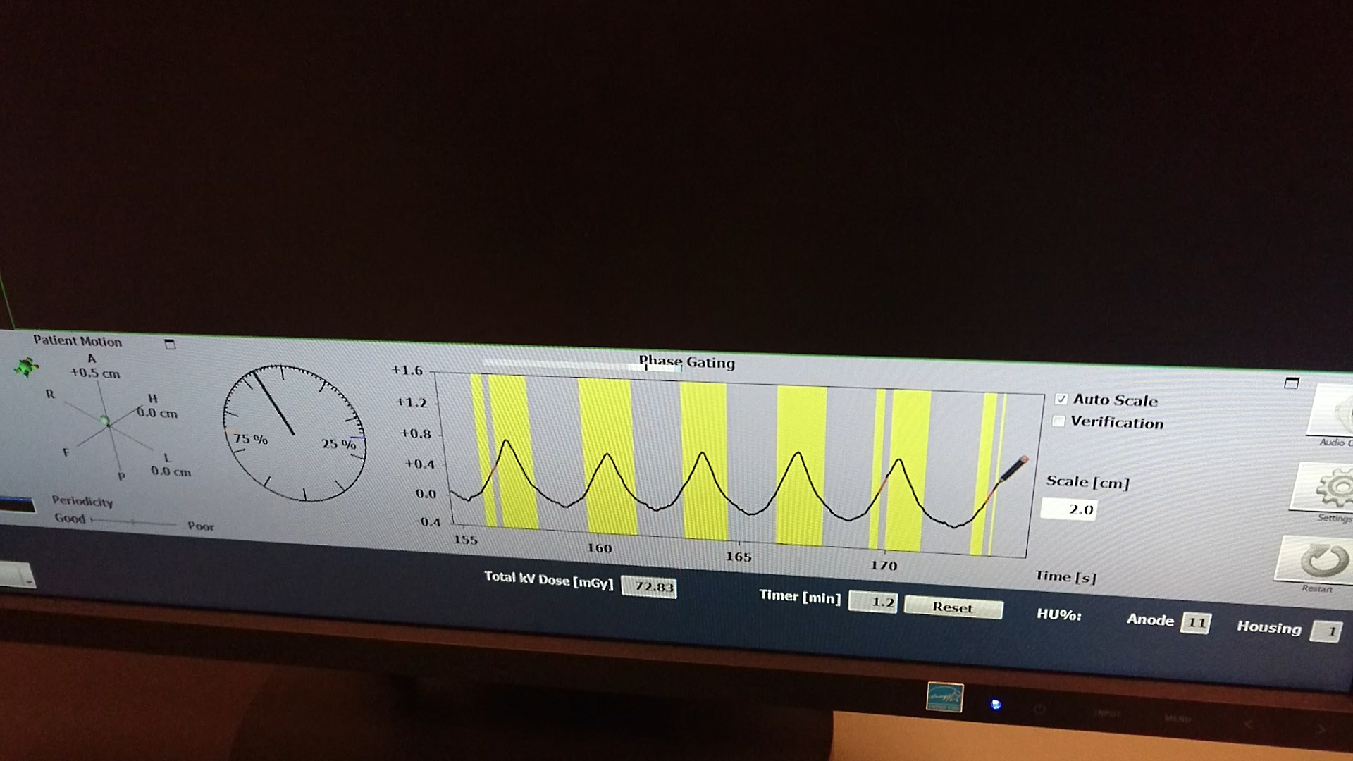
First Gated SBRT Treatment in RICM

Slide 26
Deep Inspirtion Breath Hold
Deep inspiration breath hold is used in particular circumstances to minimize radiation dose to the heart. This may be used for:
Left sided breast cancer
other tumors of the chest or upper abdomen as required
As the natural position of the heart can vary greatly from person to person, this will be assessed on an individual basis by the radiation therapy team.
Deep inspiration breath hold is a radiation therapy technique where, the patient holds the breath while the radiation is delivered. By taking a deep breath in lungs fill with air and the heart will move away from the chest.

Slide 27
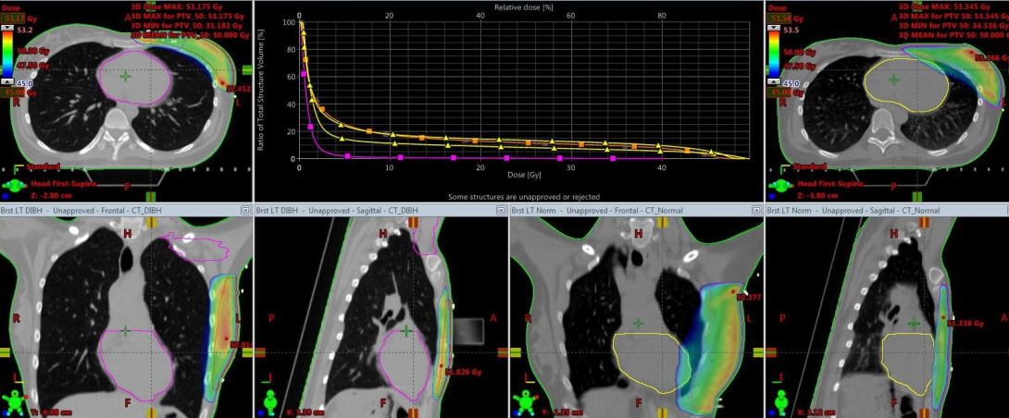
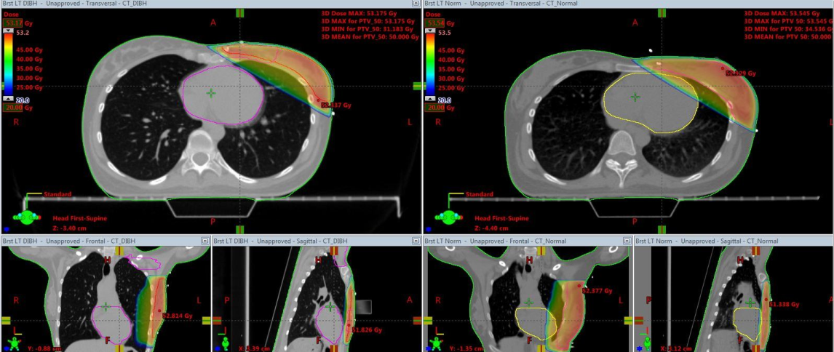
Deep Inspirtion Breath Hold
Prescribed Dose Region with DVH
Low Dose Region

Slide 28
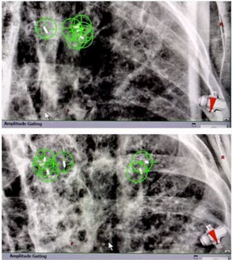
Real Time Tumor Tracking – Auto Beam Hold
To detect the target motion using radiation beam (kV image)
For detecting the tumor, surrogate markers are used in most cases
External fiducials on the skin surface or internal fiducials implanted directly into the tumor
Treatment time is increasing because of time delay between the detection of the motion and the corrective actions

Slide 29
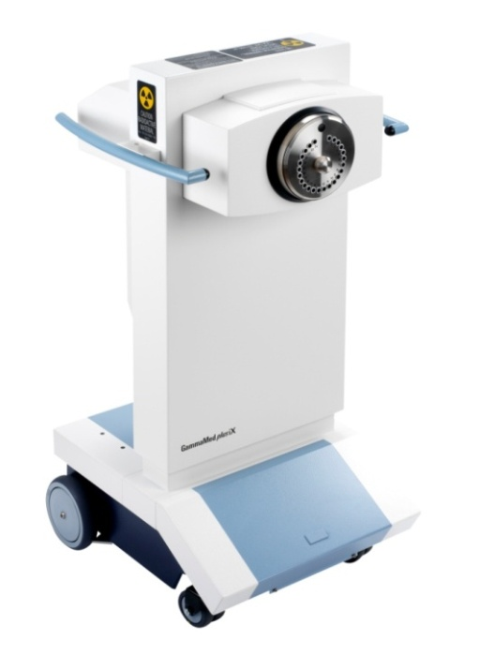
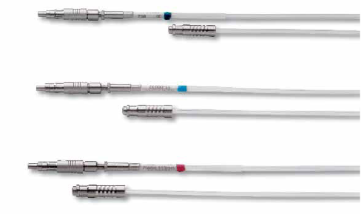
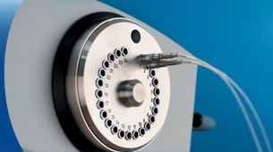
Brachytherapy
24 Channel HDR Afterloader GammaMedPlus iX (Varian Medical Systems Inc.)

Slide 30
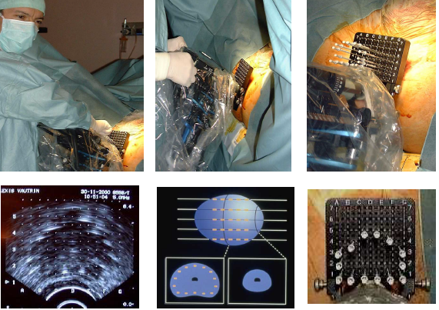
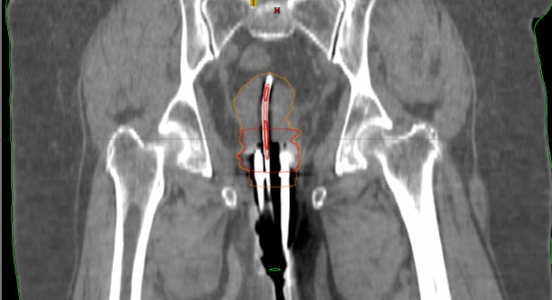
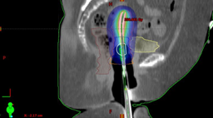
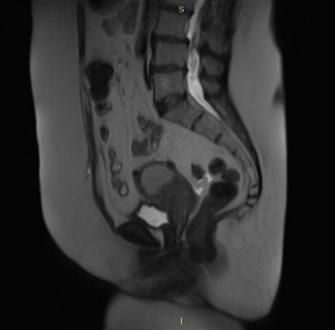
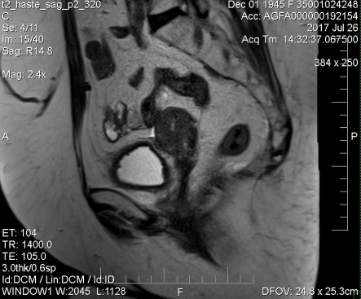
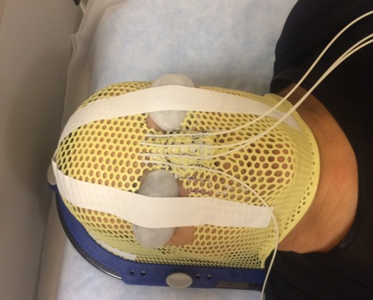
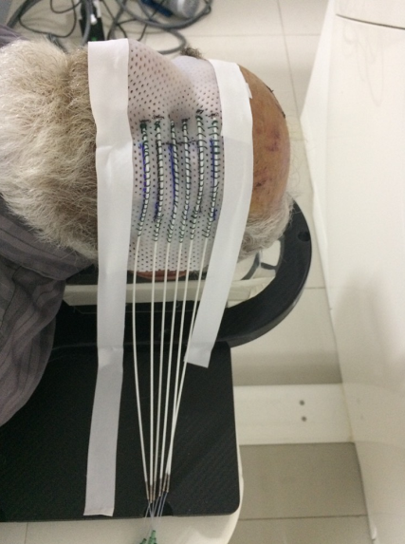
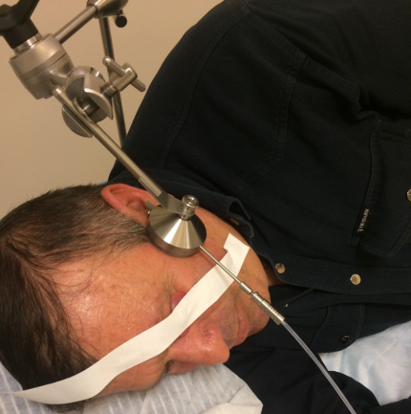
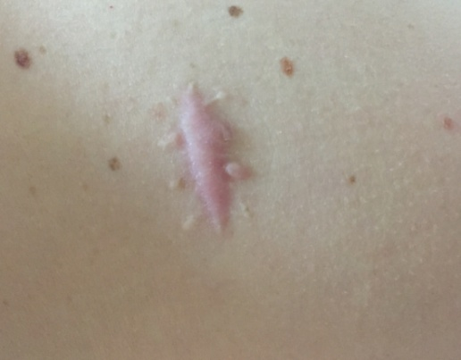
Brachytherapy
Before BT
After BT
Prostate Cancer LDR
Gynecological Cancer
Skin Cancer BCC
Non malignant Cancer- Keloids

Slide 31

Academician F. Todua Medical Center, Research Institute of Clinical Medicine
In 2021 we had 30 years anniversary of the Hospital
Consists of 5 Buildings
Radiotherapy Department was established in 2014
3 Linacs for External Beam Radiotherapy (EDGE Radiosurgery System and Truebeam Twins, Varian Medical Systems Inc)
1 Brachytherapy Unit (GammaMedPlus iX Varian Medical Systems Inc)
Treatment localizations: Gastrointestinal Tract, Gynecological Malignancies, Lymphomas, Cancer of Head and Neck, Skin Cancer, Brast Cancer, Cancer of Central Nervous System, Pediatric Malignancies, Cancer of Thoracic Region, Extremity Soft Tissue Sarcomas and etc
Available Technologies: 3DCRT, IMRT, VMAT, SRS/SBRT, IGRT, 4D and DIBH Techniques, Intra-fractional Motion Tracking
1500-2000 Patients per year (Azerbaijan, Armenia, Russia, Middle Asia (We had several patients from USA, which were for mission in Georgia when they were diagnosed with cancer and refused to go back to their country for treatment)
Certificates: Award for European Excellence in Quality and Best Regional Healthcare Provider (2017), ISO 9001:2008 (2015)

Slide 32

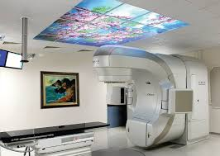
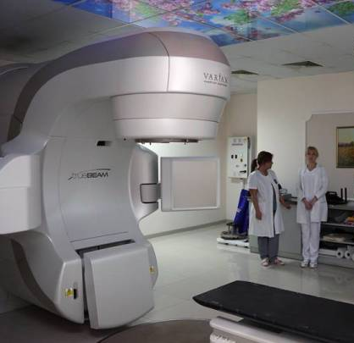
External Beam Radiotherapy of RICM
EDGE RADIOSURGERY SYSTEM
(VARIAN MEDICAL SYSTEMS INC.)
TRUEBEAM TWINS
(VARIAN MEDICAL SYSTEMS INC.)

Slide 33
Brachytherapy of RICM
24 Channel HDR Afterloader GammaMedPlus iX (Varian Medical Systems Inc.)

Slide 34
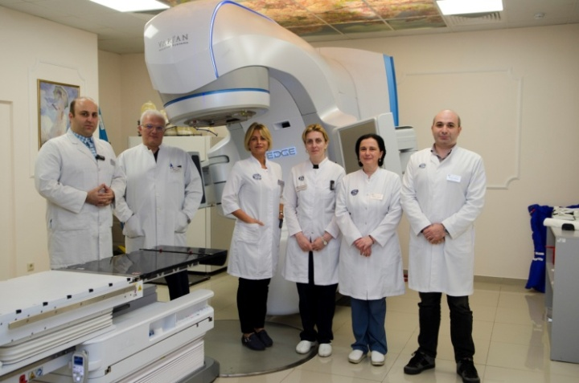
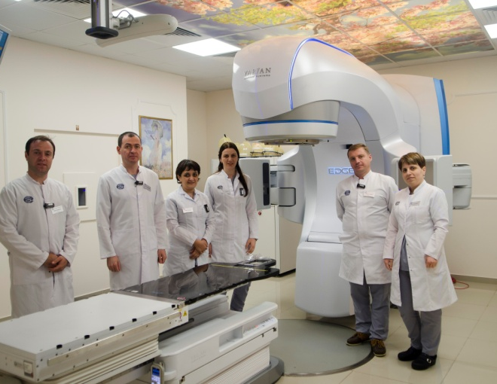
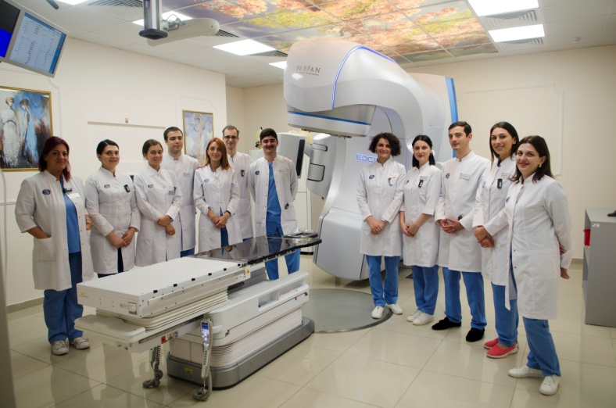
Staff of Radiotherapy Department of RICM
6 Radiation Oncologists
6 Medical Physicists
12 Radiotherapy Technicians
2 Residents in the field of radiation Oncology
ROs
MDs
RTTs

Slide 35
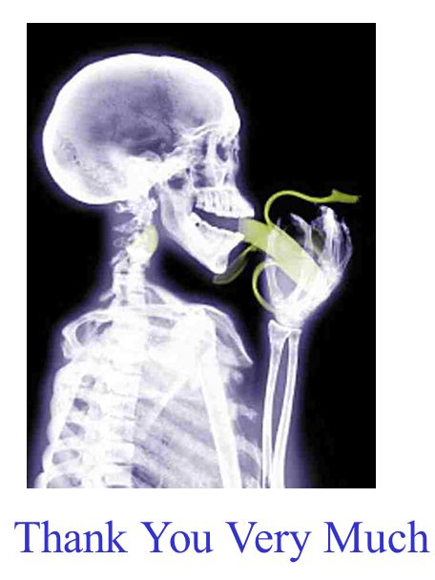
“NO MATTER HOW GOOD IS THE BEAM, IF THE TARGET IS NOT WHERE WE THOUGHT”.

