Slide 2
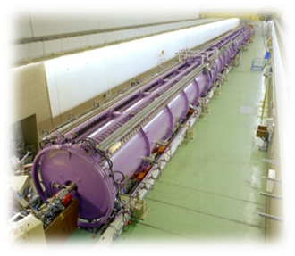
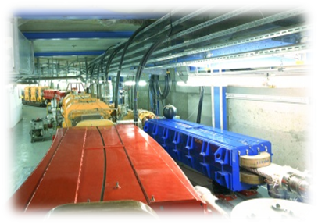
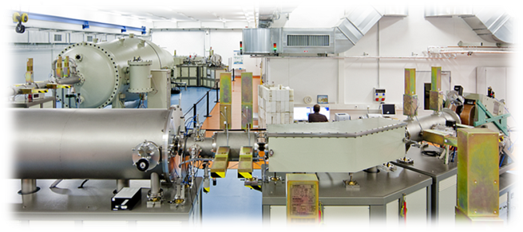
Ion Beam Facilities in Germany
Atomic Physics
Plasma Physics
Materials Research
Kinetic Energy (MeV)
Materials Research
Resource Analytics
Industrial Applications

Slide 3
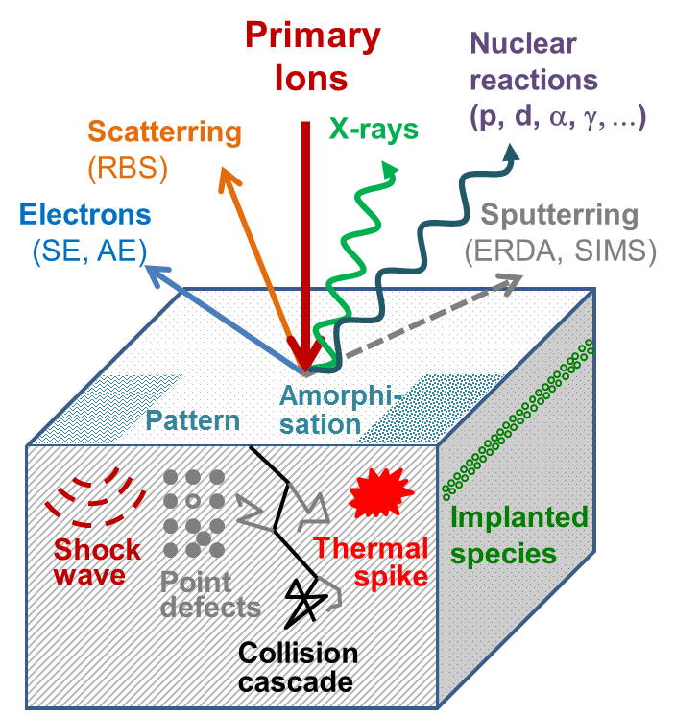
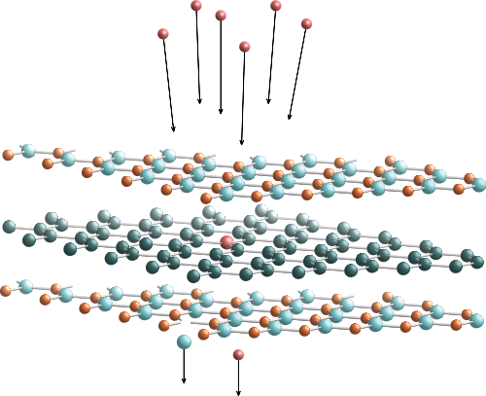
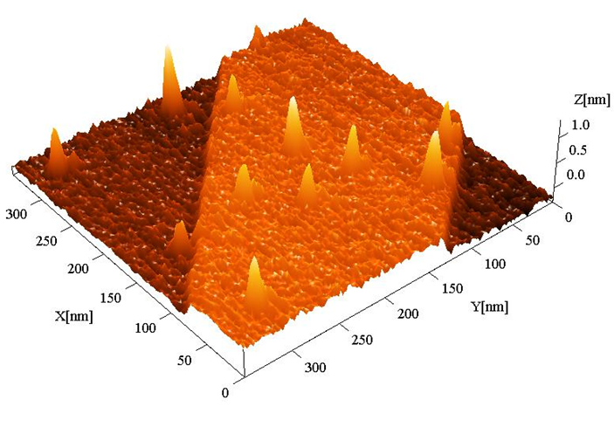
Physics and Materials Science with Ion Beams
Energy release, doping, order/disorder
→ Materials modification
2. Secondary particle / radiation emission
→ Materials analysis
Why ions?
Precision & control
ion, position, amount
Material states far from equilibrium
Chemical analysis quant., non-destructive
Fe
(at.%)
nm size

Slide 4
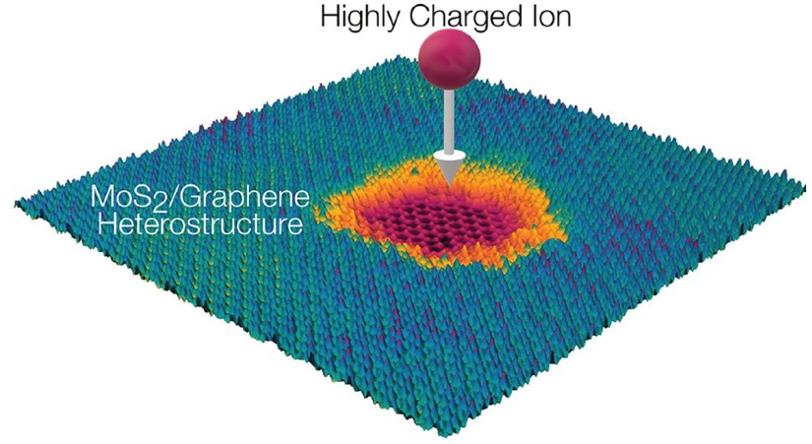
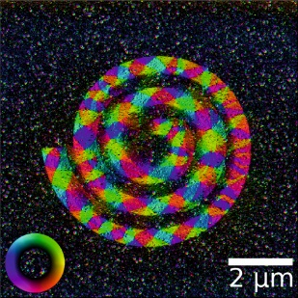
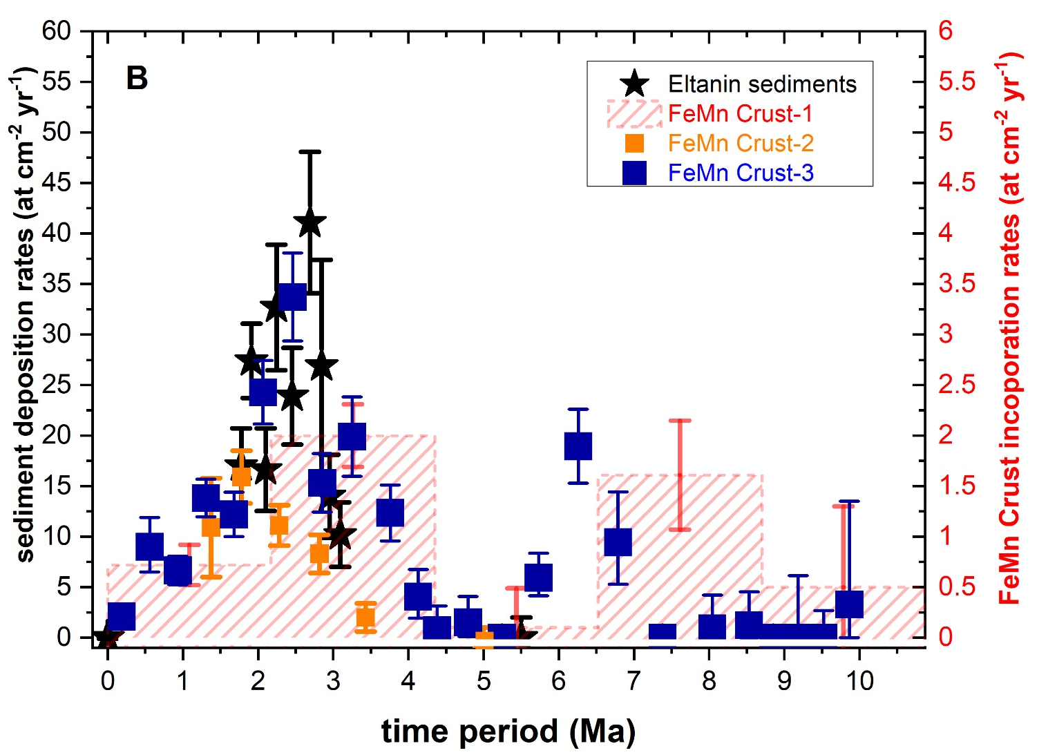
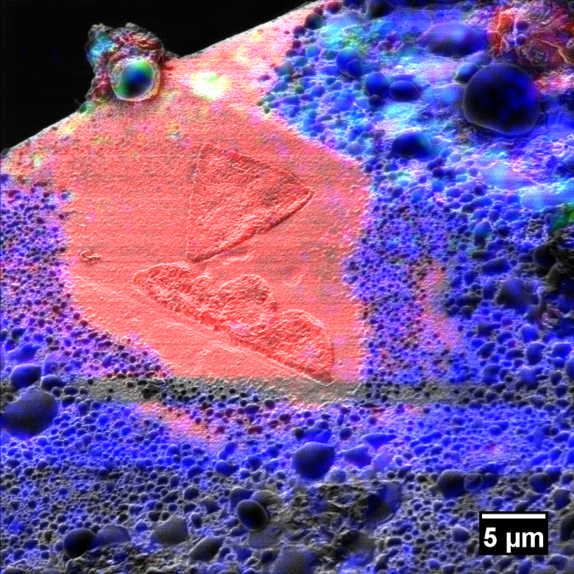
IBC – Ion Beam Center
Precise carving of nanostructures in 2D heterostructures by highly charged ions
ACS Nano. 14, 10536 (2020)
Magnetic nanostructures induced by HIM irradiation
Small 15, 1904738 (2019)
AMS dating of nearby supernova signatures
Ion beam Analysis with a lateral resolution of 8 nm
Nature 532, 69 (2016)

Slide 5
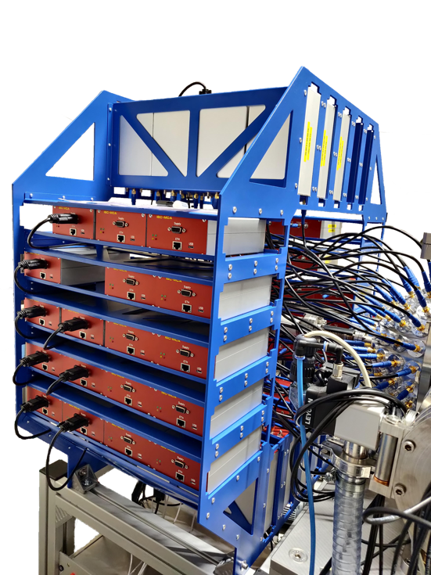
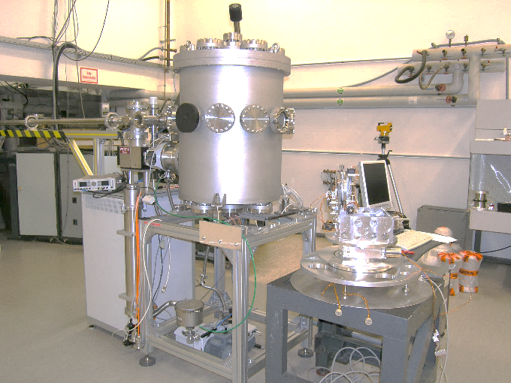
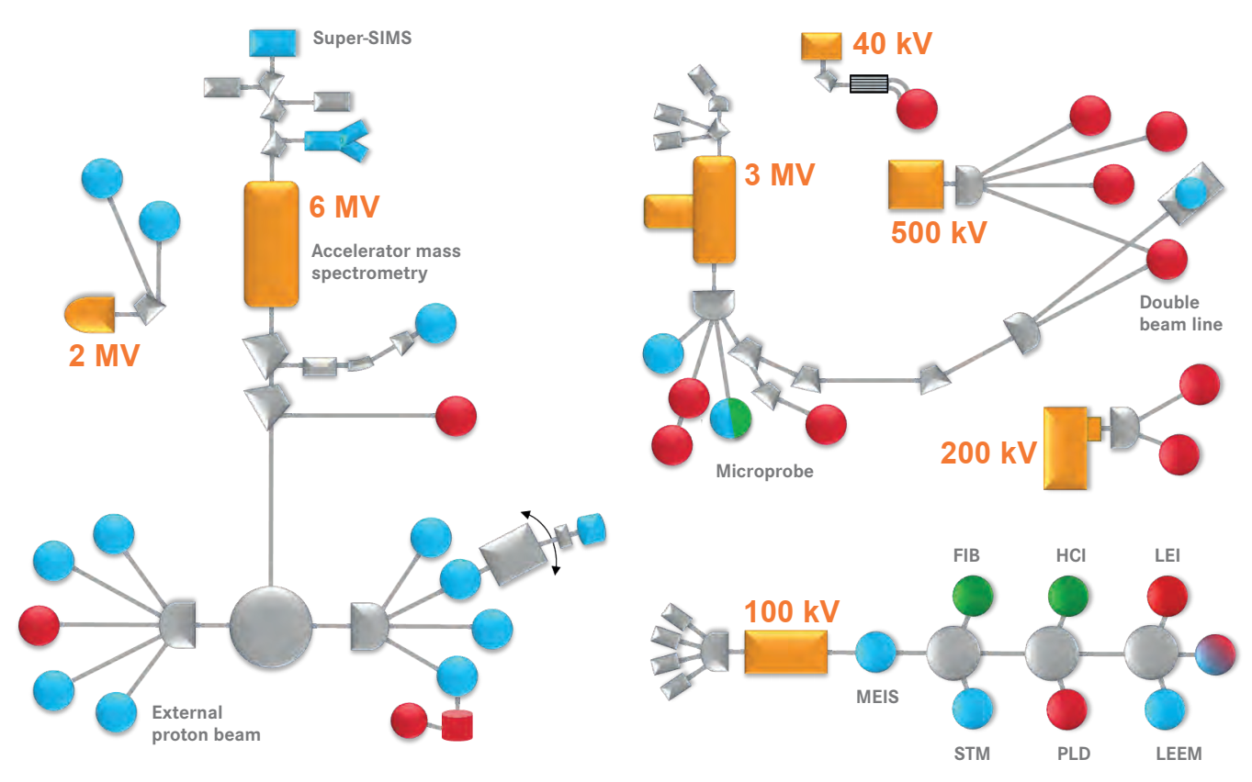
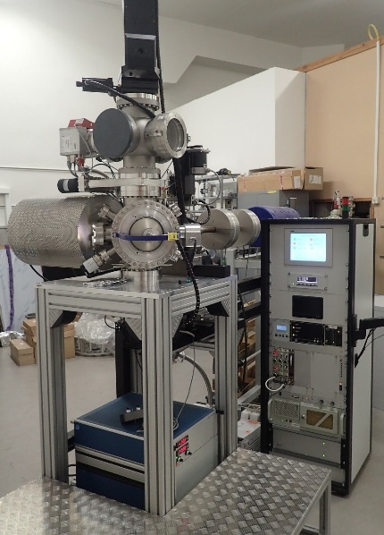
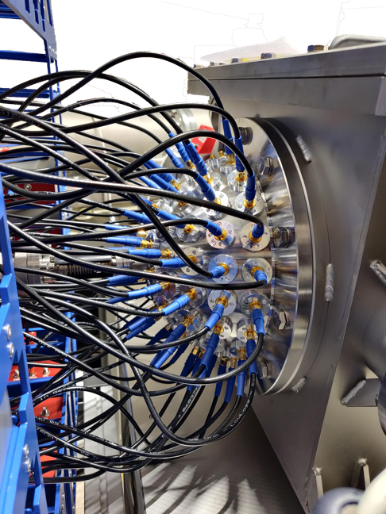
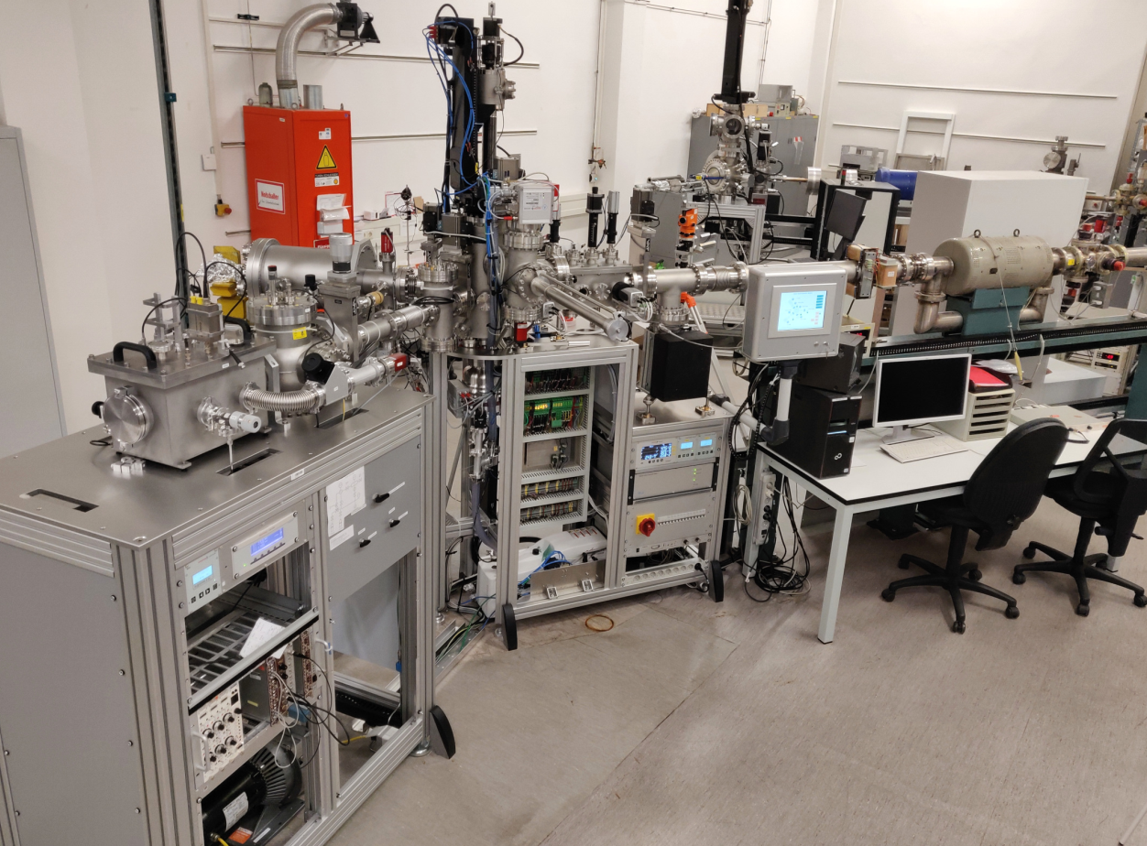
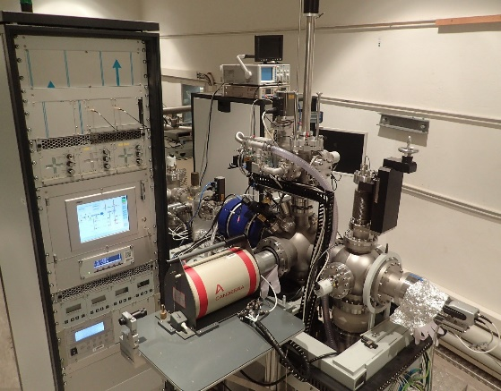
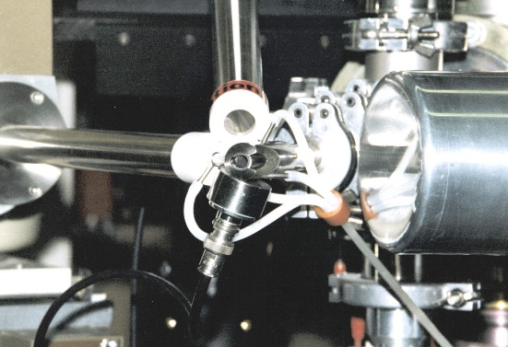
IBC – Ion Beam Center
RBS
NRA
micro beam (PIXE/PIGE/RBS)
RBS Hedgehog
ext. beam (PIXE/PIGE/RBS)
ERDA
Notes:
UPDATE

Slide 6
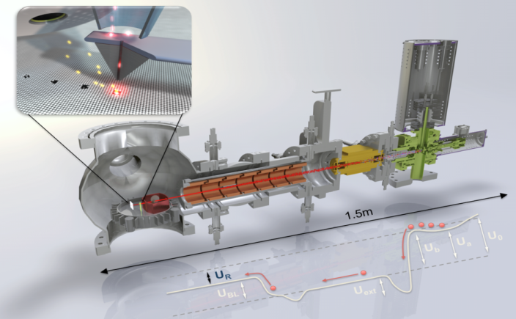
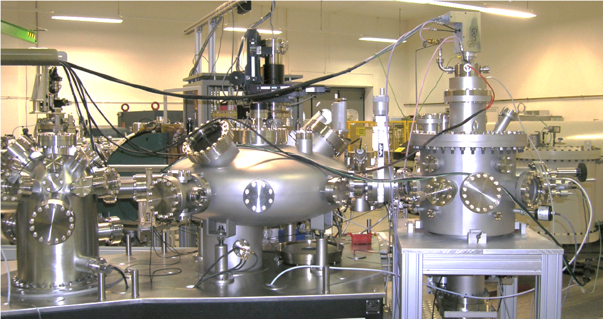
Innovative Instrumentation at IBC
Modification Modification / Analysis Analysis
Ion doping with atomic precision
Ion Beam Analysis on
the nanometer scale
Combining ion beam modification & analysis
real-time, in-situ and in-operation experiments

Slide 7
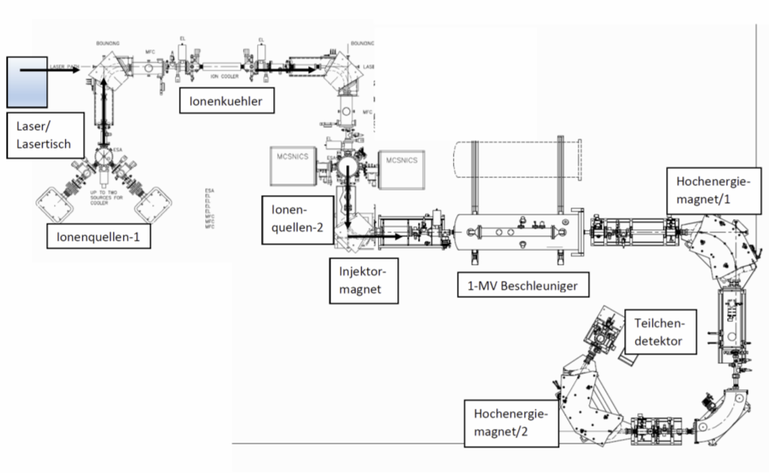
IBC – Ion Beam Center
Low Energy Ions / Focused Ion Beams
Controlled ion beam mediated doping of 2D materials
AMS extension
More beamtime for users and development of non-routine nuclides
Laser ionization

Slide 8
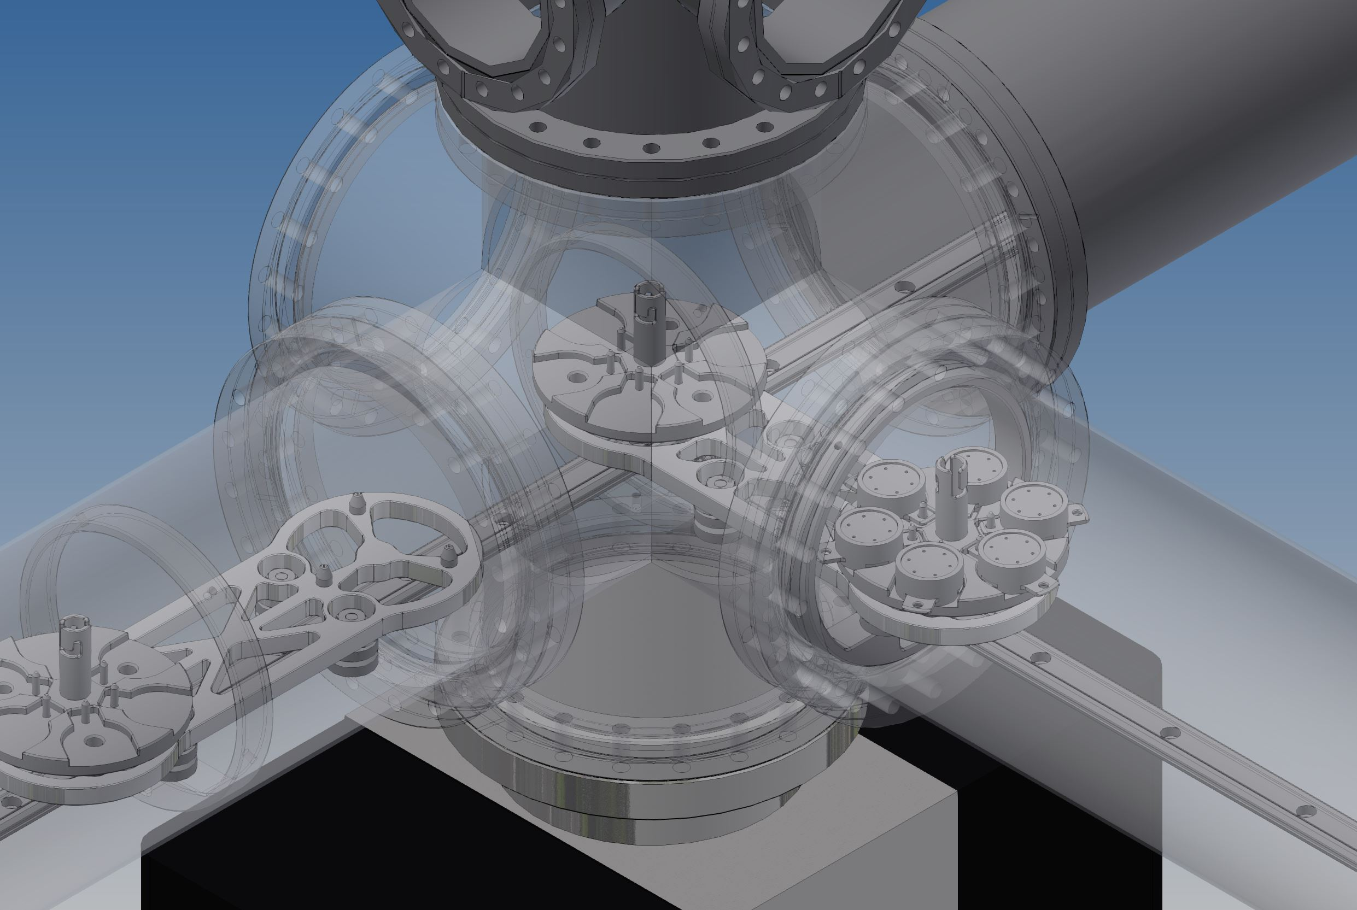
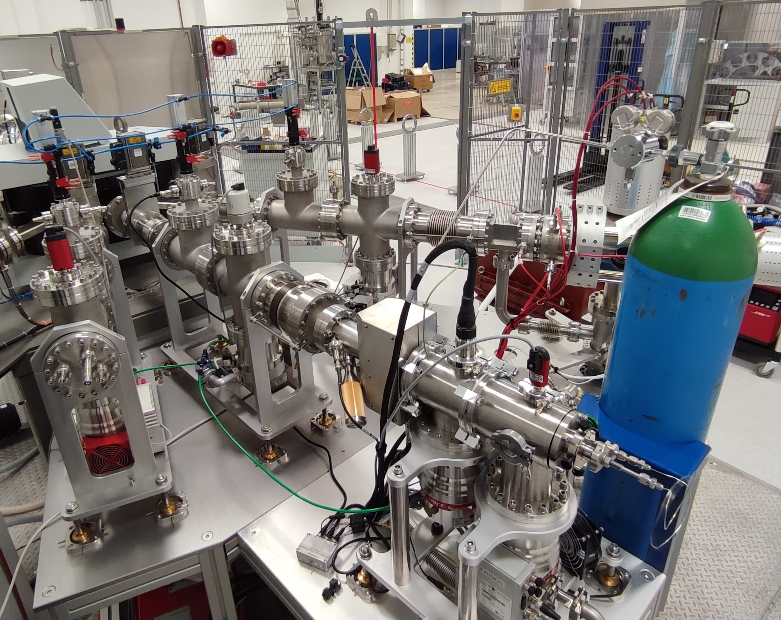
IBC – Ion Beam Center LEINEF
100kV platform moved to new site in 2021 …
Installation of transfer tunnel in 2022
Attachment of end stations in 2022-2023
… and was equipped with 3 more ion/cluster sources

Slide 9
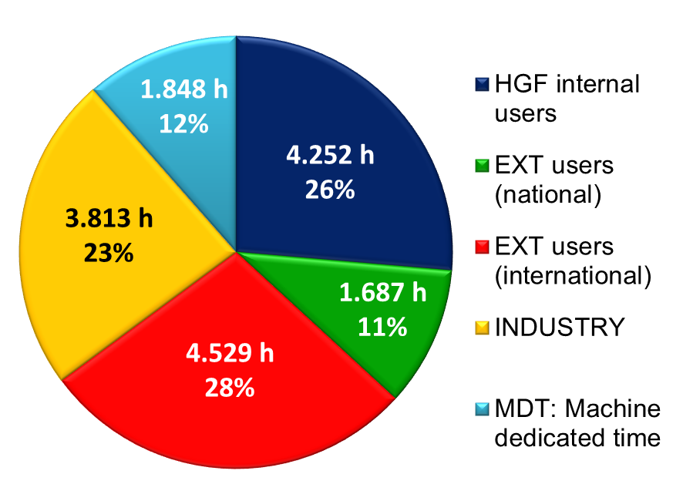
IBC – Ion Beam Center as User Facility
IBC Statistics:
Operation Time: 16.200 h (total)
User Beam Time: 14.200 h (88%)
Ext User Quote: 71%
Experiments: ~ 160/a
Publications: ~ 120/a
Collaborations:
Joint research & networking across Europe
Education, training measures & infrastructure development for ion beam facilities in emerging countries
Collaboration with industrial partners leading to product innovation

Slide 10
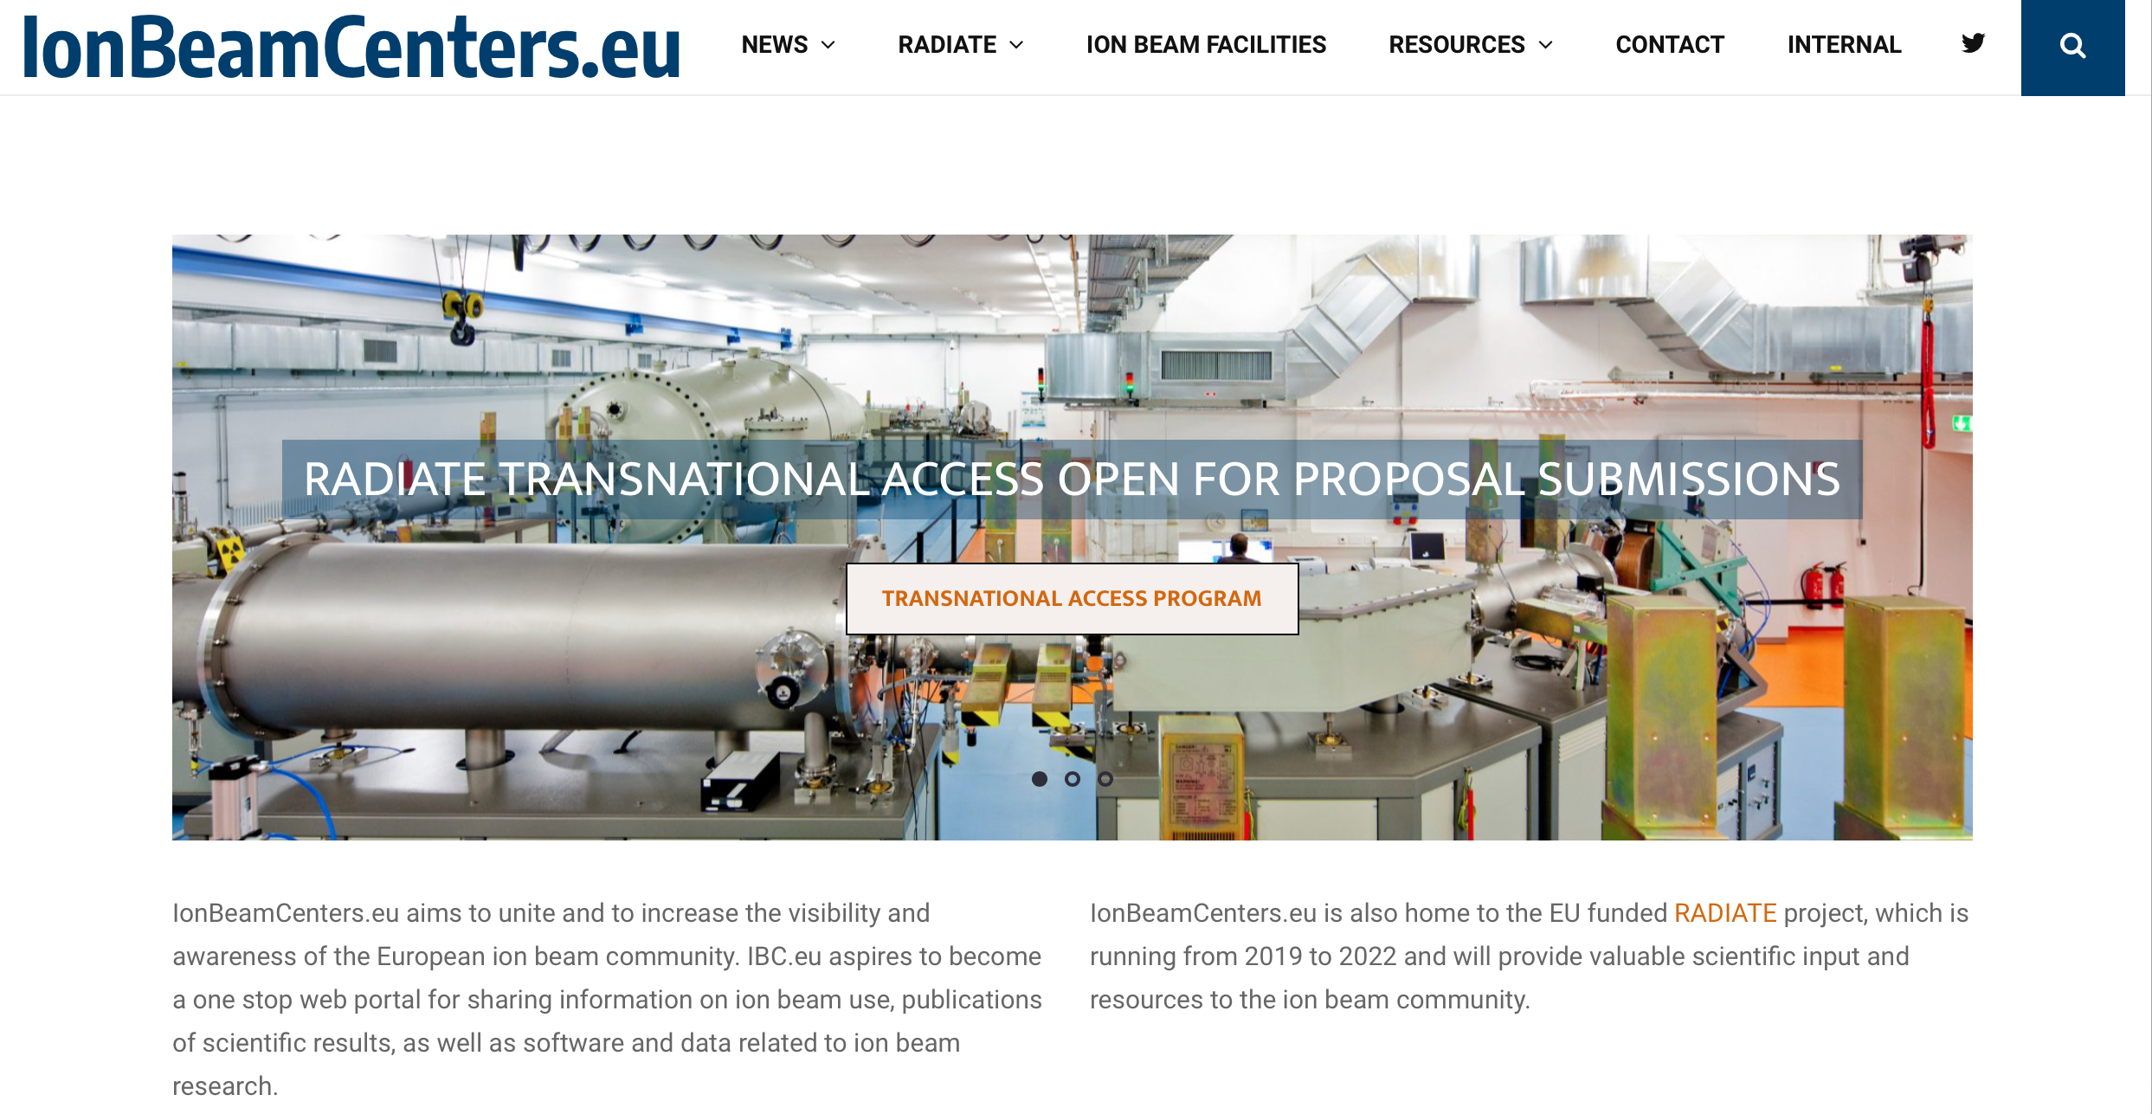
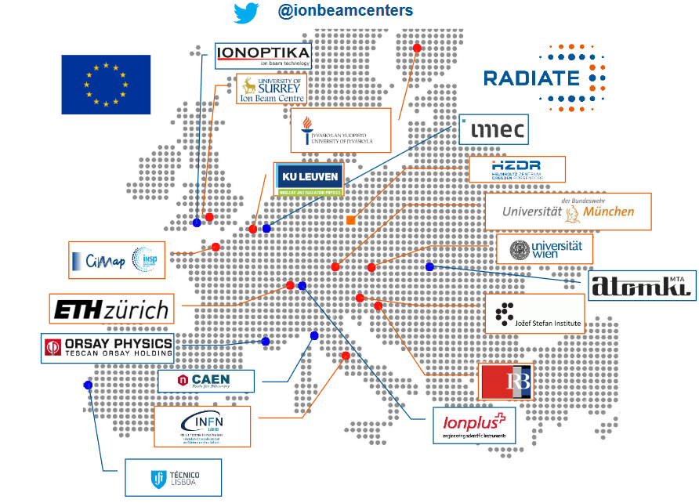
IBC – Projects: RADIATE

Slide 12
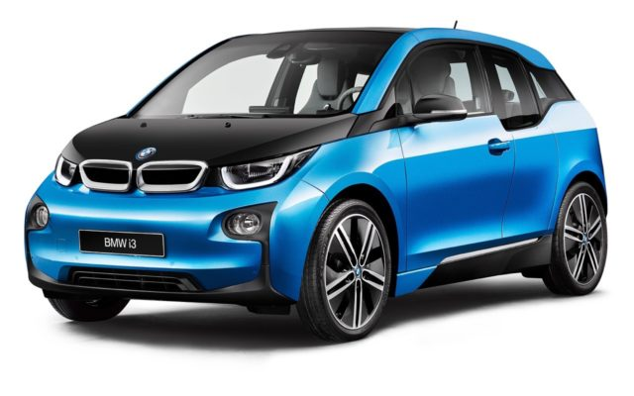
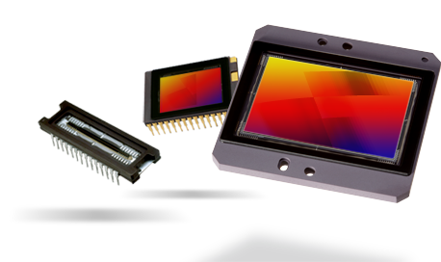
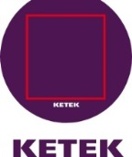
Use of IBC Facility for Innovations in Industry
Ion Beam Services
Power Electronics (Diodes, IGBT, GTO)
Less power loss
Higher switching speed
Selected partners:
Opto-Electronics
CMOS image chips
Improved lasers
Detectors (APDs, SiPM)

Slide 13
IBC - Industrial Service
confidential
2460
2124
2316
2093
3676
5032
6949
6803
8482
hours/year
for HZDRI

Slide 14
Thank you for your attention

