Slide 1
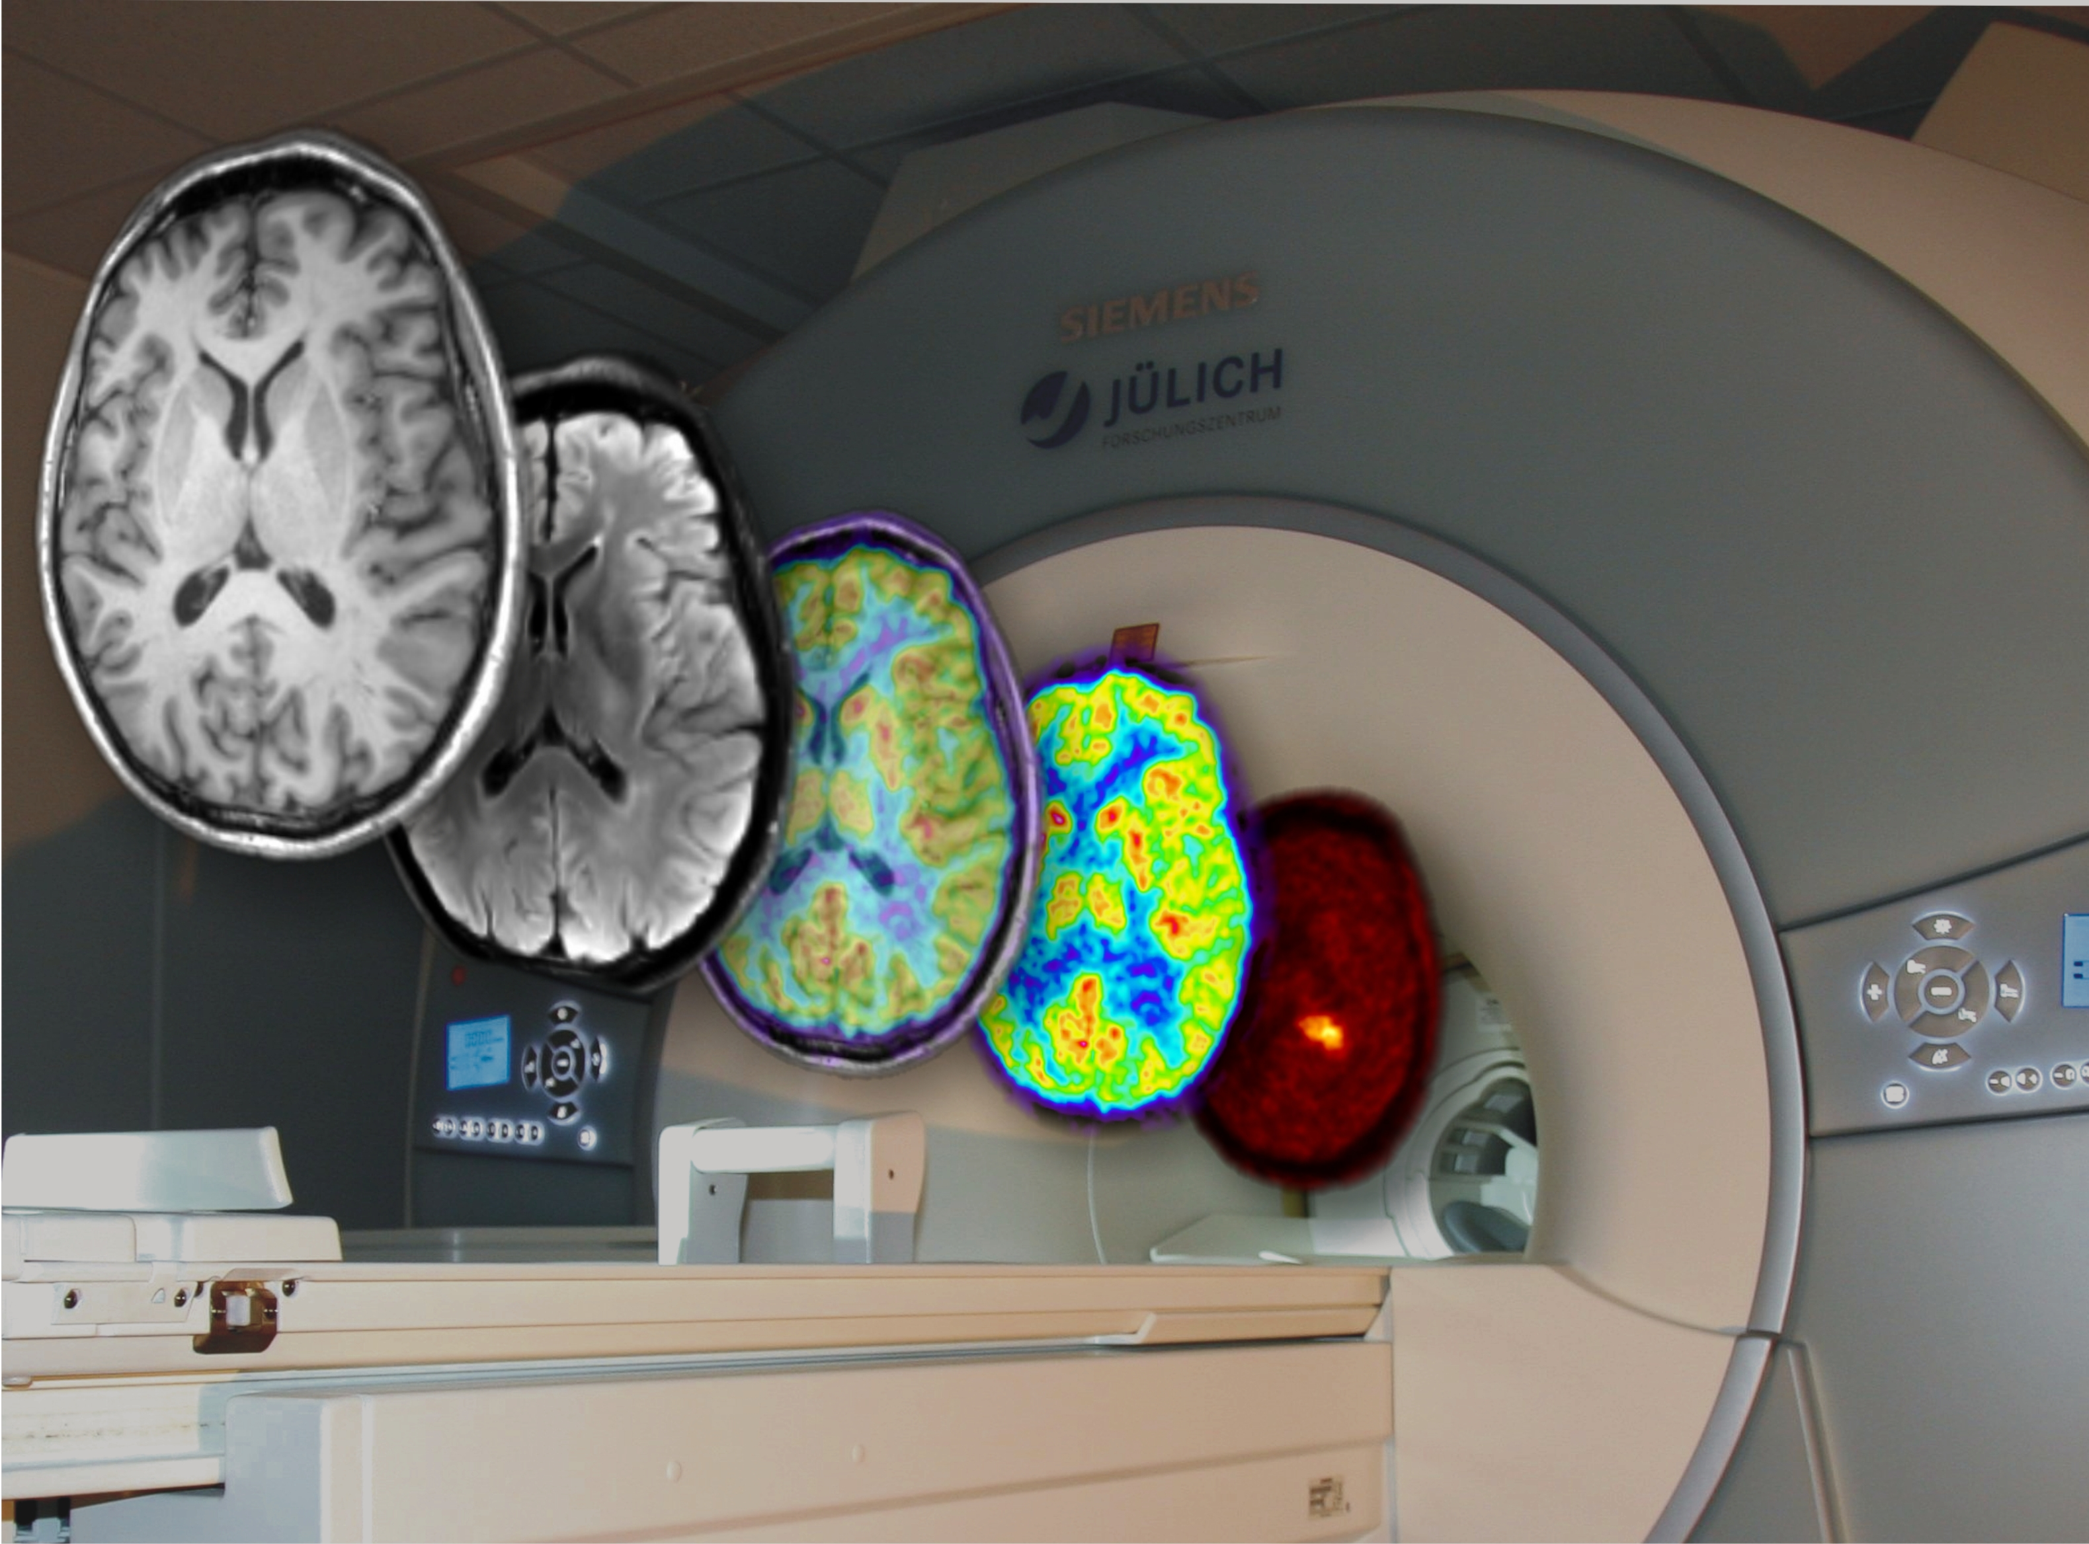
An Introduction to the Basics of PET Imaging
N. Jon Shah
Institute of Neuroscience and Medicine – 4
Research Centre Juelich
52425 Juelich
GERMANY

Slide 2
Outline
Introduction
PET Basics
Example Measurement
Overview Processing Workflow
Required Data Corrections in Detail
Attenuation
Randoms
Normalisation
Compton Scattering
Decay & Deadtime Correction
Calibration

Slide 3
Mental activity needs energy.
Example of
Functional Imaging Using PET
Substrates providing energy (glucose and oxygen) must be transported to the brain.
This transport can be observed with PET.

Slide 4
H₂O
Water is distributed within the body corresponding to blood flow
H₂¹⁶O

Slide 5
H₂O
Using “radiating“ water blood flow becomes visible
H₂¹⁵O
H₂¹⁶O
ß⁺
ß⁺
511 keV
e⁻
511 keV

Slide 6
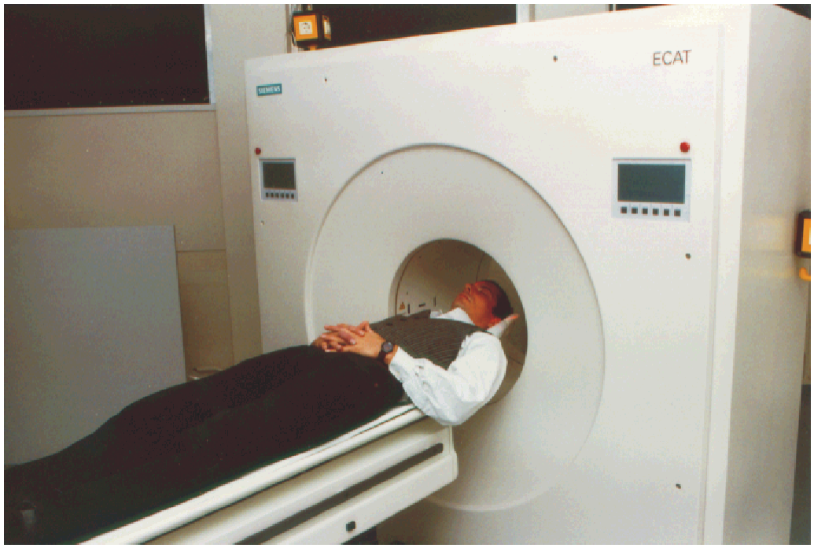
HR+ & Photonenpaare

Slide 7
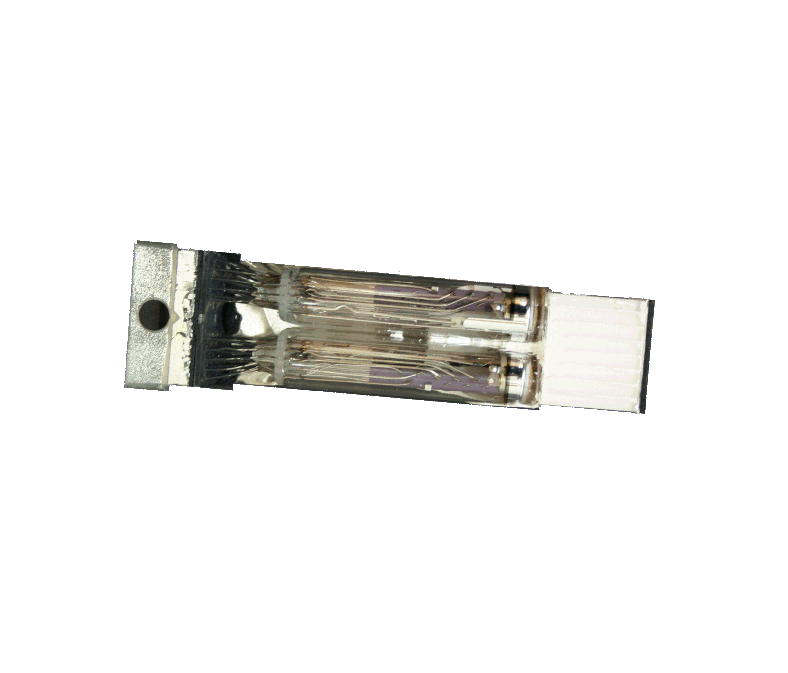
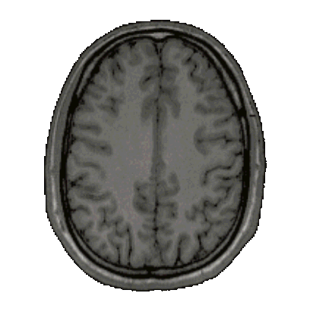
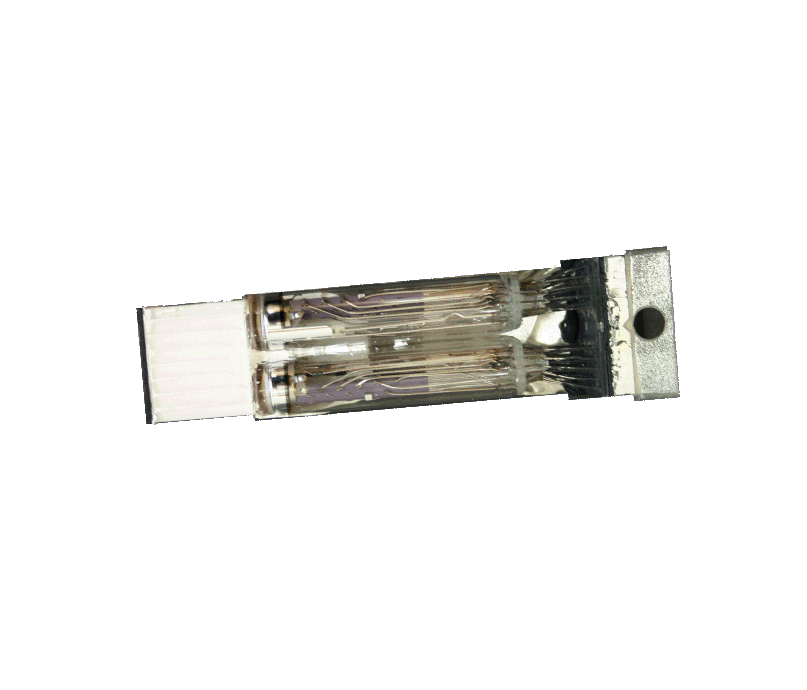
BGO
LSO
NaI
GSO
Dt < 12 ns : coincidence o.k.

Slide 8
The ring detector records pairs of annihilation photons by looking into the object from different views
Projections of the
point sources
Two point sources
emitting pairs of annihilation photons

Slide 9
Projections seen from around the head - activity used: ¹⁸F-fluoro-deoxy-glucose

Slide 10
Image Reconstruction: Backprojection of the measured projection data and superposition
Projections of point sources
Image of point sources

Slide 11
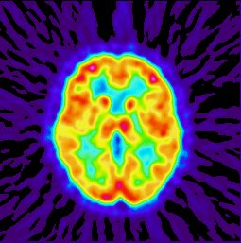
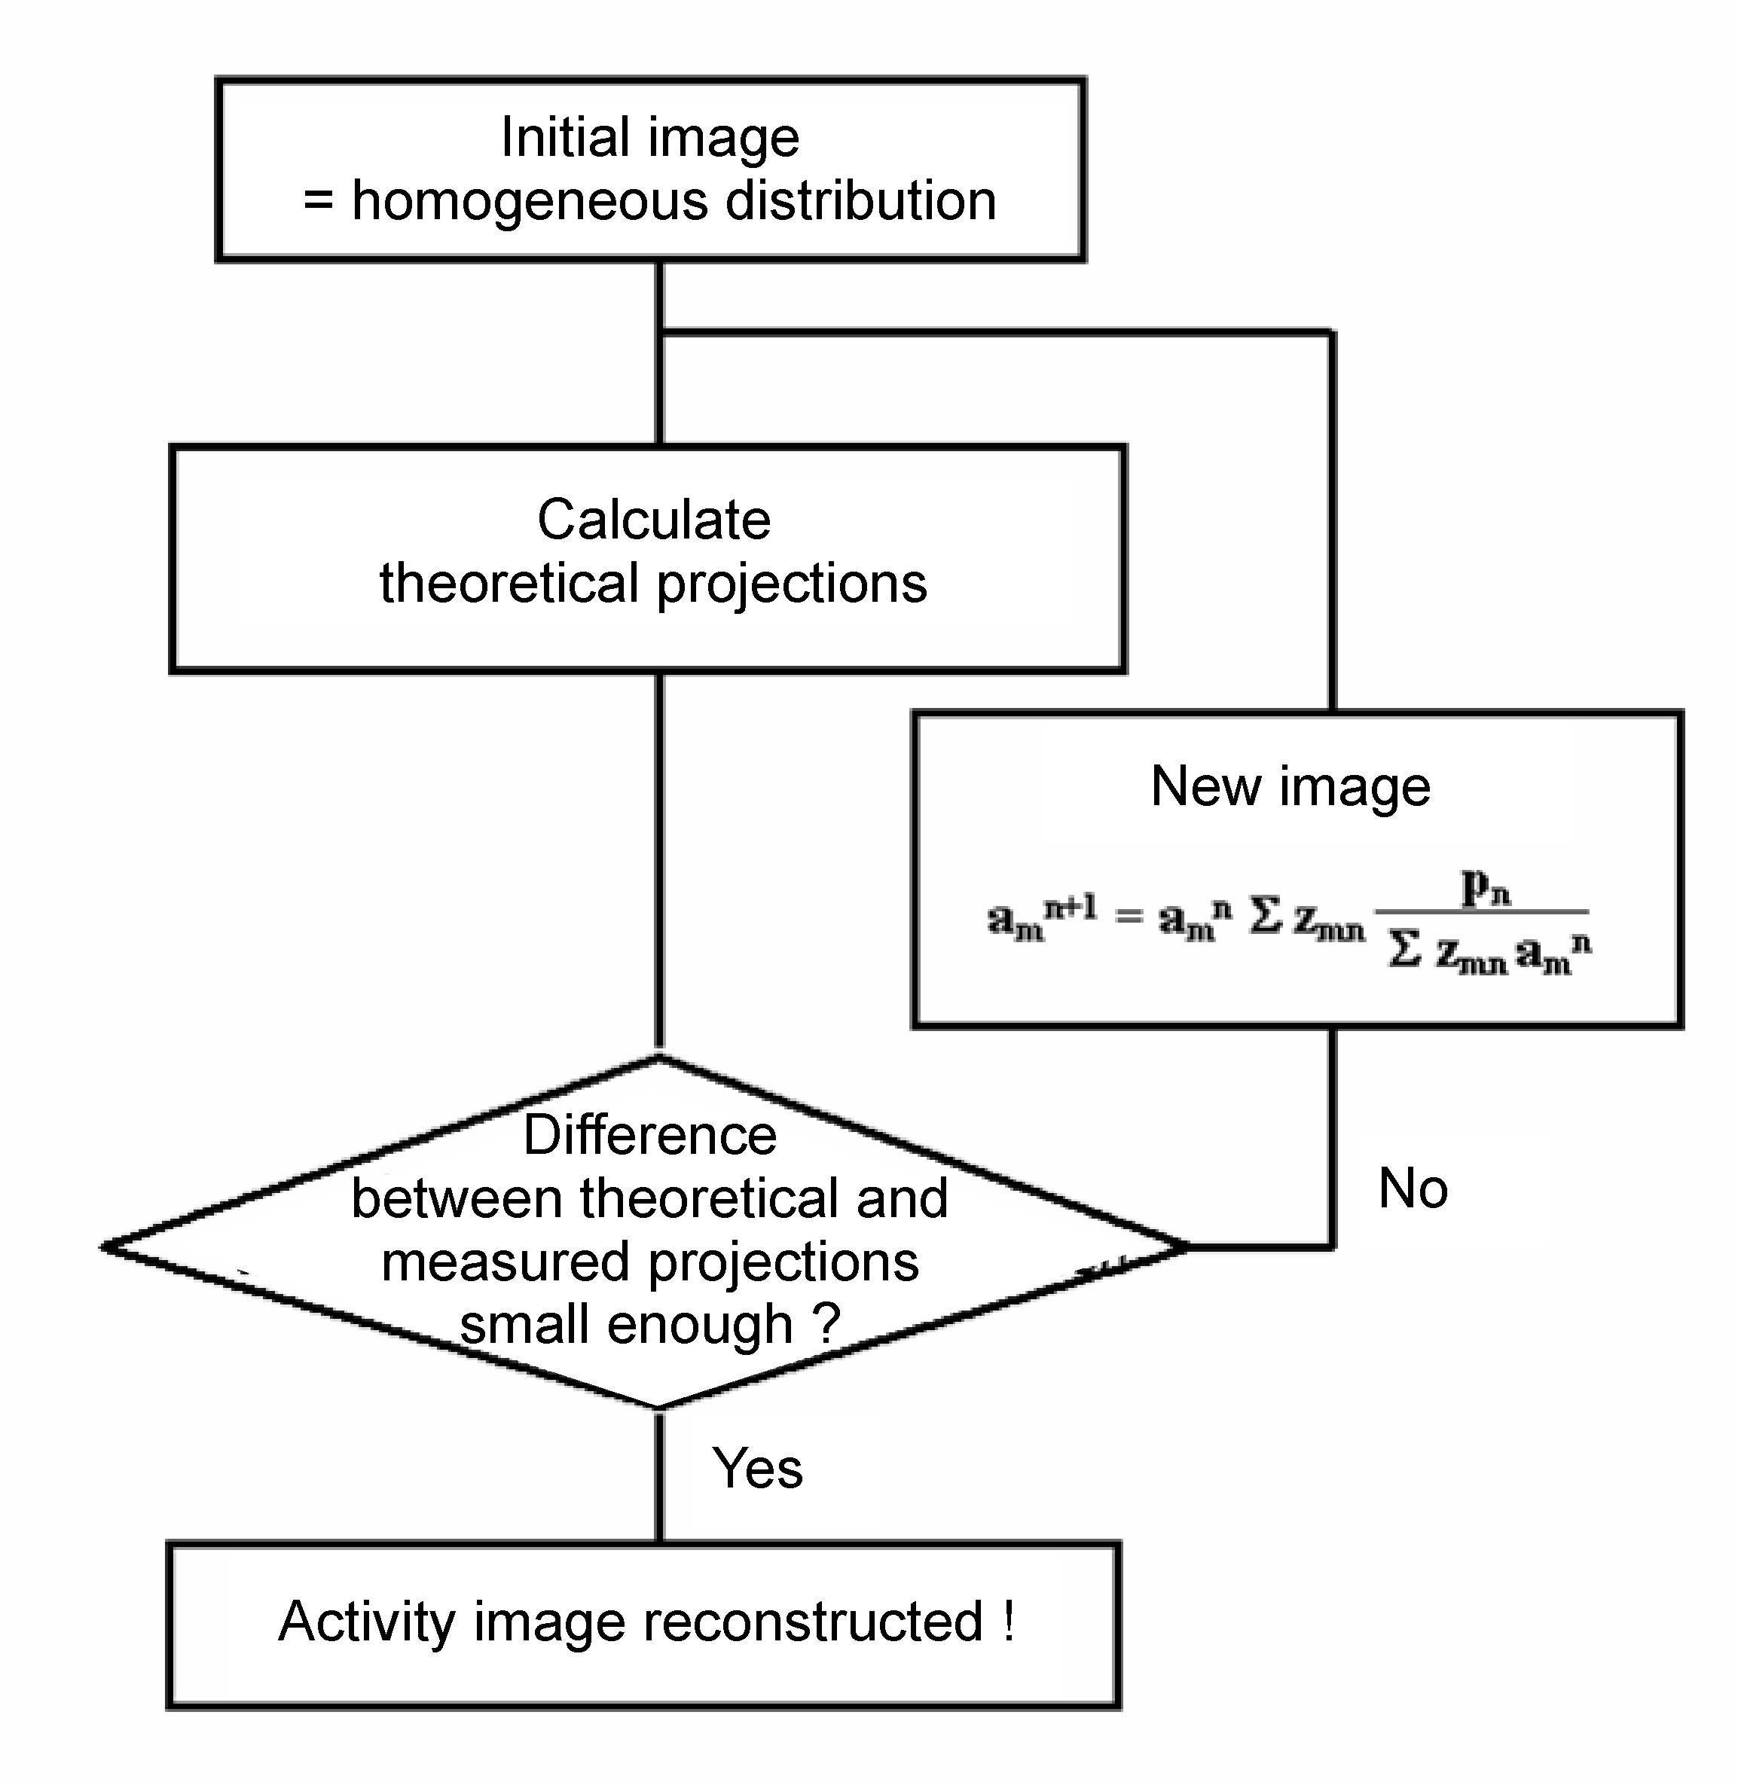
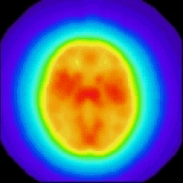
Rekonstruktionen
Analytic Reconstruction by
Filtered Backprojection
Algebraic Reconstruction by
Iterative Solving of Matrix System
P_{i} = S_{ij} A_{j}
i = 1 , ... , 288 x 144
j = 1 , ... , 128 x 128 I x J = 679.477.248

Slide 12
Metabolic Functions Visualised
Metabolic Functions Visualised by “Natural“ Tracer Molecules Labelled
with Positron Emitters
H₂¹⁵O
Perfusion
15O₂
Oxygen Consumption
CH OH
2
O
Glucose Consumption
-
O
H
HO
O
H
18
F
S
NH
2
H C
Transport
of Amino Acids
3
11
C
HO
O

Slide 13
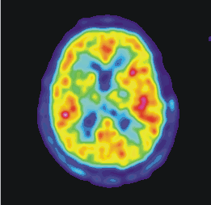
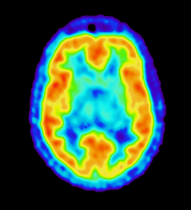
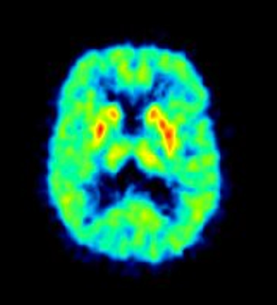
Examples of reconstructed images
11C-SDZ GLC756:
dopamine
receptors
H₂¹⁵O:
Cerebral blood flow
18F-Altanserin:
serotonin
receptors

Slide 14
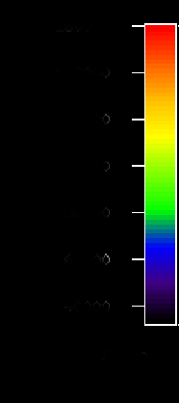
Visualisation of Radioactivity
Visualisation of Radioactivity
1.50 E06
1.29 E06
1.07 E06
8.57 E05
6.43 E05
4.29 E05
18F-Altanserin
⇨ serotonin receptors
2.14 E05
counts/s

Slide 15
Quantitation of Radioactivity Concentration
Quantification of Radioactivity Concentration
16
14
12
10
8
6
4
Measurement of ¹⁸F-altanserin uptake
kBq/ml

Slide 16
From Radioactivity Concentration (kBq/ml)
to Mass Concentration (μmol/ml)
m_{Tissue}
m_{Syringe}
=
c_{PET}
c_{Syringe}

Slide 17
Quantitation of Mass Concentration
Quantification of Mass Concentration
86
75
66
54
43
33
22
Measurement of altanserin concentration
fmol/ml

Slide 18
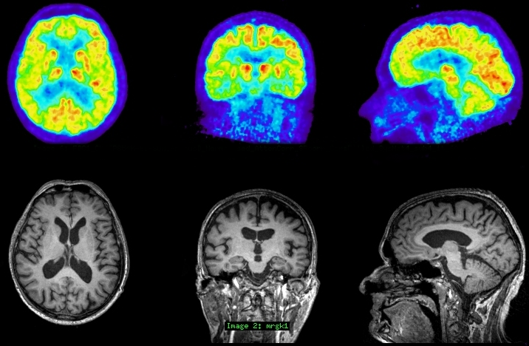
Simultaneous PET-MR patient measurements
18Flour-Deoxy-Glucose-PET
metabolic
information
simultaneous MR (T1 MPRAGE)
anatomical
information

Slide 19
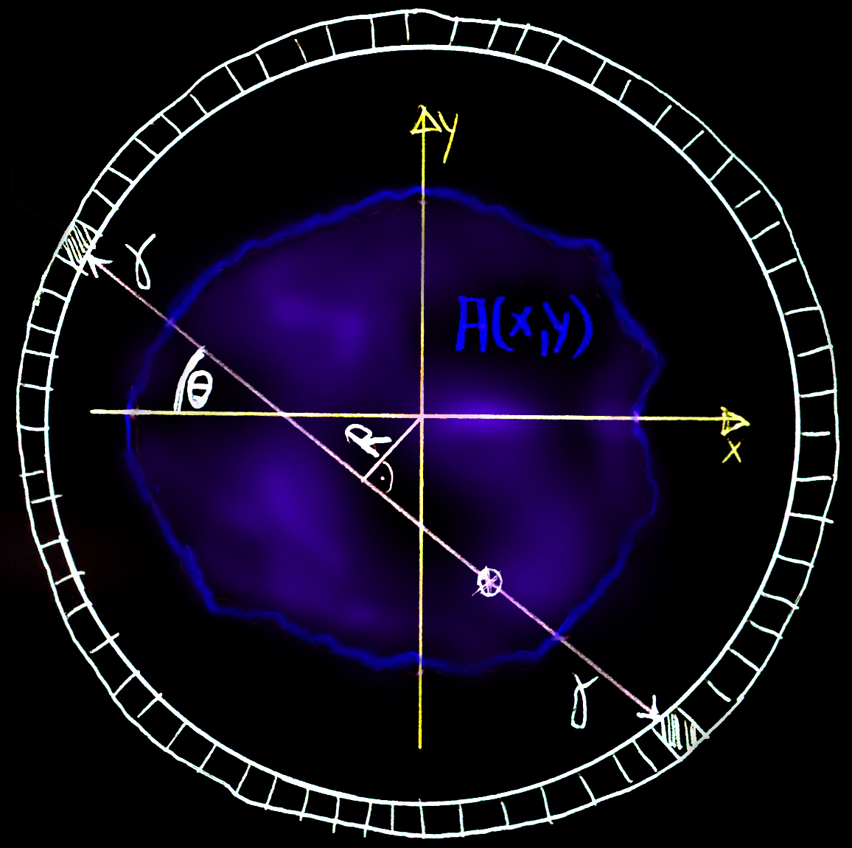
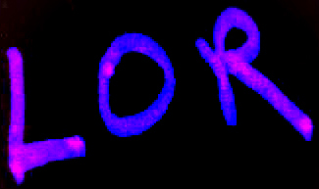
First Principle: Positron-Emission-Tomographie (PET)
b⁺ decay process of metabolic tracer:
e.g.: ¹⁸F --> ¹⁸O + e⁺ + n_{e}
e⁺ e⁻ --> 2 γ
D₁
g
detector
combination
( D₁ , D₂ )
18F
line of response
(R, θ)
g
D₂

Slide 20
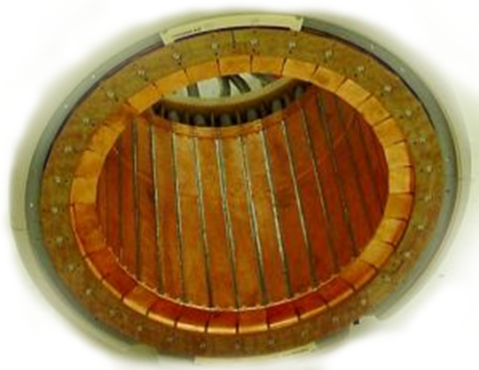
3D data acquisition
144 crystals / block
6 blocks / modul
32 moduls
27648
detector crystals
1 HEAD
227 million
detector combinations
(Lines-Of-Response)
19 OPPOSITE HEADS

Slide 21
BrainPET Data Formats (I)
List Mode (LM) Data:
list of detected coincidences
in chronological order
store pairs of
detector numbers
1
1. event: ( 1 ,50)
7
2. event: ( 7 ,41)
Acquisition
Time
3. event: (33,54)
1.
54
2.
3.
additional tags are
periodically inserted:
time tags
count rate tags
external trigger tags
50
33
41

Slide 22
BrainPET Data Formats (II)
List Mode (LM) Data
Line-of-Response (LOR) Data:
sum of detected coincidences
for any detector pair
event ( 1, 50)
event ( 7, 41)
event (33, 54)
event (29, 52)
event (17, 20)
event ( 1, 50)
x
x
x
event (33, 54)
x
x
t₁
( 0, 50) --> #0
( 0, 51) --> #0
( 0, 52) --> #2
......
( 1, 50) --> #1
.....
.....
(33, 54) --> #2
.....
.....
select data
of specific
period of time
(time frame)
230 million
detector pairs
t₂
List Mode
Sorter

Slide 23
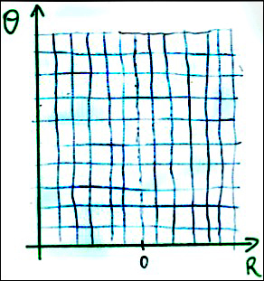
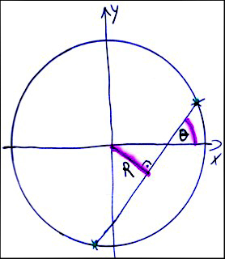
BrainPET Data Formats (III)
Sinogram Data:
geometrical sorting
of LOR data into projections
LOR Data
Sinogram
Sorter
+2
( 0, 50) --> #0
( 0, 51) --> #0
( 0, 52) --> #2
......
( 1, 50) --> #1
.....
.....
(33, 54) --> #2
.....
.....
54
33
{ D₁, D₂ } → { R , θ }

Slide 24
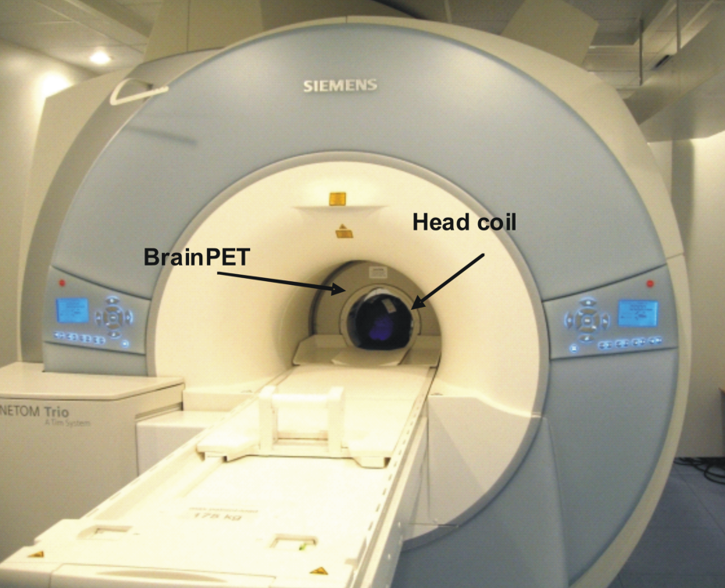
BrainPET in 3T-Tim-Trio MR

Slide 25
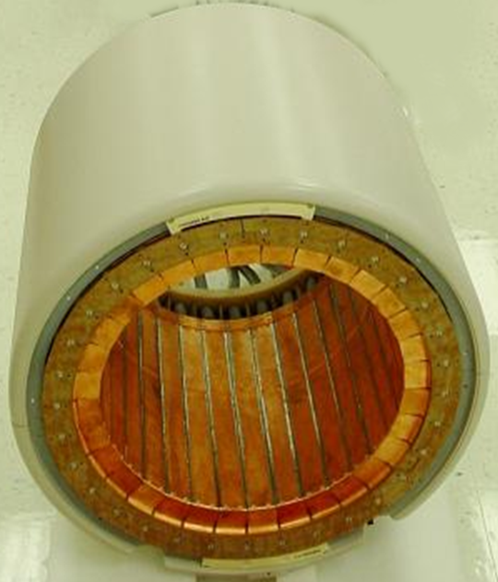
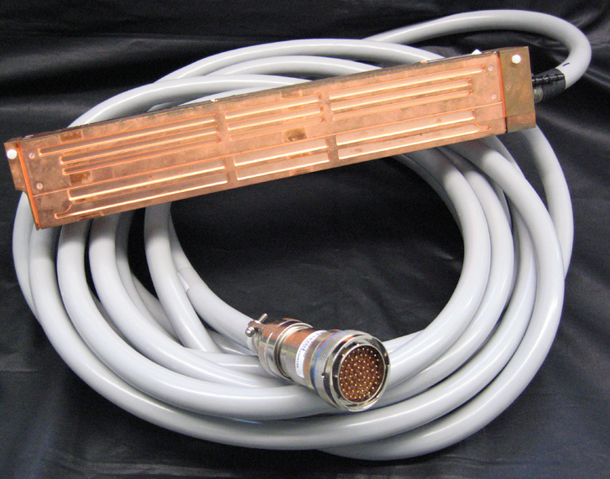
BrainPET insert
scanner with 32 heads
single detector head
20 cm
axial
electronics
20 cm
axial
38 cm
copper shielded against MR influence
6 PET detector blocks / head
12 x 12 crystals / block
2.5 x 2.5 x 20 mm³ LSO crystal
3 x 3 APD / block

Slide 26
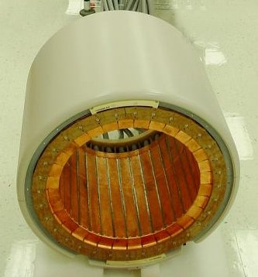
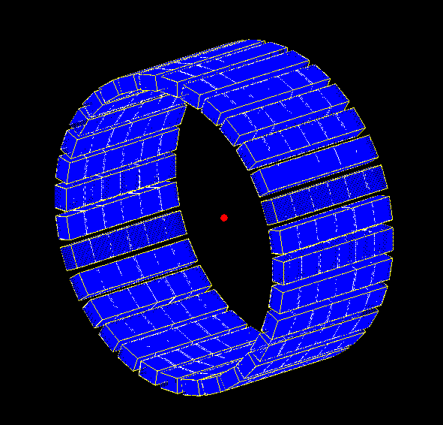
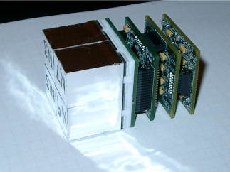
Design and Structure of the BrainPET
12x12 crystals, 3x3 APDs
unrolled detector
72
detector
rings

Slide 27
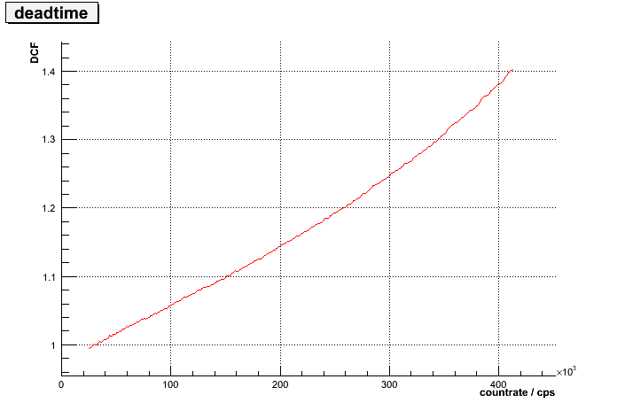
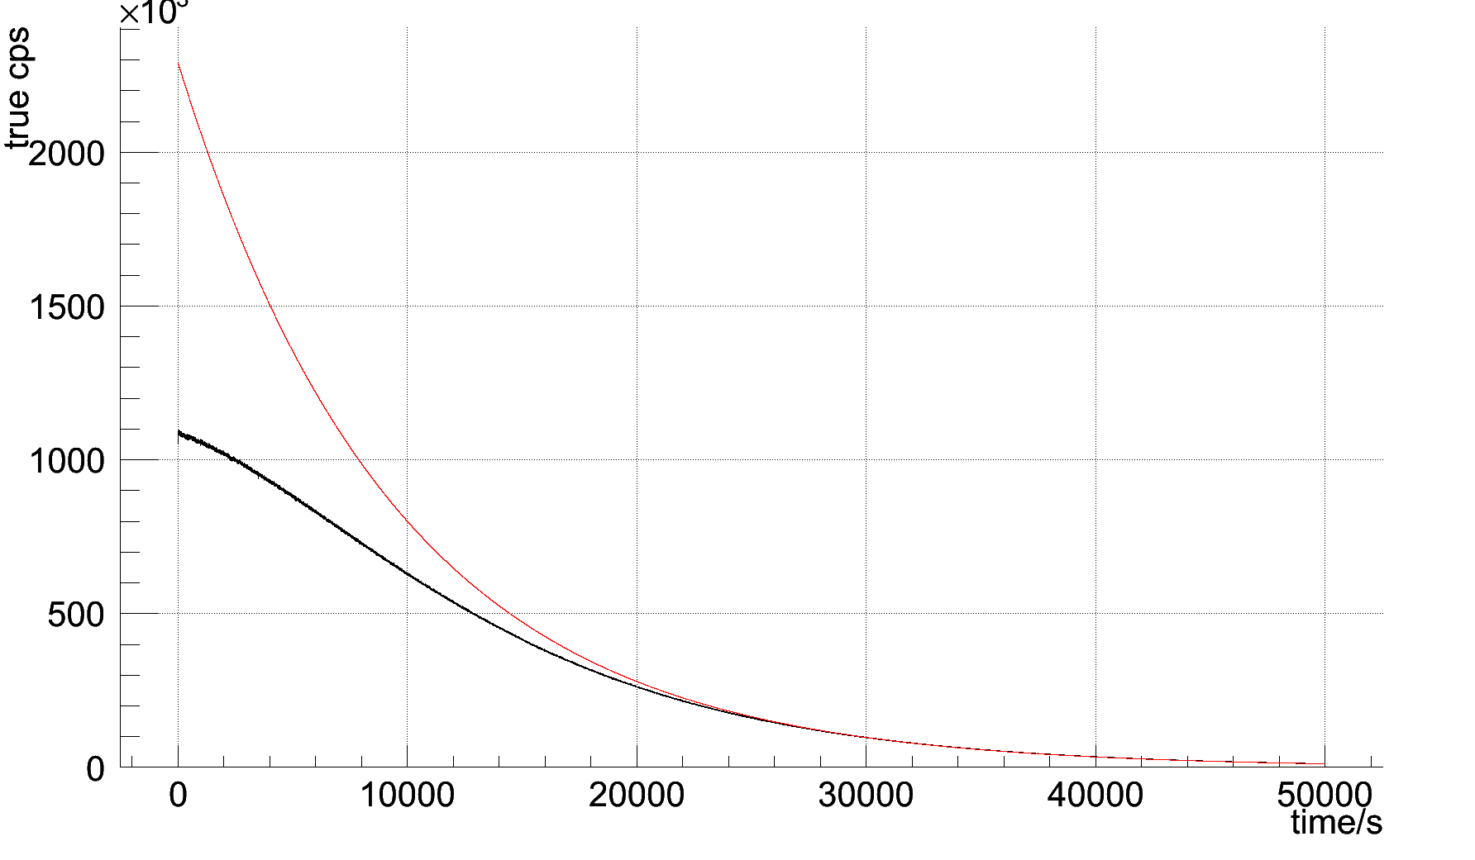
Measurement Effect: Deadtime
PET countrate:
deadtime effect:
1.4
ideal curve
measured curve
1.3
1.2
1.1
1
0
100
200
300
400
CFD-singles/s
deviation from global correction factor:

Slide 28
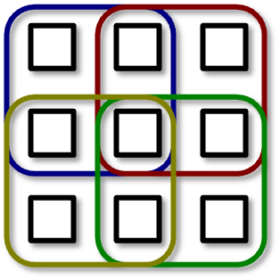
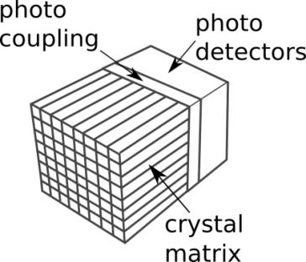
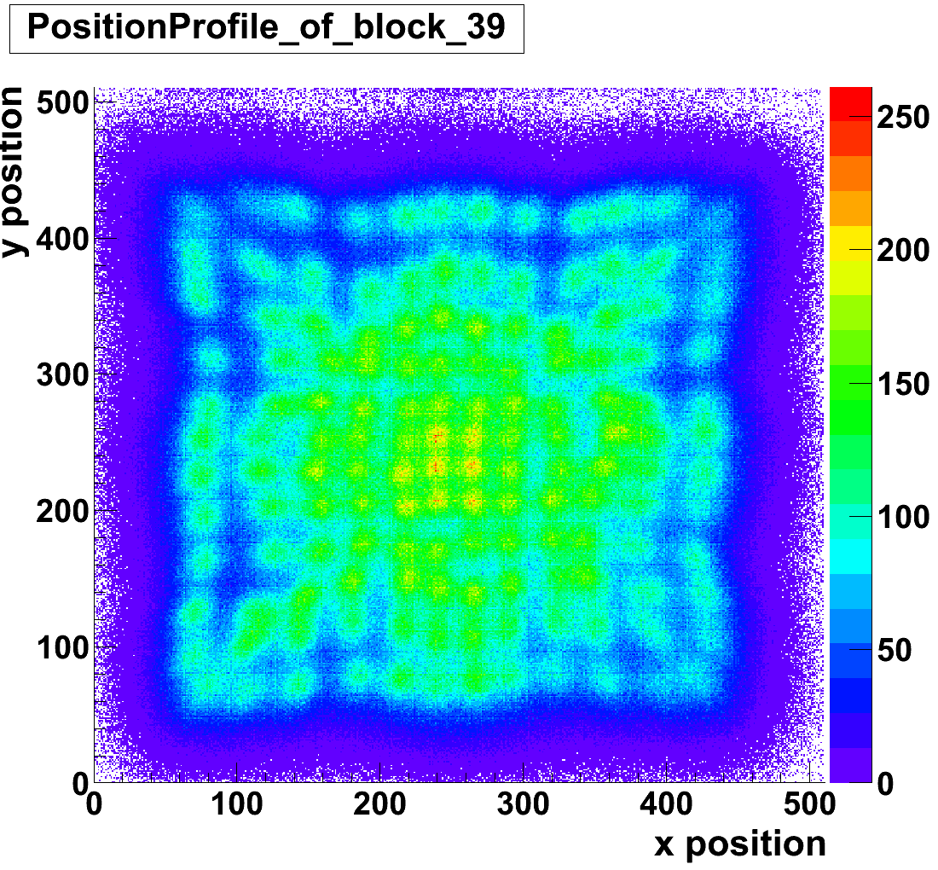
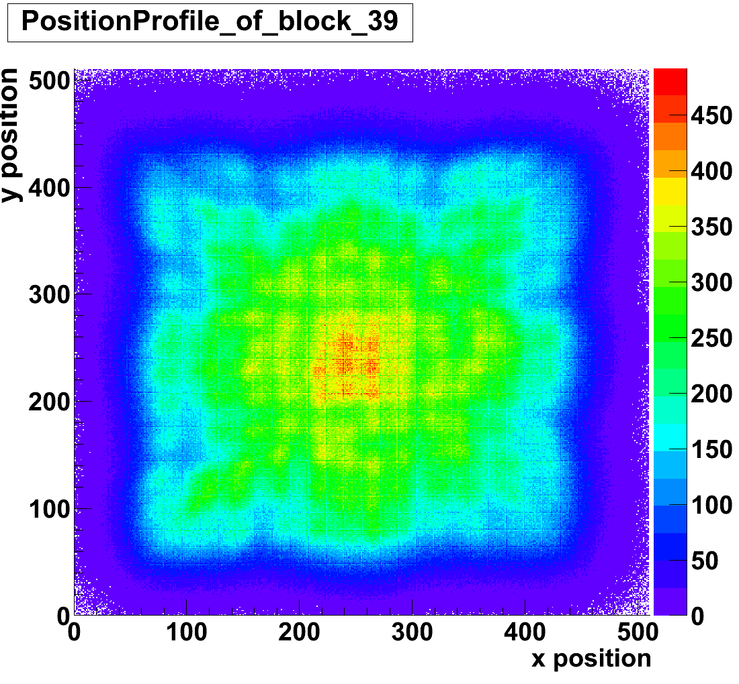
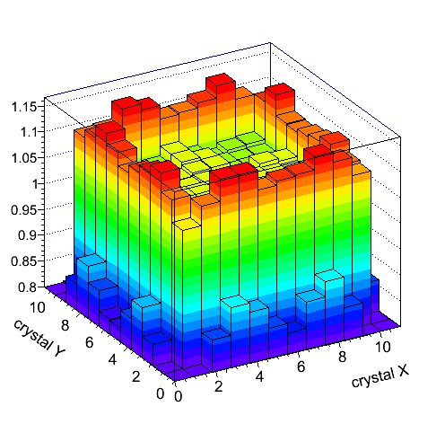
Measurement Effect: Pile-up
APD
A
C
B
D
Anger principle
at low countrate:
at high countrate:
ratio (crystal level):

Slide 29
7T BrainPET Insert
Christoph Lerche and Debora Niekämper + FZJ, RWTH, Monash Teams
Thanks to Siemens for providing the crystals!

Slide 30
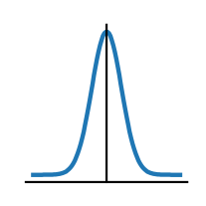
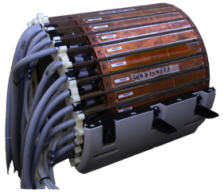
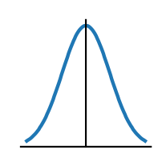
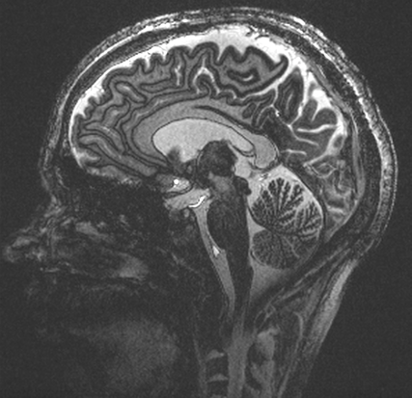
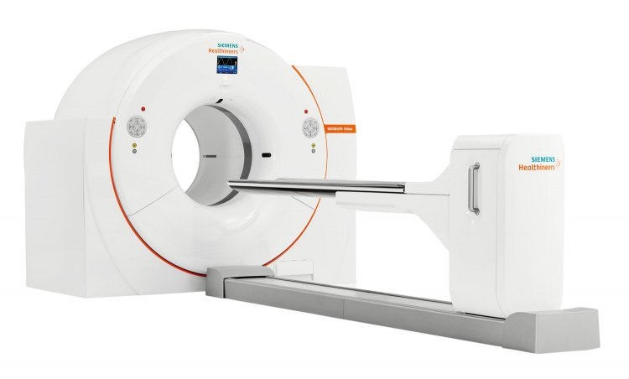
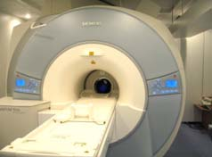
PET Scanners – State of the art
Clinical standard
Spatial resolution:
centre ≈ 4 mm
edge ≈ 6 mm
Axial field-of-view 15-25 cm
Sensitivity ≈ 2%
BrainPET
Spatial resolution:
centre ≈ 2.5 - 3 mm
edge ≈ 5 mm
Axial field-of-view 19.2 cm
Sensitivity ≈ 7%
Combined with 3T MRI
≈20cm
Siemens MAGNETOM Trio MRI and the BrainPET insert in Jülich
PET-CT Siemens Biograph Vision

Slide 31
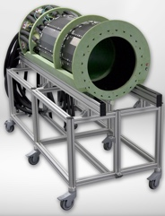
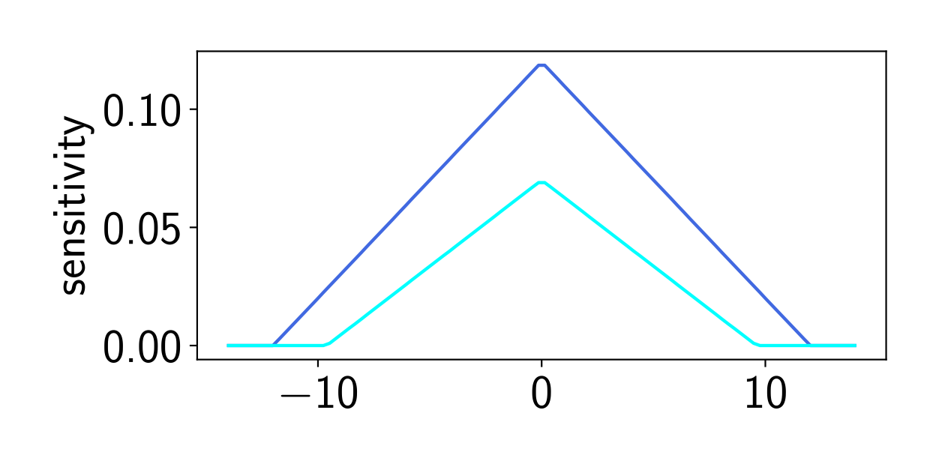
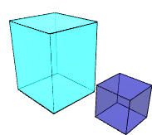
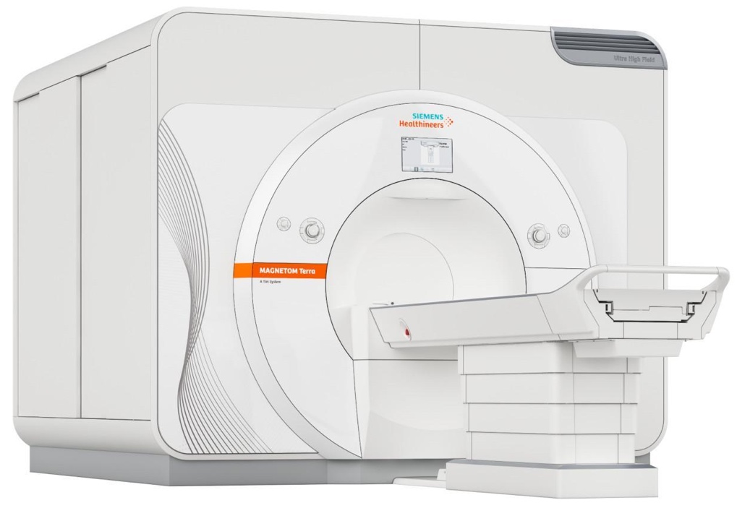
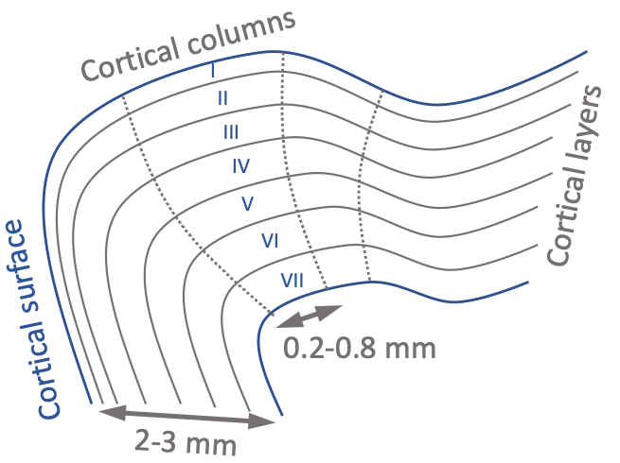
7T BrainPET Insert
Improved sensitivity (>12%)
Extended imaging region axial field-of-view ≈ 25cm
Improved spatial resolution (1.5–2 mm)
Improvement of time resolution (by >90%)
Combined with 7T MRI
BrainPET 7T gantry with mounting / transport cart Status August 2022
40 mm³
5 mm³

Slide 32
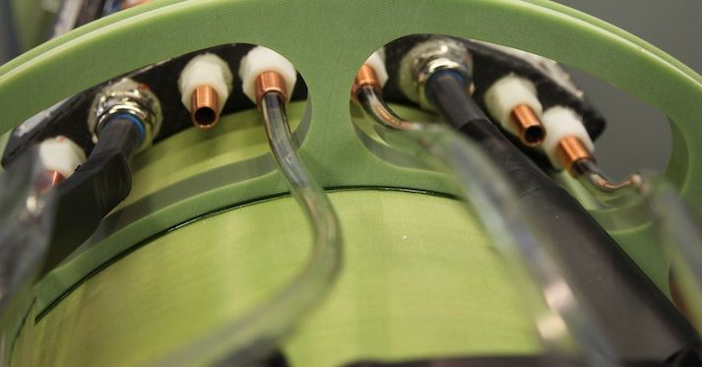
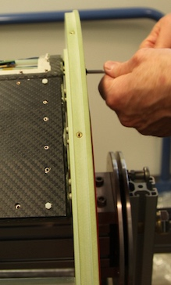
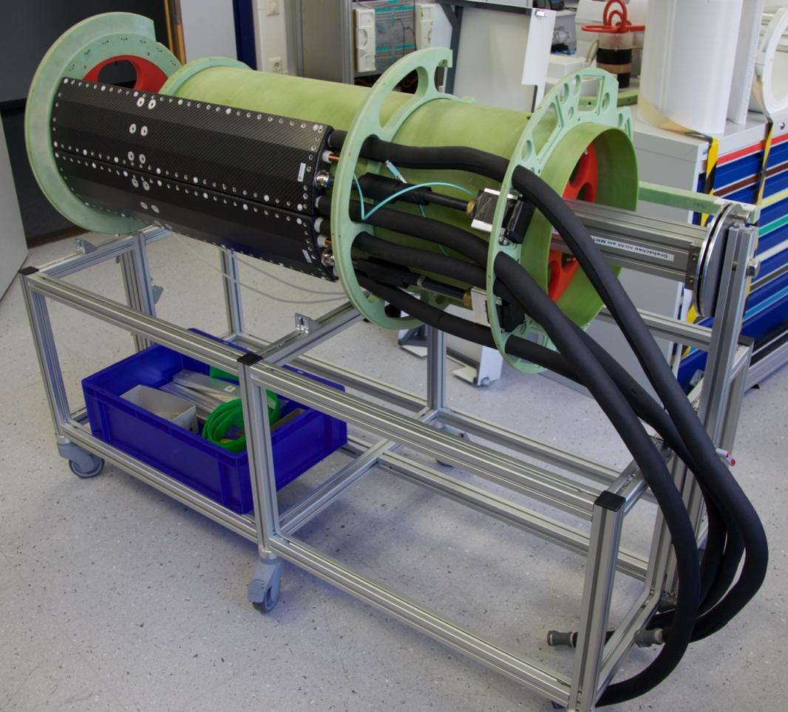
Gantry
Connectors for alarm ball and head phones
Mounting allowing rotation
Check of the integration of modules and assembly
Bar for precise axial and transversal positioning of the insert

Slide 33
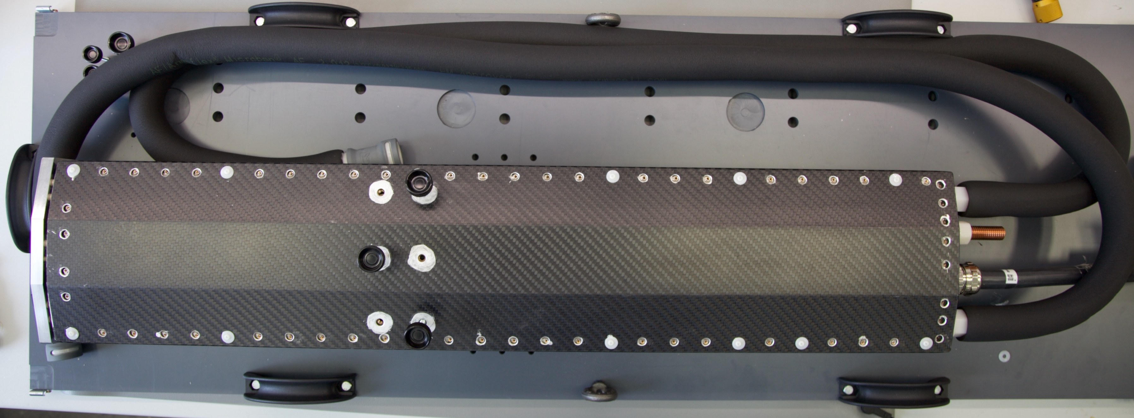
Modules (RWTH Aachen)
Hose for liquid cooling
Feed trough for optical links and air flushing
Mounting and transport box
Carbon fibre housing

Slide 34
Modules (RWTH Aachen)
RF Seal
Cooling liquid distribution
PET Module electronics

Slide 35
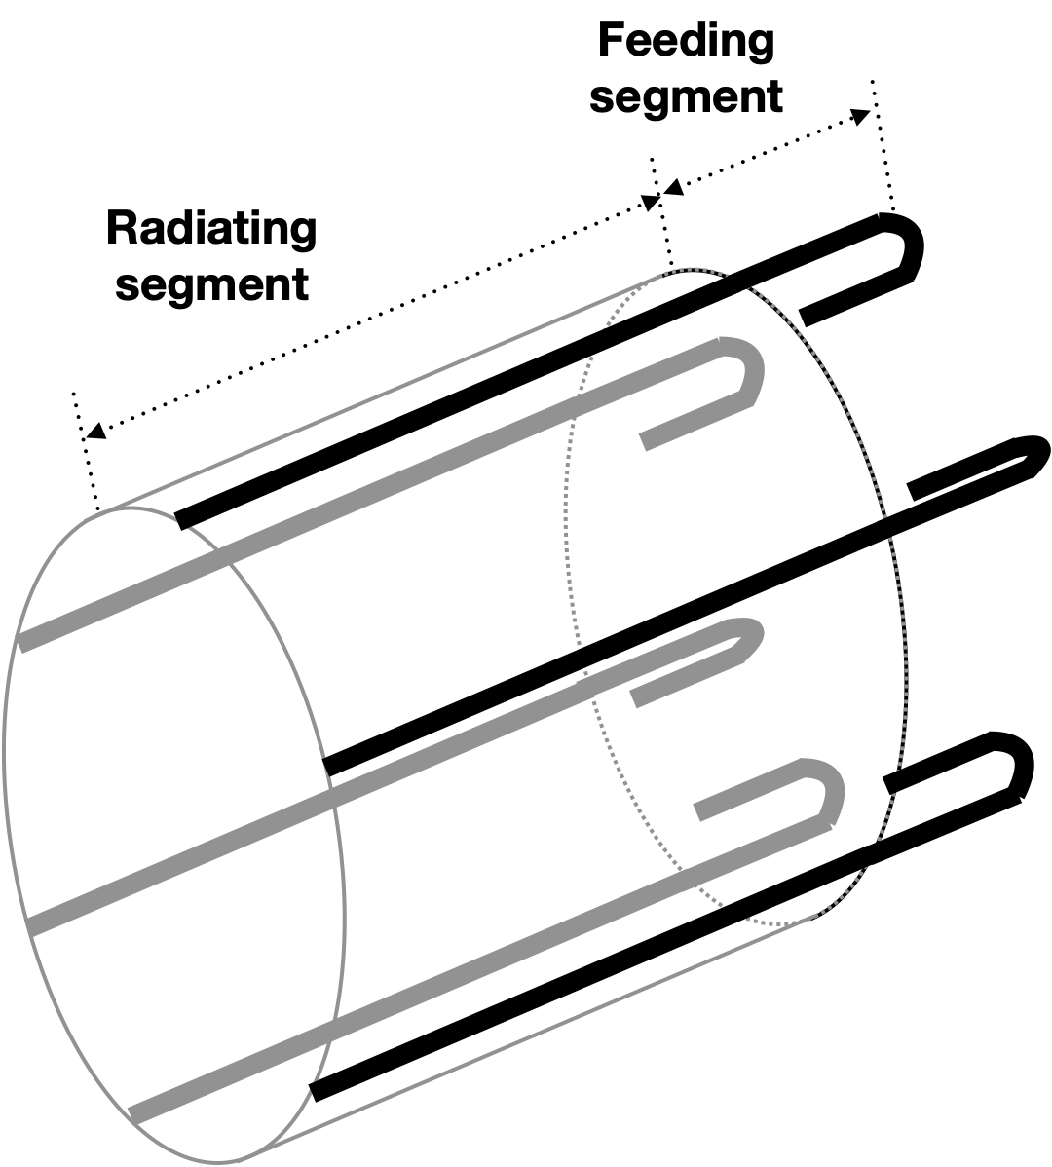
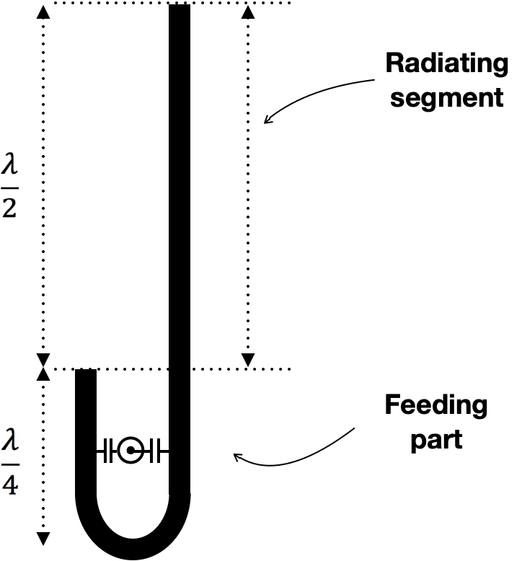
Original J-pole antenna array
Choi et al., IEEE Trans. Med. Imaging, 2022
Choi , Hong, Felder, Shah, German patent filed in 2020
Notes:
Multi-channel benefits and decoupling problem …

Slide 36
Hybrid MR-PET
dynamic FDG-PET with MRI
T1 / T2/ UTE
fMRI restingstate
Angio
ASL
DTI
PET listmode 0-60 min: Dynamic FDG-PET
Notes:
FT4799F

Slide 37
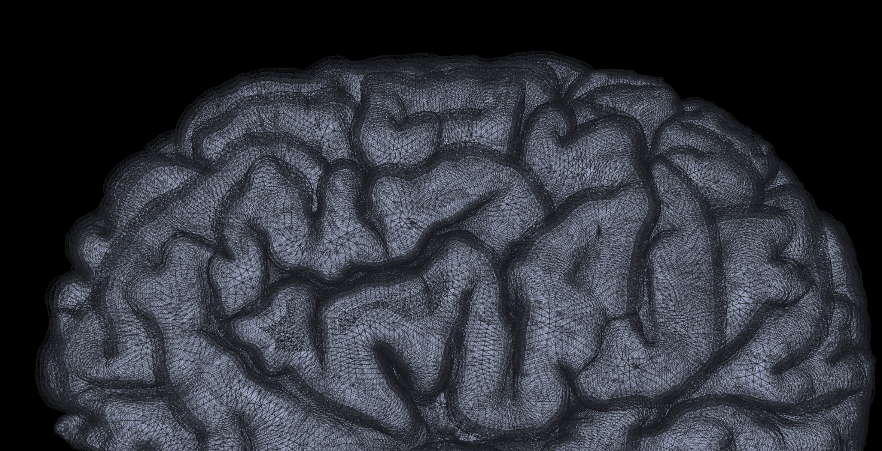
Thank you for your attention Questions?
CSF
I
II/III
IV
depth
V
WM
VI

