Slide 1
Magnetic Resonance Imaging
Introduction to the physical principles of MRI

Slide 2
Organization
Meet the lecturer
N. Jon Shah
n.j.shah@fz-juelich.de
During the breaks. Anytime by email!

Slide 3
Organization
For your self studies:
E.M. Haacke et al, Magnetic Resonance Imaging: Physical Principles and Sequence Design, John Wiley 1999
Z.P. Liang, P.C. Lauterbur, Principles of Magnetic Resonance Imaging: A Signal Processing Perspective, SPIE 1999
M.T. Vlaardingerbroek, J.A. den Boer, Magnetic Resonance Imaging: Theory and Practice, Springer, 2003
J.P. Hornak, Ph.D., The Basics of MRI,
http://www.cis.rit.edu/htbooks/mri/
Lecture materials:
Slides, and other information in the virtual learning room (L2P):
http://www.elearning.rwth-aachen.de
Login using your student account
Registration in CAMPUS office for this course is necessary:
e.g.: CAMPUS > Dozentensuche „Shah“
=> Lehrveranstaltungen
=> Experimentelle Magnetresonanztomographie

Slide 4
Course Overview
Introduction and Overview
Math Basics
MR Fundamentals
Excitation
Imaging Principles
Sequences and Contrasts
Rapid Imaging
Parallel Imaging
Hardware
Selected Applications

Slide 5
Outline
Introduction
Magnetic Resonance Imaging
Appetiser – some Examples
MR Scanner Components
Physical Introduction
Spin ½ in B₀
Larmor Precession
Resonance (excitation and signal reception)
Relaxation
FID, Echoes and Fourier Transform
Basic Idea of MR Imaging
Basic Safety Issues
Sum-up

Slide 6
MRI ≠ X-ray
EM absorbtion in the human body:
100 %
Ionizing Radiation
Frequency (Energy)
visible light
radio waves
( MRI ! )
X-ray

Slide 7
Magnetic Resonance Imaging
MRI is a tomography method but it is very different from CT (Computer Tomography)!
Some positive characteristics of MRI:
Non-ionising | Using radio-waves, not X-rays
Non-invasive | No contrast agents required
Soft-tissue sensitive | MRI signal ~ Proton density ρ ~ H₂O
Quantitative | MRI signal ~ Magnetisation = f(ρ,T₁, T₂, T₂*, D, α, …) ➔ density, relaxometry, diffusivity, perfusion, …
Multi-contrast | Various imaging sequences/ parameters
Multi-purpose/modal | Anatomy, activity, connectivity, vessels, …
Oblique slices | Flexible spatial encoding with arbitrary image slice orientation.
MRI’s weakness:
low signal-to-noise ratio and usual MRI not usable for material with little water content!

Slide 8
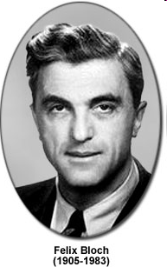
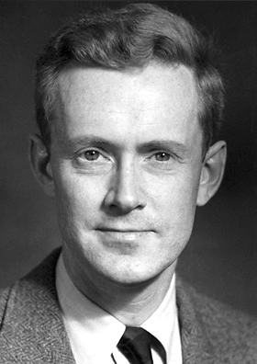
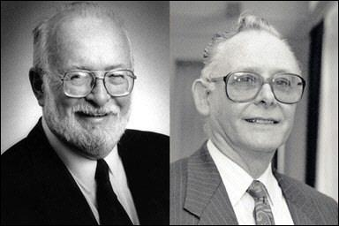
Discovery of NMR and MRI
Nuclear spin manipulation through external fields:
Static magnetic field: B₀·e_{z} ⇒ spin polarization
Radiofreq. field: B₁(t) ·e_{xy} ⇒ resonance signal
Gradient field: (G(t)·r) ·e_{z} ⇒ spatial frequencies
➔ Imaging!
Edward Purcell
Paul Lauterbur and Sir Peter Mansfield
Notes:
Bloch & Purcell: Entdecker der nuklearen Magnetresonanz (1945) -> Nobelpreis Physik
Lauterbur & Mansfield: Entdecker der Bildgebung mit Feldgradienten ->Nobelpreis Medizin

Slide 9
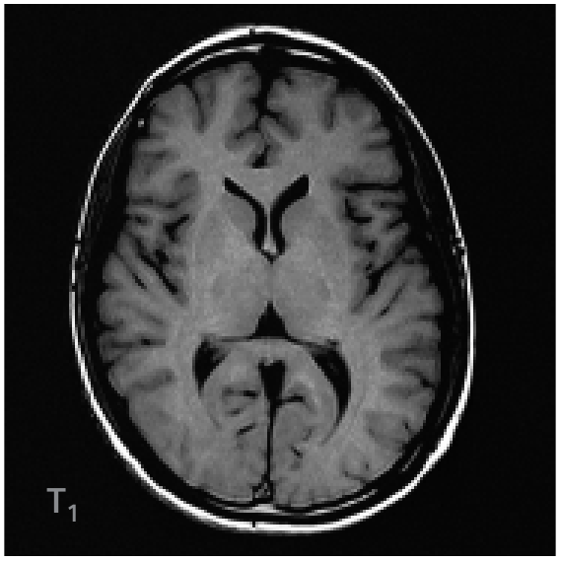
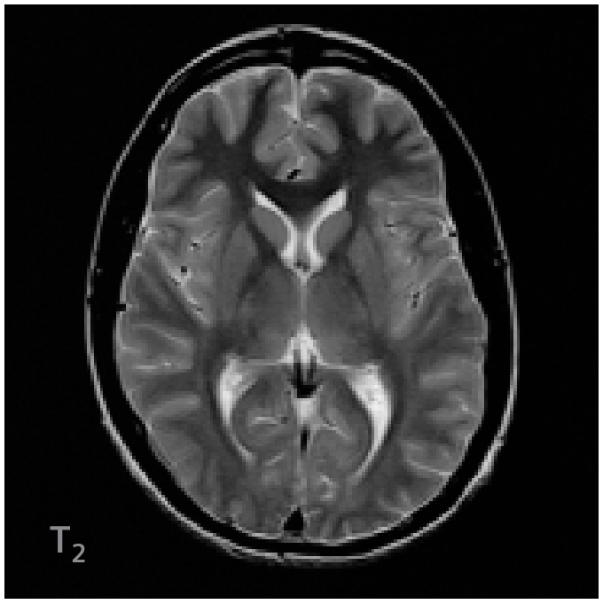
Examples: Multi-Contrast (T1/T2-weighting)

Slide 10
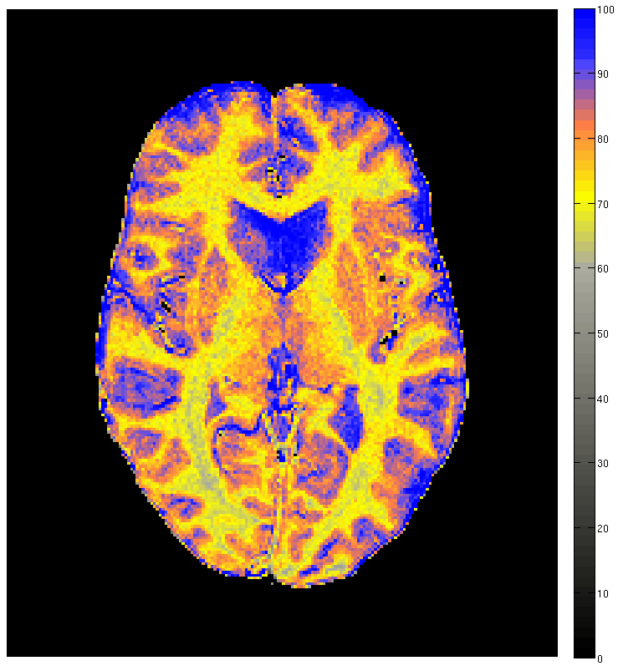
Examples: Quantitative – Watermap
100%
0%
(Fabian Keil)

Slide 11
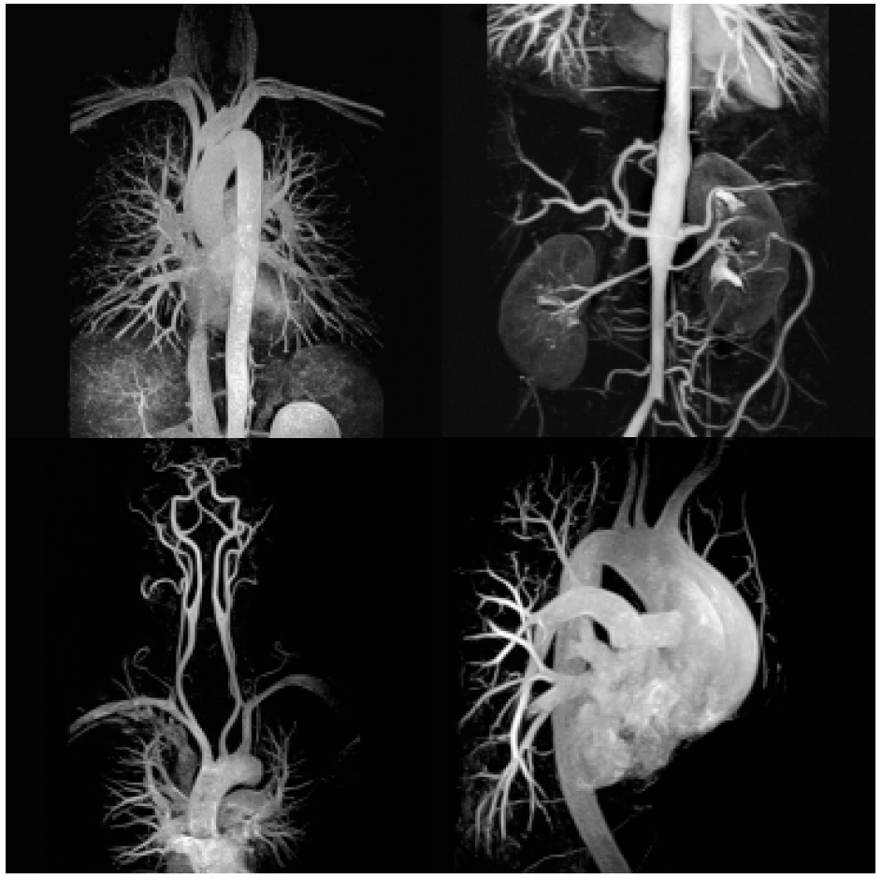
Examples: Perfusion/ Vessels (Angiography)

Slide 12
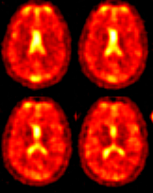
Examples: Metabolism (²³Na-Imaging)
(Sandro Romanzetti)

Slide 13
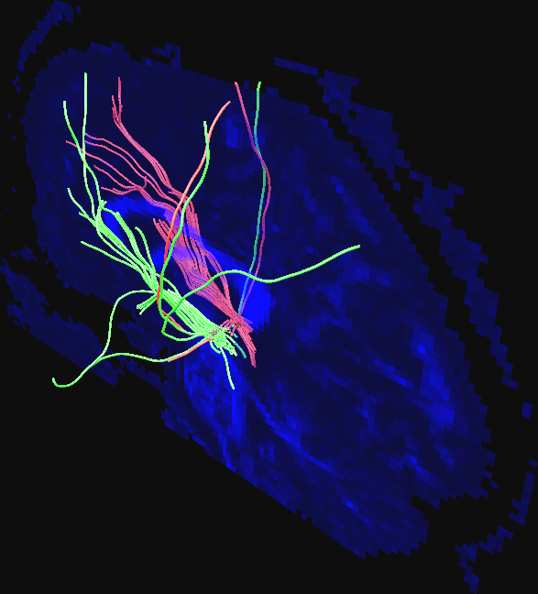
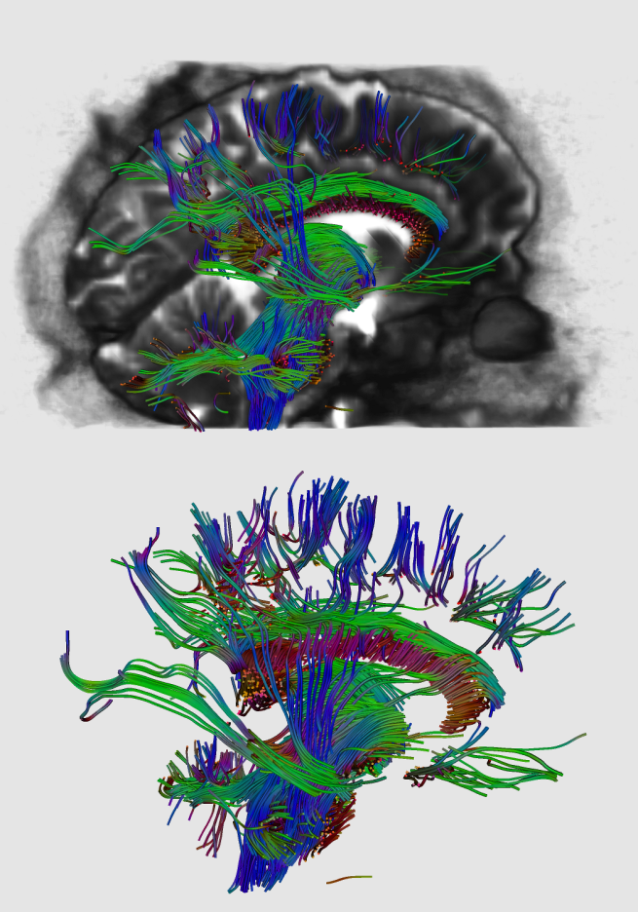
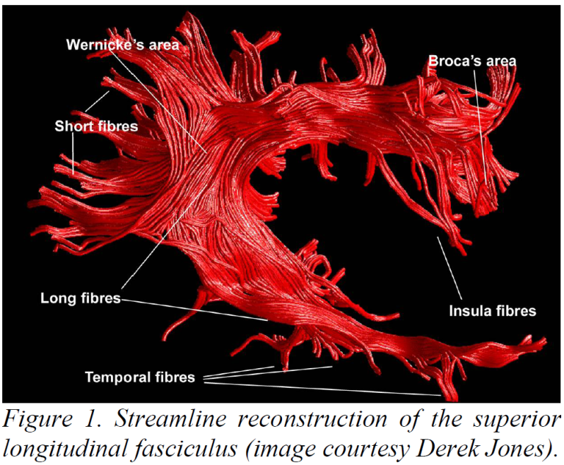
Examples: Connectivity/ Fibres (DTI)
DTI
Rüdiger Stirnberg

Slide 14
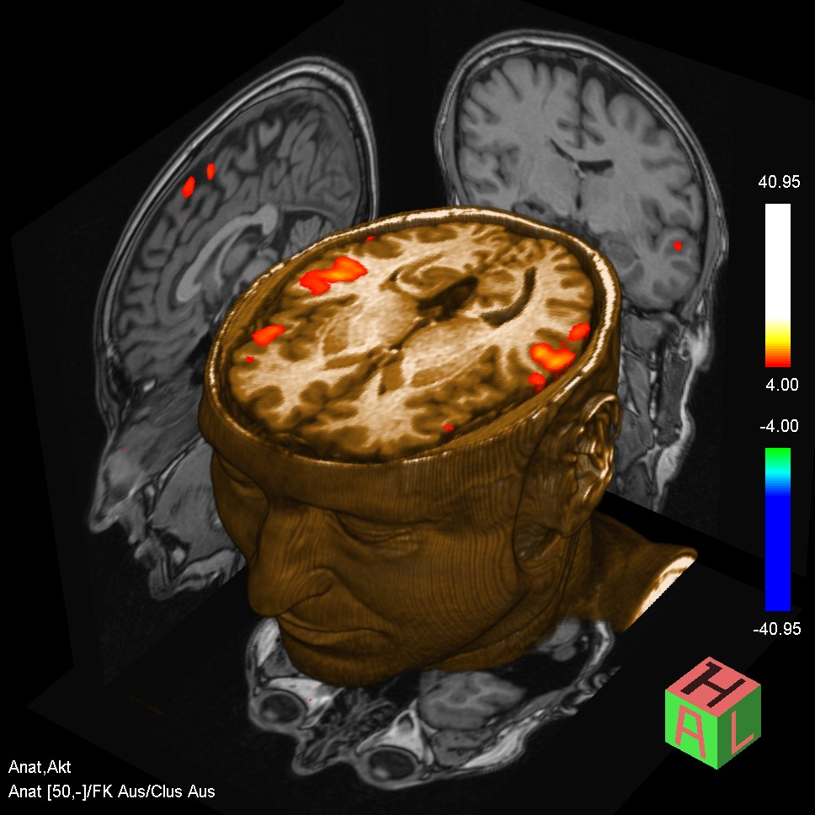
Examples: Function/ Activity (fMRI)
http://www.radiologie.ruhr-uni-bochum.de/imperia/md/images/institut/mrt/fmri.jpg

Slide 15
Examples: inner volume excitation

Slide 16
Outline
Introduction
Magnetic Resonance Imaging
Appetiser – some Examples
MR Scanner Components
Physical Introduction
Spin ½ in B₀
Larmor Precession
Resonance (excitation and signal reception)
Relaxation
FID, Echoes and Fourier Transform
Basic Idea of MR Imaging
Basic Safety Issues
Sum-up

Slide 17
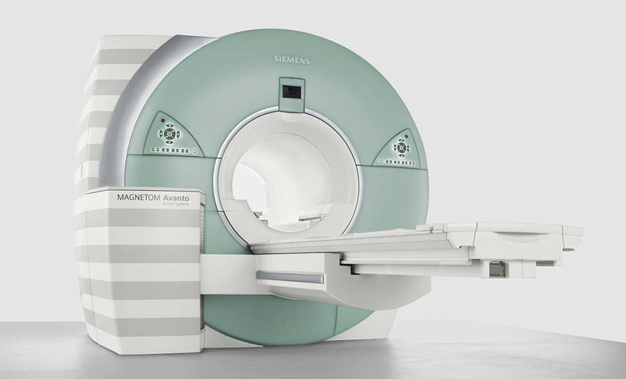
MR Scanner Components (simplified)
3 Types of magnetic fields:
Static field (B₀ ║ z)
Dynamic gradients (G_{i} = dB_{z}/dr_{i})
Radio-frequency (B₁ ┴ z)
Master Controller
Gradient
Controller
x
y
z
RF
Controller
Amps
RF coil
Transmit Amp
Gradient
coils
Image Reconstruction
y
Receive Amp
x
y
z
Superconducting magnet
(high static field)
z
x

Slide 18
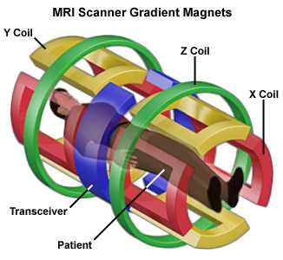
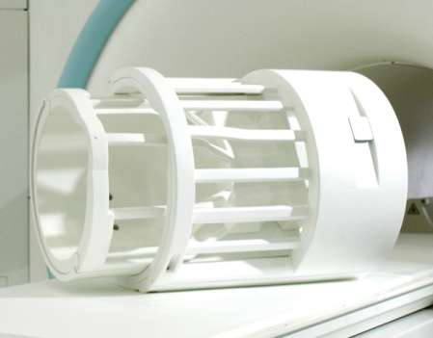
MR Scanner Components (simplified)
3 Types of magnetic fields:
Static field (B₀ ║ z)
Dynamic gradients (G_{i} = dB_{z}/dr_{i})
Radio-frequency (B₁ ┴ z)
RF coil
Gradient
coils
y
x
z
Superconducting magnet
(high static field)

Slide 19
Outline
Introduction
Magnetic Resonance Imaging
Appetiser – some Examples
MR Scanner Components
Physical Introduction
Spin ½ in B₀
Larmor Precession
Resonance (excitation and signal reception)
Relaxation
FID, Echoes and Fourier Transform
Basic Idea of MR Imaging
Basic Safety Issues
Sum-up

Slide 20
Nuclear Spin – Basic overview
Atomic nuclei are composed of protons and neutrons that have the quantum mechanical (QM) property of a spin.
Unlike the classical angular momentum the spin is an intrinsic property of elementary particles.
The overall spin of the composed nucleus is called nuclear spin.
The possible values of the spins’ z-component are quantized in integer steps.
Spin ½ example
= Planck’s constant ≈ 6.626068·10⁻³⁴ J s

Slide 21
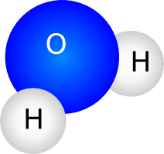
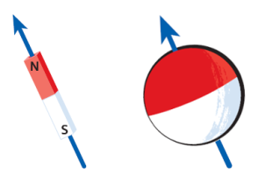
The Proton and Spin 1/2
The most simple atom is Hydrogen, H.
As the human body consists of approx. 70% water, hydrogen is very prevalent.
Hydrogen’s nucleus is only one proton.
Its nuclear spin quantum number is S=½, i.e.
Associated to every nuclear spin is a nuclear magnetic moment,
γ is called the gyromagnetic ratio and is nucleus-specific.
For hydrogen, γ = 267.513·10⁶ rad/(s·T).
42.6 MHz/T

Slide 22
Nuclear Zeeman Effect
Exposed to a static external magnetic field, B₀, the z-components of the nuclear magnetic moments align with B₀.
Without loss of generality, the direction of B₀ defines the z-axis.
Two possible orientations of the magnetic moments: parallel and anti-parallel with energies
B₀≠0
Zeeman splitting
B₀=0
Larmor frequency

Slide 23
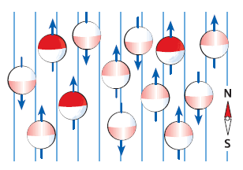
Equilibrium Magnetisation
B₀≠0
There is a small excess of spins in the lower energy states.
The population fraction is given by Boltzmann statistics
which is a very tiny number at room temperature T.
However, the small excess amounts in a measurable macroscopic magnetisation, M, which is the ensemble average of the nuclear magnetic moments.
The equilibrium magnetisation for N atoms with
nuclear spin quantum number, S, is given by
Curie’s law:
M₀
= Boltzmann constant ≈ 1.381·10⁻²³ J / K

Slide 24
Equilibrium Magnetisation – Example
B₀≠0
At B₀=1.5T and body temperature, T=310K, the spin excess in the lower energy state amounts only
Since for small x: exp(x) ~ 1 + x, the spin excess in the lower energy state is proportional to the B₀ field strength.

Slide 25
Larmor Precession
B₀≠0
Larmor frequency
Recall that in the equilibrium only the spin’s z-components are aligned with B₀.
The transverse components perform circular motion
All spins precess about B₀ with the Larmor frequency, ω₀!
But the resulting magnetisation is static and aligned with B₀!
Nuclear Magnetic Resonance: an EM wave oscillating perpendicular to B₀ at Larmor frequency deflects the equilibrium alignment!
the magnetisation precesses about B₀ with the Larmor frequency, ω₀!

Slide 26
Larmor Precession – Example
At B₀=1.5T clinical field strength the Larmor frequency (angular frequency) is
In ordinary frequencies, this corresponds to f₀=63.9MHz.
Radiofrequencies!
For 9.4T human research scanner: f₀=400MHz!

Slide 27
Descriptive Derivation of the Larmor Precession
The magnetic field causes a torque, T, on a magnetic moment, μ.
The torque is the 1st derivative of the angular momentum, I, with respect to time.
Ensemble averaging from the microscopic magnetic moments to the macroscopic magnetisation:
Equation of motion* solved by precessional motion with frequency ω=-γB. (clockwise).
* “Bloch-Equation without relaxation”

Slide 28
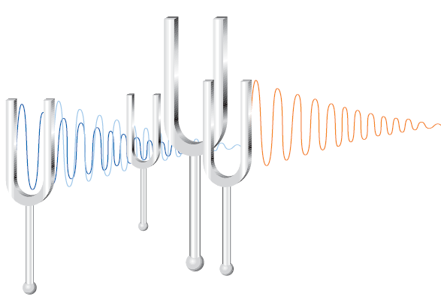
Excitation
Apply a resonant radiofrequency (RF) pulse to excite all spins, i.e. excite the macroscopic magnetisation from its equilibrium.
Resonance ↔ frequency of RF pulse = Larmor frequency ω₀.
ω₀

Slide 29
MR Signal Reception
Faraday’s law:
“A changing magnetic flux induces a voltage in a conductive loop.”
(electromotors, dynamos , …)
Maximise the area of the loop by a orienting it perpendicular to the transverse plane (in-plane would cause no voltage at all)
U [V]
t

Slide 30
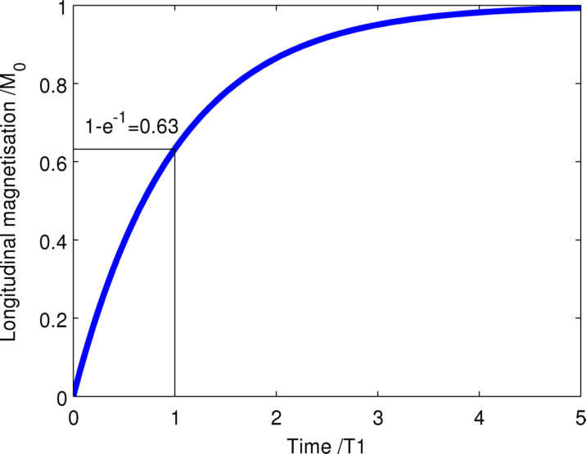
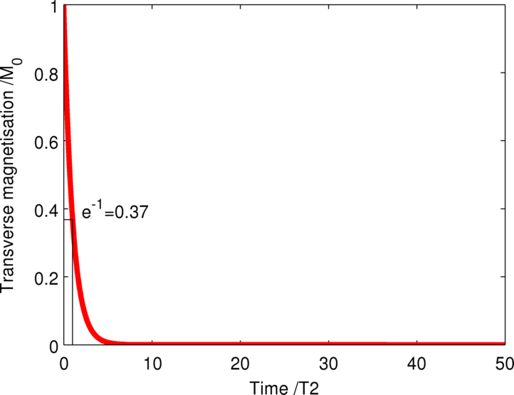
Relaxation
It is intuitive that equilibrium-magnetisation must be regained somehow.
Heuristically described by two relaxation times:
T₁ (spin-lattice relaxation time)
T₂ (spin-spin relaxation time)
T₂ ≤ T₁ !!!
|M| ≠ const, i.e. funnel-shaped trajectory back to equilibrium
e.g. T1=1000ms
e.g. T2=100ms

Slide 31
Classic Treatment of Spin ½ MR: Bloch Equation with Relaxation
Including the relaxation terms, the equation of motion is given by the phenomenological Bloch equation:

Slide 32
Free Induction Decay (FID)
The received MR signal decays exponentially with the time constant T₂.

Slide 33
The MR Signal Equation
The transverse magnetisation,
of all magnetization vectors induces the voltage:
The phase coherence of
determines the signal amplitude:
ϕ(r,t₀) = const ∀ r ∈ V ⇒ |S(t₀)| = max
ϕ(r,t₀) uniquely distributed on [0, 2π] ⇒ |S(t₀)| ≈ 0

Slide 34
Free Induction Decay (FID), Part II
T₂* < T₂ !!!
The received MR signal decays exponentially with the time constant T₂.
Local B₀ inhomogeneities cause an even shorter effective decay time, T₂* (“T-two-star”) through loss of phase coherence:

Slide 35
Spin Echo (SE)
Signal losses due to B₀ inhomogeneities is reversible!
Recall a spin echo by inversion of the spins using a 180° pulse.
The individual spin’s phase evolution due to the B₀ induced frequency dispersion (T₂*) is “rewound”. But T₂ decay is irreversible.
180°
M₀
90°
Spin Echo
Max ~ exp(-TE/T2)
Now, analyse this echo!
TE
Time t
FID ~ exp(-t/T2*)

Slide 36
Spin Echo (SE)
Signal losses due to B₀ inhomogeneities is reversible!
Recall a spin echo by inversion of the spins using a 180° pulse.
The individual spin’s phase evolution due to the B₀ induced frequency dispersion (T₂*) is “rewound”. But T₂ decay is irreversible.
180°
M₀
90°
Spin Echo
Max ~ exp(-TE/T2)
TE
Time t
FID ~ exp(-t/T2*)

Slide 37
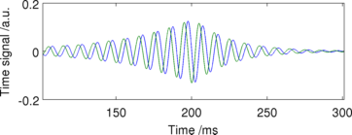
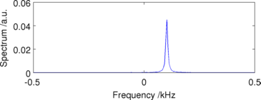
Fourier Transformation (FT)
We expect a frequency dispersion of subgroups of spins – so called isochromats.
That means: most spins precess with the Larmor frequency but some are a little faster and some a little slower.
Obtain spectrum by a Fourier transform (FT) of the time signal, usually a Fast Fourier Transform (performant implementation of a discrete FT)
Mx
FFT
My
Note: the 0.1 kHz proton peak shown in this simplified example would correspond to a very low field strength of B₀≈2.3µT according to f₀ = ω/ 2π = γB₀/2π .
In clinical scanners, the proton frequency ranges between 63.9MHz at 1.5T and 127.7MHz at 3T.

Slide 38
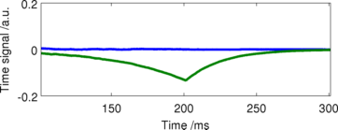
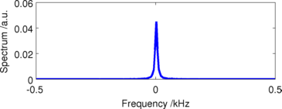
Fast Fourier Transformation (FFT)
The signal is always demodulated in an analog mixing step before analog to digital conversion (ADC, i.e. digitised sampling of the MR signal).
This demodulation corresponds to moving to another frame of reference, the “rotating frame”.
Mx
Mx (demod.)
FFT
Linewidth due to dispersion
My
My (demod.)
In this frame of reference (rotating with the Larmor frequency about z), all resonant spins point to where they were deflected initially.

Slide 39
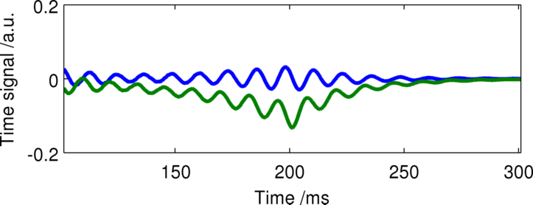
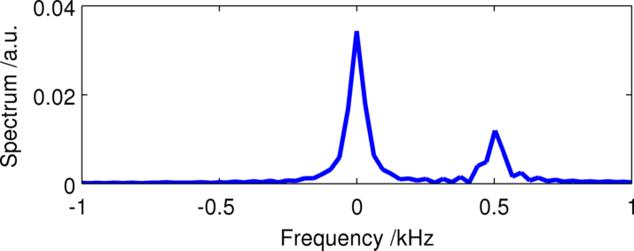
NMR Spectroscopy
Your probe may have protons with a slightly varied precessional frequency.
I.e. the Larmor frequency is influenced by the chemical binding of the protons (“chemical shift”).
Nuclear Magnetic Resonance (NMR) spectroscopy.
Mx (demod.)
FFT
My (demod.)
Artificial example with water (Larmor frequency) and a compartment with a 500Hz chemical shift (Larmor frequency + 0.5kHz)

Slide 40
Spatial Encoding
The basic idea of MRI:
Make the precessional frequency a function of space!
The “spectrum” then reflects spatial distribution.
Linear field gradients of the B-field in z-direction, e.g. G_{x} = dB_{z}/dx
B₀
G·x
x
ω₀
ω₀-dω ω₀ ω₀+dω

Slide 41
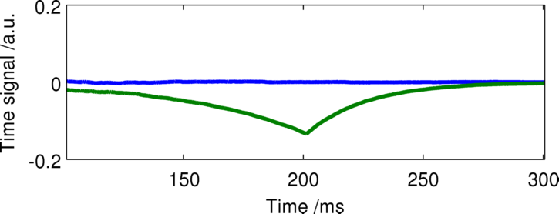
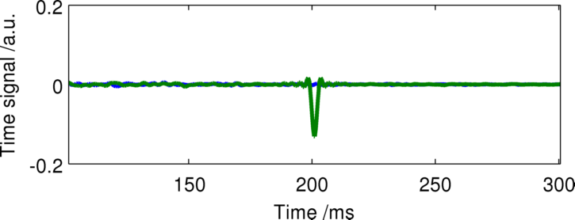
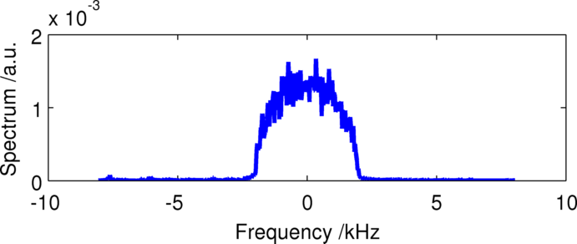
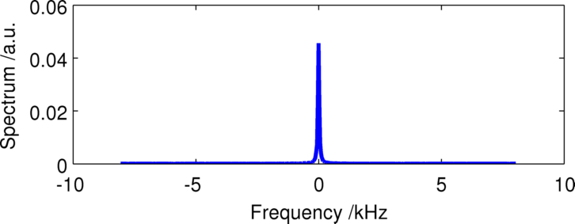
Spin Echo with Frequency Encoding
Take the spin echo and introduce gradients along x.
180°
M₀
90°
Spatial frequency, k_{x}
~ Protons
Spatial dimension, x
TE
Time t
G_{x}
Time t

Slide 42
Contrast
Different tissues have different T1/T2 times
Generate different contrasts through sequence timing parameters!
180°
M₀
90°
TE
Time t
G_{x}
Time t

Slide 43
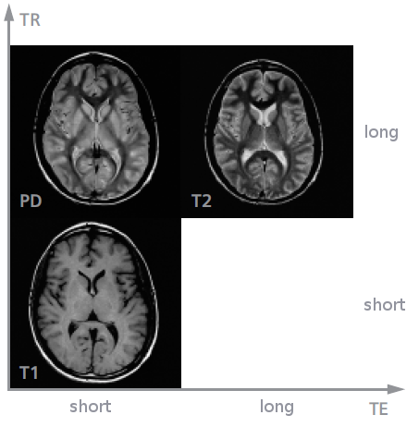
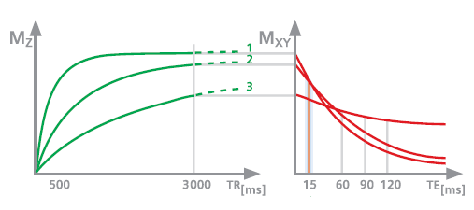
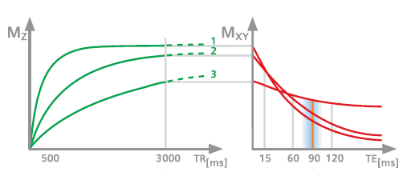
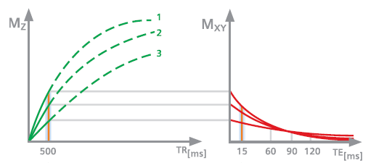
Contrast
180°
180°
180°
180°
90°
90°
90°
90°
Time t
…
TE
TR
TE
TR
TE
TR
TE
TR
Choice of
Echo time (TE)
Repetition time (TR)

Slide 44
Gradient Recalled Echo (SE)
Recall a gradient echo by dephasing and subsequent rephasing in the opposite direction.
Much faster and less RF than spin echo.
But: the individual spin’s phase evolution due to the B₀ induced frequency dispersion (T₂*) is NOT “rewound”.
M₀
90°
Gradient Echo
Max ~ exp(-TE/T2*)
TE
Time t
G_{x}
Time t

Slide 45
Imaging Sequences
RF
Gz
Gy
Gx
ADC
Gradient encoding must be applied in 3 dimensions for a complete spatial encoding.
During signal readout: frequency encoding
In a step-wise procedure (for 1 or more dimensions): phase encoding
Very common, simultaneous with excitation: slice-selection
Gradients in x, y, and z-direction (dB_{z}/dx, dB_{z}/dy, dB_{z}/dz)
Complex pulse sequences are programmed to obtain all necessary data for a complete reconstruction of the subject. Often: loop-structure.
General goal: fill the “k-space” most quickly.
(image space ⬅FFT➔ k-space = FT-coefficients = spatial frequencies).

Slide 46
Outline
Introduction
Magnetic Resonance Imaging
Appetiser – some Examples
MR Scanner Components
Physical Introduction
Spin ½ in B₀
Larmor Precession
Resonance (excitation and signal reception)
Relaxation
FID, Echoes and Fourier Transform
Basic Idea of MR Imaging
Basic Safety Issues
Sum-up

Slide 47
Basic Safety Issues – The Main Field
Permanently cooled-down (liquid Helium, ~ 4K) superconductor produces the high, static magnetic field B₀ ~ 0.1 – 3 Tesla (1T = 10000 Gauss).
Compare: the Earth’s magnetic field on its surface ~ 0.5 Gauss.
Huge force on ferromagnetic material growing rapidly when approaching the magnet.
Objects like a normal fire extinguisher, surgical instruments, tools, keys etc. can cause immense (live-threatening) damage.
Credit cards, cell phones, pacemakers will not work anymore.
Generally, currents are induced in conducting material by changing magnetic flux, e.g. in organs when entering the scanner too quickly (from 0 to B₀). Can cause dizziness.

Slide 48
Basic Safety Issues – Field Gradients
Imaging gradients are ramped up and down repetitively during an imaging sequence.
Max. Amplitude ~ 40 mT/m.
Slew rate is limited to max. 200 mT/(m ms) in order not to stimulate the patient’s peripheral nerves (muscle contraction in arms, back, …)
Patients should not cross their hands in order not to create a conducting loop through their body.
Again, ferro-magnetic parts are not allowed, they would move and cause live-threatening damage.

Slide 49
Basic Safety Issues – RF fields
High frequency em-waves are emitted to the patient in the order of 100 MHz.
This can lead to hot spots at metallic edges, e.g. cables in contact with the skin or MR-unsafe implants.
Make-up containing metallic particles can heat (also tattoos!)
For higher frequencies the wavelength of the radio-waves inside tissue approaches the extent of, e.g., the head.
High amplitudes due to standing-wave effects.
Amplitude and duration of RF must be controlled due to SAR (Specific Absorption Rate) constraints. SAR is an important issue, particularly at high field strengths because of the reduced wave length.

Slide 50
Outline
Introduction
Magnetic Resonance Imaging
Appetiser – some Examples
MR Scanner Components
Physical Introduction
Spin ½ in B₀
Larmor Precession
Resonance (excitation and signal reception)
Relaxation
FID, Echoes and Fourier Transform
Basic Idea of MR Imaging
Basic Safety Issues
Sum-up

Slide 51
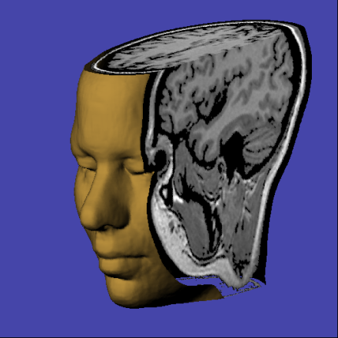
Sum-up
Proton-spins in B₀: macroscopic magnetisation (along B₀ in equilibrium).
Spins excitable using resonant radio-frequency pulses.
Motion described by Bloch-equation (generally: Larmor precession).
Relaxation described by T₁, T₂ (and T₂*).
MRI acquires echo-signals, usually Spin echoes or Gradient recalled echoes.
A general MRI sequence:
Excitation (RF pulse)
Encoding (gradients)
Data acquisition ➔ FFT ➔ image

Slide 52
Thank you for your attention
Introduction to MRI

