Slide 1




Fundamental Science: Project
GGSB Kutaisi Georgia
12.09.2022
James Ritman

Slide 2
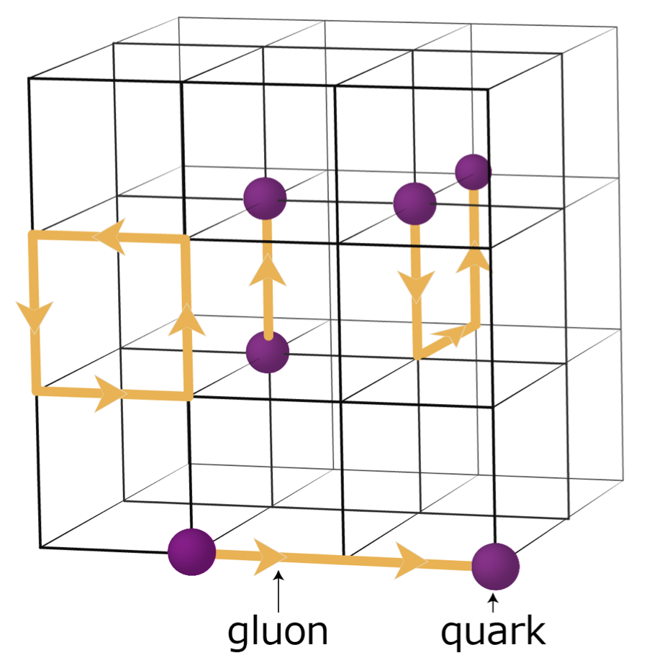
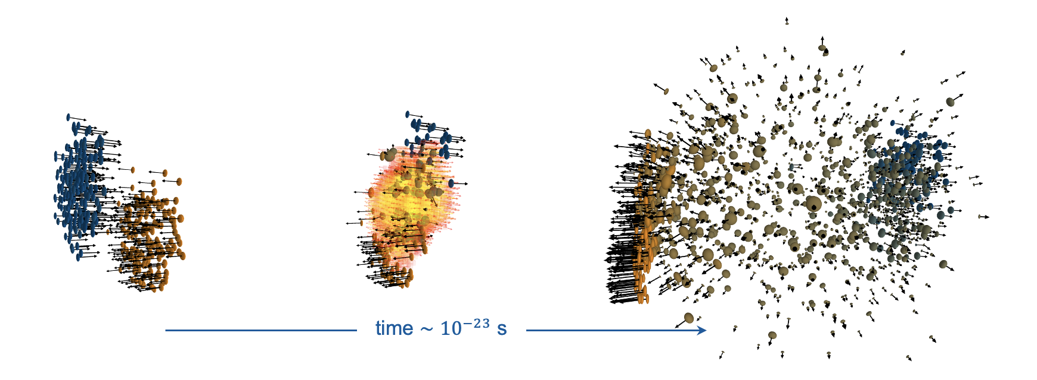
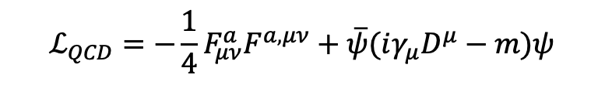
Mission and fundamental questions at CBM
Decode emergence of phases of strong interaction matter in non-perturbative regime of QCD
Unravel role of the strong interaction in the evolution of our universe
How does the strong force produce confinement?
How are the fundamental QCD symmetries
broken in nature?
How do the complex spectra of hadrons and nuclei arise from the strong force?
How does nuclear matter behave
under extreme conditions?
$$ℒ_{QCD}=−\frac{1}{4}F_{μν}^{a}F^{a,μν}+\overline{ψ}(iγ_{μ}D^{μ}−m)ψ$$
CBM slides from Tetyana Galatyuk

Slide 3

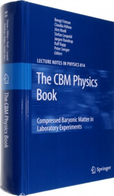
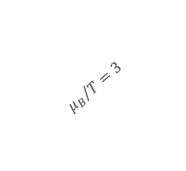
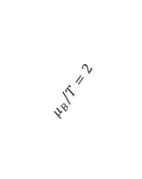
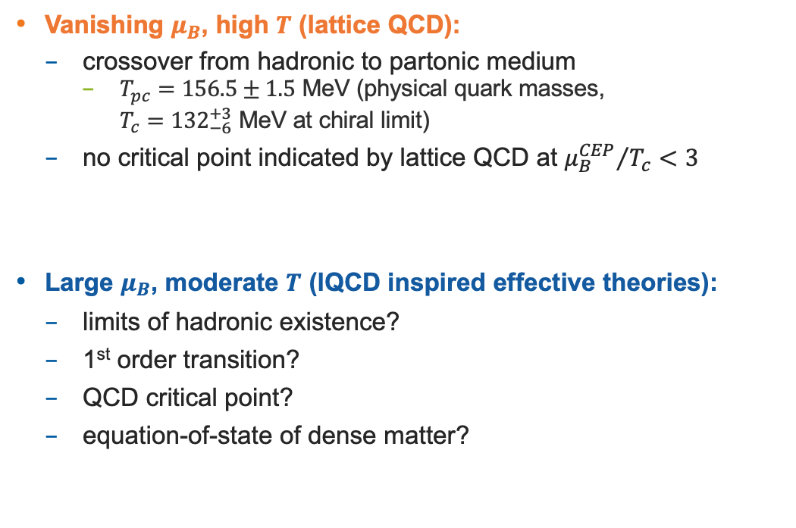
Search for landmarks of QCD matter phase diagram
Vanishing $μ_{B}$, high $T$ (lattice QCD):
  crossover from hadronic to partonic medium
    $T_{pc}=156.5±1.5$ MeV (physical quark masses,
    $T_{c}={132}_{−6}^{+3}$ MeV at chiral limit)
  no critical point indicated by lattice QCD at ${μ_{B}^{CEP}}/{T_{c}}<3$
Large $μ_{B}$, moderate $T$ (lQCD inspired effective theories):
  limits of hadronic existence?
  1st order transition?
  QCD critical point?
  equation-of-state of dense matter?
$${μ_{B}}/T=2$$
$${μ_{B}}/T=3$$
Bazavov et al. [HotQCD], PLB 795 (2019) 15-21
Ding et al., [HotQCD], PRL 123 (2019) 6, 062002
Dini et al., Phys.Rev.D 105 (2022) 3, 034510
Chiral?
Quarkyonic?
Borsanyi et al. [Wuppertal-Budapest Collab.], JHEP 1009 (2010) 073
Isserstedt, Buballa, Fischer, Gunkel, PRD 100 (2019) 074011
Gao, Pawlowski, PLB 820 (2021) 136584
Cuteri, Philipsen, Sciarra, JHEP 11 (2021) 141
Worldwide experimental and theory efforts
Relevance for astrophysics
Friman et al.,
Lect. Notes Phys. 814 (2011) 1

Slide 4
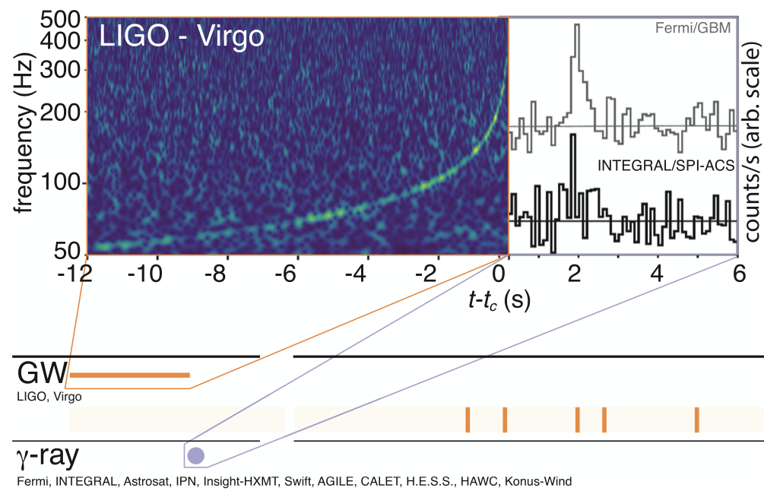
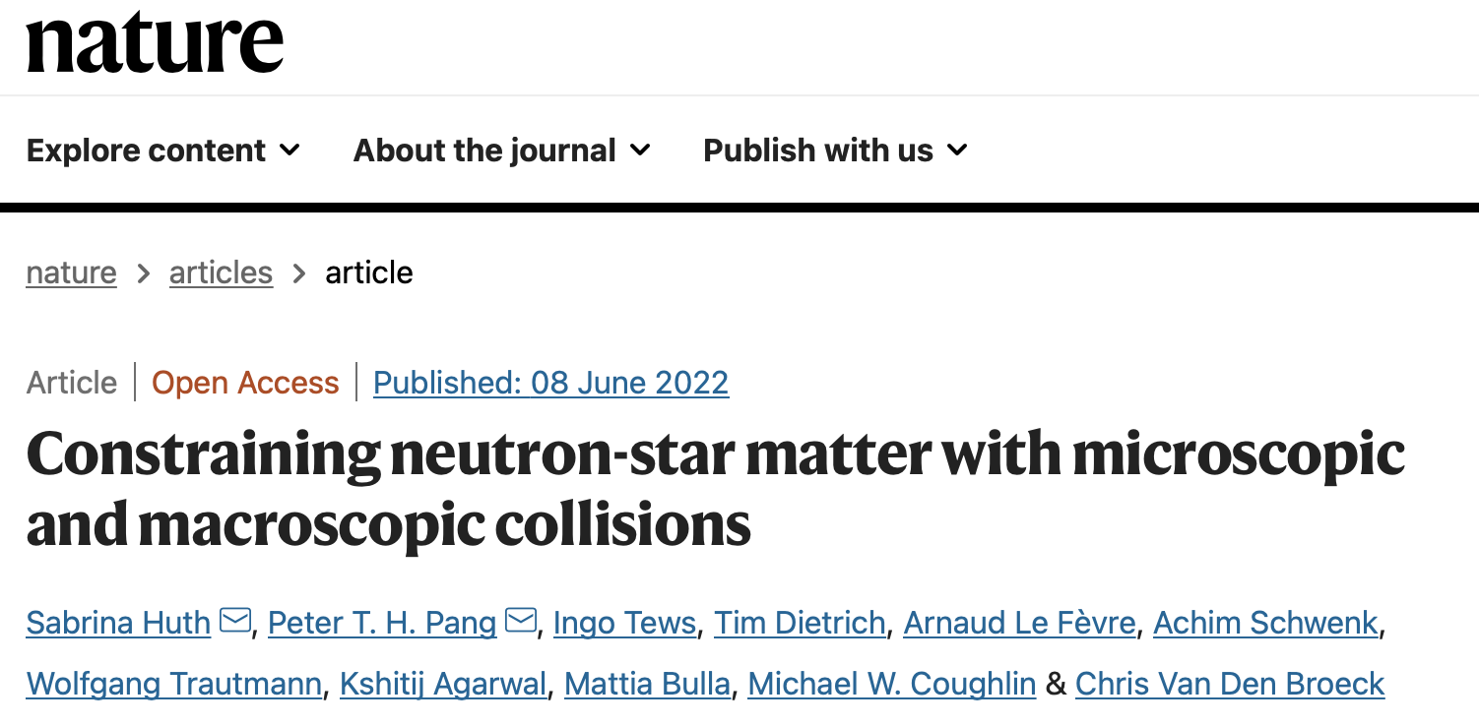
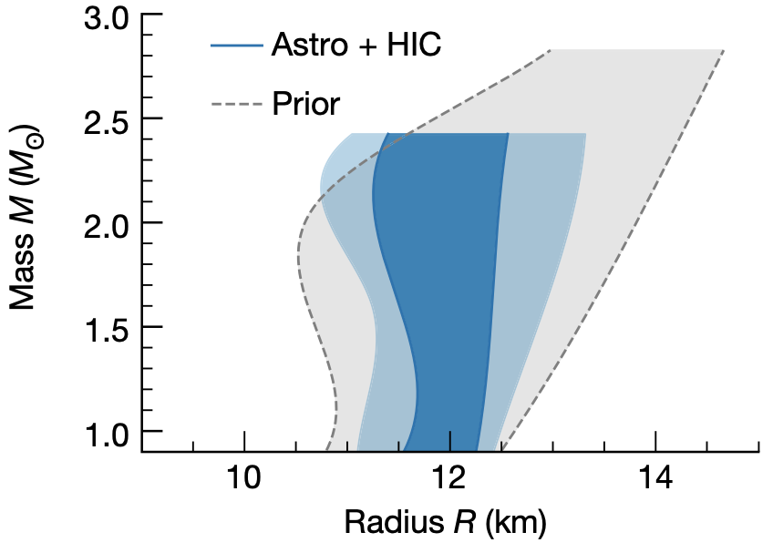
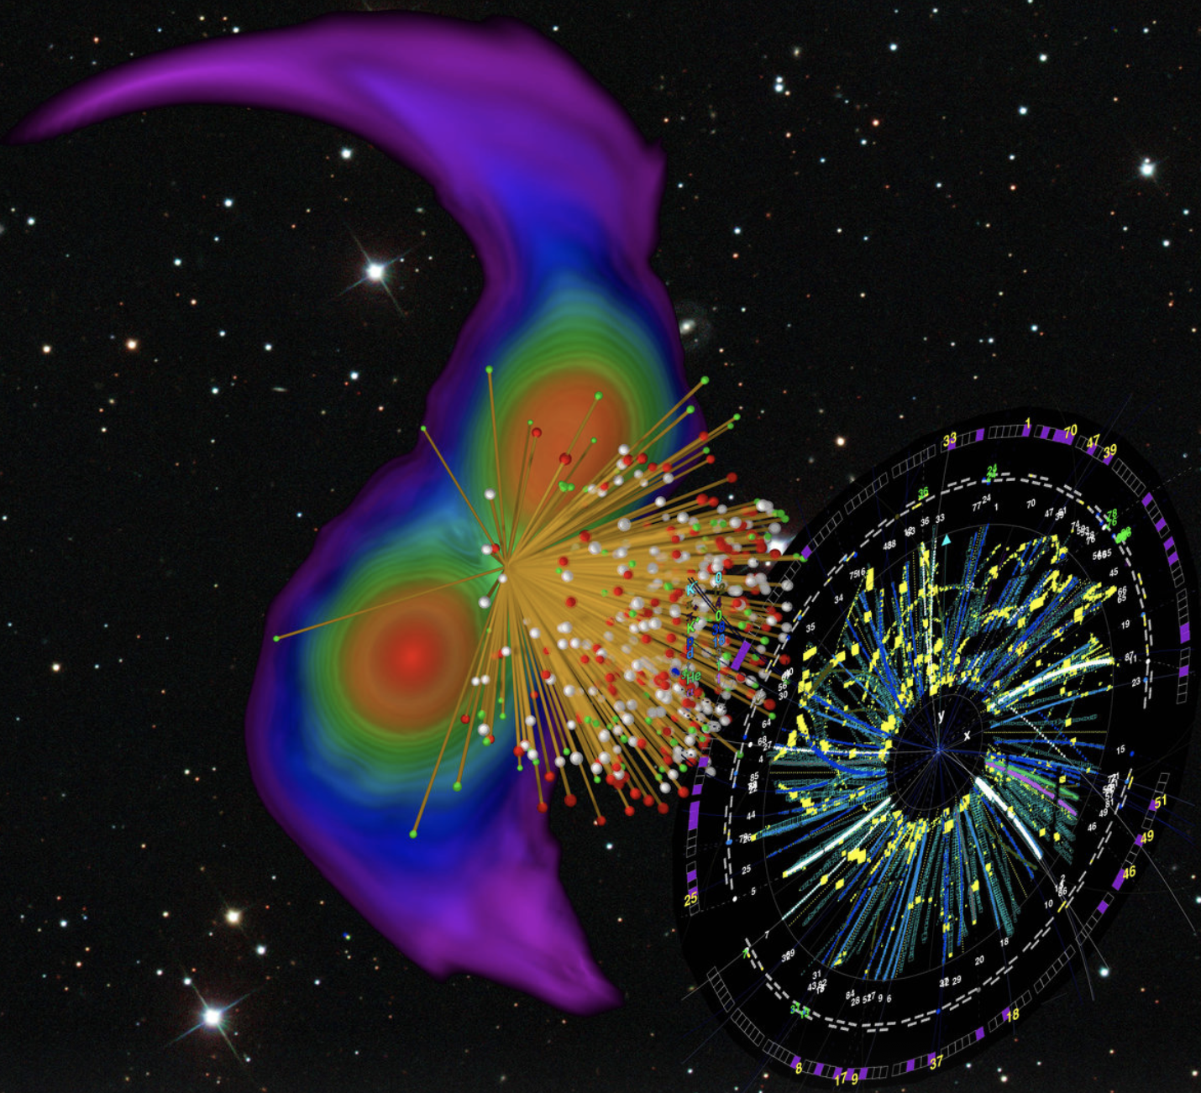
Multi-messenger signals from neutron star merger
GW170817 17 Aug 2017 12:41:04 UTC
First detection of a binary neutron start merger through gravitational waves
GRB 170817A ~1,7 s later:
Observation of the same event through electromagnetic waves (gamma-ray burst)
Remarkable consistency between multi-messenger observations and constraints from heavy-ion data
LIGO + VIRGO, PRL 119 (2017) 1611001
Fermi GBM + INTEGRAL + LIGO + Virgo, Astrophys.J.Lett. 848 (2017)

Slide 5
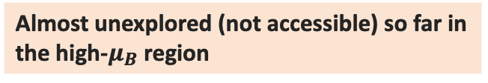
Search for landmarks of the QCD matter phase diagram
C.B.M coverage
Experimental challenge:
  locate the onset of new phases of QCD
  detect the conjectured QCD critical point
  probe microscopic matter properties
Measure with utmost precision:
  event-by-event fluctuations (criticality)
  dileptons (emissivity)
  strangeness (vorticity)
  hypernuclei (equation-of-state) NUSTAR, PANDA
  charm (transport properties) PANDA
Chiral?
Quarkyonic?
Almost unexplored (not accessible) so far in the high-$μ_{B}$ region
HADES, Nature Phys. 15 (2019) 10, 1040-1045
NA60, Specht et al., AIP Conf.Proc. (2010) 1322
Andronic et al., Nature 561 (2018) no.7723
Notes:
Indicate CBM region but also LHC and RHIC

Slide 6
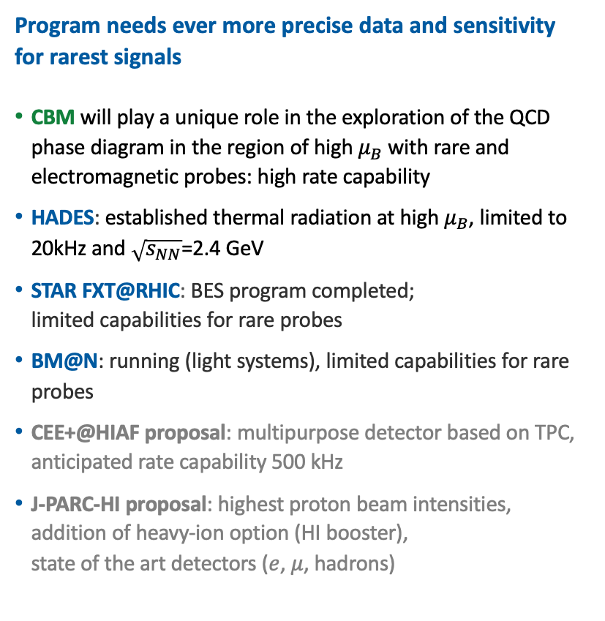

Some basic facts on high $μ_{B}$ facilities
Program needs ever more precise data and sensitivity for rarest signals
CBM will play a unique role in the exploration of the QCD phase diagram in the region of high $μ_{B}$ with rare and electromagnetic probes: high rate capability
HADES: established thermal radiation at high $μ_{B}$, limited to 20kHz and $\sqrt{s_{NN}}$=2.4 GeV
STAR FXT@RHIC: BES program completed;
limited capabilities for rare probes
BM@N: running (light systems), limited capabilities for rare probes
CEE+@HIAF proposal: multipurpose detector based on TPC, anticipated rate capability 500 kHz
J-PARC-HI proposal: highest proton beam intensities, addition of heavy-ion option (HI booster),
state of the art detectors ($e$, $μ$, hadrons)
  TG, NPA 982 (2019), update 2021 https://github.com/tgalatyuk/interaction_rate_facilities
  CBM, EPJA 53 3 (2017) 60

Slide 7
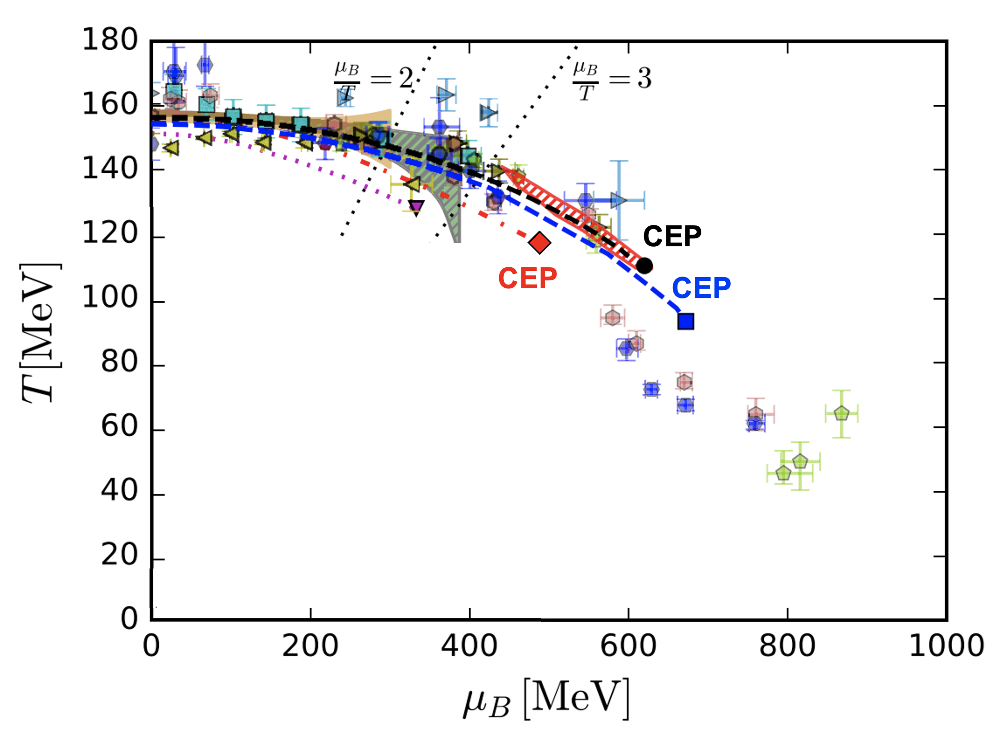
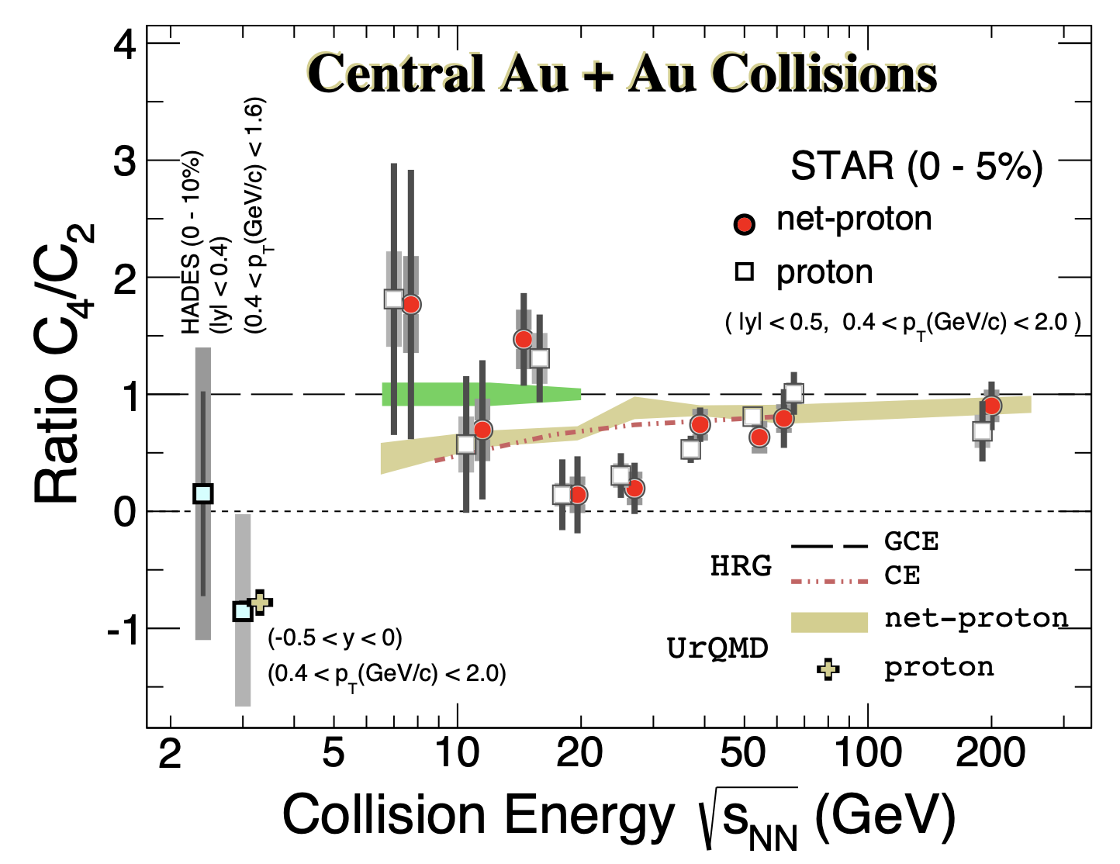


Probing criticality with fluctuations
Quest for critical phenomenon connected to the 1st order phase transition
Location of critical region
STAR, PRL 128 (2022) 20, 202303
HADES, PRC 102 (2020) 2, 024914
High moments $kσ^{2}$
CBM@SIS100
Critical point search: discontinuities of the higher moments of particle number distributions, visible in a beam energy scan
Gao, Pawlowski, PRD 102 (2020) 3, 034027

Slide 8
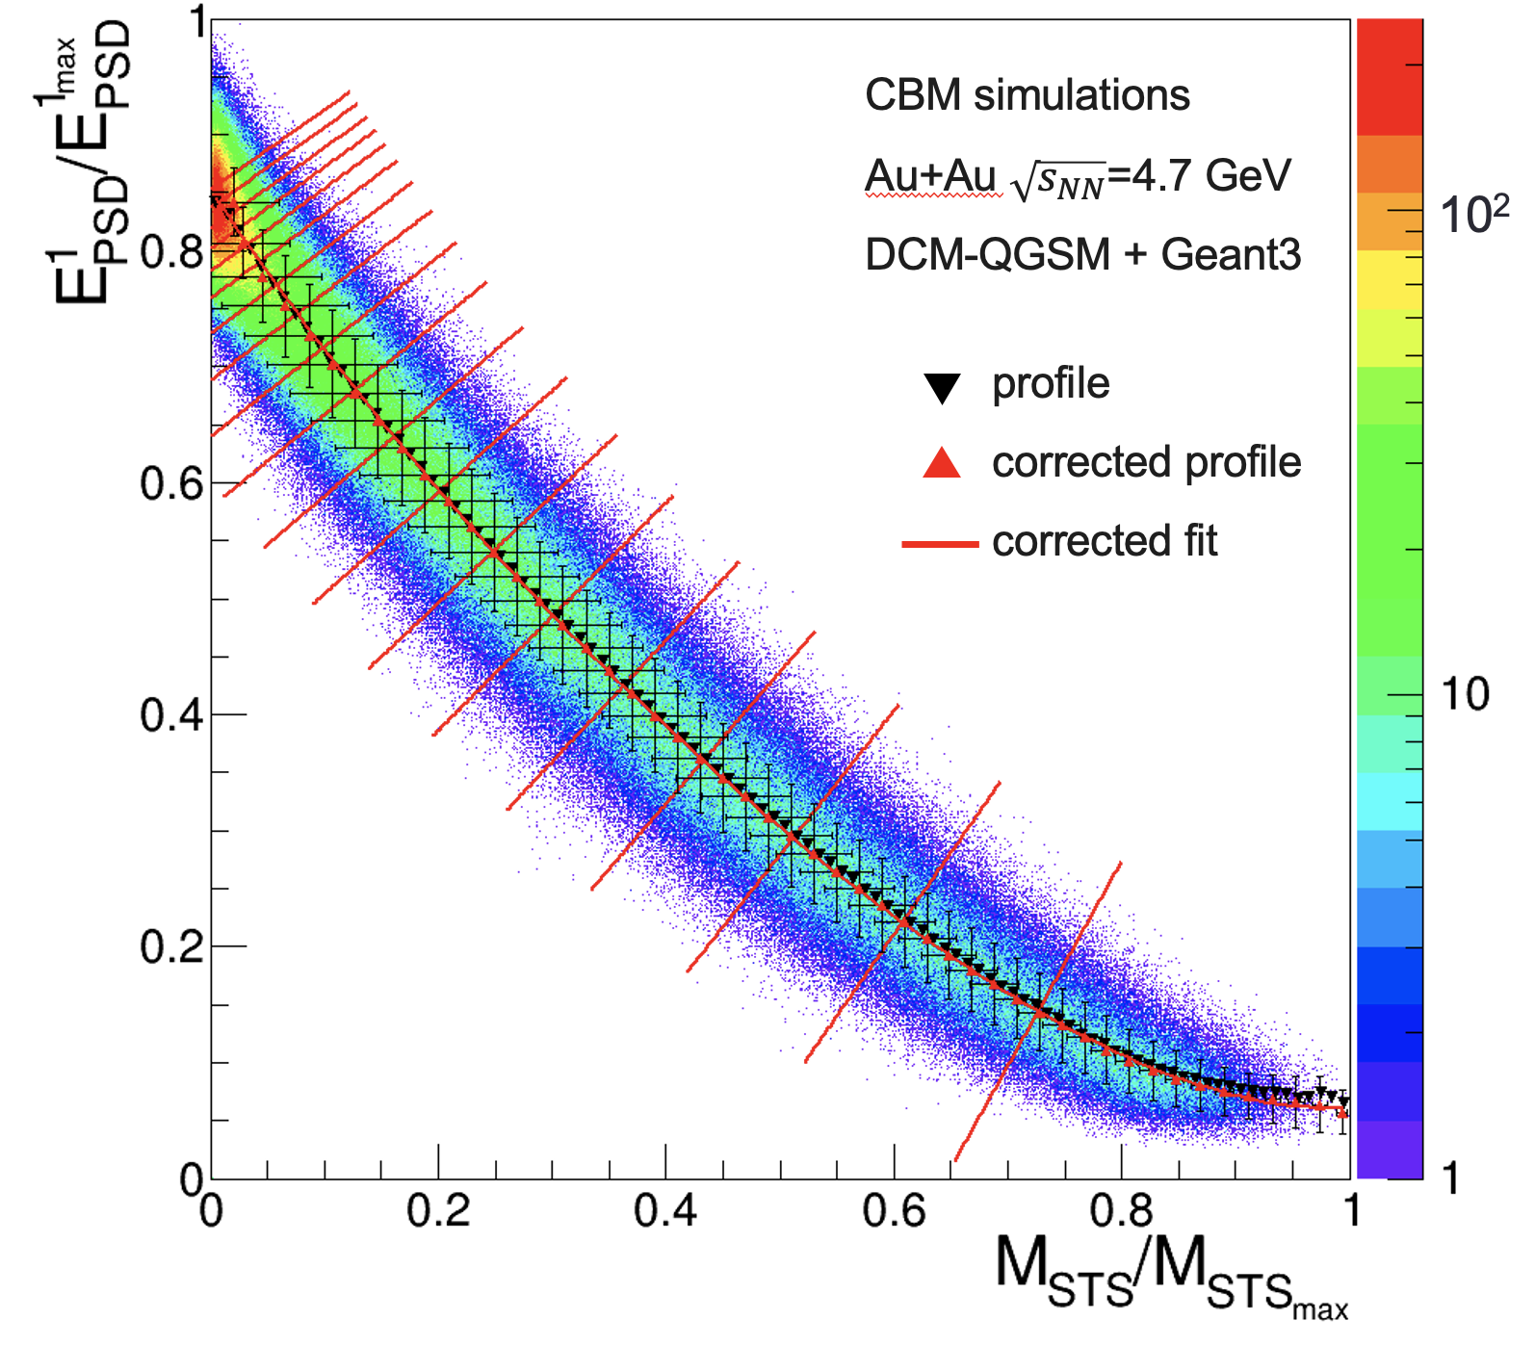
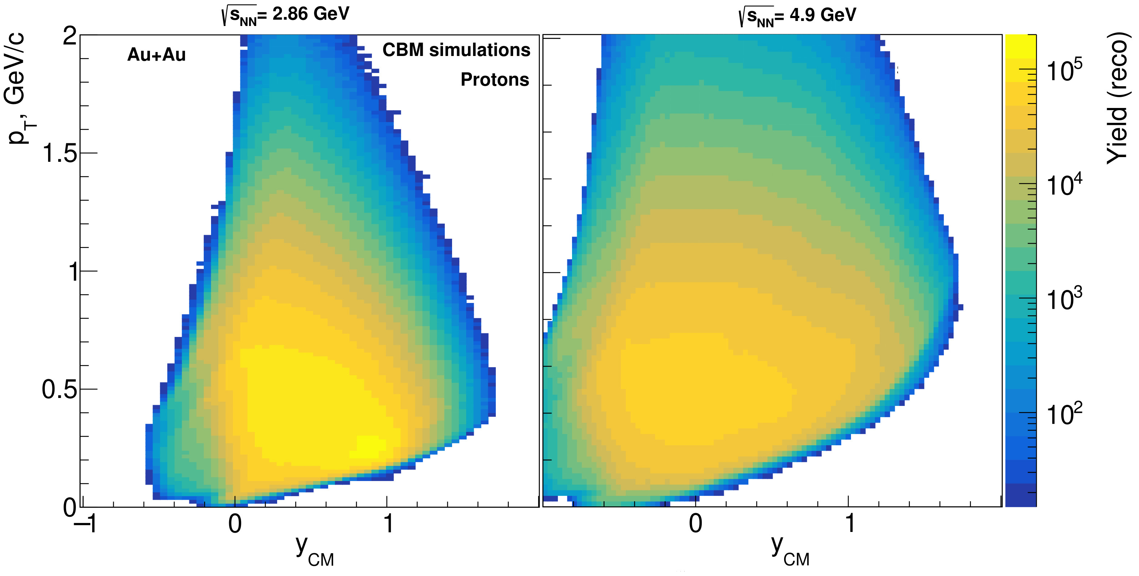
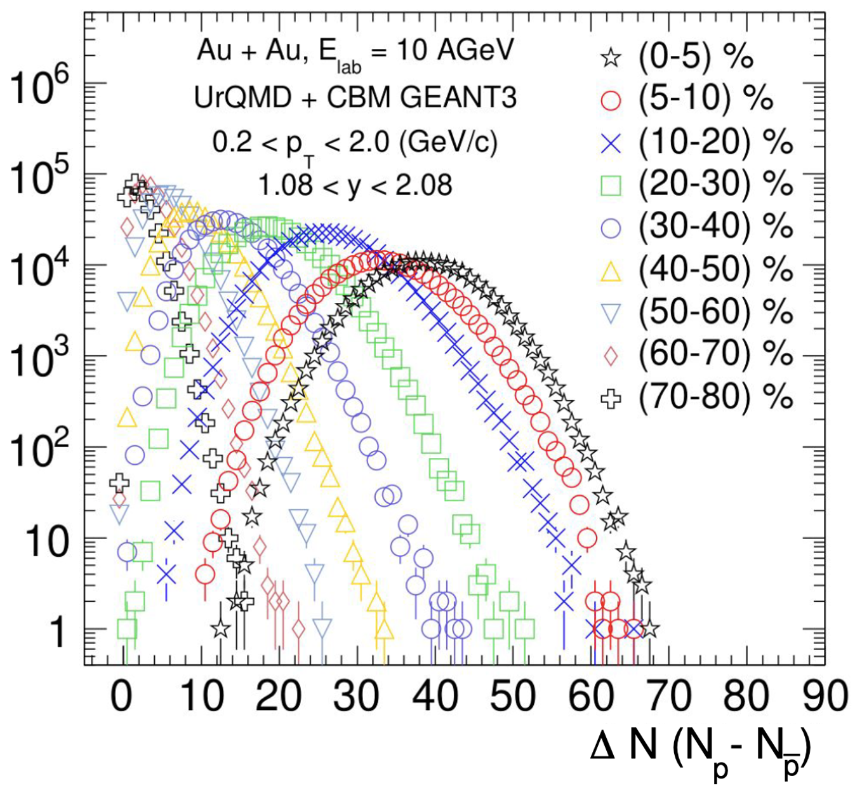
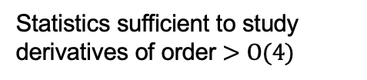
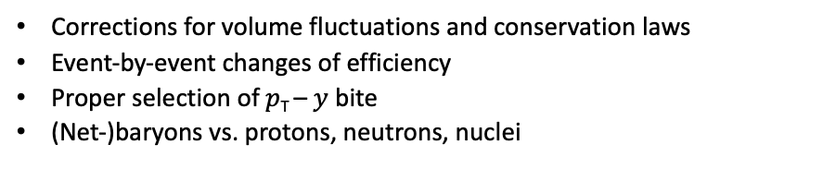
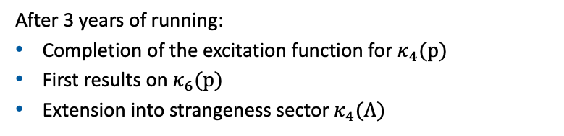
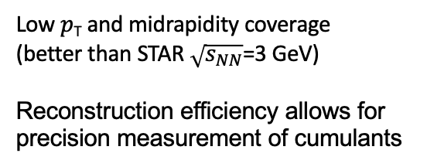
Performance studies in CBM
Corrections for volume fluctuations and conservation laws
Event-by-event changes of efficiency
Proper selection of $p$_{T} – $y$ bite
(Net-)baryons vs. protons, neutrons, nuclei
After 3 years of running:
Completion of the excitation function for $κ_{4}(p)$
First results on $κ_{6}(p)$
Extension into strangeness sector $κ_{4}(Λ)$
Impact of the effects is being scrutinized
Crucial: centrality determination with independent detector → avoids bias on e-b-e fluctuation observables
Low $p$_{T} and midrapidity coverage
(better than STAR $\sqrt{s_{NN}}$=3 GeV)
Reconstruction efficiency allows for
precision measurement of cumulants
Statistics sufficient to study derivatives of order $>Ο(4)$
Notes:
Reorder the plots

Slide 9
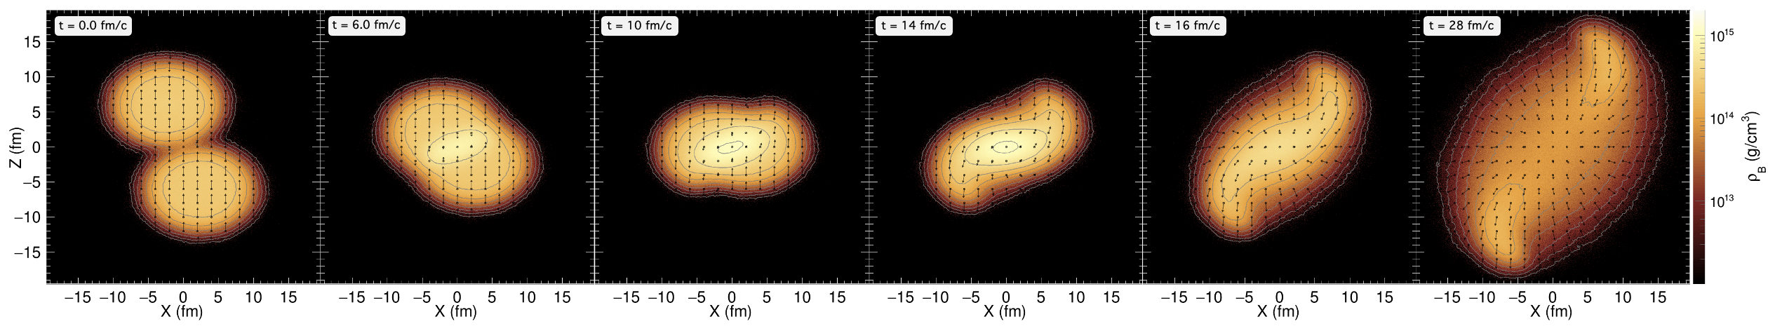



















Electromagnetic radiation as multi-messenger of fireball
$$γ^{∗}$$
$$γ^{∗}$$
beam axis
$$ℓ^{−}$$
$$ℓ^{+}$$
$$γ^{∗}$$
$$γ^{∗}$$
$$ℓ^{−}$$
$$γ^{∗}$$
$$γ^{∗}$$
$$ℓ^{+}$$
$$ℓ^{−}$$
$$ℓ^{−}$$
$$ℓ^{−}$$
$$ℓ^{−}$$
$$ℓ^{+}$$
$$ℓ^{+}$$
$$ℓ^{+}$$
$$ℓ^{+}$$
●
Encodes information on matter properties
enabling unique measurements
  degrees of freedom of the medium
  fireball lifetime, temperature, acceleration, polarization
  transport properties
  restoration of chiral symmetry
Electromagnetic radiation ($γ, γ^{∗}$)
Reflect the whole history of a collision
●
No strong final state interaction
⤳ leave reaction volume undisturbed
●
Notes:
Make contact to previous slide
Rework slide

Slide 10
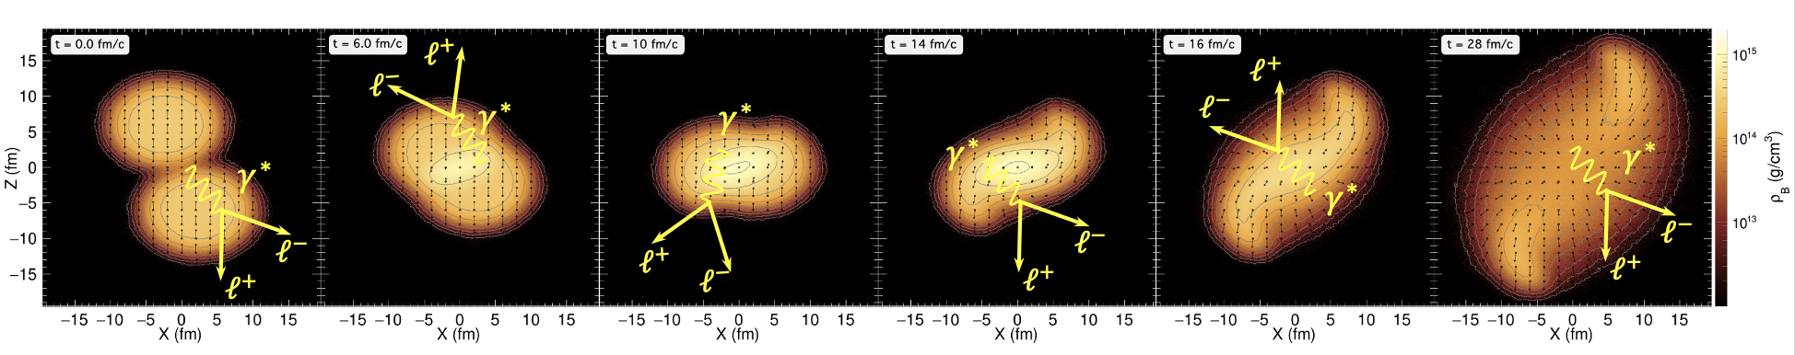
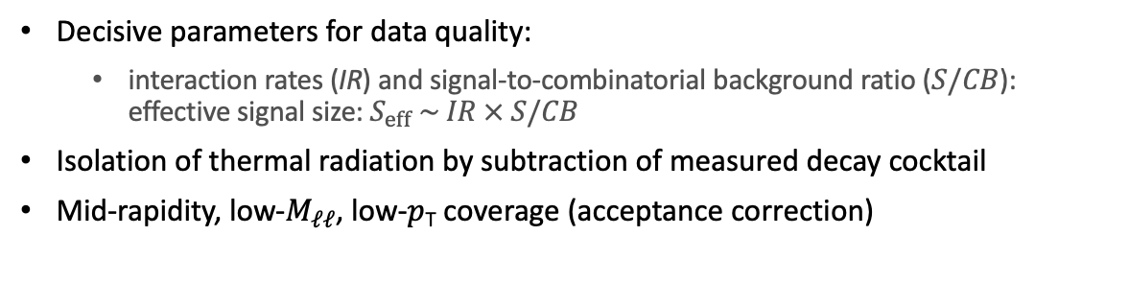
Thermal dilepton measurements
Low-mass region (LMR)
Intermediate-mass region (IMR)
first chance
collisions
freeze-out
thermal radiation
Decisive parameters for data quality:
  interaction rates (IR) and signal-to-combinatorial background ratio ($S/CB$): effective signal size: $S_{eff} \sim IR × S/CB$
Isolation of thermal radiation by subtraction of measured decay cocktail
Mid-rapidity, low-$M_{ℓℓ}$, low-$p$_{T} coverage (acceptance correction)
LMR: total yield ~ fireball lifetime
IMR: slope ~ emitting source temperature
Notes:
Fixed-target O(IR = 10⁵ – 10⁷/s ) vs Colliders O(IR = 5$×$10⁴/s )
For different experiments $S/CB≪1$ ($1/10 ÷1/500)$

Slide 11
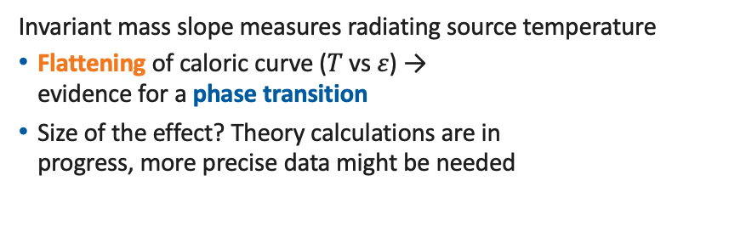
After first 3 years of running
Excess yield in LMR tracks fireball lifetime
Search for ”extra radiation” due to latent heat around phase transition (& critical point?)
Precision sufficient to observe 1st order phase transition, predicted to be of the order 2 – 3
Invariant mass slope measures radiating source temperature
Flattening of caloric curve ($T$ vs $ε$) →
evidence for a phase transition
Size of the effect? Theory calculations are in
progress, more precise data might be needed
  Tripolt et al., NPA 982 (2019) 775
  Li and Ko, PRC 95 (2017) no.5, 055203
  Seck et al., PRC (2022), arXiv:2010.04614 [nucl-th]
  TG., JPS Conf.Proc. 32 (2020) 010079
https://github.com/tgalatyuk/QCD_caloric_curve

Slide 12
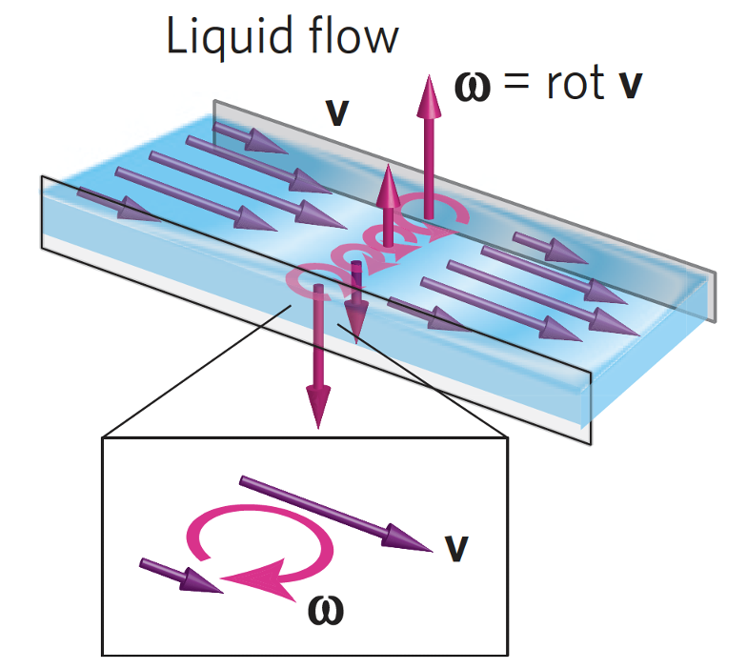


Probing the spin degree of freedom
Vorticity: Collective flow and polarization of $Λ,\overline{Λ}$and $Ξ^{−}$hyperons in CBM
First observation of fluid vorticity-polarization coupling by Takahashi, et al. Nat. Phys. (2016)
  Atomic alignment directly measured
  Direction of angular momentum known
Measurement of polarization
of $Λ$ and $Ξ^{−}$ with precision of 5%
Mapping of the excitation function for $\overline{Λ}$ requires $≥{10}^{13}$
Friction with walls induces vorticity
Vorticity of bulk ⤳ polarization of constituents
Simulated physics reach of CBM after first 3 years
Notes:
Mercury flow → omega 10^6
Magnetars → field 10^10

Slide 13
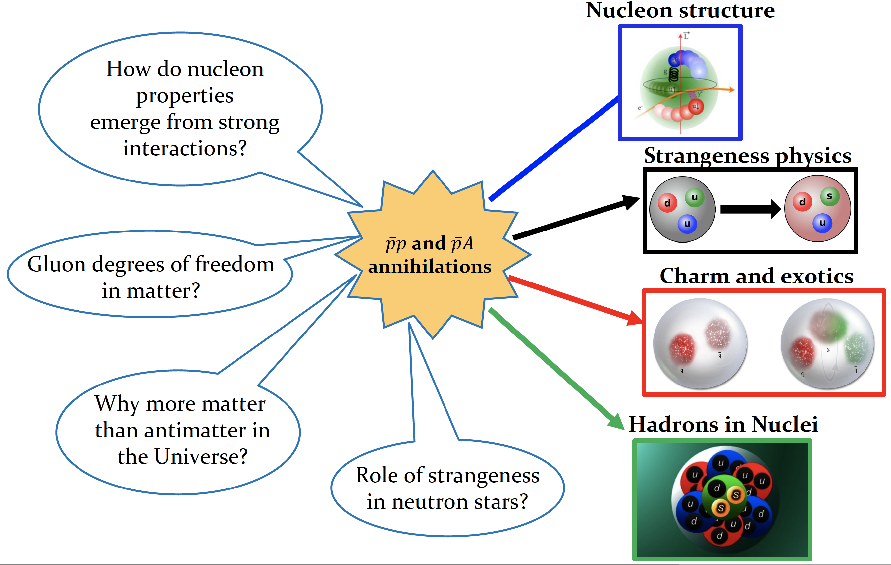
Physics topics at
PANDA slides from Karin Schöning

Slide 14
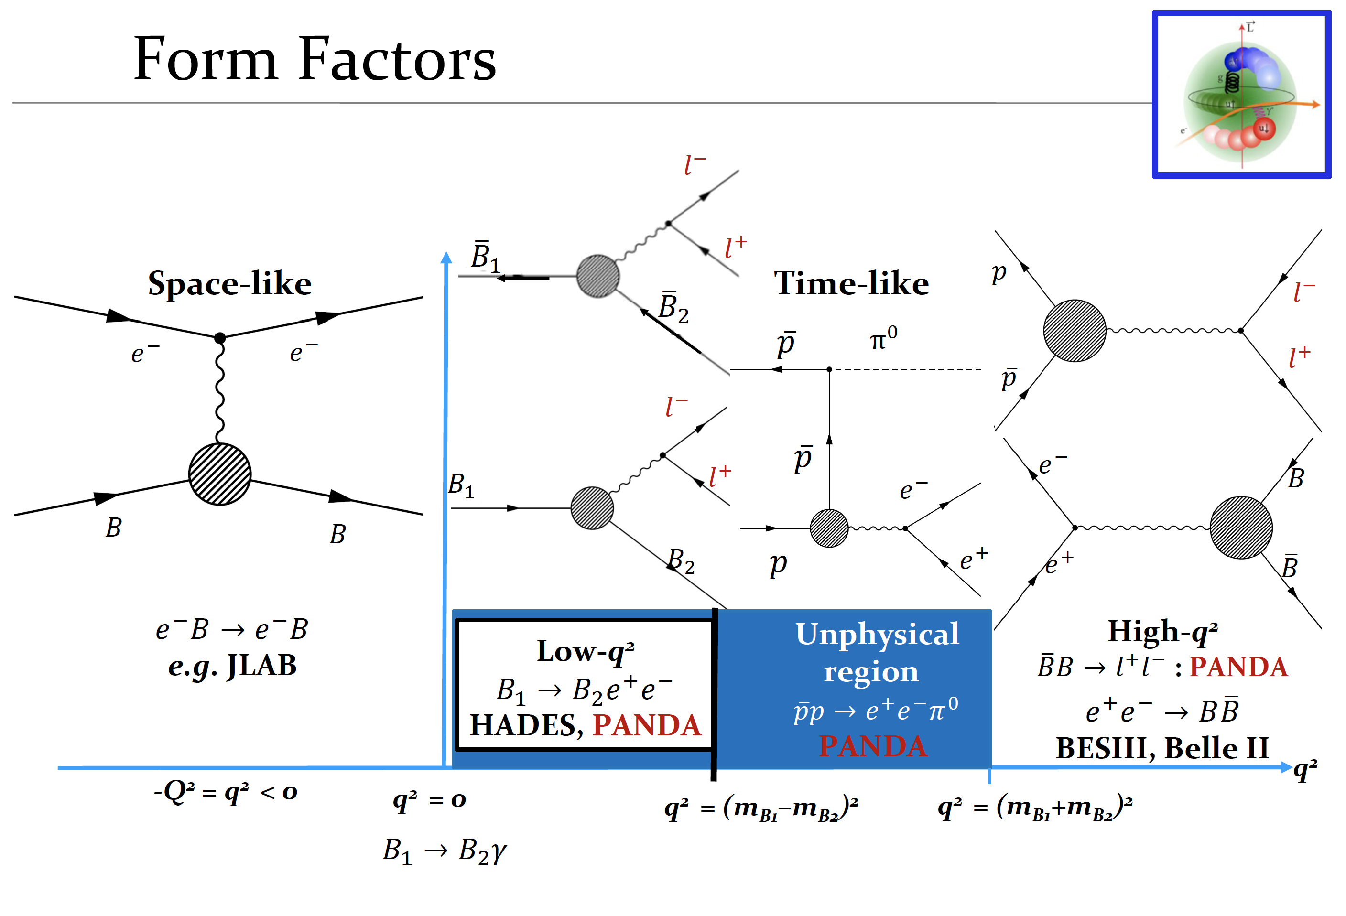

Slide 15
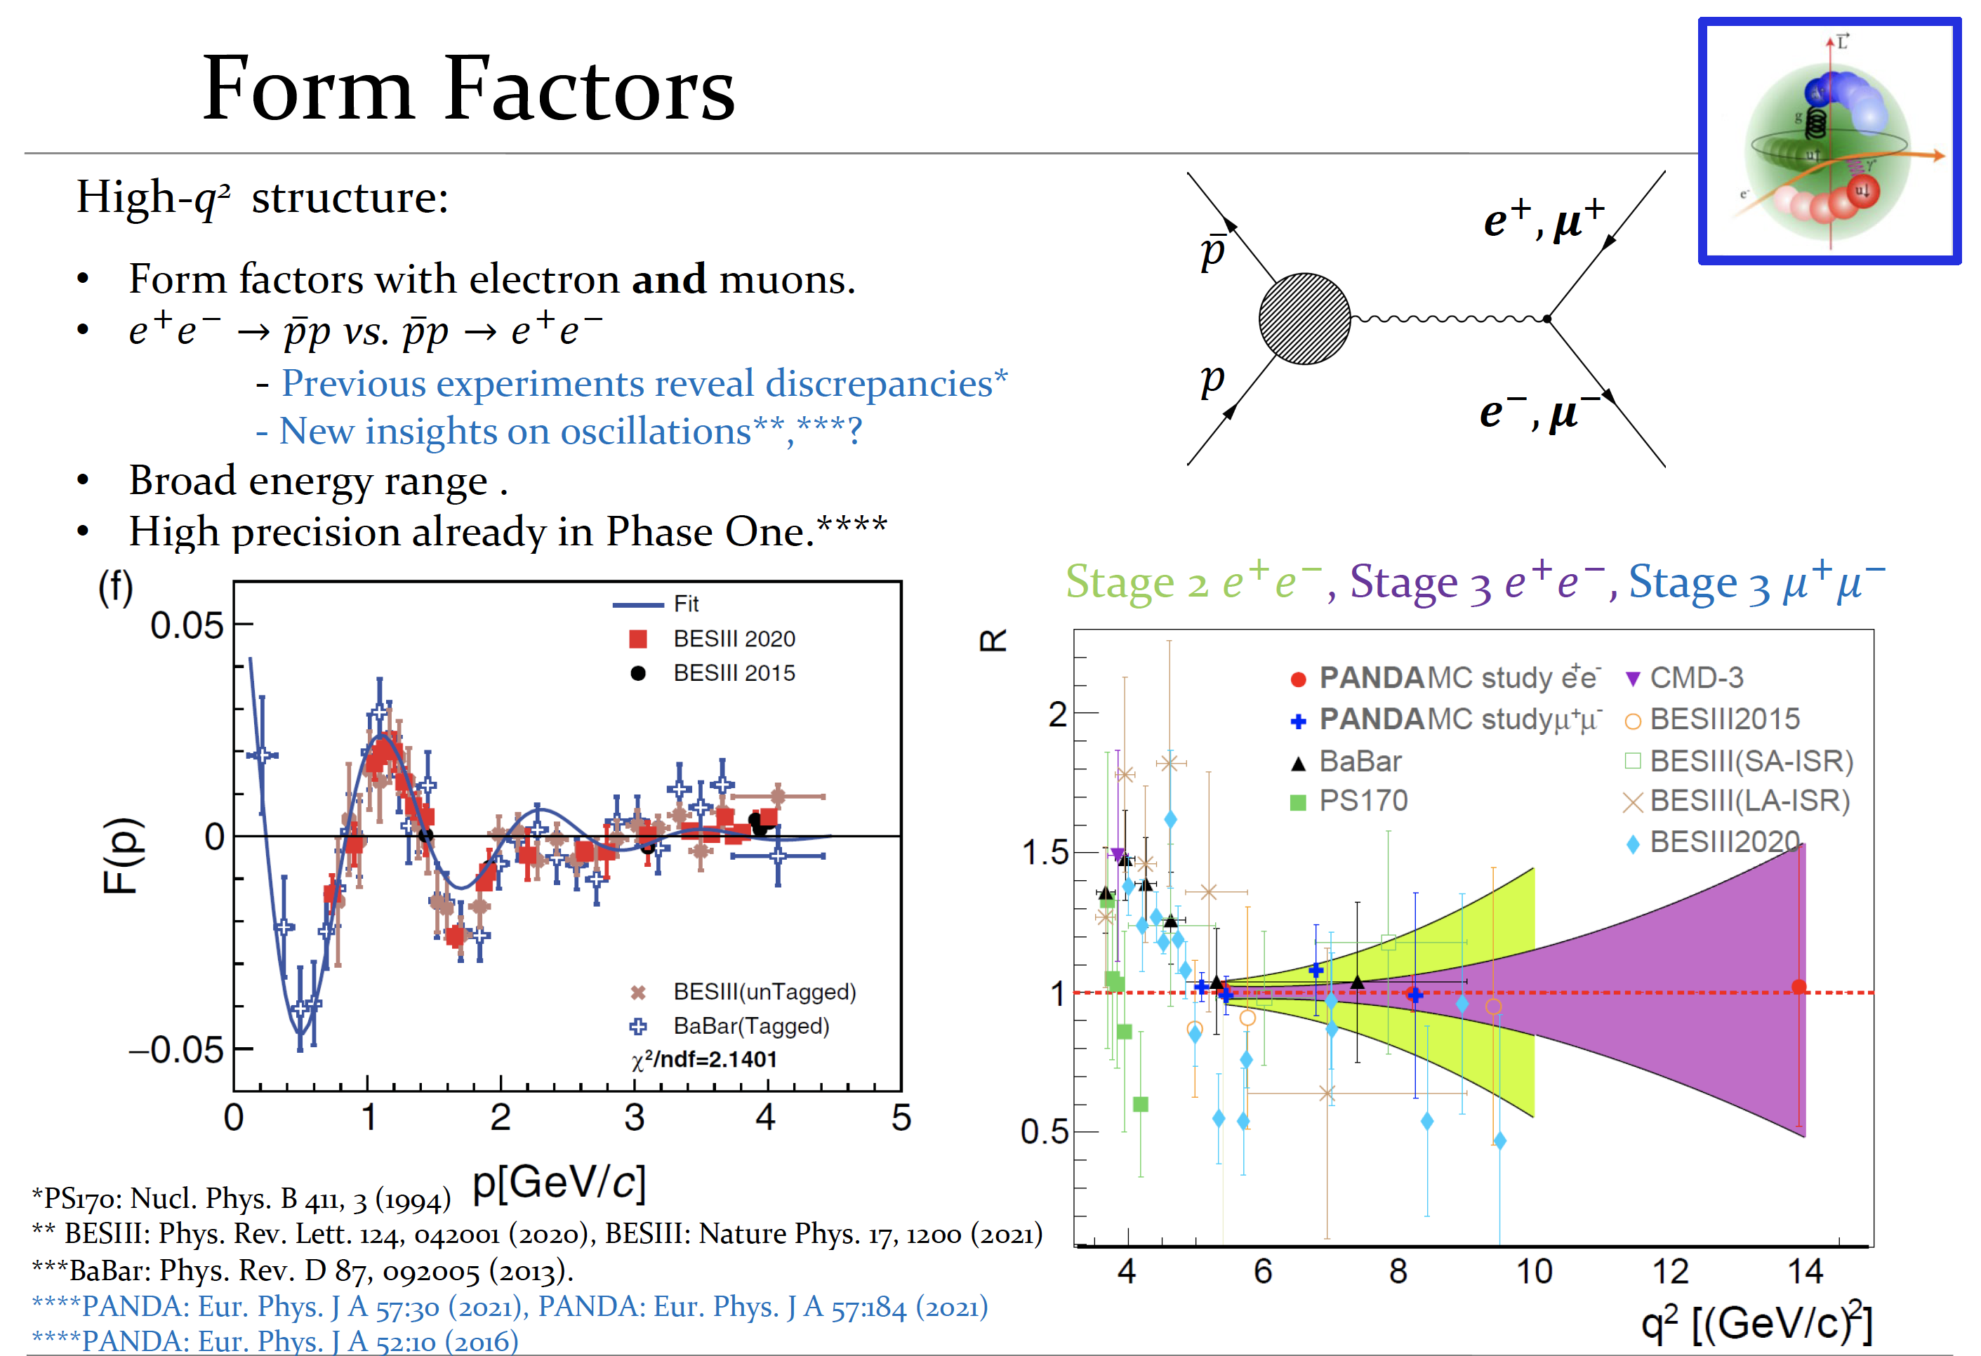

Slide 16
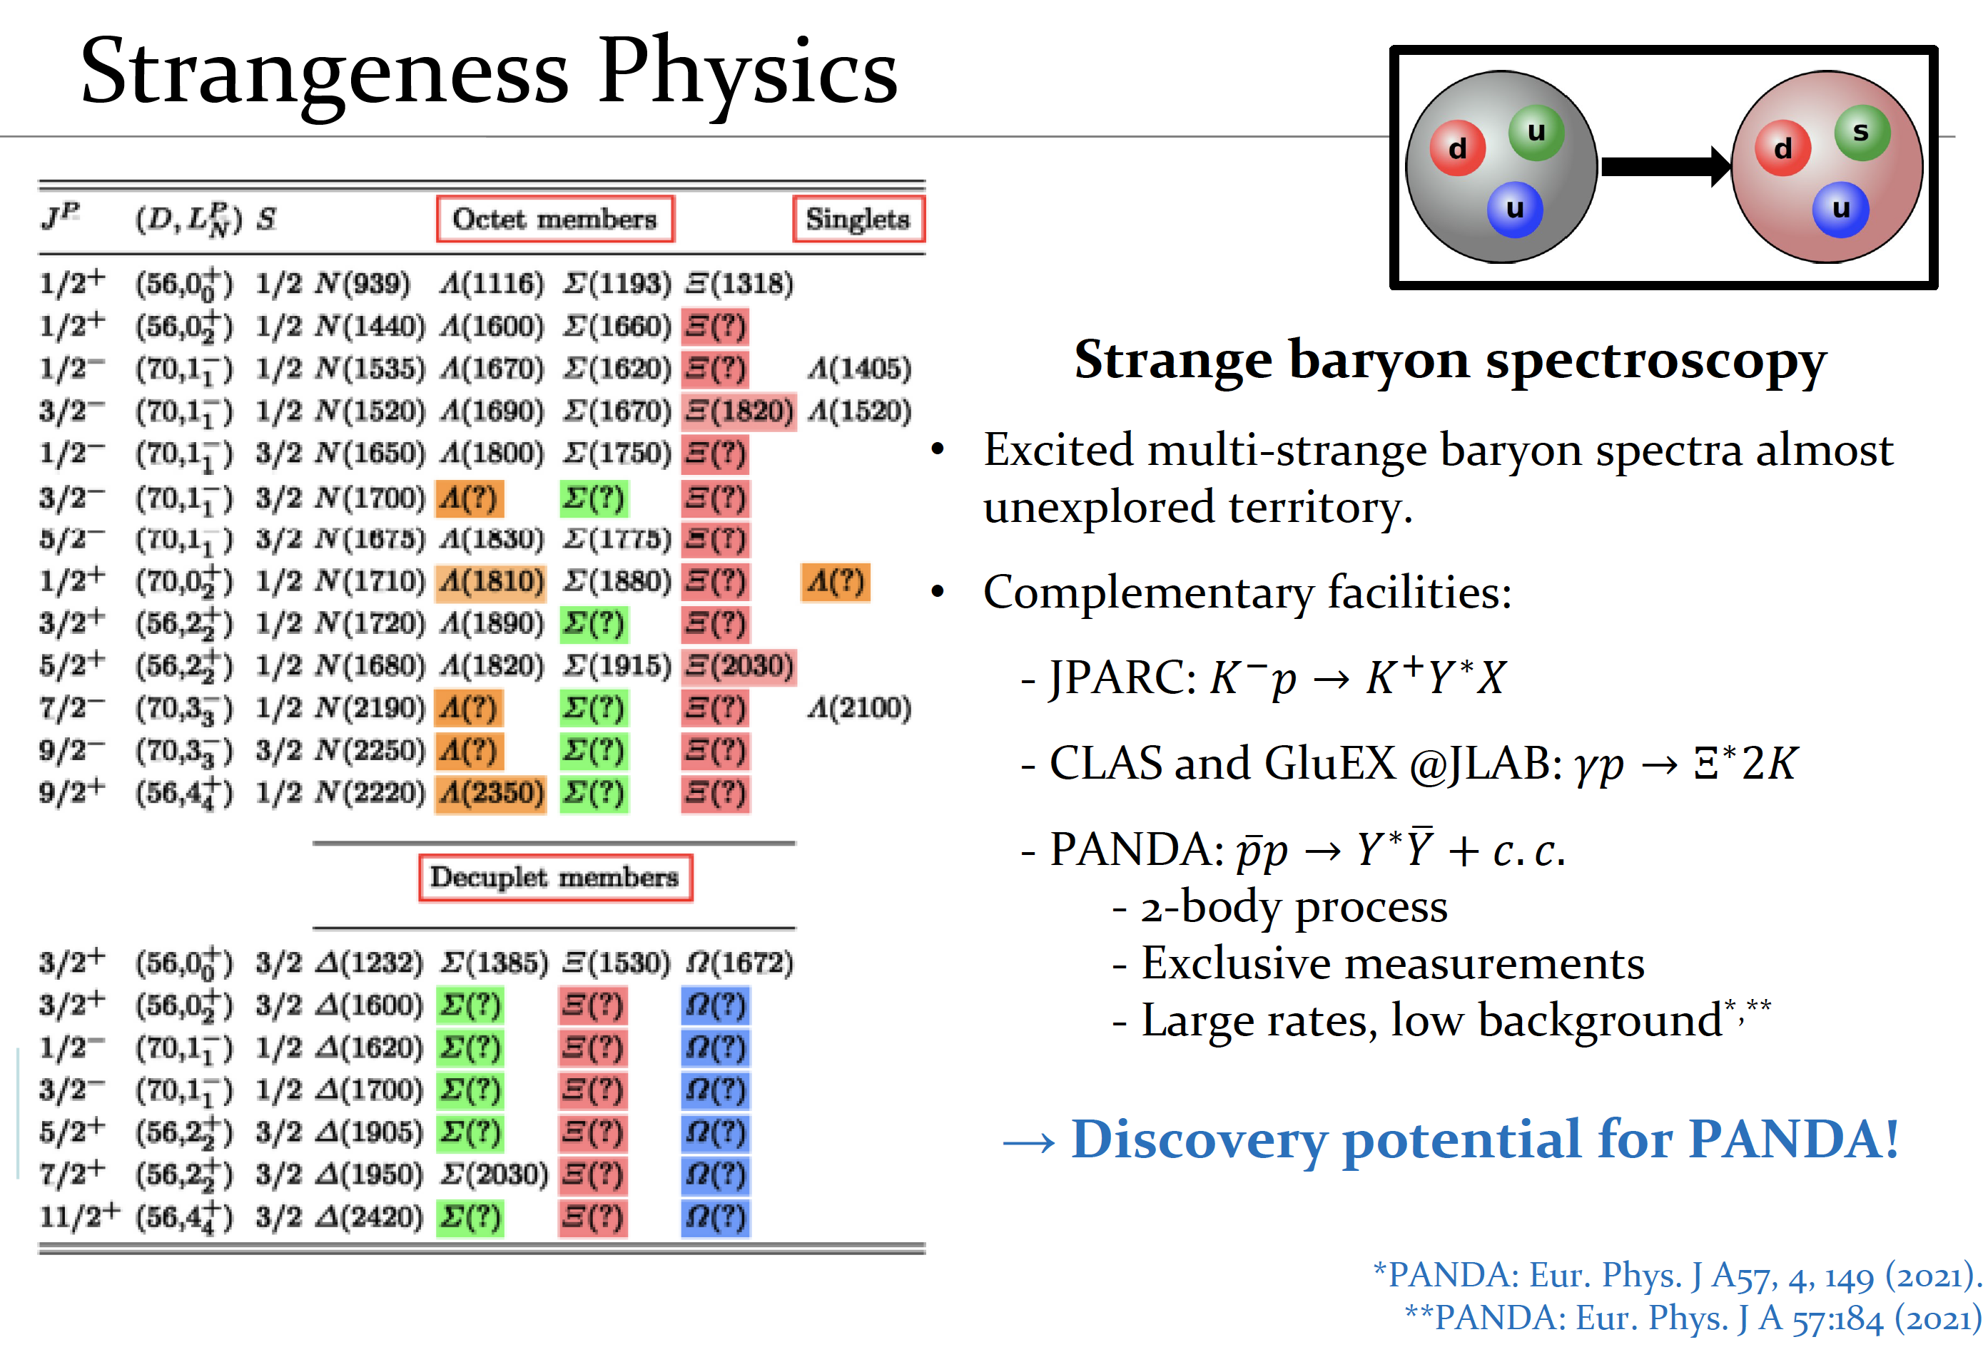

Slide 17
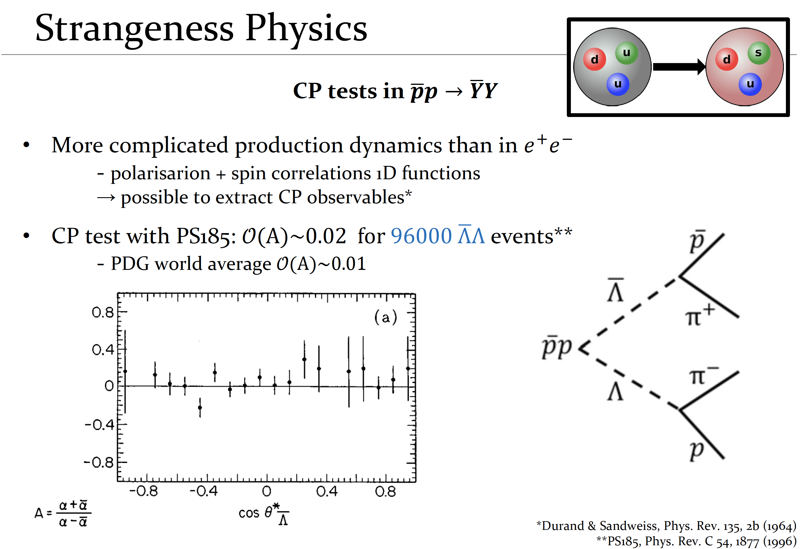
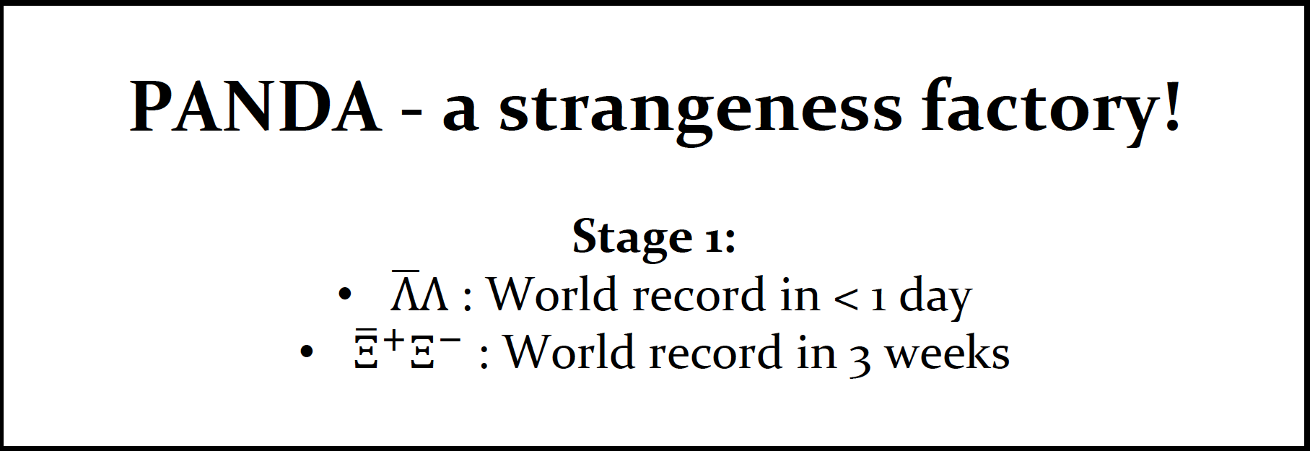

Slide 18
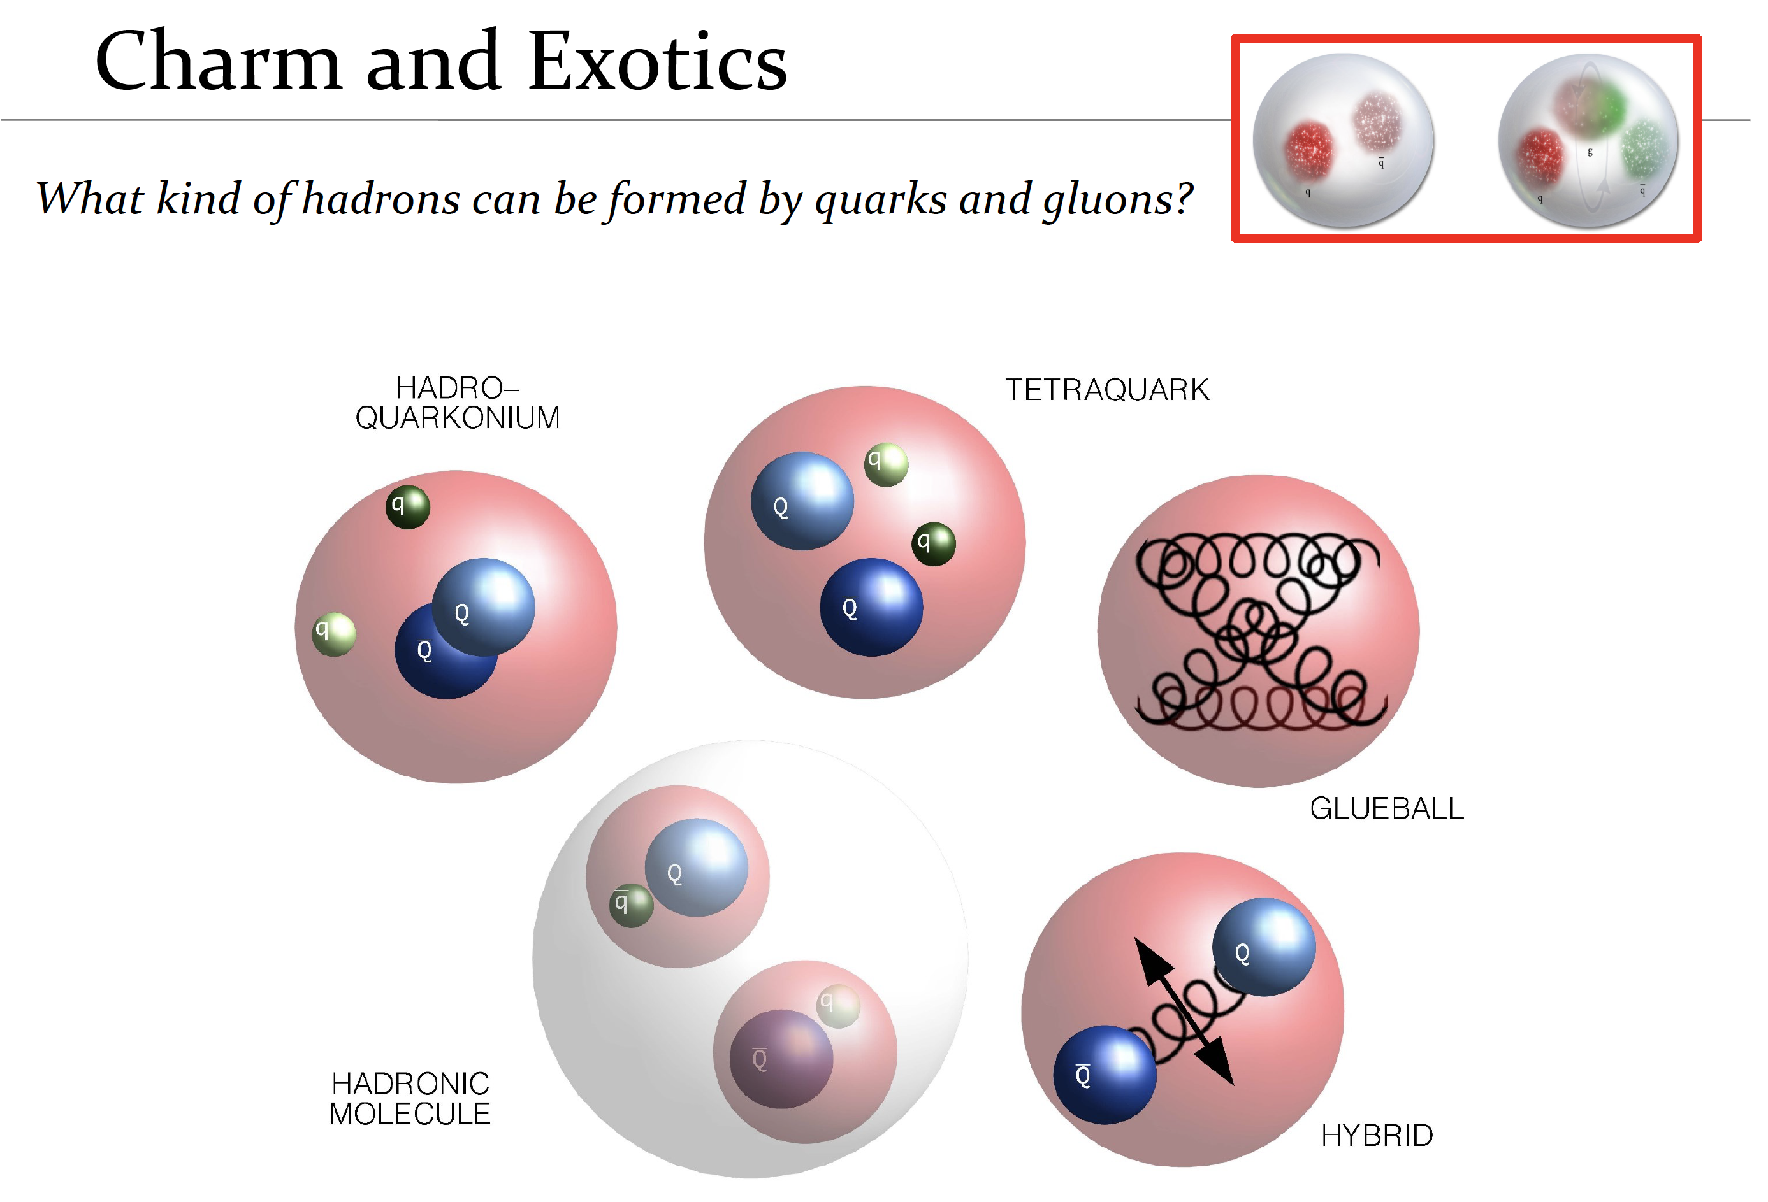

Slide 19
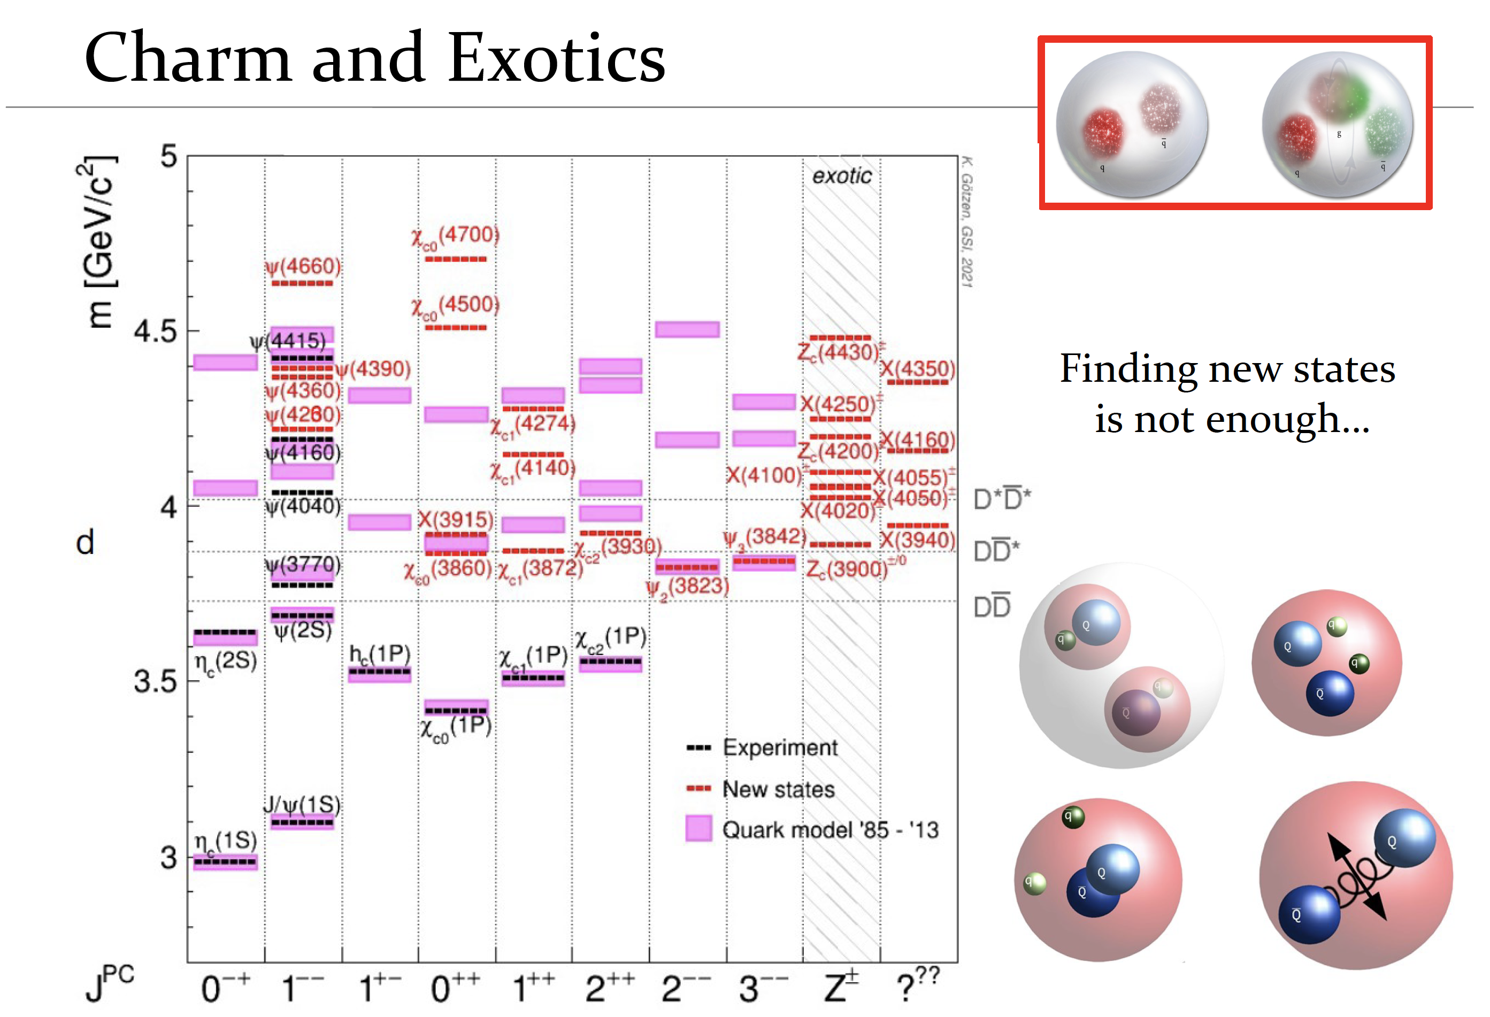

Slide 20
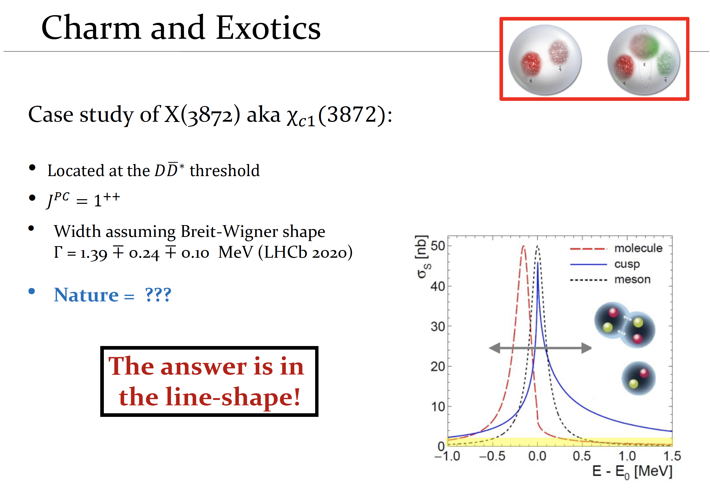

Slide 21
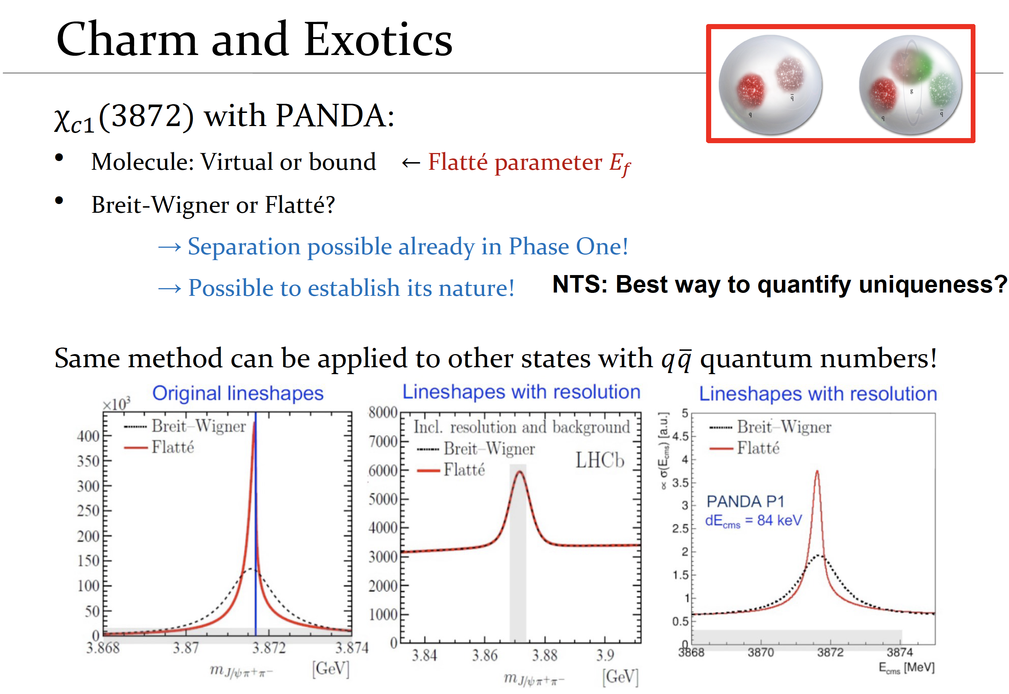

Slide 22
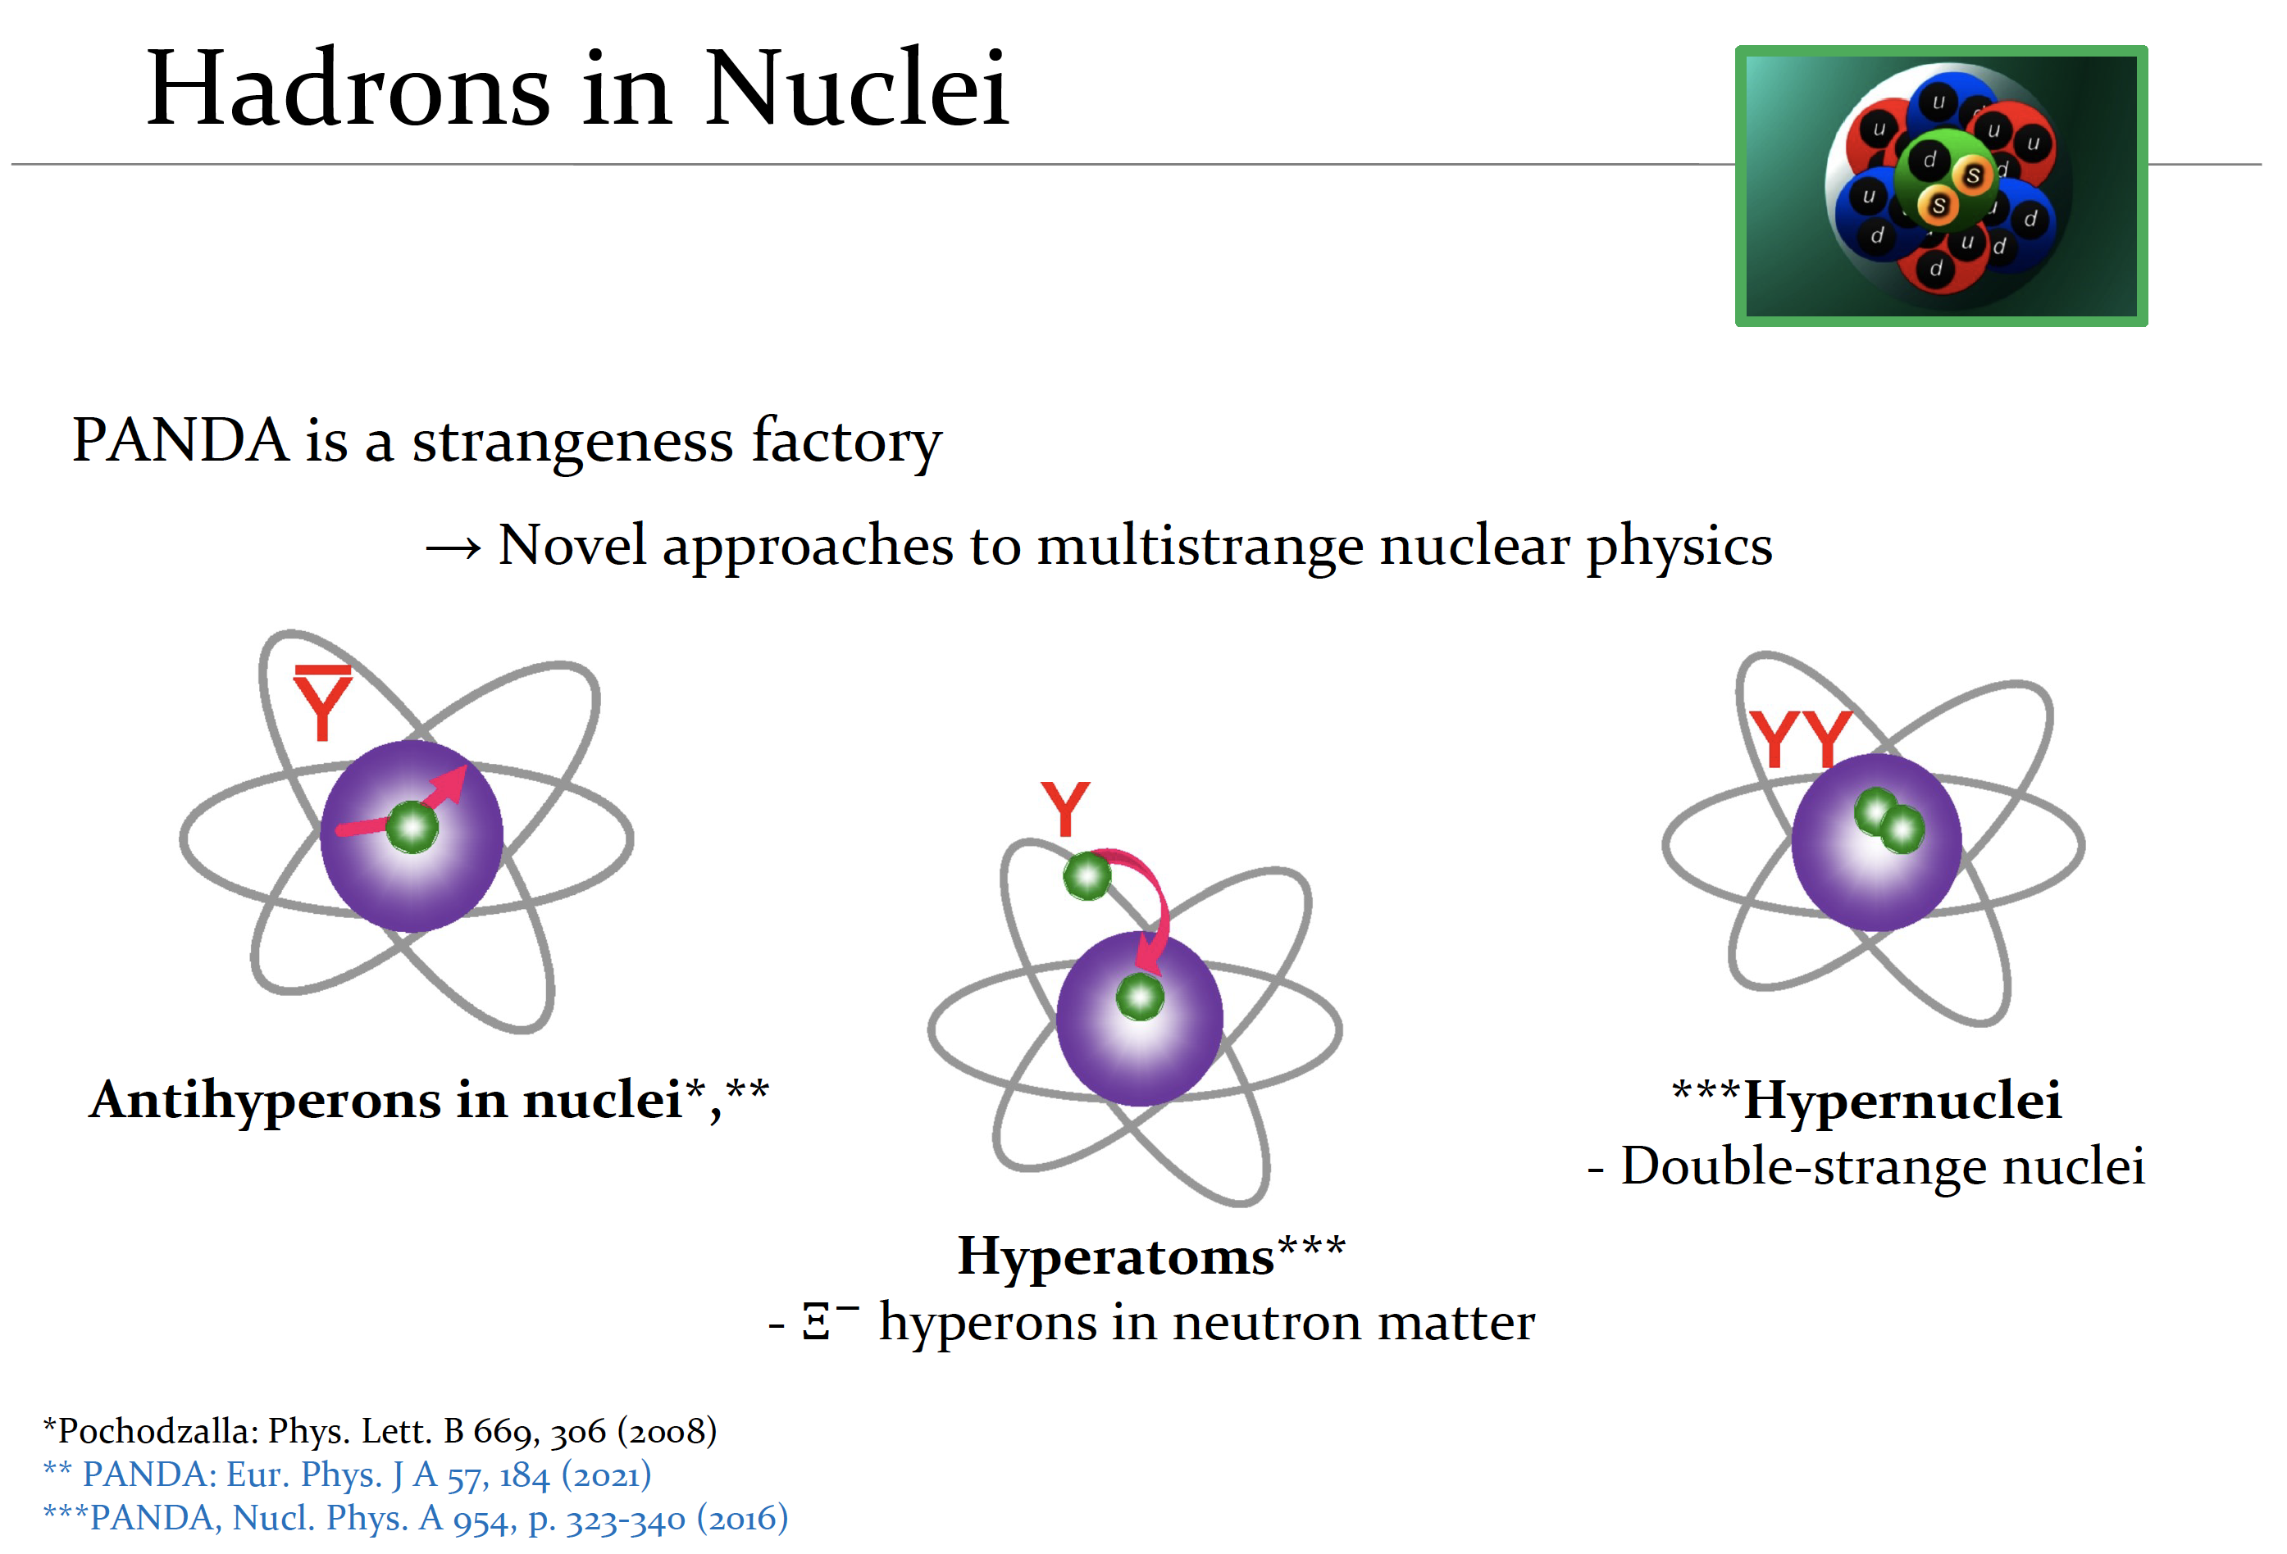

Slide 23
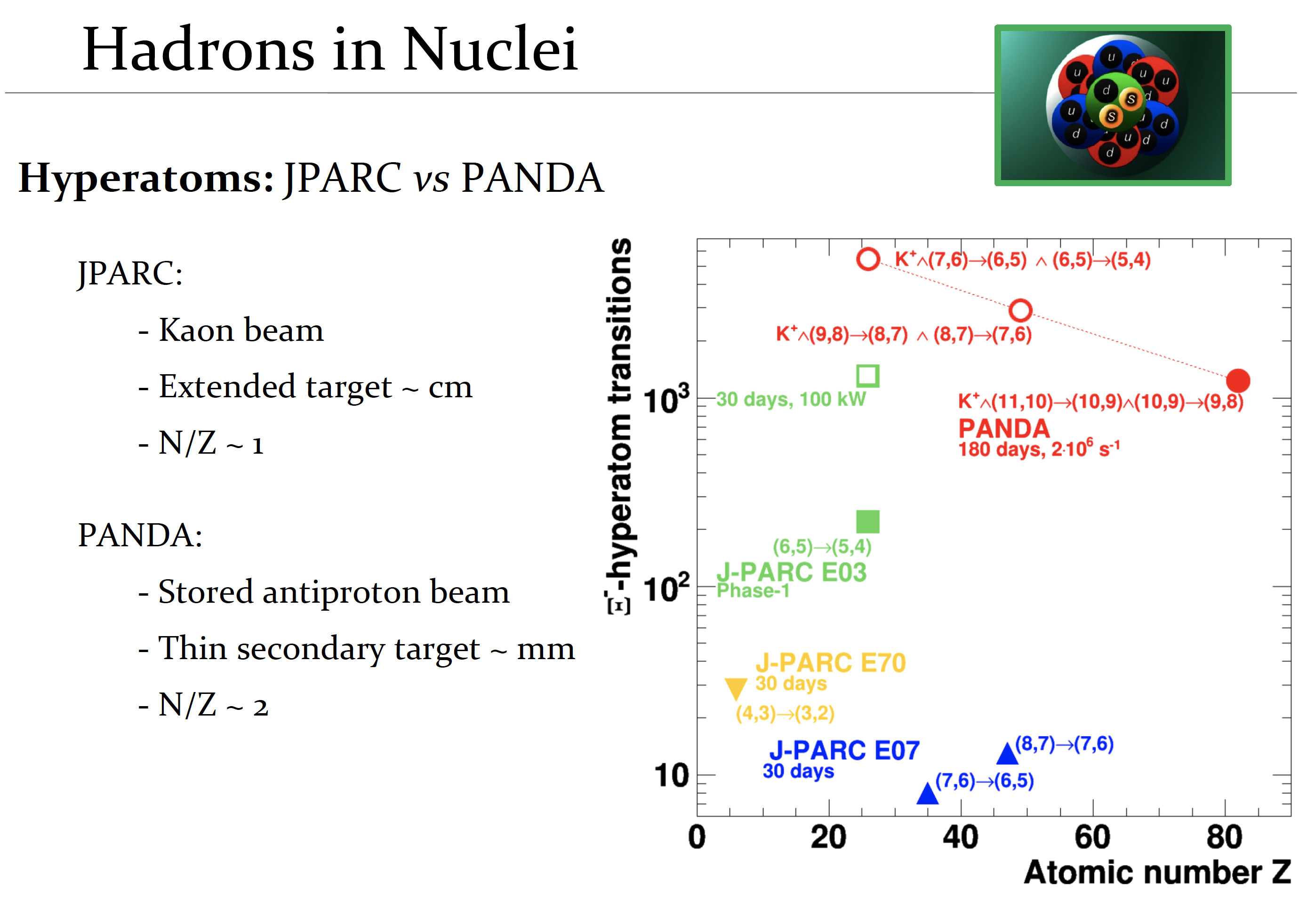

Slide 24
Conclusions
Fundamental Science program at FAIR
CBM investigates the emergence of phases of strongly interacting matter
PANDA investigates how hadron properties emerge from the strong interaction
Many scientists from Georgia are already contributing to these goals
Lots of opportunity for members of the GGSB to get involved
Thank you for your attention!

Slide 25
spares

Slide 26










Critical fluctuations
cf. Friman et al., EPJC 71 (2011) 1694
Stephanov, RPL 107 (2011) 052301
STAR, PRL 128 (2022) 20, 202303
HADES, PRC 102 (2020) 2, 024914
Thermal susceptibilities $⟺$conserved charge fluctuations $x=B, S, Q$
Higher order moments of measured multiplicity distributions
are sensitive to the correlation length
and probe the structure of QCD matter
6th order derivatives – $κ_{6}$ – in terms of chemical potentials –
particularly sensitive to features of the QCD phase diagram
$$\frac{\left\langle N2\right\rangle {−\left\langle N\right\rangle }^{2}}{{\left\langle N\right\rangle }^{2}}=\frac{{Tχ}_{x}}{V}$$
$$χ_{x}=−\frac{1}{V}{\left(\frac{∂V}{∂P}\right)}_{T}$$
diverges at $T_{c}$
$$σ^{2}/\left\langle N\right\rangle =\frac{κ_{2}}{κ_{1}}$$
$$Sσ=\frac{κ_{3}}{κ_{2}}$$
$$kσ^{2}=\frac{κ_{4}}{κ_{2}}$$
$σ$ – variance
$S$ – skewness
$k$ – kurtosis
$κ_{2},κ_{3},κ_{4}$ cumulants
High moments $kσ^{2}$
2nd order
3rd order
4th order
$$\frac{1}{VT^{3}}κ_{n}=\frac{∂^{n}\hat{p}}{∂{\hat{μ}}^{n}}$$
Critical point search: discontinuities of the higher moments of particle number distributions, visible in a beam energy scan
Higher order moments probe the tails - statistics!
Detailed systematic studies of experimental effects is curtail
Skokov et al., PRC 88 (2013) 034911; Bzdak et al., PRC 94 (2016) 064907;
PBM et al., NPA 960 (2017) 114; Kitasawa, PRC 93 (2016)

