Slide 1
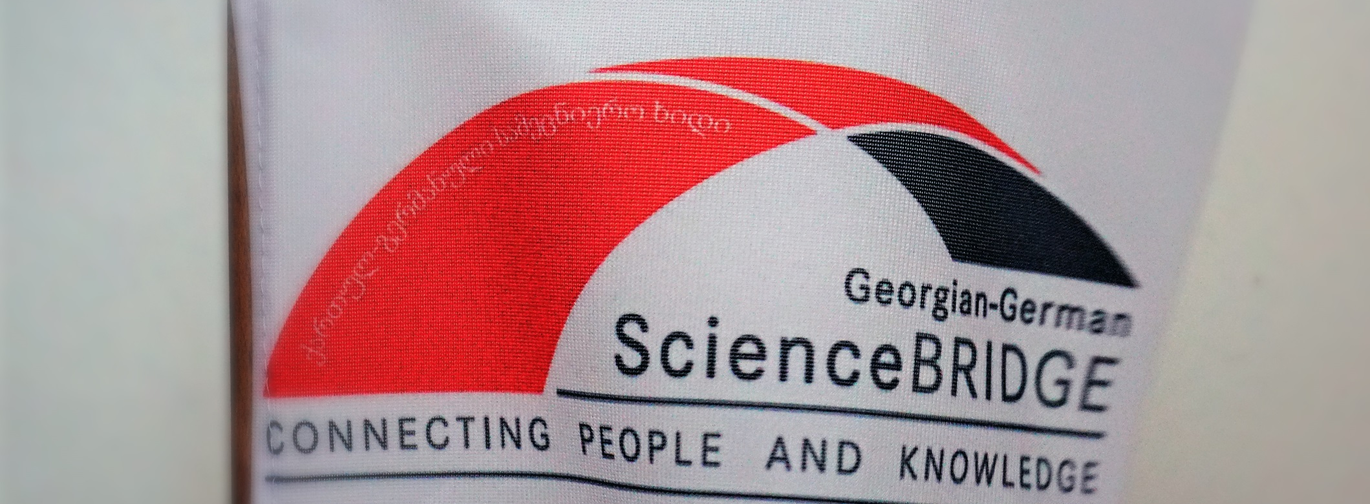
GGsb-Vision
georgian Science & Technology Center (GSTC)
hans ströher | GGSB2022 | September 14, 2022 I KIU (Kutaisi)

Slide 2
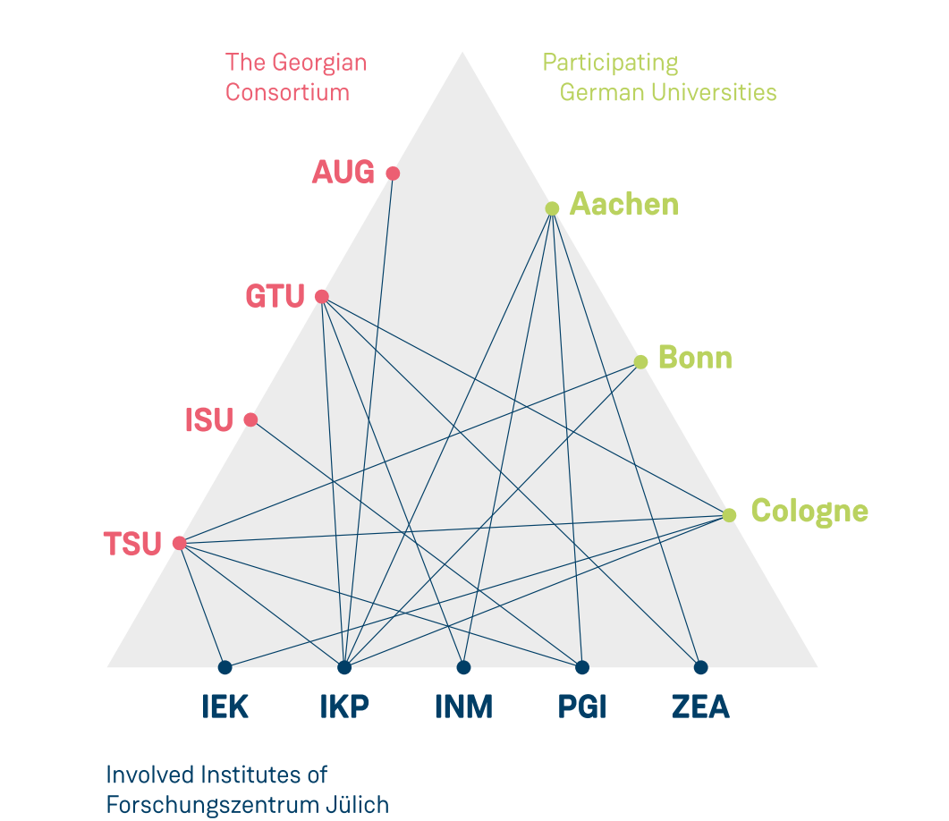
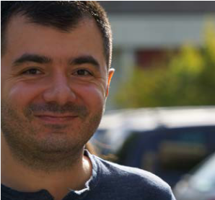
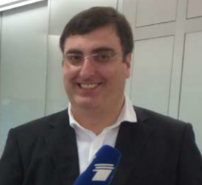
Ggsb SMART|Labs (I)
SMART|EDM_Lab
2017
2016
SMART|AtmoSim_Lab
2 existing SMART|Labs: diverse topics – but fruitful cooperation (electronics)
Both should be continued (based on external reviews; w/ possible new focus)

Slide 3
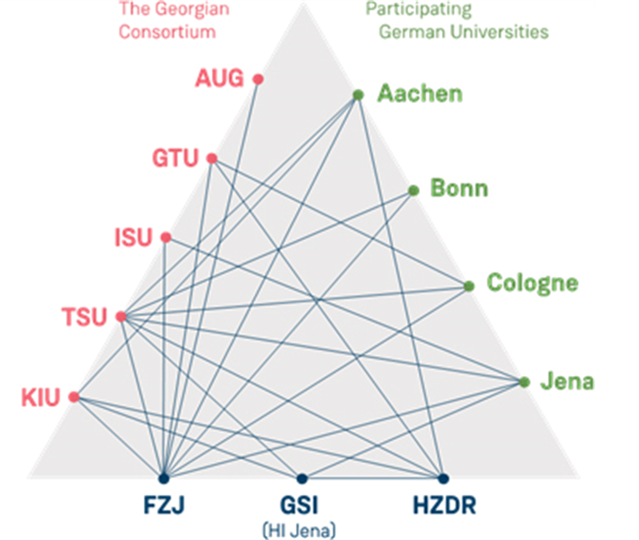
Ggsb SMART|Labs (II)
New SMART|Labs are being considered at different locations (universities)
Think big(-ger) … Georgian Science and Technology Center (GSTC)

Slide 4
GSTC
Georgian Science and Technology Center
Motivation: Demand for interdisciplinary reseach agendas and teams
Development of the SMART|Labs into an internationally
visible/recognized high-tech center
Excellence: Relation to (a) flagship project(s) in Georgia
Connection to/cooperation with int´l centers (e.g. HGF)
Objectives: Scientific/technological support for GGSB projects
Development of equipment for Georgian/int´l projects
(Leading) participation in selected research projects
Impact: Capacity building for Georgian project(s)
Fostering cross-disciplinarity
Education of students and experts in Georgia
International visibility; grant applications (e.g. Horizon Europe)
Vision for GGSB (Plus-Plus)
Details (size, location, affiliation (w/ university/-ies)) etc. open for discussion …

Slide 6
Trade name - Suggestions
Georgian Science and Technology Center (GSTC)
Science and Technology Center of Georgia (STCoG)
Science and Technology Park of Georgia (STPoG)
Georgian Advanced Institute of Science and Technology (GAIST)
Georgian Center for Science, Technology and Medicine (GCSTM)
…

