Slide 1
GGsb – A retrospective
The first two decades
hans ströher | GGSB2022 | September 12, 2022 I KIU (Kutaisi)
„Doing something once is like nothing at all;
the second time it becomes a tradition;
from the third time on it´s an ancient custom“

Slide 2
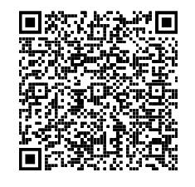
Georgian-german science bridge
GGSB Science Bridge:
Founded 2004
Consortium of Georgian
Universities (AUG, GTU,
ISU, KIU and TSU)
and
Institutes of Forschungs-
zentrum Jülich (IEK, INM,
IKP, ZEA), affiliated with
German universities:
Aachen, Bonn, Cologne
Details: Brochure

Slide 3
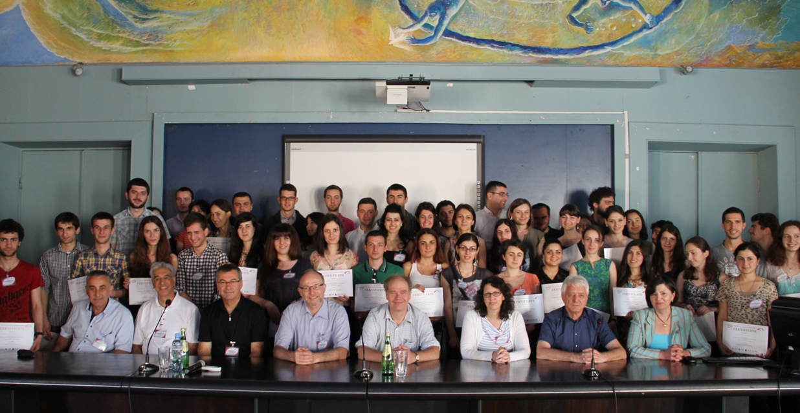
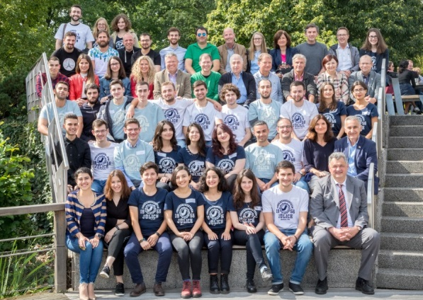
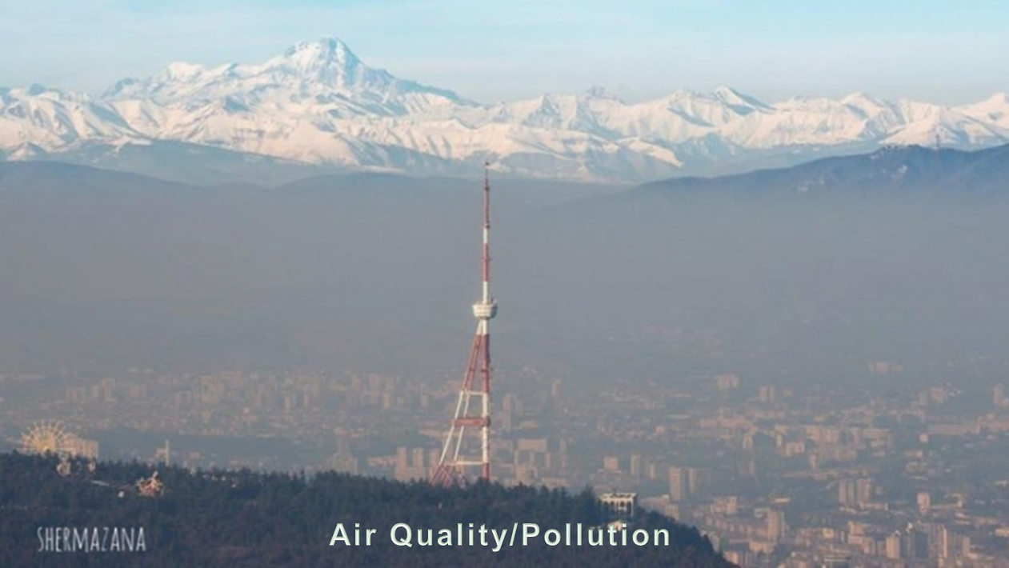
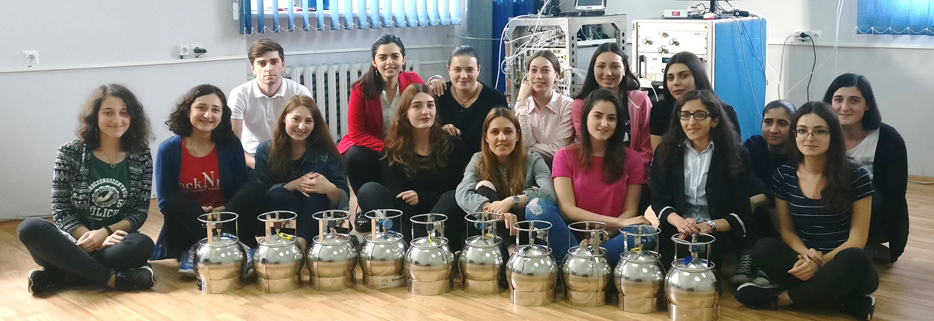
Georgian-german science bridge
Three Pillars
Joint
Research
Educational
Training
Knowledge
Transfer
Tbilisi
SMART|Labs
Jülich

Slide 4
GGSB SMArt|labs
SMART|Labs implemented into GGSB as a returners
program (knowledge transfer):
Well-quipped and maintained modern laboratories – funded
by Georgian government (via SRNSFG); FZJ support (equip.)
Affiliated to a Georgian university connected w/ FZJ institute
Dediated to common project in fundamental/applied sciences
Small expert team (3-5) headed by an outstanding young
Georgian scientist

Slide 5
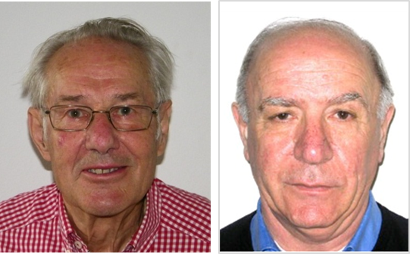
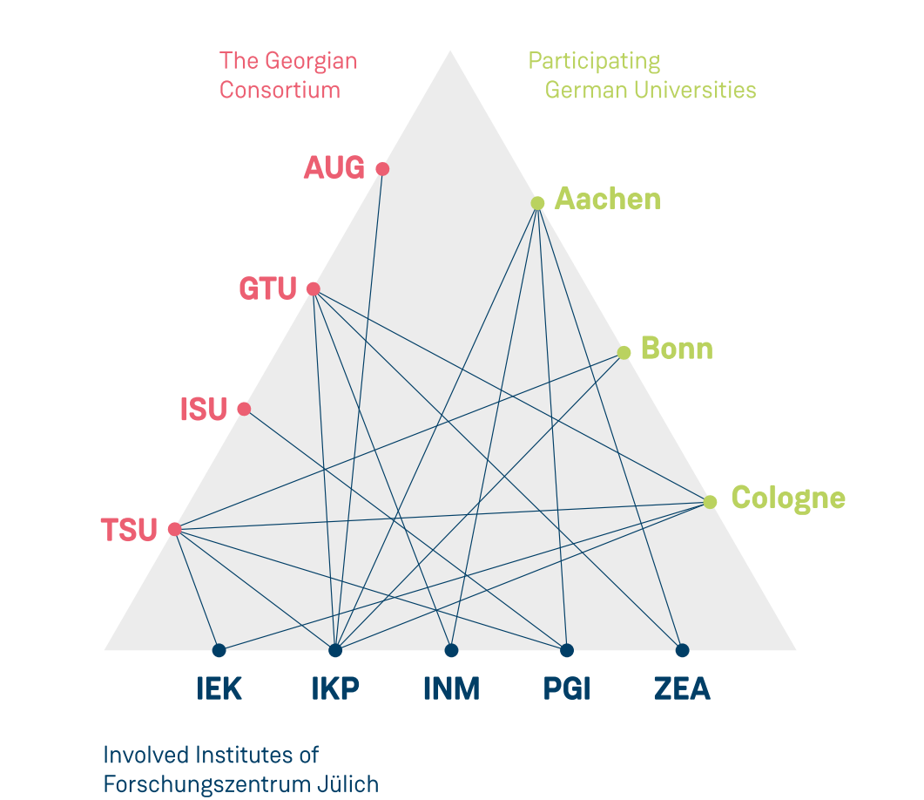
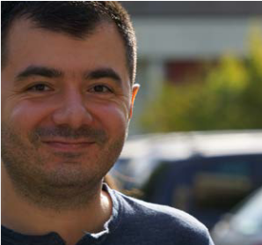
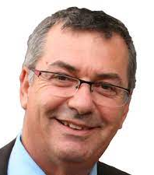
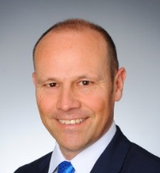
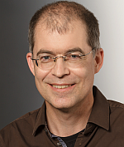
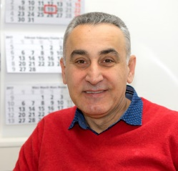
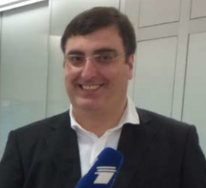
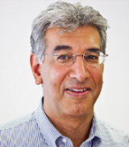
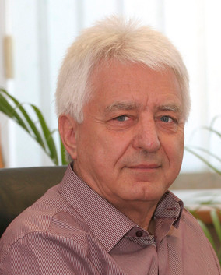
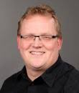
Ggsb network ⁽*
+ KIU
…via affiliated
university professors
SMART|EDM_Lab
2017
2016
SMART|AtmoSim_Lab
A success story:
FZJ: Access Georgia´s best students (→ selection)
Georgia: Scientific collaborations in basic and applied science „at the forefront“
⁽* is extended by German Helmholtz Centres GSI and HZDR (MoUs signed)

Slide 6
GGSB events (I)
Year | Name | Date | Comments
2004 | CGSWHP´04 | Aug. 27 – Sep. 4 | Tbilisi (TSU); 1st trip; Hadron Physics
2006 | GGSWHP´06 | Aug. 31 – Sep. 8 | Tbilisi (TSU); Hadron Physics; FAIR
2008 | GGSWHP´08 | Oct. 27 – Oct. 31 | CANCELED (Georgian-Russian War)
2010 | GGSWBS´10 | May 1 – May 7 | Tbilisi (TSU, GTU); Broader Scope
2012 | GGSWBS´12 | Aug. 4 – Aug. 17 | Tbilisi (TSU, GTU), Batumi (BSU)
2013 |  | Oct. 12 – Oct. 19 | 1st Autumn Lectures (GTU)
2014 | GGSWBS´14 | Jul. 4 – Jul. 12 | Tbilisi (TSU, GTU) 10 Years of GGSB
2015 |  | Oct. 6 – Oct. 13 | 2nd Autumn Lectures (GTU)
2016 | GGSWBS´16 | Aug. 28 – Sep. 2 Sep. 21 | Tbilisi (TSU); JEDI Collaboration Mtg. Inauguration SMART|EDM_Lab (TSU)
2017 |  | Sep. 11 – Sep. 15 Sep. 29 | 1st QUALI-Startup Lectures (Jülich) Inauguration SMART|AtmoSim_Lab (TSU)
2018 | GGSWBS´18 | Aug. 18 – Aug. 25 | Tbilisi (TSU, AUG); Merkel visit
2019 |  | Sep. 9 – Sep. 13 | 2nd QUALI-Startup Lectures (Jülich)
2020 | GGSWBS´20 | Sep. 7 – Sep.12 | CANCELED (Corona Pandemic)
2022 | GGSWBS´22 | Sep. 12 – Sep. 16 | Restart; Kutaisi (KIU) and Tbilisi (TSU)

Slide 7
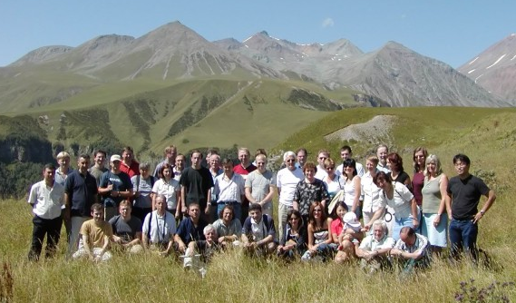
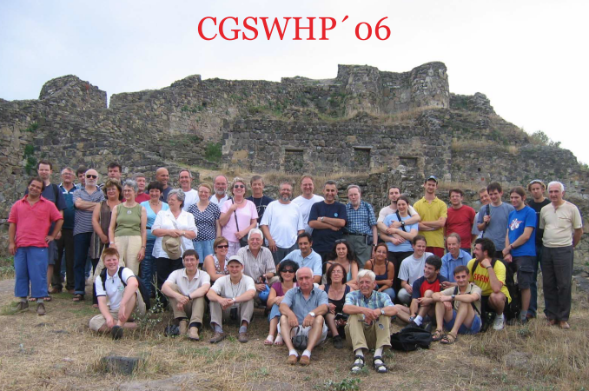
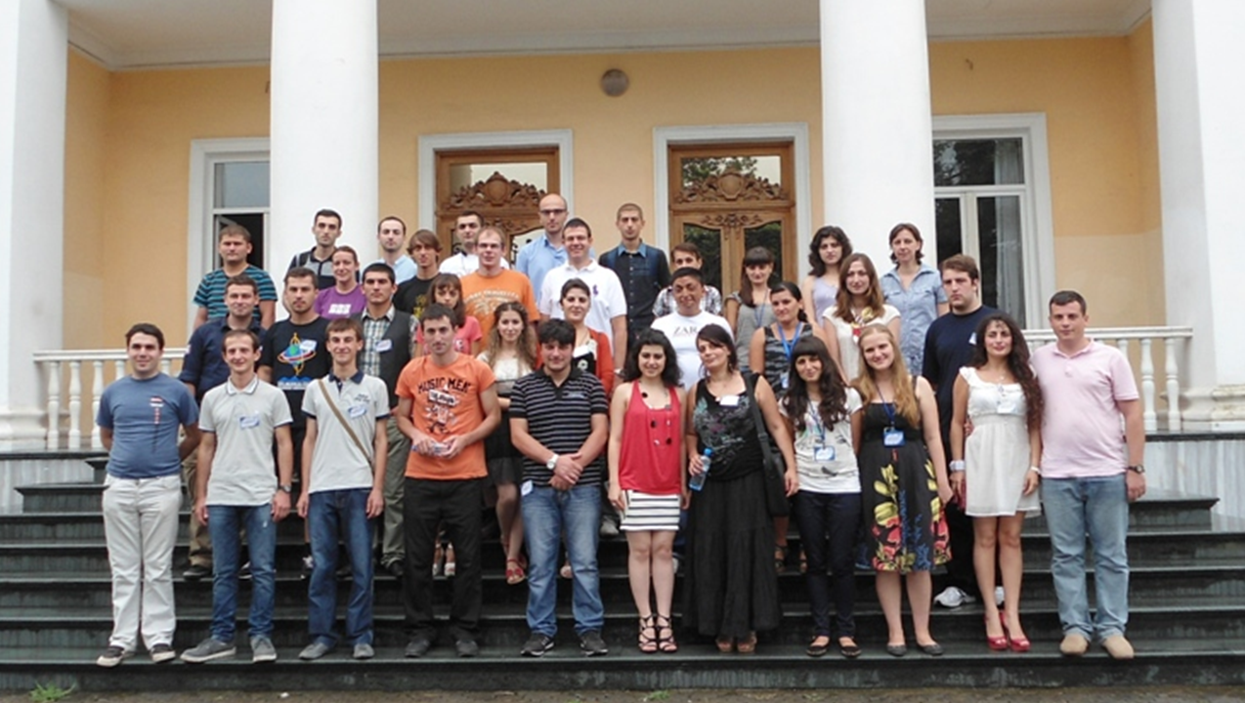
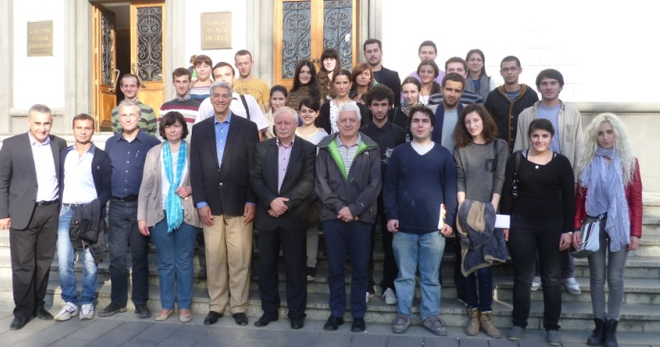
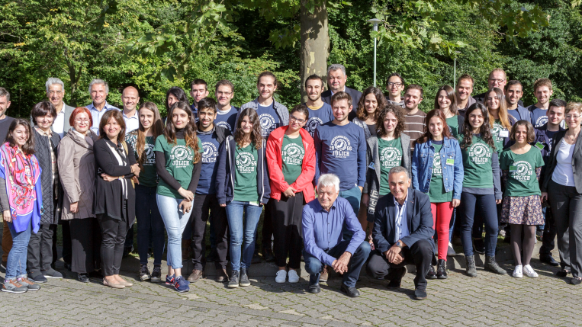
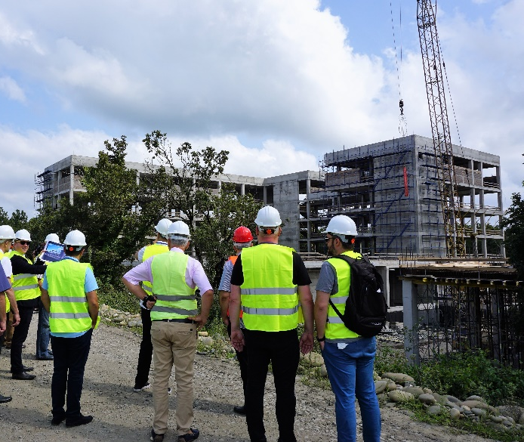
GGSB events (II)
2004 Caucasus
2010 MUZA
2012 Batumi
2013 Autumn Lectures GTU
2016 SMART|EDM_Lab
http://collaborations.fz-juelich.de/ikp/cgswhp/
2017 Jülich
2018 TSU
2019 KIU
Dr´s h.c.: TSU: Hans Ströher, Otto Schult, Sebastian Schmidt & Andreas Wahner, Ulf Meißner
GTU: Hans Ströher & Sebastian Schmidt, Jon Shah

Slide 8
GGSB events – Restart 2022
Visits of Georgian students to FZJ, GSI, HZDR
2024: 20 years anniversary of GGSB
Continuation of PhD student exchange program
Continuation/extension of SMART|Labs
2023: Autumn Lectures / QUALI-Startup Lectures
? Further extension (both in Georgia and Germany)
? (Which) involvement in HTC at KIU
? Georgian Science and Technology Center (GSTC)
→ Next talk by Jon

