Slide 1
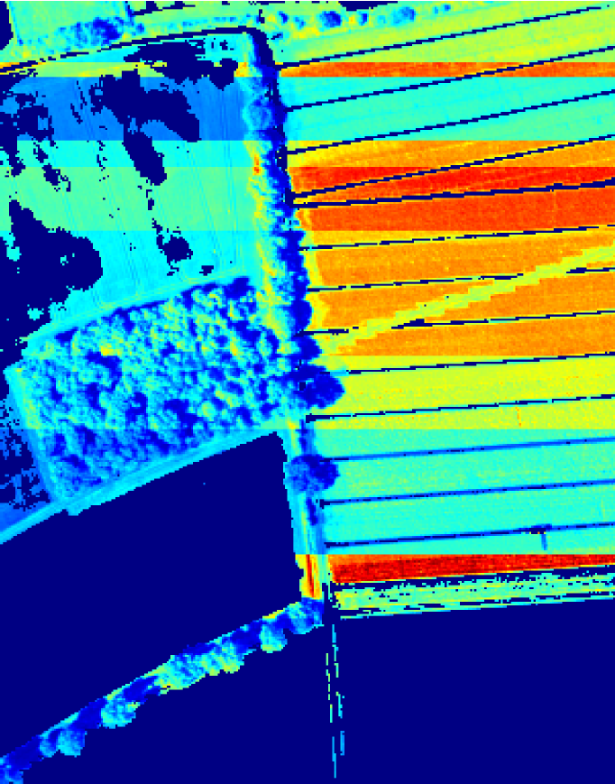
SMART|DataLab
Hanno Scharr, IAS-8, Forschungszentrum Jülich
Ramaz Botchorishvili, Kutaisi International University

Slide 2
SMART|DataLab
A platform for joint research on core AI and practical machine learning topics
Our goals
Provide a platform for students to work on core AI and practical machine learning tasks,
tasks preferably linked to GGSB research
Offer internships at participating institutes
e.g. learn how to use HPC for ML
access to HPC resources
Offer joint Bachelor, Master, and PhD thesis topics to be (partly or completely) done at Jülich
SMART DataLab
Joint
research
Educational
training
Incentives
and
access
Knowledge
transfer

Slide 3
SMART|DataLab
SMART DataLab
A platform for joint research on core AI and practical machine learning topics
Joint
research
Educational
training
Possible attractions and incentives for students
Data Challenges with own incentives like prices for winners (participation in international workshops, money, internships, joint publications etc.)
Hackathons in inspiring environment (e.g. kick-off talks / lectures, technical support, free food, low barrier access to experts)
Workshops / winter- or summer-schools
Access to soft-skills and career-building events (e.g. on entrepreneur-ship)
Incentives
and
access
Knowledge
transfer

Slide 4
SMART|DataLab
SMART DataLab
A platform for joint research on core AI and practical machine learning topics
Joint
research
Educational
training
What we offer
Joint research
topics students can work on
Educational training
Internships and Bachelor / Master / PhD thesis work
Local costs covered by Jülich institutes
Knowledge transfer
e.g. practical knowledge how to do ML on HPC
Access to HPC / compute time via Jülich institutes
Incentives
and
access
Knowledge
transfer
 | Amazon AWS | JURECA
Configuration | p4d.24xlarge | DC-GPU node
GPUs (A100/40GB) | 8 | 4
CPU kernels | 96 | 128
RAM (GiB) | 1152 | 512
Price | $41/hour | --

Slide 5
SMART|DataLab
SMART DataLab
A platform for joint research on core AI and practical machine learning topics
Joint
research
Educational
training
What we need
Office space, where students can work
Stable and fast internet connection allowing for server access
Access to on campus workstations with suitable GPU
Assistants and/or group leader
Assistants: part time, administrative, PhD and other students
Group Leader: full time, PostDoc
Event organization, software / framework / ‘every-day’ support
Lecture / seminar / hands-on course ‘Machine Learning on HPC’
Travel money for students
Cost coverage for hackathons, workshops and winter-/ summer-schools
Incentives
and
access
Knowledge
transfer

