Slide 1
Technology for Excellent Science
ZEA-1
25.08.2022 | prof. Dr. Natour

Slide 2
ZEA
Central Institute of Engineering, Electronics and Analytics
ZEA-1│Engineering and Technology│Ghaleb Natour
Design, development and fabrication of scientific and technical equipment, instruments and processes
ZEA-2│Electronic Systems│Stefan van Waasen
Development of complex electronic and information technology system solutions
ZEA-3│ Analytics │Stephan Küppers
Analytical competence for research and application

Slide 3
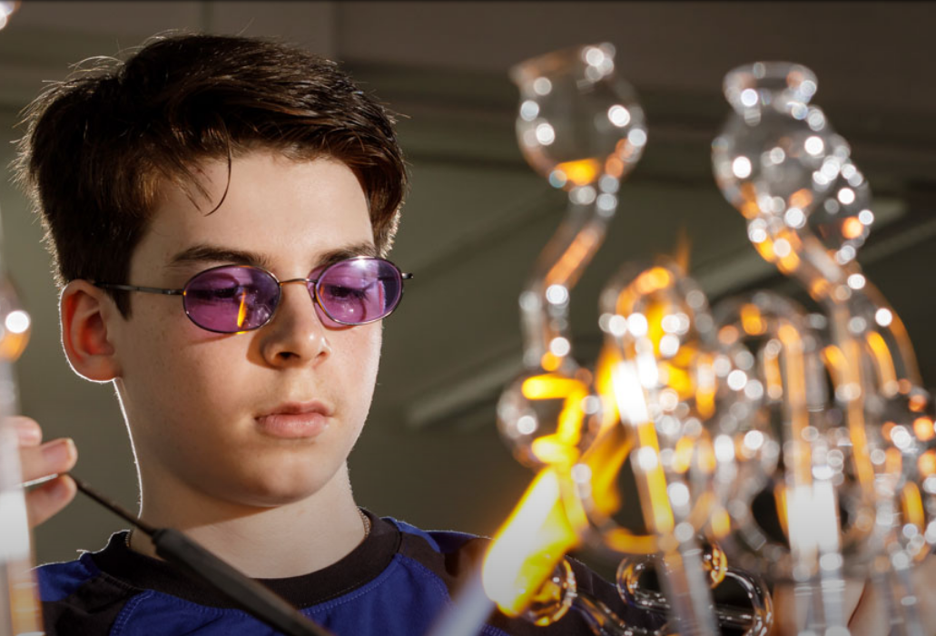
Facts and Figures (as at 09/2022)
ZEA-1
9 PhDs, 5 Master- and 4 Bachelor students, 2 Trainees and 6 Colleagues in Administration
150 on-going FZJ-cooperation
27 on-going industrial cooperation
10 funded projects with external partners
Approx. 160 Employees
100 in the Department Engineering and New Technologies
50 in the Department Fabrication Techniques and Assembly
Active in all four HGF research fields Energy, Information, Matter, Earth and Environment
Within 9 of 10 Research Programmes in every scientific priority of the FZJ
Notes:
Within 9 of 10 Research Programmes in every scientific priority of the FZJ: not in MT / Research Programm Materie
FZJ Cooperations = Summe aus Anzahl E-Nummern + Aufträge

Slide 4
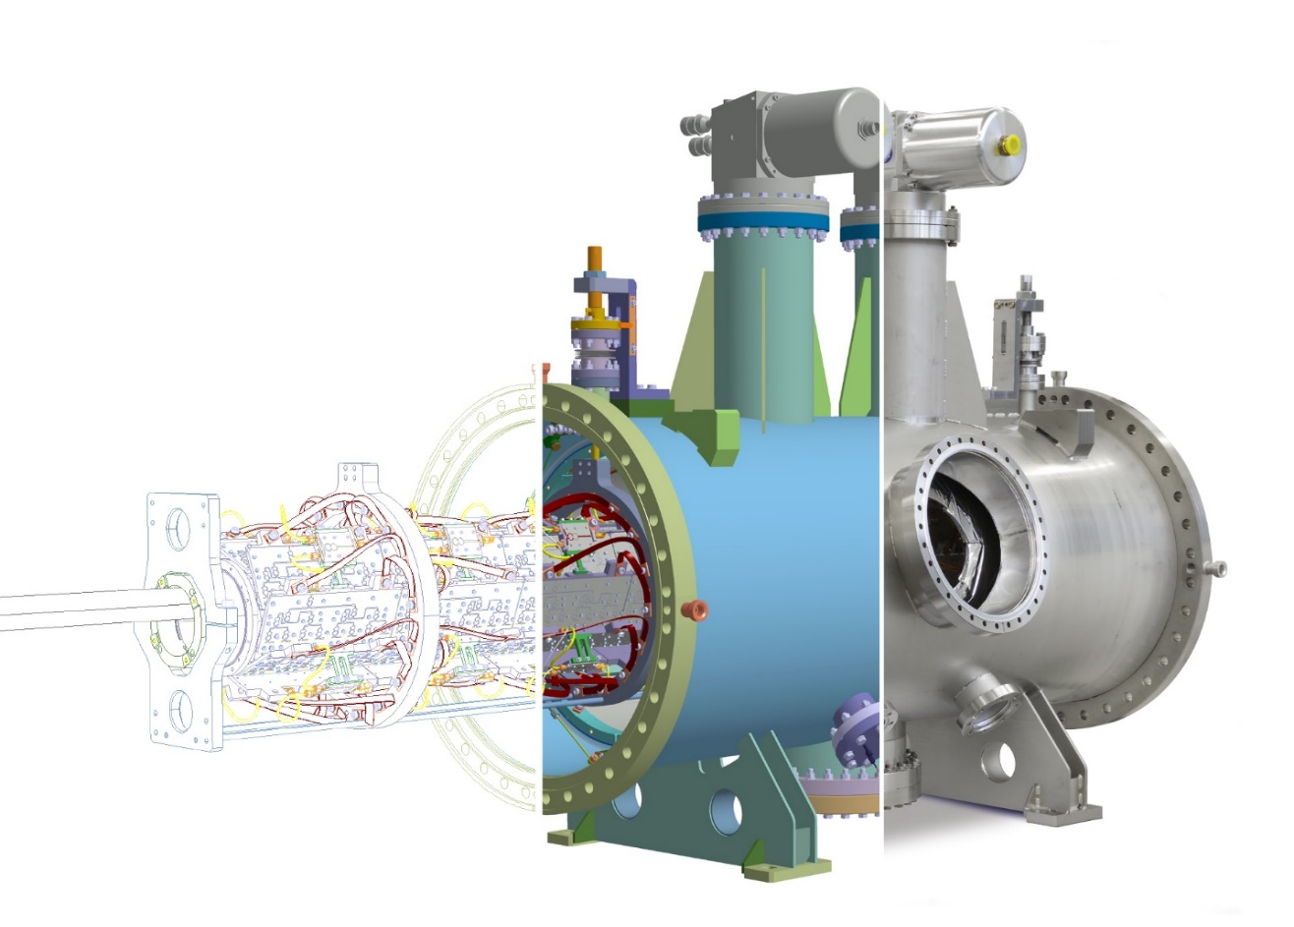
Our fields of research
RESEARCH
Neutron Science
Accelerator Physics
Energy
Climate Research
Bio-Geo Science
Information
Manufacturing Technology
5 mm
Notes:
Neutronen: NBEX (ESS)
Climate: Innensicht Saphir Kammer (Atmosphärensimulationskammer mit IEK-8)
Accelerator: Kicker für HESR (Synchrotron in FAIR, Darmstadt mit IKP-4)
Bio-Geo: Agrasim (Pflanzenkammer mit IBG-3)
Energy: Iter (IEK-4) / In internationaler Zusammenarbeit entsteht in Cadarache im Süden von Frankreich das große Fusionsexperiment ITER
Information: BrainPET (neue Generation der medizinische Bildgebung mit 7T, INM-4)
Manufacturing: mittels SLE hergestelltes miniaturisiertes Lager

Slide 5
Progrm oriented Funding of HGF
ZEA-1 Yearly budget of 16 Mio€
Scientific Divisions of FZJ
Research field distribution

Slide 6
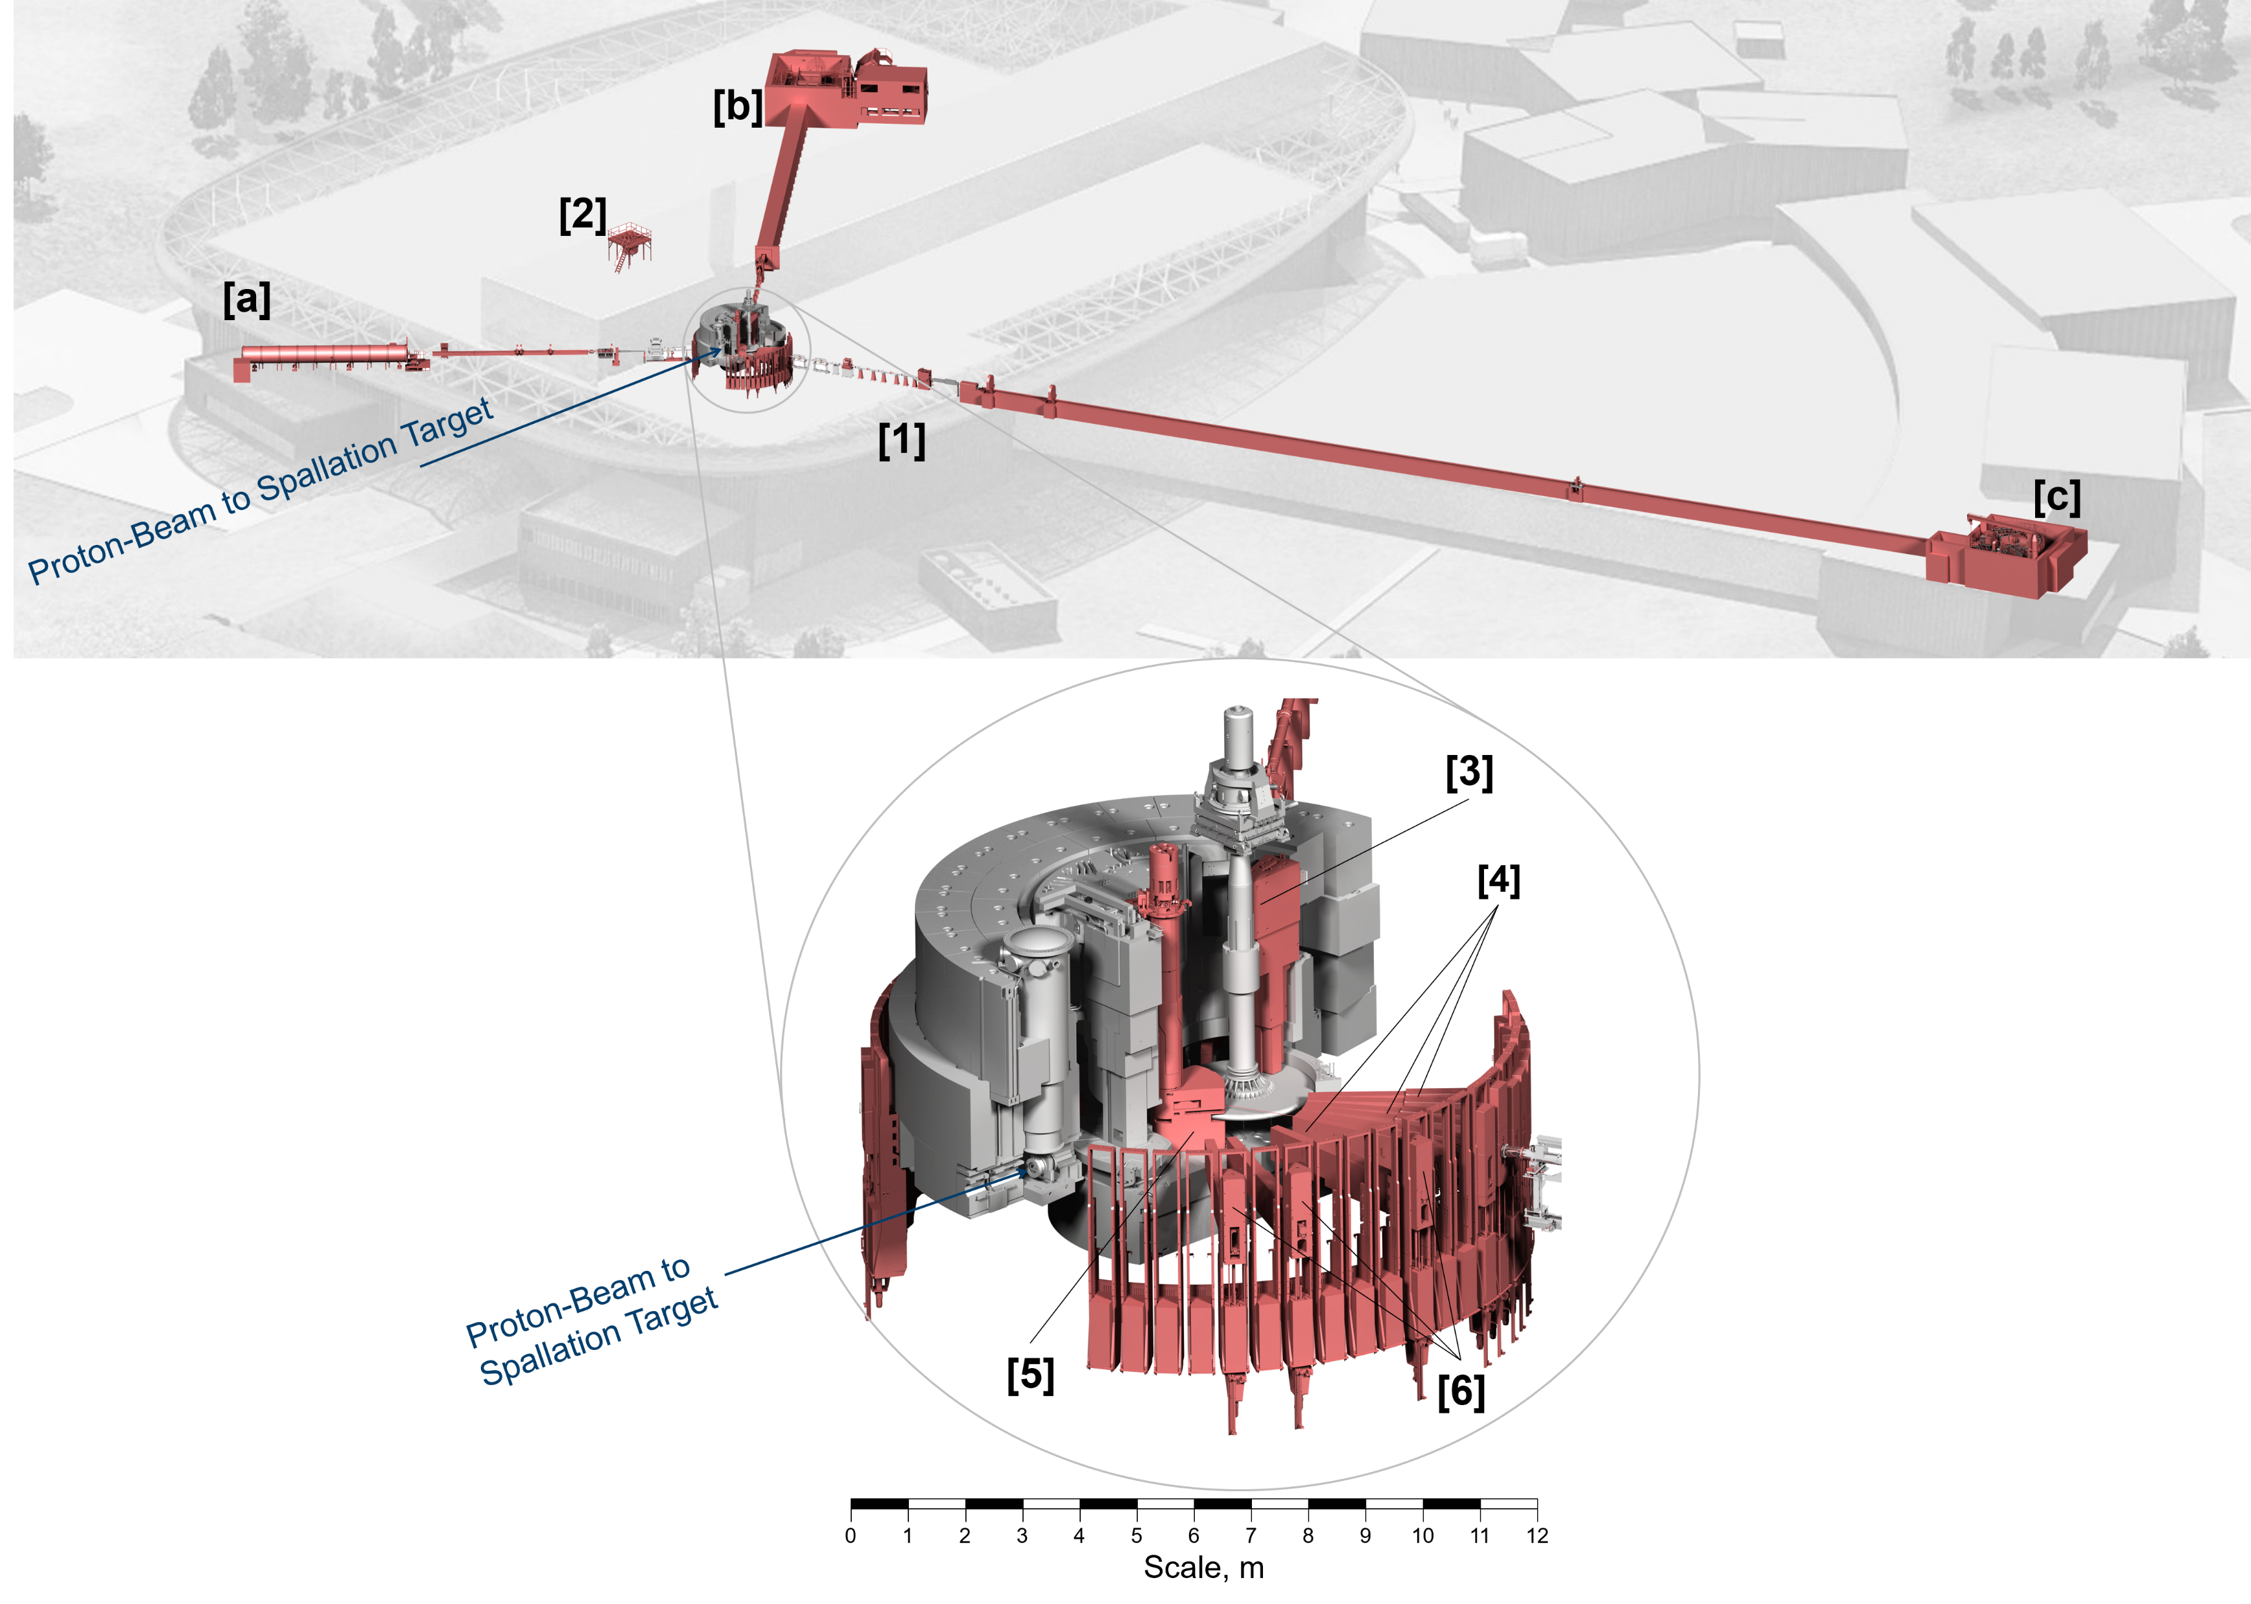
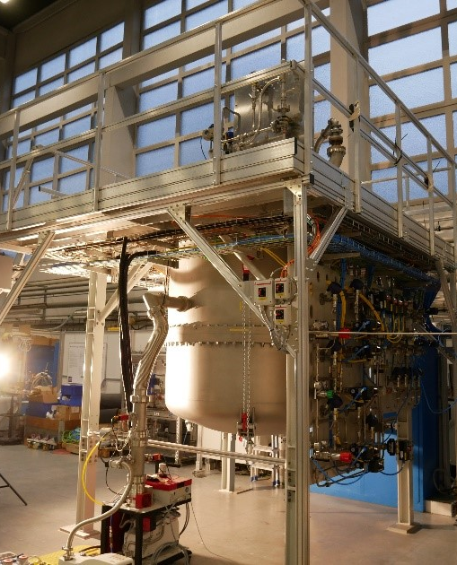
ess
Isometric View of the ESS target station and three instruments, with the components provided by ZEA‑1 highlighted in red.
[a-c] ESS Instruments SKADI DREAM and T-REX
[1] 3x Chopper Systems
[2] Hydrogen Cryostat
[3] Target Monitoring Plug
[4] 16x Neutron Beam Port Inserts
[5] Moderator & Reflector System [6] 16x Light Shutter Systems

Slide 7
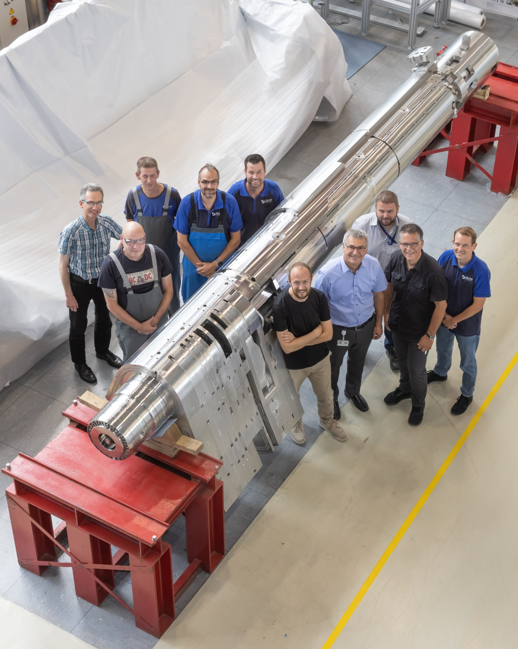
Moderator and Reflector System
ESS
Project duration: 06.2015-08.2022
13t stainless steel with low cobalt content
Pure beryllium as neutron reflector
High strength aluminium as container for the moderators
9 independent loops (water cooling) to remove 500KW of nuclear heat
2 independent liquid hydrogen loops (460 g/s at -253°C)

Slide 8
Overview
ZEA-1
Consultation
Feasibility studies
Concept and Design
Modelling and Simulation
Manufacturing
Assembly
Measurement and testing technologies
Certification

Slide 9
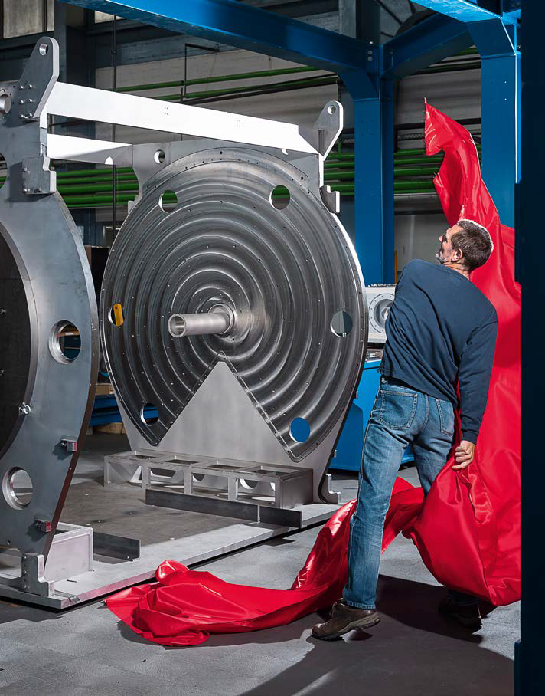
Jülicher Masterpieces
Technology for Excellent Science
We combine complex production technologies with the finest engineering to provide interdisciplinary & holistic turn key solutions
One-Stop Shop - from the idea to product
We develop new methods
Notes:
Wir können große und kleine Kammern
Wir entwicklen messgeräte

Slide 10
Daily Business
JCNS FRMII
Time of Flight Polarization Analysis Spectrometer
Design
Manufacturing Calculations Automation Testing Modification
50 tons of steel
50m O-ring sealing
3 km welding seam
Max. Deformation of 5mm at 4m length
Ø 6,5m
Volume 76m³
Hight 3.2 m
Vacuum < 10⁻⁵ mbar
Required vacuum < 2h

Slide 11
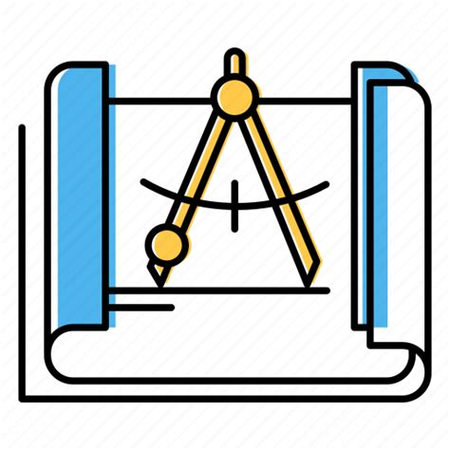
holistic approach
Modelling / Simulation
Engineering Design
Prototyping /
Demonstration Units
Manufacturing
Research &
Development
Automation / Control Techniques
Testing / Measurement
Notes:
automation and control tech statt welding

Slide 12
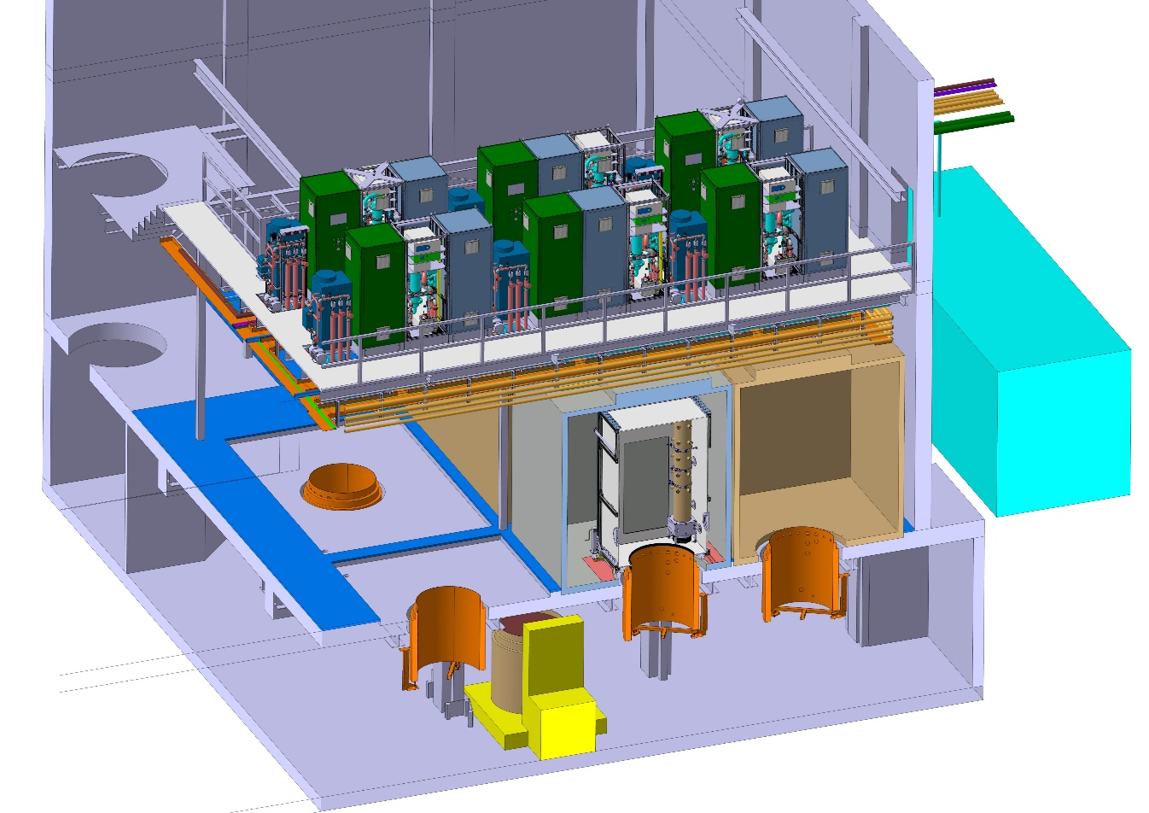
IBG3
Agrasim - Agricultural Food Production Simulator
Scientific goal Plant time machine
Simulating different climate scenarios
→ expected influence on crops
optimization of nutrient and water use efficiency of agricultural production systems based on detailed analysis and simulation of the key processes in the soil-plant-atmosphere system under present and future environmental conditions.
Technical challenges
Developing the plant chamber with inner inert surfaces and an inert cooling system with high capacity
Planning and developing the process technology to fully control the environment, for example to establish different CO₂, O₃ and humidity levels in the plant chamber
Process control equipment
Climate chamber
Plant chamber
Lysimeter with intact soil core

Slide 13
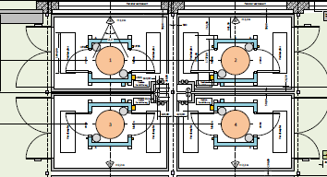
The Plant Time Machine - AGRASIM
Research & Development
Development of the overall concept for the experiment
Research for an inert cooling system for the plant chamber with high cooling capacity
Planning and development of the process technology of the experiment

Slide 14
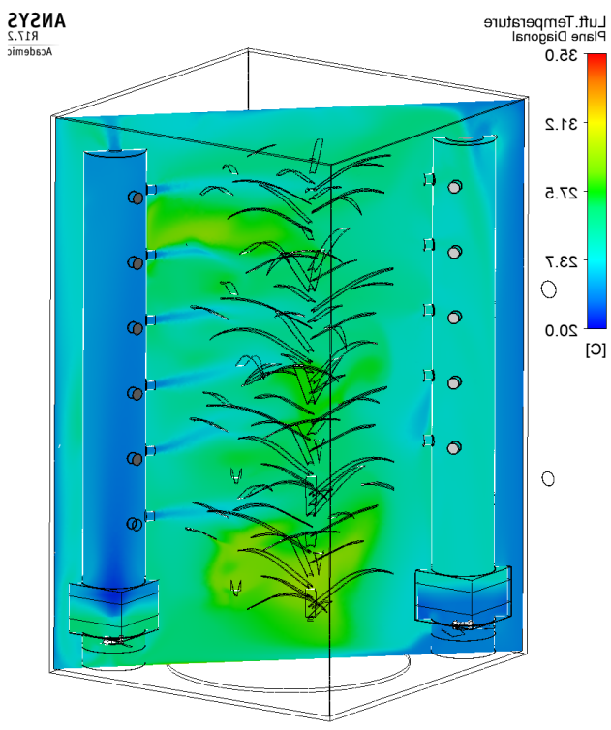
The Plant Time Machine - AGRASIM
Modelling & Simulation for the plant chamber
Simulation of cooling of the plant chamber air
Simulation of the mixing of the air inside the plant chamber to achieve homogeneous mixing
Humidity simulation
Notes:
Wärmeleistung 3 kW (laut Lampenhersteller werden nur 2kW für ausreichende Beleuchtung benötigt)

Slide 15
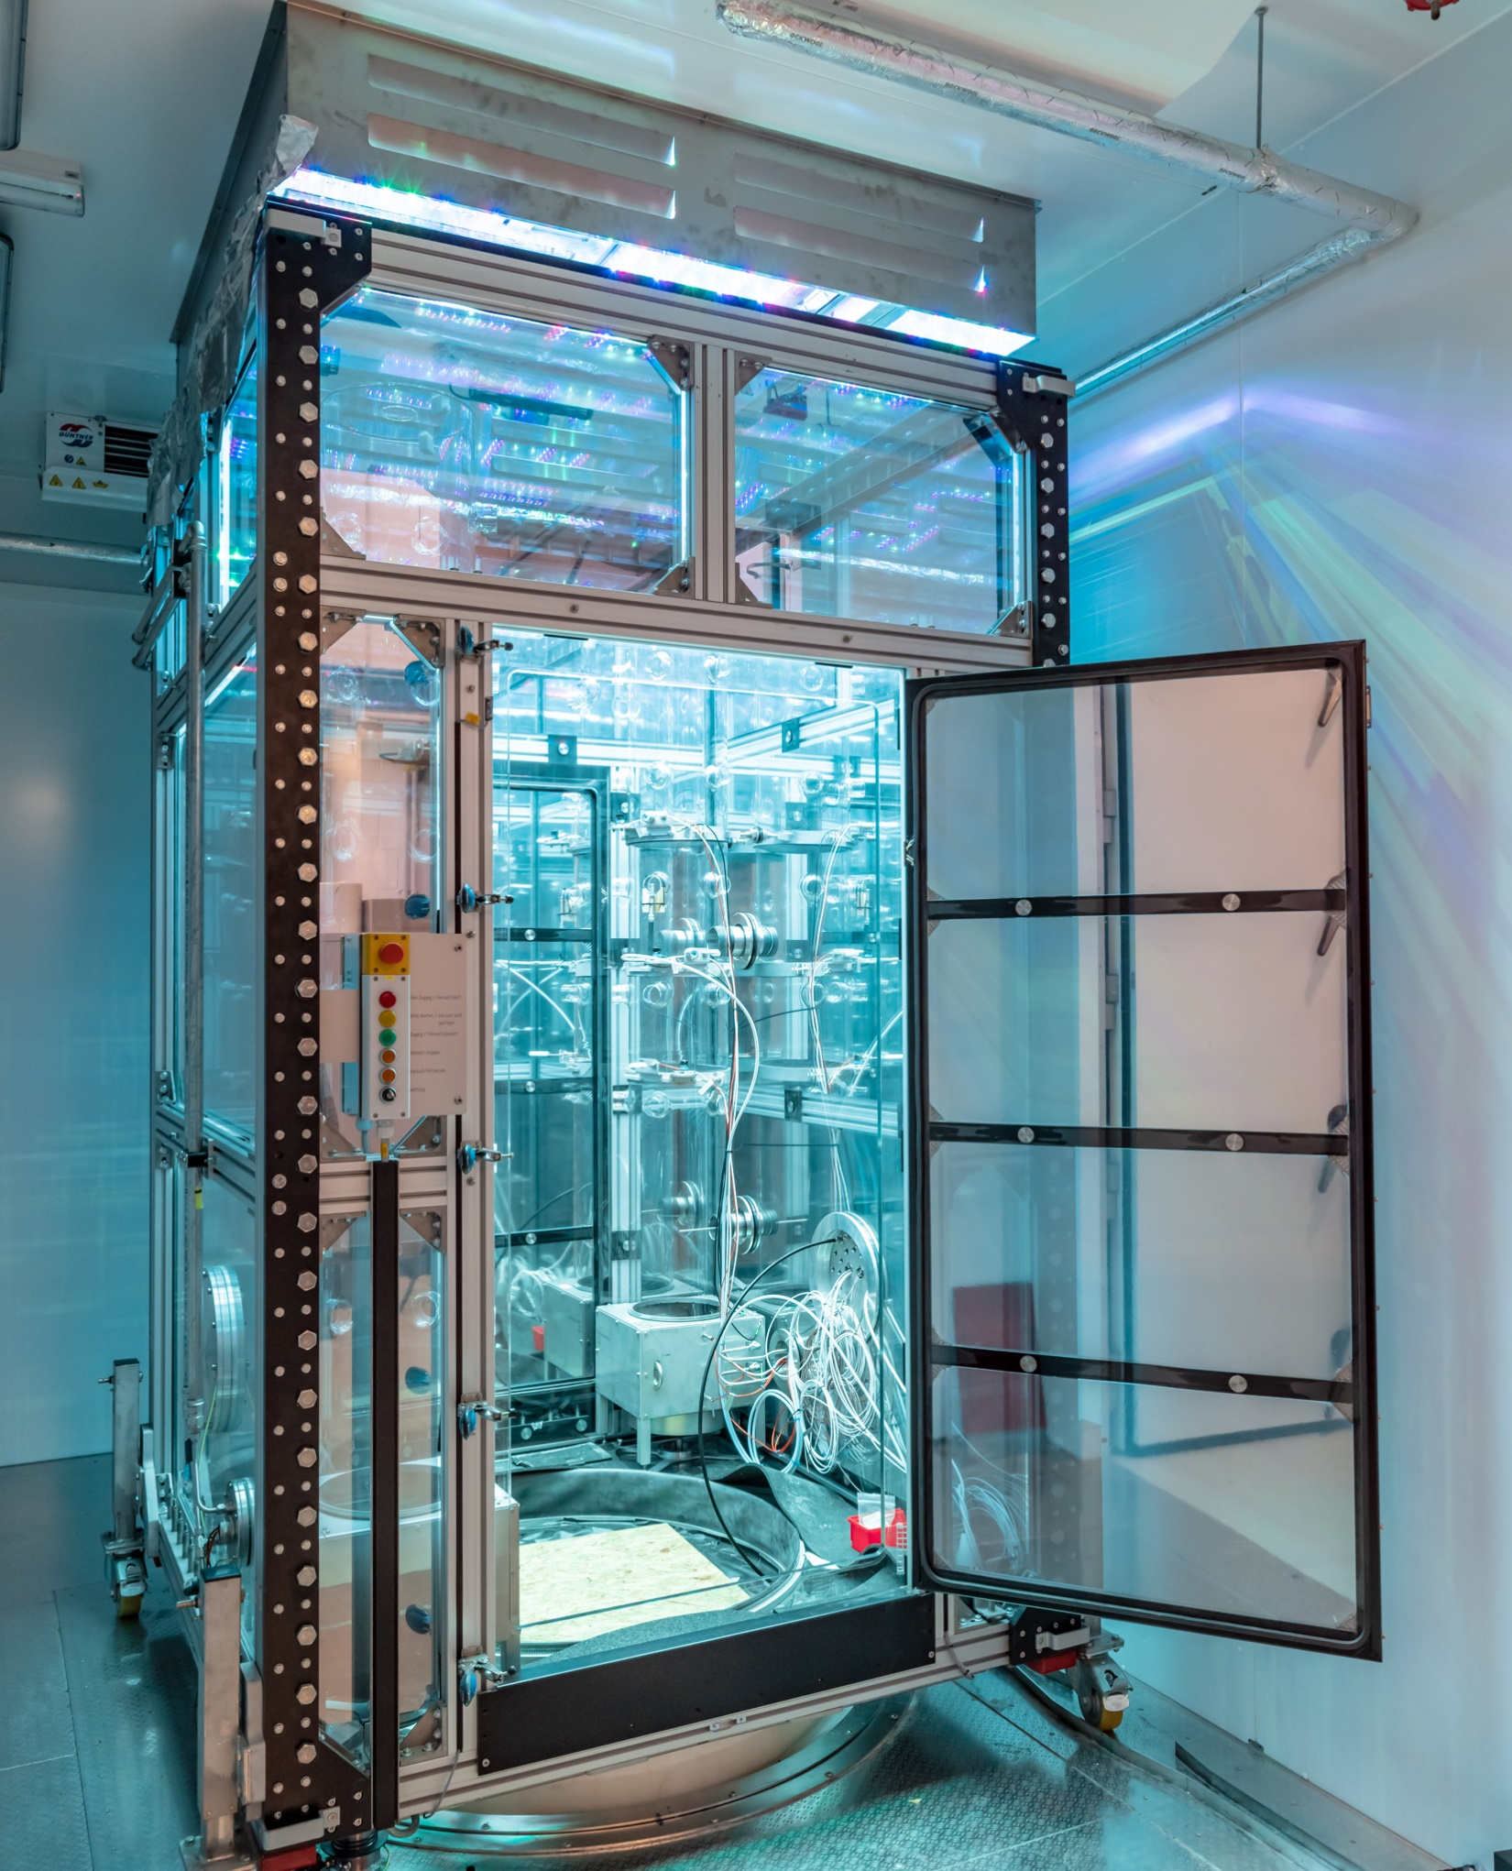
The Plant Time Machine - AGRASIM
Design
CAD design of the entire experiment, which extends over three floors
Design of all mechanical components
Calculation and selection of the entire process technology, for example valves, flow controller etc.

Slide 16
The Plant Time Machine - AGRASIM
Manufactoring
High precision milling of key components
EDM machining of complex structures
Water jet cutting
Accurate 3D printing for complex geometries with low mechanical loads

Slide 17
The Plant Time Machine - AGRASIM
Testing & Measurement
Pre-check and test of all sensors, actuators and motors in the laboratory and test hall (test of the plant lightning on the picture right)
Preliminary testing of the entire electrical system of the experiment
Pressure test of the refrigerant circuit
Helium leak test for checking the gas supply

Slide 18
The Plant Time Machine - AGRASIM
Construction & Assembly
Manufactured and ordered over 50.000 parts for the entire experiment
Assembly of the experiment on site including intermediate tests, preliminary tests and commissioning

Slide 19
The Plant Time Machine - AGRASIM
Automation and control techniques
Precise control of a wide range of parameters to simulate environmental conditions
Acquisition and control of a total of over 35.000 parameters
User-friendly visualization of the entire experiment
Worldwide remote control and error diagnosis possible
Status information can be received via mobile devices

Slide 20
holistic approach
Modelling / Simulation
Engineering Design
Prototyping /
Demonstration Units
Manufacturing
Research &
Development
Automation / Control Techniques
Testing / Measurement
Notes:
automation and control tech statt welding

Slide 21
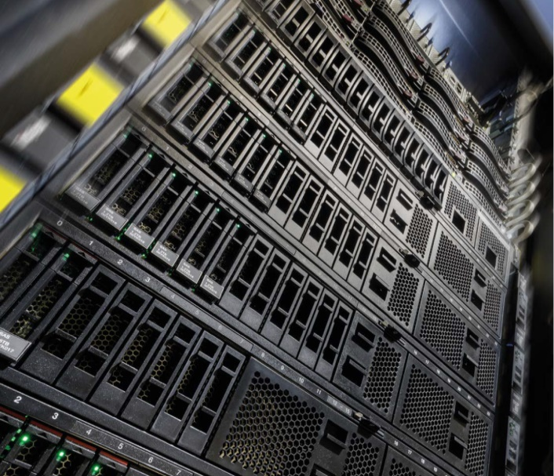
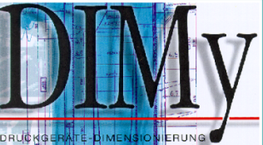
Modeling & Simulation
ZEA-1
Statics, dynamics & buckling
JuZEA-1@JSC
10 compute nodes (+ 3 nodes for login / service)
48 cores / node = 480 cores
100 Gbit/s InfiniBand network
4608 GB main memory
ZEA-1 Cluster
7 compute nodes
120 cores
10 Gbit/s Ethernet network
1920 GB main memory
+ GPFS Storage System & ZEA-1 file server
Fields of Competence
Crash simulations
interface
APDL & WB
HPC (554)
Rotor-dynamics
Fatigue & fracture mechanics
Vibration & modal analyses
Thermo-electric calculations
Ampere / Magneto / Faraday
Opera
Rifest Plus
Cobham
JuZEA-1@JSC
Thermo-mechanical calculations
magnetic & electromag. calculations
CFD / thermal-hydraulics
Optimization
Magneto-hydro dynamics (MHD)

Slide 22
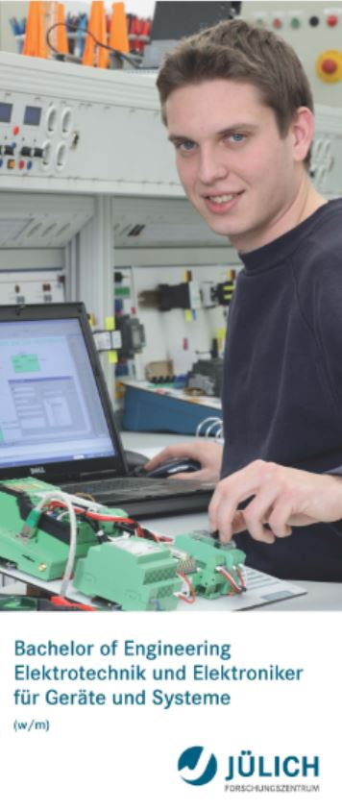
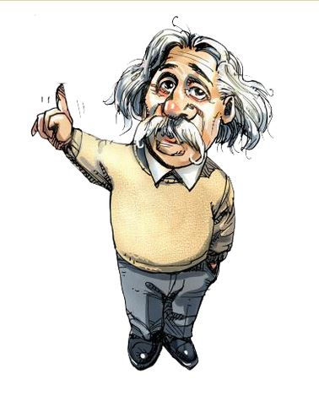
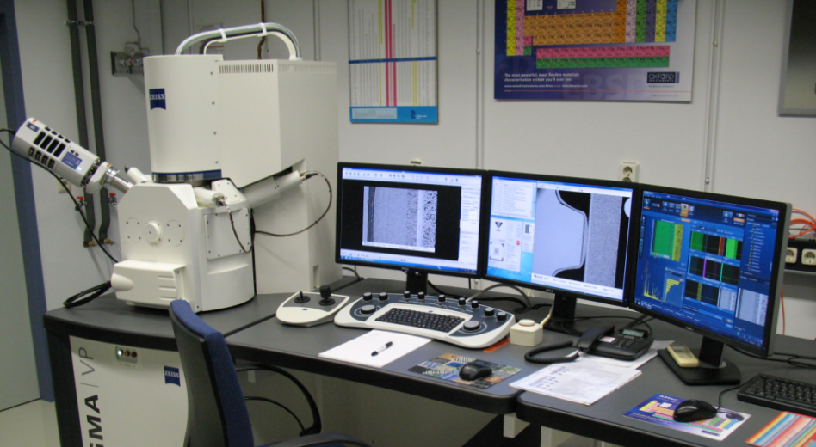
What is needed for excellent scientific research
Creative scientists
Technical equipment and instrumentation
Technical professionals (Dual studies programs)
System enabling research (political and institutional)

Slide 23
Dual Studies
Double Qualification |dual study programm consisting of study curriculum combined with a vocational training leading to the double qualification: Bachelor degtree and an aknowledged degree of IHK (Industry and Trade Chamber) or HWK (Crafts Chamber)
Significantly Shorter time compared to the time needed for the vocational training and the subsequent following study 3,5-4,5 years in total
Practical training takes place in a company,
the practical part is very high and is aligned with the requirements of the economy
Payment Whereas a purely university-based study
must be financed by the student, in a dual program of study generally the company providing the training is providing a salary to the student .
Diversity of dual study programms e.g. at Fh Aachen 14 are available: a.o. Applied Chemistry, Optometry, Business Administration, Civil Engineering, Electrical Engineering, Mechanical Engineering, Physical Therapy, Scientific Programming, Mechatronics …

Slide 24
Examples of qualifications
Bachelor of Engineering - Physics Engineering and Physics Laboratory Technician
Bachelor of Science - Applied Chemistry and Chemistry-laboratory assistant
Bachelor of Engineering - Mechanical Engineering PLuS and Industrial Mechanic (PLuS: Praxis, Lehre und Studium)
Bachelor of Science - Applied Mathematics and Computer Science and Mathematical-Technical Software-developer
Bachelor of Science - Business Administration and Office Management Assistant
Training company: Forschungszentrum Jülich
Cooperating university: Aachen University of Applied Sciences (Fachhochschule Aachen/Jölich)

