Slide 1
Controlling Advanced Experiments (Part II)
Image based measurements
Department of Research Technology · Department of Measurement Technology - FWFE · Dr.-Ing. Gerald Wedel · g.wedel@hzdr.de · www.hzdr.de

Slide 2
Introduction
Several experiments demand an optical monitoring and subsequent data processing, for example for
    parameters of an electron beam,
    condition monitoring of a running experiment and
    detection and characterization of materials to be processed.
The main components needed for accomplishing these tasks are
software for controlling and parametrisation of an optical detection device (camera),
a data processing unit (PC or embedded device) and
hard- and software for (post-)processing the retrieved data.
The 2nd and 3rd item are usually combined, if possible.
At the Department of Measurement Technology these points are addressed.

Slide 3
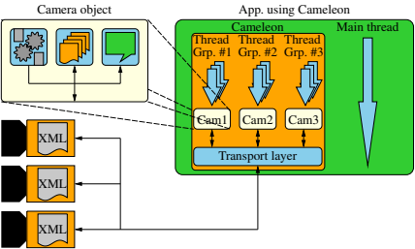
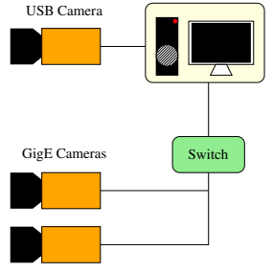
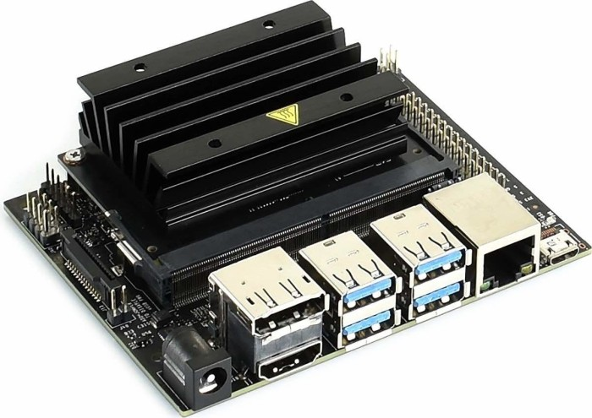
Controlling and parametrisation of a camera
Hardware & software setup
Software setup:
Proprietary mulit-threaded library Cameleon (C/C++ interface)
For each connected camera an object is created, which allows
- the camera parametrisation
- individual control of the image acquisition
- user-defined callback-functions for camera events, like for
the arrival of a new image
Hardware setup:
Industrial cameras (GenICam compliant)
Supported interfaces: GigE, USB(, CameraLink)
PC/embedded device for controlling data acquisition

Slide 4
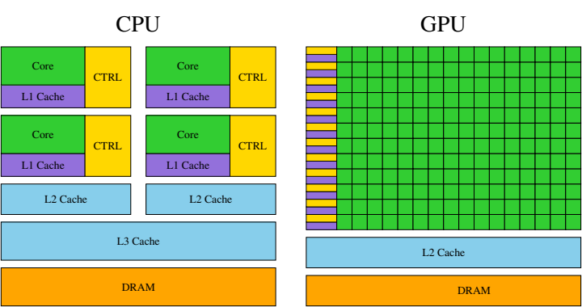
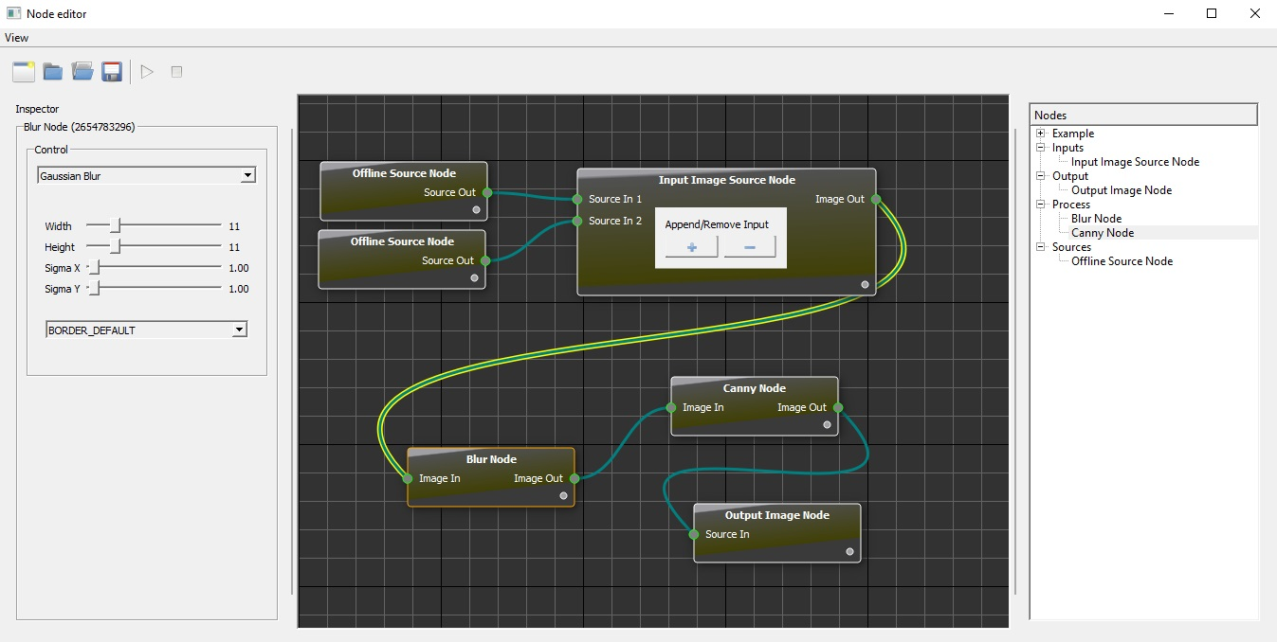
Data (post-)processing
Supported hard- and software
Supported Hardware:
PC w/wo CUDA capable GPU
Embedded system (Raspi 3-4, Nvidia Jetson series)
Supported Software:
Customized software (C/C++, CUDA)
Proprietary image pipeline (image filters, etc.)

Slide 5
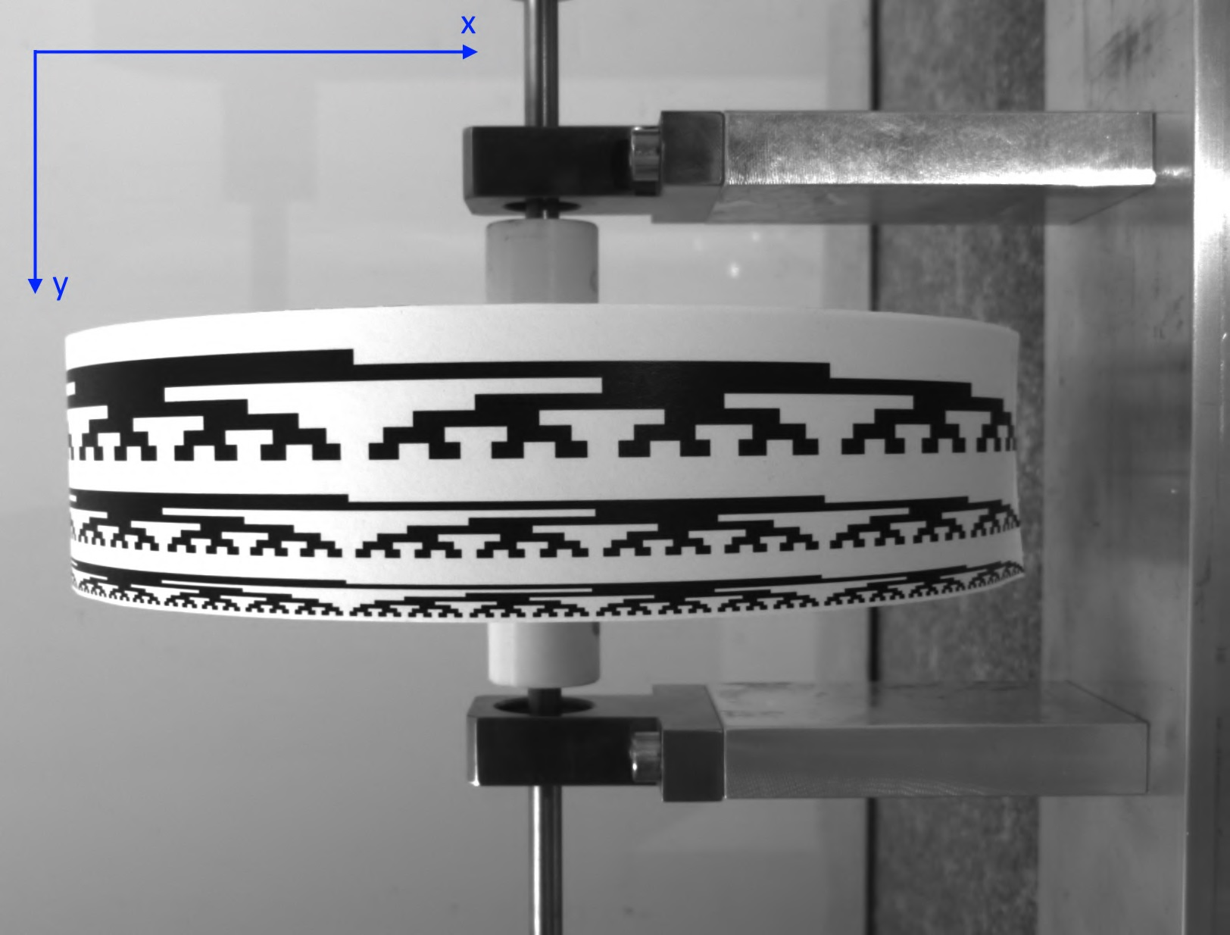
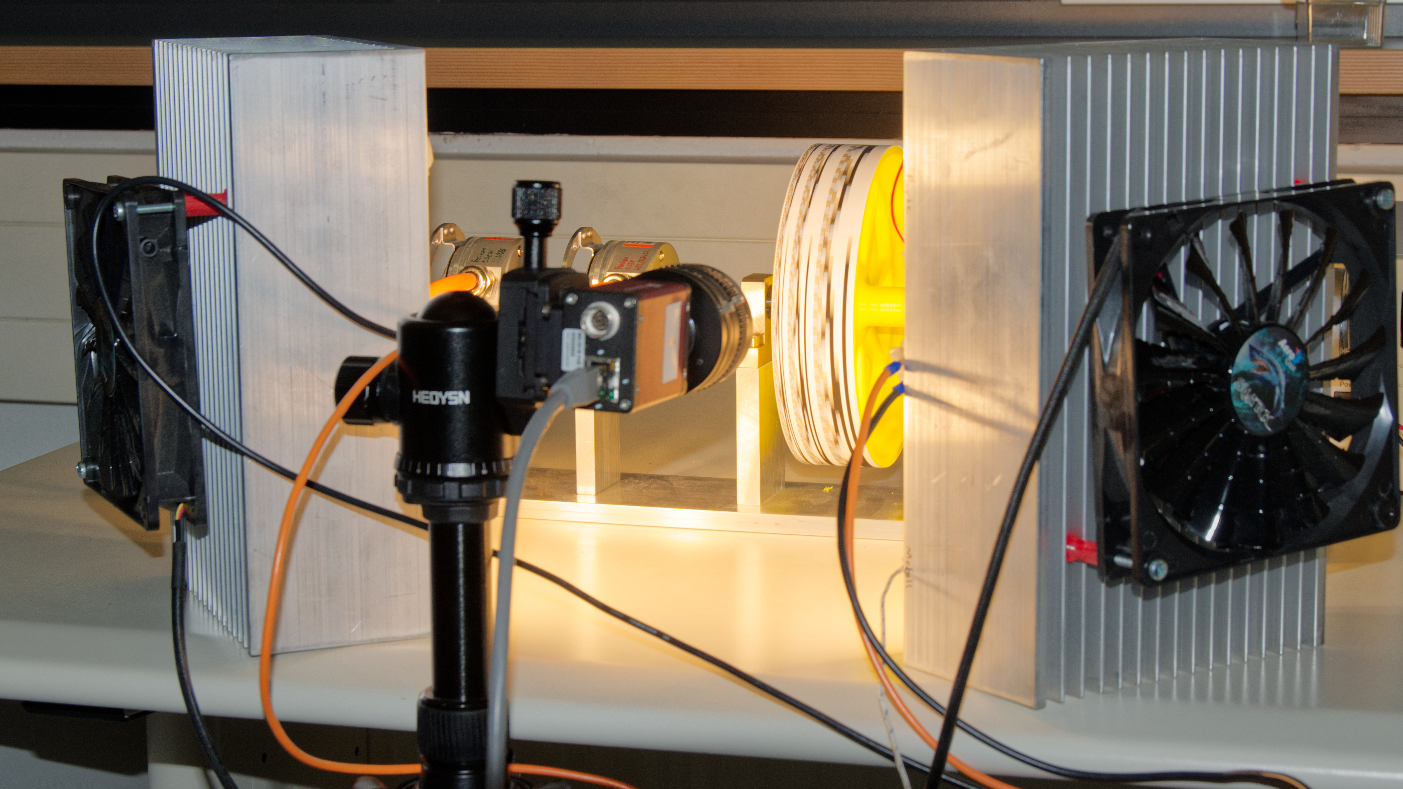
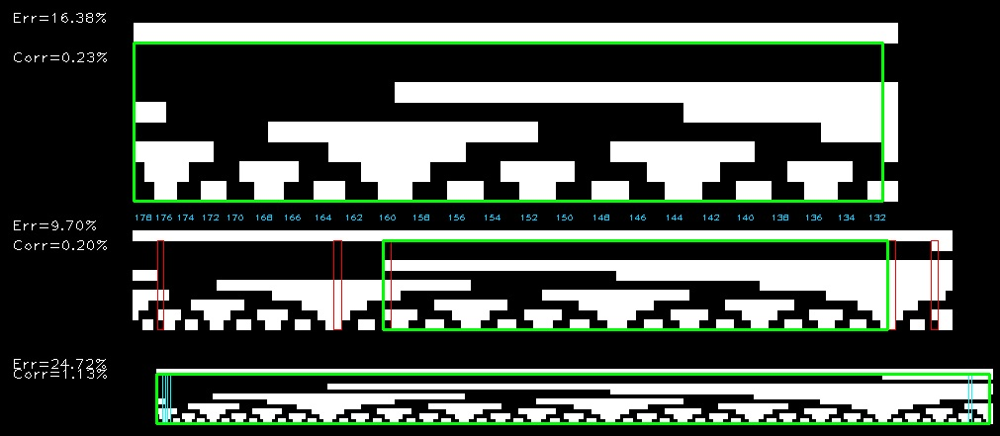
Application examples
Gray-Code decoding on a rotating vessel
Supervised Diploma thesis: Gray-Code decoding
Image acquisition (1634 x 1234 px @ 30fps) and processing on
Jetson Nano (Arm CPU + Nvidia GPU)
Transfer of the decoded numbers to a host PC via Ethernet
Gray-Code reconstruction on the host PC

Slide 6
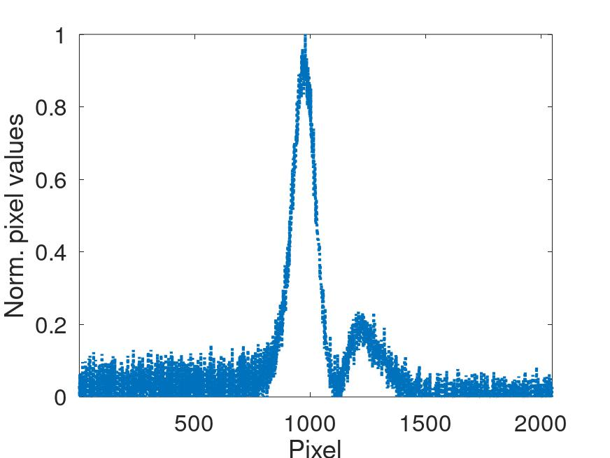
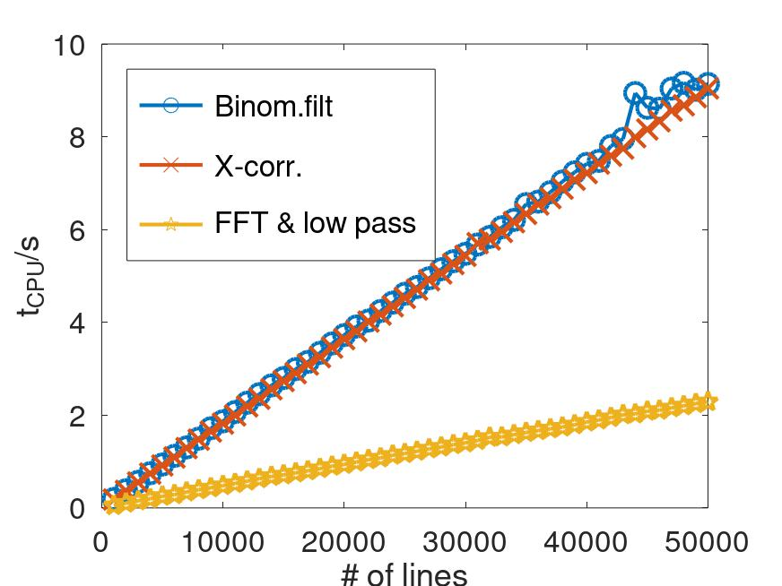
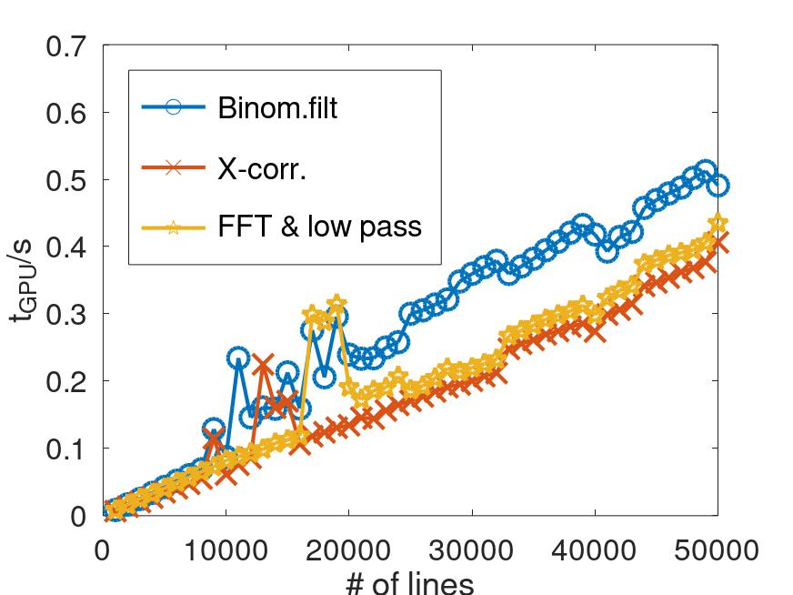
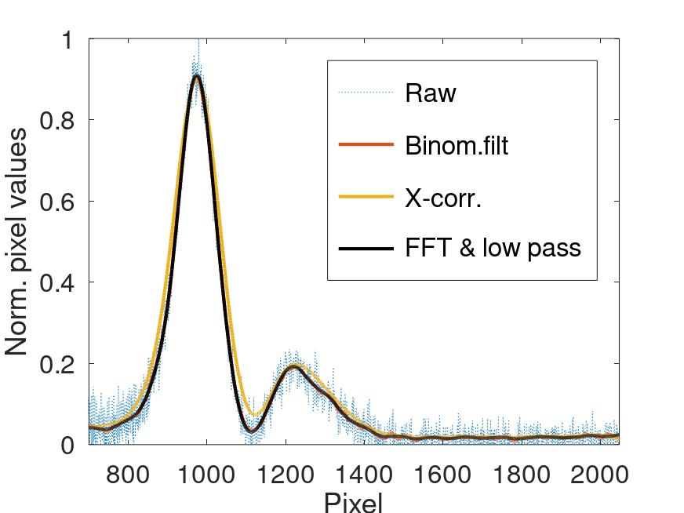
Application examples
Spectral arrival time monitoring
HZDR TELBE:
Evaluation of the pixel data of a line-scan camera (CameraLink)
Peak position within the pixel data correlates to the arrival time (px → ps)
~ 50 000 fps @ 2048 px/line, Mono12
Noisy data => smoothing & peak detection of 50 000 lines in less than 1s
CPU too slow → GPU accelerated evaluation of the pixel data

Slide 7
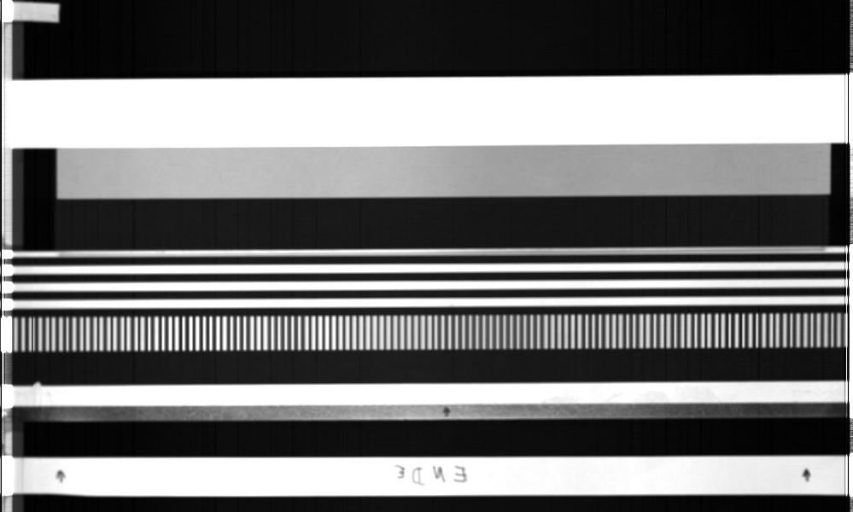
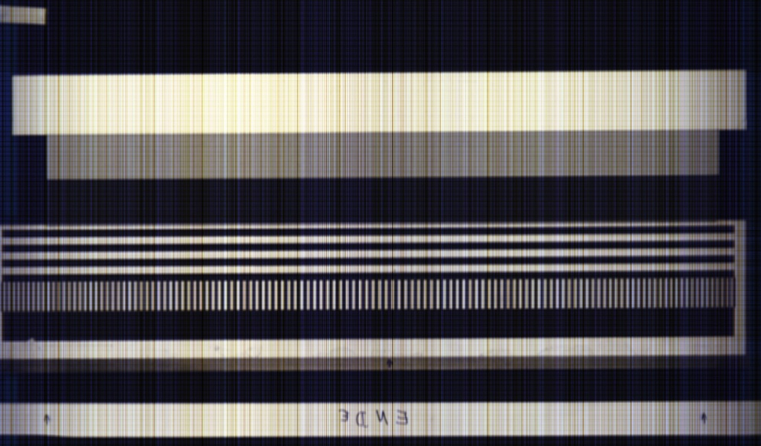
Application examples
Processing different image sources
HZDR Sensys:
Characterization of electronic scrap transported on a conveyor belt
2 GigE hyperspectral, 2-3 GigE RGB cameras
Identification and classification of the electronic components and the materials within (e.g. Gold)
Images of the HS calibration structure: left: captured by a RGB; right: by a hyperspectral camera

Slide 8
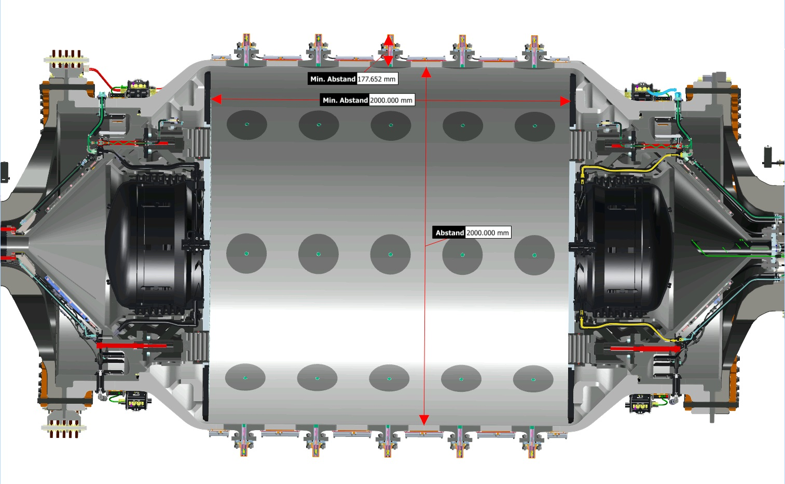
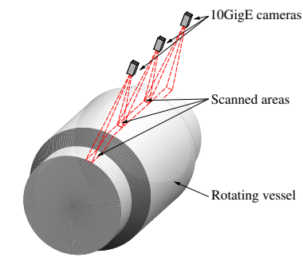
Application examples
Condition monitoring of a rotating vessel
HZDR DRESDYN:
Large scale liquid sodium experiments with geo- and astrophysical background
Aims at clarifying whether precession could be a viable source of planetary magnetic fields
Inspection of the rotating vessel filled with liquid sodium
Scan for displacements of vessel’s installations, e.g. at measuring flanges
Maximum rotation frequency: fmax = 10 Hz
Maximum frame-rate: ~ 4 kHz
Parallel image acquisition of 3 cameras

