Slide 1

Detector Laboratory at GSI,
Competences, Activities and starting Georgian contacts and cooperation
9th Georgian German Science Bridge, Kutaisi, Sept. 12th to 16th 2022
Christian J. Schmidt, GSI Darmstadt

Slide 2
Outline
Introduction GSI-Detector Laboratory
Engagements in Experiment-Instrumentation
EURIZON as converted CREMLIN-Plus EU Project
  WP 7 and the School on Particle Detector Technologies
Seeded cooperation with SMART-Lab through interchange of personnel

Slide 3
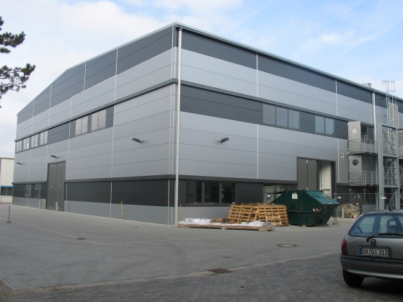
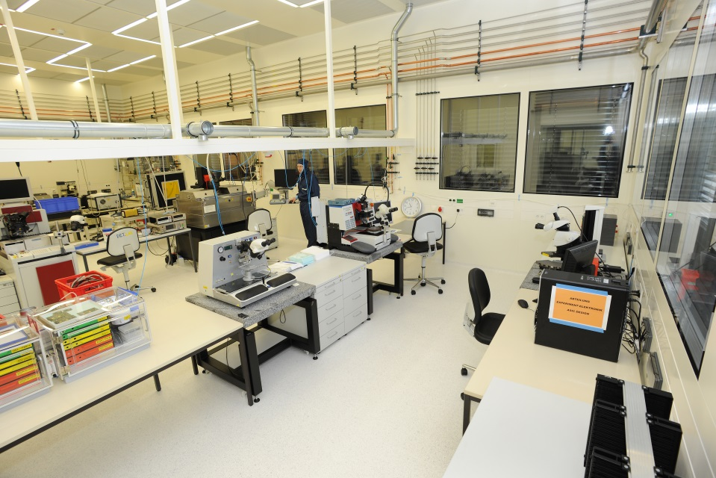
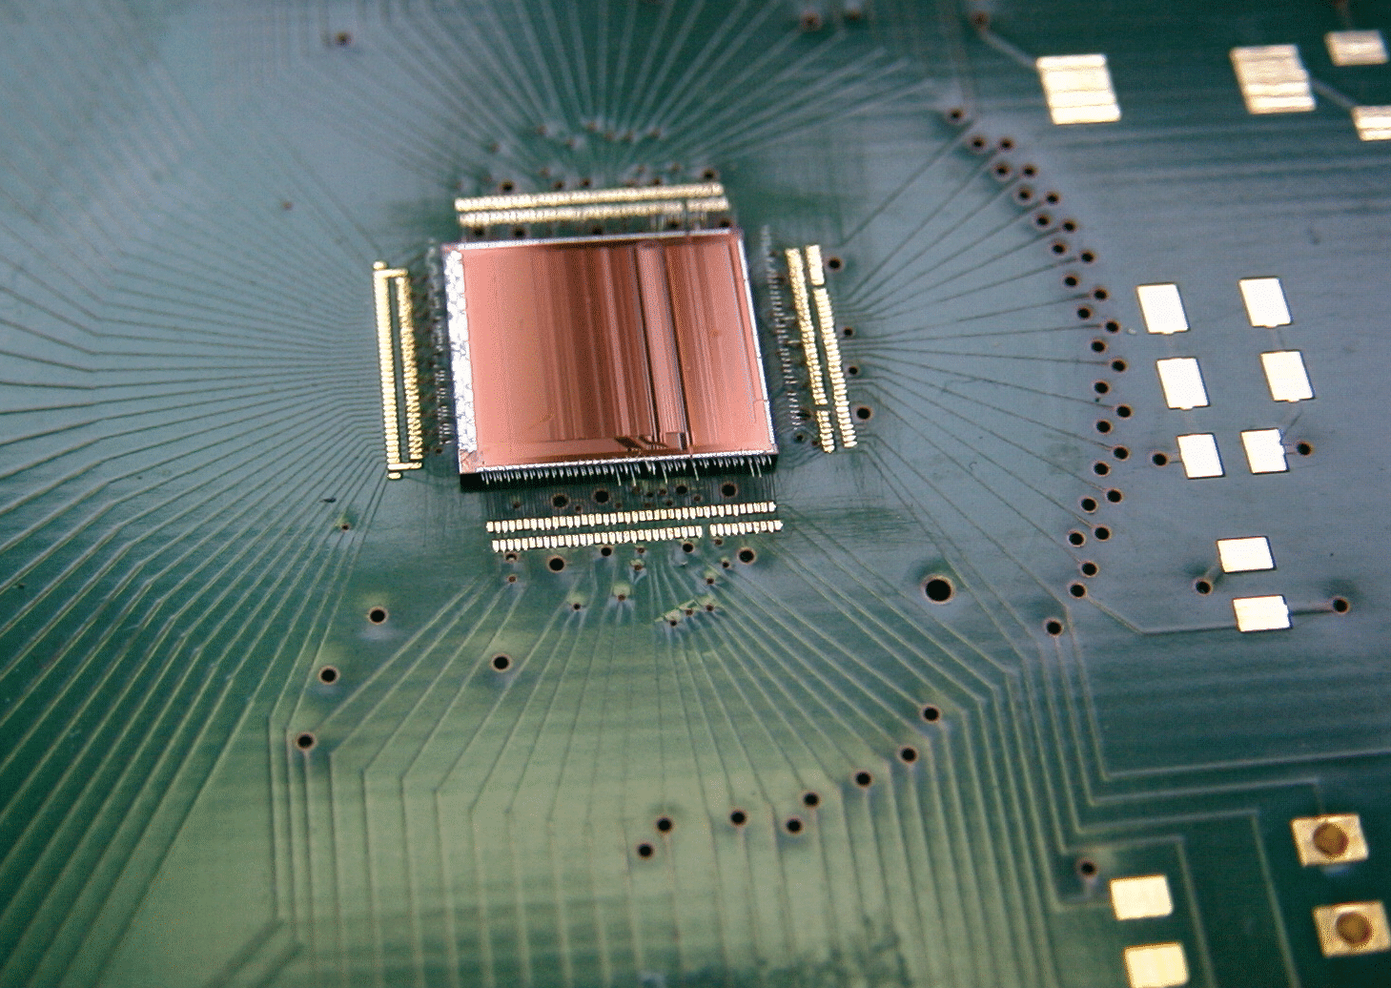
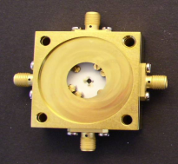
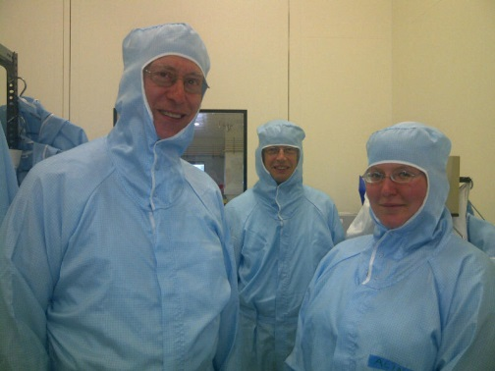
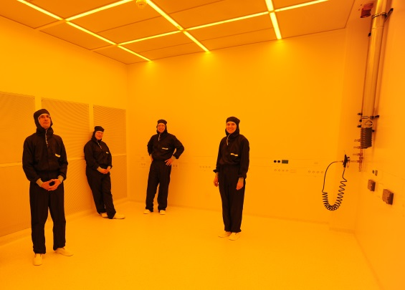
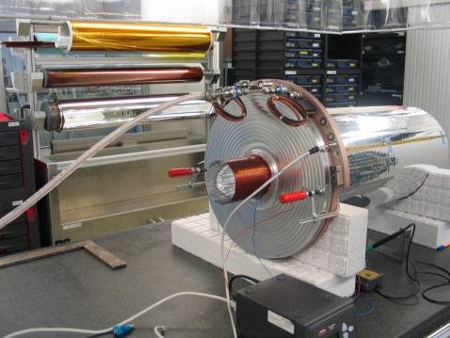
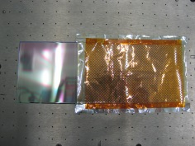

Detector Laboratory: 600 m² Clean-Room
36 m
22 m
Competences:
Micro Patterned Gaseous Detector Technology
Silicon Strip Detector Integration
ASIC Handling and Integration
Diamond Detectors
Machinery:
Laser Lithography
PVD
Bonding Automates
Probestation and Chip Handling
Automated Wire and Fibre Winding
Digital Microscope
Thin Foils Handling and Processing
Detector Ageing Teststands
Large Prototyping CNC Milling Machine

Slide 4
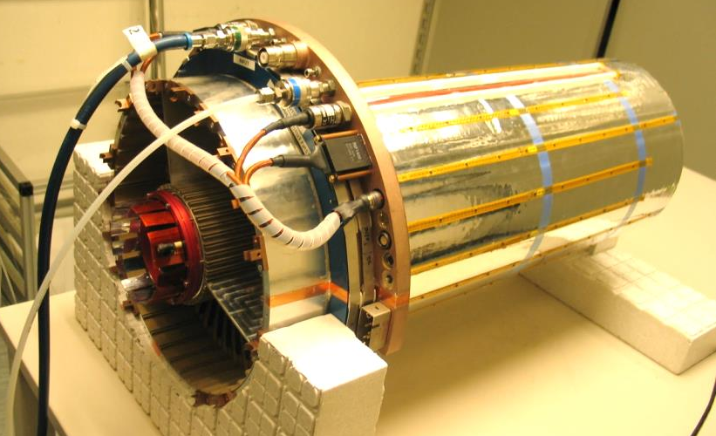
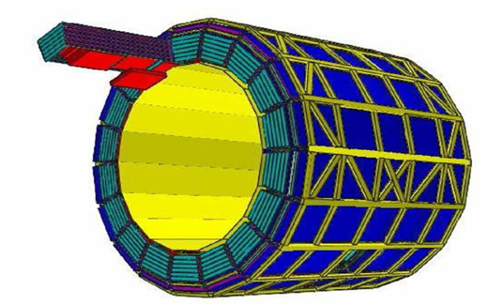
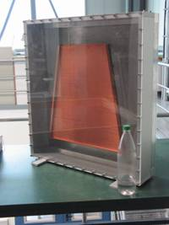
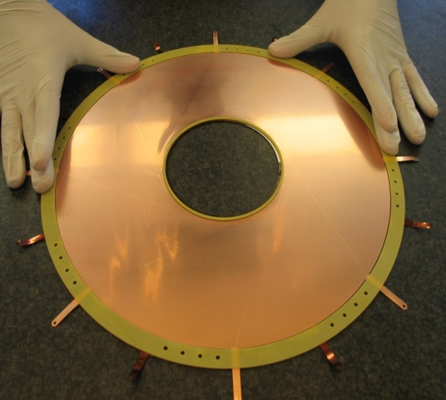
Gaseous Detectors Wire Chambers and MPGD
Traditional stronghold and
technological core competence
Drift chambers for HADES and FOPI at GSI
Large scale, large size prod. of ALICE TRD chambers
R&D and production of ALICE TPC ROC-chambers
GEM-TPC for FoPi/PANDA
GEM-TPC prototype for PANDA
Framed GEM for FoPi
ALICE TRD comprising 540 TRD modules
150 assembled at GSI
ALICE TPC ROC

Slide 5
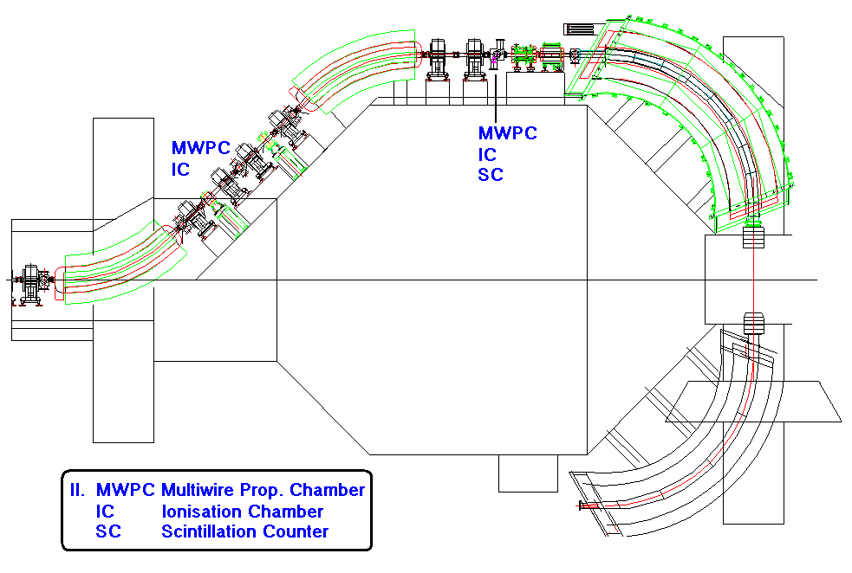
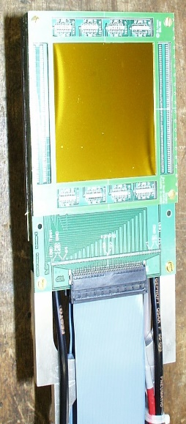
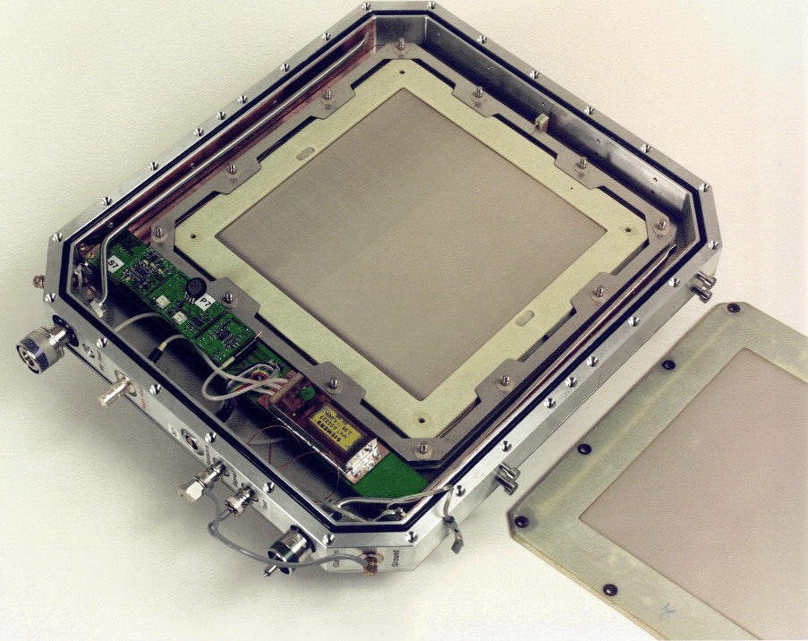
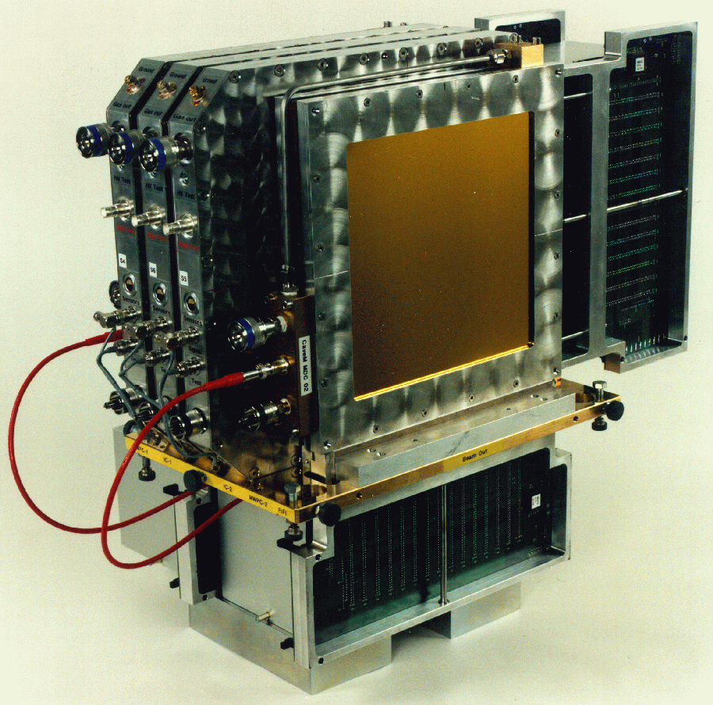
Detectors for Heavy Ion Therapy
Deep engagement and various detector developments at the detector lab for the ion therapy project
Technology transfer to industry
QS and risk-management
Beam Monitor
PPIC
Patient Monitor

Slide 6
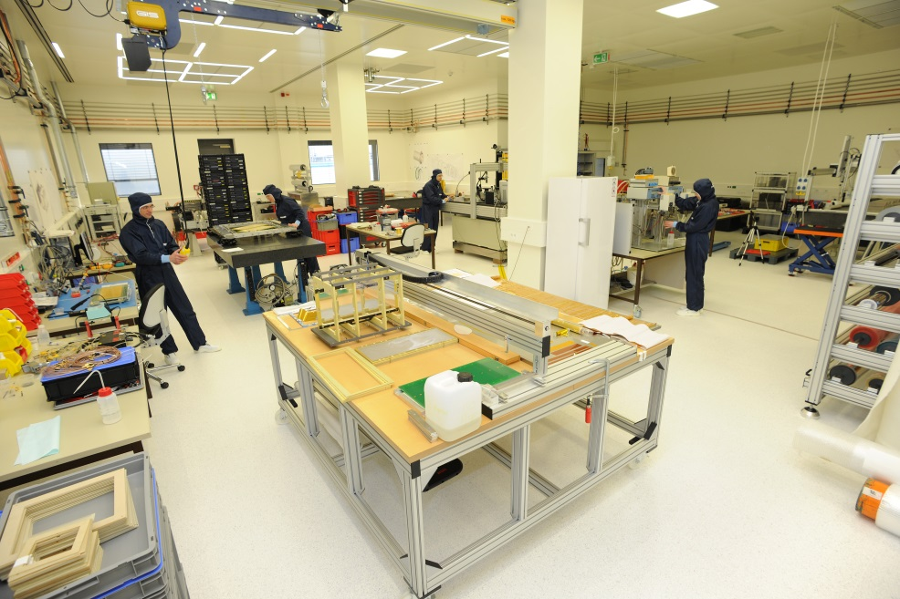

Recent: ALICE TPC-Upgrade
2018 - 2019
GEM-Framing
Chamber Assembly
System Assembly at CERN
ALICE TPC
~ 100 m³ open drift volume
Readout on cylinder endcap
Upgrade: GEM based, self triggered

Slide 7
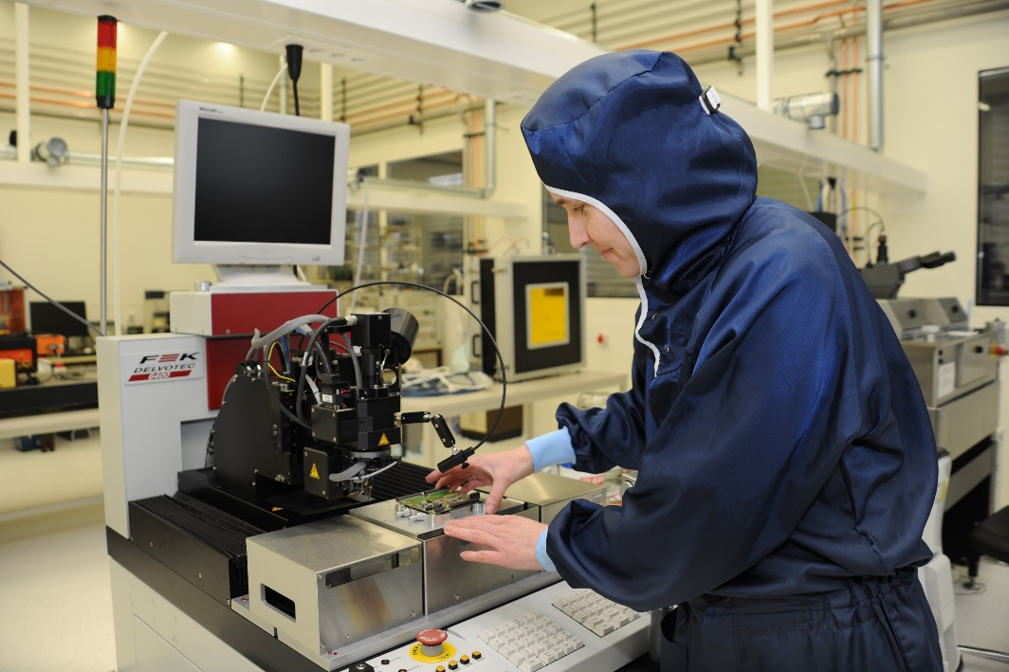
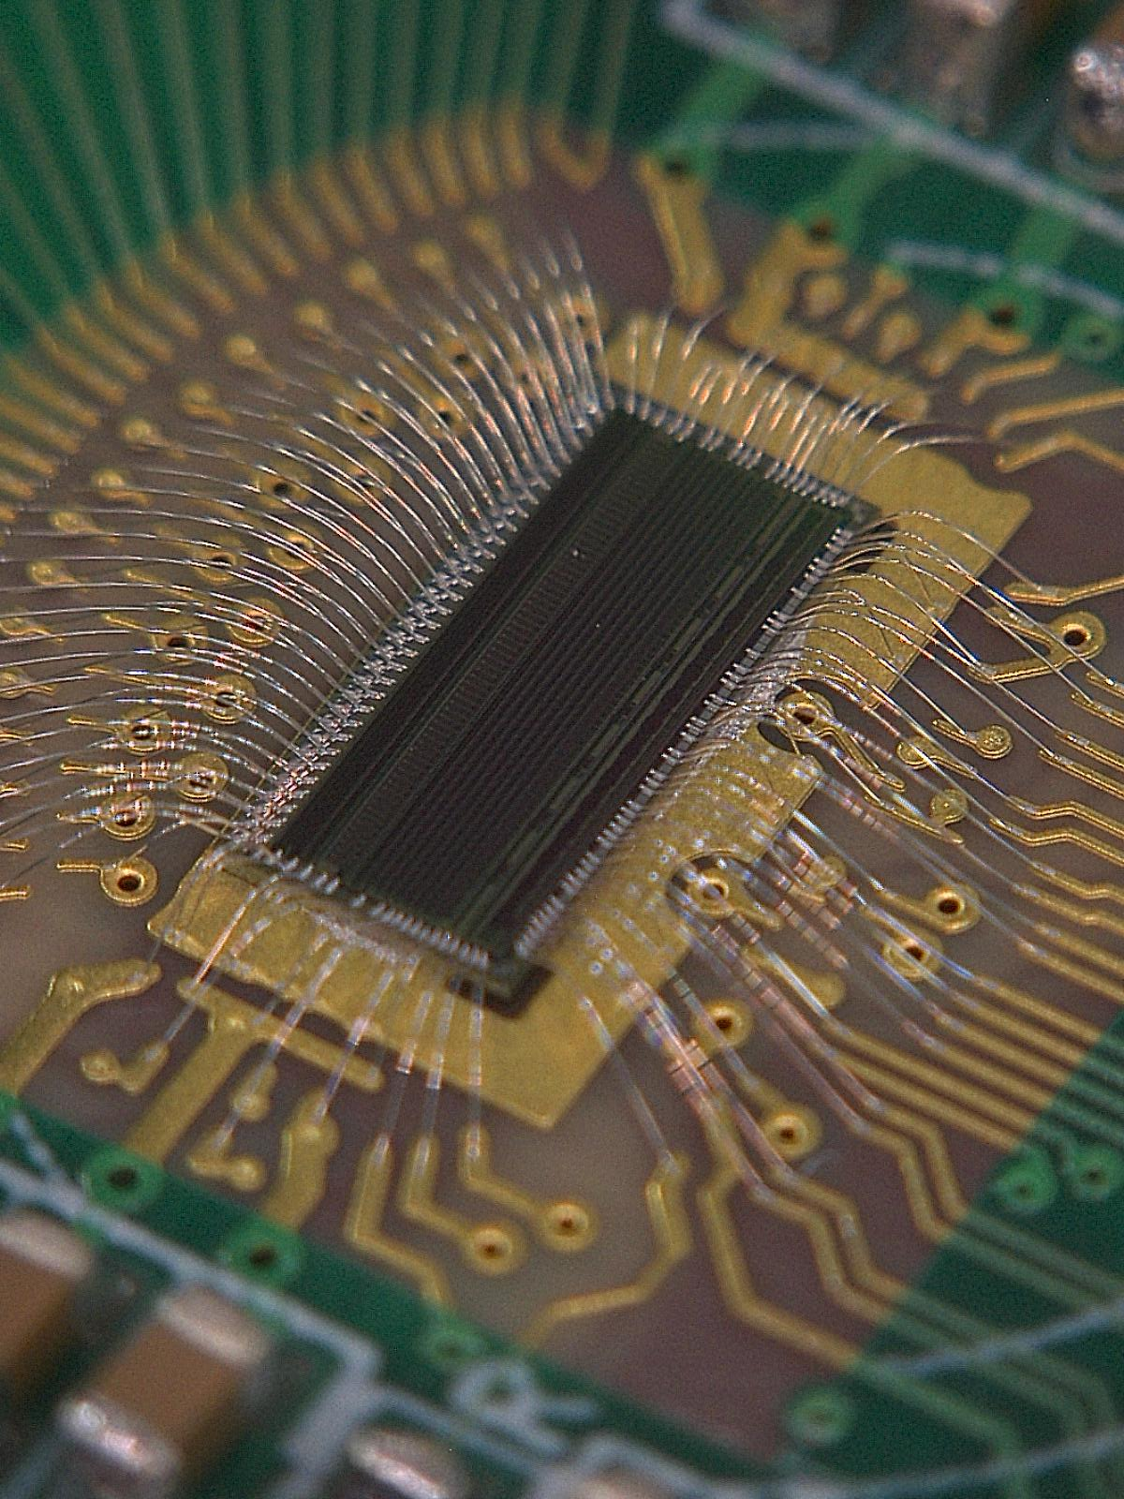
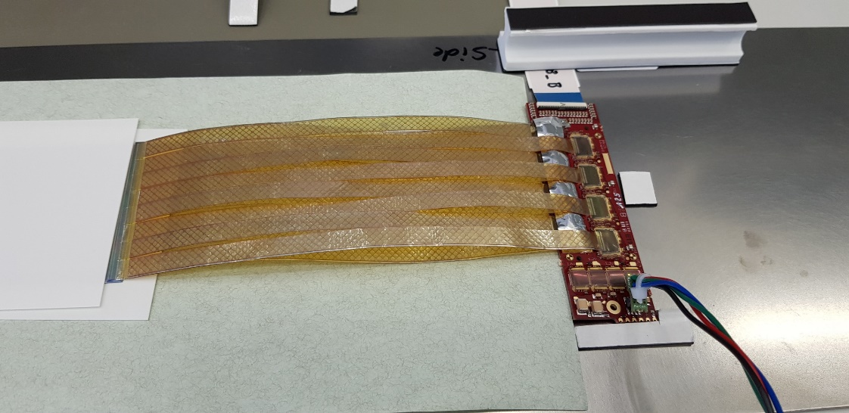
Silicon Competence and Micro-Bonding Technolgies

Slide 8
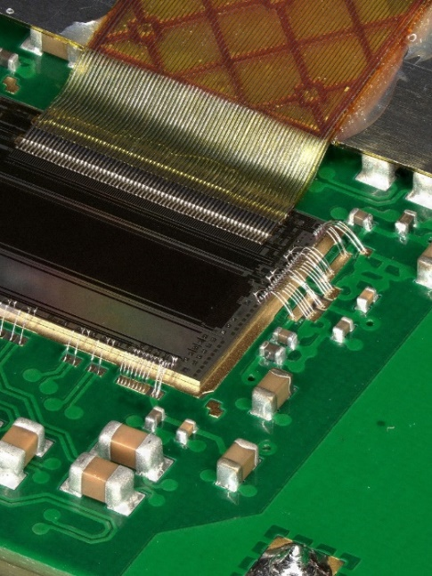
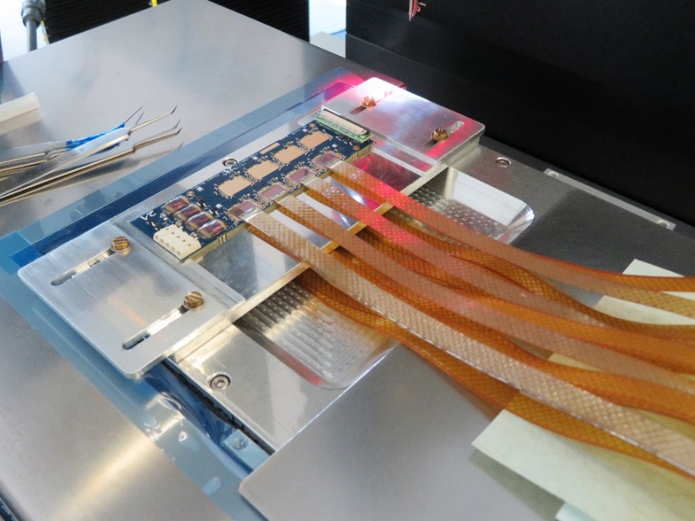
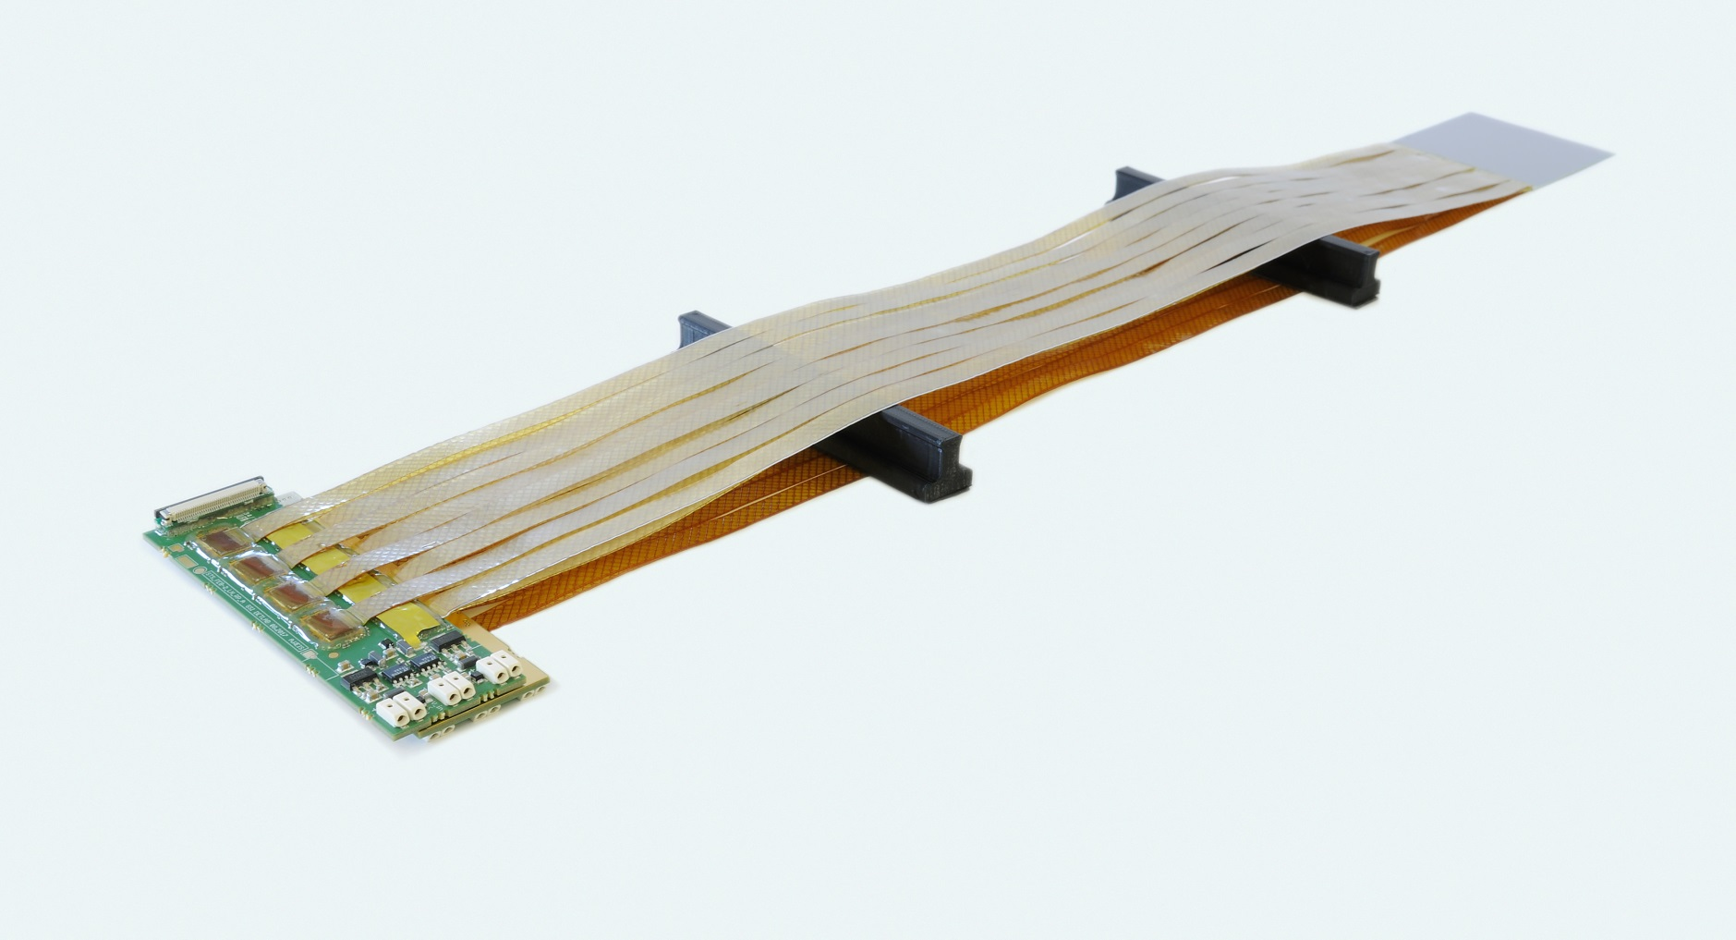
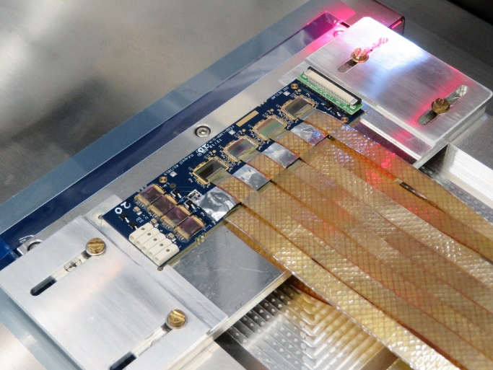
CBM-STS Double Sided Silicon Strip Module Assembly
Wire Bonding to contact readout ASICs
Tab-Bonding to connect signal micro cables

Slide 9

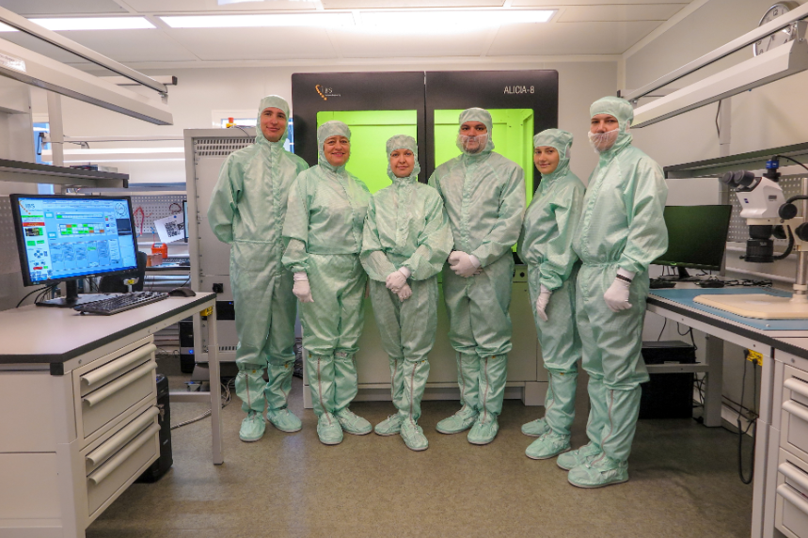



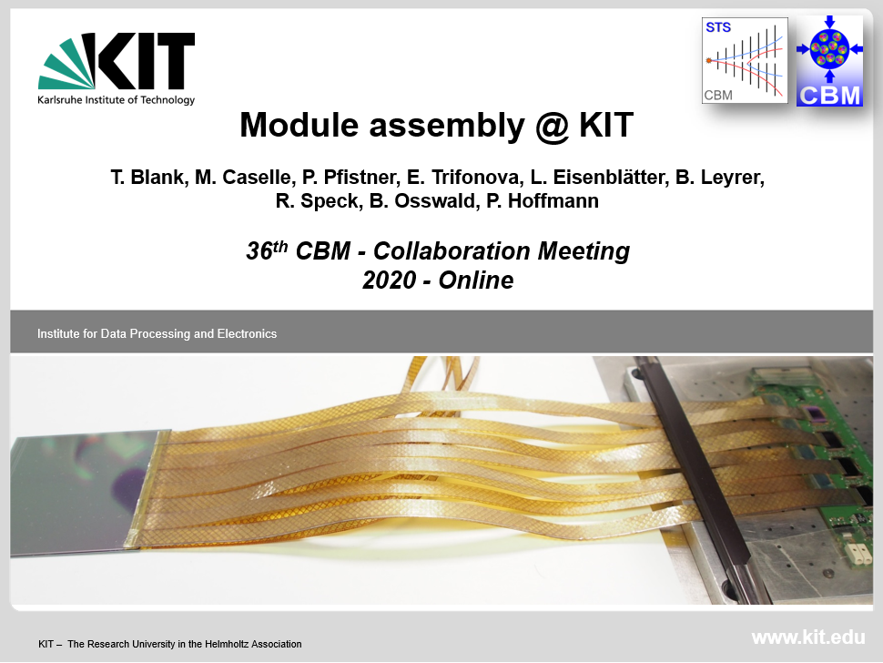

Three Module Assembly Sites, 876 Modules
GSI detector lab

Slide 10
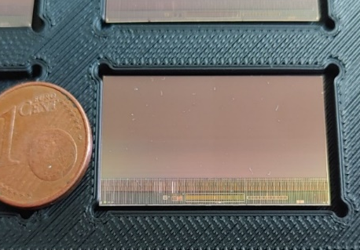

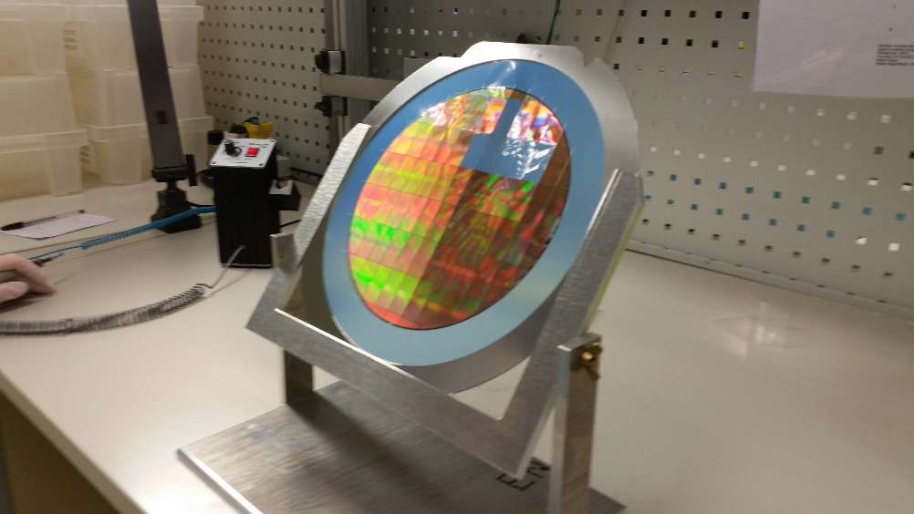
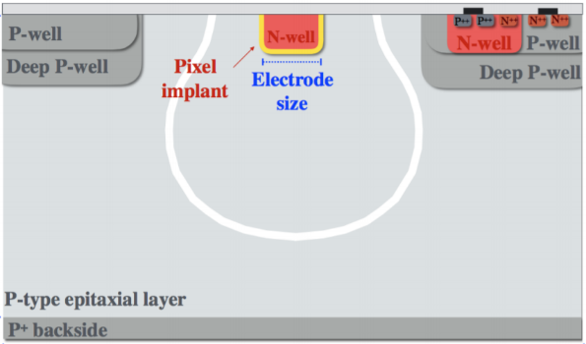
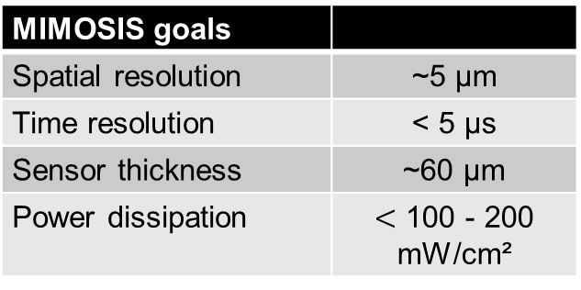
MIMOSIS: Dedicated MAPS Development at IPHC for CBM-Micro Vertex Detector
GSI Detector Laboratory: adds integration competence
additionally expert engaged (Michael Deveaux)
MIMOSIS goals
Spatial resolution | ~5 µm
Time resolution | < 5 µs
Sensor thickness | ~60 µm
Power dissipation | $<$ 100 - 200 mW/cm²
1024 x 512 pixels
MIMOSIS -1 goal:
Find best substrate and pixel
10
CERN ALICE ALPIDE Chips on a thinned wafer

Slide 11
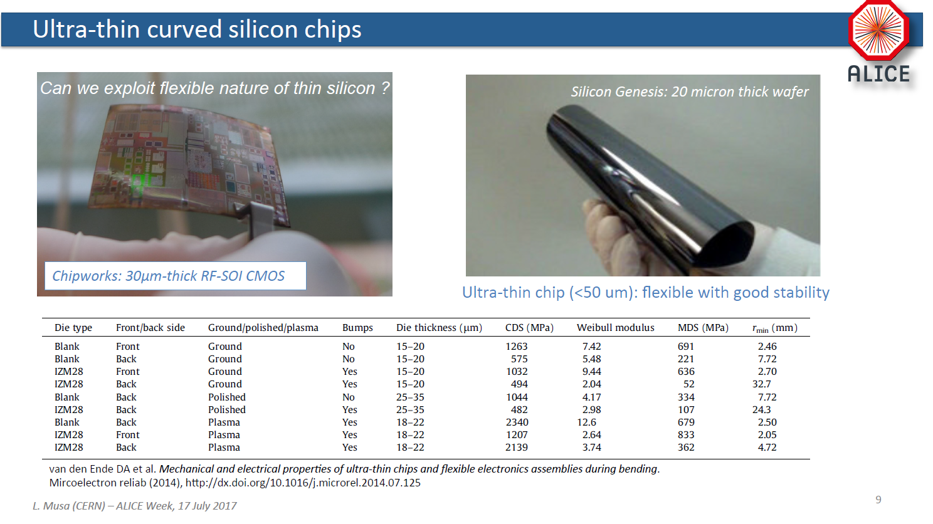
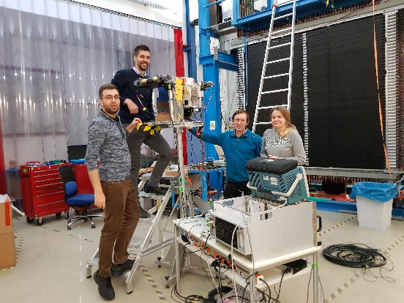
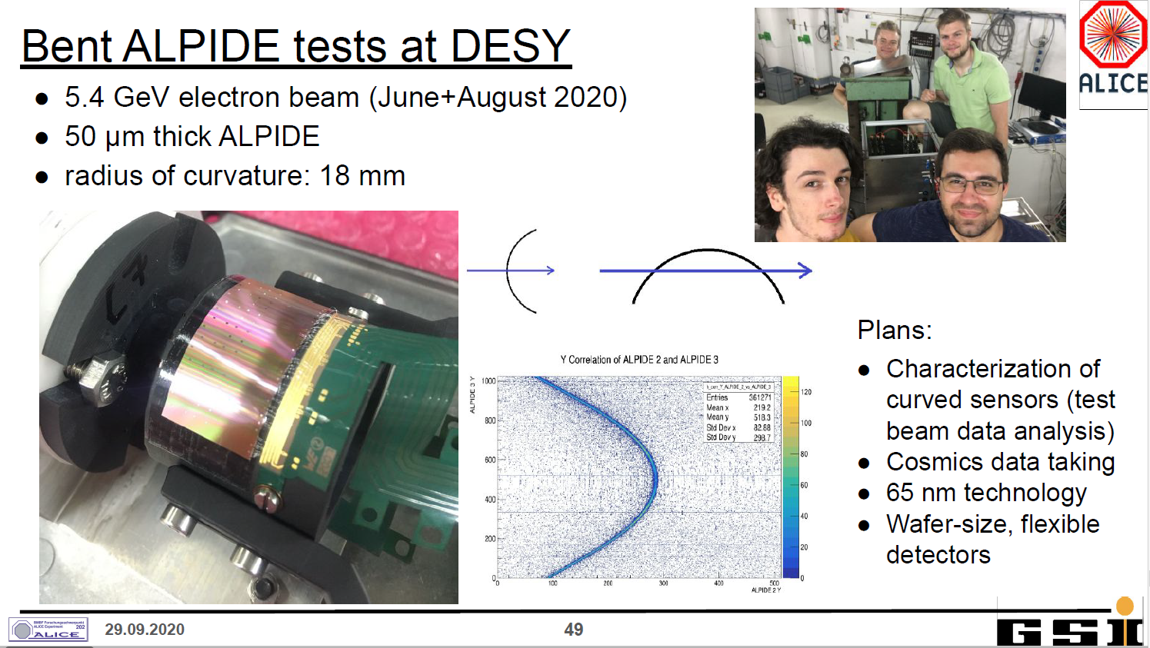
R&D Activities Towards ALICE ITS 3 (2025)
65 nm TowerJazz process
Stitching → wafer size sensors
Thinning → bent sensors

Slide 12

EURIZON as Project Transfer Proposal following CREMLIN-Plus
CREMLINplus was an ambitious project of international collaboration between 25 European and 10 Russian research institutions and their researchers. (Volume 25 Mio Euro)
With Russia´s brutal and ferocious attack on Ukraine on Feb. 24th,2022, and the following and continuing war against Ukraine and the West, this collaboration proved entirely impossible.
The European Partners have phrased a new proposal in which to transfer the project and named it
Aim to take actions, accept the consequences, take up a stance on the situation and foster Ukrainian Scientists while continuing the scientific program without Russia

Slide 13
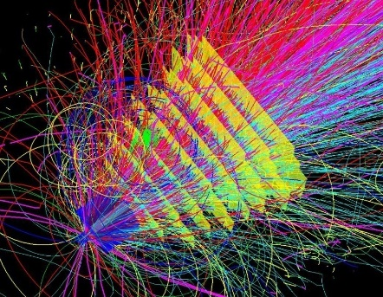
WP7: horizontal activity DETEC
Joining two fields that typically have only few links:
Aim: foster cooperation, ideas and technologies interchange between the fields as well as education to young scientists in the field of particle detectors
MAPS-CMOS pixel sensors for nuclear- and high energy physics tracking applications
Detector technologies for thermal neutrons
Training and school for young scientists on particle detector technologies (~ 60 students, ~ 120 participants)

Slide 14

WP7-DETEC
Task 3 Detector School
We had planned to have the school July 3-16, 2022 at Budker Insititute in Novosibirsk.
→ Now obsolete with the Russian war against Ukraine.

Slide 15
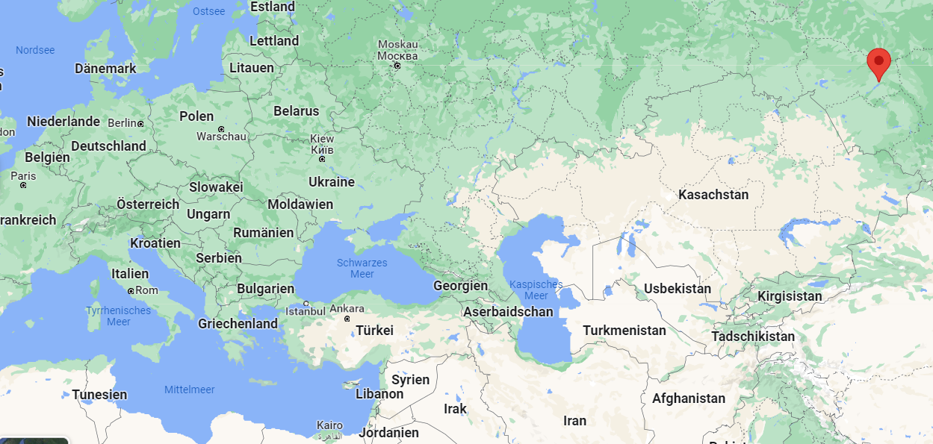
Proposal: Have the detector school in Georgia at Kutaisi International University (KIU)
Detector school
First visit to Kutaisi in May
Organizing committee reengaged
Thanks to Prof. Alexander Tevzadze, Nikoloz Chkhetiani, Vakhtang Tsagareli and the Cartu Foundation
we may be able to have the school at KIU in July 2023

Slide 16
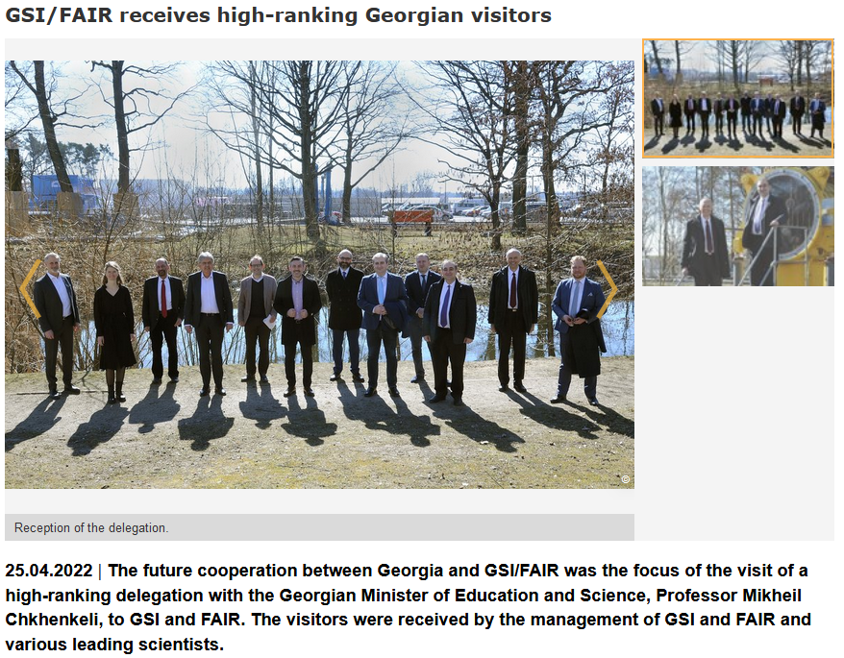
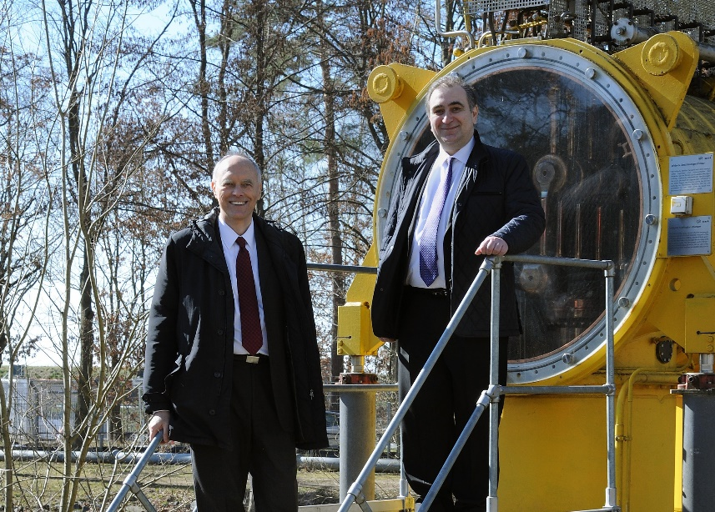
Cooperation seeded through visit to GSI/FAIR on April 10th

Slide 17
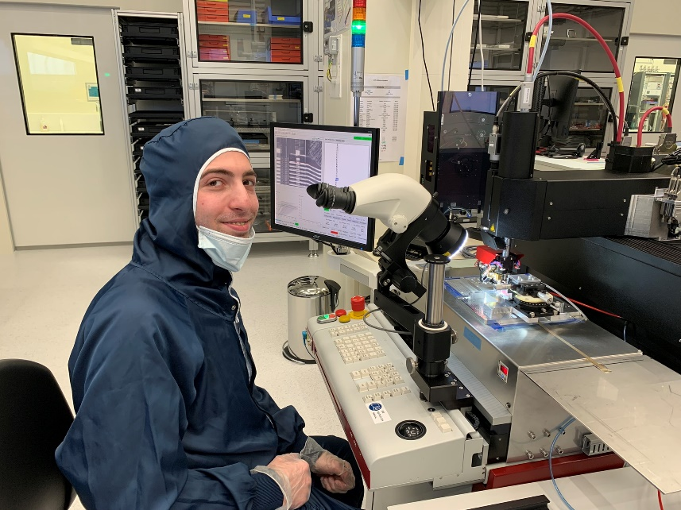
Rapid developments… also thanks to Irakli Keshelashvili
Minister Prof. Chkhenkeli´s visit (April 10th 2022) triggered various ideas and proposals
  Potential Georgian Participation in FAIR
  MOU between Georgia and GSI
  New Venue for Detector School at KIU
  Interchange young scientists
    Dachi Okropiridze realizing Master´s Thesis at GSI Detector Laboratory
    Nika Putkaradze (Tbilisi Agricultural University) spent one month at GSI detector laboratory on testing and qualifying the STS-XYTER readut ASIC
    David Mchedlishvili of SMART Lab visited GSI for one month
    Otari Javakheshvili applied as electronics engineer
Nica Putkaradze at GSI

Slide 18
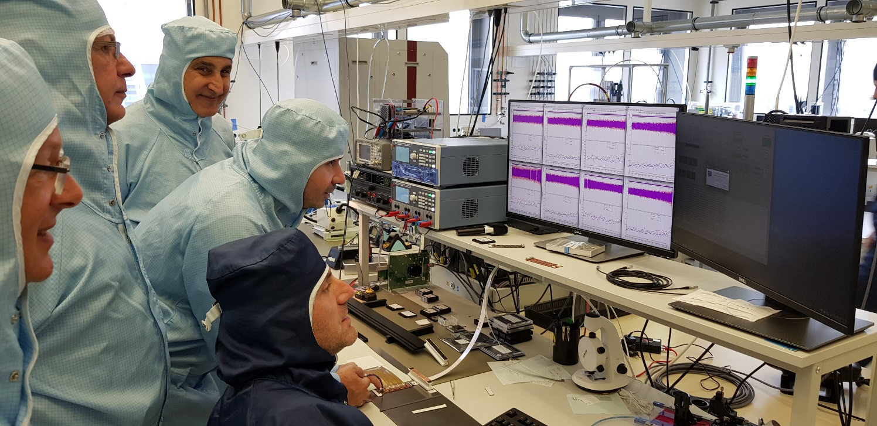
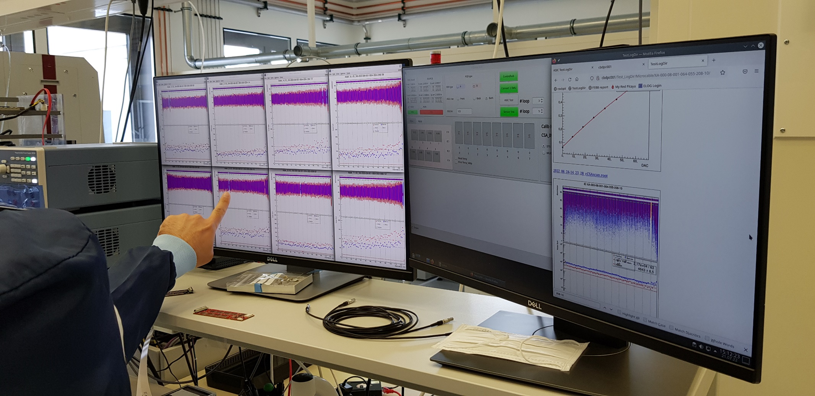
Georgia gets engaged…
… in STS module tests
Prof. Zaza Metreveli and Andro Kacharava at GSI in preparation of GGSB
Lots of room for cooperation with SMART-Lab

Slide 19
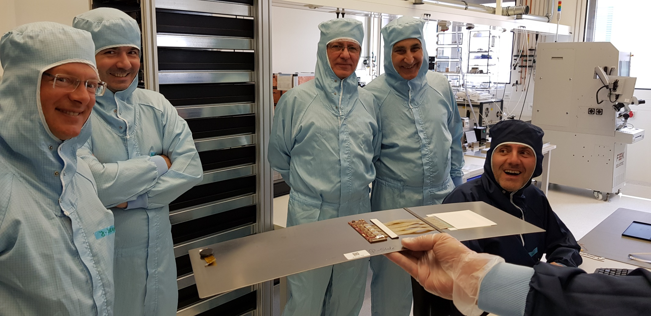
… all successful right from the start ☺
Latest experience shows:
CBM-STS module assembly yield at practically 100% well feasible

Slide 20
