Slide 1
Radiotherapy using VMAT and IMRT techniques
Dr. Beka Bochorishvili, Medical physicist
Radiation Oncology Department, Todua Clinic, Tbilisi, Georgia
Scientific technical consultant, Kutaisi International University, Georgia
September 2022

Slide 2
Radiotherapy in cancer treatment
Diverse methods of treating cancer:
Surgery
Radiation therapy
Chemotherapy
Immunotherapy
Hormone therapy
Different combinations
About 50% of cancer patients need radiotherapy at some stage of their cancer treatment.
About 50% treated with curative intent (rest 50% with palliative intent).

Slide 3
The rationale of Radiotherapy
Radiotherapy is treating mostly malignant tumors with ionizing radiation (photons, electrons, protons, ions…).
Ionizing radiation destroys cancer cells, but also healthy ones.
Radiotherapy as almost all treatments means has side effects like:
Sore skin
Feeling sick
Problems of eating and drinking
Diarrhea
Stiff joins and muscles
Fertility issues
Lymphoedema
Getting another cancer
Many others

Slide 4
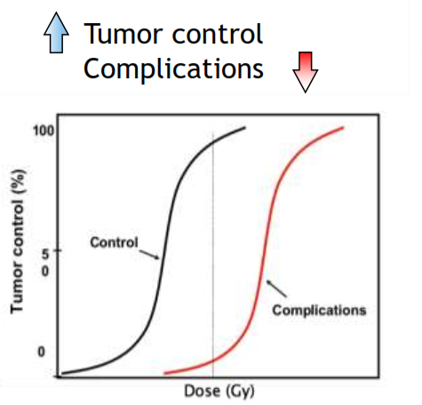
Ideal radiotherapy: Treating tumor with high (enough) dose without irradiating healthy tissue – unfortunately not possible!!! We have to compromise between these two.
Treating tumor we call - Tumor Control
irradiation of healthy tissues we call - Complications

Slide 5
Radiation therapy general routine workflow
Main steps are:
CT simulation
Delineating the region witch has to be irradiating and organs at risk
Treatment planning (3D conformal, IMRT, WMAT)
Quality Assurance and Quality Control procedures
Treatment delivery (using image guided RT, respiratory gating)

Slide 6
CT simulation

Slide 7
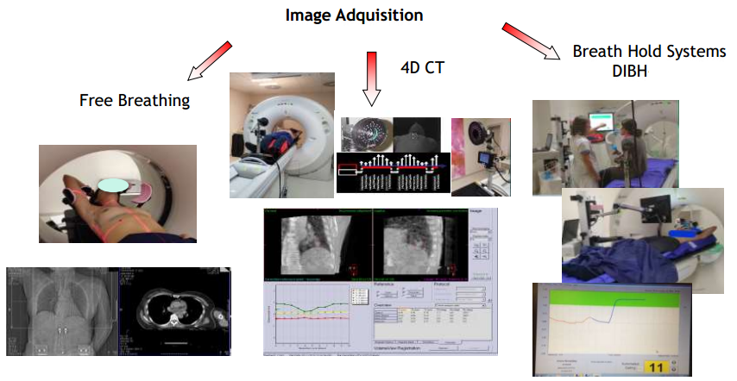
CT simulation with motion management

Slide 8
Accurate delineation of tumor, GTV, CTV, PTV and organs at risk
All contours must be delineated according to clinical protocols and contouring guidelines.

Slide 9
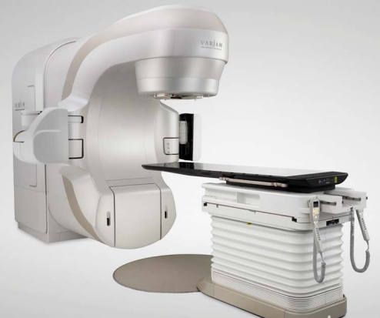
Medical linear accelerator (Linac)
Types of radiation
Photons
Electrons
We will talk about radiotherapy
That uses photons

Slide 10
Treatment planning
In order to deliver radiation to a patients we need make a plan according which machine irradiates the patient.
Software we us for planning is called Treatment Planning System (TPS)
In our department we use VARIAN Eclipse. Treatment plans are done by medical Physicists.
Two types of planning
Forward planning - 3D conformal (3D CRT)
Inverse planning - VMAT/IMRT

Slide 11
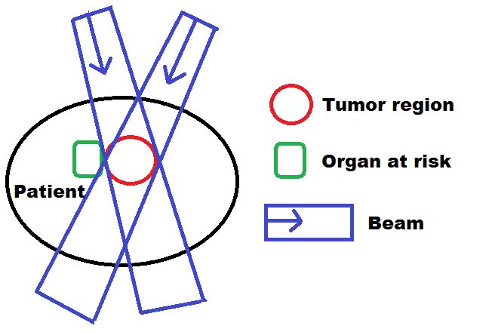
3D CRT planning
Optimisation:
Gantry angle
Beam weight
Beam energy
Beam wedge
Collimator angle
3D CRT is forward planning
We set all parameters (Gantry angles, beam weight, beam energy, wedges, collimator angles, jaws, MLC ) ; calculate plan and get dose distribution.

Slide 12
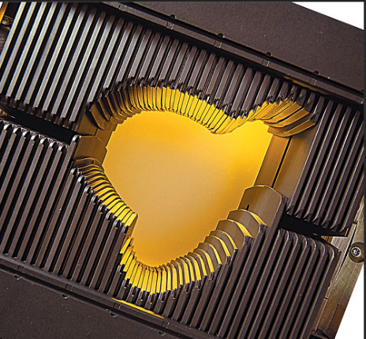
Jaws and MLC – Multi-Leaf Collimators
Beams are shaped by jaws and MLC
Jaws can make rectangular shapes
MLC do additional fine shaping

Slide 13
VMAT –Volumetric Modulated Arc Therapy
VMAT – is Intensity modulated arc therapy
1.Radiation is delivered through continuous gantry rotation
2. MLC changes continuously as the gantry rotates
3. Intensity of radiation changing simultaneously
VMAT – planning is inverse planning
1.We set number of arcs, starting and final gantry angles
2. We set objectives for tumor region
3. We set constraints on Organs At Risk
4. We optimize using the special software and get dose distribution

Slide 14
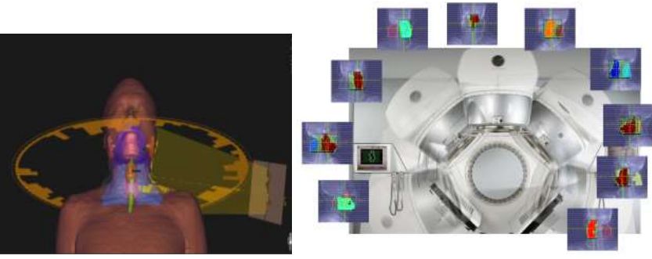
VMAT

Slide 15
IMRT – Intensity-Modulated Radiation Therapy
Two types of IMRT
Static IMRT (step and shoot)
Dynamic IMRT (Sliding window)
Gantry angles are fixed in both types of IMRT.
Static IMRT – Field is divided id different segments, radiation is not delivered while the leaves move to create next segment.
Dynamic IMRT – Radiation is delivered as leaves are moving.

Slide 16
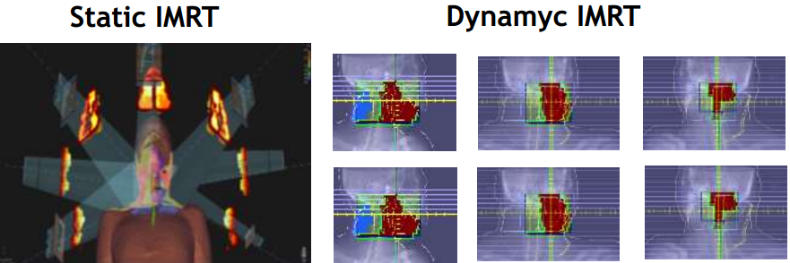
1. We set number of field and their angles, collimator angles
2. We set dose objectives for tumor region
3. We set constraints on Organs At Risk
4. We optimize using the special software and get dose distribution

Slide 17
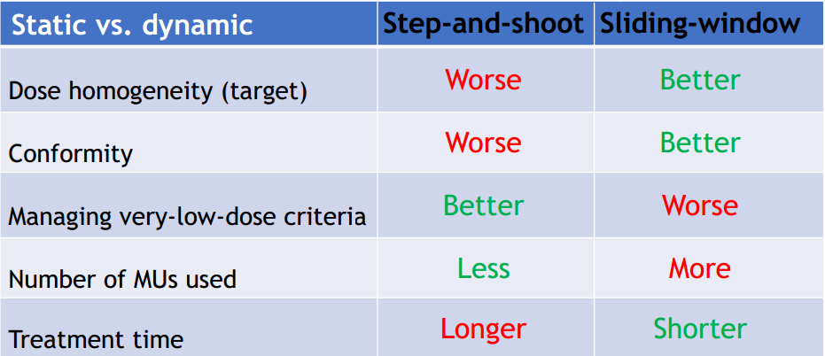
Which is better?

Slide 18
3D conformal vs VMTA/IMRT
Main advantage VMAT/IMRT Which is very important
High degree of conformity, steep dose gradient and healthy tissue sparing
Disadvantages of VMAT/IMRT Which are less important
Large region of low dose
Taking much time to deliver
Requiring complicated QA /CA
Is 3D CRT some times better than VMAT/IMRT?
Yes: When clinically high conformity not needed, healthy tissues are spared enough and delivering time is preferred to be short.

Slide 19
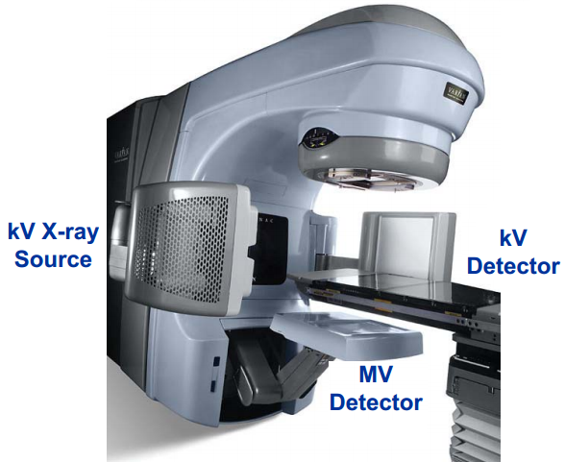
Treatment delivery with IGRT – Image Guided Radiation Therapy
Linear accelerator with on boar imagers:
1.Kilovoltage X-ray source and detector
2 .Megavoltage X-ray source and detector

Slide 20
IGRT is for:
Patient positioning
Tumor positioning
IGRT additionally allows:
Tracking moving tumors
Find tumor shape changes as well as other anatomical changes in patients
Do adaptive radiotherapy
Thus IGRT helps:
Reduce dose to healthy tissue
Irradiate tumor region with steep dose gradients (especially for VMAT/IMRT)

Slide 21
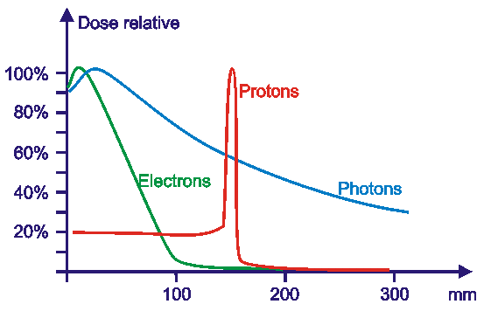
Photons and Electrons vs Protons in radiotherapy
Percentage depth dose (PDD) curves for photons, electrons and protons

Slide 22
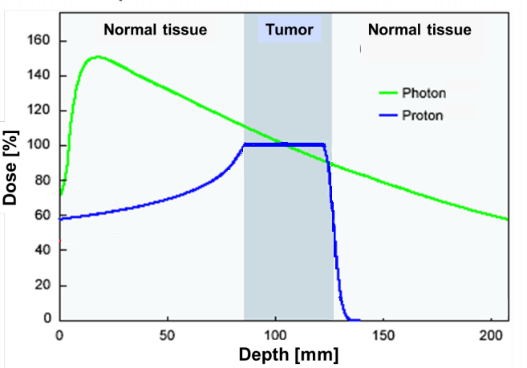
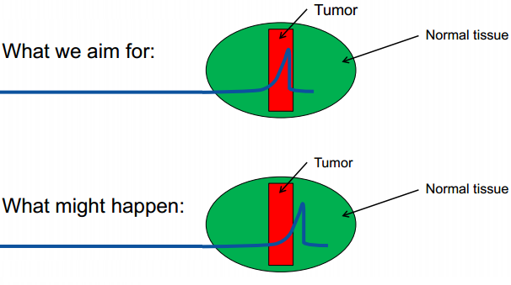
Protons are very sensitive to range and density uncertainties

Slide 23
Increasing quality of radiation therapy
High professional staff
Dose prescription, patient clinical management, contour delineation, treatment planning, QA and QC procedures, CT simulation, treatment delivery.
Modern machines
IGRT, Motion management, VMAT/IMRT irradiation techniques
Type of radiation
In some cases protons do much better than photons
Adaptive radiation therapy
Biological strategies
Fractionation, drugs-sensitize tumors and protect healthy tissue, exploiting individual variations in normal tissue toxicity

Slide 25
Radiation Oncology Department
Opened in 2014
Tree linear accelerators of VARIAN - two TrueBeams one EDGE
One brachytherapy unit - VARIAN GammaMedplus iX
Staff
6 radiation therapists
5 medical physicists
13 radiation technologist
Number of patients per year is about 2000
30%-40 % patients are treated using VMAT or IMRT

Slide 26
I wish you never get cancer!
Thank you !

