Slide 1

Climate Change
Astrid Kiendler-Scharr
Andreas Wahner, Forschungszentrum Jülich GmbH, Institut für Energie und Klima: IEK-8 Troposphäre,
Germany; GGSB 12.09.2022

Slide 2
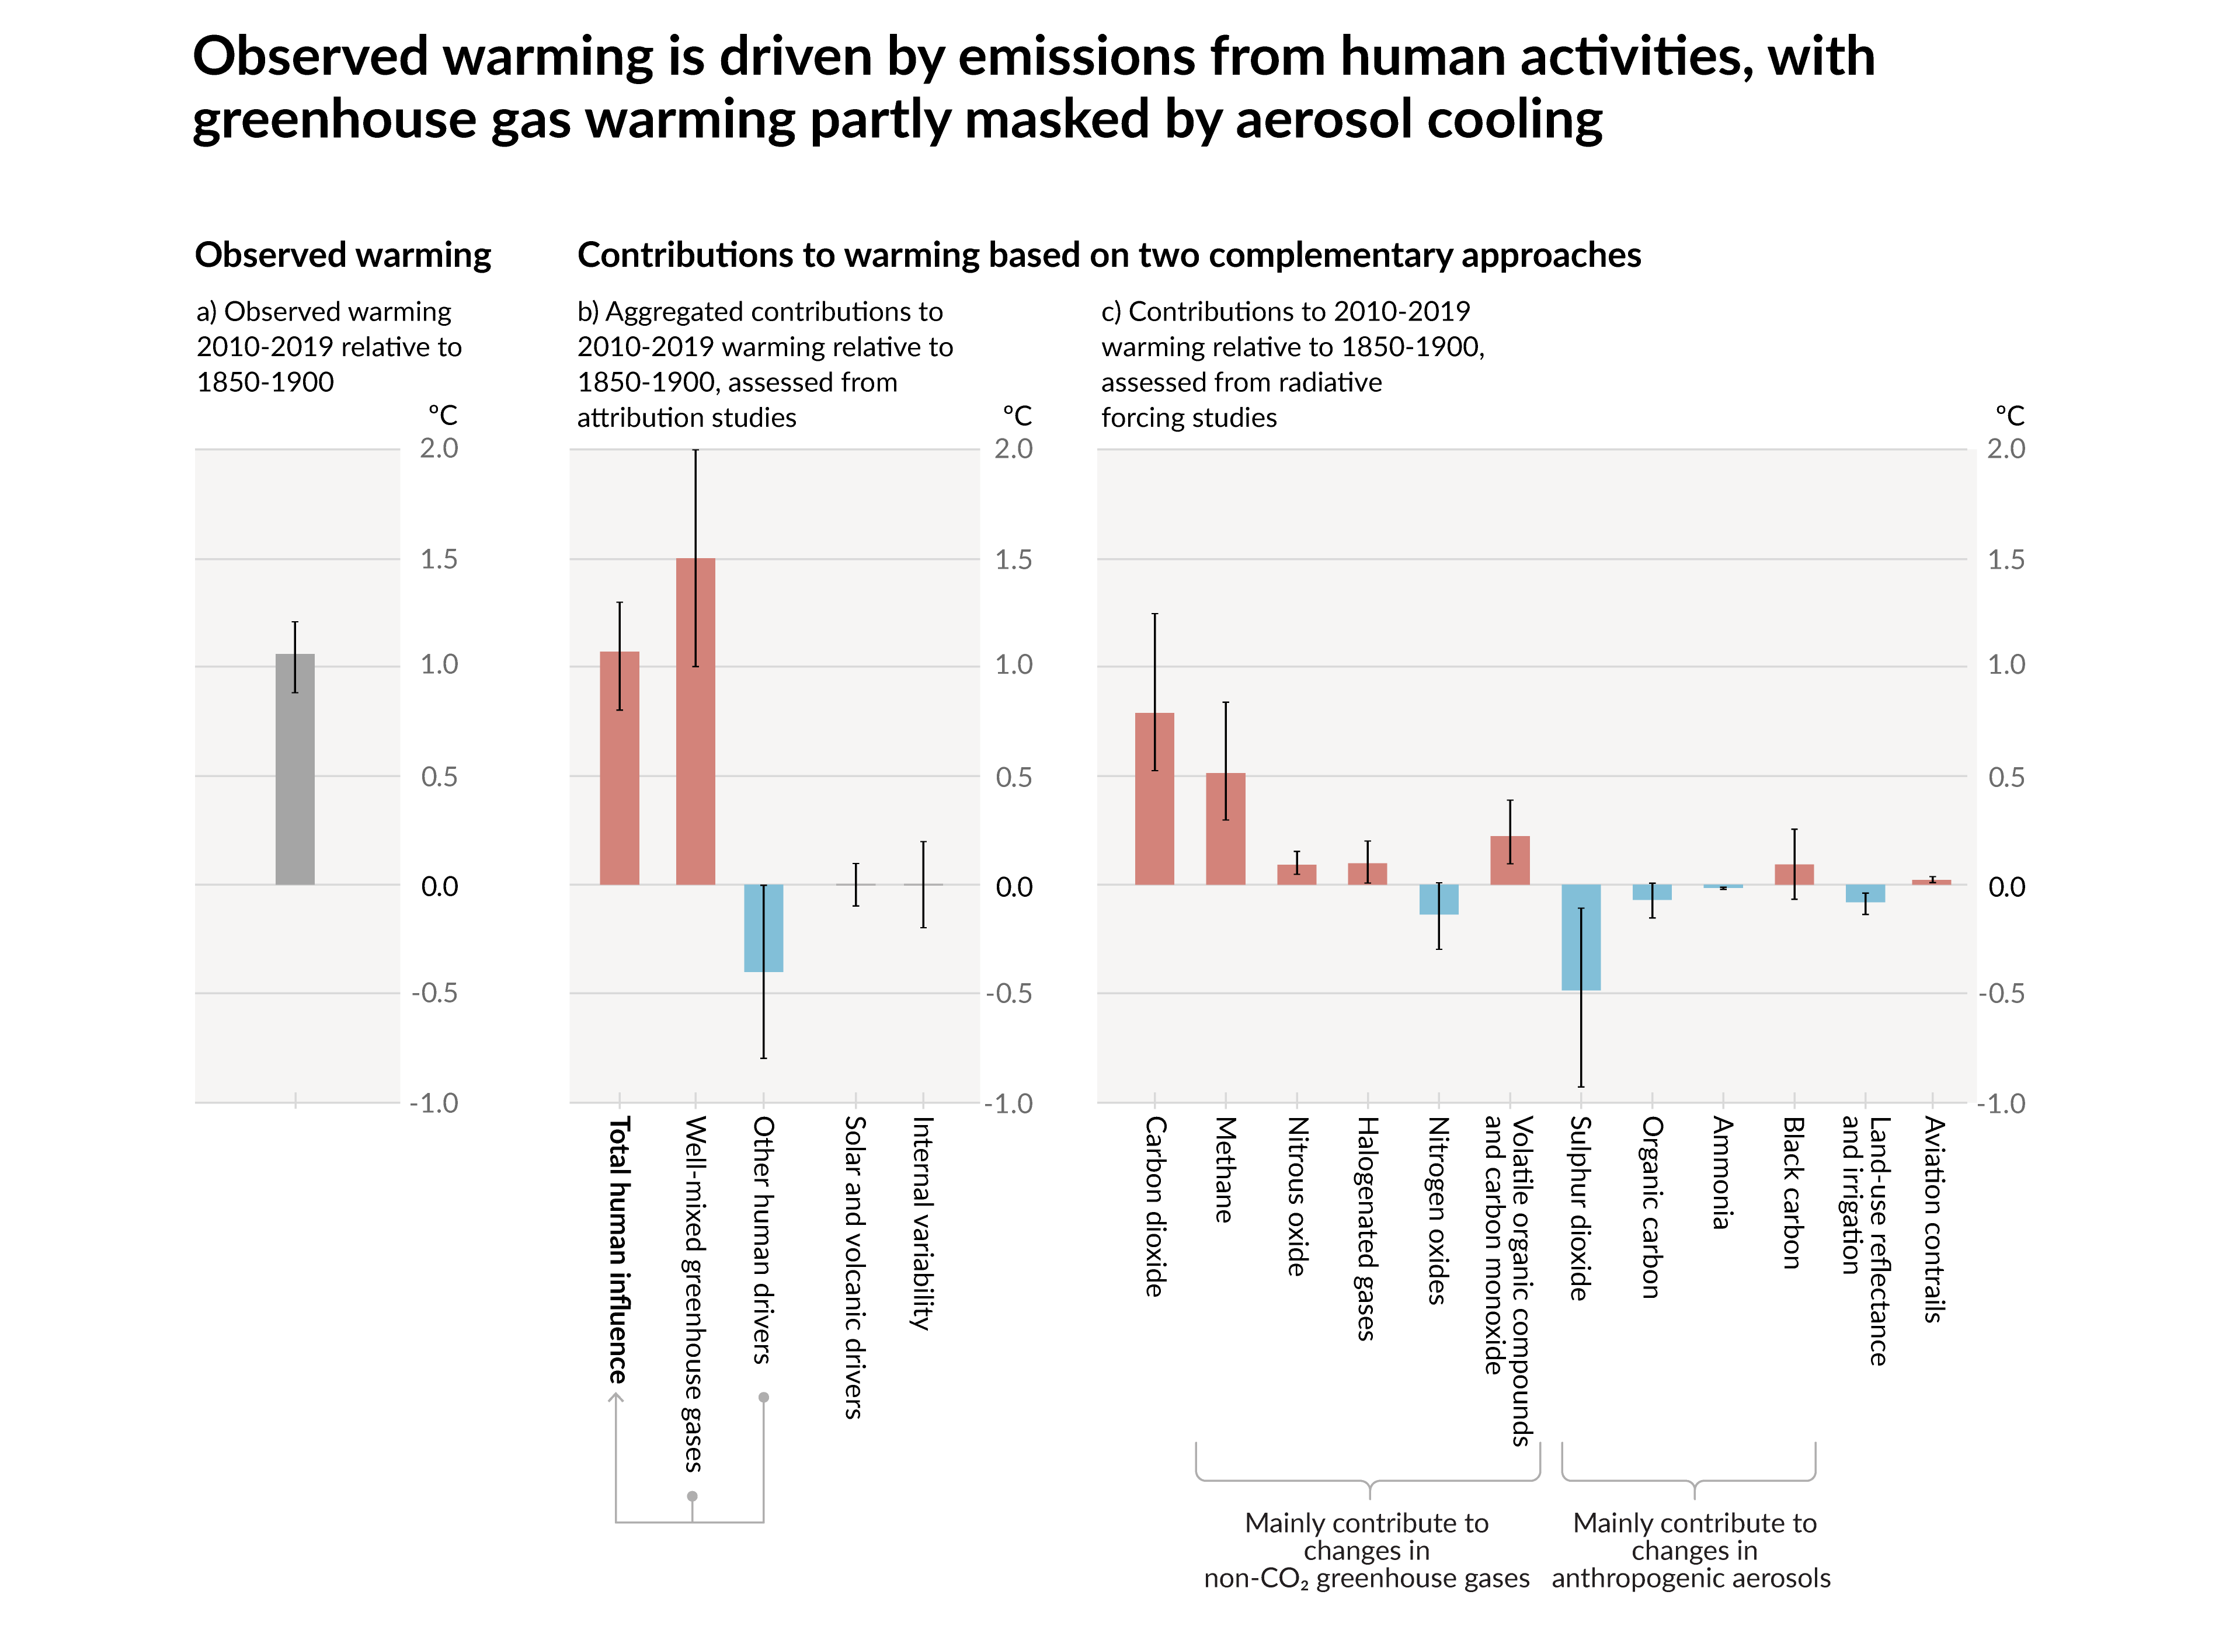
We currently observe a warming of 1.09°C compared to pre-industrial times.
The observed warming is driven by emissions from human activities.
The warming from greenhouse gases is partly masked by the cooling effect of aerosols.
Abb. SPM.2

Slide 3
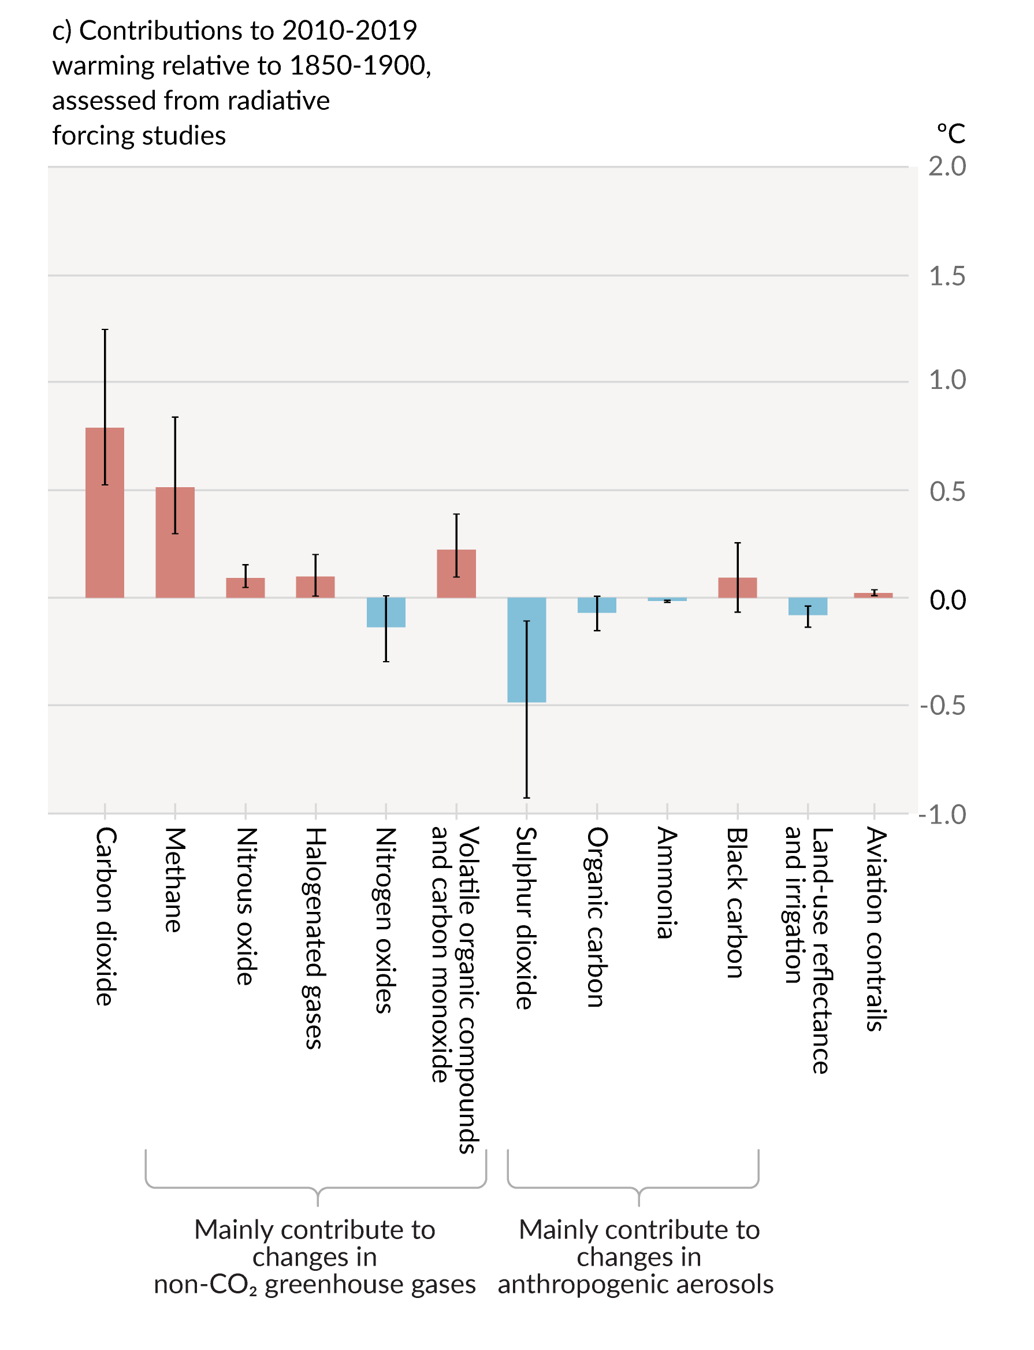
We currently observe a warming of 1.09°C compared to pre-industrial times.
Methane is the second most important greenhouse gas after CO2 and has contributed 0.5°C to warming so far.
The sum of short-lived greenhouse gases and soot contribute to warming in the same order of magnitude as CO2.
Abb. SPM.2

Slide 4
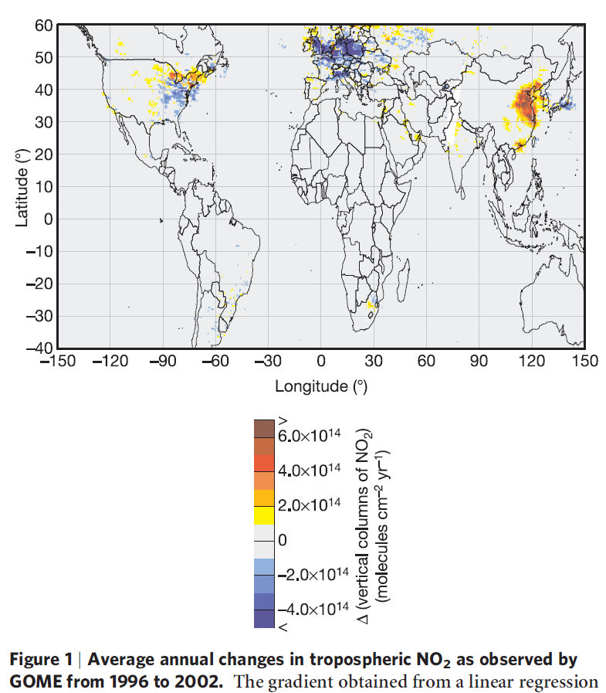
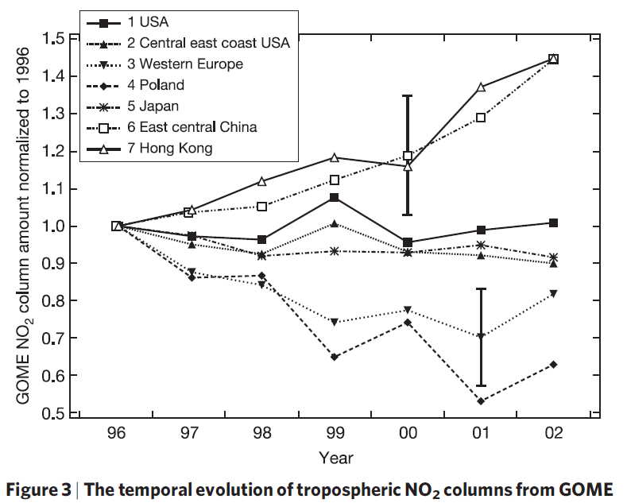
Regional Anthropogenic NOx Change !
A. Richter et al.,
Vol 437|1 September 2005|
doi:10.1038/nature04092

Slide 5
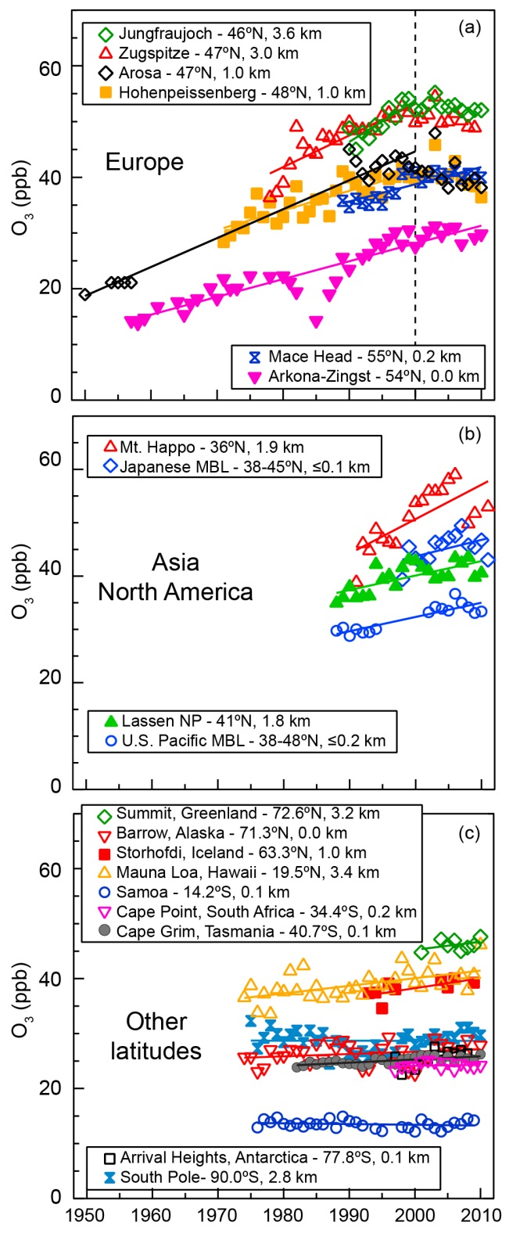
Increase of Tropospheric Ozone

Slide 6





SIXTH ASSESSMENT REPORT
Working Group I – The Physical Science Basis
“
To limit global warming, strong, rapid, and sustained reductions in CO2, methane, and other greenhouse gases are necessary.
This would not only reduce the consequences of climate change but also improve air quality.
[Credit: Evgeny Nelmin | Unsplash]

Slide 7
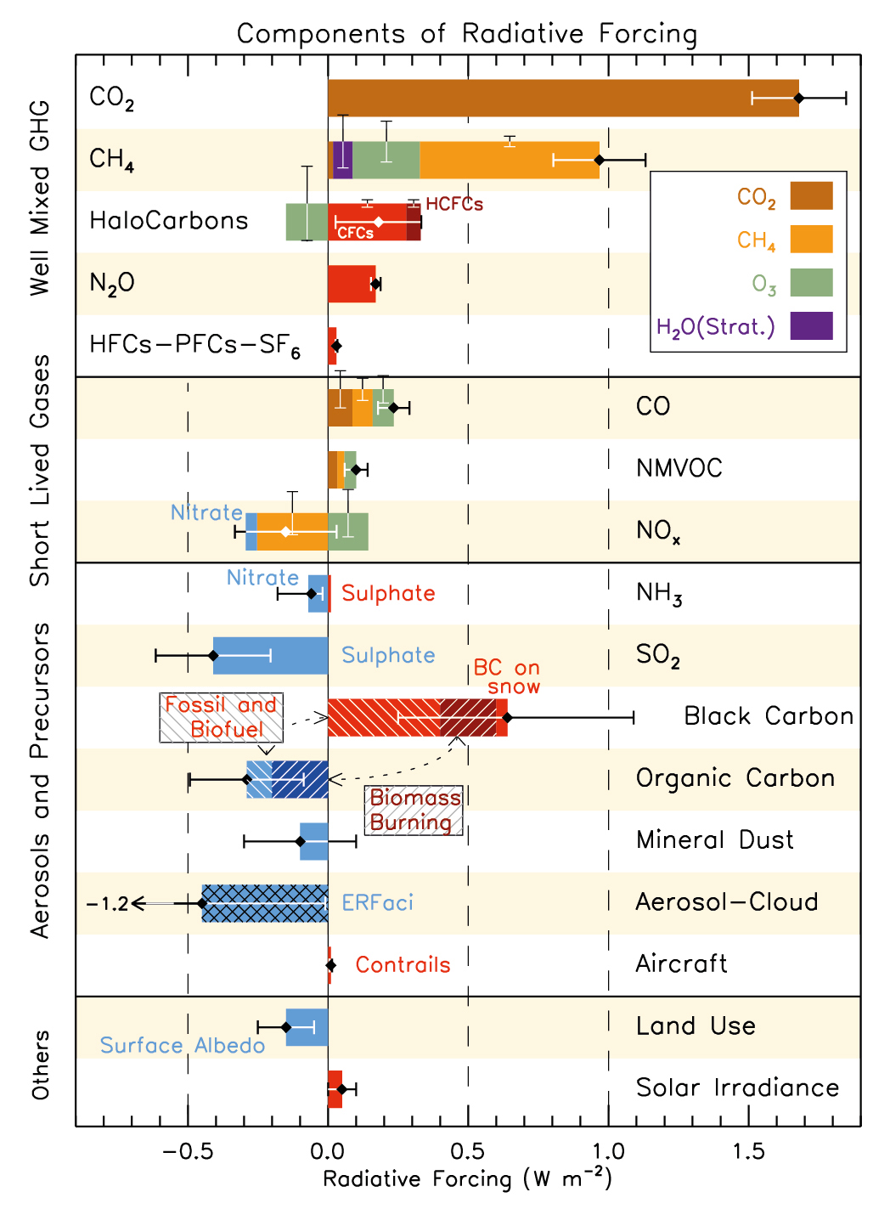
Climate change depend on
short lived climate pollutants (SLCPs)

Slide 8
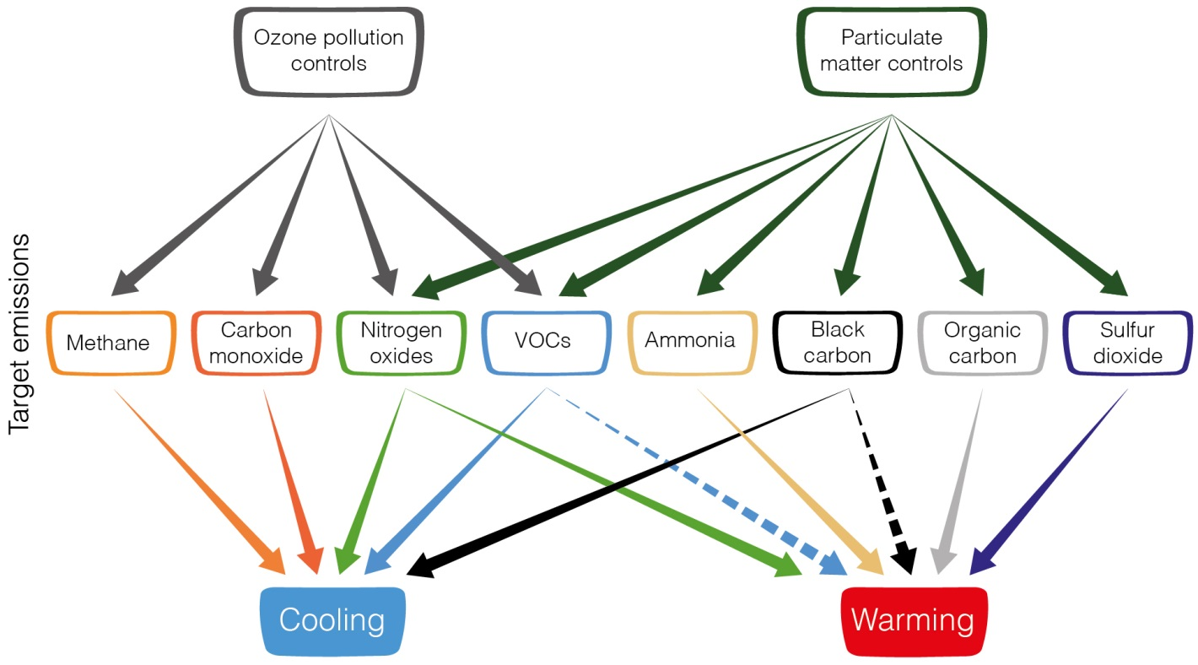
Air Quality Controls on SLCPs
Impact Global Warming

Slide 9
Contributions of different sectors to anthropogenic emissions of short-lived climate forcers (2014).
Abbildung 6.3

Slide 10
Regional contributions to anthropogenic emissions of short-lived climate forcers (2014).
Abbildung 6.3

Slide 11



Unless there are immediate,
SIXTH ASSESSMENT REPORT
Working Group I – The Physical Science Basis
“
rapid, and large-scale reductions in greenhouse gas emissions, limiting warming to 1.5°C will be beyond reach.
[Credit: Peter John Maridable | Unsplash]

Slide 12

SIXTH ASSESSMENT REPORT
Working Group I – The Physical Science Basis
Temperature change due to emissions of one year (2014) after 10 and 100 years
Figure 6.16

Slide 13
SIXTH ASSESSMENT REPORT
Working Group I – The Physical Science Basis
Temperature change due to emissions of one year (2014) after 10 and 100 years
Figure 6.16

Slide 14

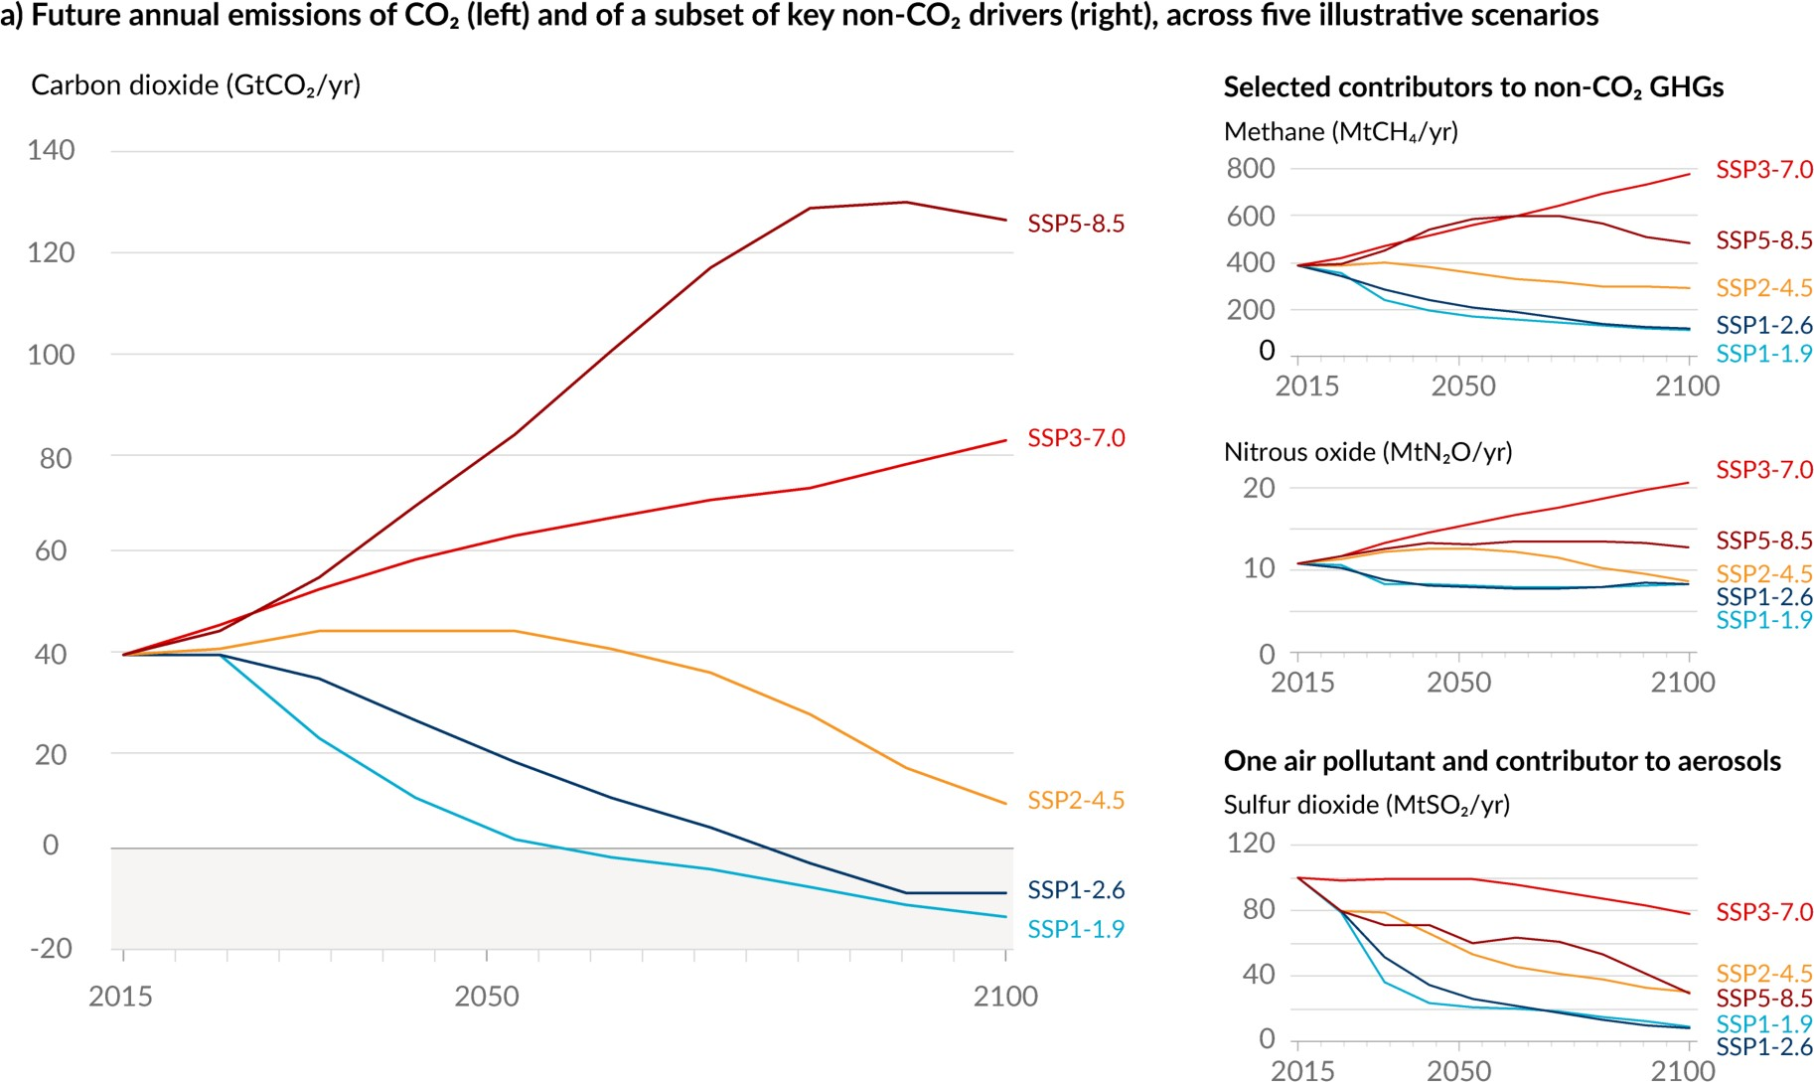
SIXTH ASSESSMENT REPORT
Working Group I – The Physical Science Basis
Future emissions cause future additional warming, with total warming dominated by past and future CO₂ emissions
Stringent reduction of methane, soot, and other short lived climate forcers can reduce warming until the end of the century of 0.8°C
Figure SPM.4

Slide 15
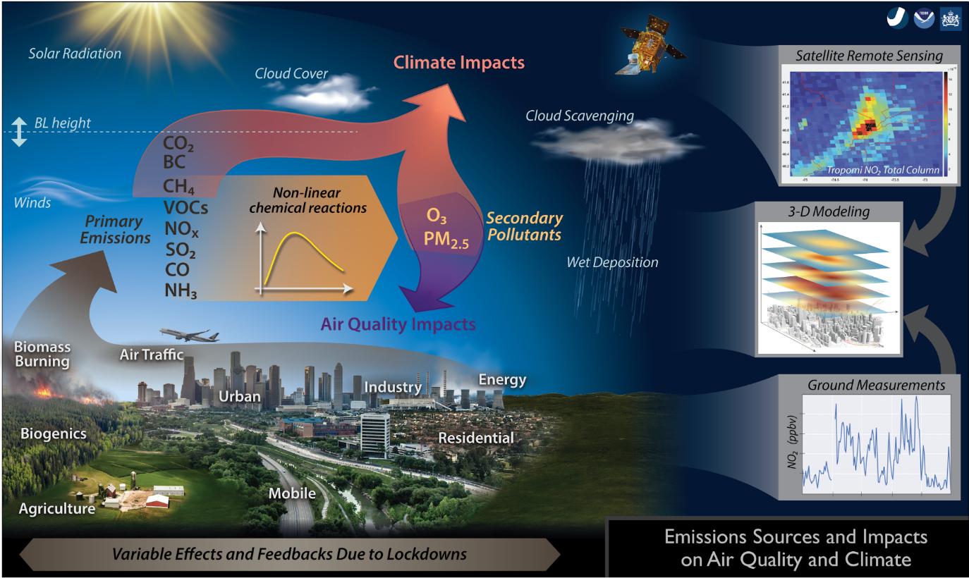

Slide 16
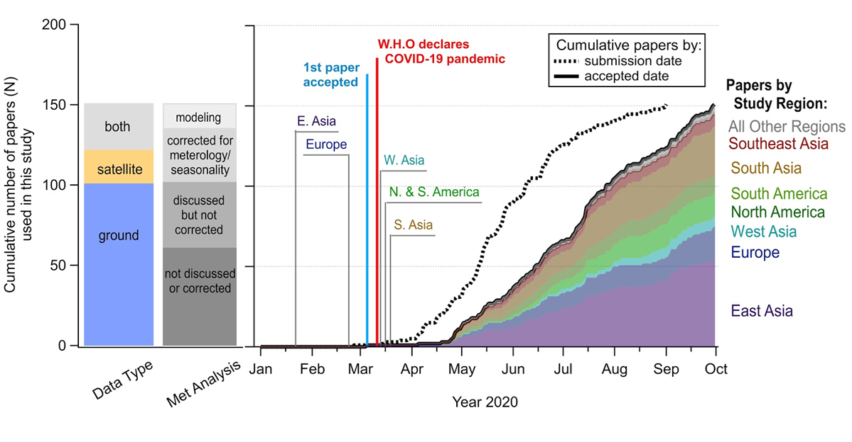
Literature review process: Response to the pandemic
Papers were digitized based on the country the measurements were performed, the method used (satellite or ground-based), and whether they accounted for the effects of meteorology.
2/3 of the studies included in this review did not account for the effects of meteorology
The cumulative number of papers for which we digitized data for this analysis. The papers are grouped by data type, treatment of meteorology/seasonality, and study region as a function of the manuscript acceptance date. The dates that the first country within each geographic region to undergo a strict lockdown are included, starting with China on January 22, 2020.

Slide 17
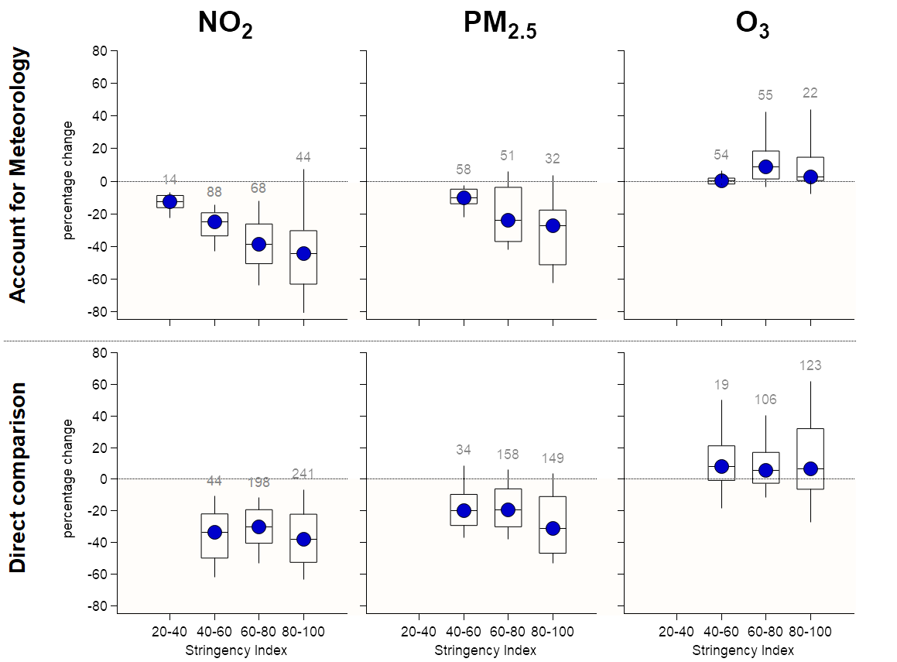
Percent changes vs. stringency index
Importance of accounting for meteorology
When accounting for the effects of meteorology clear trends between percent changes of pollutant concentrations and stringency index are evident.
These trends seize to exist when studies do not account for the effects of meteorology
It is essential to account and quantify the effects of meteorology to quantitatively link changes in atmospheric abundance with changes in emissions
Studies that
Important remaining question:
What is the chemical composition of PM_{2.5} during these periods? What is the contribution of secondary PM to particulate pollution?
What happens to O₃ in photochemically active seasons?
How do we compare to inventories?
Studies that perform a

Slide 18
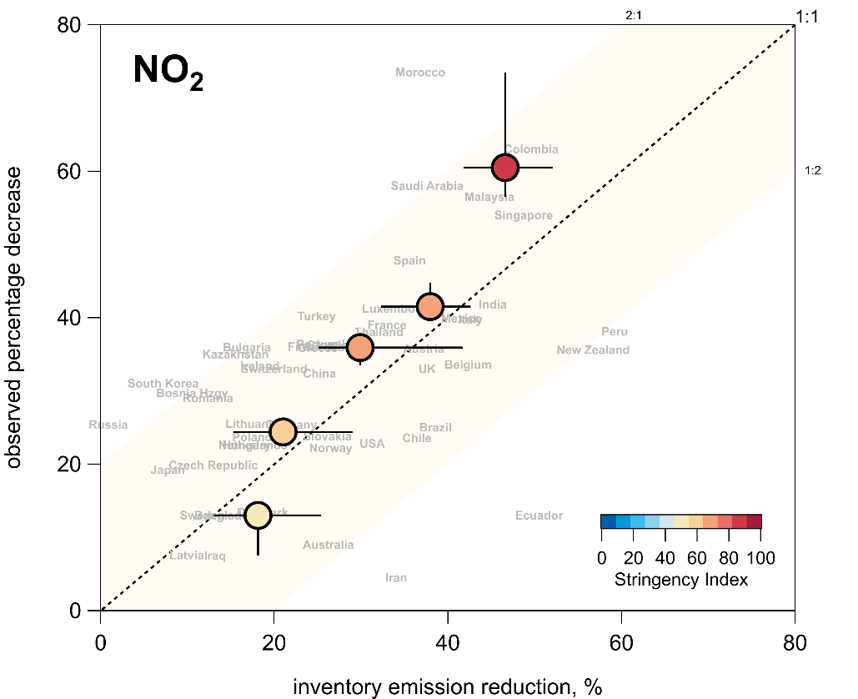
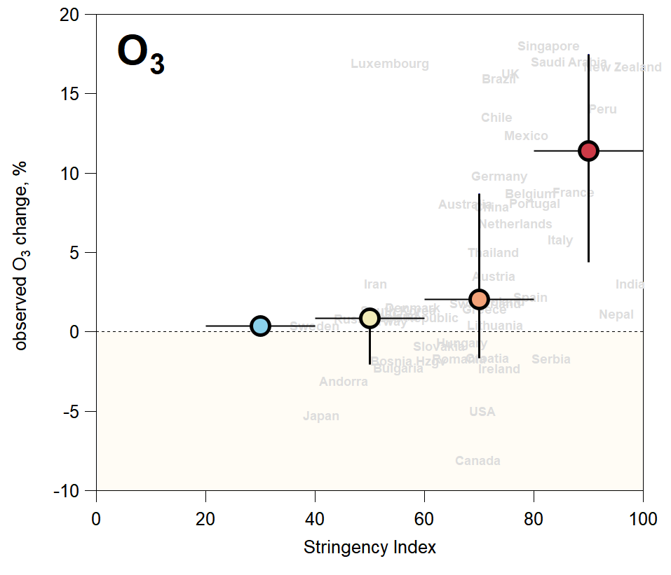
NO2 and O₃ percent changes and correlation to stringency index
Forster et al. (2020), Nature
15

Slide 19

Thank you
by Glynn Gorick

