Slide 1
The RWTH in figures - 2021
May 2022
RWTH Aachen University I Department 6.0 Planning, Development and Controlling

Slide 2
Overview
The RWTH in figures - 2021
RWTH Aachen University | Department 6.0 | Division 6.3 | May 2022

Slide 3
The RWTH in WS 2021/22
47.269 Students
3 Clusters of Excellence
(1st funding line)
University of Excellence
(2nd funding line)
7.344 Graduates (Academic Year 2021)
22 Collaborative Research Centers and (Transregional) CRCs
39 Research Training Programmes
13.354 International students
170 Courses of study
(including 16 of them privately are offered)
1.108 Mio. Euro Budget
10.249 Total number of staff (FTE)
The RWTH in figures - 2021
RWTH Aachen University | Department 6.0 | Division 6.3 | May 2022

Slide 4
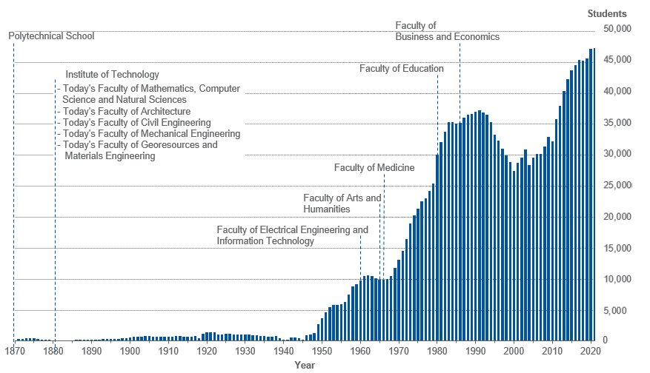
Development of RWTH
The RWTH in figures - 2021
RWTH Aachen University | Department 6.0 | Division 6.3 | May 2022

Slide 5
Structure and Organisation
The RWTH in figures - 2021
RWTH Aachen University | Department 6.0 | Division 6.3 | May 2022

Slide 6
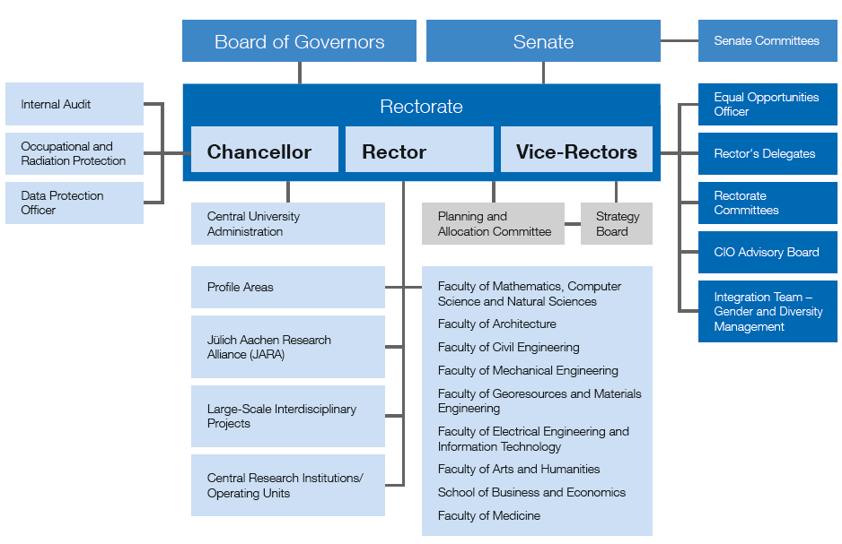
Organisation
The RWTH in figures - 2021
RWTH Aachen University | Department 6.0 | Division 6.3 | May 2022

Slide 7
Scientific and industrial connections
Institutional
collaborations
Working groups, research and competence centers
Affiliated Institutes
Federal ministries,
BMBF and others
Transregional Collaborative Research Centers
German Research Foundation,
European Union
International networks and cooperation
Cooperation agreements RWTH – industry and associations
Excellence Strategy:
Clusters of Excellence,
University of Excellence
Endowed professorship, Guest scientists,
Alumni
The RWTH in figures - 2021
RWTH Aachen University | Department 6.0 | Division 6.3 | May 2022

Slide 8
Students WS 2021/22 Graduates in 2021 (Academic Year)
The RWTH in figures - 2021
RWTH Aachen University | Department 6.0 | Division 6.3 | May 2022

Slide 9
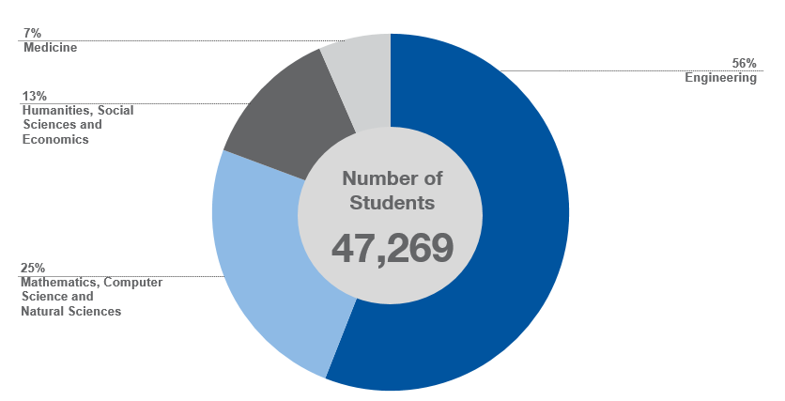
Students by Discipline WS 2021/22
The RWTH in figures - 2021
RWTH Aachen University | Department 6.0 | Division 6.3 | May 2022

Slide 10
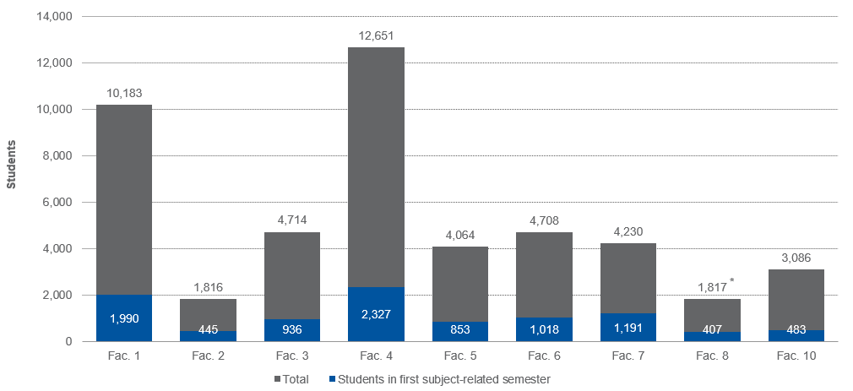
Students by Faculty and students in first subject-related semester WS 2021/22
* incl. Business Administration and Engineering: 6.543 students
Fac. 1 | Faculty of Mathematics, Computer Science a. Natural Sciences
Fac. 2 | Faculty of Architecture
Fac. 3 | Faculty of Civil Engineering
Fac. 4 | Faculty of Mechanical Engineering
Fac. 5 | Faculty of Georesources and Materials Engineering
Fac. 6 | Faculty of Electrical Engineering a. Information Technology
Fac. 7 | Faculty of Arts and Humanities
Fac. 8 | Faculty of Business and Economics
Fac. 10 | Faculty of Medicine
The RWTH in figures - 2021
RWTH Aachen University | Department 6.0 | Division 6.3 | May 2022

Slide 11
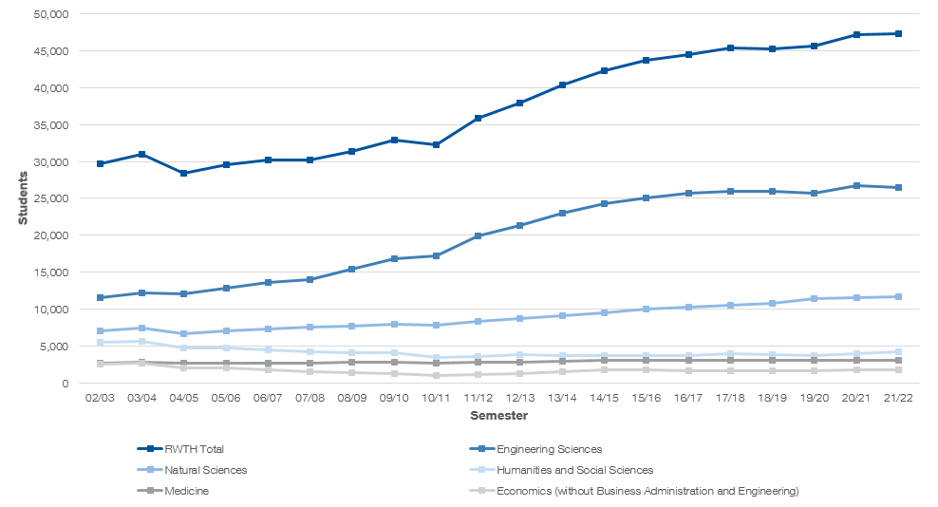
Development of the Number of Students
The RWTH in figures - 2021
RWTH Aachen University | Department 6.0 | Division 6.3 | May 2022

Slide 12
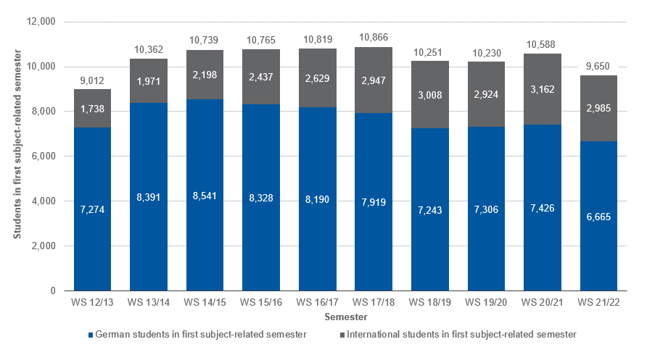
Development of the Number of Students in first subject-related semester
Note: Analysis based on nationality
The RWTH in figures - 2021
RWTH Aachen University | Department 6.0 | Division 6.3 | May 2022

Slide 13
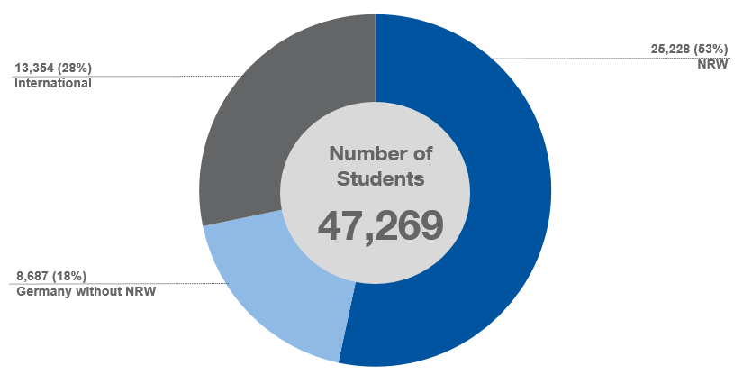
Origin of the Students WS 2021/22
Distribution according to North Rhine-Westphalia, other Federal States of Germany and foreign countries
Note: Analysis based on nationality
The RWTH in figures - 2021
RWTH Aachen University | Department 6.0 | Division 6.3 | May 2022

Slide 14
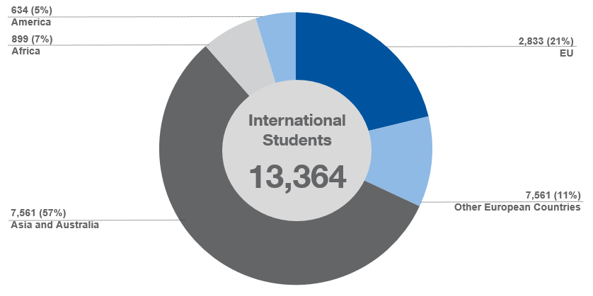
Catchment Area of Students WS 2021/22
Distribution according to foreign countries divided in European Union, other European countries, Asia and Australia, Africa and America
Note: Analysis based on nationality
The RWTH in figures - 2021
RWTH Aachen University | Department 6.0 | Division 6.3 | May 2022

Slide 15
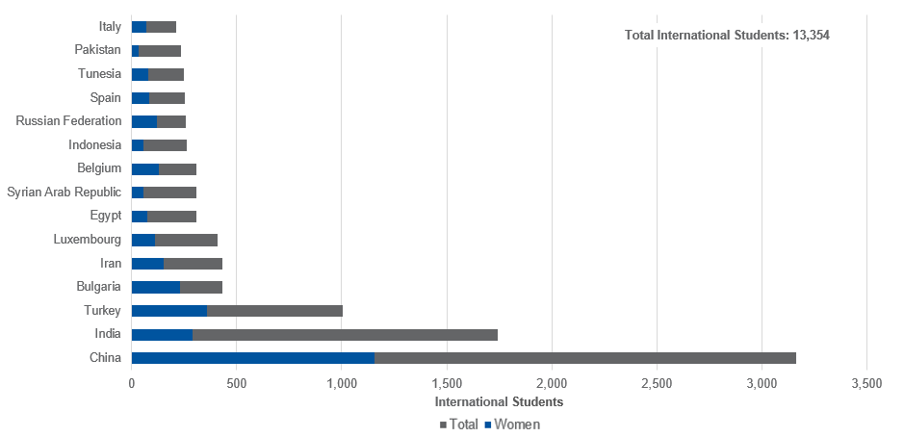
International Students WS 2021/22 Top 15 Countries
Note: Analysis based on nationality
The RWTH in figures - 2021
RWTH Aachen University | Department 6.0 | Division 6.3 | May 2022

Slide 16
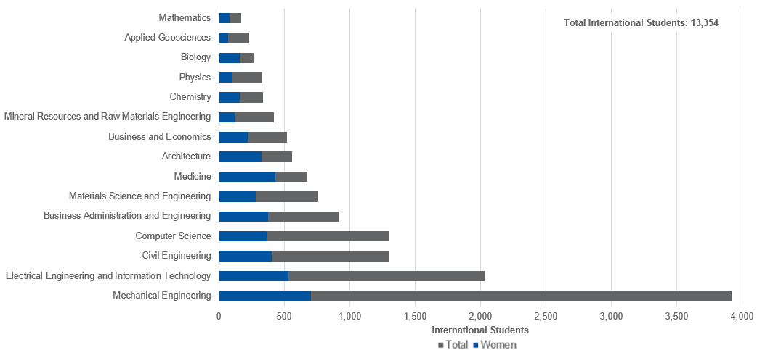
International Students WS 20/21 Top 15 Subjects
Note: Analysis based on nationality
The RWTH in figures - 2021
RWTH Aachen University | Department 6.0 | Division 6.3 | May 2022

Slide 17
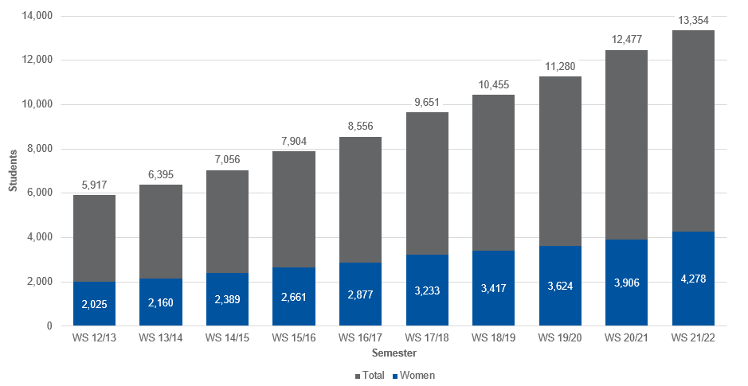
Development of the Number of International Students
The RWTH in figures - 2021
RWTH Aachen University | Department 6.0 | Division 6.3 | May 2022

Slide 18
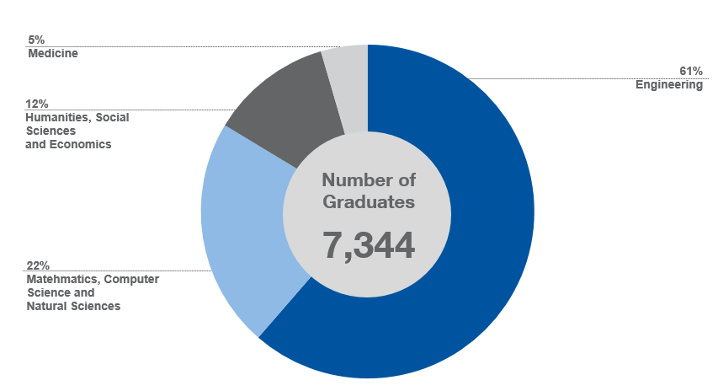
Graduates by Discipline in the Academic Year 2021
The RWTH in figures - 2021
RWTH Aachen University | Department 6.0 | Division 6.3 | May 2022

Slide 19
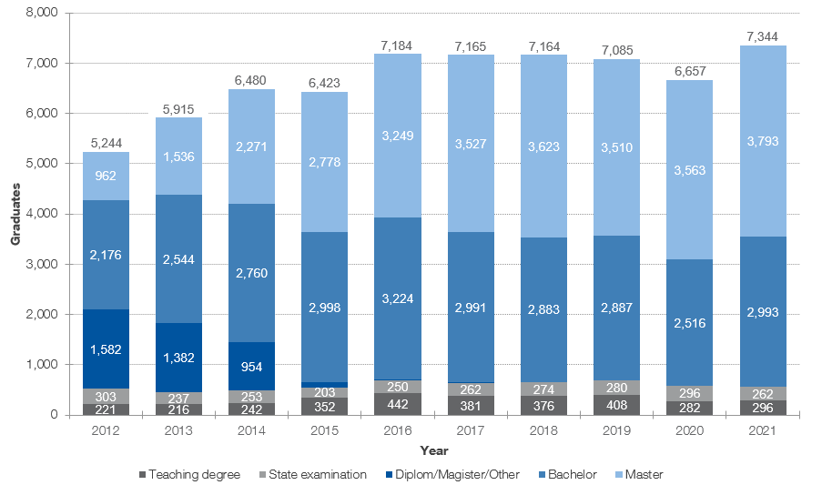
Development of the Number of Graduates by Degree
The RWTH in figures - 2021
RWTH Aachen University | Department 6.0 | Division 6.3 | May 2022

Slide 20
Utilised Capacity of Faculties 1 - 8 WS 2021/22
Fac. 1 | Faculty of Mathematics, Computer Science a. Natural Sciences
Fac. 2 | Faculty of Architecture
Fac. 3 | Faculty of Civil Engineering
Fac. 4 | Faculty of Mechanical Engineering
Fac. 5 | Faculty of Georesources and Materials Engineering
Fac. 6 | Faculty of Electrical Engineering a. Information Technology
Fac. 7 | Faculty of Arts and Humanities
Fac. 8 | Faculty of Business and Economics
The RWTH in figures - 2021
RWTH Aachen University | Department 6.0 | Division 6.3 | May 2022

Slide 21
Physics @ RWTH Aachen Univeristy

Slide 22
Physics @ RWTH Aachen University
Experimental Physics
Institute IA (solid state physics, nono-opics, biophysics)
Institute IB (particle/astroparticle CMS, LHC-B, AMS)
Institute IIA (solid state physics e-systems, structure)
Institute IIB (solid state physics 2-materials)
Institute IIC (solid state phyiscs quantum information)
Institute IIIA (particle/astroparticle CMS, Auger, axions, AI)
Institute IIIB (particle/astroparticle Neutrinos, ET, med.phys., AI)
Theoretical Physics
Institute A Statistical Physics
Institute C Solid State Physics
Institute E Particle Physics & Cosmology
Institute IQI Quantum Information
Didactics
Institute IA
43 professors
about 50 associate professors (external)

Slide 23
Department of Physics
Some statistical information (2021):
Published 527 articles in peer-reviewd journals.
Around 20. Mio. € third-party funding
191 scientist positions (3/4 third-party funded)
60 PhDs completed
123 Master degrees (incl. 26 women) Ø 5.4 terms
141 Bachelor degrees (incl. 33 women) Ø 8.3 terms
17 teacher‘s degrees (incl. 4 women)
Credit points awards: 57801

Slide 24
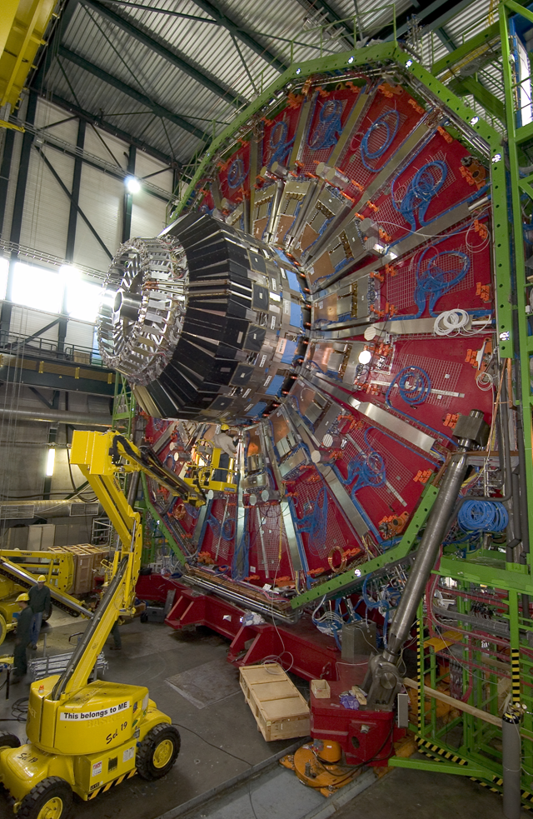
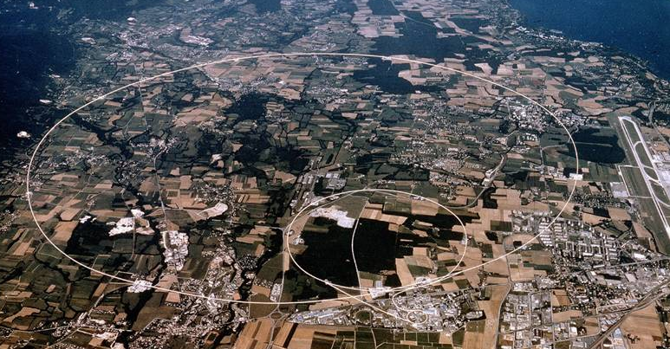
Particle Physics
RWTH @ CERN

Slide 25
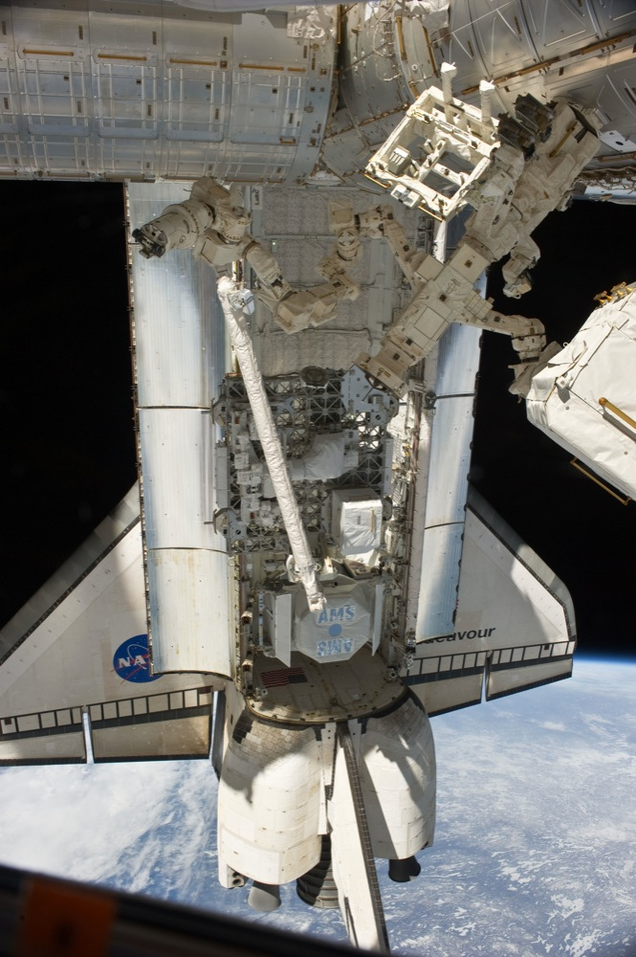
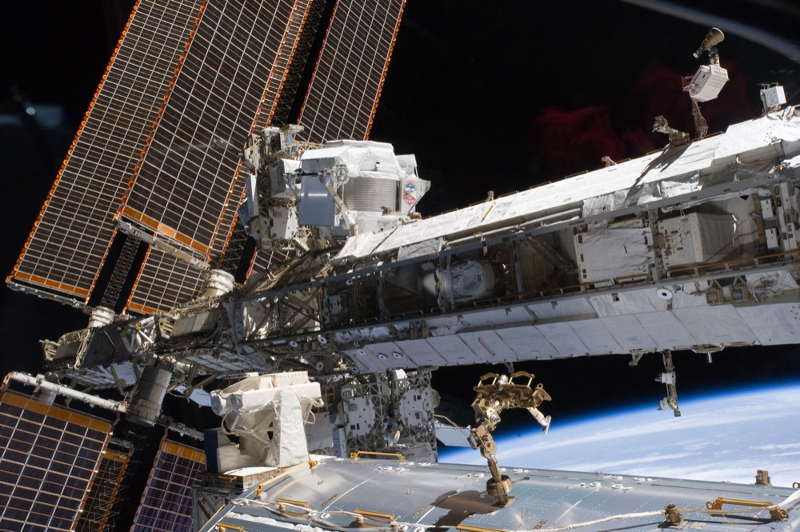
Astrophysics
AMS-Experiment at the ISS
Search for antimatter in space

Slide 26
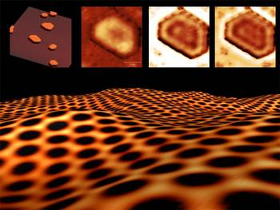
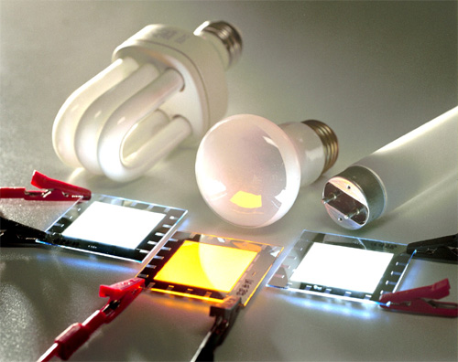
Condensed Matter
Sudy of materials on atomic scales
Graphen, organic layers

Slide 27
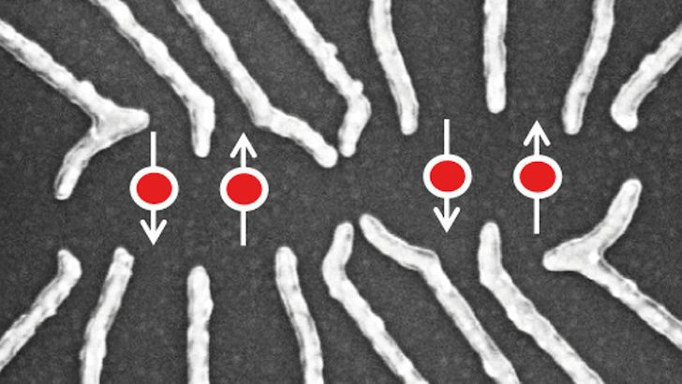
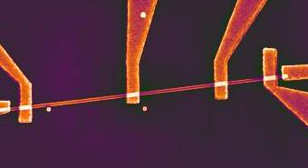
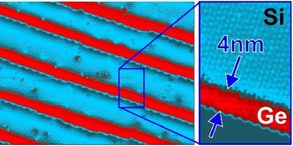
Nanoelectronics and Quantum Technologies
Electronics on atomic scales
Quantum effects
Quantum computing

Slide 28
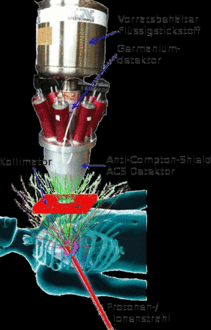
Biophysics and medical physics
Spektroskopische Untersuchung von Proteinen
Strahlentherapie mit Teilchenstrahlen
Bildgebende Verfahren

Slide 29
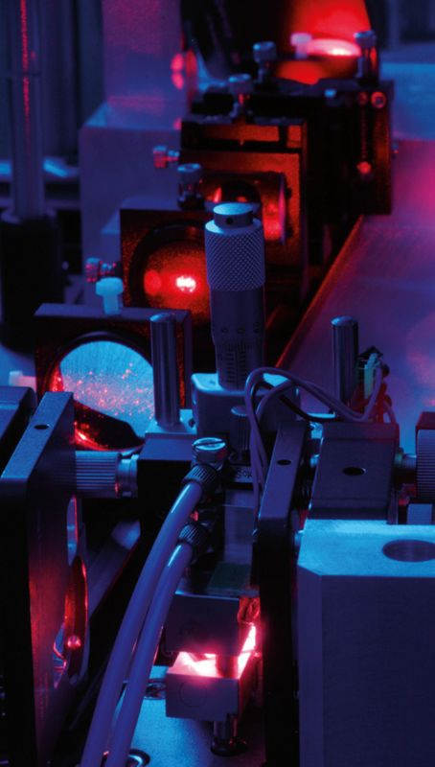
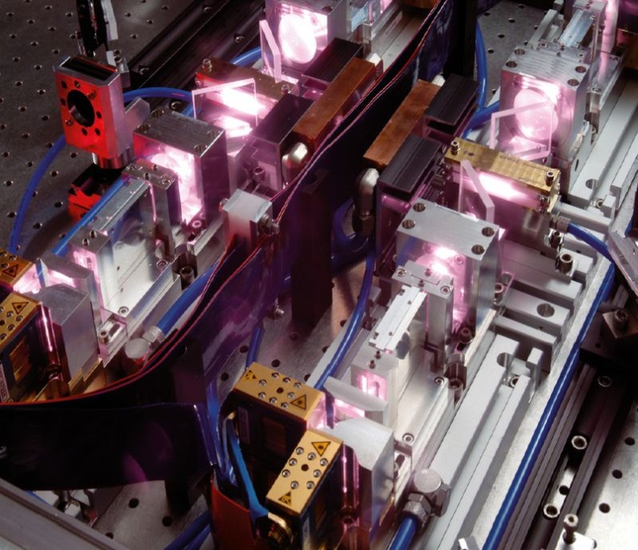
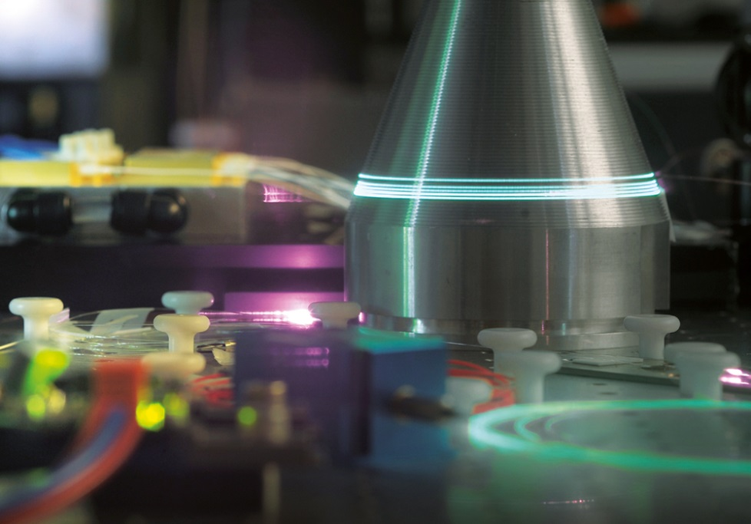
Optics und laser physics
Neue Laser mit höhere Leistung und kürzeren Pulsen
Berechnung und Design komplexer Optiken
Nano-Optik und Photonik

Slide 30
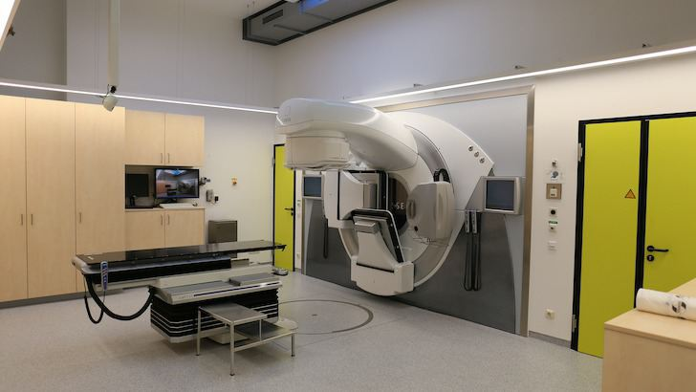
Radiation Therapy
MC-Simulations
Achim Stahl, RWTH Aachen University
Notes:
Titel

Slide 31
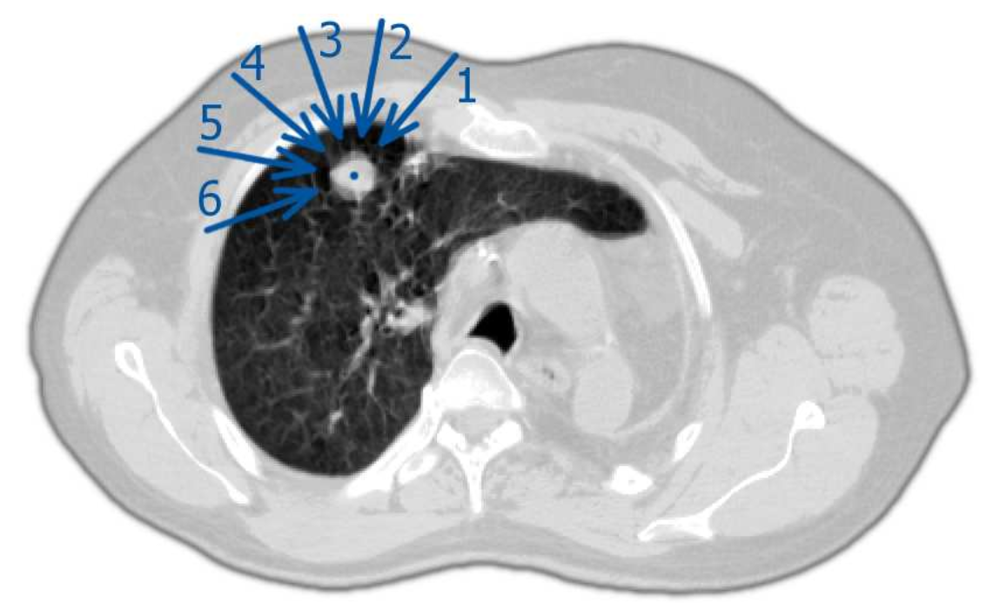
GEANT4: Real Patient
Notes:
Esophagus = Speiseröhre

Slide 32
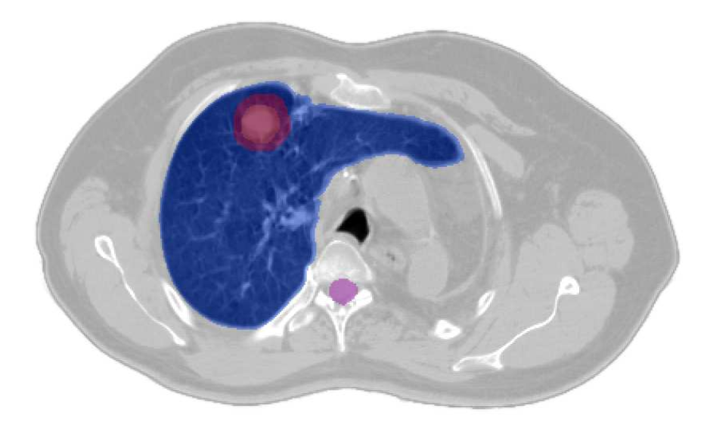
GEANT4: Real Patient

Slide 33
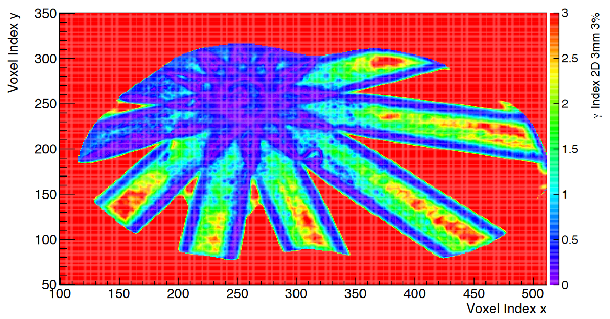
GEANT4: Real Patient
Comparison: GEANT4 with commercial planning software (Pinnacle)

Slide 34
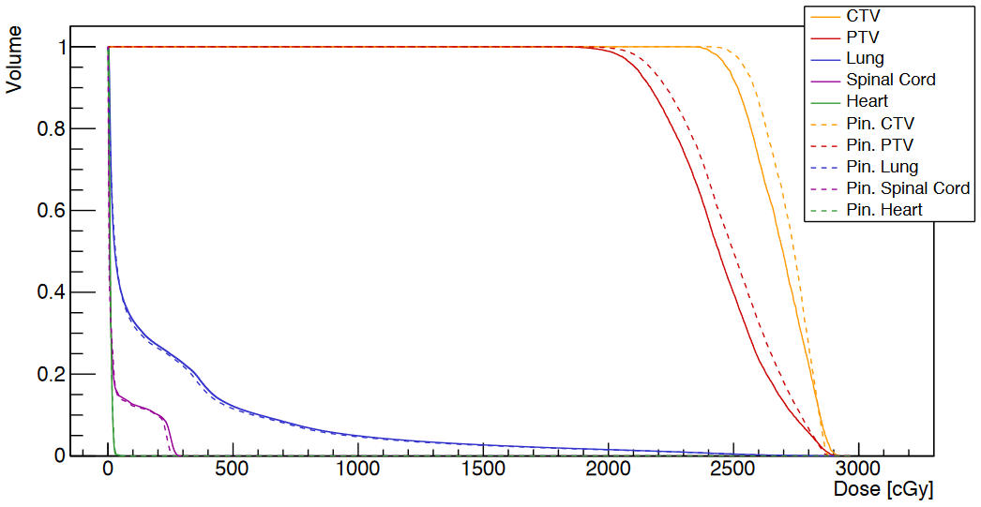
GEANT4: Real Patient
Pinnacle
GEANT4
Dose-to-Volume histogram
PTV
Prescribed: 20. Gy
Pinnacle: 21.07 Gy
GEANT4: 20.39 Gy
Spinal Cord
Pinnacle: 2.45 Gy
GEANT4: 2.61 Gy
Comparison: GEANT4 with commercial planning software (Pinnacle)

Slide 35
Radiation Therapy
In-Situ Monitoring
Achim Stahl, RWTH Aachen University
Notes:
Titel

Slide 36
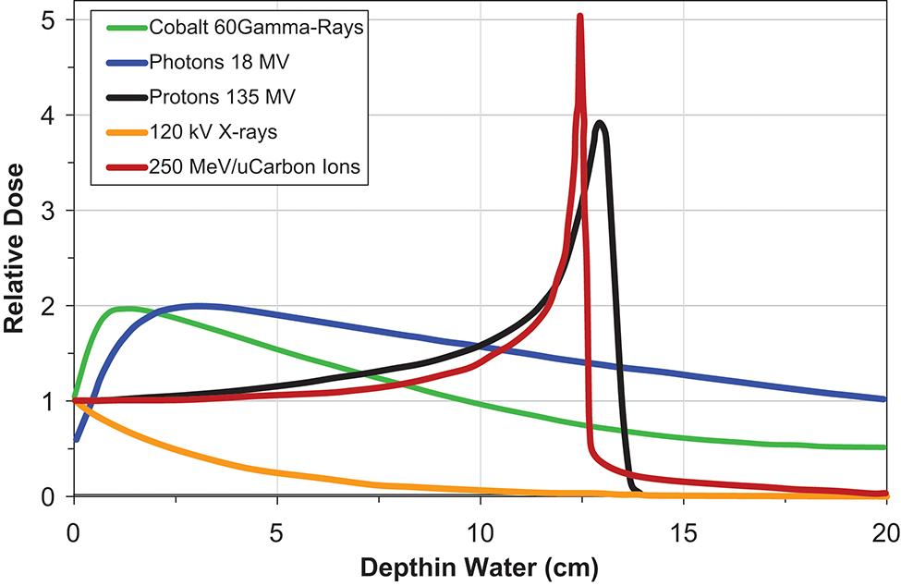
Depth Dose Profiles
Particle beams destroy tumor cells through ionization
charged particles (e⁻, p, ¹²C): dE/dx, Bethe-Bloch Eq.
photons: photo-effect, Compton-Scattering

Slide 37
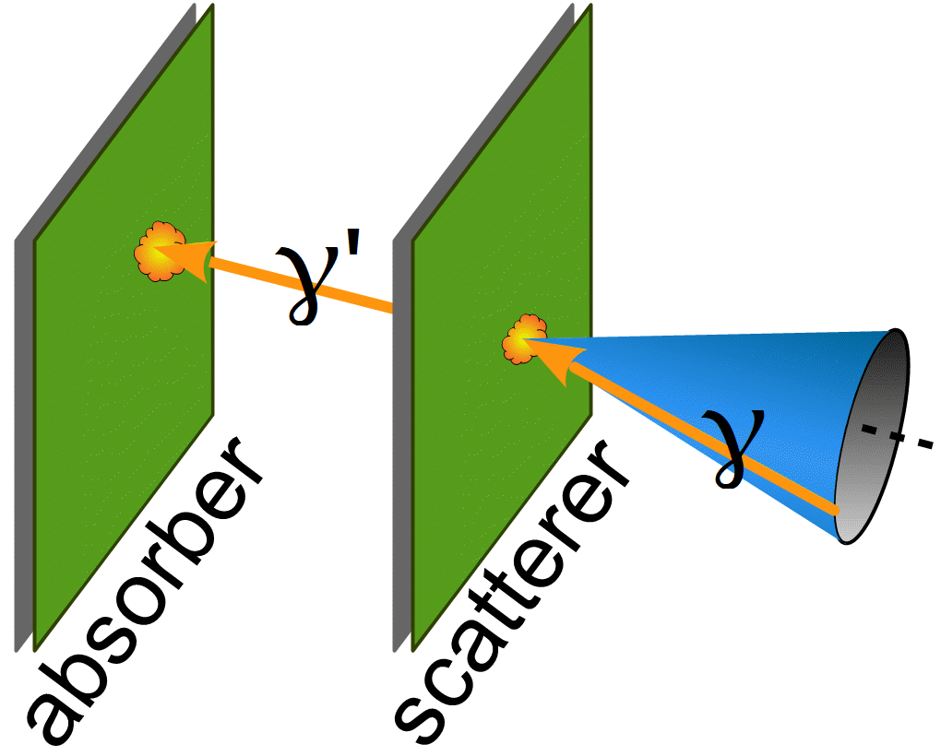
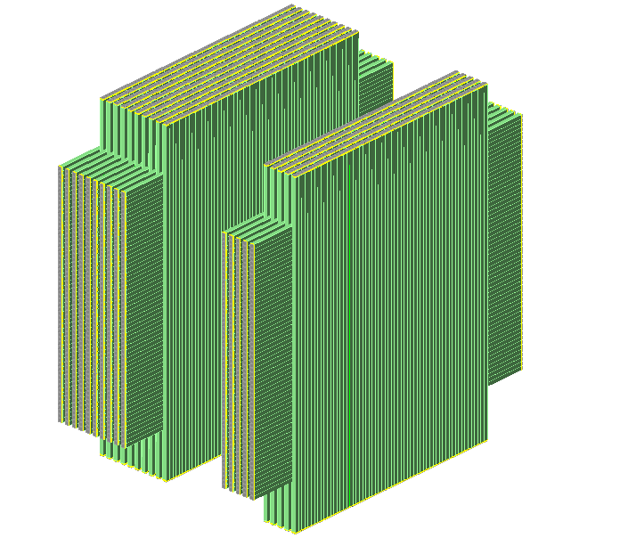
In-Situ Diagnosis: Advanced Compton Camera
Look for γ-radiation emitted near the Bragg-peak
Joint project with groups in Cracow
(new proton-center in Cracow
with beamline for experiments.)
Phase 1: Identify and measure γ-lines
Phase 2: Test detection technology
Phase 3: Build full-size prototype

Slide 38
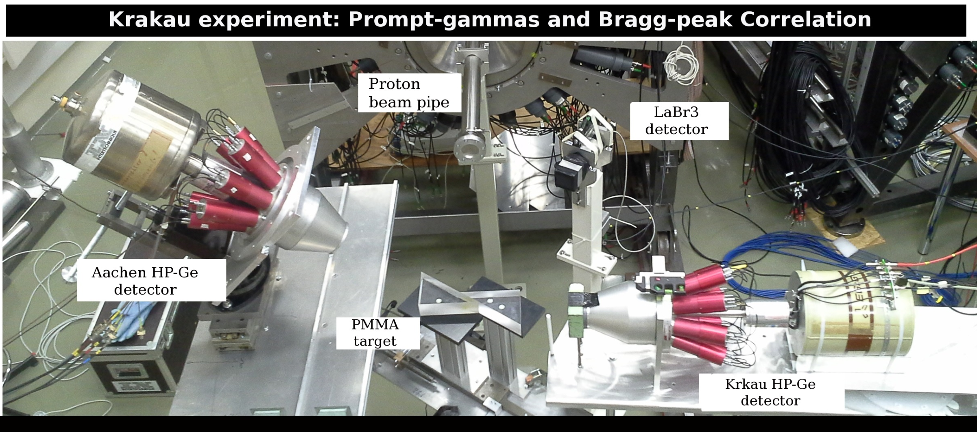
In-Situ Diagnosis: γ-Emission
Notes:
Diagnosis: Krakow-Experiment

Slide 39
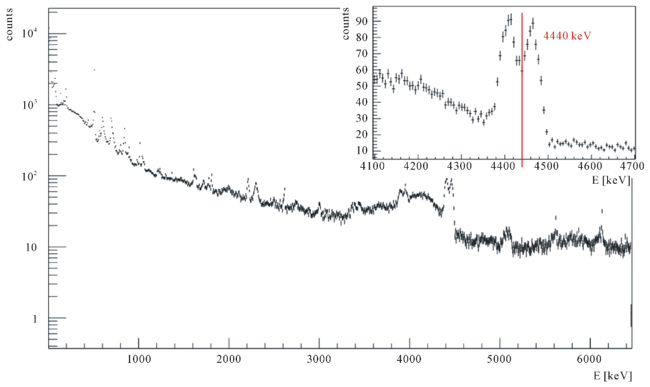
In-Situ Diagnosis: γ-Emission
K. Rusiecka et al., World Journal of Nuclear Science and Technology, 2016, 6, 63-70

Slide 40
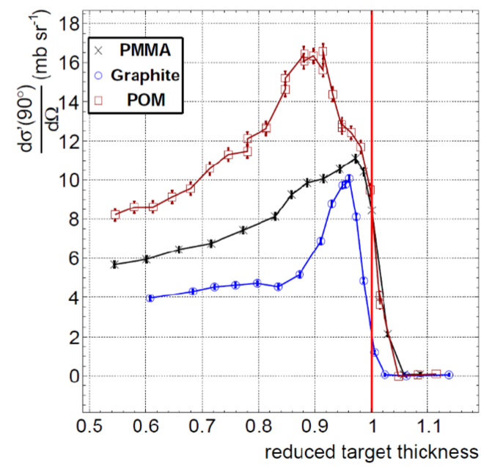
In-Situ Diagnosis: γ-Emission
Bragg-Peak
PMMA: C₅H₈O₂
Graphite: C
POM: (CH₂O)_{n}

Slide 41
In-Situ Diagnosis: Advanced Compton Camera
Look for γ-radiation emitted near the Bragg-peak
Joint project with groups in Cracow
(new proton-center in Cracow
with beamline for experiments.)
Phase 1: Identify and measure γ-lines
Phase 2: Test detection technology
Phase 3: Build full-size prototype

Slide 42
Physics @ RWTH Aachen Univeristy
Thanks

