Slide 1
Frontiers of fundamental physics
GGSB – 8th GGSWBS, Tbilisi, georgia
august 20-25, 2018 I hans ströher

Slide 2
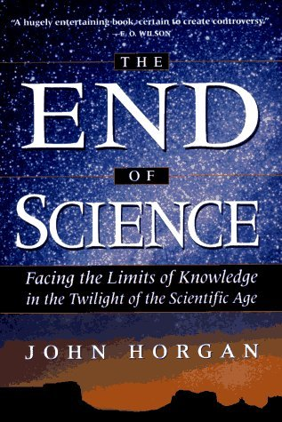
Science – the endless Frontier ?
Current
KNOWLEDGE
U n k n o w n
Lord Kelvin (1900)

Slide 3
Science – the endless Frontier !
There are things we know that we know;
there are things we know that we don´t know, and
there are things we don´t know that we don´t know
(after D. Rumsfeld)
Questions
Puzzles
Mysteries
U n k n o w n

Slide 4
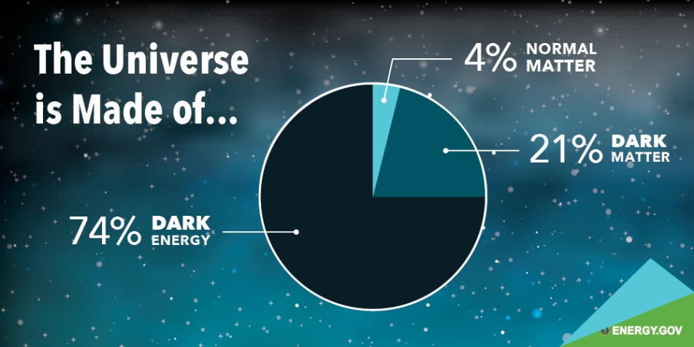
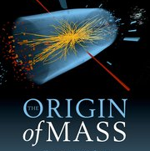
Big questions (of particle physics)

Slide 5
Dark matter and dark energy
Only about 4% of the
energy content of the Universe – normal matter –
is currently understood
Rest (96%) – nature of dark matter and dark energy – is unknown!

Slide 6
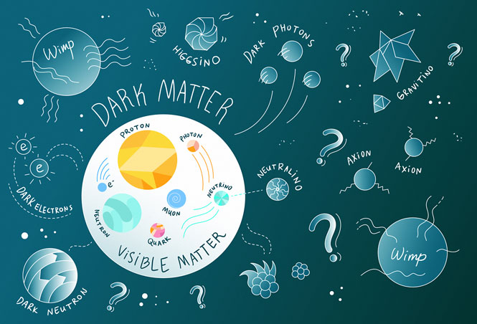
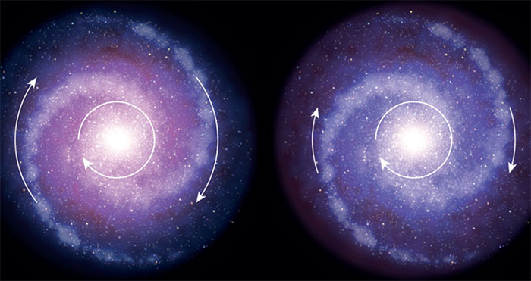
Dark matter – What is it?
Normal matter: brightly shining stars, glowing gas and clouds of dust Dark matter: does not emit, absorb or reflect light
Observed via its gravitational effects, e.g.:
a higher speed of rotation in the outer parts of spiral galaxies

Slide 7
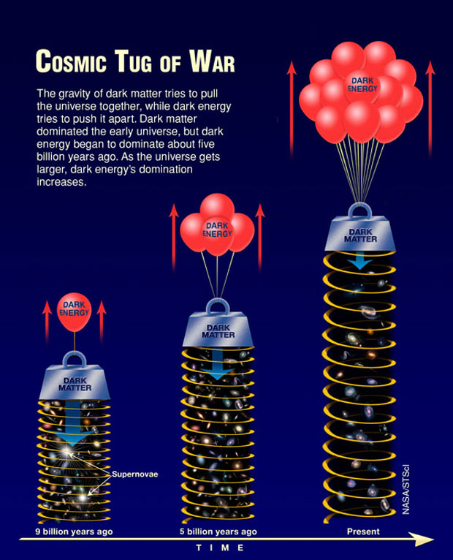
Dark Energy – What is it?
Dark energy:
exotic form of energy;
causes the universe expansion to accelerate;
most abundant form of
energy in the universe;
may be Einstein´s cosmological constant;
But: possibility that dark energy doesn’t exist;
i.e. something strange going on with gravity

Slide 8
neutrinos
Neutrinos: most abundant
particle species in the Universe
(~ 100/cm³); almost no interaction with matter (billions pass us every second)
Neutrinos (and anti-neutrinos): unconventional and mysterious particles

Slide 9
Neutrinos – what are they?
Species
(flavors)
Masses
ν_{e,μ,τ} are combinations of ν_{1,2,3}
Neutrino oscillations:

Slide 10
Neutrinos – what are they?
Difference between matter and anti-matter?
Don´t know yet!

Slide 11
antimatter
Normal matter – is all abundant
Anti-matter – a priori no reason
why not as abundant
Matter – anti-matter annihilation
results in an empty universe
Puzzle of our existence!

Slide 12
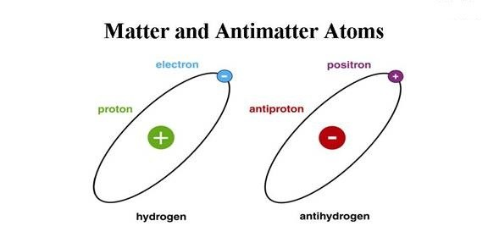
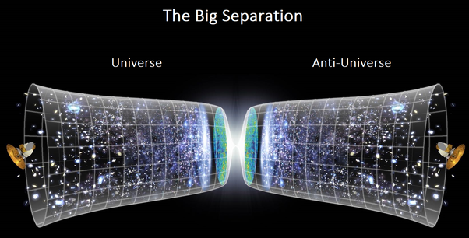
antimatter – Where is it?
Our world
(Universe)
Hardly anything:
where is it?
New Physics
(e.g. Electric Dipole Moments (EDMs))
AMS recently detected
6 anti-³He and 2 anti-⁴He
candidate events

Slide 13
Mass of particles
Quarks (up, down, strange, …) and leptons (electrons, muons, neutrinos) have vastly different mass
How do particles aquire different mass?

Slide 14
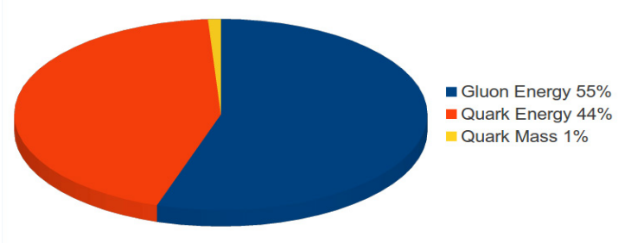
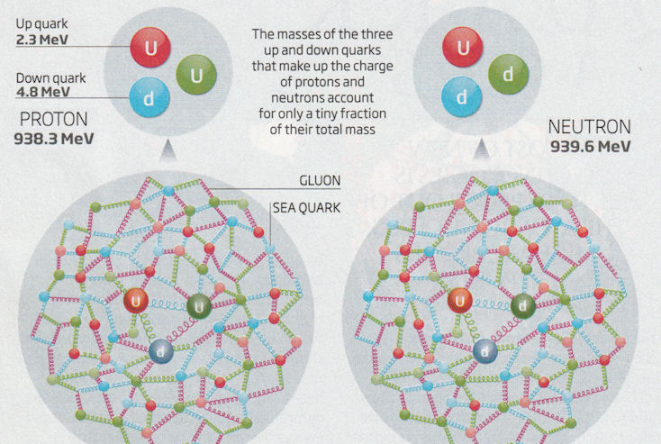
Mass of particles – Only Higgs?
photon (Mass = 0)
electron (M = 0.5)
muon (M = 200)
Mass by inter-
action with
Higgs-field:
~ 1%
quark
mass
Most of nucleon mass contained in interaction of qq-pairs and gluons
→ how ?
(Note: US plans
new accelerator)
Not so for
light quarks
and nucleons:
~ 44%
quark
energy
~ 55%
gluon
energy

Slide 15
Forces of nature
Forces of Nature:
electric, magnetic, weak, strong and gravitation
Do they originate from 1 basic force?

Slide 16
Forces of nature – unification?
Electroweak (established)
Grand Unified Theory (GUT)
(predicts free proton-decay, e.g.: p → e⁺ π⁰ – not yet observed (τ >10³⁴ y))

Slide 17
Unknown symmetries
Physics is the study of symmetries and symmetry breaking:
Are there yet unknown symmetries?

Slide 18
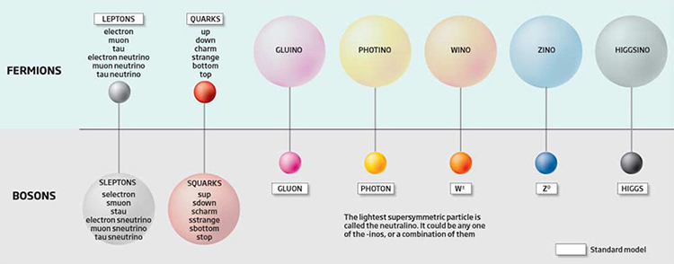
Supersymmetry – hope or dead end?
Matter
Force Carriers
If nature is supersymmetric: a "doppelgänger" state to every presently known elementary particle (lightest one … stable; Dark Matter?)
None
observed
yet !

Slide 19
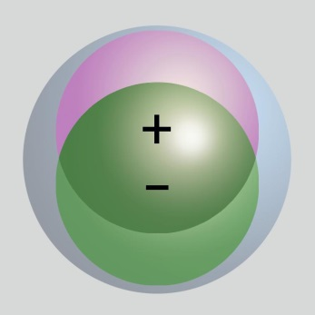
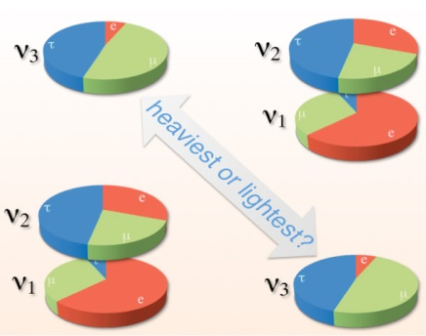
Our contributions
Search for CP-Violation
Electric Dipole Moments (EDM):
Search for
Dark Matter (Axions):
Investigate neutrino properties:

Slide 20
Big questions – who cares?

Slide 21
Big questions – who cares?
Do we (really) need to know:
if neutrinos have mass?
why matter has won over antimatter?
what the fate is of the Universe?
…
Use-inspired (instead of curiosity-driven) basic research?!

Slide 22
Big questions – who cares?
Do we (really) need to know:
if neutrinos have mass?
why matter has won over antimatter?
what the fate is of the Universe?
…
Use-inspired (instead of curiosity-driven) basic research?!
Similar questions may have been asked by our ancestors:
GR: tiny influence of mass on time → GPS
Spin: magnetic moment of protons → NMR/MRI
QM: stimulated emission of light → LASER
…

Slide 23
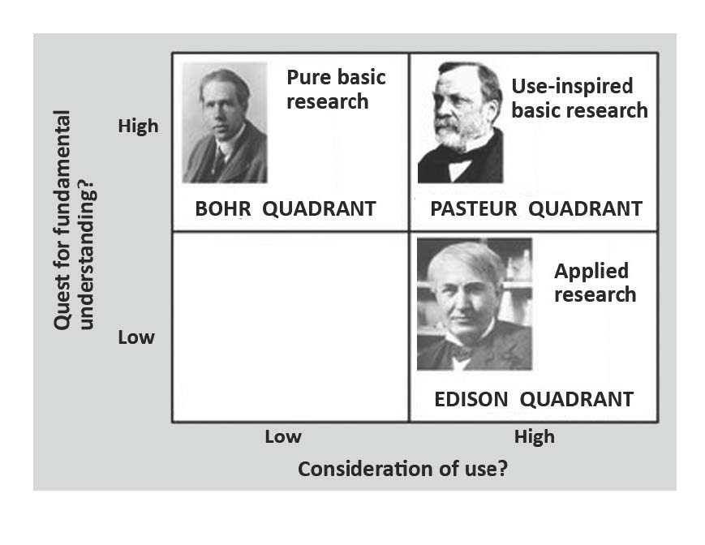
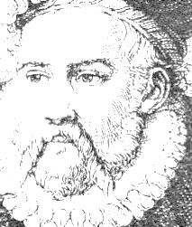
Take home: Science comprises all!
Data
Collection
(BRAHE QUADRANT)

Slide 25
