Slide 1

8TH GEORGIAN – GERMAN SCHOOL AND WORKSHOP
IN BASIC SCIENCE (GGSWBS ‘18)
SCIENCE AT MULTIDISCIPLINARY
SMART | LABS IN GEORGIA
August 20 – 25, 2018 • Tbilisi, Georgia
Tbilisi I 20.08.2018 B. Neumaier

Slide 2

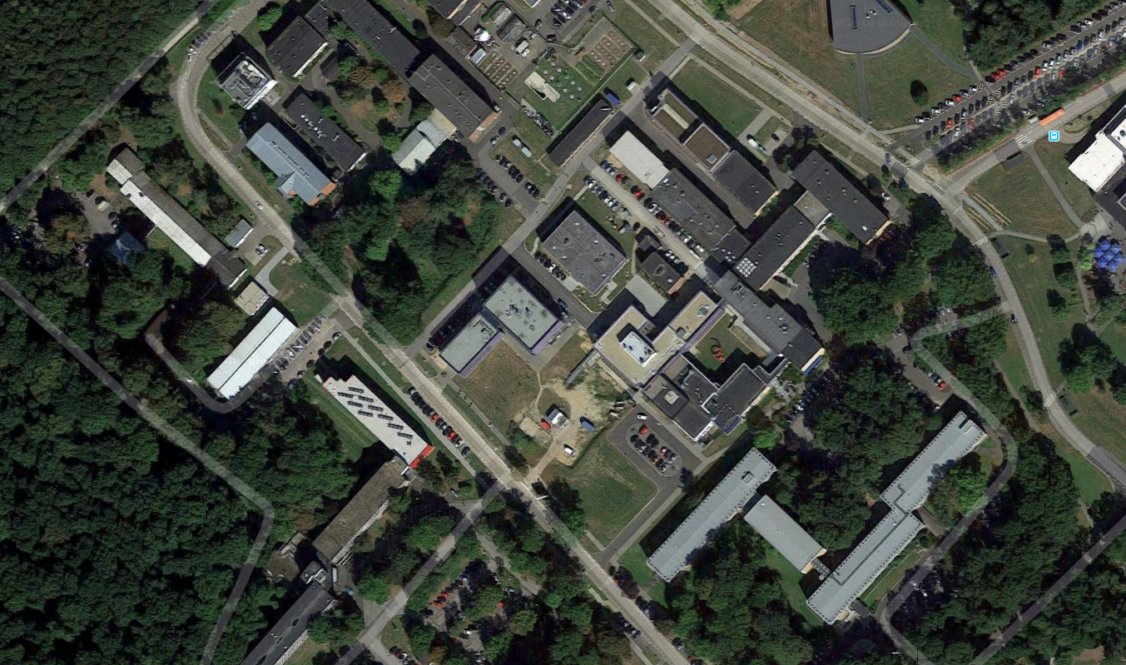
Imaging Core Facility
„Old“ PET Center
New Building for Radiochemistry
High-field
MRT 4 T (7 T)
MRT 9.4 T
New PET Center with 30 MeV Cyclotron

Slide 3

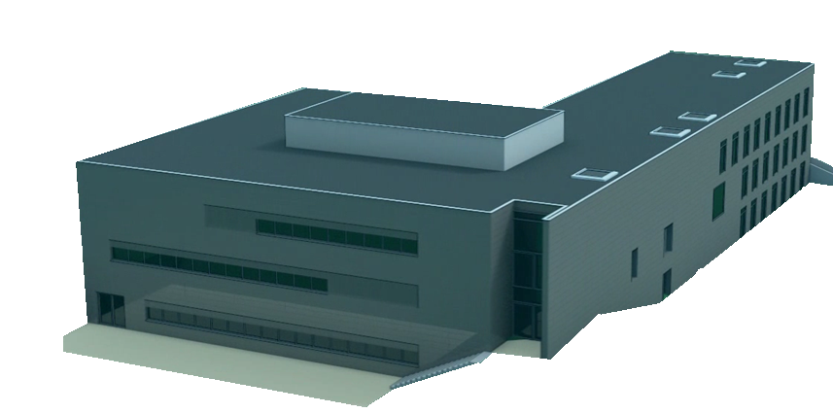
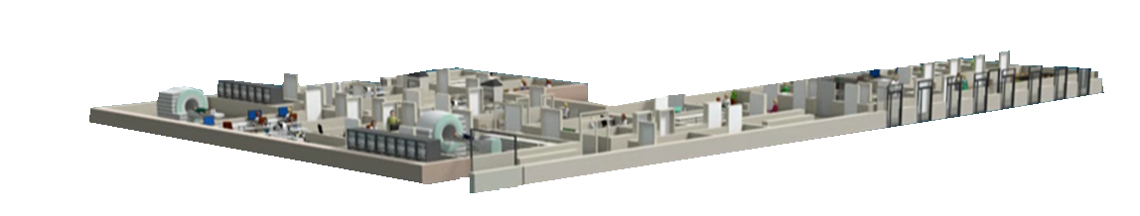
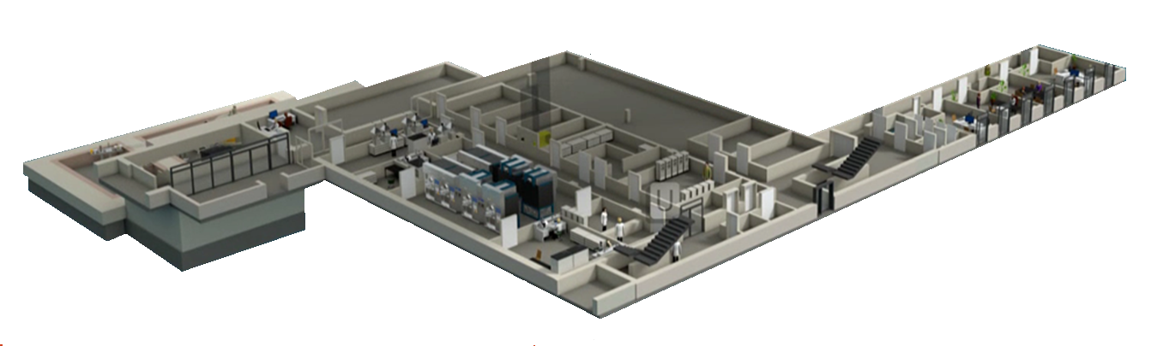

The new PET-Center
CLINICAL LEVEL
PRECLINICAL LEVEL
RADIOCHEMISTRY
Notes:
Sectioned drawing of the building, radiation protection needs an upgrade

Slide 4
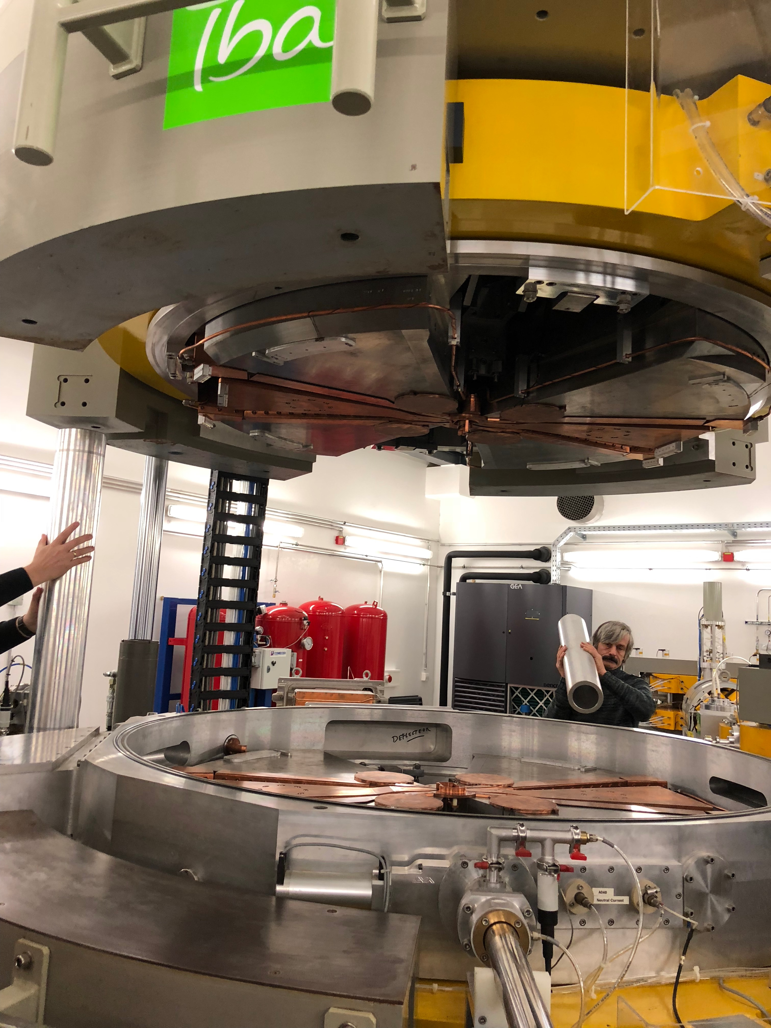
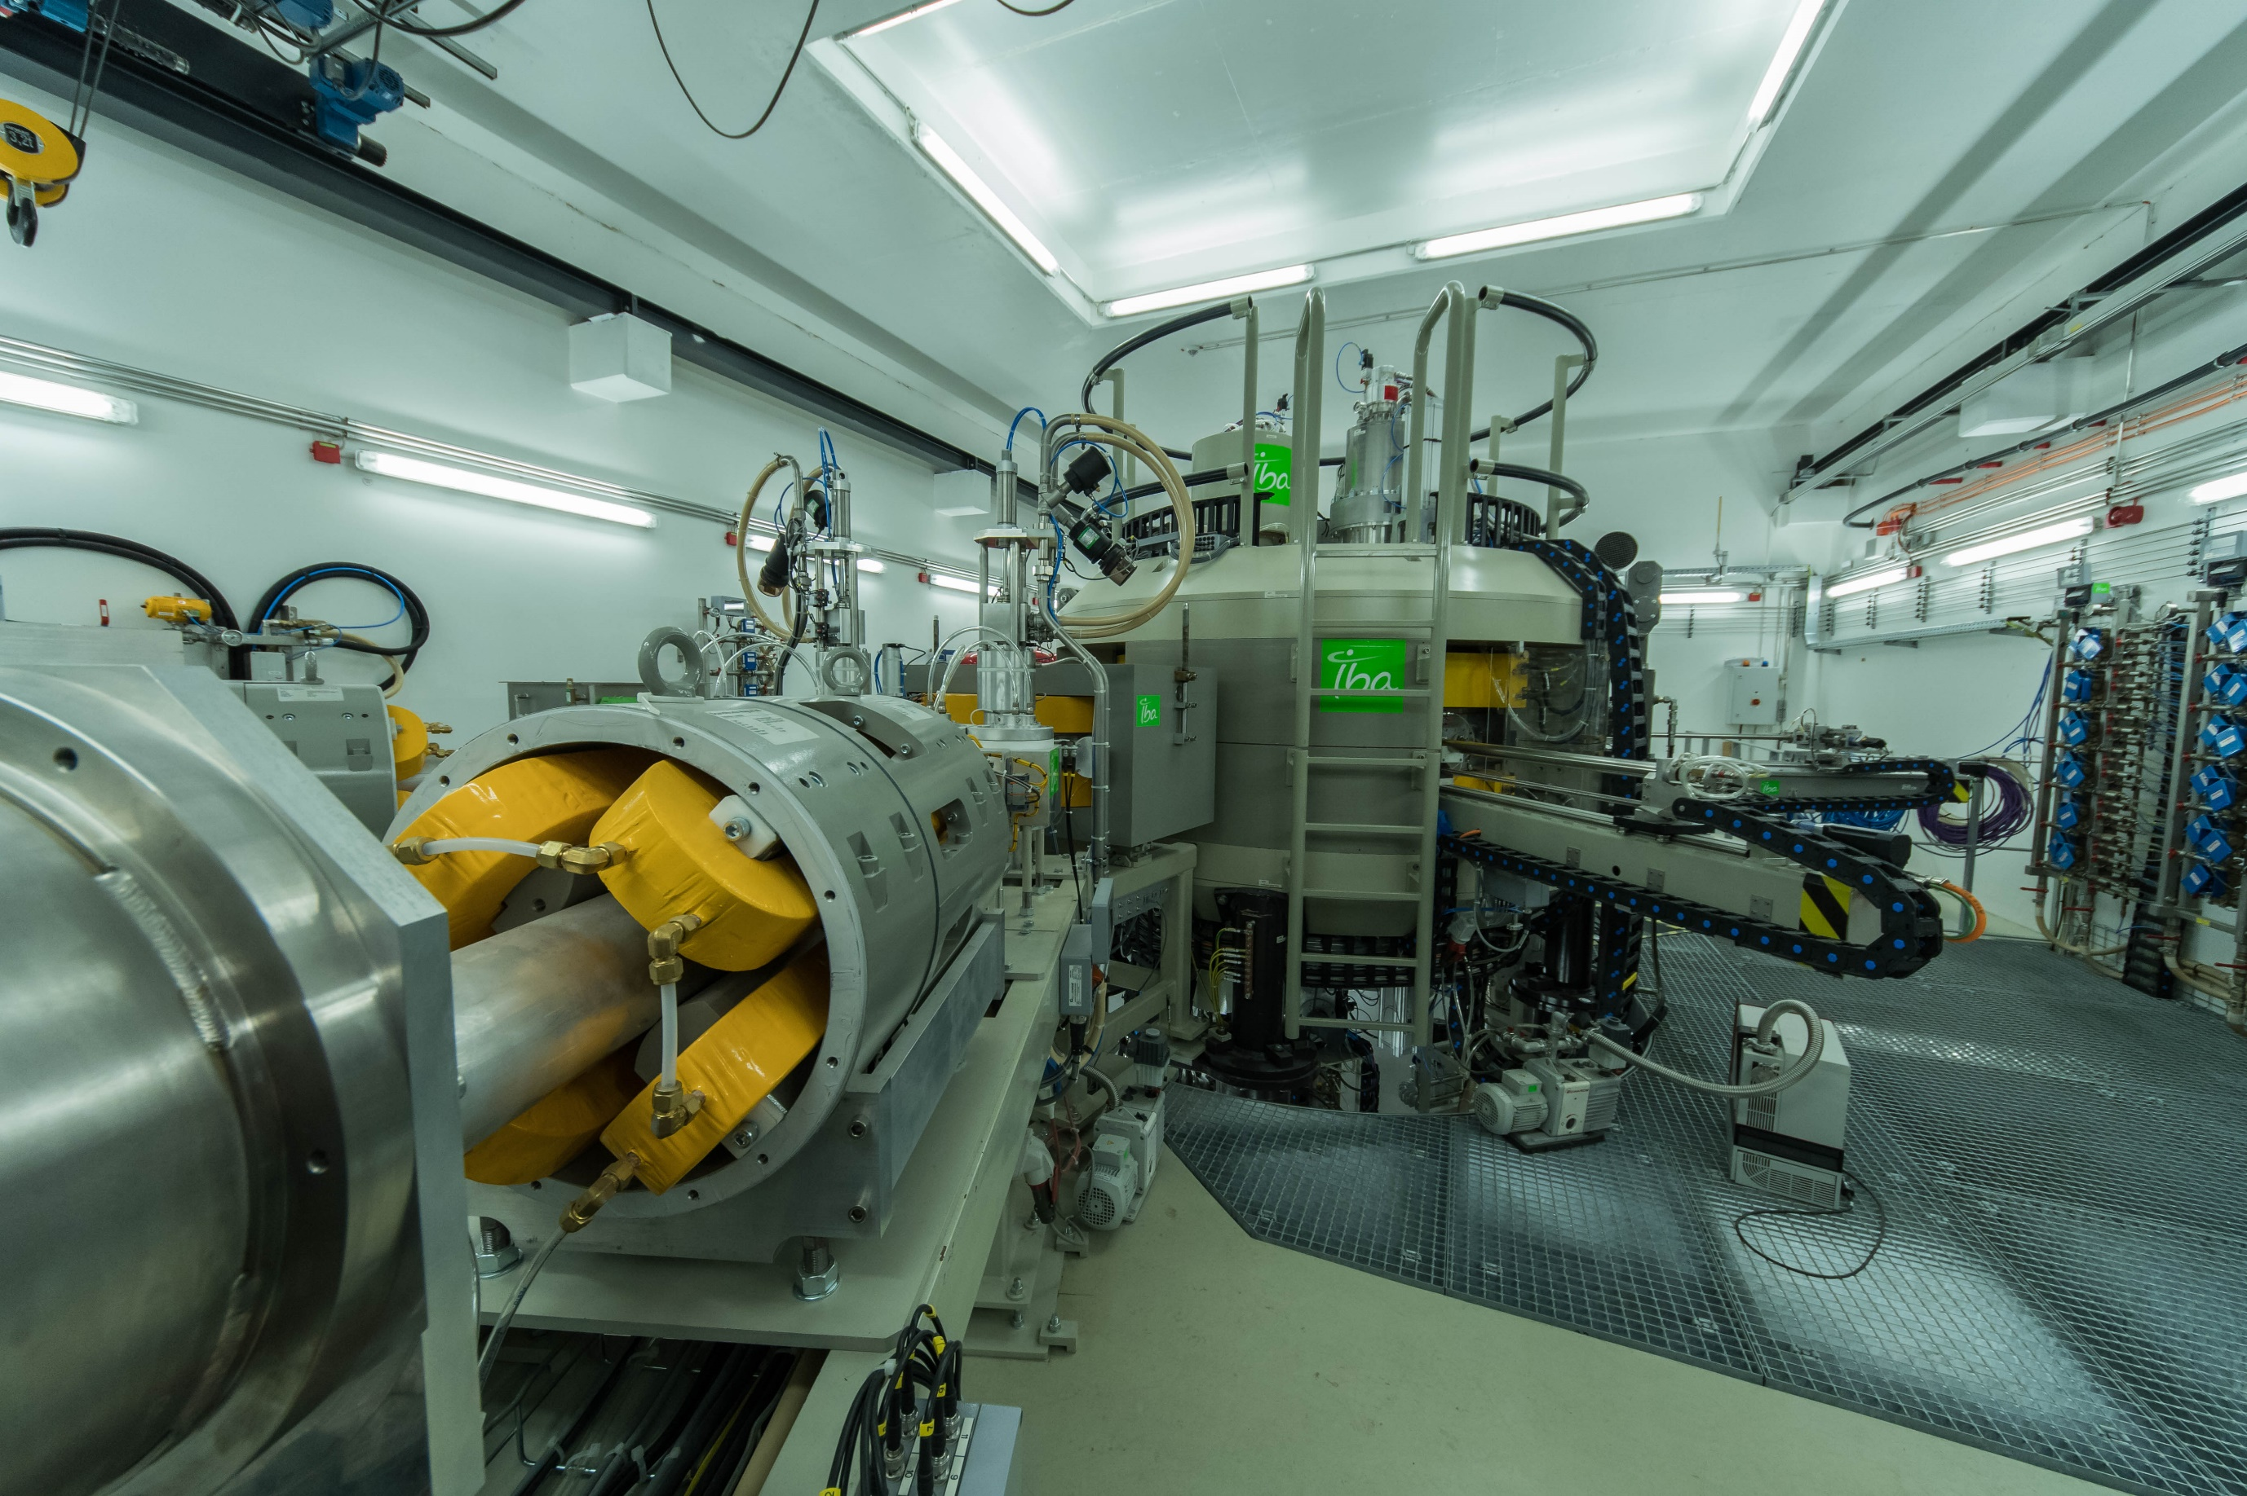
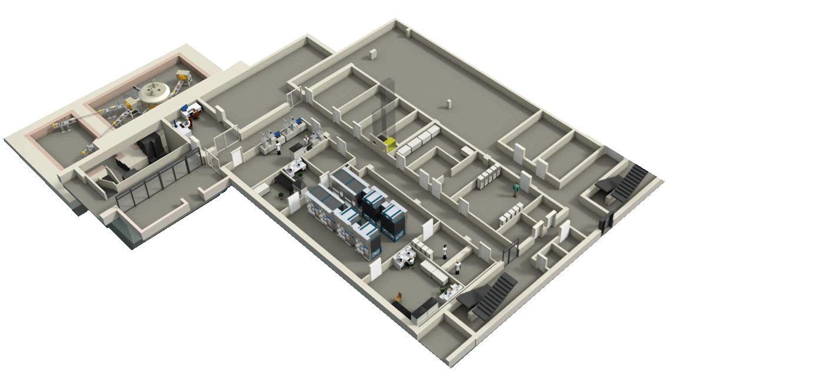
Radiopharmaceutical production Area of INM-5
Cyclotron
Hot cells for production of radiopharmaceuticals
Cyclotron control
room
Quality control

Slide 5



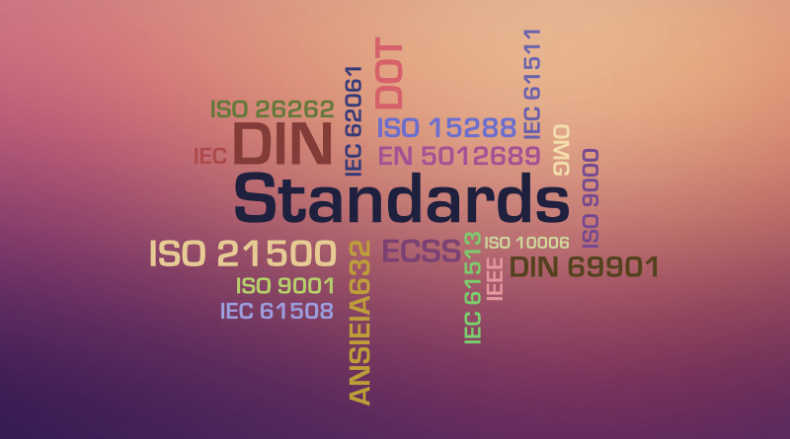

Steps of tracer development
Definition of clinical need
Establishment of an appropriate
preclinical model for testing
Evaluation in an appropriate clinical setting
Comparison with existing standards
Documentation of safety, efficacy,
dosimetry & toxicity
Notes:
On this slide the developmental steps of radiopharmaceuticals is shwon.
First of course there must be a clinical need to develop diagnostic tools for the detection of diseases or disorders like cancer or neurodegenerative diseases. E.g. you a diagnostic method to detect brain tumors or adenocarcinoma. For this cancer or neurological disorder you need an appropiate preclinical model, like a tumor xenograft mouse model.
N
The next step is to apply this new probe in a clinical setting, so called first in man study. Subsequently you have to compare these results to already existing examinations.

Slide 6
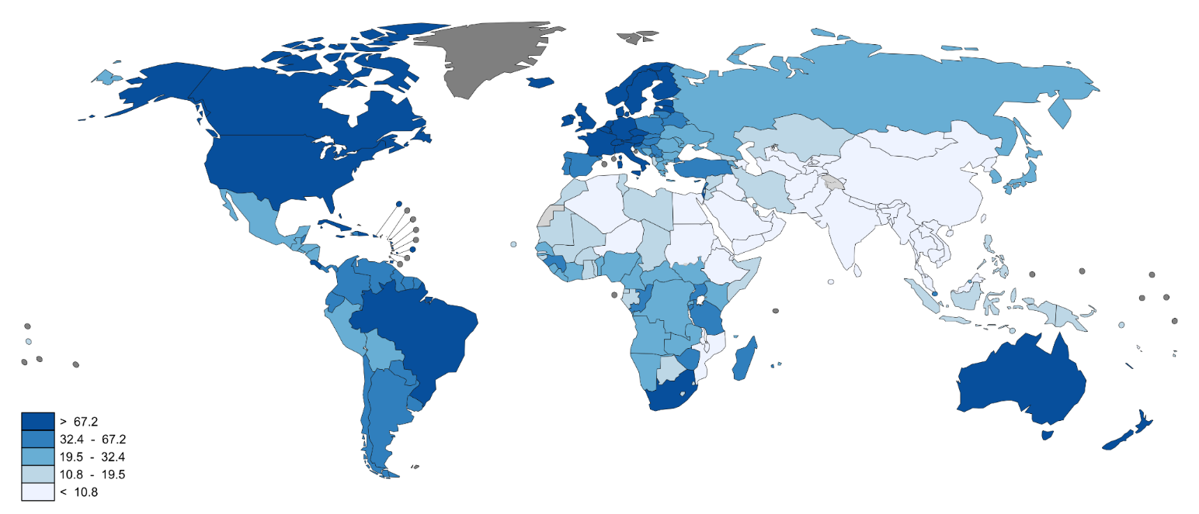
Clinical Need: Prostate carcinoma (PCa)
second most frequently diagnosed cancer worldwide
incidence rates highest in developed countries
1,1 million men with PCa (2012)
sixth leading cause of cancer death in males
Estimated age-standardised rates (World) per 100,000
…early detection of PCa and recurrent prostate cancer and/or metastases enables best treatment opportunities
Notes:
Second most common cancer in men. 1.1 million men worldwide were diagnosed with PCa in 2012.
70% of the cases occured in more developed countries
PCa incidence rates were highest in Australia/New Zealand and Northern America, and in Western nad Nothern Europe owing to the practice of PSA antigen testing and subsequent biopsy which has become widespread in these countries.
Incidence rates are also relatively high in less developed regions such as the Carribean, Southern Africa an South America, but remains low in Asian population.
Therefore methods for the detection of PCa and PCa recurrence are highly sought after.

Slide 7
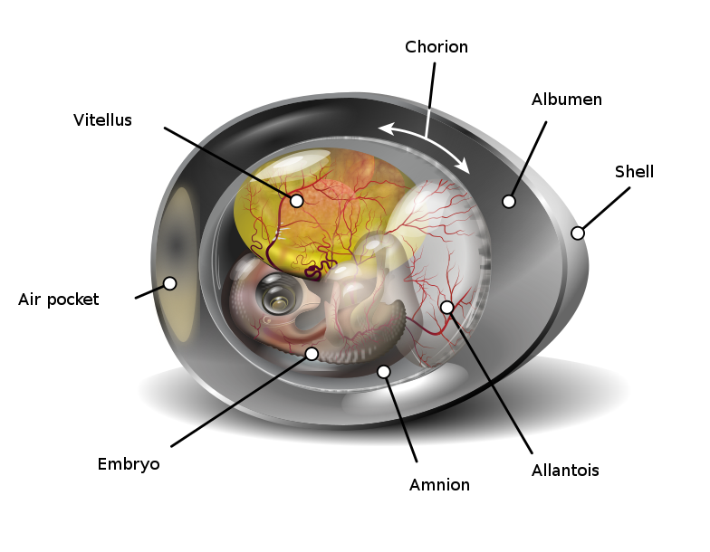
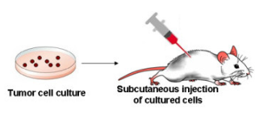
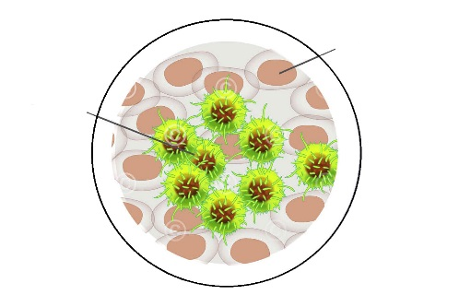
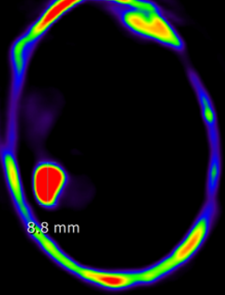
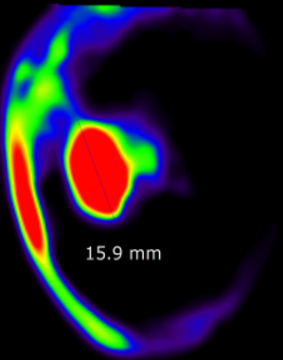
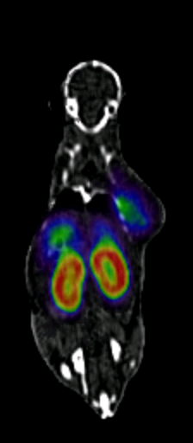
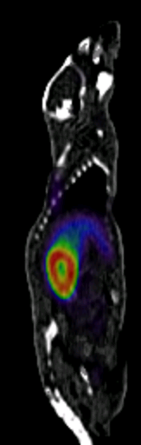
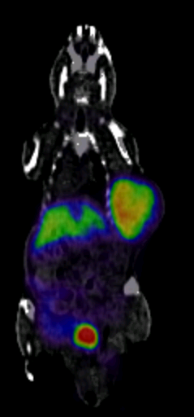
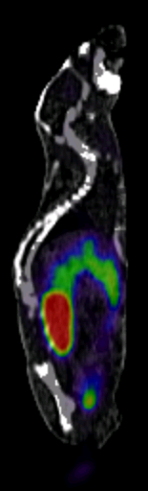
Establishment of an appropriate preclinical model for testing
Chicken Chorioallantoic
Membrane Model
In Vitro Evaluation
Human Tumor Xenograft Model
healthy cell
tumor cell
Cellular uptake of PSMA-7
PC-3 (PSMA-) LNCap C4-2 (PSMA+)
PC-3 (PSMA-) LNCap C4-2 (PSMA+)
PC-3 PSMA-6
LNCaP C4-2 PSMA-6
PC-3 PSMA-7
LNCaP C4-2 PSMA-7
0.0
MBq/ccm
0.5
0.0
MBq/ccm
0.5
0.0
MBq/ccm
0.5
0.0
MBq/ccm
0.5
LNCaP C4-2 PSMA-7 + PMPA
LNCaP C4-2 PSMA-6 + PMPA
Notes:
First the novel probe is tested in vitro in cell culture models. On the left side you can see the cellular uptake of radiolabeled probes in different cell lines.
The chick embryo CAM is a model for tumor biology and metastasis, being naturally immunodeficient the chick embryo may receive transplantations from different tissues and species. Chick`s immunocompetent system is not fully developed

Slide 8
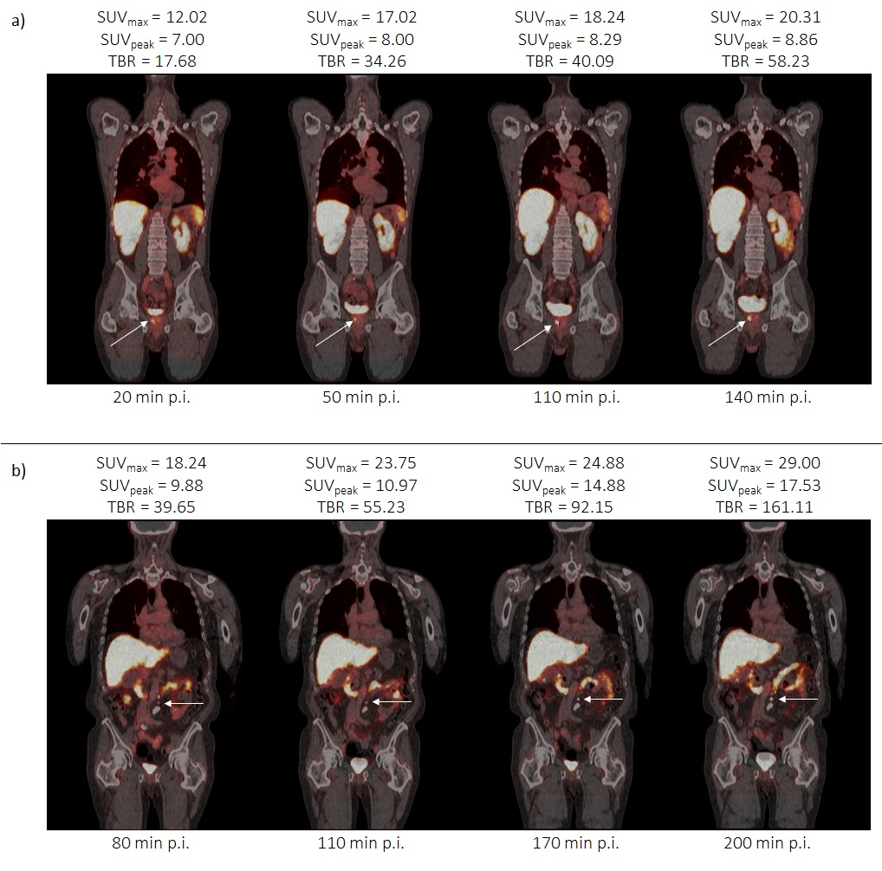
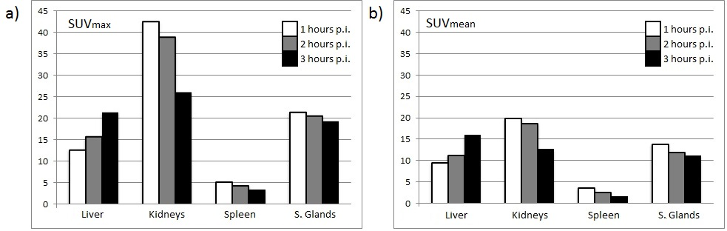
design and production of new tracers
Preparation of drug master file (dosimetry, toxicity etc.)
Organ | Mean absorbed dose [mGy/MBq]
Kidneys | 0.172
Liver | 0.0740
Spleen | 0.0181
Salivary Glands | 0.0468
Effective Dose | 0.0099
Notes:
Dose uptake is below the limit

Slide 9
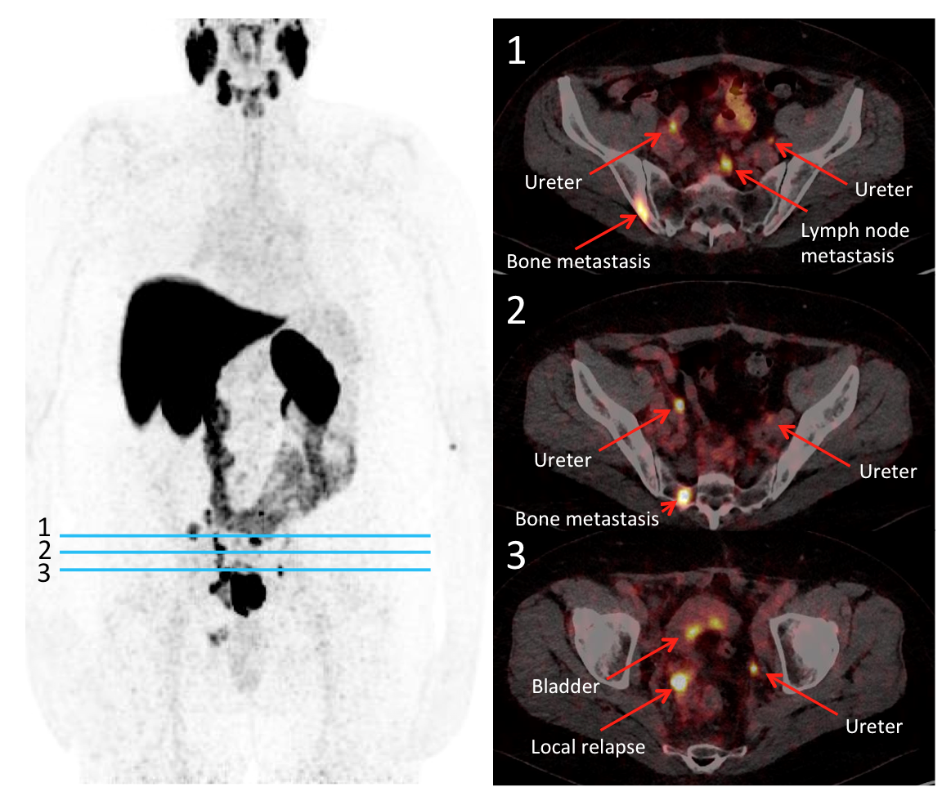
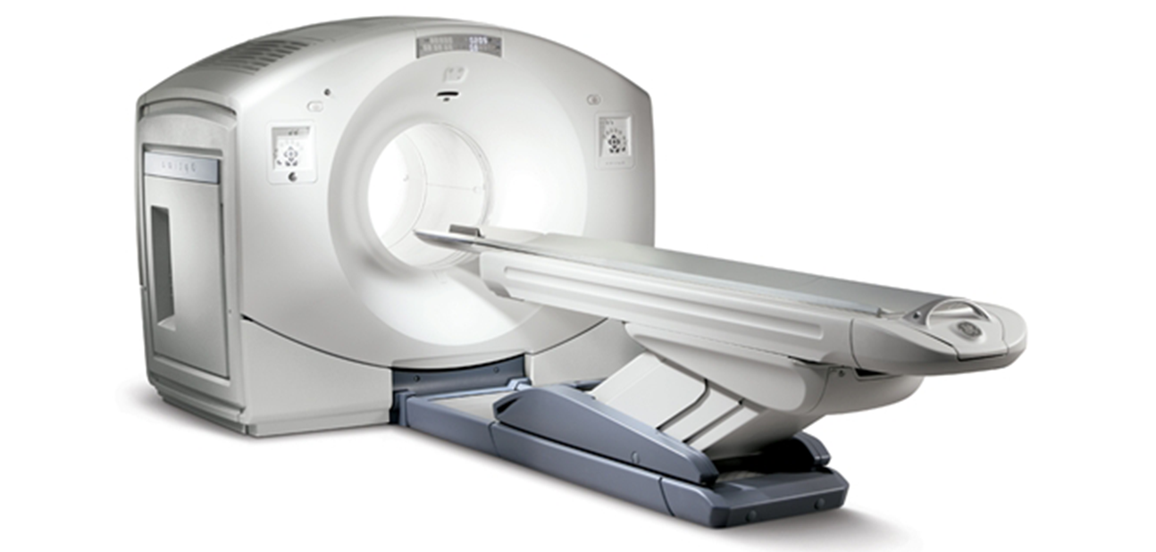
Evaluation in an appropriate clinical setting
Notes:
Bone metastasis in pelvic bone

Slide 10
Comparison with existing standards
Courtesy of C. Kobe, M. Dietlein, Nuklearmedizin UKK
Notes:
Patient with a rising PSA level. Usually in the clinical practice [68Ga]Ga-PSMA-HBED-CC is used to detect PCa recurrence. However, using the 18F-labeled compound [18F]DCFPyL revealed several several additional supradiaphragmatic PSMA-positive lesions whereas PET/CT with [68Ga]Ga-PSMA-HBED-CC PET/CT showed only the supradiaphragmal lesion in the sternum.

Slide 11
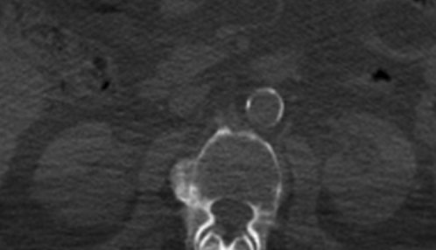
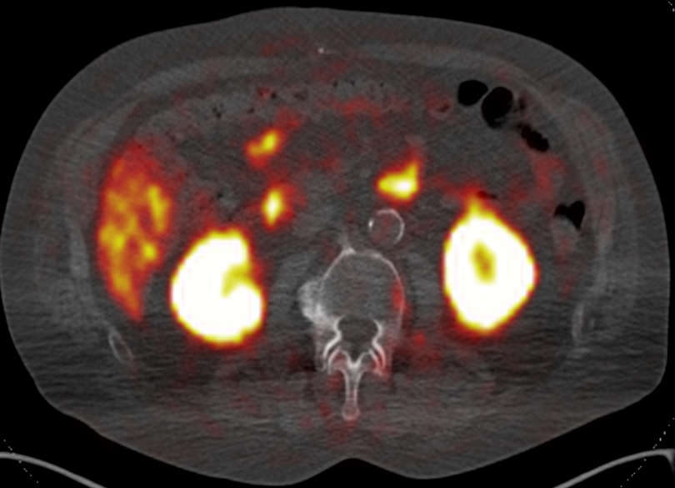
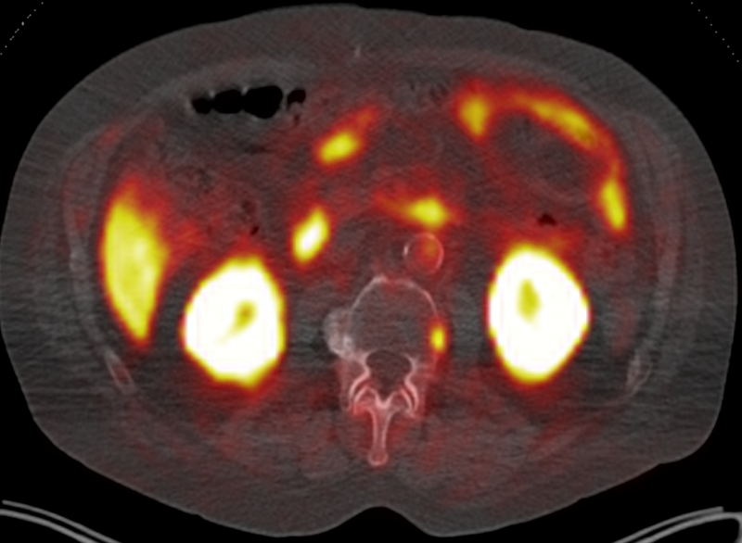
Comparison with existing standards
Detection of even very small lesions
?
?
[⁶⁸Ga]PSMA-PET
[¹⁸F]PSMA-6-PET
Courtesy of C. Kobe, M. Dietlein, Nuklearmedizin UKK

Slide 12

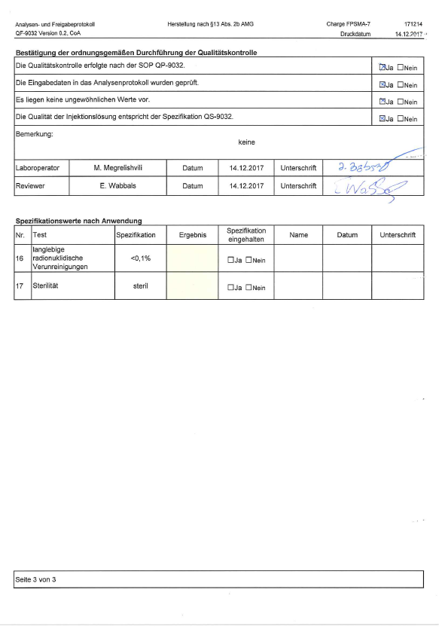
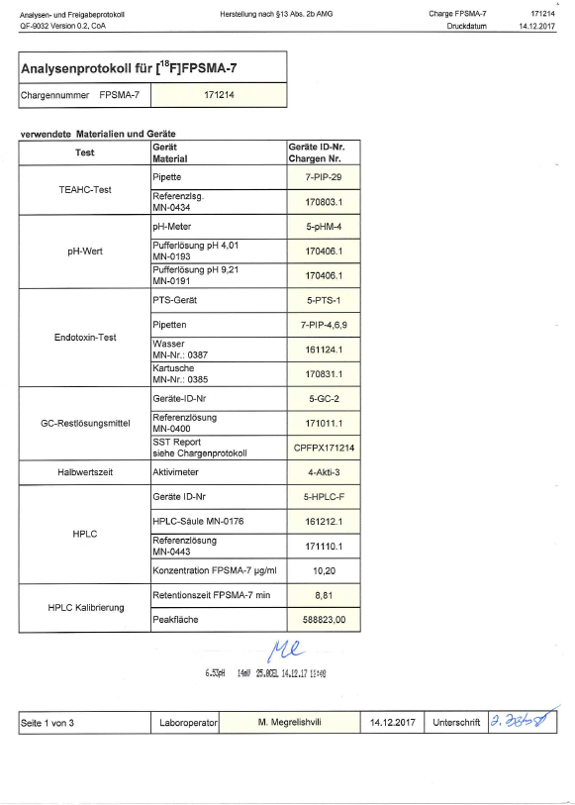
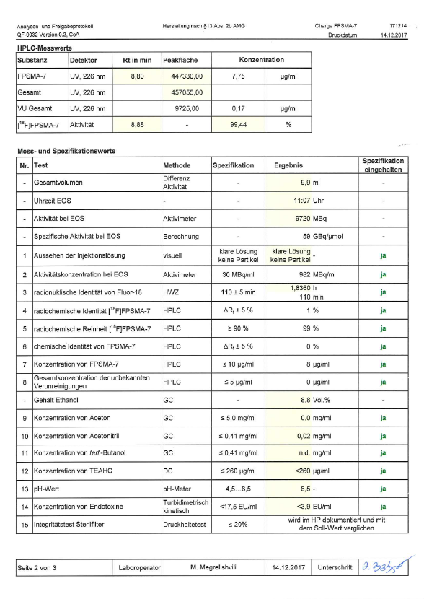
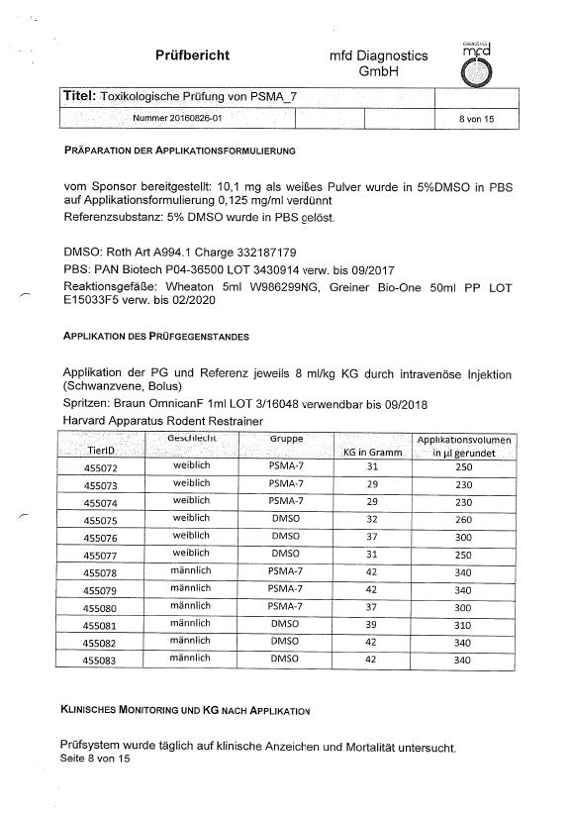
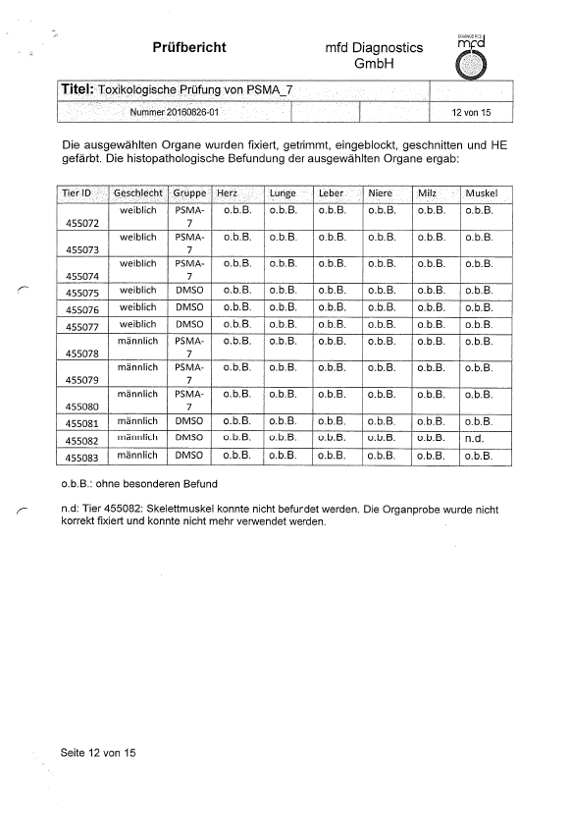
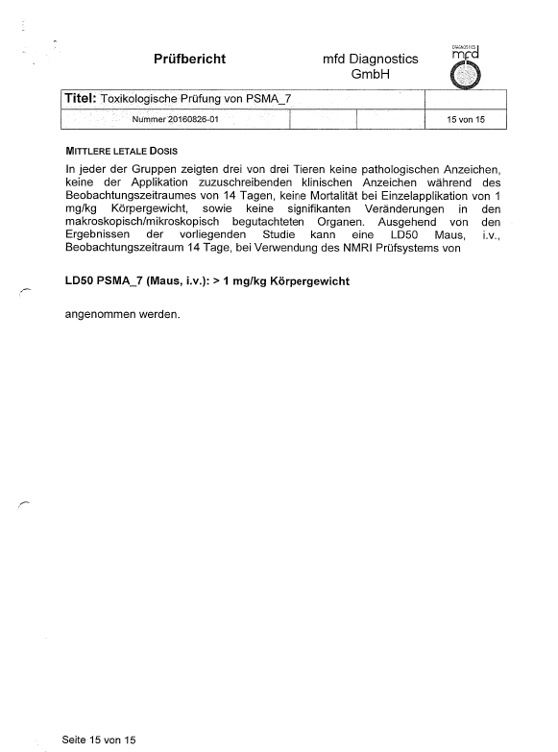
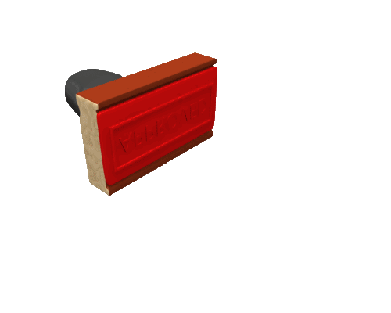

Documentation of safety and efficacy
[⁶⁸Ga]PSMA-PET

Slide 13
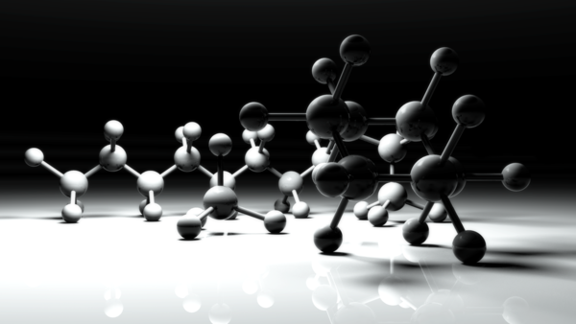
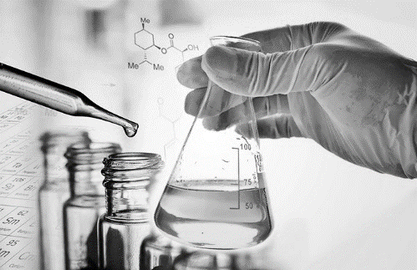
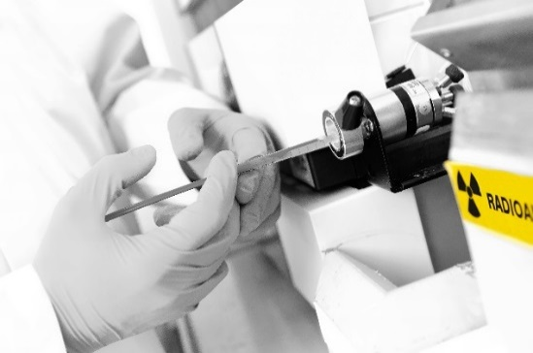

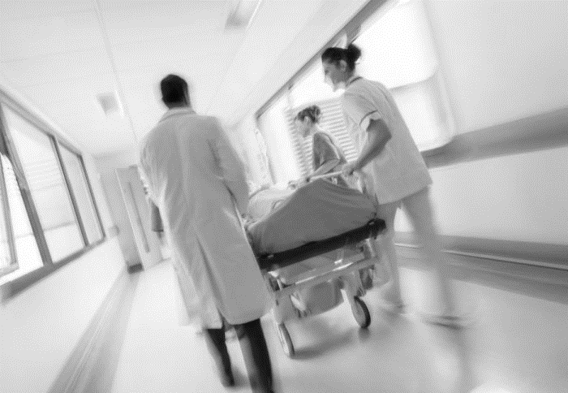
design and production of new tracers
Identification of an appropriate target
Selection of lead structure with high affinity for molecular target
Precursor synthesis
Development of labeling strategies
Optimisation of labeling and QC
Documentation of drug master file (dosimetry, toxicity etc.)

Slide 14
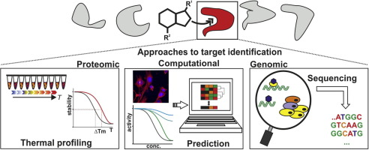
design and production of new tracers
Identification of an appropriate target
Notes:
Approaches to target identification can be broadly divided into three distinct and complementary classes: proteomic approaches, e.g. direct affinity-based biochemical methods (i.e. affinity purification of interacting/binding proteins using chemically modified small-molecule probes follwowed by mass specrometry (chemical proteomics
Genetic approaches, e. g. transcriptional profiling of chemically or genetically manipulared cellular states to correlate a compound of interest with its target, investigation of altered chemical sensitivity for identifying drug induced resistant mutations in the putative target encoding genes
Computational methods e.g. in silico target prediction based on chemical similarities, molecular docking or analysis of bioactivity spectra.

Slide 15
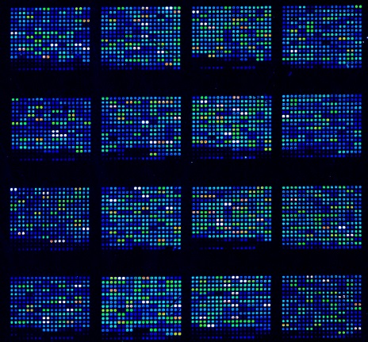
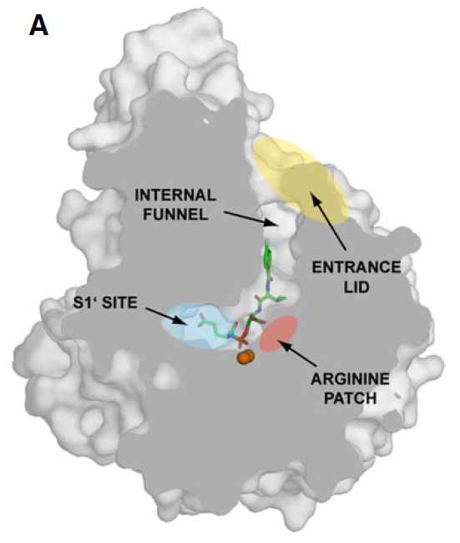
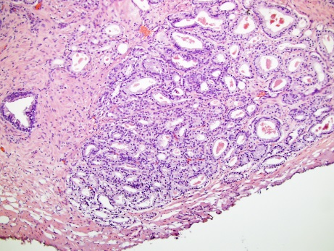
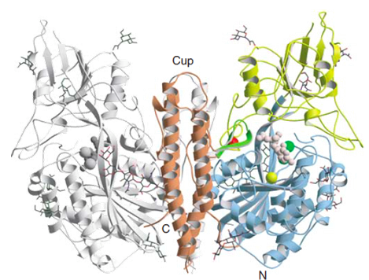

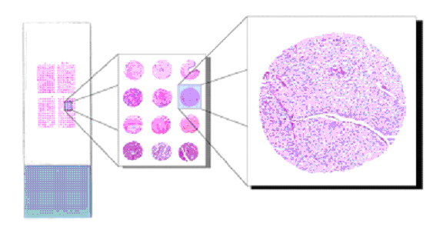
design and production of new tracers
Molecular biological
screening
Selection of key processes and target identification
Prostate-Specific-Membrane-Antigen:
Membrane-bound zinc metallopeptidase
in vivo: Hydrolysis of N-acetylaspartylglutamate (NAAG) into glutamate and N-acetylaspartate
High expression in the ephithel cells of most PCa tumors

Slide 16
design and production of new tracers
Selection of lead structures with high affinity for molecular target
K_{i} = 1,57 nM
K_{i} = 10,97 nM
K_{i} = 3,88 nM
K_{i} = 0,049 nM

Slide 17
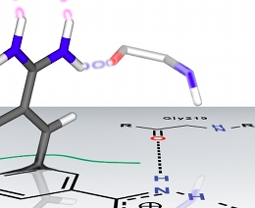
design and production of new tracers
Tracer design
Arginine-rich
Patch
Kozikowski et al. (2001)
Glutarat Sensor
Tracer design and
development
Endogenous ligand of PSMA
in-vivo: Cleavage to N-acetylaspartate and glutamate => short plasma half life
Not suitable as PET probe
Development of PSMA inhibitor
High affinity for PSMA
High metabolic stability
Suitable for radiolabeling by prosthetic groups

Slide 18
design and production of new tracers
Development of labeling strategies

Slide 19
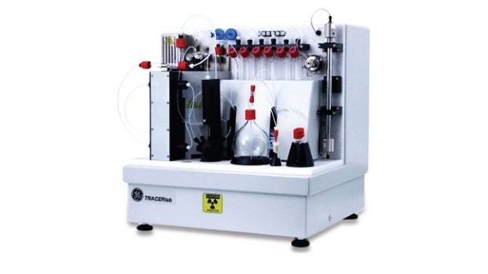
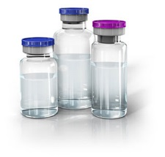
design and production of new tracers
Mechanism
+
[¹⁸F]FPSMA
[¹⁸F]F-Py-TFP

Slide 20
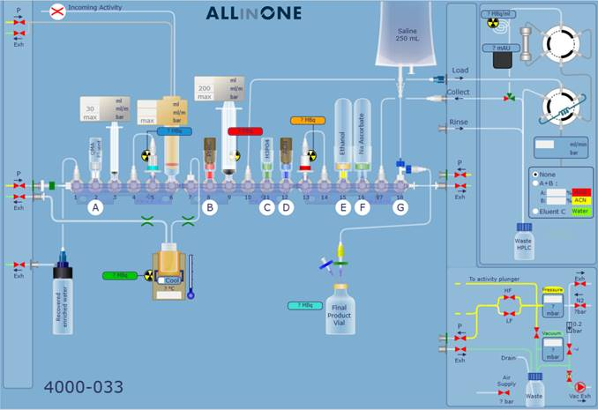
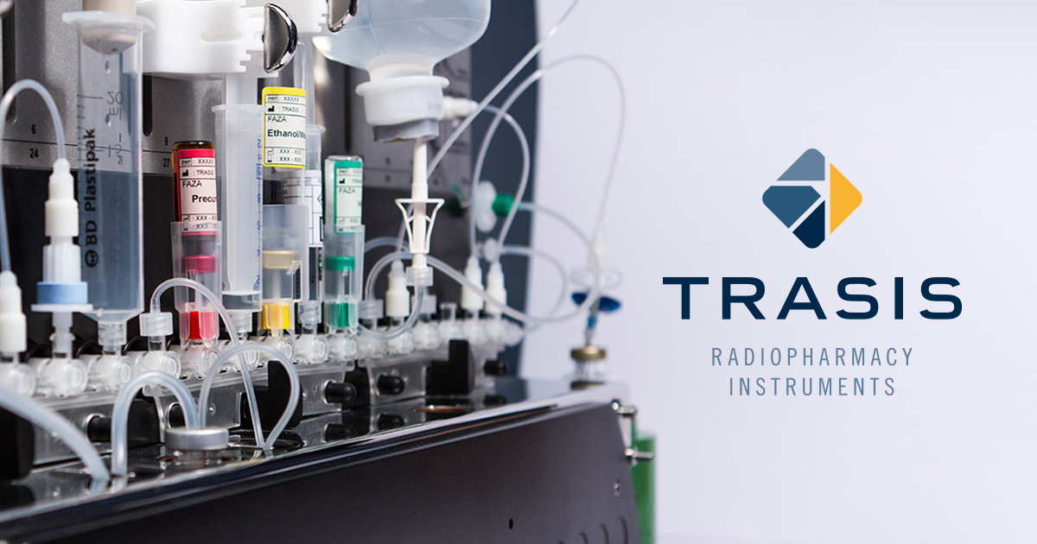
design and production of new tracers
Disposable cassette system

Slide 21
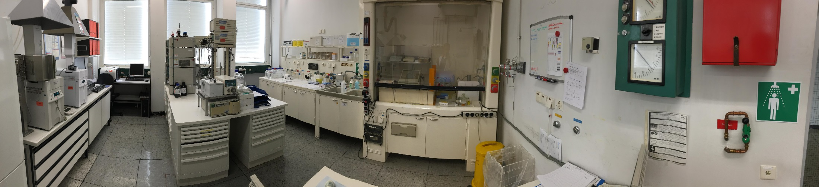
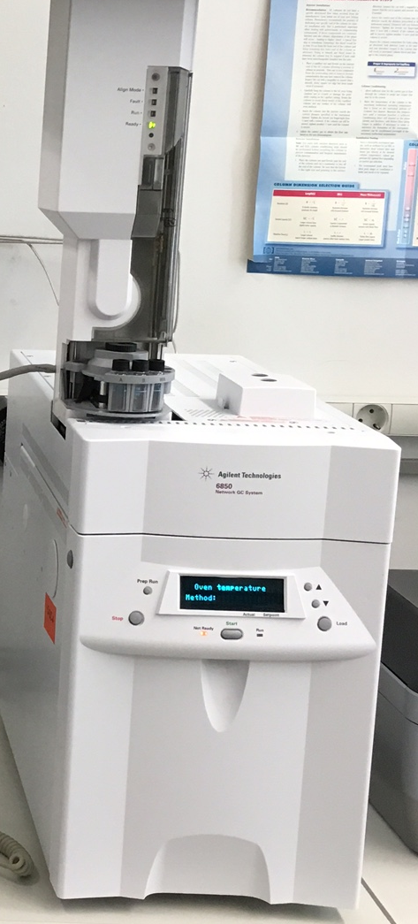
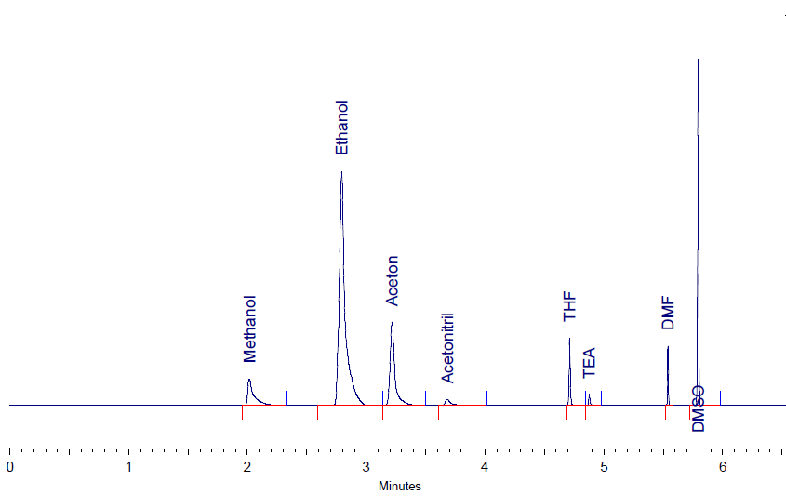





design and production of new tracers
Quality control
GC
HPLC
also:
Endotoxins
pH…

Slide 22






Summary of Tracer discovery
Cellular & Genetic Targets
Genomics
Proteomics
Bioinformation
Synthesis & Isolation
Combinatorial Chemistry
Assay Development
High-throughput Screnning
Library Development
Structure Activity Studies
In Silico Screening
Chemical Synthesis
Drug Affinity & Selectivity
Cellular Disease Models
Mechanism of Action
Lead Candidate Refinement
Animal Models of Disease States
Behavioural Studies
Functional Imaging
Ex Vivo Studies
Studies in Healthy Humans (Phase I)
Student in patients
(Phase II)
Large Clinical Trials in many Patients
(Phase III)
Target selection
Lead Discovery
Medicinal Chemistry
In Vitro Studies
In Vivo Studies
Clinical Trials

Slide 23

დიდი მადლობა

Slide 24





Entwicklung molekularer Sonden
Molekularbiologisches
Screening
Auswahl von Schlüsselprozessen
Target-Identifikation
Tracer-Design and Radiolabeling
Human
Rat
Primate
Mice
Präklinische Evaluation
Toxizität, Stabilität, Spezifität, Synthese
Translation in die KLinik
Pharmakokinetik, Bioverteilung, Dosimetrie, Nachweis der Wirksamkeit im Menschen

