Slide 1
Advanced radiotherapy for lung cancer
DaviD sebua Elene Lortkipanidze

Slide 2
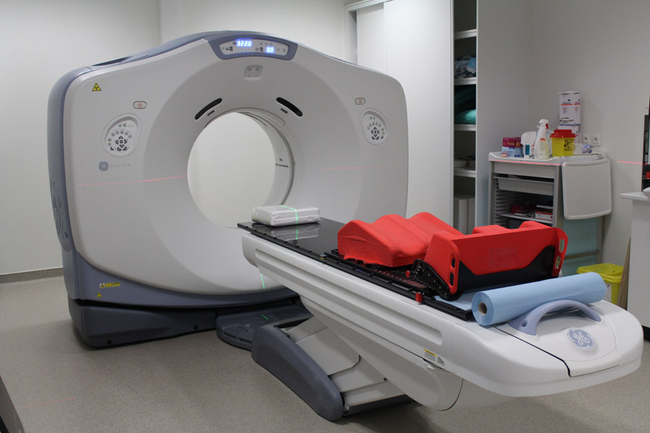
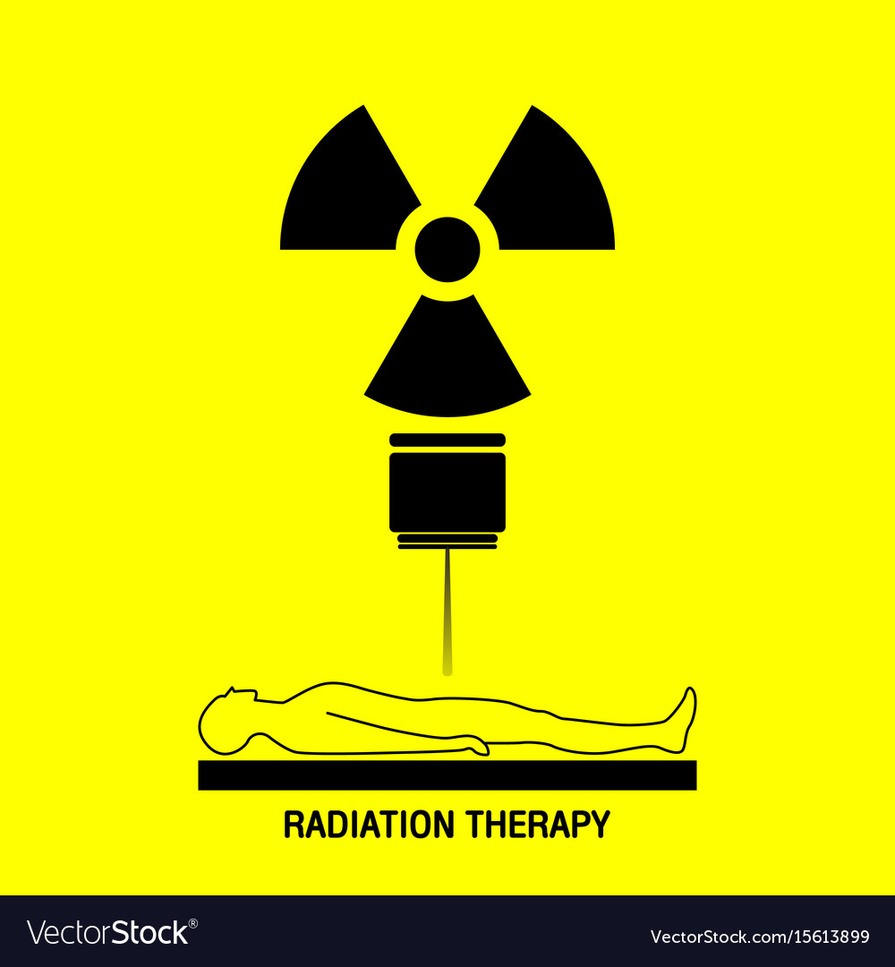
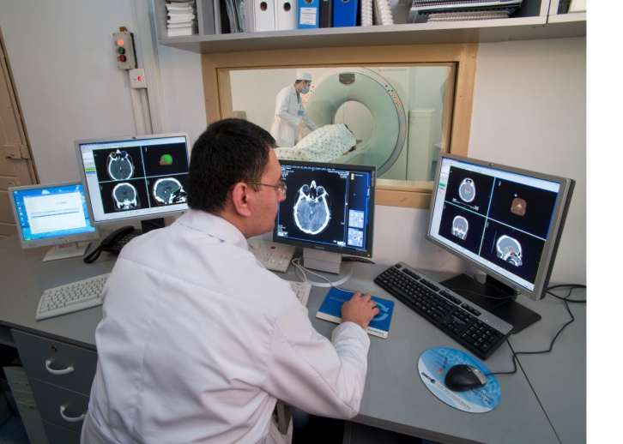
Introduction

Slide 3
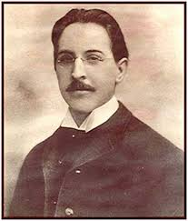
History of Radiotherapy
The history of radiotherapy starts from the discovery of X-rays in 1895 by Wilhelm Conrad Rontgen. It was not intended for treatment rather than for imaging.
Before understanding the physical properties of X-rays and their biological effects, one year later their discovery, X-rays were used by Emil Herman Grubbe to treat a patient with breast cancer.

Slide 4
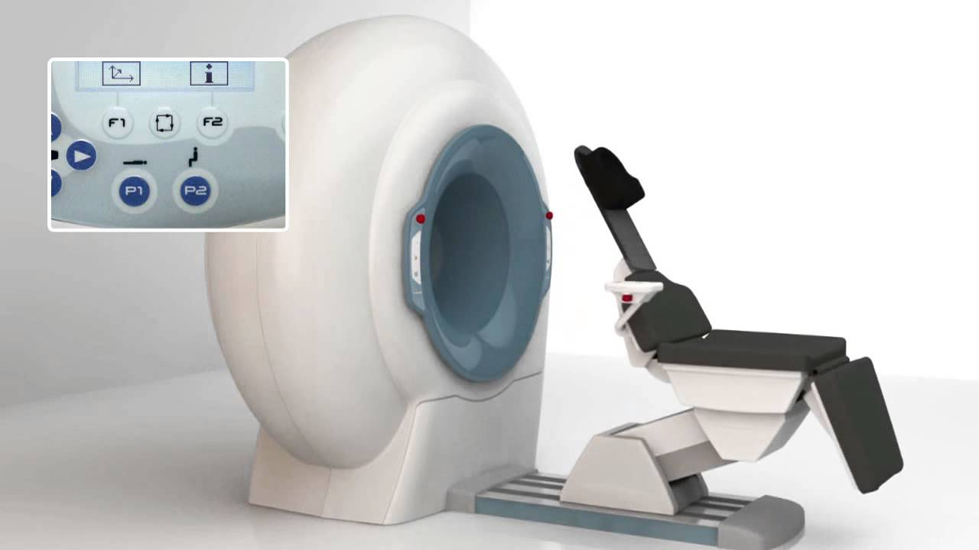
CBCT - Cone Beam Computed Tomography
Cone beam computed tomography is a medical imaging technique consisting of X-ray computed tomography where the X-rays are divergent, forming a cone.

Slide 5
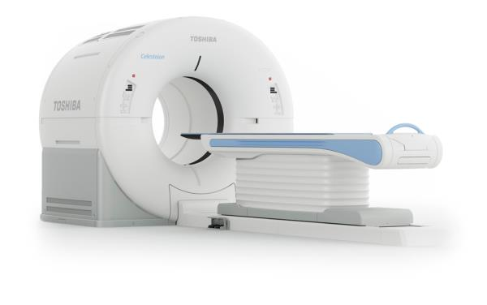
CT - Computed Tomography
A CT scan, also known as computed tomography scan, makes use of computer-processed combinations of many X-ray measurements taken from different angles to produce tomographic images of specific areas of a scanned object, allowing the user to see inside the object without cutting.

Slide 6
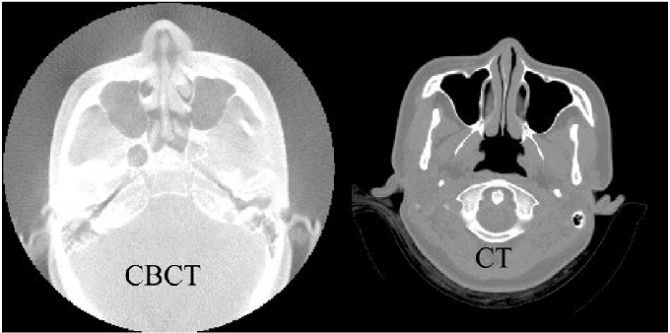
CBCT & CT
The main difference between CT and CBT is the shape of the beams—CT scans use fan-shaped x-ray beams that rotate while the patient advances (think of a CAT scan) to capture limited thickness slices, while CBCT uses a cone-shaped area detector that does not require patient movement.

Slide 7
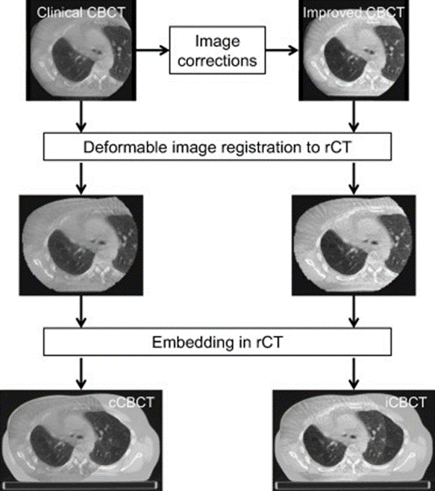
Difficulties and Solutions
CBCT images acquired in the small field of view gave us suffered images from truncation of the anatomy so the missing anatomy in the CBCT images was added from the CT.

Slide 8
Results
The present study showed that comprehensive artefact corrections in chest CBCT allows for accurate dose calculations to be performed directly on the CBCT images.
Deformable registration between CT and CBCT images acquired on the same day was used to emphasize the accuracy of dose calculations based on the artefact general corrected CBCT images.

Slide 9
Thanks for your attention

