Slide 1
Axions Search Experiment
Speaker: Goga Suknidze TSU, Physics Faculty, I⋁ Course
Supervisor: Mirian Tabidze
`

Slide 2
Theoretical motivation for searching Axions
The gauge invariant QCD lagrangian is
$ℒ_{QCD}=\overline{ψ_{і}}{(і(γ^{μ}D_{μ})}_{іȷ}$ - m$δ_{іȷ}$)$ψ_{ј}$ - $\frac{1}{4}G_{μν}^{a}G_{a}^{μν}$ (1)
We can write the term in QCD lagrangian which violates P and T invariance
$ℒ_{θ}=−θ(\frac{α_{s}}{8π})G_{μν}^{a}\tilde{G_{μν}^{α}}$ $\tilde{G_{μν}^{α}}=\frac{1}{2}ε_{μνβσ}G_{βσ}^{α}$ (2)
most famously, the $θ$ term provides a contribution to the neutron electric dipole moment $d_{n}$
$d_{n}=−3.3×{10}^{−16}θ$ $[e∙cm]$ (3)

Slide 3
Experimental upper limit on neutron EDM is
$d_{n}=2.9×{10}^{−26} e∙cm$
Therefore this implies $θ$ has to be really small number
$\left|θ\right|<9×{10}^{−11}$ (4)
This is the strong $CP$ problem.
A solution to the strong CP is to leave the $θ$ term as it is, but to somehow make it irrelevant. Peccei-Quinn achieved this by by introducing an extra global symmetry into the theory. They considered $θ$ as a ﬁeld, not a ﬁxed parameter. Such a symmetry leads in turn to the prediction of a new light pseudoscalar particle, the axion
Axions are sub-eV mass, spin 0 and charge 0 particles

Slide 4
Axion searches overview

Slide 5
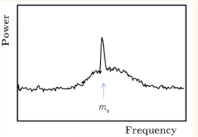
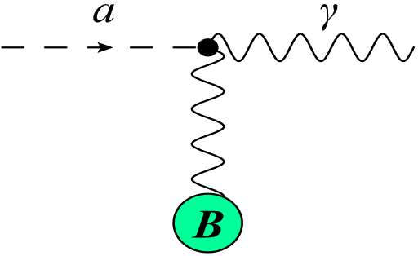
Axion Dark Matter Experiment
The experiment is designed to detect the very weak conversion of dark matter axions into microwave photons in the presence of a strong magnetic field. . Mass: $1{μeV}/{c^{2}}−40{μeV}/{c^{2}}$
$P={10}^{−23}Watts$
$P\sim g^{2}m_{a}ρ_{a}Q_{cav}CB^{2}V$ (3)
$SNR∝\frac{P_{out}}{k_{B}T_{system}}\sqrt{\frac{t}{BW}}$ (4)
Axion to photon $production \sim E∙B$
Figure 1
Figure 2
Figure 3

Slide 6
ADMX insert

Slide 7
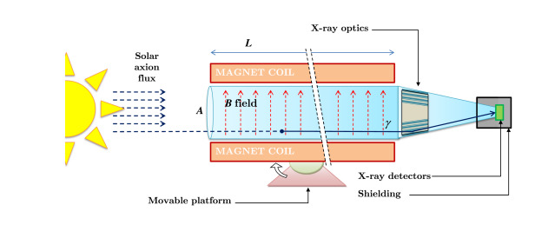
SEARCH FOR SOLAR AXIONS: THE CAST EXPERIMENT AT CERN
Figure 4
Telescope (CAST) is an experiment to search for axions originating from the sun

Slide 9
In Jülich Research Center physicists propose to develop and demonstrate a method of using COSY with an in-plane polarized deuteron beam to search frequency space for a resonance associated with a hypothetical axion field that induces an oscillating electric dipole moment (EDM) on the deuteron.

Slide 10
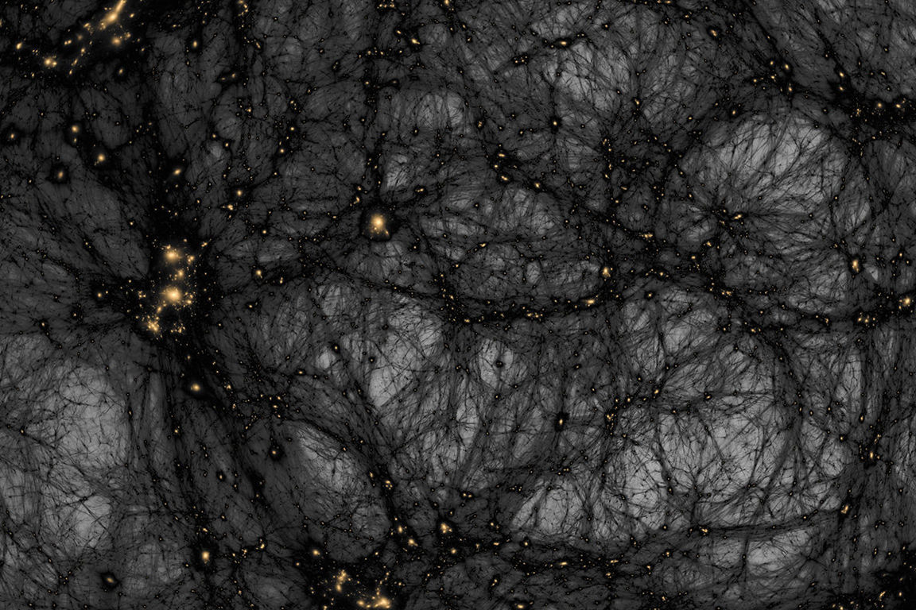
Thank you for your attention

