Slide 1
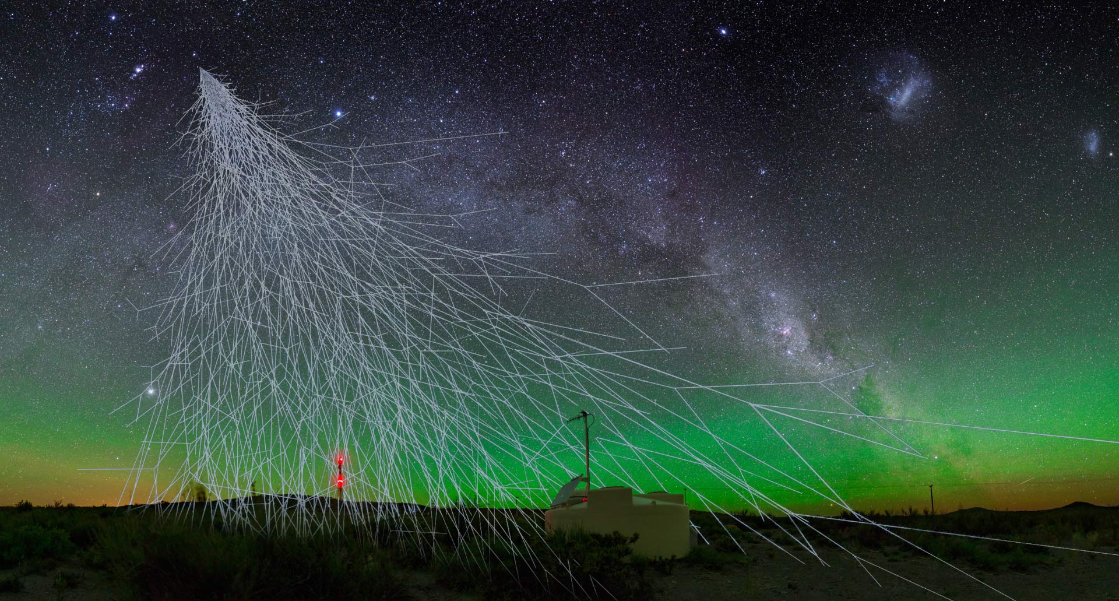
Galactic Cosmic Rays and Climate Change Natia Porchkhidze
(Ilia State University)

Slide 2
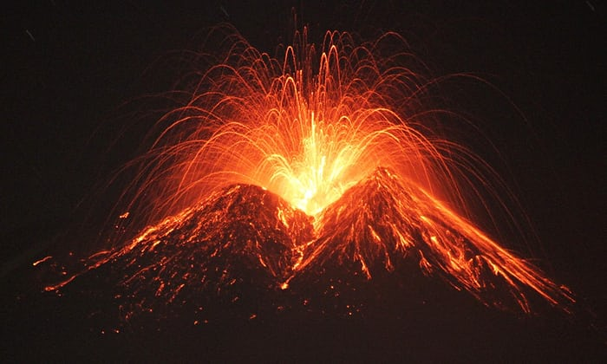
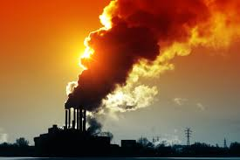
Reasons of the climate change
Natural
Anthropogenic

Slide 3
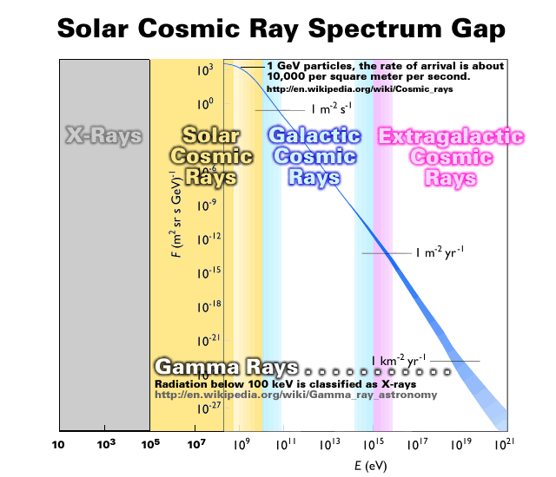
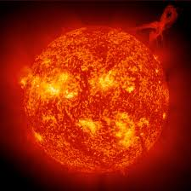
One of the most important natural reason is Cosmic factor

Slide 4
An influence of GCRs on the climate change is under increased -interest last decade (CERN CLOUD experiment).

Slide 5
GCR-s have influence on atmospheric structure, because they(Secondary ones) can create cloud condensation nucleus and have influence on cloud covering

Slide 7
Cloud covering influences on radiative balance at the Earth’s surface and its consequence on the planet’s climate

Slide 8
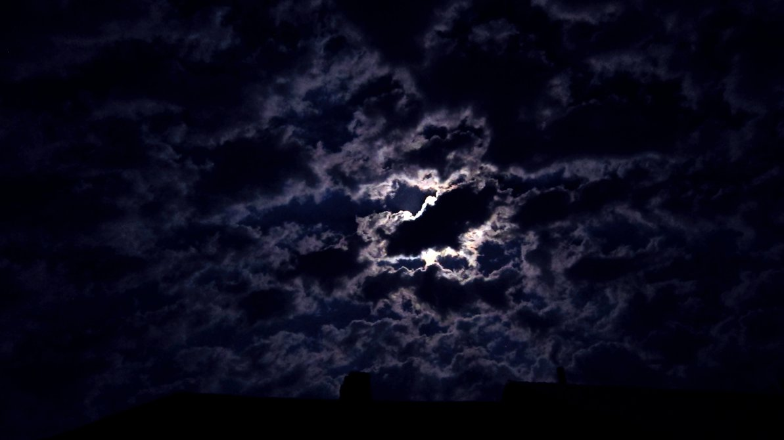
On the cloudy days, solar visible electro-magnetic radiation is reflected and reduced it’s absorption by the planet’s surface
On the cloudy nights, they scatter and partly send back the Earth’s infrared thermal radiation.

Slide 9
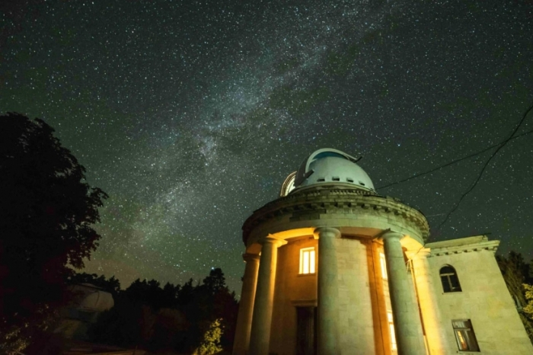
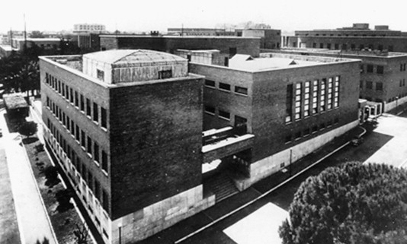
To estimate more exactly influence of GCRs on cloud covering and climate needs consideration sensitivity of day and nighttime cloud covering processes under influence of GCRs
To consider a possible influence of GCRs on day and nighttime cloud covering is used the data of Abastumani Astrophysical Observatory at ilia state university (during 1957-1993) and GCRs flux changes from Rome Neutron Monitor data ( includes data set during 1957-1993. Geomagnetic cut-off rigidity is close to our region 6-7 Gev(For Tbilisi Rc=6.91Gev and for Rome Rc=6.32Gev)).

Slide 10
The Observed and corrected data with pressure are compared to each in different cases
The barometric effect induces variations to the measured data of the Neutron Monitors which are related to the variations of local atmospheric pressure of each station. For this reason the calculation of barometric coefficient constitutes a prerequisite for the quality of data.
If CR are stable $N=N_{0}∗e^{b\left(p−p0\right)}$
If CR are not stable N’=N(1+v); $v=\frac{N−N_{av}}{N}$

Slide 11
Long-term trends for spring and summer seasons

Slide 12
Long-term trends for autumn and winter seasons

Slide 13
Long-term trends for CD-s and CN-s of spring season

Slide 14
Long-term trends for CD-s and CN-s of summer season

Slide 15
Long-term trends for CD-s and CN-s of autumn season

Slide 16
Long-term trends for CD-s and CN-s of winter season

Slide 17
Conclusions:
The difference between long term trends of the cloudless
days and cloudless nights show GCR flux influence of the Cloud coverage
CD and CN GCR trends have opposite behavior in the Summer and in the Winter.
This graphs show the importance of cosmic factor, which has not been in confidence before.
GCR effects on the Earth’s climate.
Direct consideration of GCR on Climate Change needs whole monitoring around the globe.

Slide 18
References
Dorman L. “Cosmic ray interactions, propagation, and acceleration in space plasmas’’ Springer 2006.
Didebulidze G.G. Todua M. “The inter-annual distribution of cloudless days and nights in Abastumani: Coupling with cosmic factors and climate change. “ “Journal of Atmospheric and Solar-Terrestrial physics’’, 2015.
Svensmark H. “Cosmic rays, clouds and climate.” “Europhysics news’’ 2015
https://home.cern/about/updates/2016/10/cloud-experiment-sharpens-climate-predictions
http://www.stce.be/esww12/contributions/public/S15-P1/S15-P1-15-GerontidouMaria/ESWW12_S15_GERONTIDOU.pdf

Slide 19
Acknowledgements:
I am grateful :
to SVIRCO NM for the GCR data
To Professors: Didebulidze G. , Todua M. and Dalakishvili G. for supervising and suggestions

Slide 20
Thank you for attention! ☺

