Slide 1
Quantitative
Magnetic Resonance Imaging
14 September 2018
Ezequiel Alejandro Farrher

Slide 2
Outline
Motivation
Reminder
Excitation and acquisition
Relaxation
T₁ contrast and mapping
Saturation and inversion recovery
TAPIR
T₂ contrast and mapping
Spin echo
Water content mapping

Slide 3
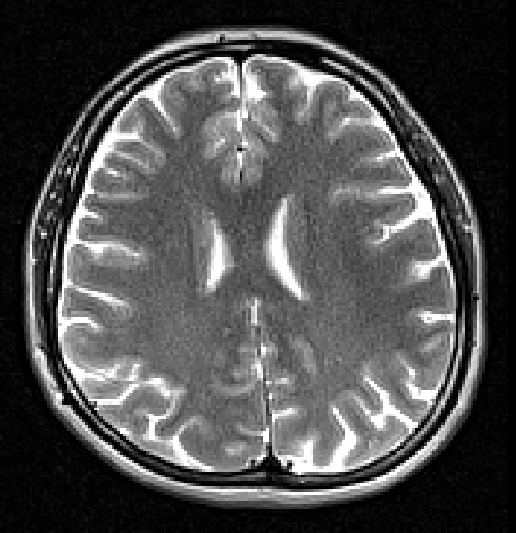
Quantitative MRI (qMRI)
arbitrary units
Conventional MRI is based on the acquisition of contrast images.
Affected by:
controlled parameters: TR, TE, TI, flip angle
uncontrolled experimental parameters: B₀ and B₁ inhomogeneities
different tissue properties.
qMRI → direct measurement of physical tissue properties, such as the relaxation times, T₁ and T₂, the proton density (PD) and diffusion coefficient (D).
These properties are -ideally- independent of
acquisition method,
system imperfections,
scanner,
etc.

Slide 4
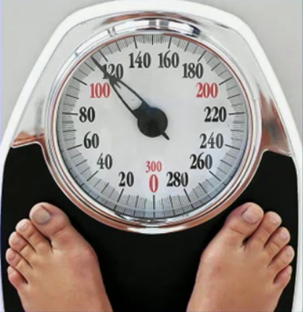
Quantitative measure
Example: body weight
→ Units [kg]
We expect: accurate and reproducible
Assuming instrumental variation < biological variation

Slide 5
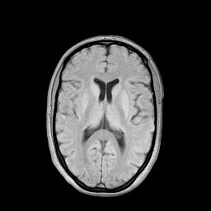
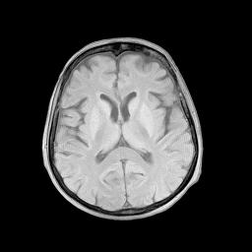
Example - In vivo water content mapping
C5
Which one has more water?
conventional contrast
conventional contrast
putamen
putamen
thalamus
Hepatic Encephalopathy grade HE 0
Hepatic Encephalopathy grade HE II
Shah et al., US Patent No.: 6,803,762
Shah et al., NeuroImage: 2001 14(5): 1175-85
Steinhoff et al., Magn. Reson. Med.: 46(1) 131-140 2001
Zaitsev et al; Magn. Reson. Med.: 49(1) 1121-1132 2003
Shah et al., German Patent No.: 10028171
Shah et al., Hepatology: 2003 38: 1219-26
Neeb H, Shah NJ. Magn Reson Med. 2006 56(1):224-9.
Neeb H, Zilles K, Shah NJ. NeuroImage. 2006 31(3):1156-68.
Neeb H, Zilles K, Shah NJ. NeuroImage. 2006 29(3):910-22.
Shah et al., NeuroImage: NeuroImage 2008 41(3):706-17
Courtesy of Prof. N.J. Shah

Slide 6
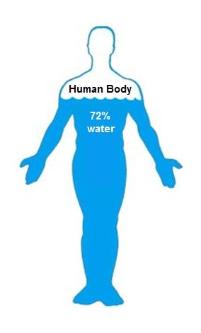
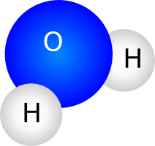
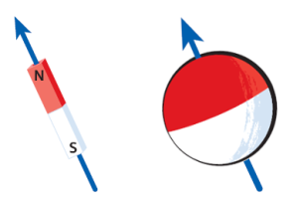
Spin ½ NMR in two slides - 1
The human body consists of approx. 70% water, hydrogen is very prevalent
Hydrogen nucleus is only one proton, S=½, i.e.
Associated to every nuclear spin is a nuclear magnetic moment

Slide 7
Spin ½ NMR in two slides - 2
Zeeman effect
Larmor precession
Magnetic field
(classical picture)
B₀
Macroscopic magnetisation
M₀

Slide 8
Reminder: excitation and signal reception
Excitation: apply a resonant radiofrequency (RF) pulse to excite spins
ω₀
e.g. 90 degree pulse
Reception: Faraday’s law:
quadrature detection
U [V]
t
Magnitude signal

Slide 9
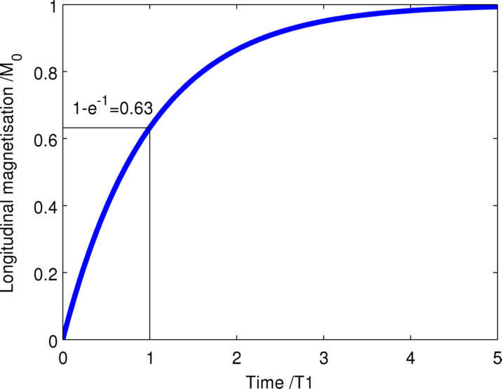
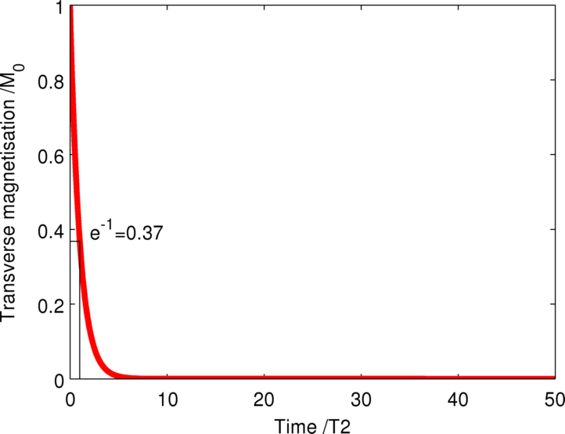
Reminder: relaxation
B₀
After excitation longitudinal magnetisation is recovered
T₁ (longitudinal relaxation time)
After excitation transverse magnetisation vanishes
T₂ (transverse relaxation time)

Slide 10
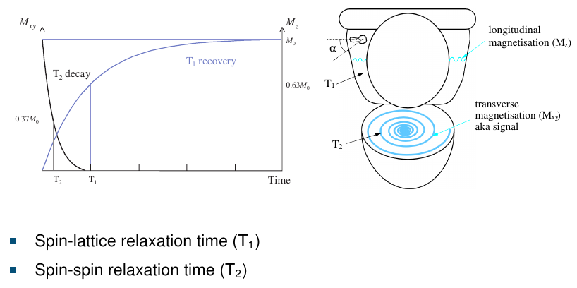
Relax, a bit of toilette humour ;)
T₁ (longitudinal relaxation time)
T₂ (transverse relaxation time)
McRobbie, MRI from Picture to Proton, Cambridge University Press, 2007

Slide 11
T₁-weighted images and mapping

Slide 12
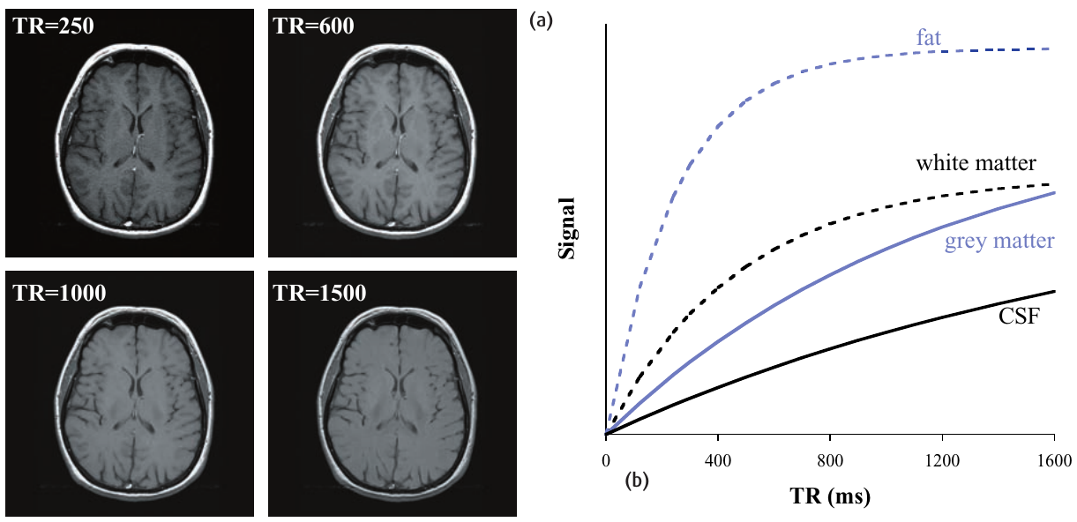
T₁-weighted contrast images – saturation recovery
Contrast generated by changing the repetition time (TR)
Different tissue have different T₁ values
McRobbie, MRI from Picture to Proton, Cambridge University Press, 2007

Slide 13
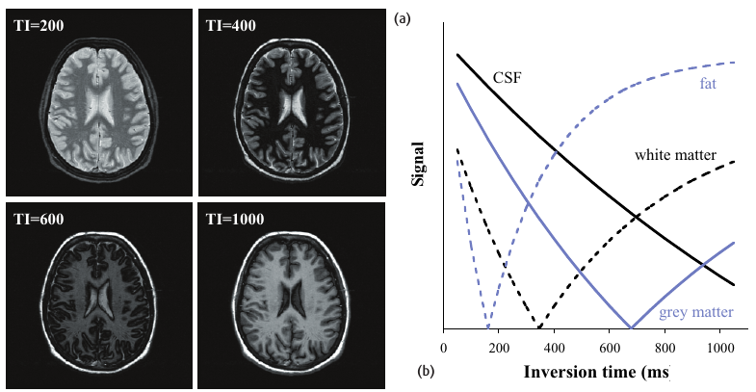
T₁-weighted contrast images – inversion recovery
Contrast generated by changing the inversion time (TI)
Allows for suppression of a given tissue
Why?!
Not quantitative!
McRobbie, MRI from Picture to Proton, Cambridge University Press, 2007

Slide 14
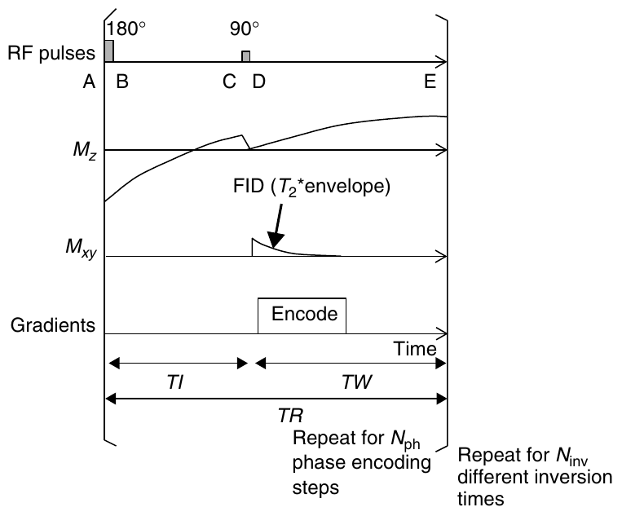
T₁ mapping - inversion recovery
Acquire several images at different TI
Signal → general
Signal → TR >> T₁
McRobbie, MRI from Picture to Proton, Cambridge University Press, 2007
P. Tofts, Quantitative MRI of the brain: measuring changes caused by disease, Wiley 2003

Slide 15
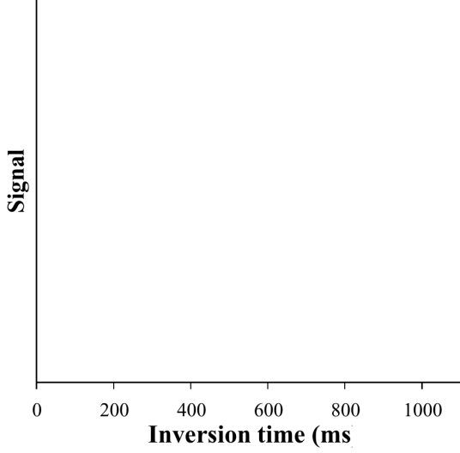
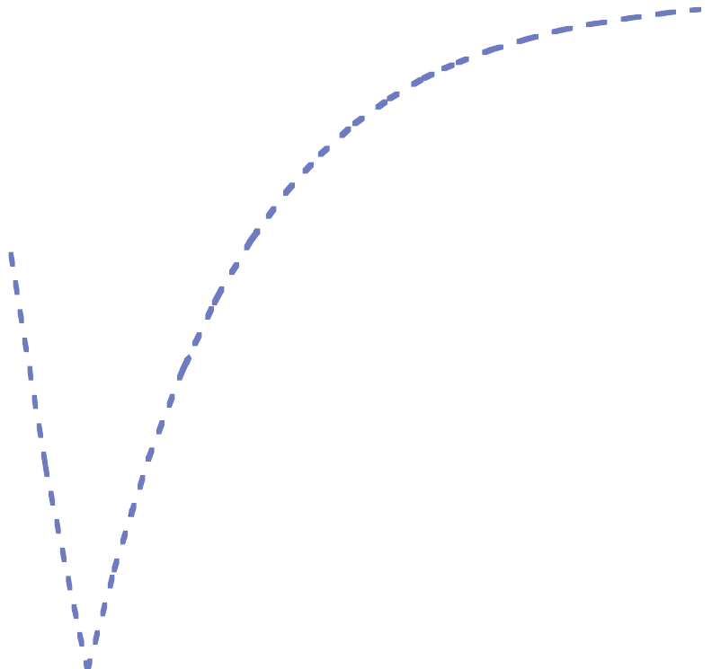
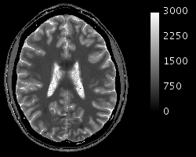
T₁ mapping - inversion recovery
Voxel-by-voxel model fitting
T₁ [ms]
Too slow !!!

Slide 16
TAPIR (T1 mApping of Partial Inversion Recovery)
Shah et al., US Patent No.: 6,803,762
Shah et al., NeuroImage: 2001 14(5): 1175-85
Steinhoff et al., Magn. Reson. Med.: 46(1) 131-140 2001
Zaitsev, et al; Magn. Reson. Med.: 49(1) 1121-1132 2003
Shah et al., Hepatology: 2003 38: 1219-26
Courtesy of Prof. N.J. Shah

Slide 17
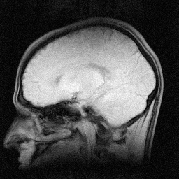
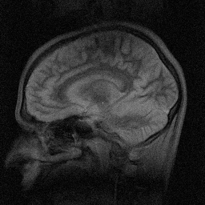
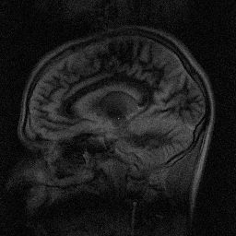
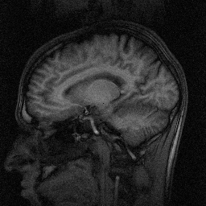
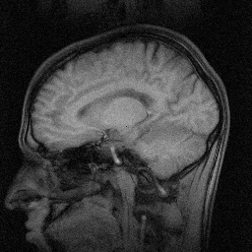
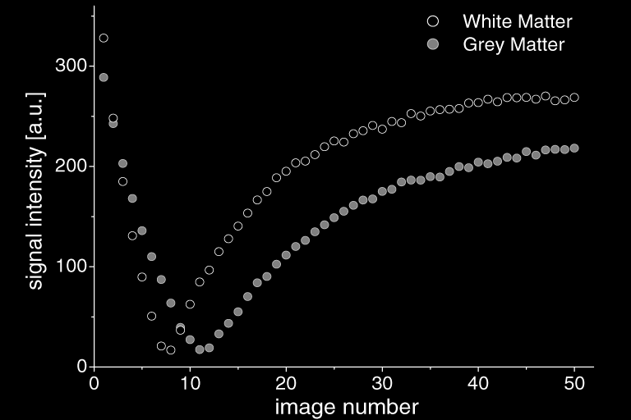
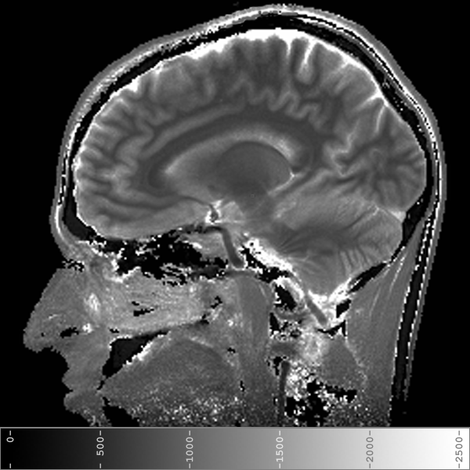
TAPIR: in vivo T₁ mapping
Look-Locker method results in an effective T₁* which is smaller than T₁ and is given by:
1
4
7
12
35
A precise knowledge of the flip angle is requires time. If multiple measurements have been made, then T₁ can be obtained from a 3-parameter fit:
And then solve
Courtesy of Prof. N.J. Shah

Slide 18
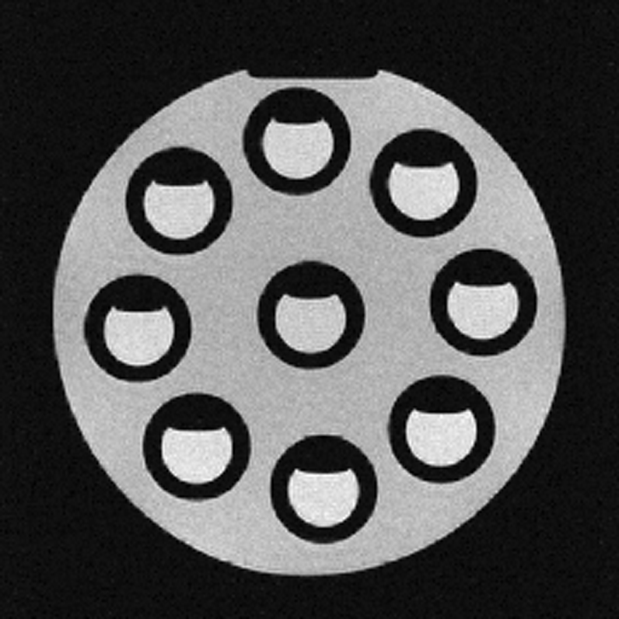
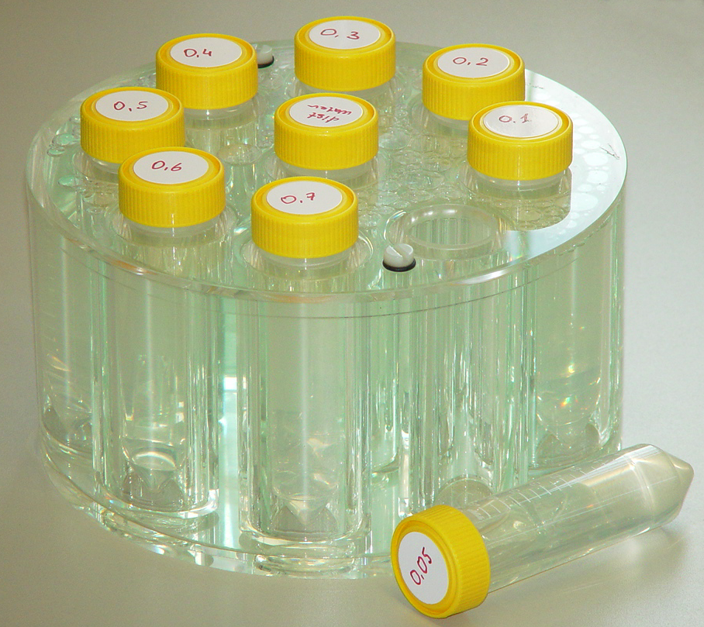
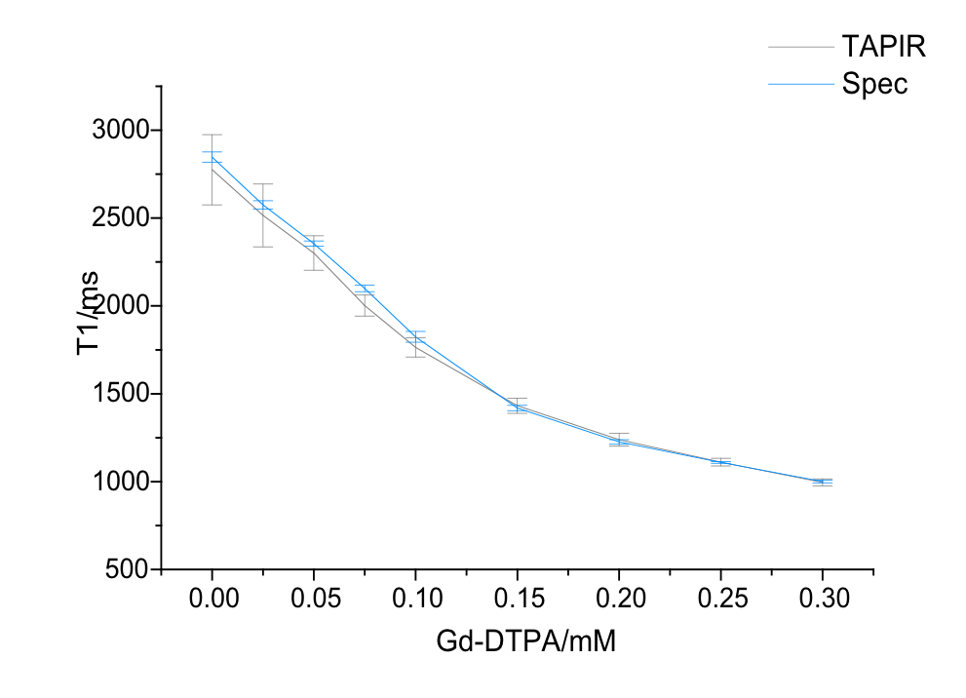
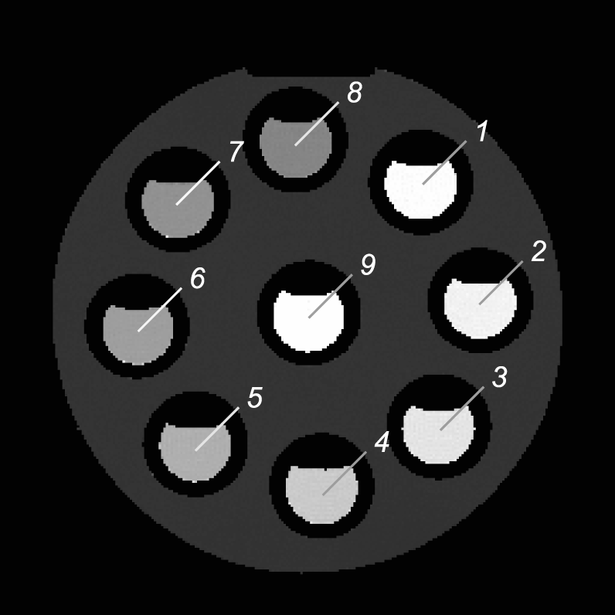
TAPIR: validation using phantoms
FLASH
Acquisition parameters:
T_{R}=13ms; T_{E=}1.9ms; TI=30ms; TD=3s; α=6°; 4 slices; 48 time points; 256²; FoV=250mm; slice-thickness = 8mm; interleaved
500ms<T₁<3s
T1 Map
Courtesy of Prof. N.J. Shah

Slide 19
TAPIR: in vivo T₁ mapping
Typical T₁ GM: 1000 ± 25ms
Typical T₁ WM: 600 ± 90ms
Acquisition parameters:
T_{R}=13ms; T_{E}=1.9 / 2.7 / 3.5ms; TI=30ms; TD=3s; α=8°; 4 slices; 48 time points; 256², FoV=230mm, slice-thickness = 5mm; interleaved
Shah, Steinhoff, and Zaitsev; US Patent No: 6,8,762
Shah et al., NeuroImage: 2001 14(5): 1175-85
Steinhoff et al., Magn. Reson. Med.: 46(1) 131-140 2001
Zaitsev et al., Magn. Reson. Med.: 49(6) 1121-32 2003
Courtesy of Prof. N.J. Shah

Slide 20
T₂-weighted images and mapping

Slide 21
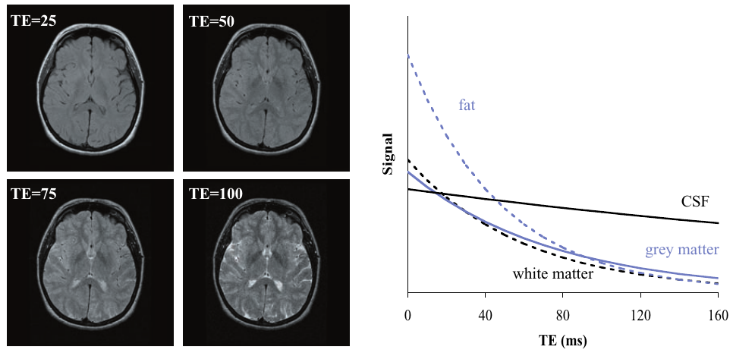
T₂-weighted images – spin echo
Contrast generated by changing the echo time (TE)
T₂
T₂*
Different tissue have different T₂ values
Not quantitative!
McRobbie, MRI from Picture to Proton, Cambridge University Press, 2007

Slide 22
T₂ mapping – spin echo
Signal → general
Signal → TR >> T₁
Source: Siemens, Magnete, Spins und Resonanzen
Acquire several TE’s

Slide 23
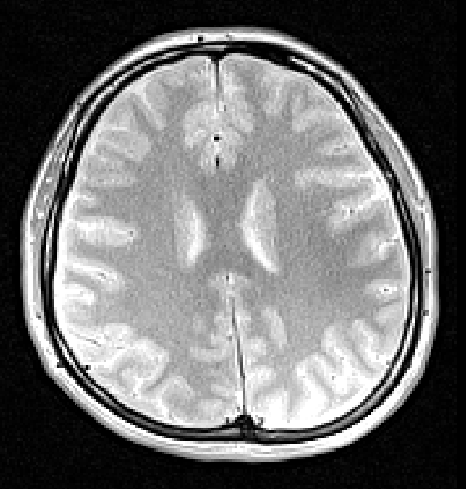
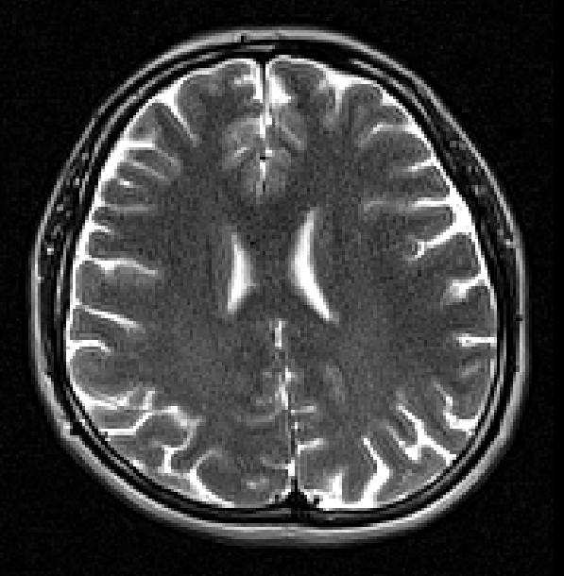
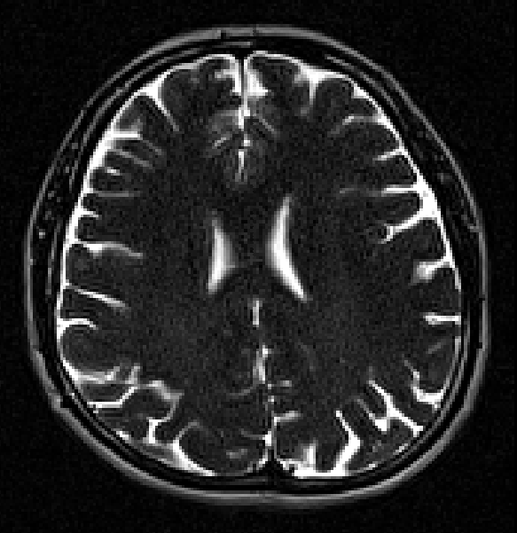
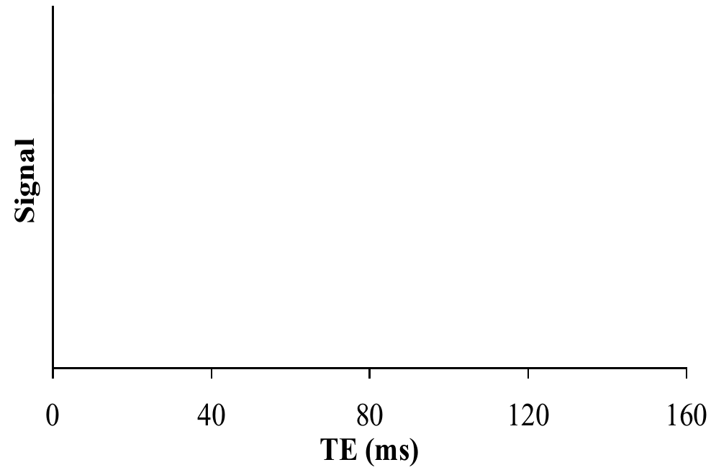
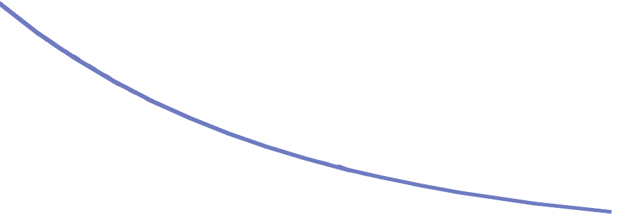
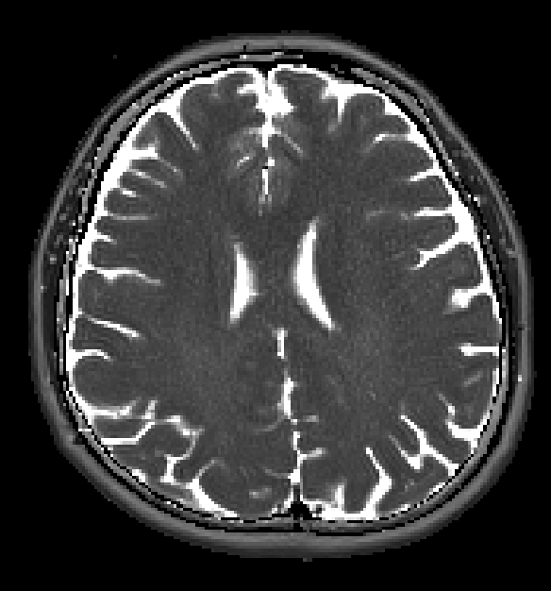
T₂ mapping – spin echo
T₂ [ms]
Voxel-by-voxel model fitting
0
200

Slide 24
Water content mapping
M₀

Slide 25
Water content mapping
Concentration of protons in tissue.
Protons → hydrogen nuclei that resonate and give rise to the NMR signal.
M₀
B₀
M₀
Visible MRI signal is proportional to proton density (PD).
Most visible tissue protons are resident in free water → water content.

Slide 26
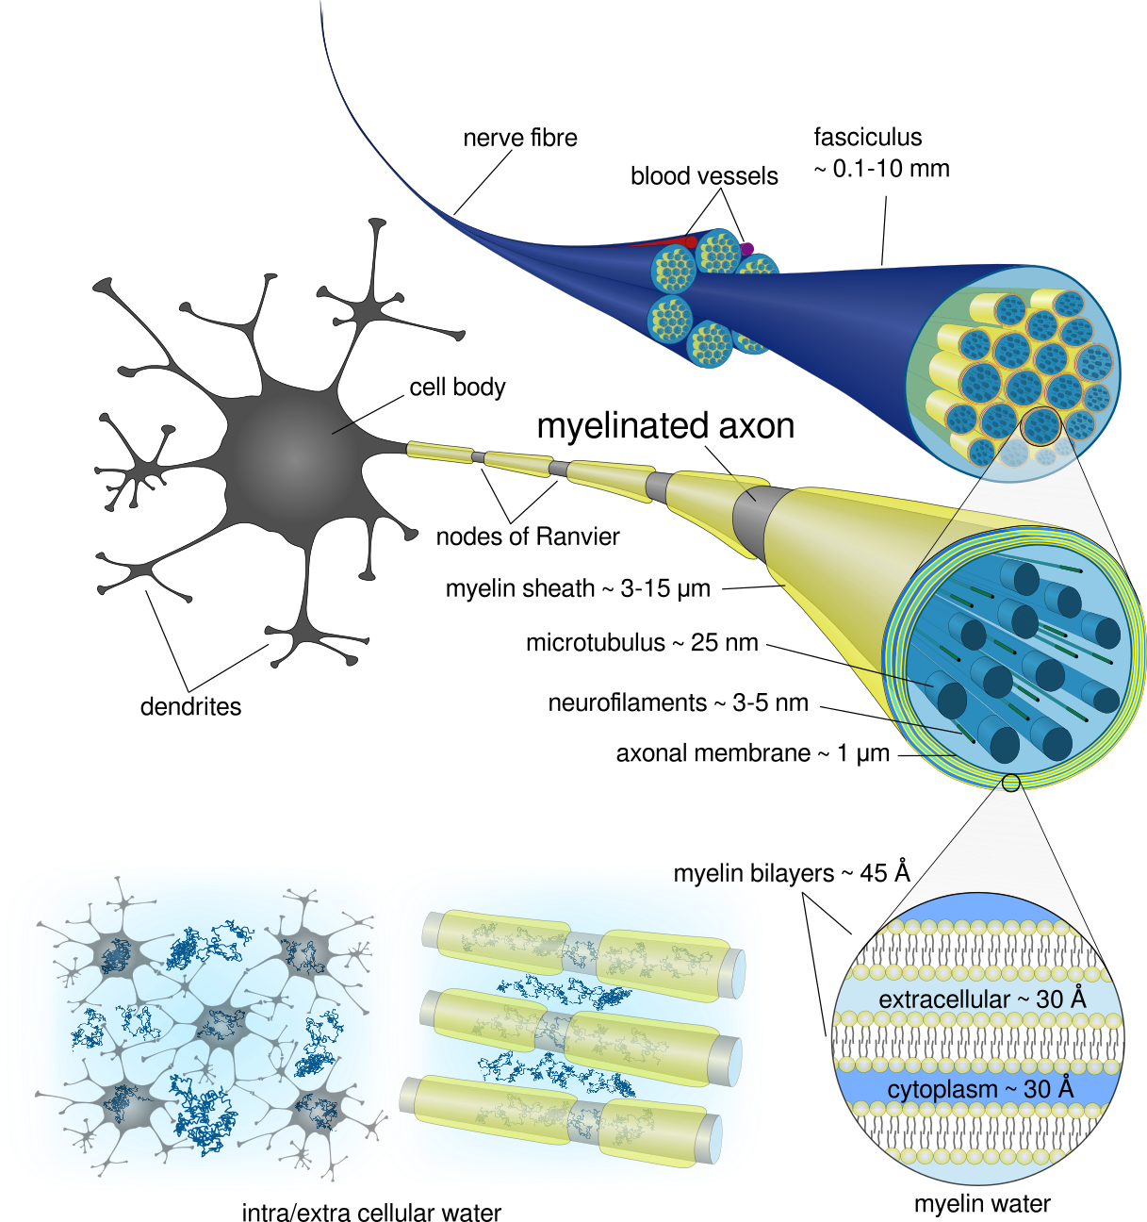
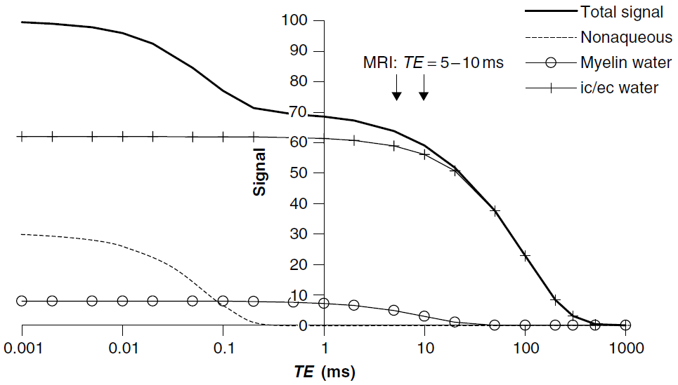
Water content mapping
MRI-visible protons? → ‘free water’.
Typical experiments
P. Tofts, Quantitative MRI of the brain: measuring changes caused by disease, Wiley 2003

Slide 27
Water content mapping
Example: spin echo sequence
Signal → general
M₀
Receive coils sensitivity profile
Proton density
Measure and remove the effects of ALL parameters causing signal loss

Slide 28
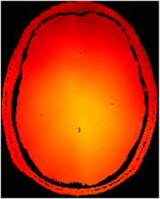
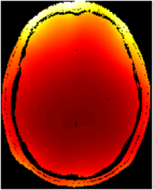
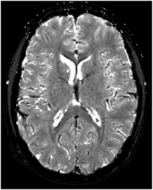
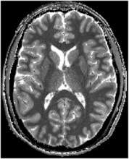
Proton density (PD) – corrections factors
flip angle
B₁ inhomogeneities
Measurement of effective flip angle required at each point
Receiver coil inhomogeneity
Must be done separately if Tx/Rx independent
T₂* decay compensation
Measured with multi-echo gradient-echo
T₁ saturation effects
Measured with TAPIR
receiver
T₂*
T₁

Slide 29
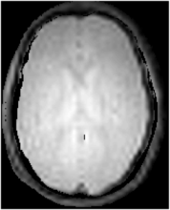
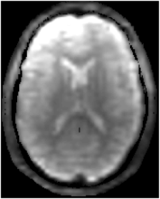
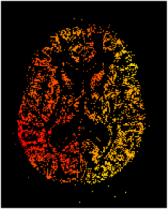
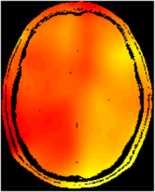
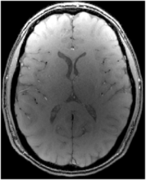
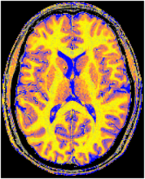
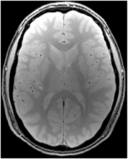
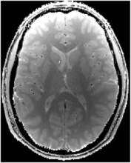
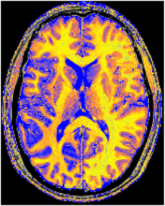
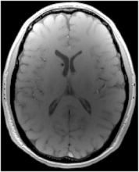
Advanced method - processing chain (INM-4)
GRE
Rx=PA/BC
1 minute
EPI
Variable FA
30,60,90,120◦
1.5 minute
regularisation
M₀ (uncalibrated)
T₁-w. GRE
3.5 minutes
M₀-w. GRE
6 minutes
Multi-echo
3D GRE
2.5 minutes
Acquisition Time : < 14 Minutes
Processing Time : < 10 Minutes
Courtesy of Dr. Z. Abbas

Slide 30
Conclusions
Contrast images are useful, but depend on many aspects.
Quantitative maps (T1, T2, PD, ...) are ideally independent of the acquisition method, scanner, institution, etc.
Conventional techniques are easy to understand and implement, but they are not practical (time constraints).
More advanced techniques are more complicated but enable the reduction of the acquisition time.
Newly developed techniques need validation compared to gold standard techniques.

Slide 31
Forschungszentrum Jülich
Thank you!

