Slide 1
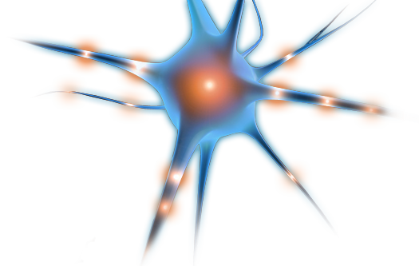

Plenary session 3
Radiotracers for diagnostic
applications with PET
Bernd Neumaier
August 2016 | Bernd Neumaier

Slide 2
Molecular Imaging - Why?
Aim:
Non-invasive elucidation of disease specific biochemical-, molecular-, physiological- and pathological processes
Disease detection as early as possible
Patient stratification – optimal and individual therapy for each patient
Evaluation of molecular response
Monitoring of therapy efficacy
Notes:
In molekularer Bildgebung wird als Sond ein Targeting Molekül benutzt, das mit einem Target spezifisch interagiert und ein Radioizotop, Fluoreszenz- oder Magnetlabel enthält.

Slide 3
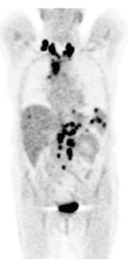
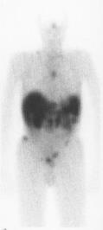
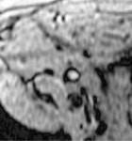
Molecular Imaging: Definition and Examples
„In-vivo-characterization of biological processes at the molecular level“
PET
Positron Emission
Tomography
(NHL;[¹⁸F]FDG )
SPECT
Single Photon Emission
Computed Tomography
(NET; ¹¹¹In-DTPA-
Octreotid)
Softscan
NIR
Fluorescence Imager
(Breast cancer;
DeoxyHb)
MR
Magnetic Resonance
(PCa, lymph node metastasis; Sinerem NT)
Notes:
Die molekulare Bildgebung ist: . Sie soll helfen eine richtige Diagnose zu stellen, eine richtige Therapieoption aus zu wählen und die Effizienz der Behandlung genau aus zu werten. Hier ist ein Paar Beispiele: ein FDG-Scan eines Patientes mit Non Hodgkin Lymphom, ein In-Octreotid-Scan eines Patientes mit Karzinoid und ein Brustkrebssoftscan. Für einige Tumorarten (Pankreastumor) gibt es keine Markers die Tumorstaging erlauben und/oder können Entzündung vom Cancer unterscheiden.

Slide 4
Principle of molecular imaging
Targeting molecule
(Vehicle)
Reporter
(Radionuclide,
fluorescent dye or
magnetic label)
Biological targets
Notes:
In molekularer Bildgebung wird als Sond ein Targeting Molekül benutzt, das mit einem Target spezifisch interagiert und ein Radioizotop, Fluoreszenz- oder Magnetlabel enthält.

Slide 5
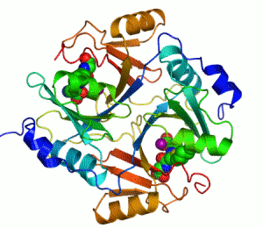

Disease detection
Visualization of molecular processes - measurement of molecular alterations
Activation or inhibition of
Receptors
Enzymes
Signal transduction processes

Slide 6



Probes for molecular imaging
Biological molecule with reporter unit
Reporter systems:
PET
¹⁸F (109 min), ¹¹C (20 min)
⁶⁸Ga (68 min),¹³N (10 min)
¹⁵O (2 min), ¹²⁴I (4.2 d)
SPECT
^{99m}Tc (6.0 h), ¹¹¹In (2.8 d)
¹²³I (13 h)
MR
Gd³⁺, Fe_{n}O_{m}
Fluorescence:
Alexa Fluor, Cyanine dyes
  Biological probes:
  Peptides
  Peptidomimetics
  Nucleosides
  Small molecules
  Antibodies
  Affibodies
¹⁸F
  Corresponding targets:
  Cell surface receptors
  Transporters
  DNA/RNA
  Receptors
  Enzymes
Notes:
In der linken Spalte sind einige Markierungsansätze gezeigt. Als Sonden können ganz unterschiedliche Moleküle wie: peptide, Peptidomimetics
Nukleoside
kleine Moleküle
Antikörper verwendet werden und als Targets z. B. Zelloberflächenrezeptoren
Transportmechanismen
Proteine
DNA/RNA

Slide 7
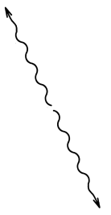

Positron decay and positron-electron-annihilation (e.g. for ¹⁸F)
PET: Physical background
511 keV
γ-Photon
¹⁸F
¹⁸O
e⁺
e⁺
ν
e⁻
511 keV
γ-Photon
Emission of an positron as a result of β⁺ decay
Positron is thermalized and undergoes recombination with electron
Conversion of mass into energy by E = m.c²
Emission of 2 γ-quants in opposite directions (180°)

Slide 8
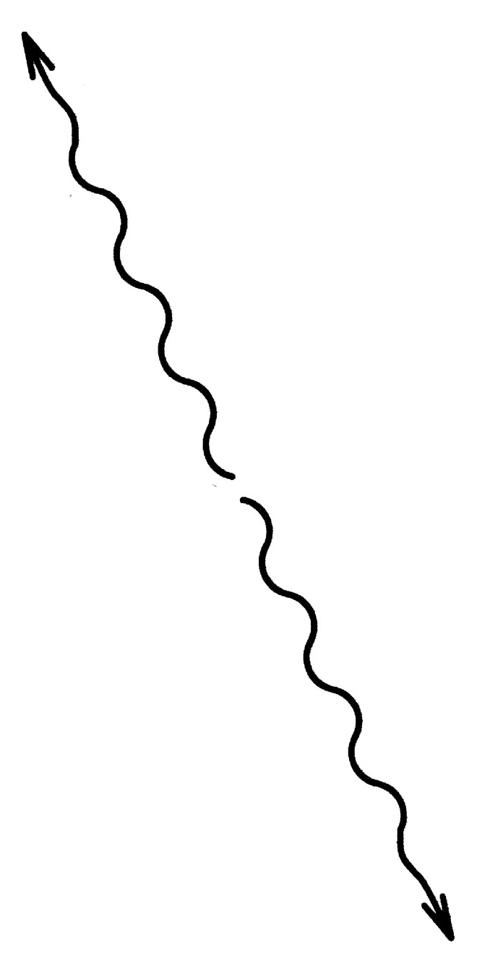

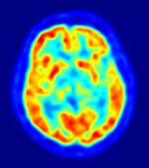
PET: Physical background
Detection of coincident decay events
Reconstruction of point of decay based on cross points of γ-photon trajectories
Real-time reconstruction of 3D nuclide distribution by modern computer techniques

Slide 9
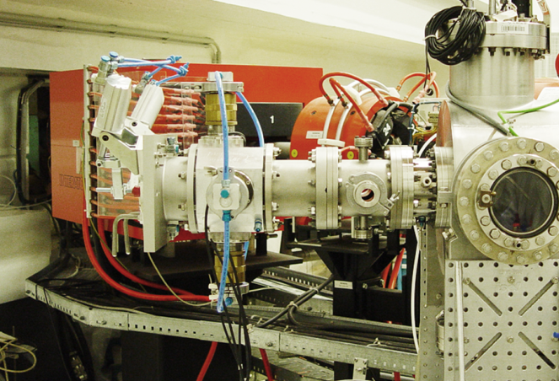
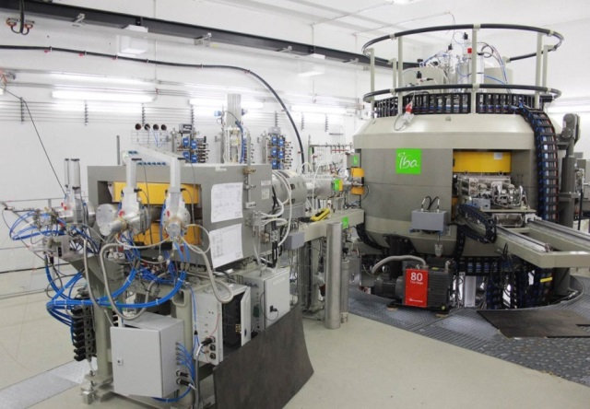
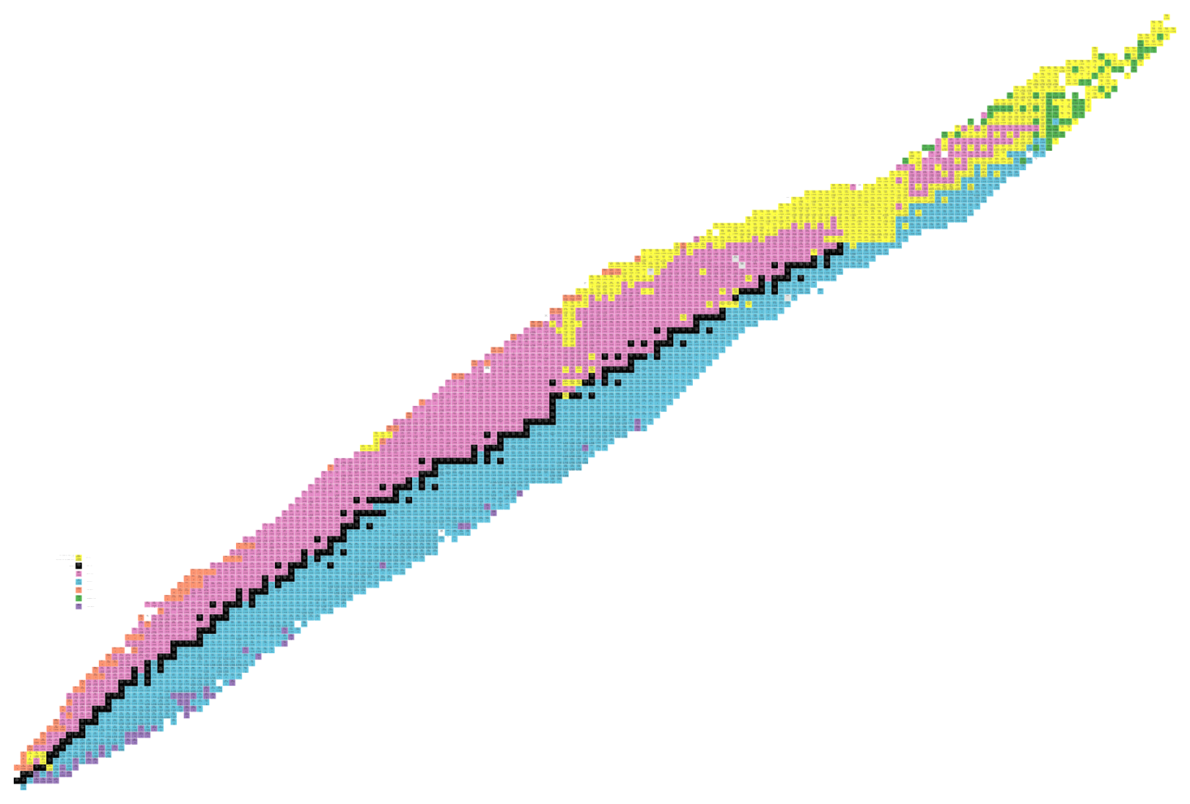
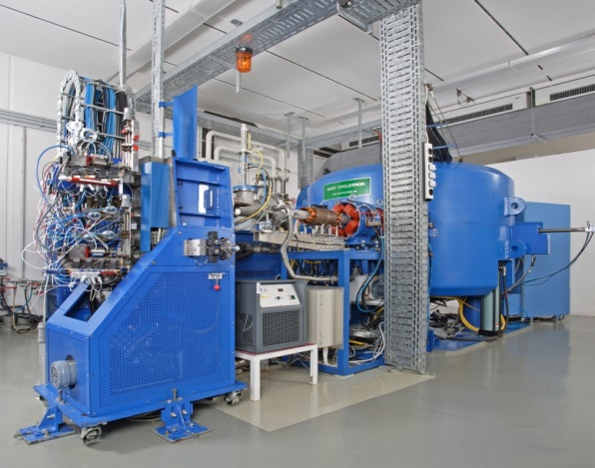
Production of Radionuclides
Production of standard und non-standard radionuclides
PET Nuclides (e.g. ^{34m}Cl, ³⁸K, ⁵¹Mn, ⁵⁵Co, ⁷²As)
Therapeutic Nuclides (e.g. ⁶⁷Cu, ¹⁰³Pd, ¹⁴⁰Nd, ¹⁶⁷Tm, ^{193m}Pt)
Targetry
Nuclear data

Slide 10
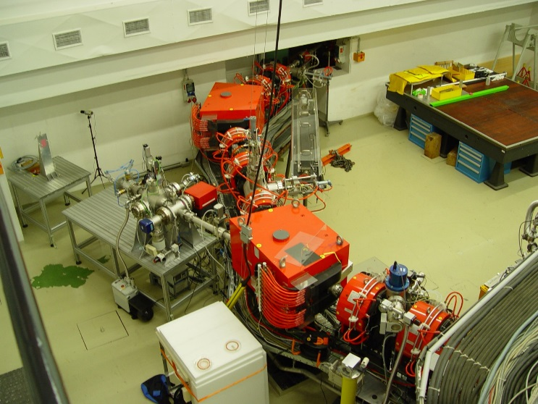
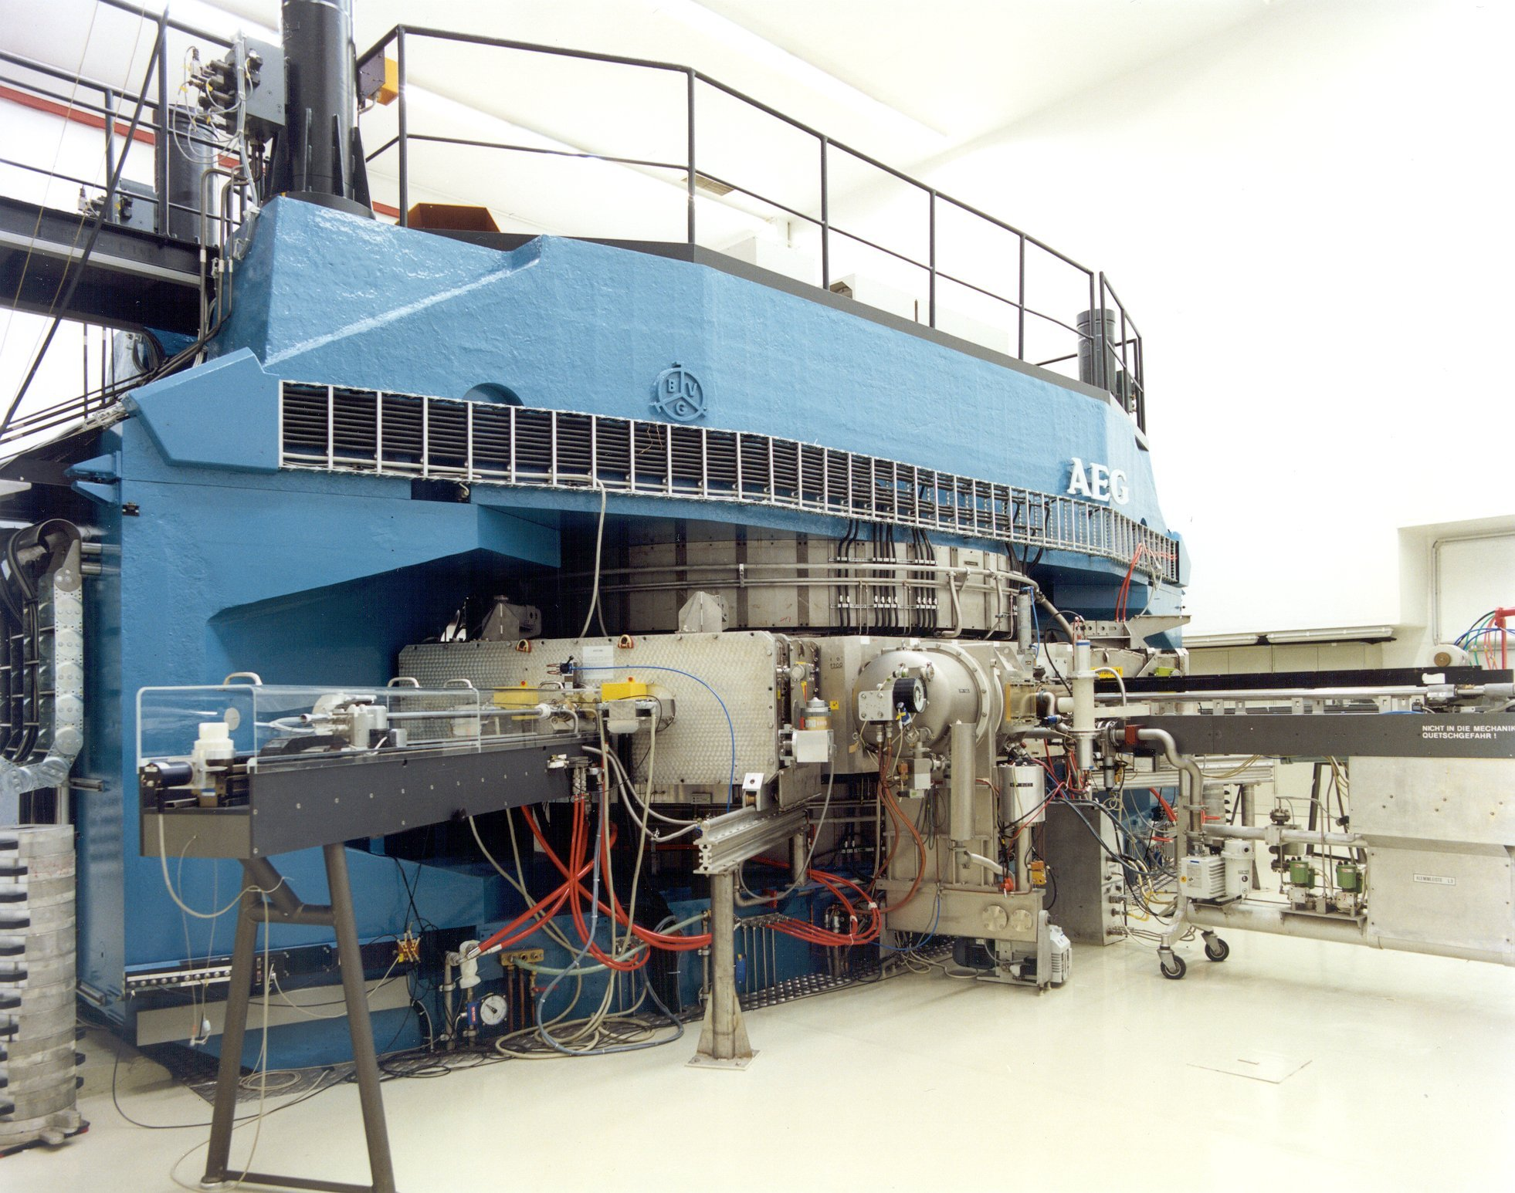
High energy cyclotron Julic
Beamline to COSY
p = 45 MeV
d = 78 MeV
Notes:
This is the JULIC accelerator of the Institute of Nuclear Physics. It was build in the late 1960s and converted to be the injector of the Cooler Synchrotron named COSY at the end of the 1980s. It delivers now proton and deuteron beam 45 and 78 MeV, respectively, use for cross section measurement and radionuclide production.

Slide 11
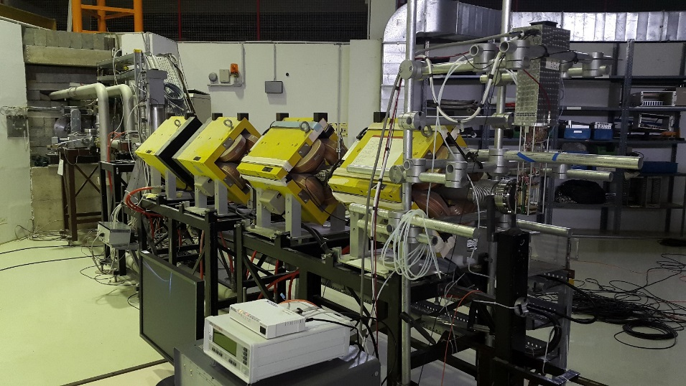
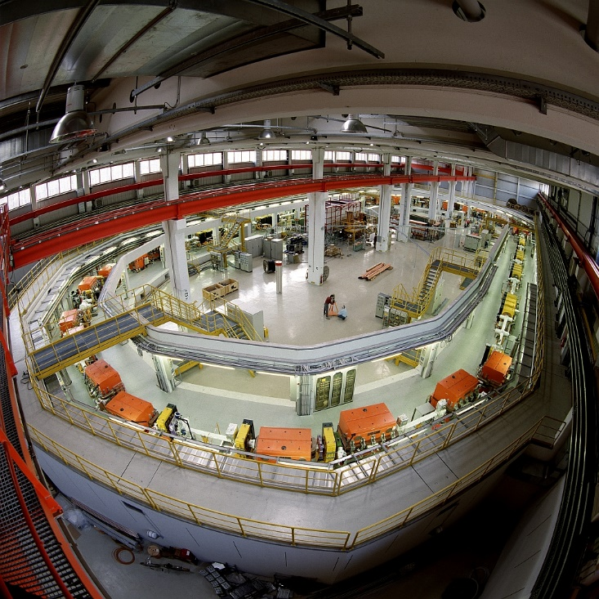
High energy nuclear reactions COSY
2.88 GeV Cooler Synchrotron
Target position
4 Quadrupole magnets
p = 150 MeV

Slide 12
Medically relevant radionuclides via high-energy reactions
Target | Reaction | Radionuclide | Usage | Remarks
⁴⁰Ar, ^{nat}Ar | (p,α3n) | ^{34m}Cl | PET
³⁹K, ^{nat}K | (p,αpn ) (p,α2n), decay | ^{34m}Cl | PET
^{nat}V | (p,αp) | ⁴⁷Sc | Therapy | ⁴³Sc/⁴⁷Sc theragnostic pair
⁵⁵Mn (nat.) | (p,4n) | ⁵²Fe | PET | Multimodal imaging,
⁵⁵Mn (nat.) | (p,p3n) | ⁵²Mn | PET | Multimodal imaging
⁶⁸Zn | (p,αn) | ⁶⁴Cu | PET
⁶⁸Zn | (p,2p) | ⁶⁷Cu | Therapy | ⁶⁴Cu/⁶⁷Cu theragnostic pair
^{nat}Rb, ⁸⁵Rb | (p,xn) | ⁸²Sr/⁸²Rb | PET | Generator
⁸⁸Sr | (p,3n) | ⁸⁶Y | PET | ⁸⁶Y/⁹⁰Y theragnostic pair
¹⁰⁷Ag, ^{nat}Ag | (p,αn) | ¹⁰³Pd | Therapy
¹⁹⁷Au (nat.) | (p,αn) | ^{193m}Pt | Therapy | Alternative to ¹⁹²Os(α,3n)

Slide 13
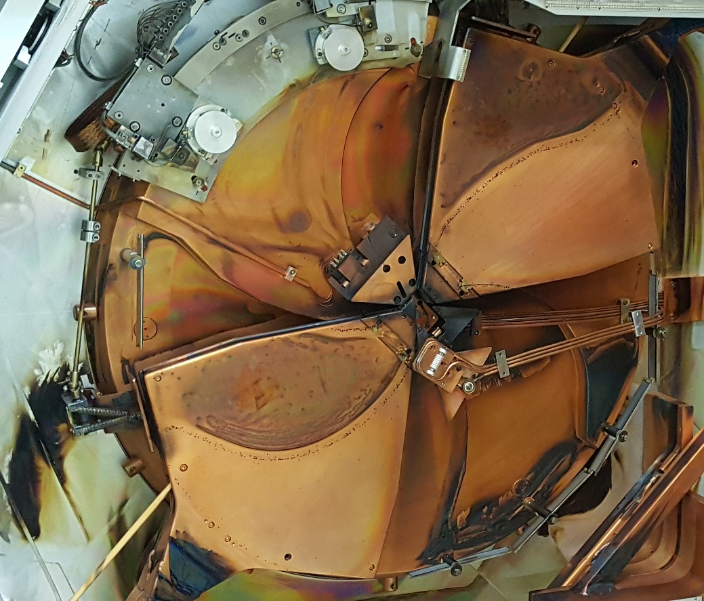
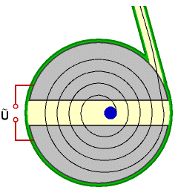
Production of radionuclides at a cyclotron
Target
Ion beam
Duands
Ion source
Alternating electric field

Slide 14
The cyclotron-produced radionuclide [¹⁸F]fluoride
neutron
¹⁸Oxygen
≠
proton
¹⁸Fluoride
Compound nucleus [¹⁹F]*
Reaction: ¹⁸O(p,n)¹⁸F
¹⁸F half life: 110 min

Slide 15

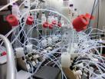
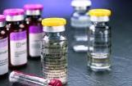
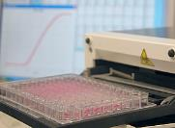
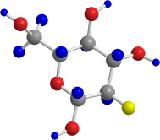
Production of radiopharmaceuticals
Radionuclide production
60 min
Radiosynthesis
90 min
Sterilization / Dispensing
115 min
Quality control
125 min

Slide 16
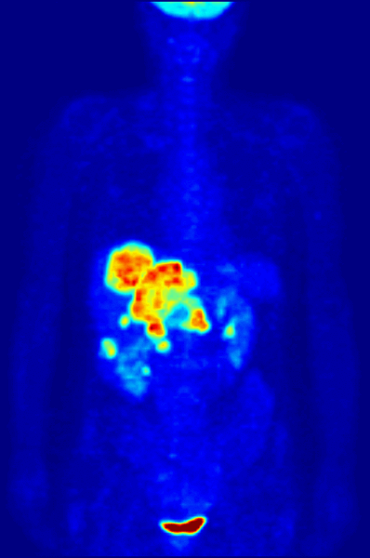

PET Diagnostics with [¹⁸F]FDG
Glucose-
Transporter

Slide 17
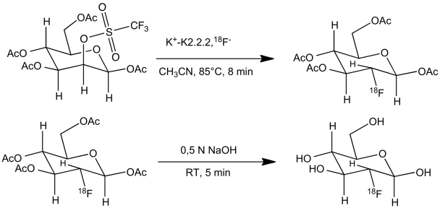
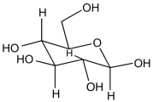
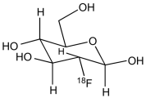
Production of [¹⁸F]FDG
D-Glucose
[¹⁸F]FDG

Slide 18
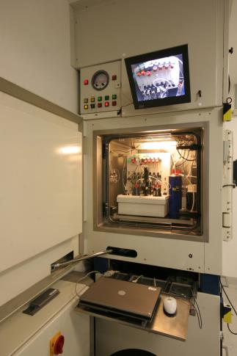
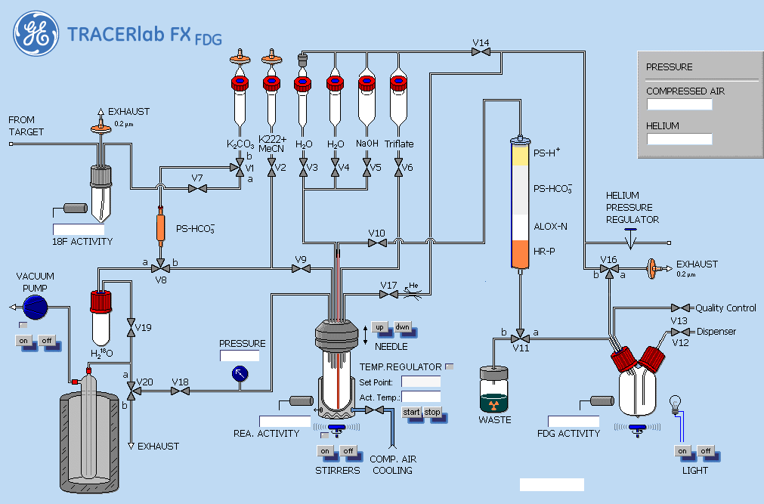
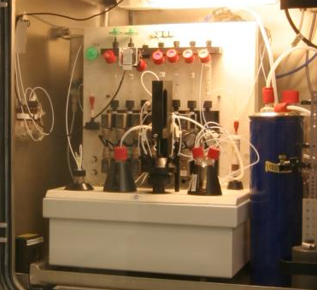
Radiosynthesis in hot cells
Purification
¹⁸F-Trapping
Reaction
Dispensing
Automated and remotely controlled synthesis module

Slide 19

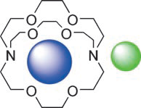

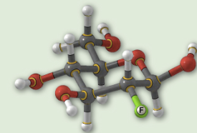

Reaction steps of [¹⁸F]FDG synthesis
1. Recovery of ¹⁸O-water and fixation of ¹⁸F⁻
- Trapping of ¹⁸F⁻ on anion exchange cartridge
- Elution of ¹⁸F⁻ with K₂CO₃-solution as [¹⁸F]KF
2. ¹⁸F activation, incorporation & deprotection
Addition of K2.2.2 cryptand for ¹⁸F⁻ activation
Removing of water by repeated azeotropic drying
Reaction at 85 °C with precursor in acetonitrile
Hydrolysis with NaOH
K⁺
¹⁸F⁻
3. [¹⁸F]FDG purification
Solid phase extraction purification
Formulation
Sterilization
Quality control

Slide 20
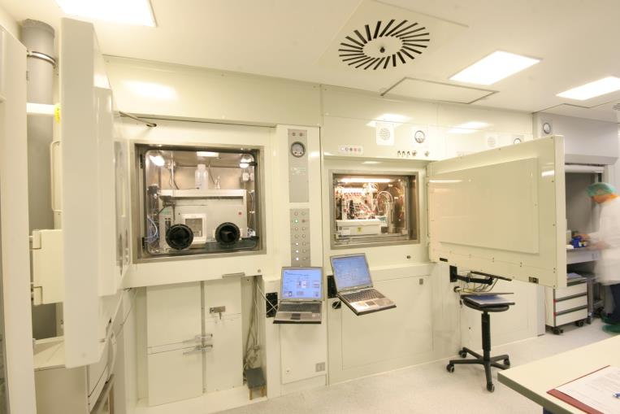
[¹⁸F]FDG sterilisation and dispensing
Dispenser
Synthesis module

Slide 21
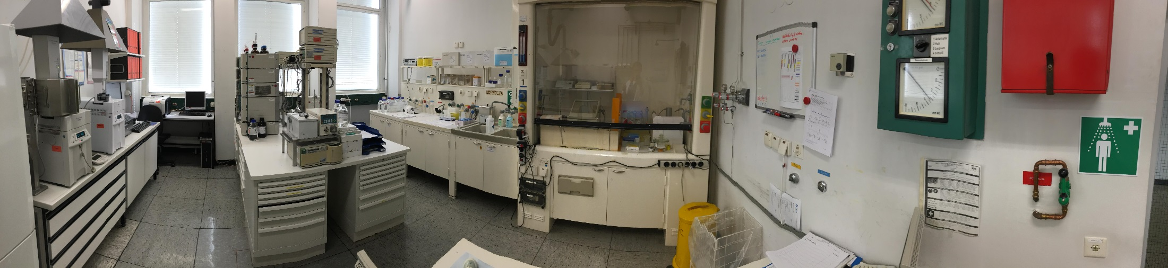
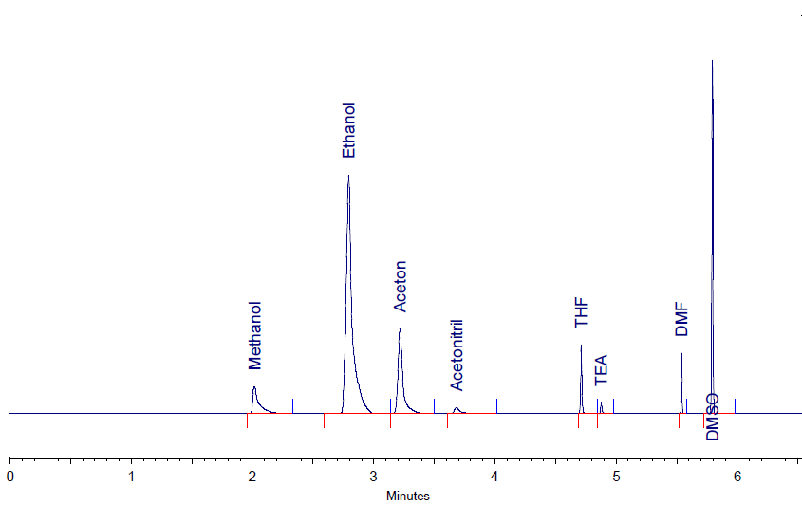
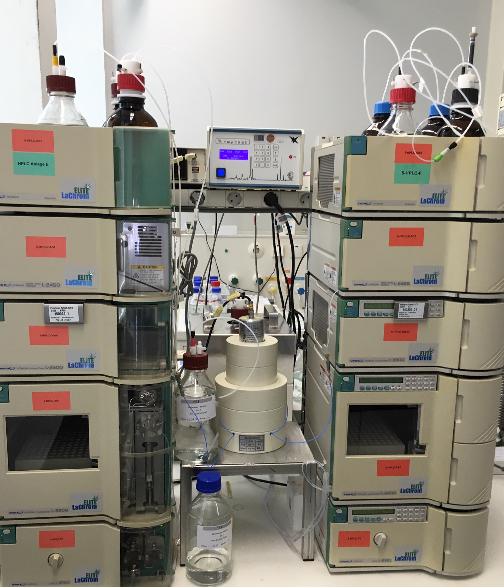
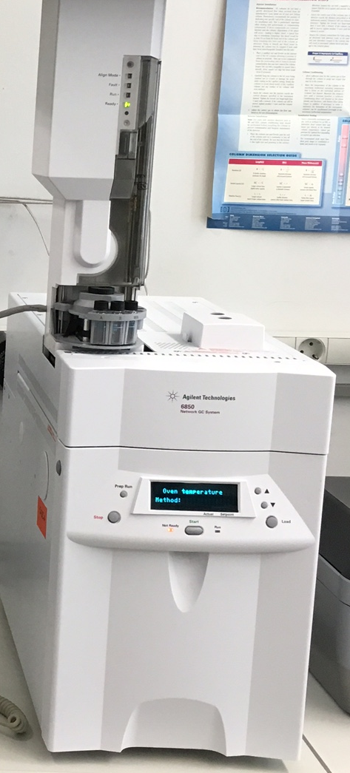
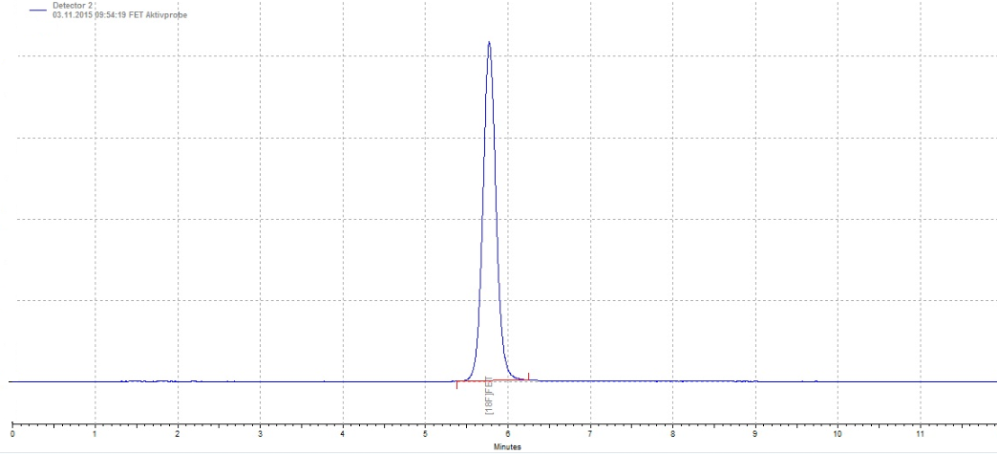
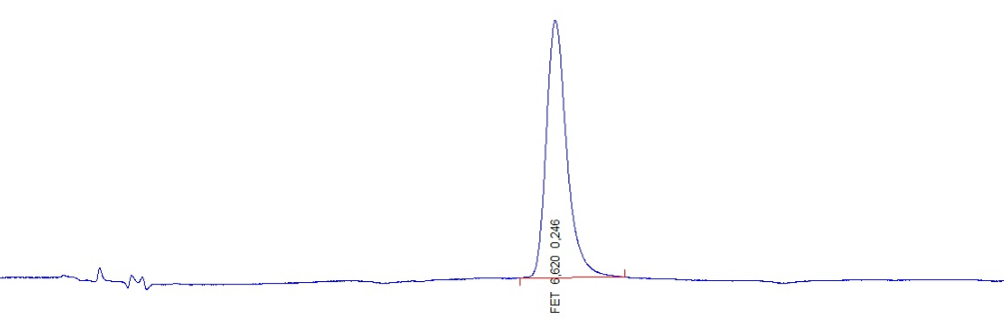
Quality control
HPLC
GC
also:
Endotoxins
pH…
Notes:
.

Slide 22
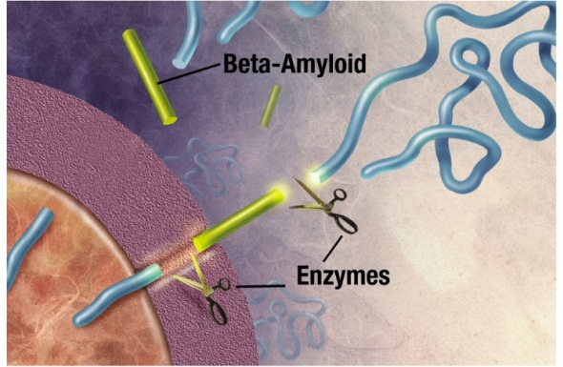


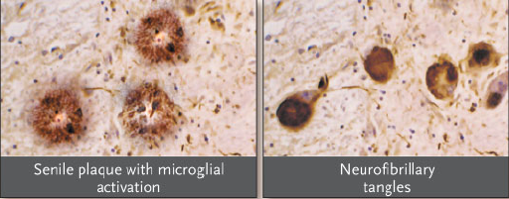
Alzheimer’s Disease: Amyloid cascade hypothesis
β-Secretase
γ-Secretase
APP mutations
Presenilin 1 mutations
Presenilin 2 mutations
Increase of Aβ production
Lipoprotein ε4
LRP
Cholesterol
α2 Macroglobuline
Aggregation triggered and clearance of amyloid decelerated

Slide 23
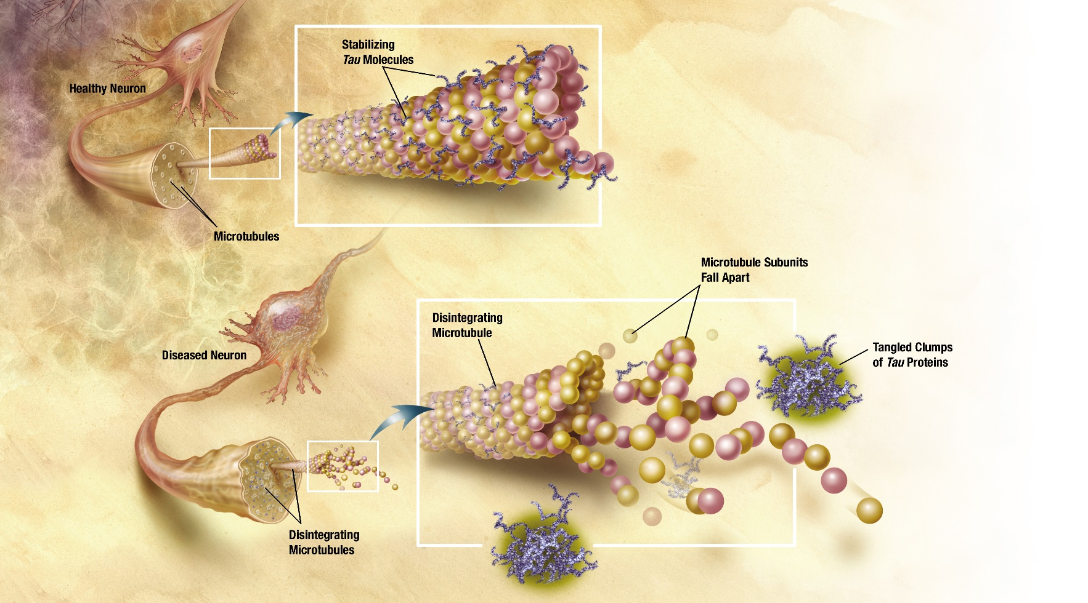
Alzheimer’s Disease: Tau-hypothesis
Changes in tau protein lead to the disintegration of microtubules in brain cells
This may result in malfunctions and eventually the death of the neurons
Over time damage may lead to pathogenesis of AD

Slide 24
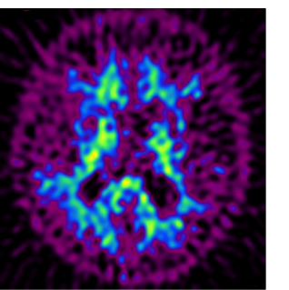

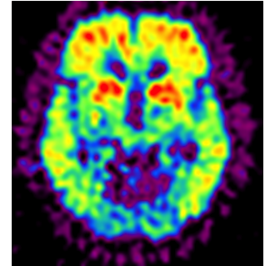
Amyloid imaging by [¹¹C]PIB-PET
Amyloid Plaque Imaging C-11 PIB
40-70 min p.i.
Control
Alzheimer‘s
disease
Axial slices
caudal aspects
Drzezga et al. Ann of Nuclear Med. 2009

Slide 25
Tau imaging by [¹⁸F]AV1451 (T807) PET
Healthy
control
person
Alzheimer‘s
disease
© 2015 unpublished data, University of Cologne

Slide 26
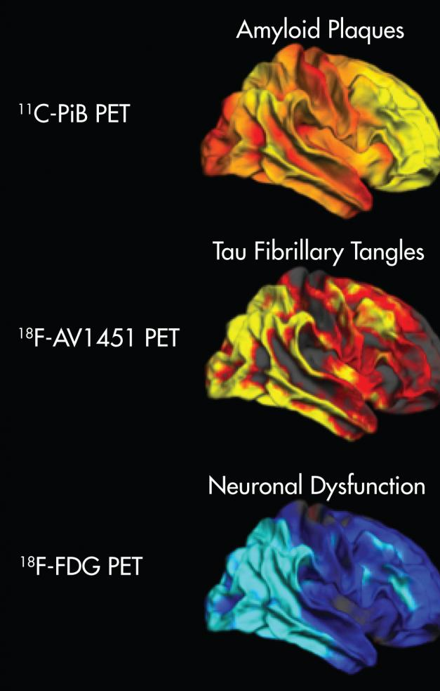
AD imaging by [¹¹C]PIB and [¹⁸F]AV1451 PET
Deviation from healthy controls;
yellow/red: higher uptake
blue: lower uptake

Slide 27
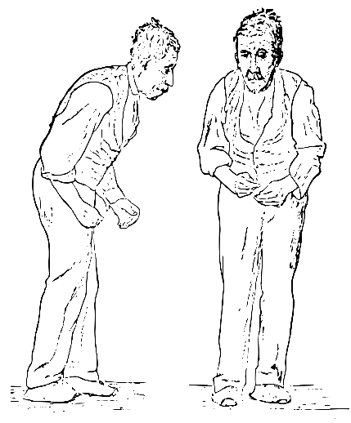
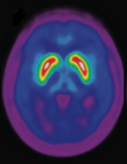
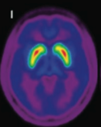
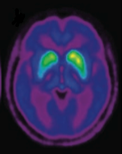
Imaging of Parkinson’s Disease with [¹⁸F]FDOPA
non-invasive assessment of the binding capacity of the cerebral D2 dopamine receptor
Early ilustration of PD by Sir William Richard Gowers in A Manual of Diseases of the Nervous System 1886
healthy young
person
healthy aged
person
Parkinson‘s
Disease

Slide 28
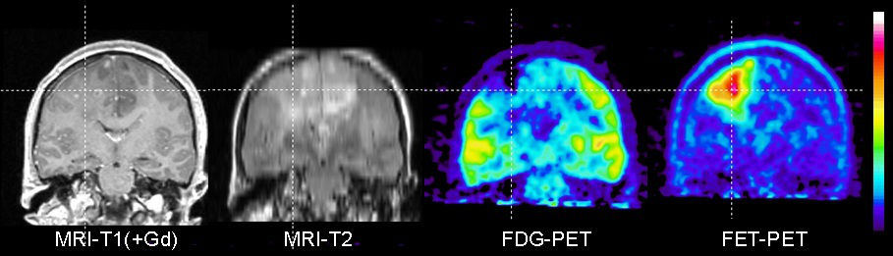
Imaging of brain tumors with [¹⁸F]FET
?
?
?
Anaplastic Astrozytom Grade III:
T1-and T-2 weighted MRI do not allow differentiation of the tumor
In contrast FET PET allows precise differentation of the solid tumor
FDG PET indicates decreased glucose-metabolism in the region of the tumor

Slide 29
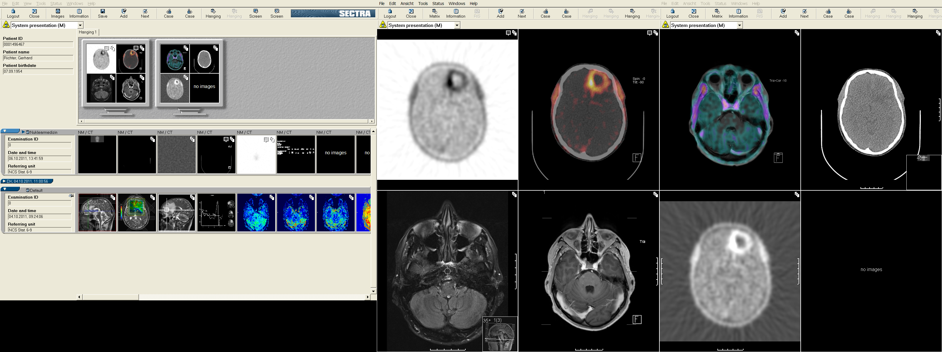


CT imaging: only morphological deviations are visible
PET/CT: Combination of molecular and morphological imaging
PET: Molecular imaging indicates deviation of biochemical processes
MR imaging: morphological deviations are visible. Higher resolution than CT
PET/MRI: Combination of molecular and morphological imaging with high resolution

Slide 30

Prostate carcinoma (PCa)
second most frequently diagnosed cancer worldwide
sixth leading cause of cancer death in males

Slide 31


Prostate Specific Membrane Antigen (PSMA)
Mesters JR et al EMBO Journal, 2006
Navakova Z et al. FEBS Journal, 2016
In-vivo:
750 amino acids, ~84 kDa
PSMA - zinc metalloenzyme
that resides in membranes
catalyzes hydrolysis of N-acetylaspartylglutamate (NAAG) to glutamate and N-acetylaspartate (NAA)
up-regulated in prostate cancer cells

Slide 32
[¹⁸F]DCFPyL, the novel [¹⁸F]PSMA-PET
Natural ligand of PSMA
High affinity for PSMA
High metabolic stability
Amenable for labeling

Slide 33
[¹⁸F]DCFPyL superior to [⁶⁸Ga]PSMA-HBED-CC PET/CT

Slide 34



Imaging of PCa bone metastasis by [¹⁸F]PSMA-6-PET
Detection of even very small lesions
?
?
[⁶⁸Ga]PSMA-PET
[¹⁸F]PSMA-6-PET

Slide 35
Thank You!

Slide 36
Labeling with radiometals
Pro:
Fast
Easy
One-step
Commercial kits available
Generator systems: no cyclotron necessary
Contra:
Strong influence of chelating group
Limited amounts of generator nuclides
Possible loss of metal
Sophisticated chelator chemistry

Slide 37




Example: ⁶⁸Ga-PET
Complexation

Slide 38
Bifunctional Chelators for ⁶⁸Ga
[Ga(DOTA)]
[Ga(NODASA)]
[Ga(HBED-CC)]
Macrocyclic chelators offer enhanced metabolic stability

Slide 39

Peptides for molecular imaging
Features of radiopeptides
Small in size
Easy to synthesize
Easy to radiolabel
Feasibility of kit formulation
Amenable to chemical/molecular modifications
Ability to attach a chelating agent at the C- or N-terminus of the peptide
High receptor binding affinity
High tumor penetration
Favorable pharmacokinetics
Attain high concentration in target tissues
Rapid clearance from the blood and non-target tissues
Rate and way of excretion can be modified
Few side effects
Not immunogenic
Many possible targets

Slide 40
Somatostatin for tumor labeling ?
+ overexpression of somatostatin receptors in neuroendocrine tumors
+ tumors often express several somatostatin receptor types
Somatostatin unstable in vivo (plasma half-life: 3 min)
- modifications of natural molecule
- analogs resistant to enzymatic degradation
Notes:
Somatostatin (has two active forms somatostatin-14 and 28) is a peptide that regulates neuroendocrine system and has mainly inhibitory action. Its receptors are overexpressed in almost all neurocrine (njueroendokrain) tumors. Most tumor express more than one receptor type. Nevertheless somatostatin can not be used as tumor tracer because of low in vivo stability.
The part of Molecule responsible for receptor binging is shown in bold.

Slide 41
Somatostatin-Rezeptor-Imaging ⁶⁸Ga-DOTATOC
Patient with neuroendocrine cancer and hepatic/osseous metastases.
Somatostatin analogs are predominantly taken up by the highly expressed somatostatin receptor subtype 2 (sst2). After receptor mediated internalisation, the receptor-ligand complex is cleaved and most of the receptor is recycled. A significant amount of radiolabelled DOTA-octreotide is intracellularly trapped and provides high contrast imaging
Notes:
Somatostatin (has two active forms somatostatin-14 and 28) is a peptide that regulates neuroendocrine system and has mainly inhibitory action. Its receptors are overexpressed in almost all neurocrine (njueroendokrain) tumors. Most tumor express more than one receptor type. Nevertheless somatostatin can not be used as tumor tracer because of low in vivo stability.
The part of Molecule responsible for receptor binging is shown in bold.

Slide 42
Therapy and diagnostics in one: theranostics

Slide 43


Theranostic approach: Neuroendocrine tumors
⁶⁸Ga-DOTA-TOC PET
before treatment
¹⁷⁷Lu-DOTA-TATE
scintigram
⁶⁸Ga-DOTA-TOC PET
after radiotherapy
Notes:
Somatostatin (has two active forms somatostatin-14 and 28) is a peptide that regulates neuroendocrine system and has mainly inhibitory action. Its receptors are overexpressed in almost all neurocrine (njueroendokrain) tumors. Most tumor express more than one receptor type. Nevertheless somatostatin can not be used as tumor tracer because of low in vivo stability.
The part of Molecule responsible for receptor binging is shown in bold.

Slide 44
Theranostics : PRRT with ¹⁷⁷Lu/⁹⁰Y, PET/CT with ⁶⁸Ga

Slide 45
Non-standard radionuclides for PET
Radionuclide | Half-life | Production route | E_{β+} [keV]
¹⁸F | 108.9 min | ¹⁸O(p,n)¹⁸F | 633
⁶⁸Ga | 68.3 min | ⁶⁸Ge/⁶⁸Ga | 1,899.1
^{34m}Cl | 14.60 h | ³⁴S(p,n)^{34m}Cl ³²S(α,pn)^{34m}Cl | 1,311.4 1099,0
³⁸K | 7.6 min | ³⁸Ar(p,n)³⁸K | 1212.1
⁴⁵Ti | 184.8 min | ⁴⁵Sc(p,n)⁴⁵Ti | 1040.1
⁵²Mn | 5.6 d | ^{nat}Cr(p,xn)⁵²Mn | 575.6
⁶⁴Cu | 12.7 h | ⁶⁴Ni(p,n)⁶⁴Cu ⁶⁷Zn(p,α)⁶⁴Cu | 653.0
⁷¹As | 65.3 h | ⁷⁰Ge(p,γ)⁷¹As | 816
⁷⁶Br | 16.2 h | ⁷⁶Se(p,n)⁷⁶Br ⁷⁵As(α,3n)⁷⁶Br | 3383
⁸⁶Y | 14.7 h | ⁸⁶Sr(p,n)⁸⁶Y | 1221
⁸⁹Zr | 78.4 h | ⁸⁹Y(p,n)⁸⁹Zr | 902
^{94m}Tc | 52.0 min | ⁹⁴Mo(p,n)^{94m}Tc | 2439
¹²⁴I | 4.2 d | ¹²⁴Te(p,n)¹²⁴I | 1534.9 2137.6

Slide 46


PET with ⁸⁹Zr

Slide 47
Immuno-PET in Oncology with ⁸⁹Zr Labeled Monoclonal Antibodies
doi: 10.3389/fphar.2016.00131

Slide 48

…or [¹¹C]raclopride-PET
Patient with parkinsonian syndrome. Clinical symptoms predominantly on the right side and pronounced decrease of raclopride uptake on the contralateral left side

