Slide 1



Time Reversal Invariance at COSY (TRIC)
Yury Valdau

Slide 2
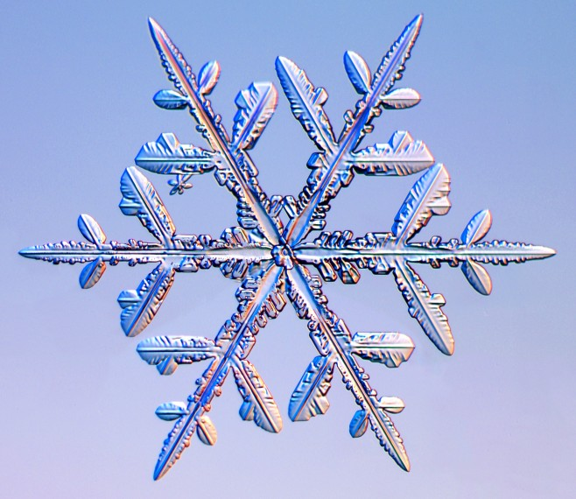
“…physics is the study of asymmetry”
Symmetries in Nature
Six fold symmetry
But not perfect
P.W. Anderson, Nobel prize physics (1977)
Notes:
Our existence proofs that nature likes to violate symmetries
Sectors

Slide 3
Symmetries in Physics
3 discrete symmetries C, P, and T
C, P, T, and CP violated in weak interactions
Combined CPT conserved
Combined CP/T symmetry links matter and anti-matter
+
C
−
P
T
All known symmetry violations
incorporated in Standard Model (SM)

Slide 4
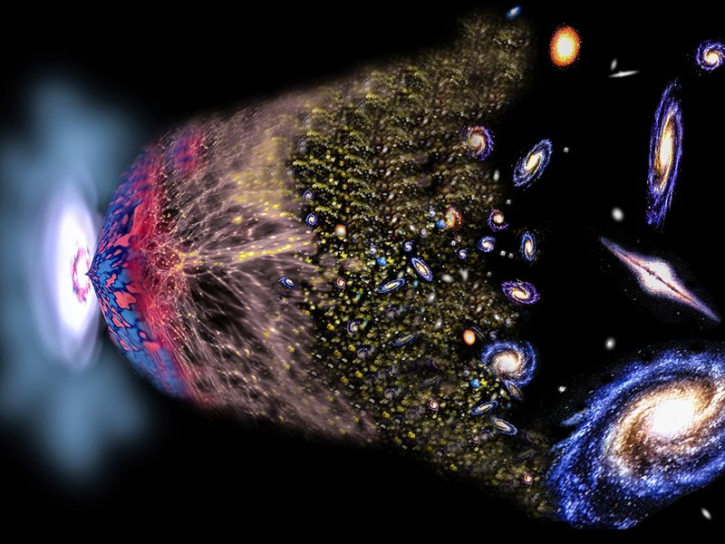
CP/T Violation in Early Universe
Time
Big Bang
Today
Matter and Antimatter
Only Matter!
CP/T violation in SM too weak
New CP/T violation beyond SM must exist!

Slide 5
Physics Beyond SM
Consider T violation (with and without P conservation)
$L=L_{SM}+ α_{TVPV} L_{TVPV}+ α_{TVPC} L_{TVPC}+ …$
EDM
α_{TVPC}
TRIC
TRIC
α_{TVPV}
EDM
EDM and TRIC test different extensions of SM

Slide 6
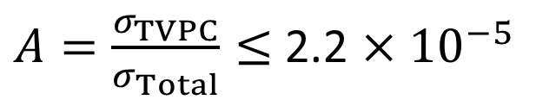

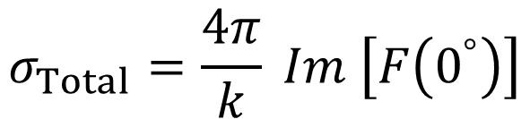
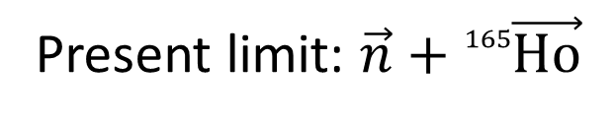
Search for TVPC effects
Null observable in double polarized forward scattering
$$σ_{Total}=\frac{4π}{k} Im \left[F\left(0^{°}\right)\right]$$
Optical theorem:
Present limit: $\vec{n}+{}_{}^{165}{\vec{Ho}}$
$A=\frac{σ_{TVPC}}{σ_{Total}}≤$ 2.2 $×{10}^{−5}$
TRIC (Time Reversal Invariance at Cosy):
search for direct T violation in $\vec{p}\vec{d}$ scattering
transmission experiment in Storage Ring
Goal: improve limit by at least one order

Slide 7
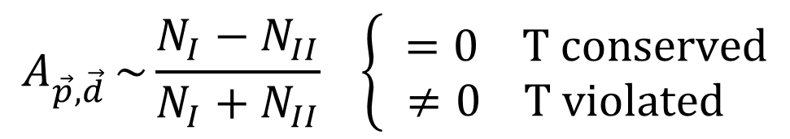

Principle of TRIC
Genuine T-violating observable in $\vec{p}\vec{d}$scattering:
$$A_{\vec{p},\vec{d} }\sim \frac{N_{I}−N_{II}}{N_{I}+N_{II}} \left\{ \begin{aligned}=0 T conserved \\ ≠0 T violated \end{aligned}\right.$$
T
p
p
d
d
I
II
Trick behind TRIC: T reversal via spin-flip!

Slide 8
Measurement Principle
Beam Current Sensor
Polarimeter
N_{I}
N_{II}
N_{I}
N_{II}
Beam current
Storage Ring
time
Target
p
d
Beam
Comparison of slopes for I and II

Slide 9
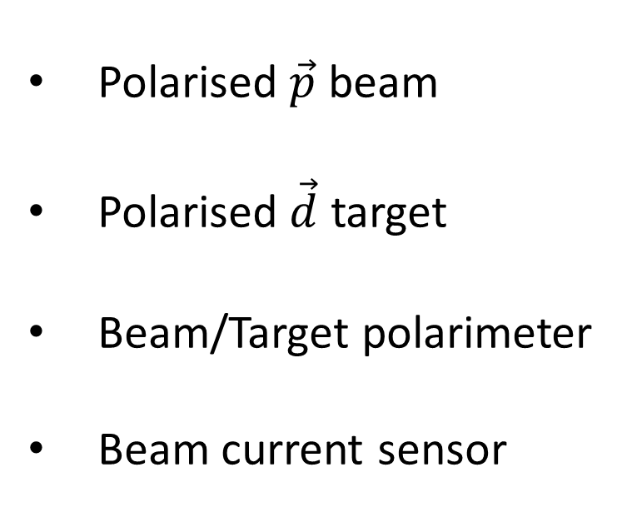
Prerequisites
Polarised $\vec{p}$ beam
Polarised $\vec{d}$ target
Beam/Target polarimeter
Beam current sensor

Slide 10
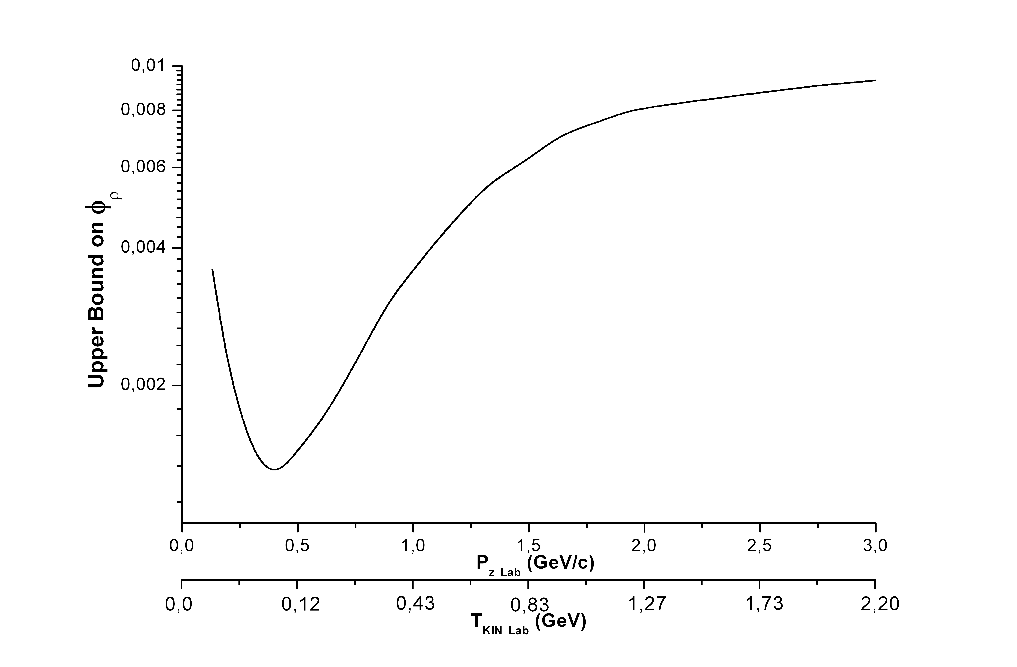
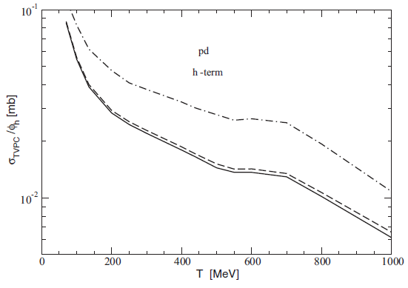
Beam Energy for TRIC
M. Beyer NPA 560 (1993) 895
Yu. Uzikov PRC 92 (2015) 014002
Two independent theoretical calculations suggests to perform TRIC below 200 MeV
COSY injection energy is 45 MeV
COSY 100 kV e-cooler is operational up to 184 MeV
Polarimetry data at 135 MeV is available (PRC 74 (2006) 064003)

Slide 11
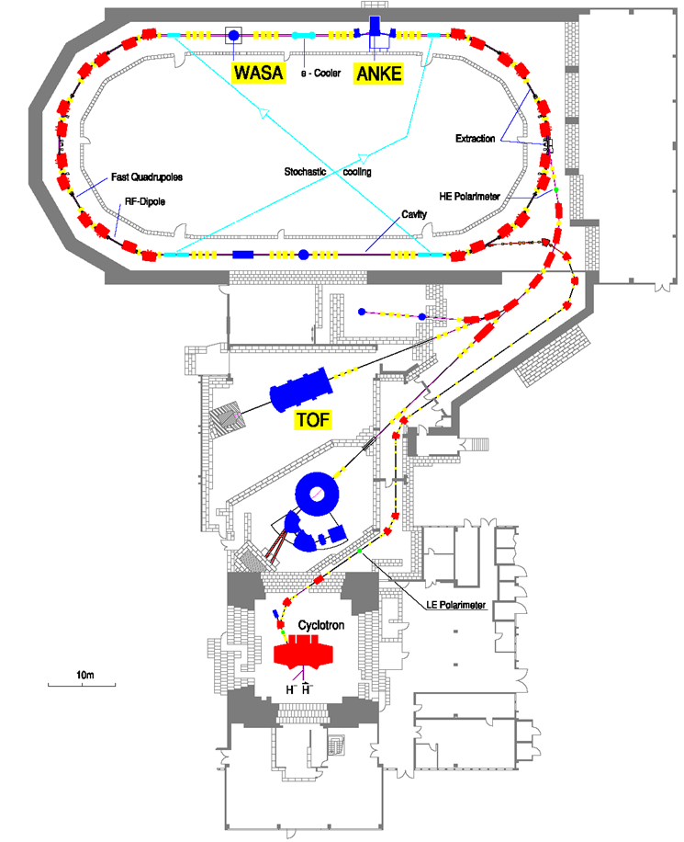
COoler-SYnchrotron COSY-Jülich
Momentum range:
0.045-3.700 GeV/c
Polarised and unpolarised p/d beams
Stochastic and electron cooling
Internal polarised gas targets
Beam and target polarimeters
PAX

Slide 12
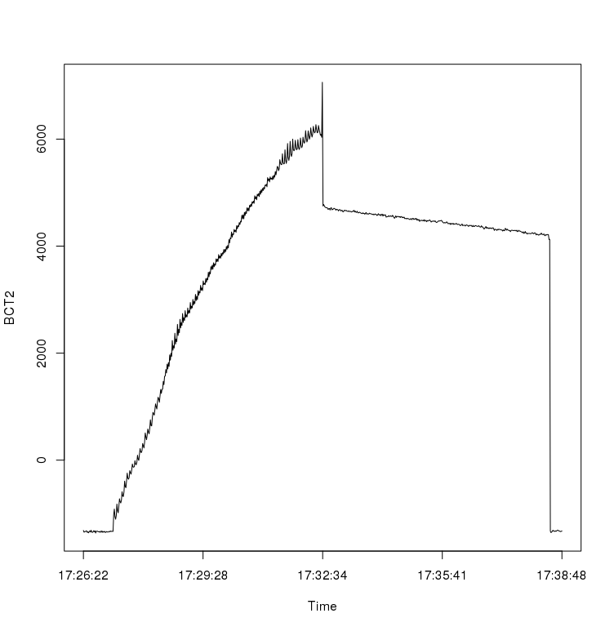
Polarised beam @ COSY
Polarised beam intensity after stacking for: 120 s →1.7×10⁹ 600 s →5.0×10⁹
Polarisation in the ring >50%
Polarisation life time >10000s
Beam life time 5000 s (12000 s in Sep 2012)
30/07/2016
Beam Current
Time
COSY can provide beam for TRIC

Slide 13
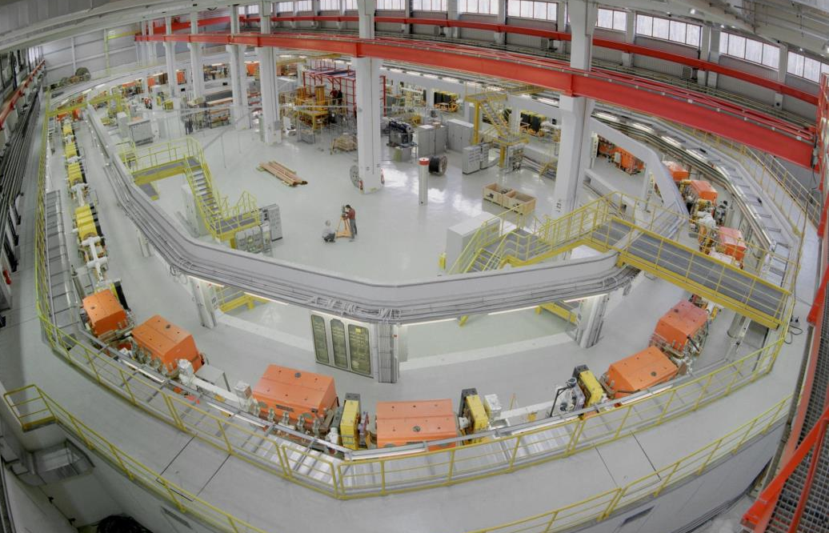
Prerequisites
Polarised $\vec{p}$ beam
Polarised $\vec{d}$ target
Beam/Target polarimeter
Beam current sensor
COSY Storage Ring

Slide 14
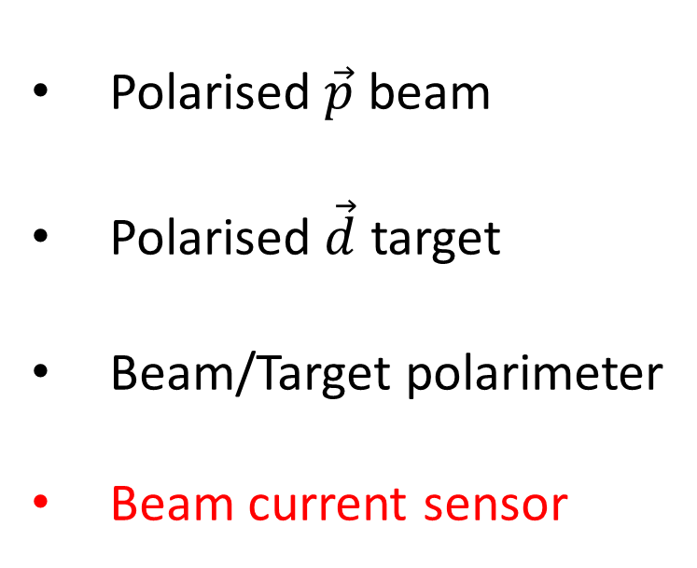
Prerequisites
Polarised $\vec{p}$ beam
Polarised $\vec{d}$ target
Beam/Target polarimeter
Beam current sensor
COSY

Slide 15
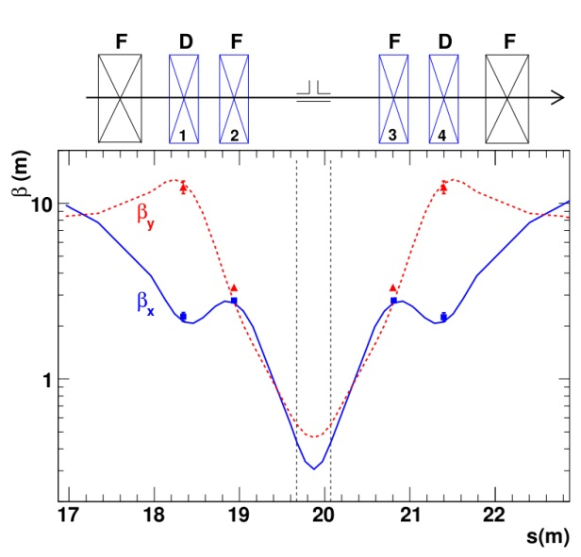
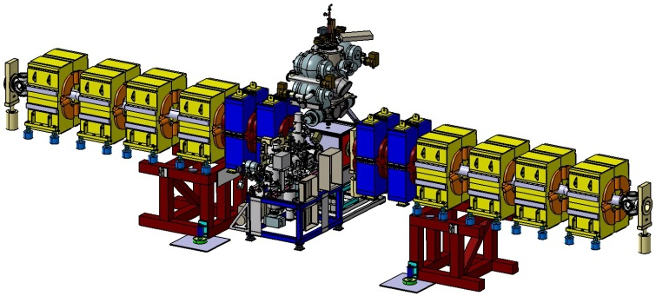
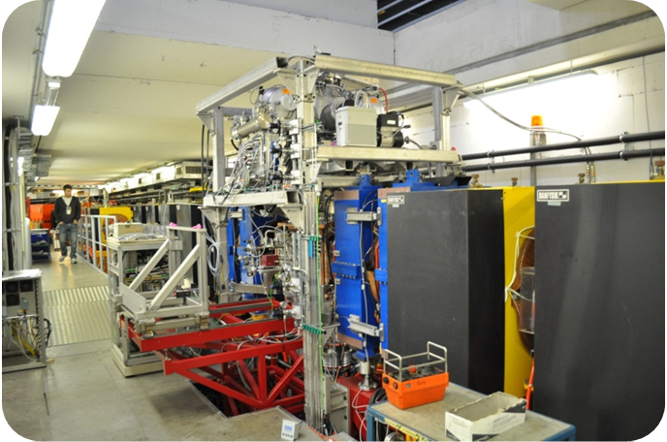
PAX@COSY
Low-β
Quadrupoles
Target
Chamber
The low-𝛽 section allows to use a storage cell of small diameter
The storage cell and detector can be place inside a PAX target chamber
The holding field system allows to control and flip the target polarisation

Slide 16
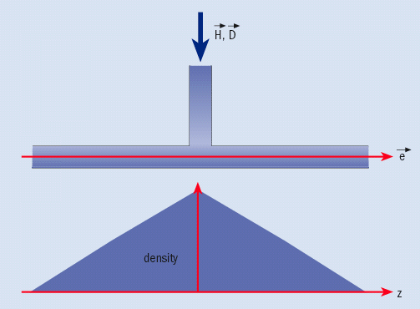
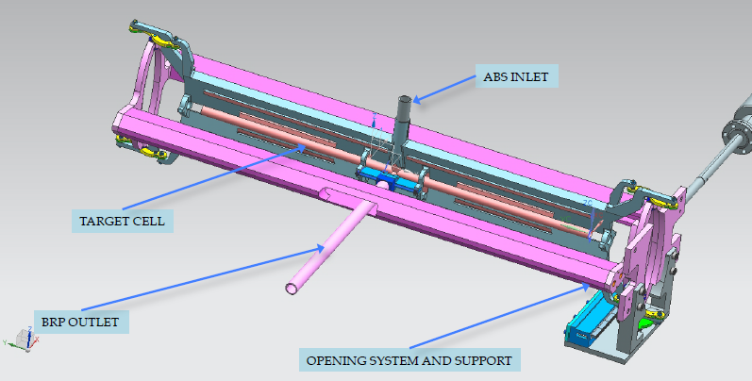
Storage Cell
Closed storage cell
Opennable storage cell
At PAX we have option to installation both types of the storage cells
An opennable storage cell is under the preparation by the Ferrara group (2017)

Slide 17
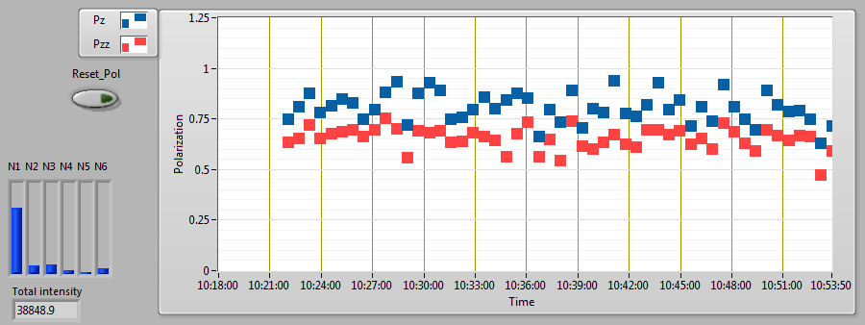
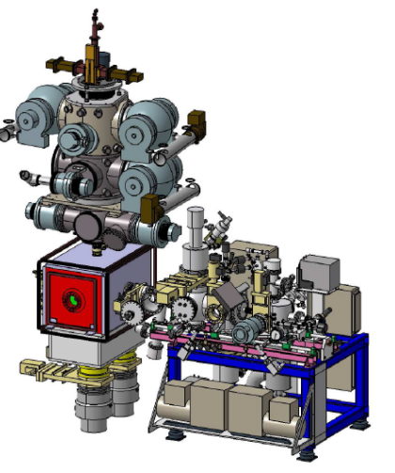
Polarised D Target and Polarimeter
ABS
BRP
During experiment in June 2016 PAX ABS and BRP were commisioned with D gas at COSY
Deuterium Vector and Tensor polarisations more than 75% were measured with BRP
PAX D target is ready for TRIC

Slide 18
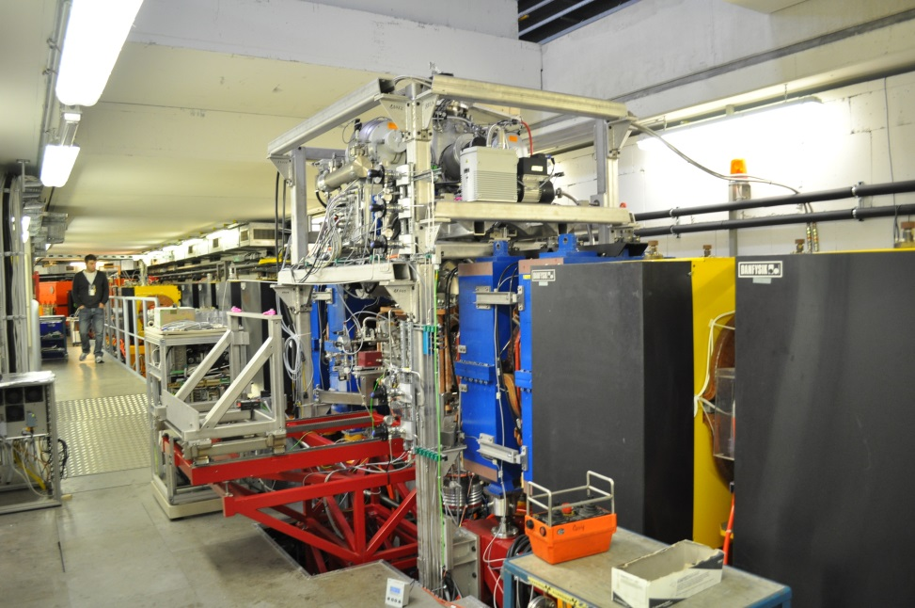
Prerequisites
Polarised $\vec{p}$ beam
Polarised $\vec{d}$ target
Beam/Target polarimeter
Beam current sensor
COSY
PAX target
PAX@COSY

Slide 19

Prerequisites
Polarised $\vec{p}$ beam
Polarised $\vec{d}$ target
Beam/Target polarimeter
Beam current sensor
COSY
PAX target

Slide 20
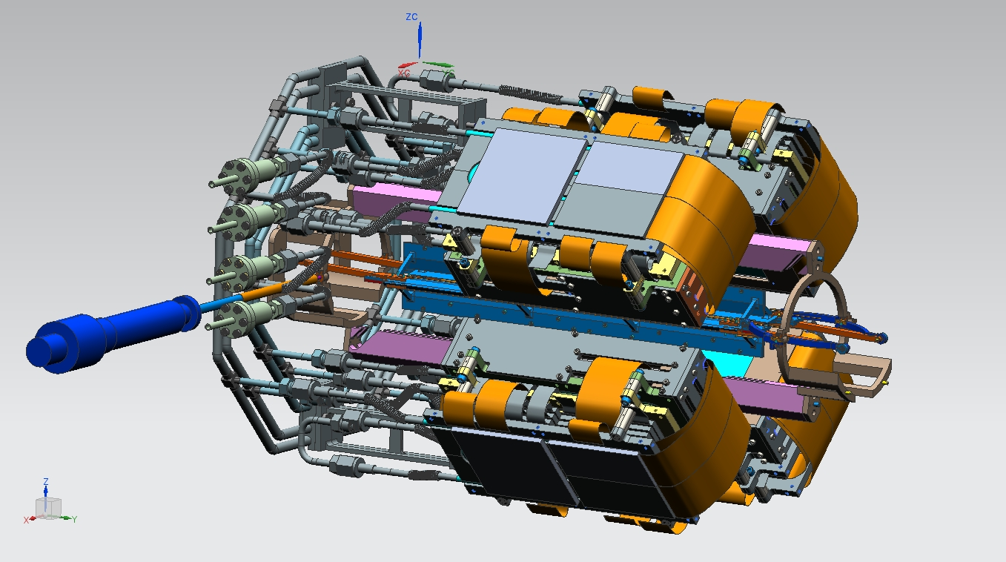
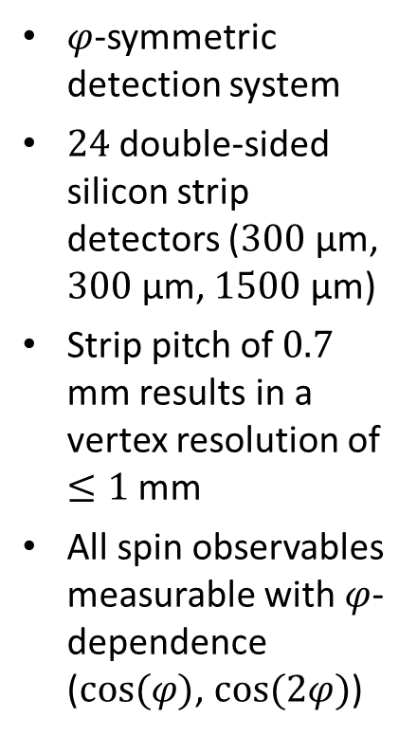
PAX Detector
$φ$-symmetric detection system
$24$double-sided silicon strip detectors ($300$μm, $300$μm, $1500$μm)
Strip pitch of $0.7$ mm results in a vertex resolution of $≤1$mm
All spin observables measurable with $φ$-dependence ($cos⁡(φ)$, $cos⁡(2φ)$)
Setup and commissioning by COSY-PAX collaboration in 2017
Courtesy: PAX detector group

Slide 21
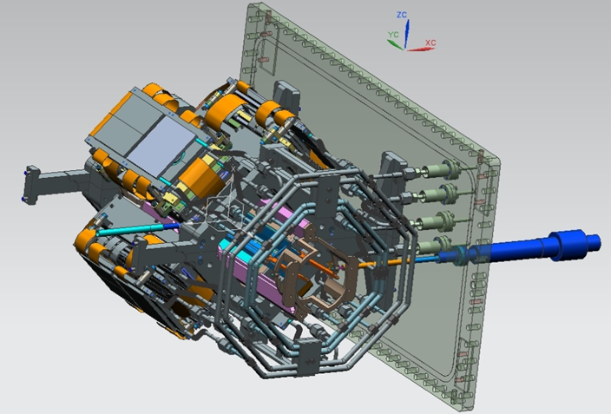
Prerequisites
Polarised $\vec{p}$ beam
Polarised $\vec{d}$ target
Beam/Target polarimeter
Beam current sensor
COSY
PAX target
PAX detector

Slide 22

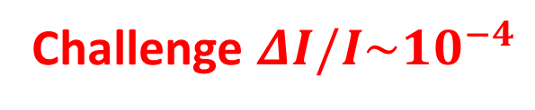
Prerequisites
Polarised $\vec{p}$ beam
Polarised $\vec{d}$ target
Beam/Target polarimeter
Beam current sensor
COSY
PAX target
PAX detector
10 cm
Challenge $ΔI/I\sim {10}^{−4}$

Slide 23
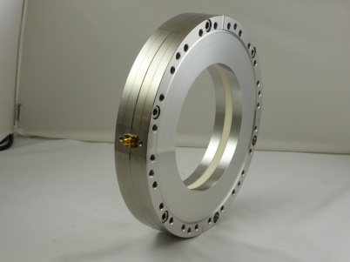
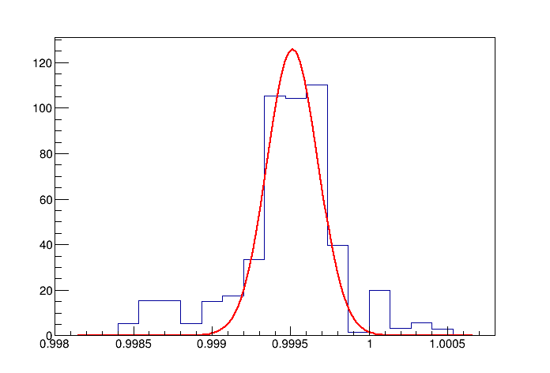
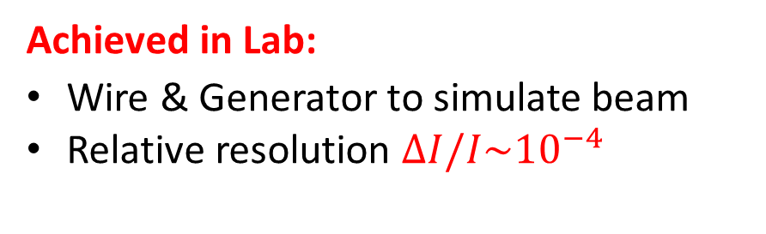

Meeting the Challenge
Fast Current Transformer:
Commercial device (Bergoz)
Sensor for bunched beam
Readout Electronics:
Lock-In-Amplifiers
High resolution ADC
4 cm
4 cm
$$σ=160 nA$$
N [events]
Achieved in Lab:
Wire & Generator to simulate beam
Relative resolution $ΔI/I\sim {10}^{−4}$
Challenge:
Same resolution for stored COSY beam
I_{wire} [mA]

Slide 24
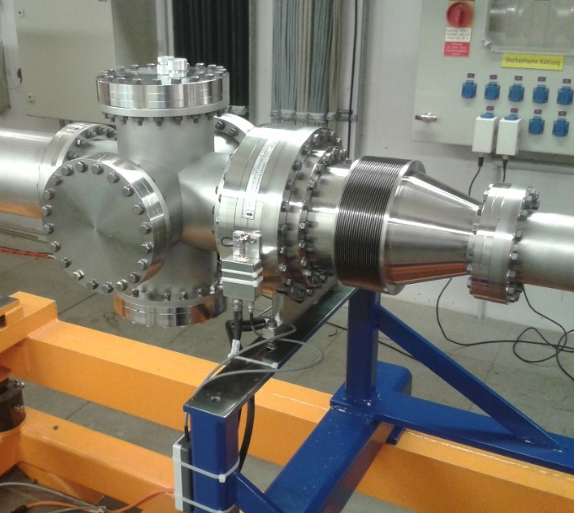
FCT Commisioning @ COSY
FCT Sensetivity
Protons in COSY
FCT & analog readout have been commissioned at COSY in June 2016
With FCT we can detect down to 40000 protons stored in COSY
FCT is ready for TRIC

Slide 25
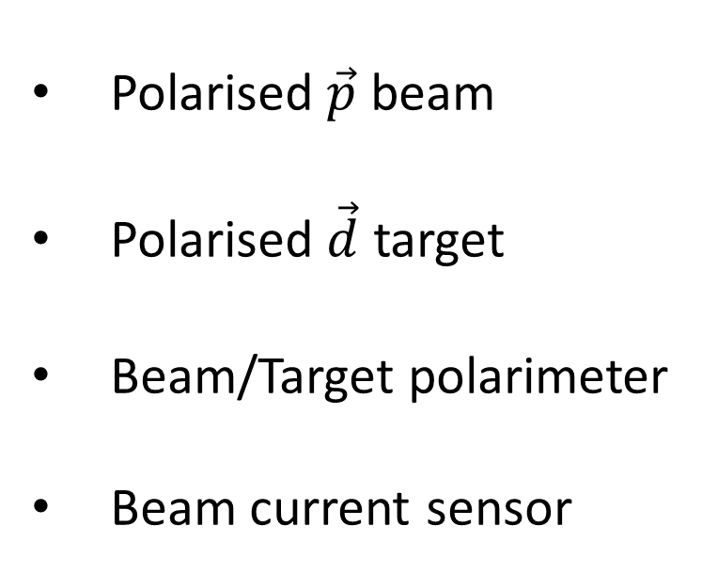
Prerequisites
Polarised $\vec{p}$ beam
Polarised $\vec{d}$ target
Beam/Target polarimeter
Beam current sensor
COSY
PAX target
PAX detector
10 cm
FCT
TRIC is possible at COSY

Slide 26
Summary & Outlook
TRIC is search for physics beyound of SM
TRIC is precision transmission null experiment at COSY
COSY, PAX ABS, PAX BRP, and FCT are ready for the TRIC experiment
Data collected in June 2016 allow to develop TRIC analysis methods
We plan to apply for a new beam time in 2017

Slide 27
Backup slides

Slide 28
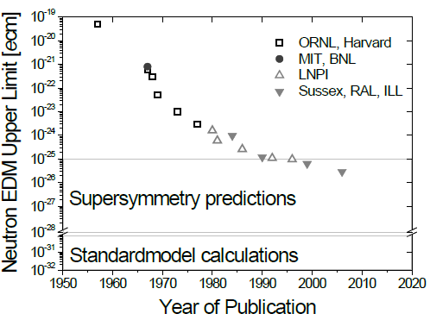

Test of T Symmetry
P
T
C
P
T
T
Complementary
EDM (T-odd, P-odd)
T-symmetry (T-odd)
Only in case
P is conserved:
otherwise, no limit!
Kurylov et al., PRD63 (2001) 076007
Theory
$α_{T}≤$ ${10}^{−15}$

Slide 29

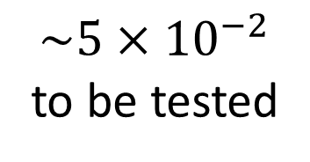

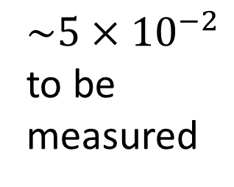

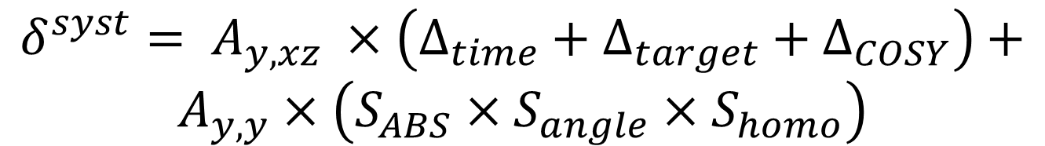
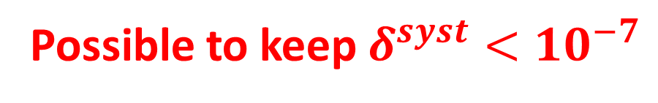
Possible Systematic Uncertainties in TRIC
TRIC Result:
$$A_{y,xz}±σ^{stat}±δ^{syst}$$
Yu. Valdau et al., Journal of Physics: Conference Series 678 (2016) 012027
10⁻⁵
10⁻⁴
10⁻³
10⁻⁴
$$δ^{syst}= A_{y,xz} ×\left(Δ_{time}+Δ_{target}+Δ_{COSY}\right)+$$
$$A_{y,y}×\left(S_{ABS}×S_{angle}×S_{homo}\right)$$
$${\sim 5×10}^{−2}$$
to be measured
$\sim 5×{10}^{−2}$
to be tested
$$\sim {10}^{−2}$$
to be prepared
$$\sim {10}^{−2}$$
to be prepared
Possible to keep $δ^{syst}<{10}^{−7}$

Slide 30
Parametrizing BSM Physics
Considering only flavour conserving CP/T tests (u,d,s quarks)
L=LSM+ α_{TVPV} L_{PVTV} + α_{TVPC} L_{PCTV}
O(1)
O(1)
EDM
O(α_{W})
O(α_{W})
TRIC
β=α_{TVPV}+ζα_{TVPC}
log(γ)
γ=α_{TVPC}+ηα_{TVPV}
TRIC
log(β)
EDM
EDM and TRIC experiments are complementary

Slide 31
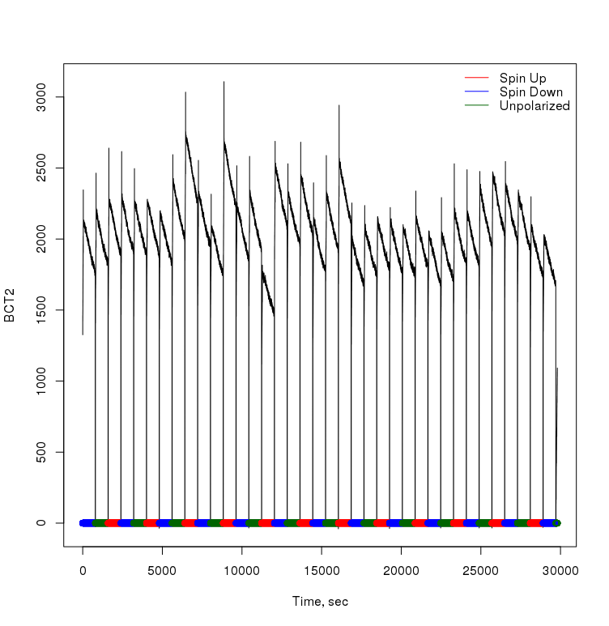
Data collected in June 2016
Night from 30/07/2016 to 1/08/2016
12h of data with polarised beam and target have been collected
We plan develop TRIC analysis methods and extract A_{Y,Y} and σ_{tot} from this data
Analysis is in progress

Slide 32
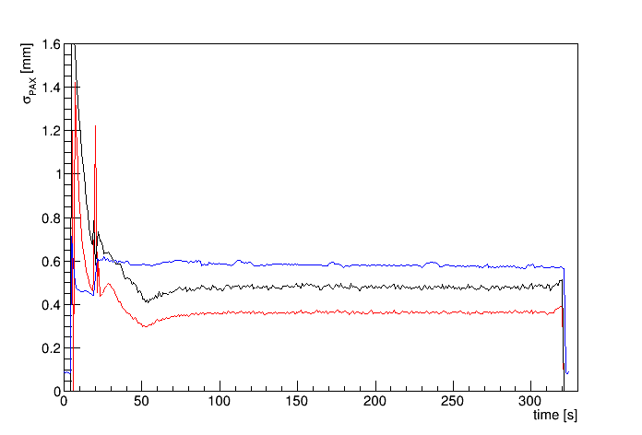
COSY Beam at 135 MeV
Injection
Cooling 180mA
Cooling 210mA
Beam size PAX
Beam current
Width in Y direction
Width in X direction
The COSY beam at the PAX has a diameter ~1.4 mm (σ) at 45 MeV (injection energy)
The COSY beam at PAX has a diameter ~0.6 mm (σ) at 135 MeV
A clossed/opennable storage cell of 10/5 mm diameter can be used

Slide 33
TRIC – direct T symmetry test
Science Case: search for physics beyond SM
Measurement: null observable in $\vec{p}\vec{d}$scattering
Experiment: transmission experiment at storage
ring COSY (FZ-Jülich)
Challenge: precision beam current
measurement
Expected result: improved upper limit by at least
one order of magnitude
Impact: New insight into evolution of the Universe

Slide 34
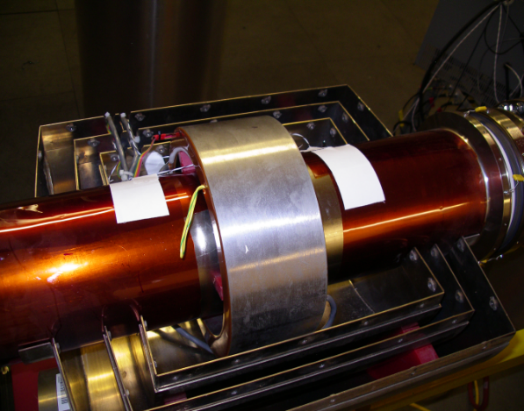
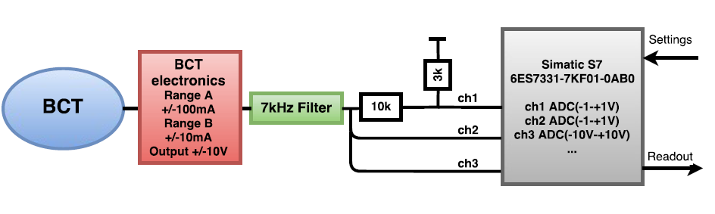
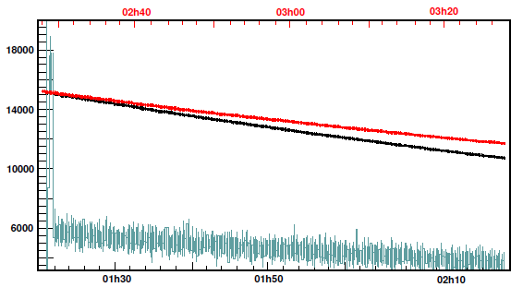
Beam Current Measurement at COSY
Bergoz BCT@COSY
Profibus and WAGO system
Beam current measurements at COSY are done using BCT Bergoz with a maximal accuracy δI/I~10⁻³ (per sec.)
COSY can provide both bunched and unbunched beams
Precision in the bunched beam current measurement can be δI/I~10⁻⁵
Lifetime measurement at 135 MeV
N [protons]
τ≈11000 s
τ≈8000 s
time [s]
We bring the new sensor for a bunched beam to COSY

Slide 35
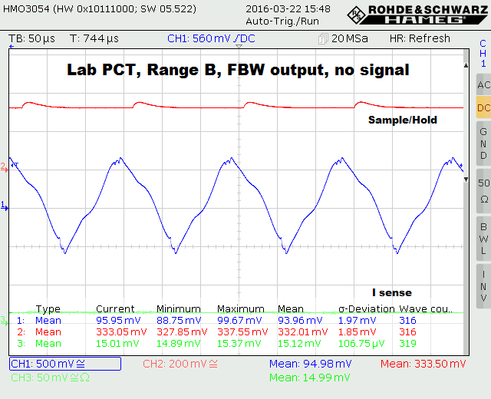
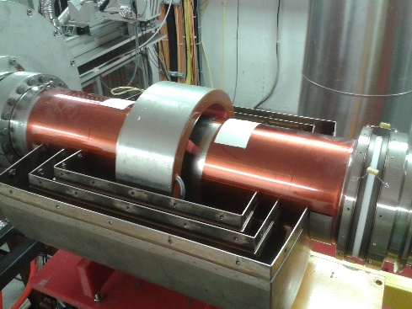
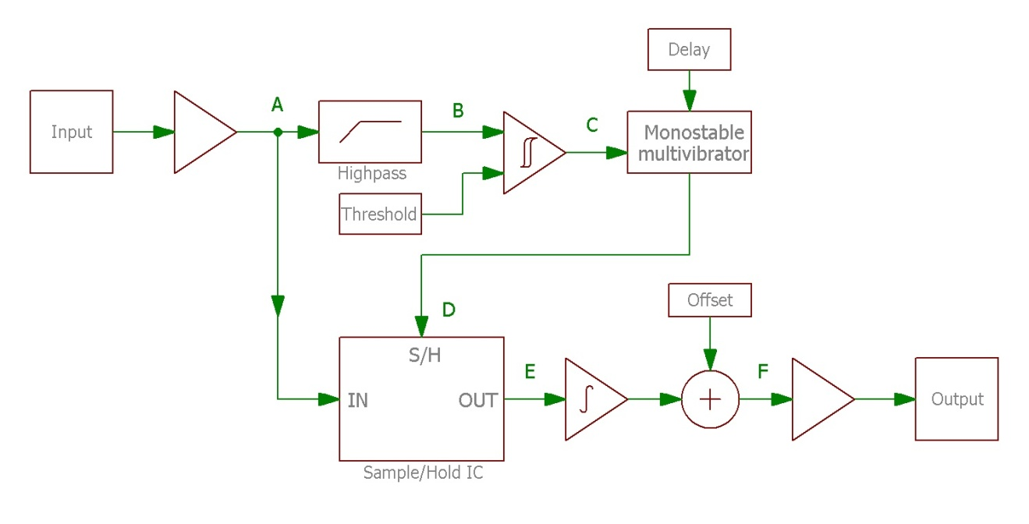
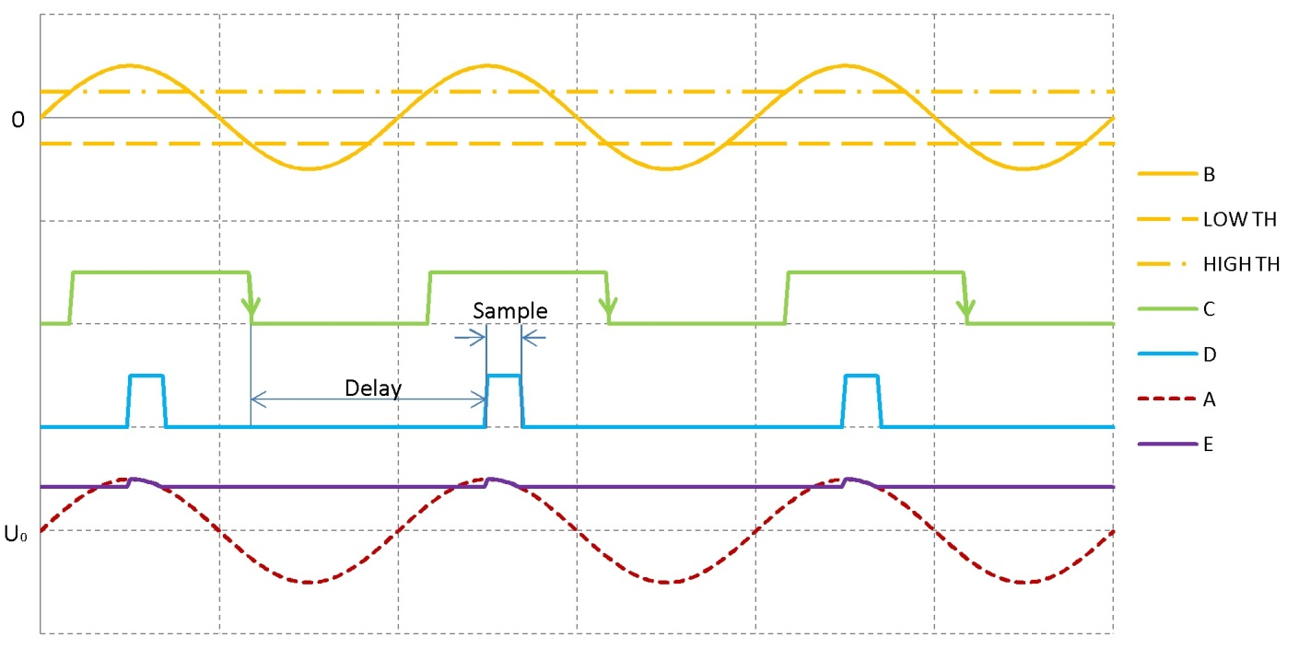
Upgrade for BCT readout
The new sample and hold system allows to reduce initial fluctations by a factor 3-5
Beam current and BCT temperature are readout via the Ethernet
A common BCT/FCT calibration scheme for the bunched beam is prepared
Master thesis L. Eltcov

Slide 36
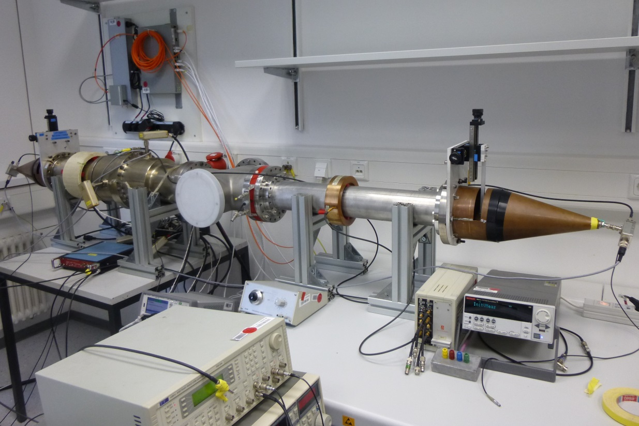
Test Stand for Beam Current Measurement Sensors
In the test stand:
Accelerator beam is simulated using a pulse generator and a conductive wire
The wire position can be changed using precision XY tables
Various beam diagnostic devices are available (BCT, BPM, FCT, and …)
Parameters:
Wire diameter 50μm
Wire movement range ±8 cm
Wire movement step 10μm
Wire position hor. 100μm
Wire position vert. 92μm
Sender
Receiver
Master thesis: S. Kirfel

Slide 37
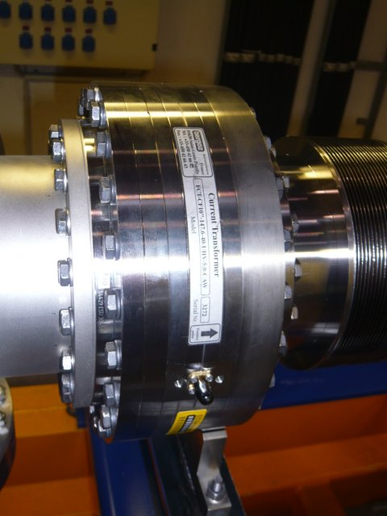
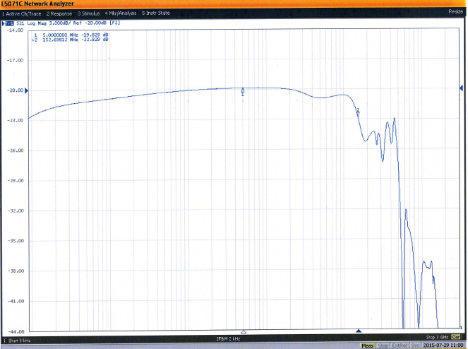

FCT for COSY
4 cm
Two on flange FCTs have been produced for COSY by the Bergoz company
One FCT is installed at COSY
On flange construction is:
  UHV compatible
  Includes a calibration winding
  Includes a ceramic beam pipe break

Slide 38




Readout&Calibration of FCT
COSY bunches 6/5/2016
Consist of a custom build: preamplifier, currents source, calibration module; and commercial Lock-In-Amplifier SR844
Is controlled and readout via the Ethernet
Accepts trigger signal and COSY RF signals to produce a calibration impulse of defined amplitude
COSY bunches 6/5/2016
Master thesis L. Eltcov

Slide 39


FCT Readout
Analog electronics: S. Mikitychyants, L. Eltcov, D. Eversheim
DAQ: S. Trusov
Analysis: Yu. Valdau, A. Aksentyev

Slide 40

DAQ
Easy to integrate into any DAQ for COSY experiments
Allows to readout commercial devices with Ethernet support (LXI support)
Data with UNIX time stamp can be stored in text or binary file
DAQ allows also to setup devices over the network
Devices with COM interface readout via Perle boxes over the Ethernet
Analysis software in ROOT
DAQ codes developed by: S. Trusov

Slide 41



FCT Test in Laboratory
ΔI/I~10⁻⁴
~1mA
Lock-In-Amplifier
From first studies:
Averaged current of 1 mA in the test stand can be measured using a FCT and Lock-In-Amplifier with a resolution better than 2x10⁻⁴
An identical FCT is installed at COSY
DAQ
FCT
Generator
Integrator&Voltmeter
Signal: Gauss, 1 MHz, V 0.1-1.5V

Slide 42

T Symmetry Violation in SM
T violation:
discovered in K⁰ by CP LEAR (PLB 444, 43 (1998))
discovered in B⁰ by BABAR (PRL 109, 211801 (2012))
experiment at DAPHNE is under discussion
http://www.economist.com/node/21561111
$𝓛=$ $−\frac{1}{4}{×F}_{μν}F^{μν}+i\overline{Ψ}DΨ+\overline{Ψ}{iY}_{ij}Ψ_{j}φ+h.c. +{\left|D_{μ}φ\right|}^{2}−V\left(φ\right)−Θ{×F}_{μν}F^{μν}$
All discovered effects are implemented in to the SM
New effects are needed to explain the Baryon Assymetry of the Universe

