Slide 1
– Trends and Perspectives –
Outline
The Intention of this Lecture
Analog: Amplifiers, OpAmps, Analog Computers
Example of a Feedback System
Digital: Logic Circuits, µP, PLCs, DSPs, FPGAs, ASICs
Analysis Layer
Complexity Layer
Summary
→ …hiskp.uni-bonn.de → lectures → archive
Electronics for Physicists (in SS)
Advanced Electronics and Signal Processing (in WS)

Slide 2
– The Intention of this Lecture –
− Introduce principal, basic hardware and analysis concepts
− Understand that a given problem has not only hardware aspects
− There are more “Layers” to be considered:
Hardware
Analysis/Synthesis
Complexity

Slide 3
– Analog: Amplifiers, OpAmps, Analog Computers –
How everything begun
1904 Vacuum Diode (John Ambrose Flemming)
1930 DifferentialAmplifier (Bell Labs, Harold S.
Black, Harry Nyquist, Hendrik Wade Bode)
1952 K2-W, First OpAmp
(George A. Philbrik Researches)
1877 Bell Patent for Telephone
1912 First Vacuum Tube Amplifier
1906 Triode (Lee de Forest)
1885 AT & T
1958 FF, 2 Transistor IC,
(Jack Kilby)
1916 Mechanic Tide Computer
1936 Z1, Relay Calculator (Zuse)
1952 Semiconductor Amplifier (5
Transistor IC Werner Jacobi)
1580 Astronomic Clock, Heilbronn
1946 ENIAC, 18.000 Tubes until 1955
1948 Point Transistor (Bardeen, Brattain)

Slide 4
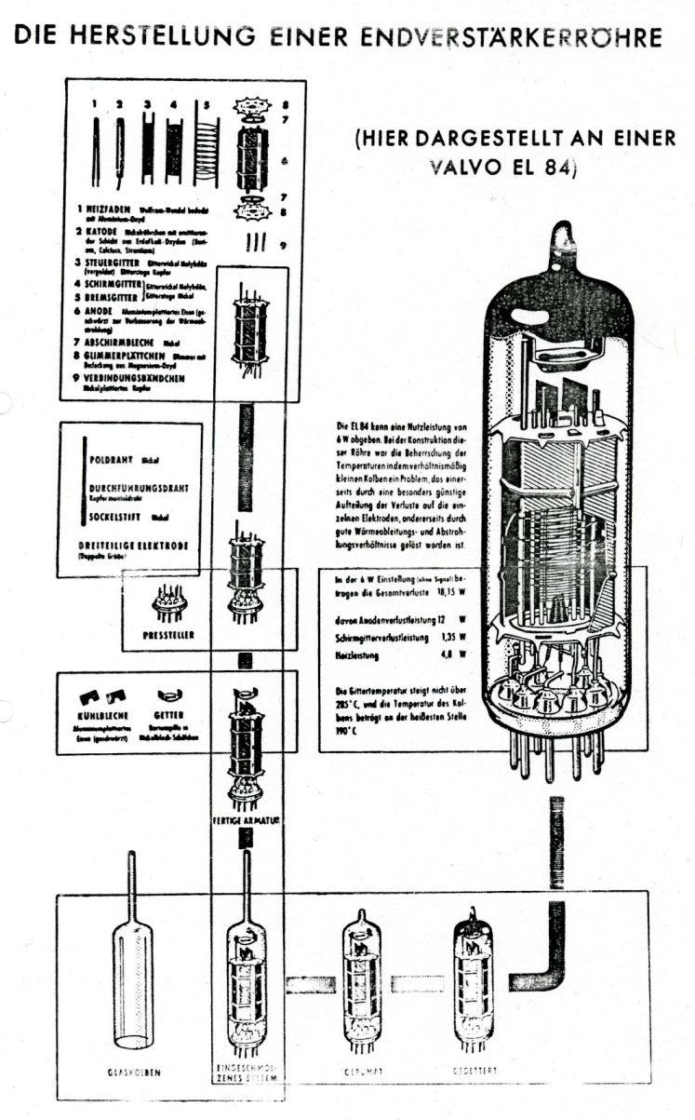
– Analog: Amplifiers, OpAmps, Analog Computers –
EL84
K2-W (1952, First OpAmP)

Slide 5
– Analog: Amplifiers, OpAmps, Analog Computers –
Effect of a Negative Fedback Loop
(Experimental Finding)
A
A
ν
ν
ν
A → ∞
ν
−
ν
A
ν
ν

Slide 6
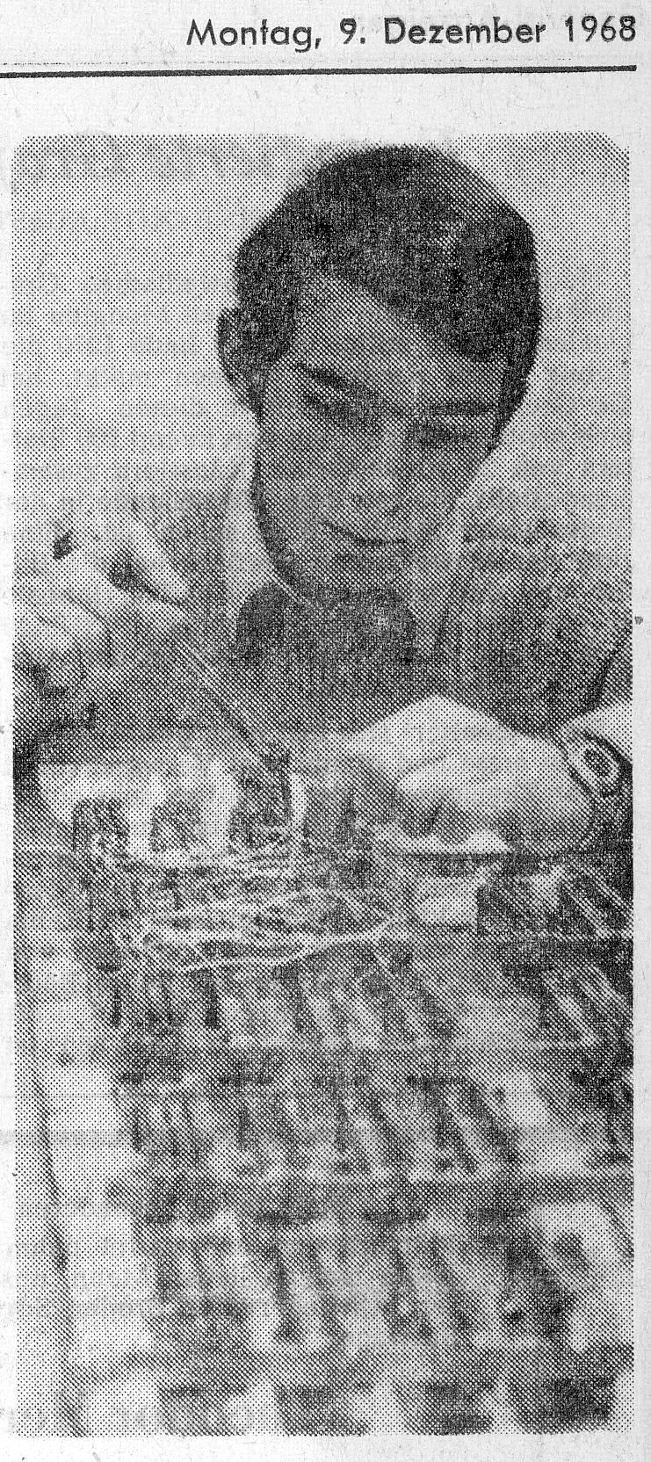
– Analog: Amplifiers, OpAmps, Analog Computers –
Working on a binary Adder/Subtractor with a FF as Memory
+
Flip
Flop
C
Positive Feedback
C

Slide 7
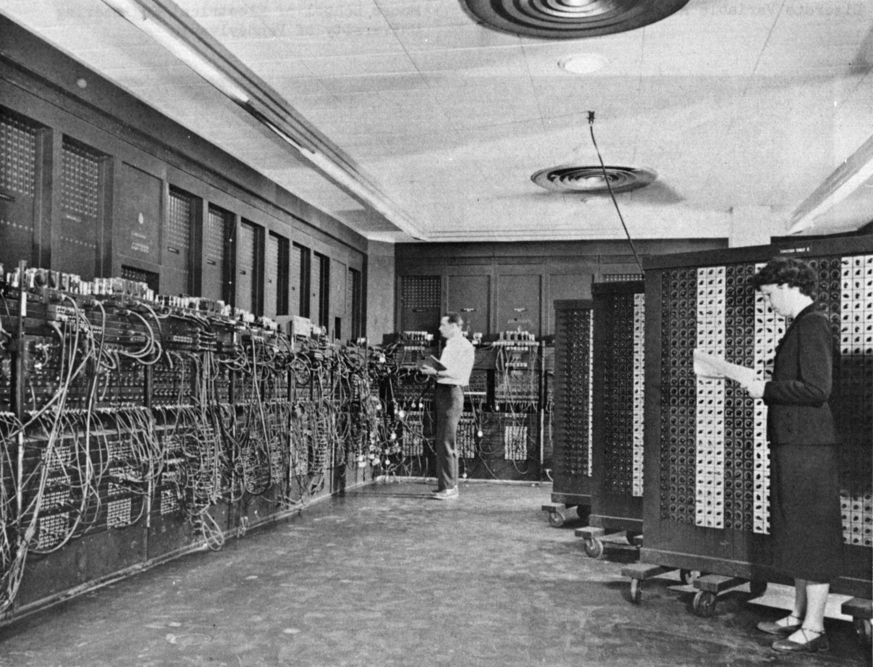
– Analog: Amplifiers, OpAmps, Analog Computers –
Electronic Numerical Integrator And Computer
18 000 Vacuum tubes
70 000 Resistors
10 000 Capacitors
174 KW Power
30 t Weight
100 KHz Clock
0,2 ms per Addition
2,8 ms per Multiplication
The computer was
programmed by
these switchboards.

Slide 8
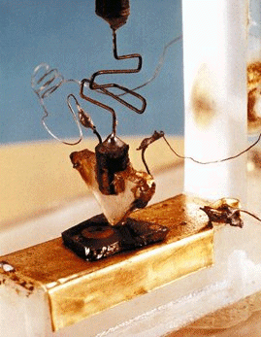
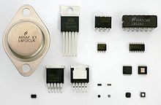
– Analog: Amplifiers, OpAmps, Analog Computers –
Discrete OpAmp
Modern OpAmp Packages
First point-contact transistor realized by
J.Bardeen, W.H.Brattain & W.B.Shockley (Bell Telephone Laboratories).
With the help of OpAmps (Gain stages) the circuit behaviour is determined by externnal components (R, C, L . . .) only.

Slide 9
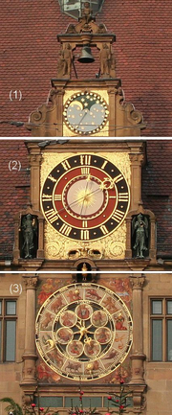
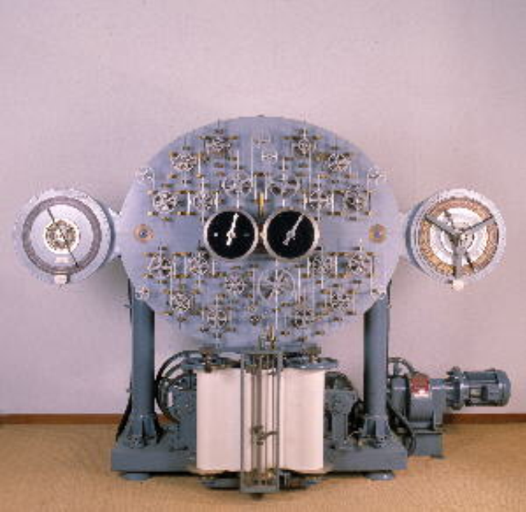
– Analog: Amplifiers, OpAmps, Analog Computers –
Astronomic Clock
(1580, Heilbronn)
Tide Computer (1916)

Slide 10
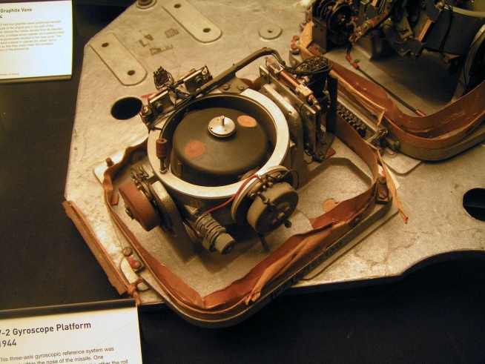
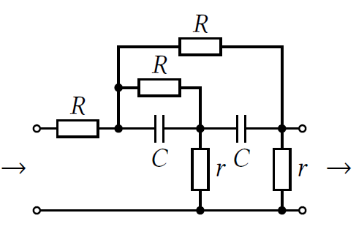
– Analog: Amplifiers, OpAmps, Analog Computers –
The Need For Analog Computers (Accuracy 10⁻² − 10⁻⁴)
V2 Gyro (~7000 US$)
Angular speed and acceleration circuit
(~2.5 US$)
U_{in}
U_{out}

Slide 11
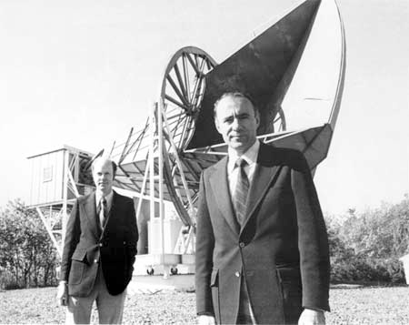
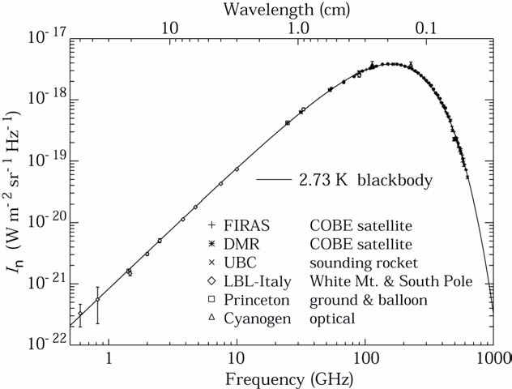
– Analog: Amplifiers, OpAmps, Analog Computers –
R.W. Wilson & A.A. Penzias in front of their
microwave antenna, Nobelprize 1978
Background radiation spectrum

Slide 12
– Analog: Amplifiers, OpAmps, Analog Computers –
10 000
1000
100
10
1
Semiconductor diode mixer
1,38·10⁻¹⁸
1,38·10⁻¹⁹
1,38·10⁻²⁰
1,38·10⁻²¹
1,38·10⁻²²
Vacuum-
Triodes
Bipolar
Transistor
Tunnel-
Diodes
not cooled
cooled
77°K
HEMT
Transistor
Varactor-
Diodes
cooled
20°K
Atmospheric noise
Vertical incidence
Maser
Min.
Max.
Galactic noise
0 1 10 100

Slide 13
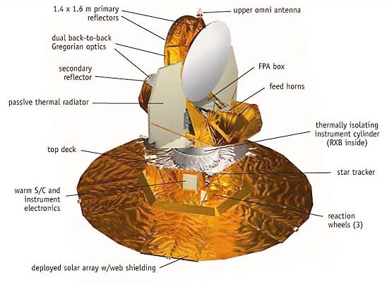
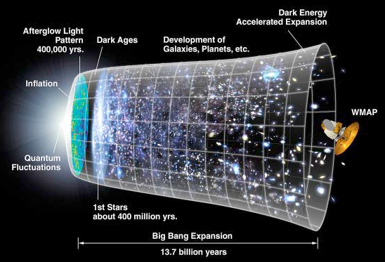
– Analog: Amplifiers, OpAmps, Analog Computers –
WMAP: Wilkinson Microwave Anisotropy Probe

Slide 14
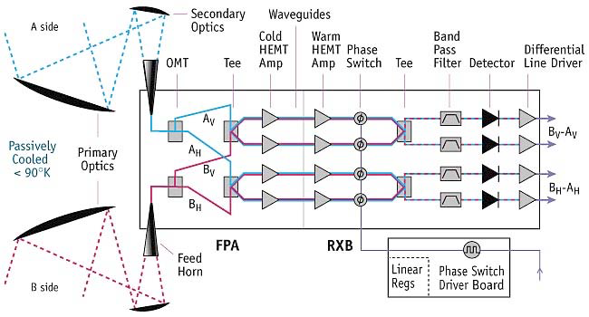
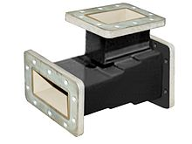
– Analog: Amplifiers, OpAmps, Analog Computers –
OMT: Orthomode Transducer
Splits circular polarized waves in horizontally-
and vertically polarized waves
HEMT: High Electron Mobility Transistor
Special JFET Transistor on ALGaAs/GaAs Heterostructur

Slide 15
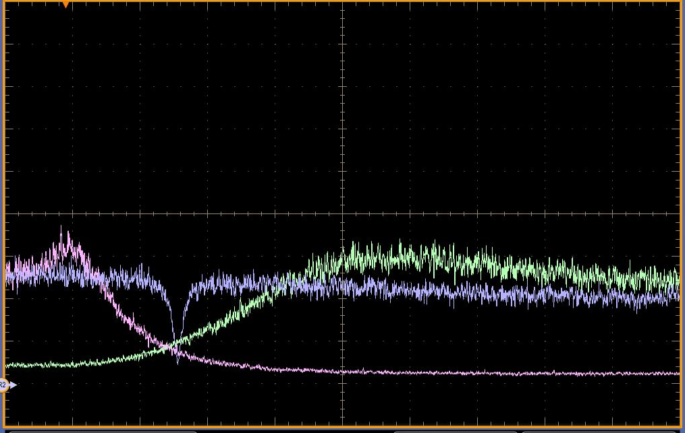
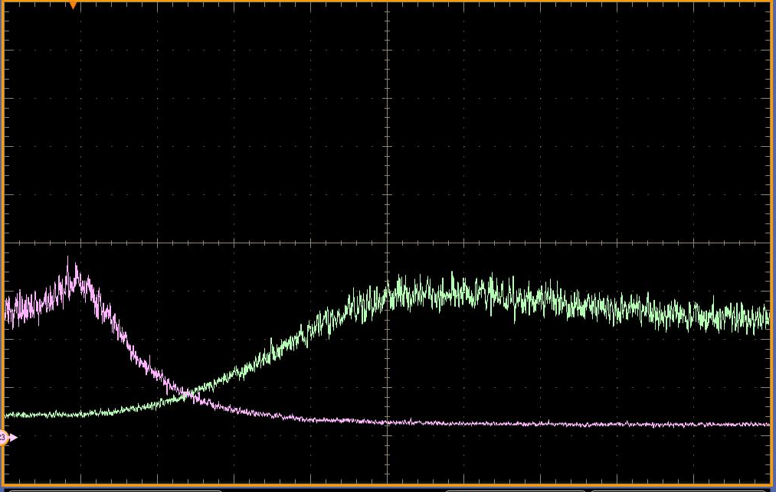
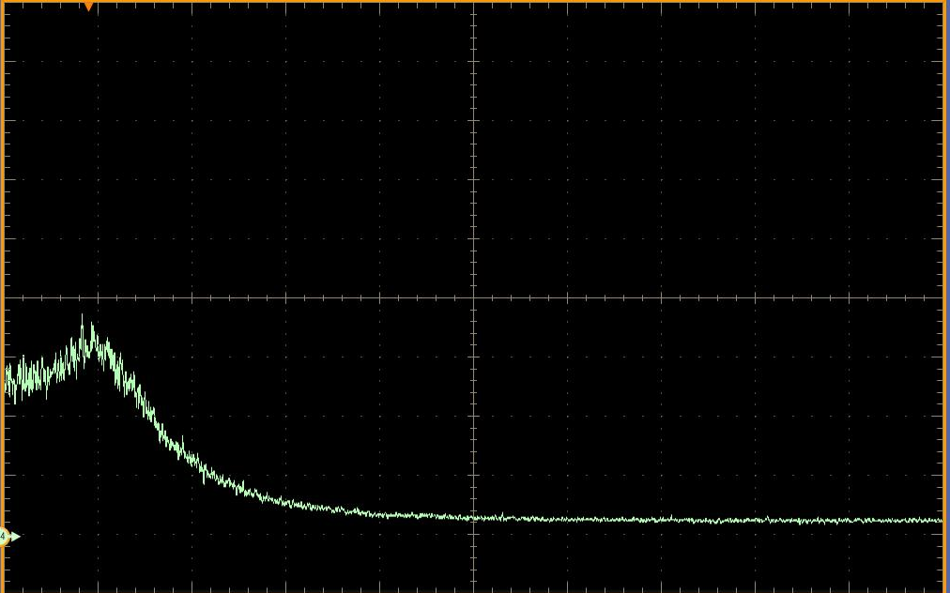
– Example of a Feedback System –
ν
ν
Filter
A
ν

Slide 16
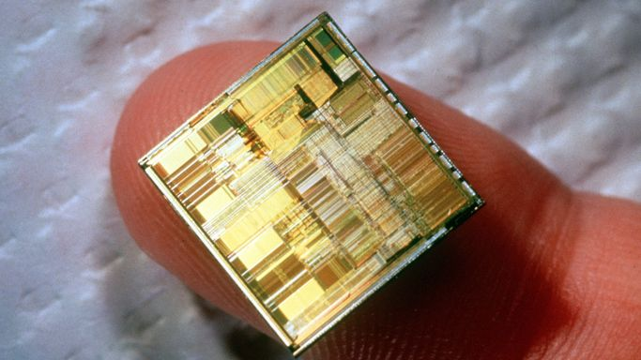
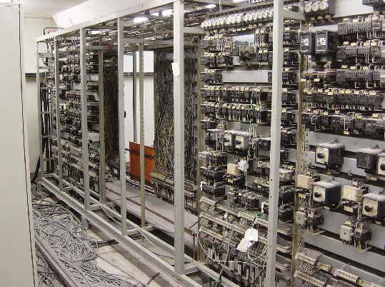
– Digital: Logic Circuits, µP, PLC, DSP, FPGA, ASICS –
Contactor/Relay Machine Control
Modern µP on a Fingertip
What is a processor anyway ?

Slide 17
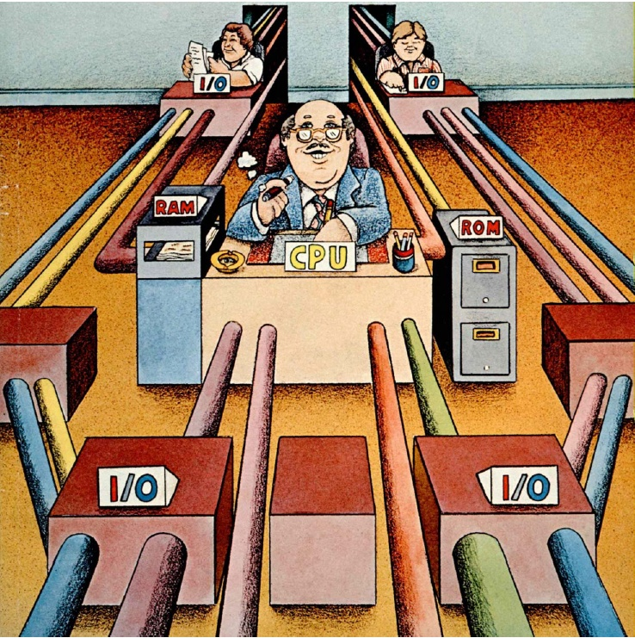
– Digital: Logic Circuits, µP, PLC, DSP, FPGA, ASICS –

Slide 18
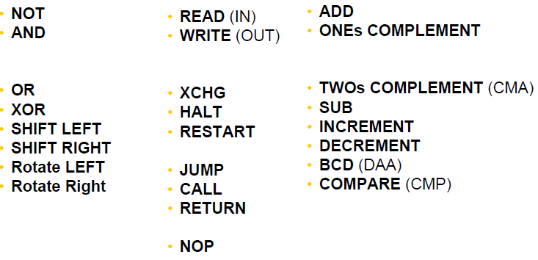
– Digital: Logic Circuits, µP, PLC, DSP, FPGA, ASICS –
Statements:
Logic Organization Arithmetic
Minimal Instruction Set
Restrict calculations to the 4 fundamental arithmetic operations

Slide 19
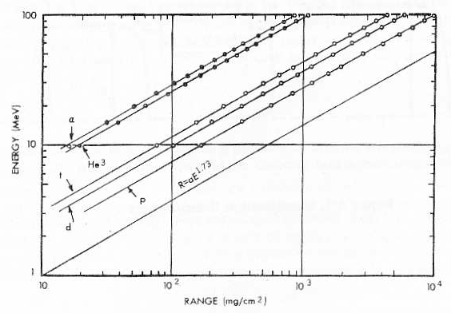
– Digital: Logic Circuits, µP, PLC, DSP, FPGA, ASICS –
The Goulding Particle Identification Method
This equation identifies particles via Z²M since Δx is constant (Energy range ≈ 5→200 MeV)
Energy in MeV
Range in Silicon in mg/cm²

Slide 20
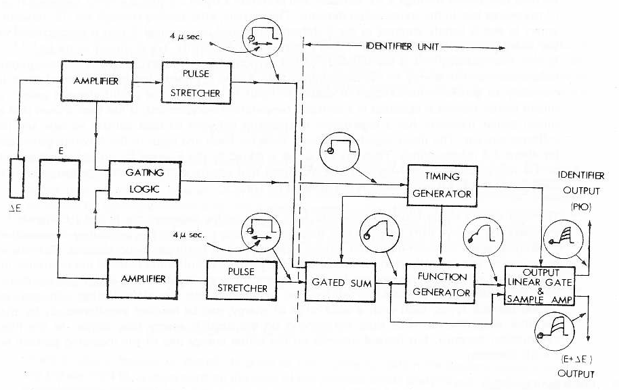
– Digital: Logic Circuits, µP, PLC, DSP, FPGA, ASICS –
Goulding Particle Identification Circuit
PA
E
TSCA
Universal
Coincidence
Gate
TSCA
PA
E
TP10
4 µs

Slide 21
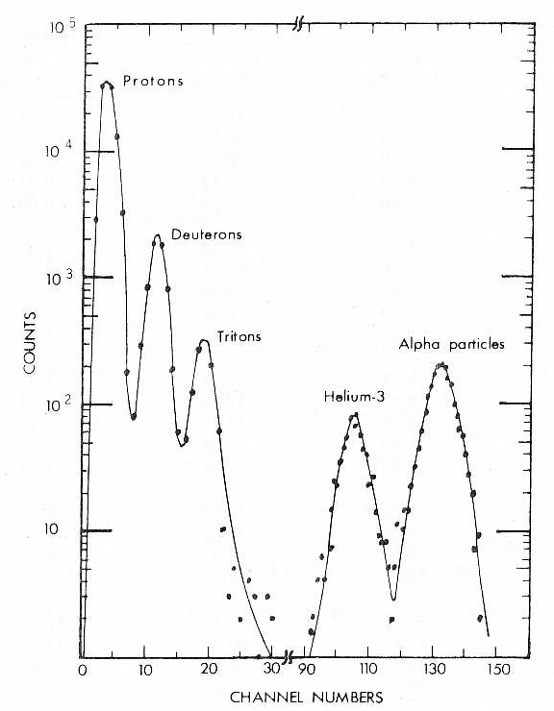
– Digital: Logic Circuits, µP, PLC, DSP, FPGA, ASICS –
Results
54 MeV α on ¹²C
α
³He
PI-Output
t
d
p
MCA Display of the PI-Output
E+E

Slide 22
– Digital: Logic Circuits, µP, PLC, DSP, FPGA, ASICS –
Execution time for: ?
- Read/Write 3 clock-cycles
- Add (Floating Point: FP) 100 clock-cycles (about)
- Multiplication (FP) 150 clock-cycles (about)
- Exponential 4000 clock-cycles (about)
- Ln 5000 clock-cycles (about)
- Power 10000 clock-cycles (about)
~ 20 000 clock-cycles @ 0.25ns each: 5µs (without ADC convertion time)
Even a 45 year old analog solution can compete with digital calculations.

Slide 23
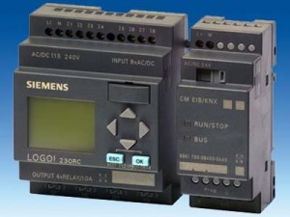
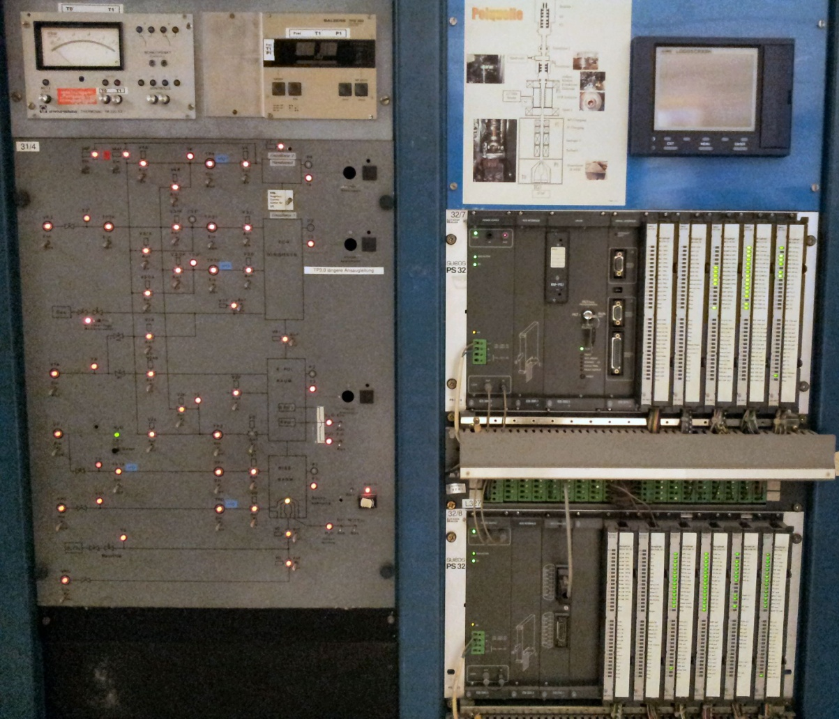
– Digital: Logic Circuits, µP, PLC, DSP, FPGA, ASICS –
PLC Control for the Vacuum Interlock of an Ion Source for Polarized Particles
PLC

Slide 24
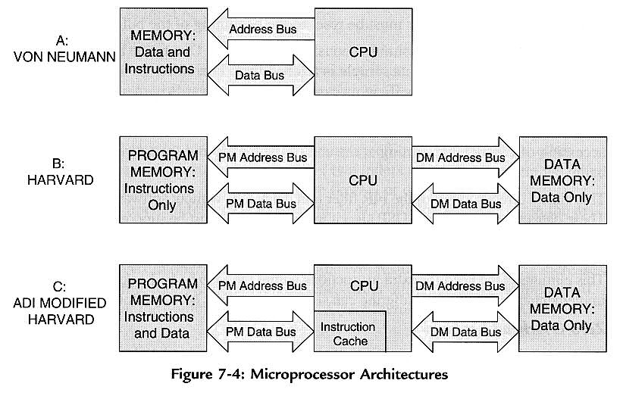
– Digital: Logic Circuits, µP, PLC, DSP, FPGA, ASICS –
Digital Signal Processors (DSP) are optimized for fast repetitive mathematics and for real-time processing.
The most fundamental mathematics operation in DSP is the sum of products (FIR, IIR, FFT, Convolutions)
Fast arithmetic, extended precision (40 bit), dual operand fetch (Harvard
architecture), circular buffering, and zero overhead looping (hardware)

Slide 25
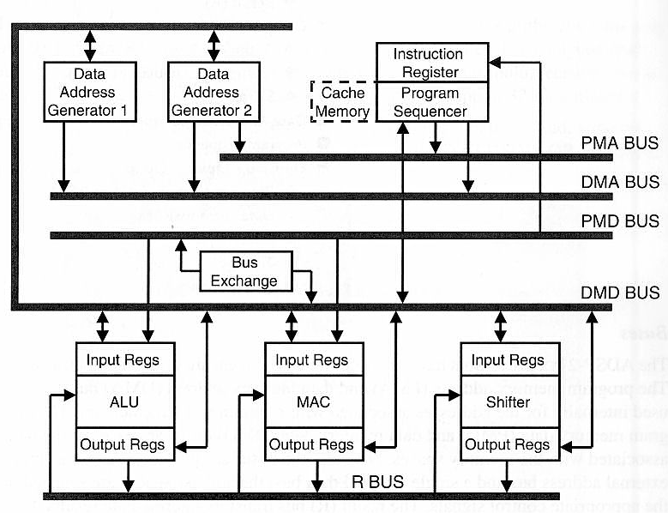
– Digital: Logic Circuits, µP, PLC, DSP, FPGA, ASICS –
DSP (Harvard) Core Architecture
Program Memory Address Bus
Data Memory Address Bus
Program Memory Data Bus
Data Memory Data Bus
ALU – Arithmetic Logic Unit
MAC – Multiply Accumulator

Slide 26
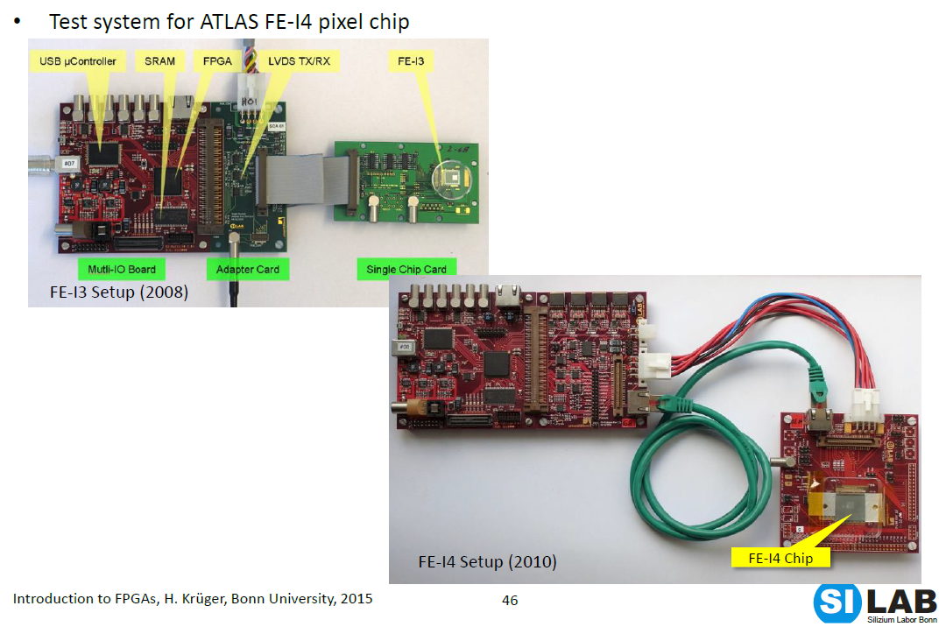
– Digital: Logic Circuits, µP, PLC, DSP, FPGA, ASICS –

Slide 27
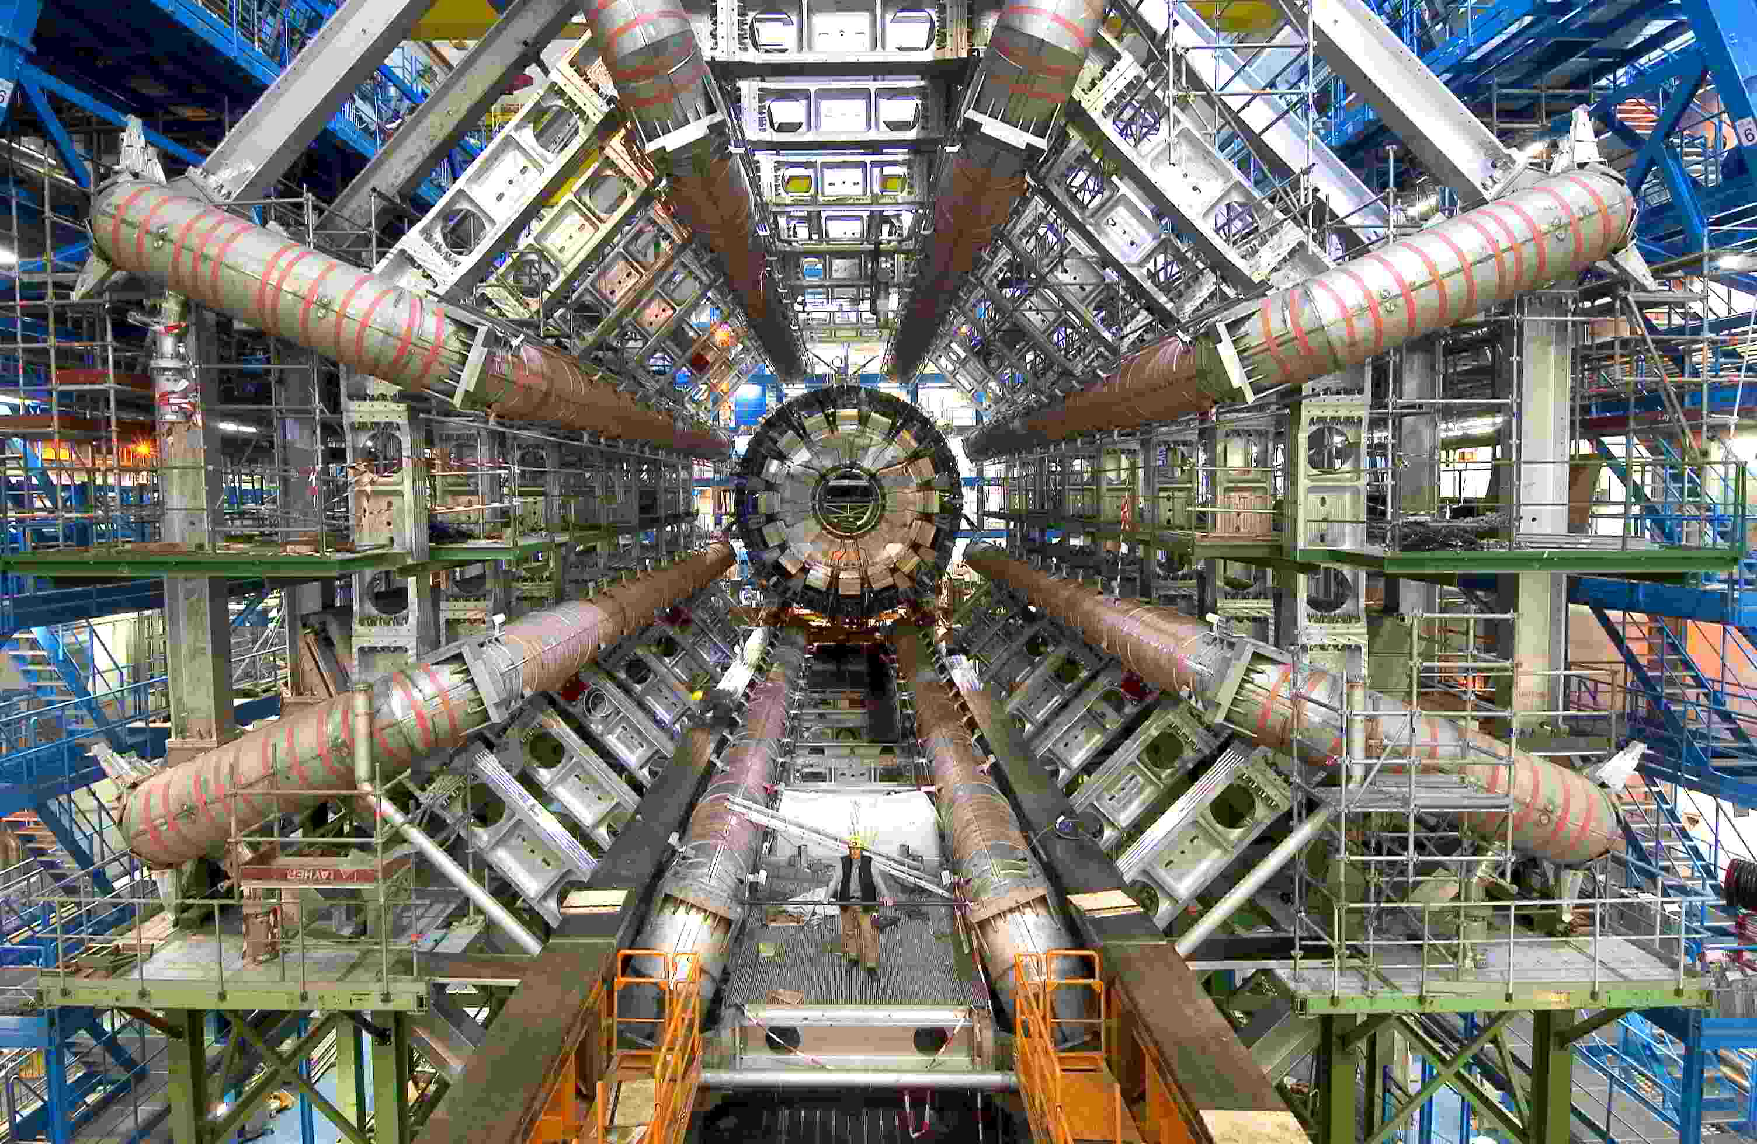
– Digital: Logic Circuits, µP, PLC, DSP, FPGA, ASICS –

Slide 28
– Digital: Logic Circuits, µP, PLC, DSP, FPGA, ASICS –
Tasks of Digitized Front-End:
Shapes signals (reduce noise)
Amplifies signal
First level trigger (Discriminator)
Provides timing signal
Provides time stamp
Suppresses Zeros
Necessary for Digitized Front-End:
Fast Analogue → Digital Converter
Real Time (Kernel) operating system
Special (Harvard) processor architecture, that allows
summing & multiplication within 1 clock cycle with:
– Digital Signal Processor Slices
– Gigabit Transceivers
– Dual ported memory
– Ring buffers
Calculations utilize special Laplace Transform:
z-Transform:
For a stable system → Poles inside unit circle

Slide 29
– Digital: Logic Circuits, µP, PLC, DSP, FPGA, ASICS –
Hardware Realization
ASIC
Application Specific
Integrated Circuit
FPGA
Field Programmable
Gate Array

Slide 30
– Digital: Logic Circuits, µP, PLC, DSP, FPGA, ASICS –
Analog
Digital
Low Noise Amplifiers
Logic
Pos. Feedback
OpAmps
FF, µP
Neg. Feedback
Analog Computers
Filters
PLC, PC, DSP
ADC
DAC
FPGA
ASIC

Slide 31
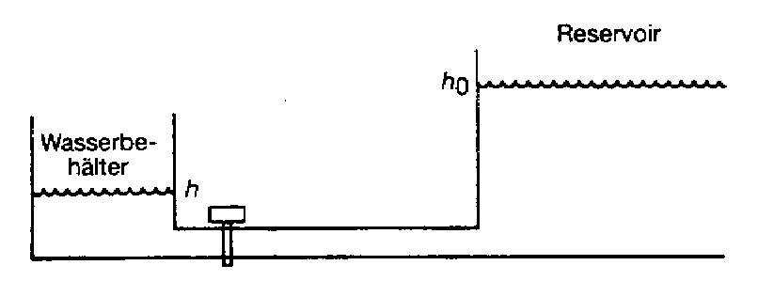
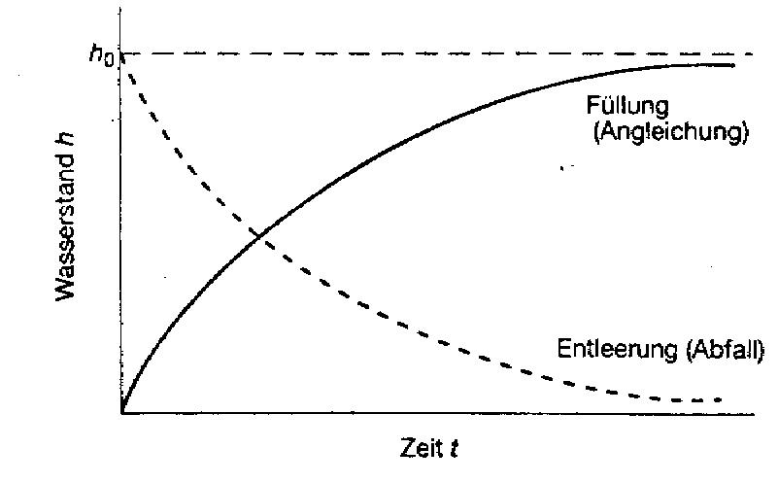
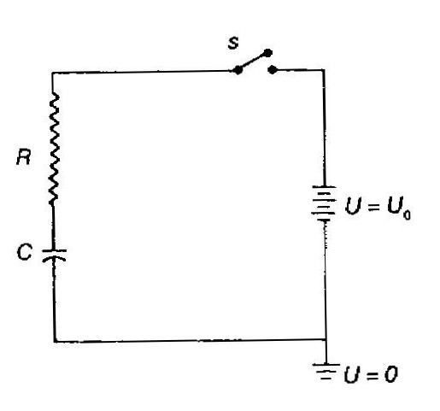
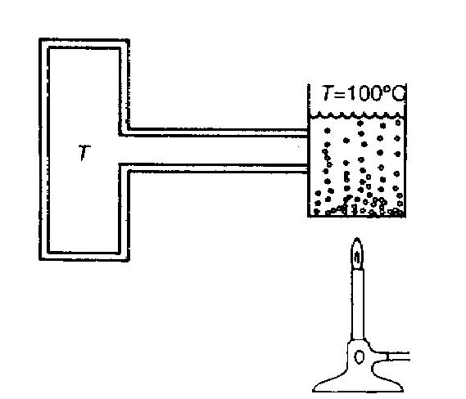
– Analysis Layer –
Reservoir
Water
tank
Filling
(Rise)
Water level h
Drain (Drop)
The water tank is filled from a reservoir of unlimited capacity;
The water level approaches exponetially h₀.
Time t
U_{R}
100°C -T
The temperature of a piece of metal approaches exponetially 100°C.
The voltage across the capacitor C approaches exponetially U₀

Slide 32
– Analysis Layer –

Slide 33
– Analysis Layer –
In
Out
System
Refinery
Aeroplane
Musical instrument
Electronic Circuit
Nucleus
A_{in}(t)
A_{out}(t)
f(t)

Slide 34
– Analysis Layer –
The Laplace Transform
− Is a „generalized“ Fourier Transform f(t) → F(s); s = iω + ρ
− „Algebraizes“ linear differential equations (that represent the dynamics of systems with concentrated energy „reservoirs“ like L, C, . . .)
− A convolution in the time domain corresponds to a multiplication of the Laplace transform
Scheme: f(t) F(s)
A_{out}(t) A_{out}(s)

⁻¹

Slide 35
– Analysis Layer –

Slide 36
– Analysis Layer –
iω
Stable Systems have poles only in the negative half-plane (imaginary axis included), since otherwise ρ>0
Allpasses stand out due to the symmetric position of Poles and Zeros with respect to the imaginary axis. |T(s)| = const.; but the phase changes.
Phase minimum systems do not have any Zeros in the right half-plane.
Inferences:
All stable linear systems
can be set up by allpasses and
phase minimum systems.
ρ
iω
ρ
iω
ρ
iω
iω
Phase min.-
system
Allpass
ρ
≡
ρ
-a
b
-a
b

Slide 37
– Analysis Layer –
For physically feasible systems applies: n ≤ m
s-plane
ρ

Slide 38
– Analysis Layer –
Feedback (especially: negative feedback)
X(s)
Δ(s)
Y(s)
Y(s) = F₁(s)·Δ(s)
Δ(s) = X(s) R(s)
R(s) = F₂(s)·Y(s)
F₁(s)
R(s)
→Y(s) = F₁(s) · {X(s) (F₂(s)·Y(s))}
F₂(s)
Trick:
Remarks:
The trick from above is used to linearize amplifier stages. The equation can be also interpreted that independent from (the linearity of F1) the transfer function T(s) only depends on the properties of the negative feedback circuitry (F₂). This finding justifies the demand for „Gain Stages“ or the development of Operational Amplifiers (with high gain V).

Slide 39
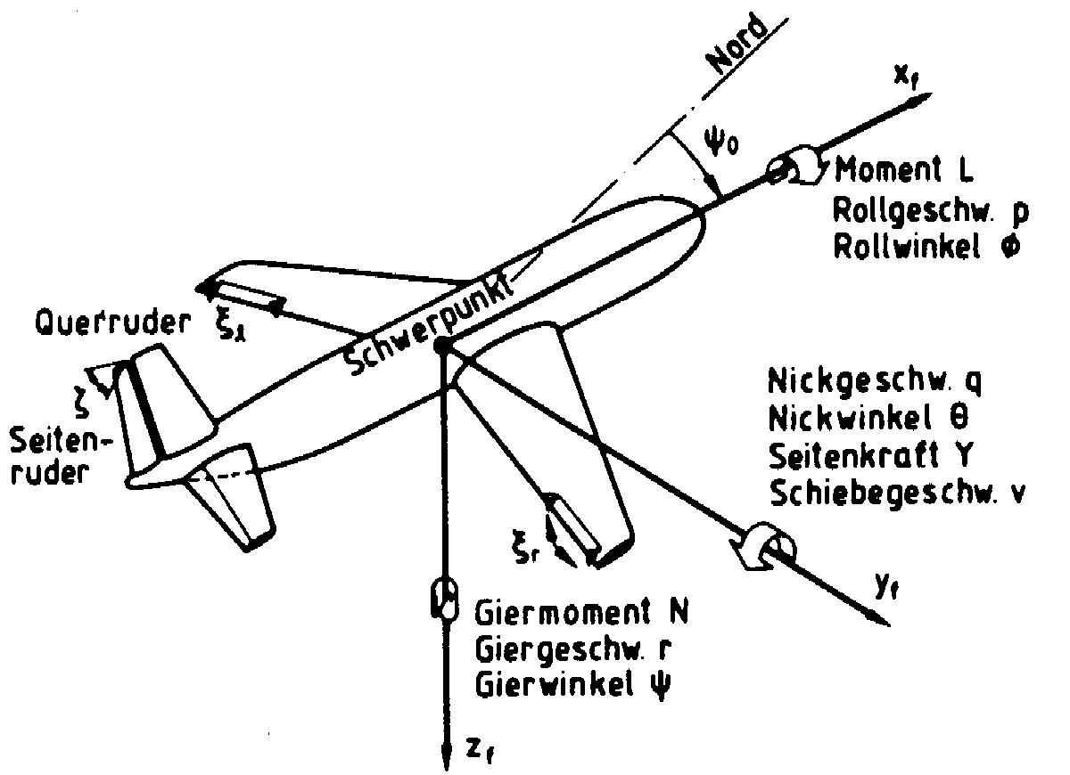
– Analysis Layer –
Set Value
Distortion
V
Controlled
System
U_{E}
U_{A}
Controller
S(s)
R(s)
the dynamics of T(s) can be determined by the position of the Pole/Zero-distribution of R(s).

Slide 40
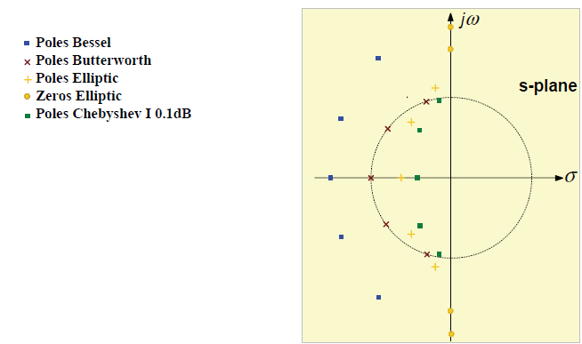
– Analysis Layer –
Bessel
Poles located outside on an ellipse of the unit circle
Butterworth
Poles located on the unit circle with equal angles
Chebyshev I
Poles located on an ellipse inside the unit circle
Elliptic (for instance Cauer)
n Poles on an ellipse in- and outside the unit circle
n-1 Zeros on the jω axis
s-plane
ρ

Slide 41
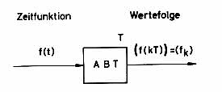
– Analysis Layer –
Function and Step-Function
Time Domain
Data Sequence
Sampler
Data Sequence
Step Function
Hold

Slide 42
– Analysis Layer –
The Laplace transform of a sampled signal is periodic:
This can be conveniently represented by a circular polar diagram such as the z-plane
=1
The iω axis of the s-plane
is the location of the
Fourier transform
S-Plane
Im
Z-Plane



Inside the unit circle
corresponds to σ < 0
of the s-plane
Outside the unit circle
corresponds to σ > 0
of the s-plane
ω
Re



The unit circle corresponds
to the iω-axis of the s-plane
The z-plane is constructed from the s-plane by bending the iω-axis of the sampled signal in the direction of the left hand side half of the s-plane to form a circle such that the points at π and –π meet.

Slide 43
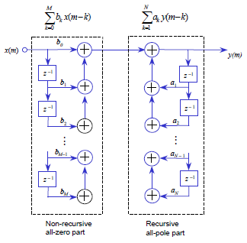
– Analysis Layer –
Recursive and non-Recursive Filters
The transfer function is the ratio of two polynomials in the variable z and may be written in a cascade form with H₁(z) is the transfer function of a feed forward, all-zero filter and H₂(z) is the transfer function of a feedback, all-pole, recursive filter.
Non-recursive all-zero part
Recursive
all-pole part
Direct-form pole-zero IIR filter

Slide 44
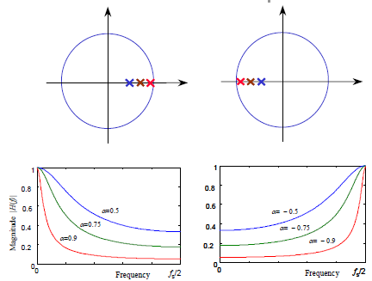
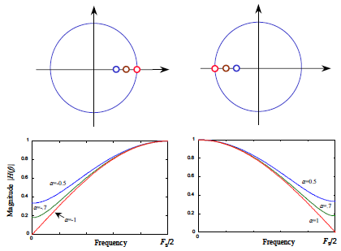
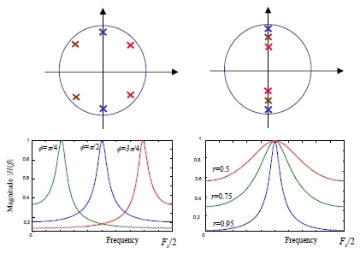
– Analysis Layer –
b = -0.5
b = 0.5
b = -1
b = 1
b = -0.7
b = 0.7
Resonators
Notch Filter
3-Tap
Moving Average

Slide 45
– Analysis Layer –
Transfer Function:
Im(z)
j
Operating Point
Pole/Zero:
A
F
B
E
C
D
B
A

Re(z)
C
D
Magnitude:
Phase:

Slide 46
– Complexity Layer –
Where to look for a solution, since the analysis/synthesis of an analog or digital solution compares over most applications ?
Analog
Digital
DAC
ADC
(HEMT, Varactor)
Low Noise
(Graphene)
Ultimate Speed
Flexibility
(FPGA, 100 Discriminators/Chip)
Complexity
(PLC, FPGA, ASIC)

Slide 47
– Summary –
Commons
The analysis/synthesis can be performed analogly (L - Transform) or as well as digitally (z - Transform)
Differences
For signal handling there exist nowadays only a few problems that can be solved analogly or digitally only(low noise amplification, high precision calculations, . . ).
Trends
Harware (analog & digital) becomes ever faster & smaller.
Fastest response to an event is best realized by analog hardware
For fast computations restrict to the 4 basic arithmetic operations ( +, −, *, / )
The more complex and flexible a problem appears the more a digital solutrion seems appropriate.
The higher a module is specialized the faster is its response (DSP, FPGA ↔ ASIC)
Since digital hardware becomes ever cheaper, more problems will be solved digitally for the sake of standardisation and flexibility (Σ−Δ ADC)

