Slide 1
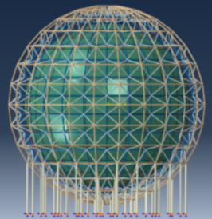
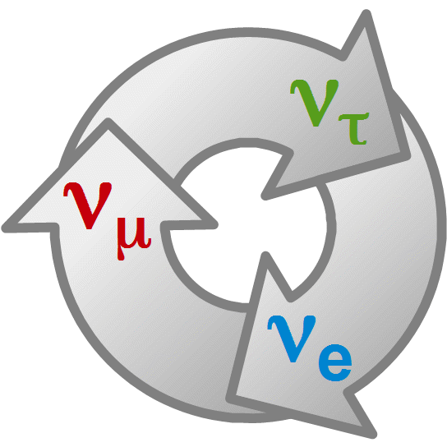
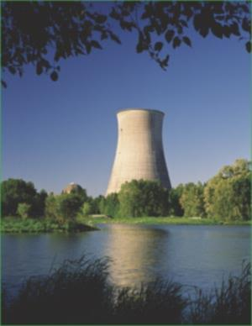
Georgian-German School and Workshop in Basic Science
Neutrino Physics
JUNO
Project
Achim Stahl – RWTH Aachen University – JARA-FAME

Slide 2
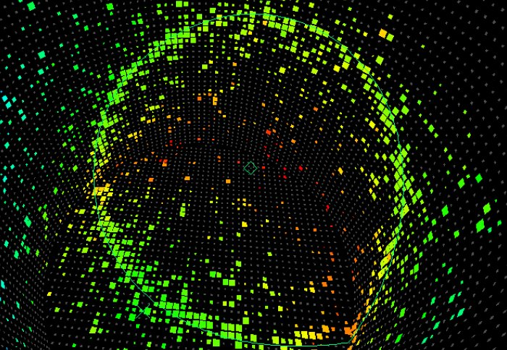
Georgian-German School and Workshop in Basic Science
Content
The Fate of Antimatter
Neutrino Oscillations
CP-Violation
The Mass Hierarchy
Summary

Slide 3
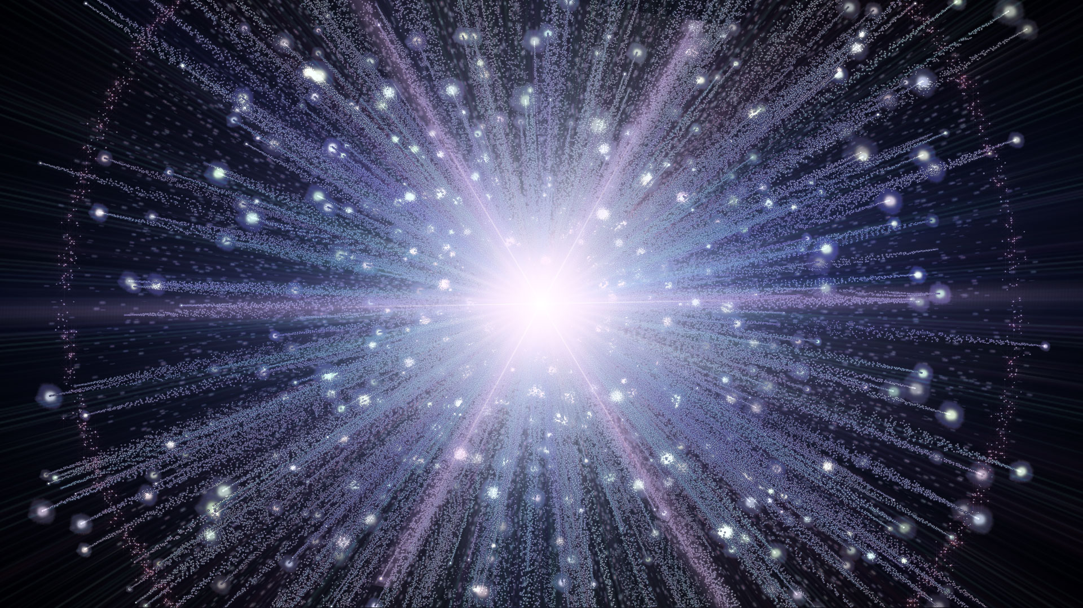
The Fate of Antimatter

Slide 4
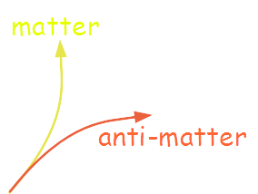
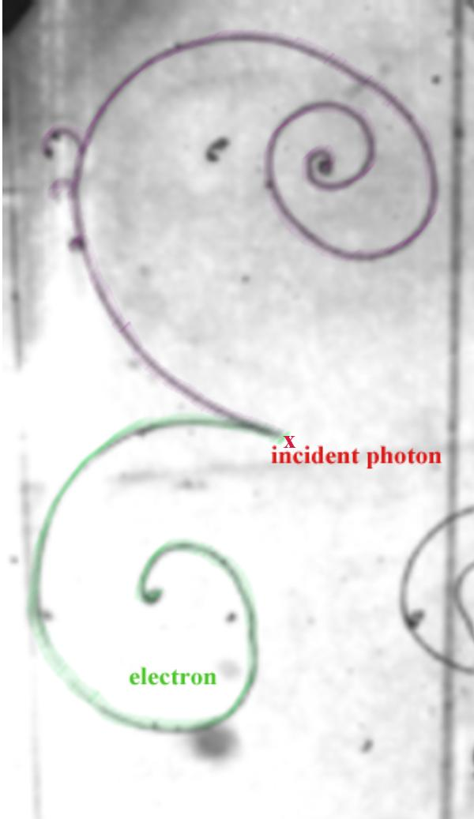
In the beginning …
created matter and antimatter
in equal amounts
… the Big Bang

Slide 5
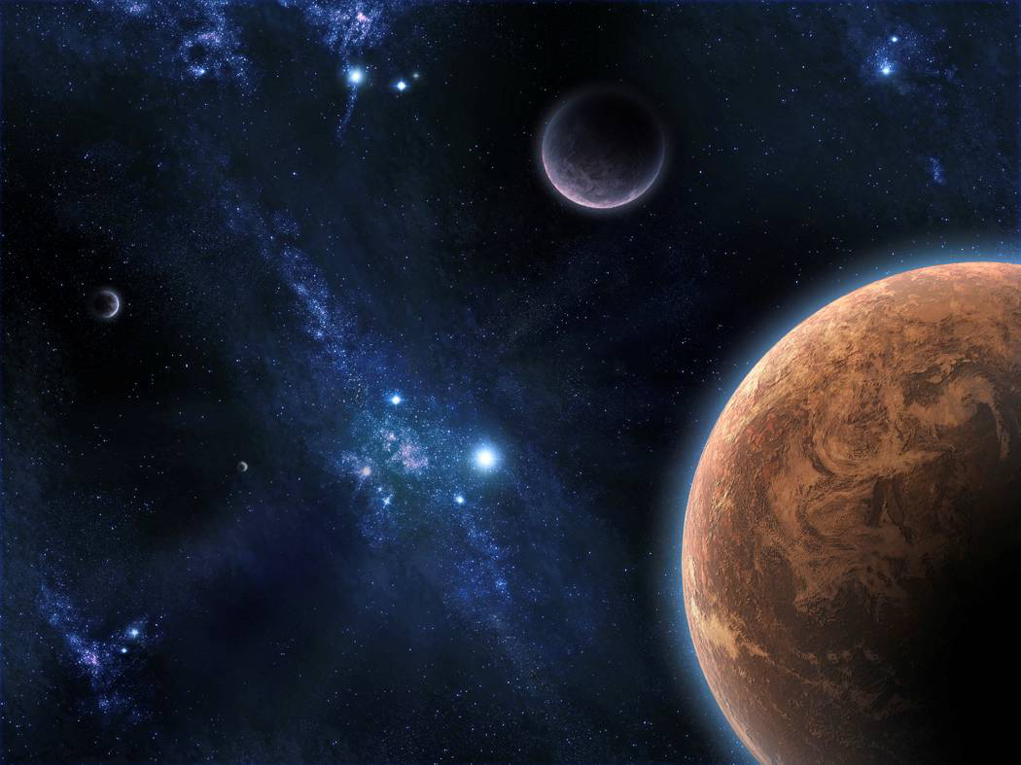
Today …
… we only find matter

Slide 6
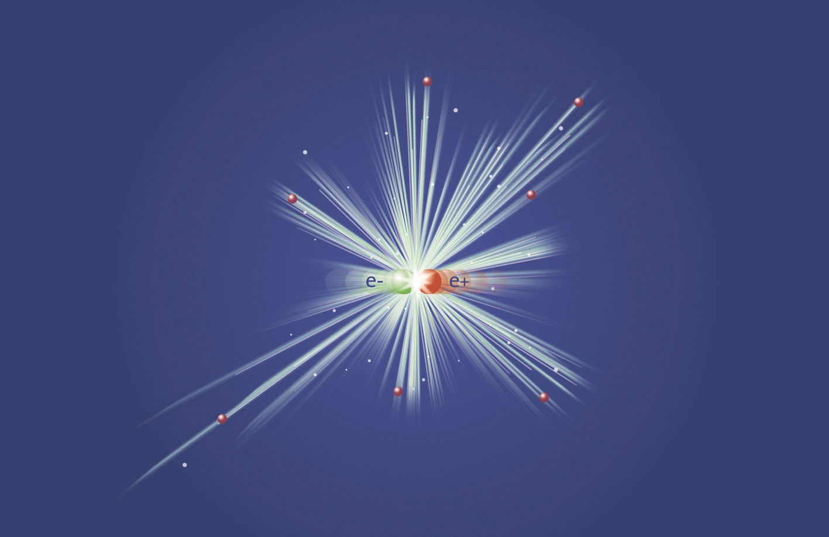
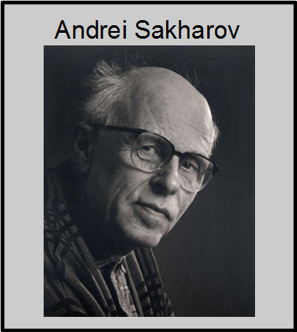
Evolution of Matter
matter and antimatter annihilated …
How ?
… some matter survived
Baryon-Number Violation
CP-Violation
Thermal Non-Equilibrium
theoretical ideas
not enough !
understood

Slide 7
Today …
Baryon to Photon Ratio:
$$η=\frac{n_{B}−n_{\overline{B}}}{n_{γ}}≈5⋅10^{−10}$$
$n_{γ}≈0.4/{mm}^{2}$
$n_{B}≈0.2/m^{2}$
$n_{\overline{B}}≈0$
Standard Model fails by
many orders of magnitude
… we only find matter

Slide 8
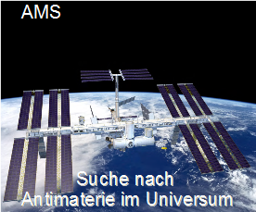
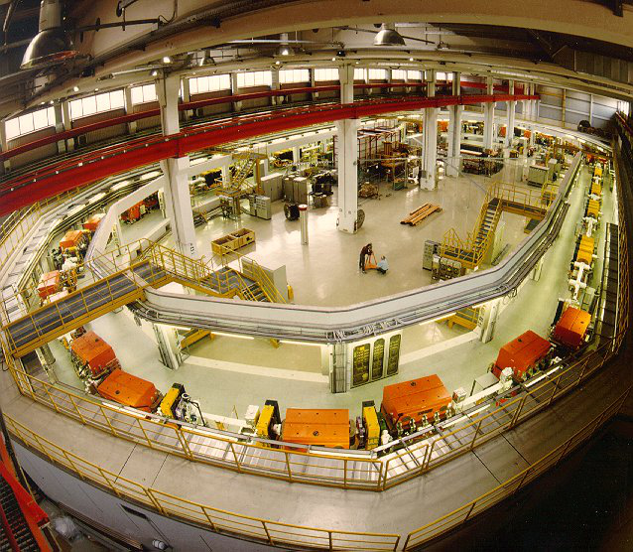
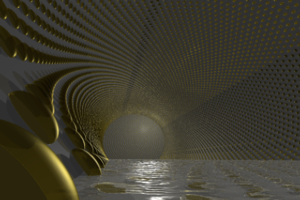
Concept of JARA-FAME
antimatter
separated
antimatter
disappeared
More CP-violation needed !
baryo-genesis
lepto-genesis
JEDI - EDM
JUNO neutrinos

Slide 9
The Fate of Antimatter ?
Motivation of Neutrino Physics
Topic of JARA-FAME
Motivation of my Research

Slide 10
Neutrinos-Oscillations

Slide 11
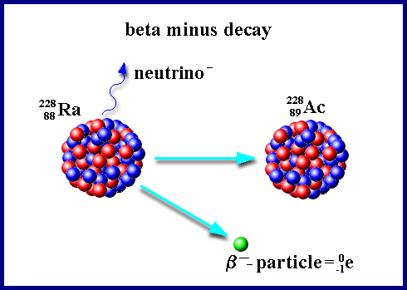
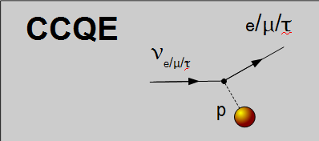
Neutrinos
Standard Model elementary particles
$ν_{e}$ $ν_{μ}$ $ν_{τ}$
three flavours
Masses are very small: $m_{ν} <{10}^{−6} m_{e}$
cross sections are very low !

Slide 12
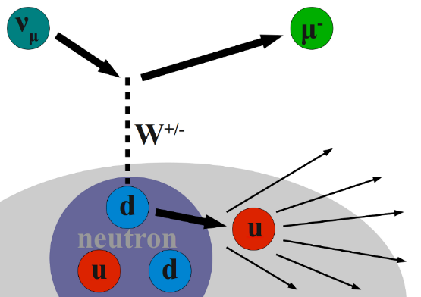
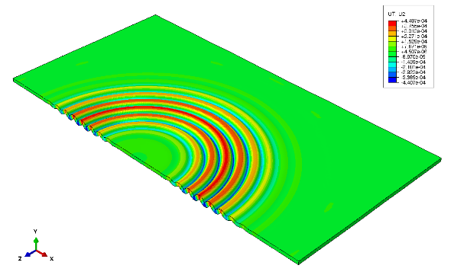
Neutrino Oscillations
Flavour
Eigenstates
Mass
Eigenstates
$$\left|ν_{α}\right.〉=\sum_{i=1}^{3}{U_{α,i}\left|ν_{i}〉\right.}$$
$$e μ τ$$
1$2 3$
How neutrinos
interact
How neutrinos
propagate
Propagation: $ν_{i}\left(z\right)=c e^{i\left(pz−Et\right)}≈c e^{i \frac{m_{i}^{2}}{2E} z}$

Slide 13
Neutrino Oscillations
Flavour
Eigenstates
Mass
Eigenstates
$$\left|ν_{α}\right.〉=\sum_{i=1}^{3}{U_{α,i}\left|ν_{i}〉\right.}$$
$$e μ τ$$
1$2 3$
How neutrinos
interact
How neutrinos
propagate
$$\left(\begin{matrix}1 & 0 & 0 \\ 0 & \cos{θ_{23}} & \sin{θ_{23}} \\ 0 & −\sin{θ_{23}} & \cos{θ_{23}}\end{matrix}\right) \left(\begin{matrix}\cos{θ_{13}} & 0 & \sin{θ_{13}}e^{−iδ} \\ 0 & 1 & 0 \\ −\sin{θ_{13}}e^{iδ} & 0 & \cos{θ_{13}}\end{matrix}\right) \left(\begin{matrix}\cos{θ_{12}} & \sin{θ_{12}} & 0 \\ −\sin{θ_{12}} & \cos{θ_{12}} & 0 \\ 0 & 0 & 1\end{matrix}\right)$$
Pontecorvo Maki Nakagawa Sakata - matrix

Slide 14
Neutrino Oscillations
Production through
weak interaction:
Flavour $α$
Propagation:
Detection through
weak interactio:
Flravour $β$
$$|ν_{α}〉=x_{1}|ν_{1}〉+x_{2}|ν_{2}〉+x_{3}|ν_{3}〉$$
$$|ν_{i}\left(z\right)〉=c\exp\left(i\left(pz−Et\right)\right)|ν_{i}〉$$
$$\begin{matrix}t≈\frac{z}{c} \\ E=\sqrt{p^{2}c^{2}+m_{i}^{2}c^{4}}≈pc+\frac{m_{i}^{2}c^{4}}{2pc}≈pc+\frac{m_{i}^{2}c^{4}}{2E}\end{matrix}$$
$$|ν_{i}\left(z\right)〉=c\exp\left(−i \frac{m_{i}^{2}c^{4}}{2E} z\right)|ν_{i}〉$$
$$|ν_{α}\left(z\right)〉=x_{1}|ν_{1}\left(z\right)〉+x_{2}|ν_{2}\left(z\right)〉+x_{3}|ν_{3}\left(z\right)〉$$
$${\left|\left\langle ν_{β} | ν_{α}\left(z\right)\right\rangle \right|}^{2}$$

Slide 15
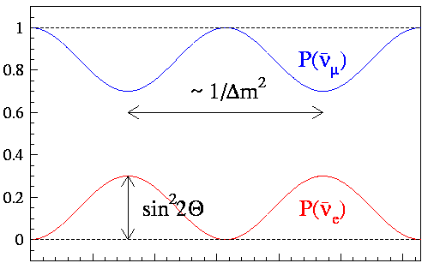
Neutrino Oscillations
Special case: 2 flavours only
$$\left(\begin{matrix}ν_{e} \\ ν_{μ}\end{matrix}\right)=\left(\begin{matrix}\cos{θ} & \sin{θ} \\ −\sin{θ} & \cos{θ}\end{matrix}\right)\left(\begin{matrix}ν_{1} \\ ν_{2}\end{matrix}\right)$$
Mass difference $Δm^{2}=m_{2}^{2}−m_{1}^{2}$
Mixing anlge $θ$
Oscillation length:
$$\frac{4π E_{ν}}{Δm^{2}}≈2.48 m \frac{E_{ν} \left[MeV\right]}{Δm^{2} \left[eV^{2}\right]}$$
$$L/E$$
Disappearance: $P\left(ν_{α}→ν_{α}\right)=1−\sin^{2}{2θ}\sin^{2}{\frac{Δm^{2}L}{4 E_{ν}}}$
Appearance: $P\left(ν_{α}→ν_{β}\right)= \sin^{2}{2θ}\sin^{2}{\frac{Δm^{2}L}{4 E_{ν}}}$

Slide 16
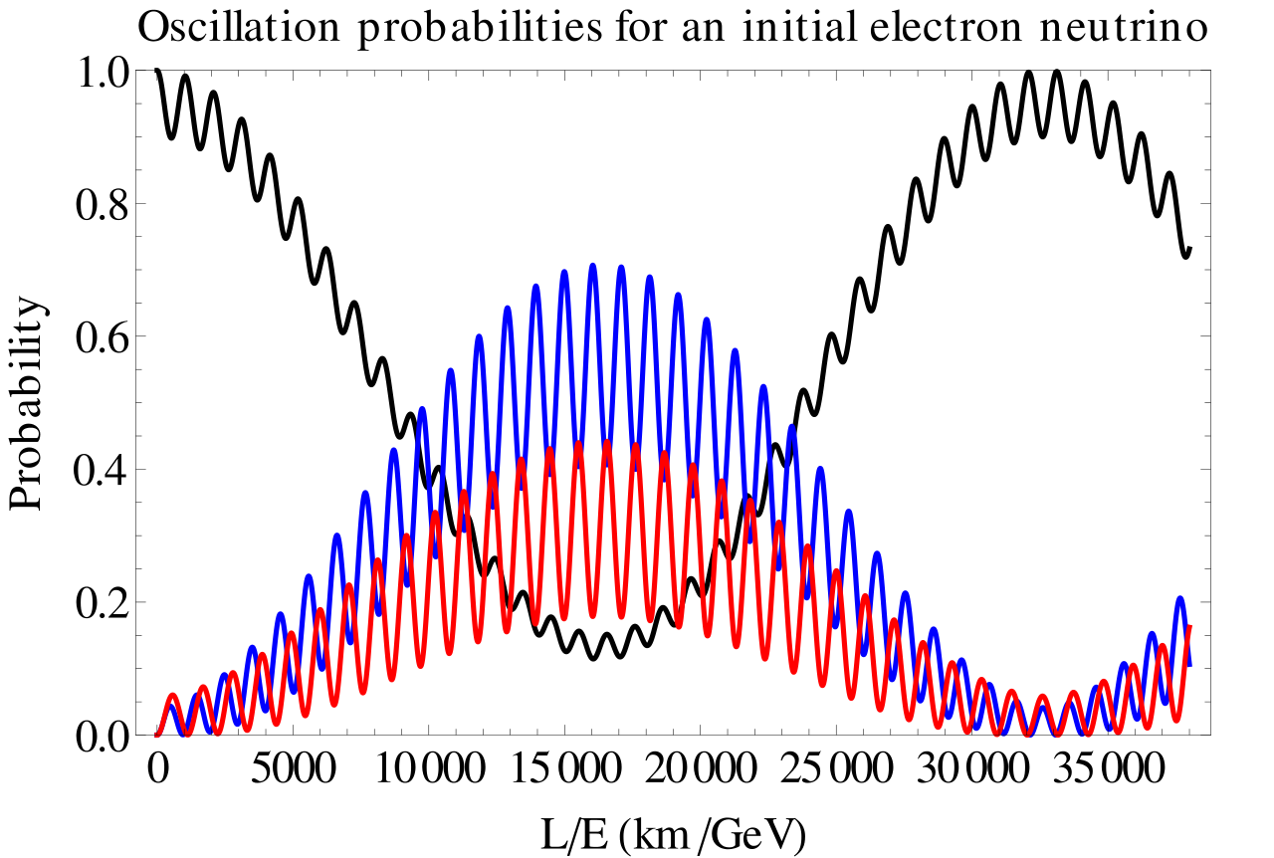
Oscillation Pattern
$$\begin{matrix}P_{α→β}=δ_{αβ} −4 \sum_{i>j}{Re\left(U_{αi}^{∗}U_{βi}U_{αj}U_{βj}^{∗}\right)\sin^{2}{\frac{\left(m_{i}^{2}−m_{j}^{2}\right)L}{4E}}} \\ +2 \sum_{i>j}{Im\left(U_{αi}^{∗}U_{βi}U_{αj}U_{βj}^{∗}\right)\sin{\frac{\left(m_{i}^{2}−m_{j}^{2}\right)L}{2E}}} \end{matrix}$$
Oscillations require some $m_{i}≠0$
$$ν_{e}$$
$$ν_{μ}$$
$$ν_{τ}$$
$$Δm_{\text{solar}}^{2}≈7.5 {10}^{−5}eV^{2}$$
$$Δm_{\text{atmos}}^{2}≈3.4 {10}^{−3}eV^{2}$$

Slide 17
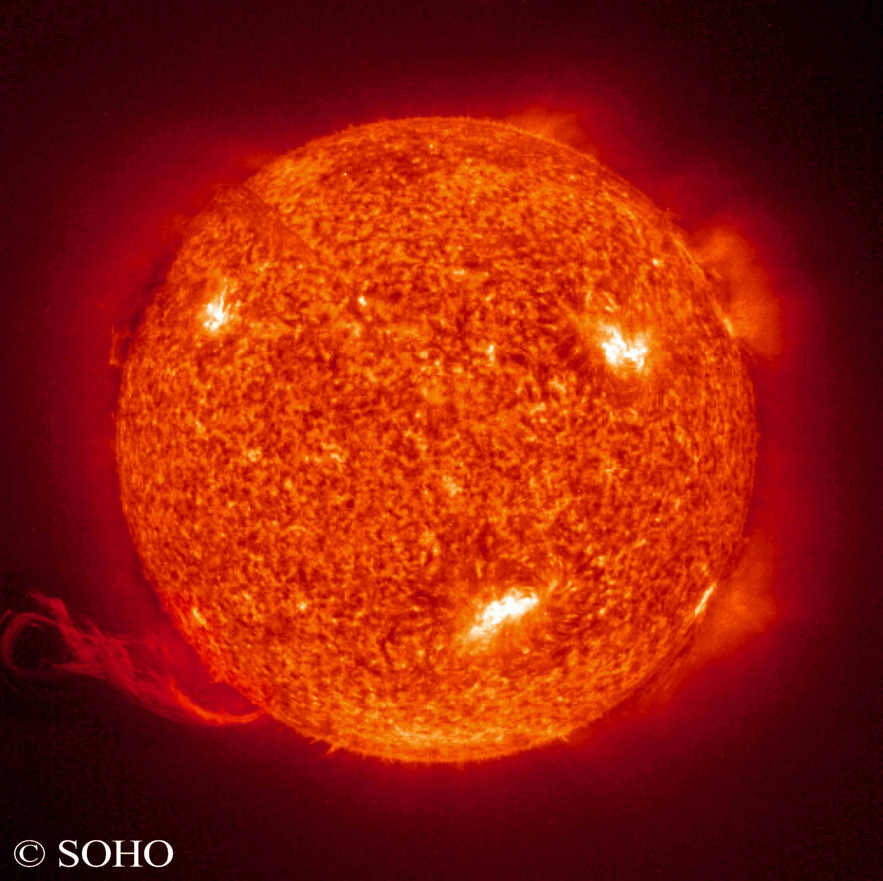
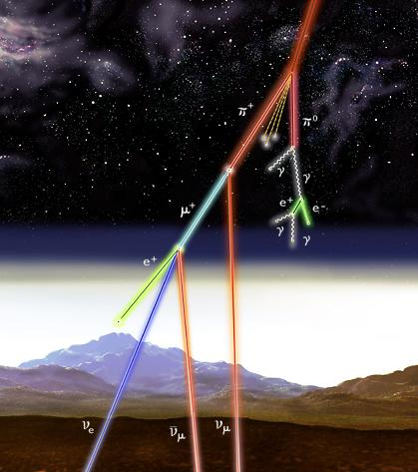
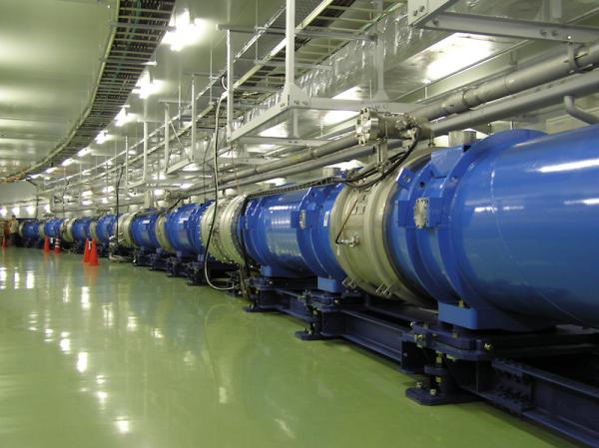
Neutrino Oscillations
Solar Neutrinos
Atmospheric Neutrinos
Reactor Neutrinos
Neutrino Beams
Homestake
KamiokaNDE
Gallex
Sage
SNO
Borexino
$$Δm_{solar}^{2}$$
Super-K
Macro
IceCube
$$Δm_{atmos}^{2}$$
Bugey, Chooz, ….
$$Δm_{eV}^{2} ?$$
LSND
MiniBoone
$$Δm_{eV}^{2} ?$$
Double-Chooz
Daya Bay
Reno
$$Δm_{atmos}^{2}$$
K2K, T2K
Minos, Noνa
Opera
$$Δm_{atmos}^{2}$$
KamLand
$$Δm_{solar}^{2}$$

Slide 18
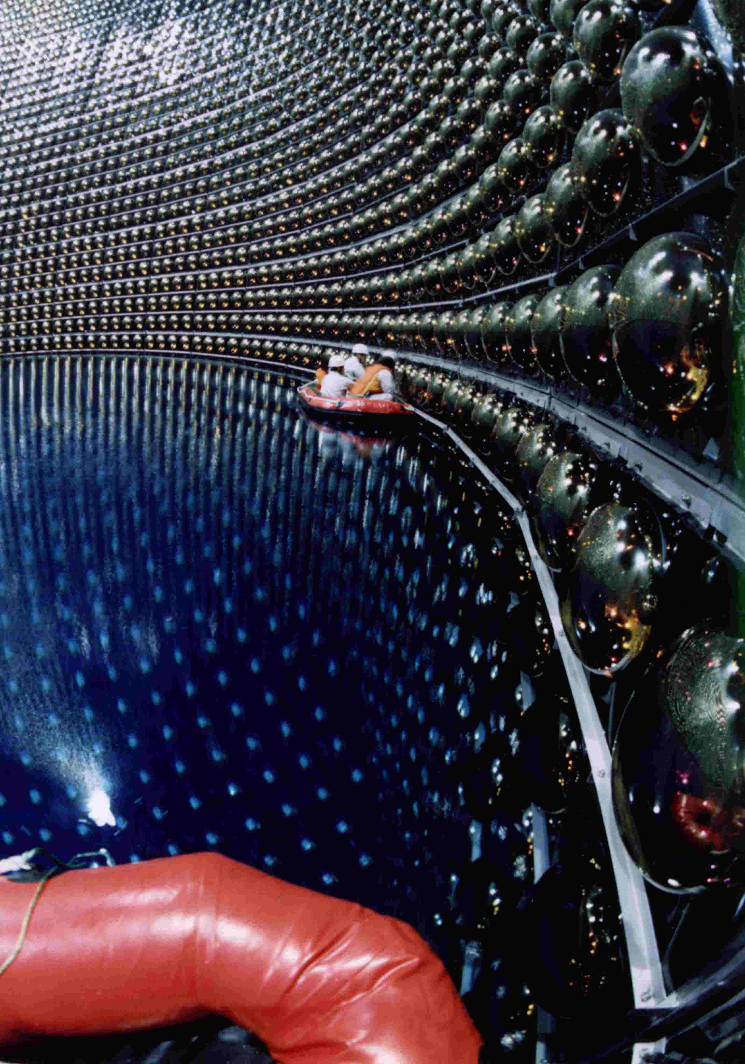
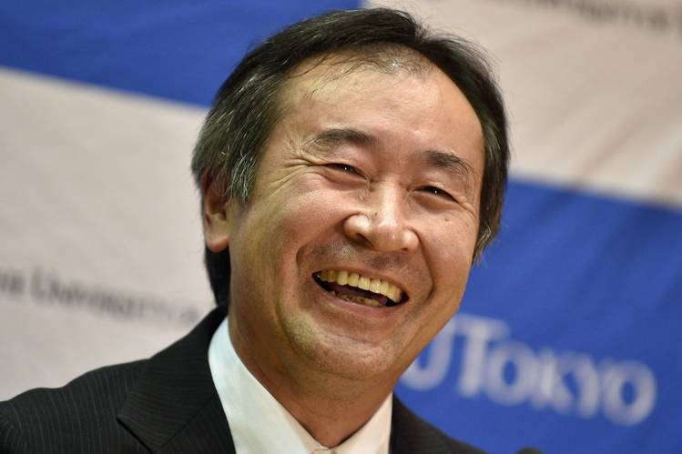
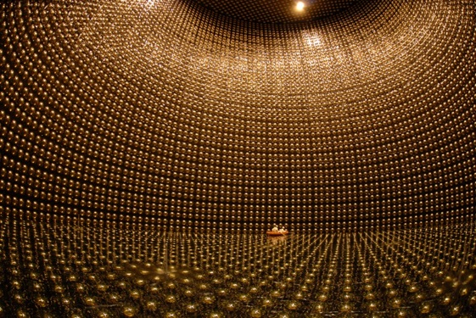
Atmospheric υ
$$π→μ ν_{μ}$$
$μ→e ν_{e} ν_{μ}$
$$\frac{ν_{μ}}{ν_{e}} ≈2$$
Takaaki Kajita
"for the discovery of neutrino oscillations, which shows that neutrinos have mass"

Slide 19
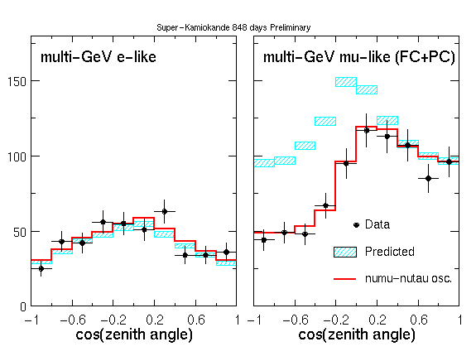
Atmospheric υ

Slide 20
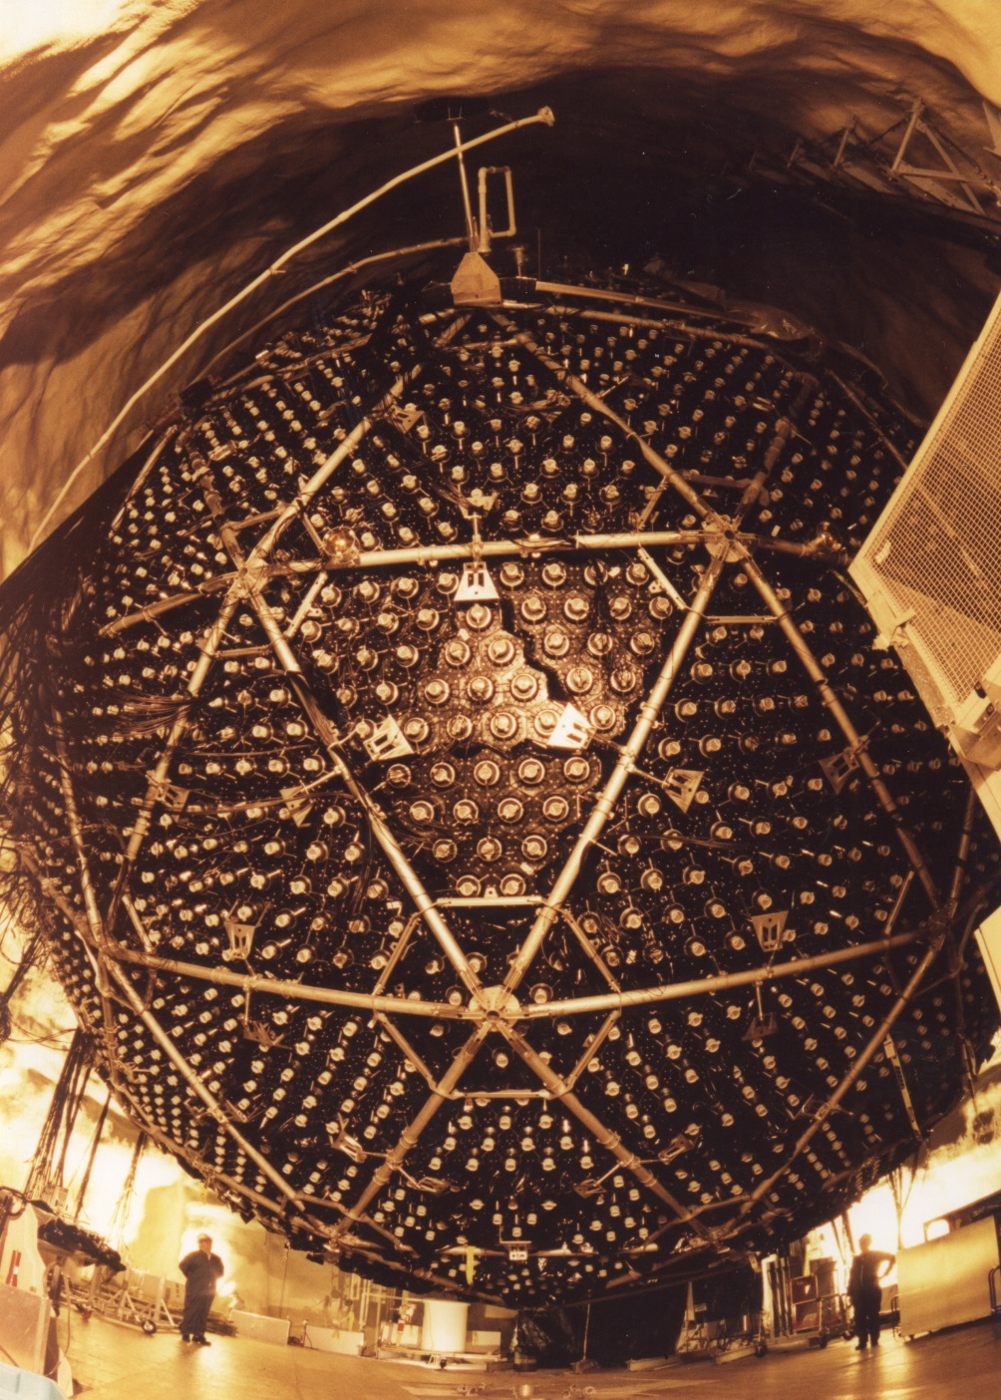
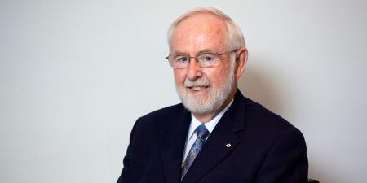
SNO Experiment
Sudbury Neutrino Observatory
Arthur McDonald
"for the discovery of neutrino oscillations, which shows that neutrinos have mass"

Slide 21
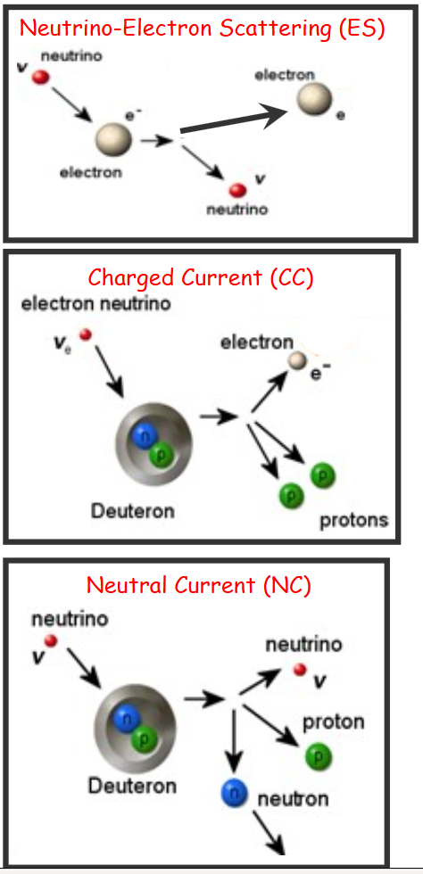
SNO Experiment
mostly: $ν_{e}$
some: $ν_{μ},ν_{τ}$
only: $ν_{e}$
Heavy water: ${}_{ }^{2}H$
$$ν_{e},ν_{μ}, ν_{τ}$$

Slide 22
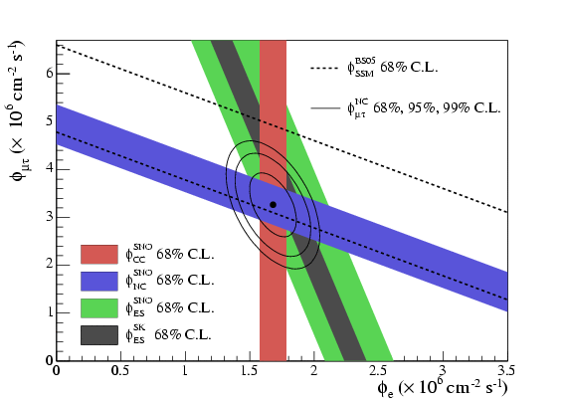
SNO Experiment
mostly: $ν_{e}$
some: $ν_{μ},ν_{τ}$
only: $ν_{e}$
Heavy water: ${}_{ }^{2}H$
$$ν_{e},ν_{μ}, ν_{τ}$$

Slide 23
CP-Violation
Matter = Anti-Matter?

Slide 24
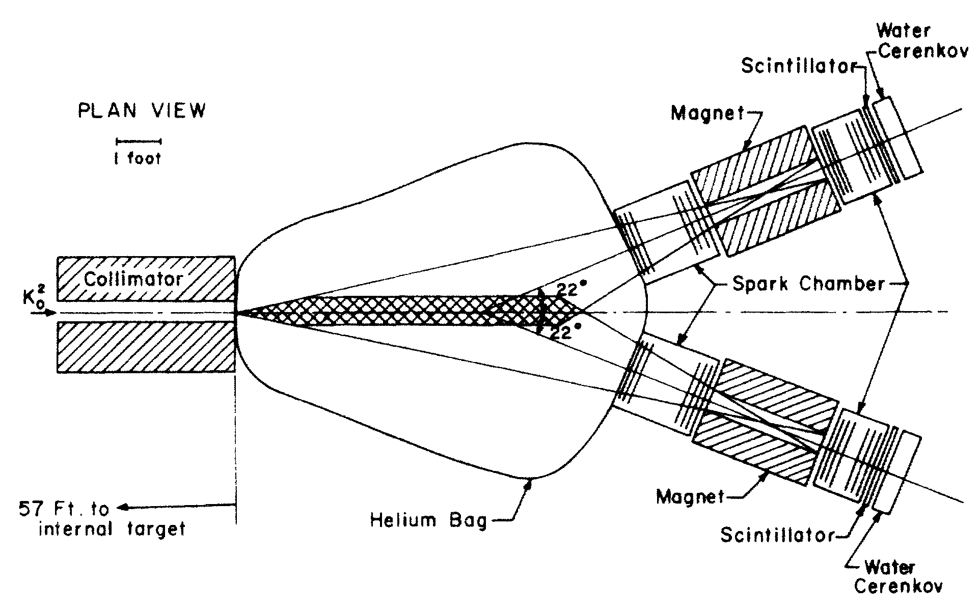
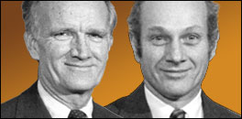
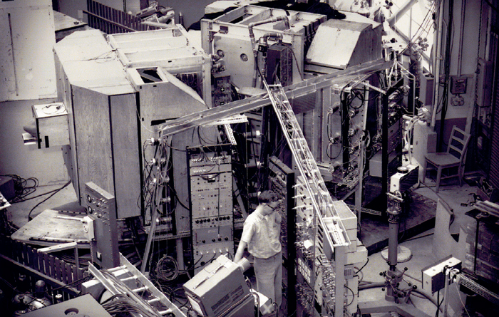
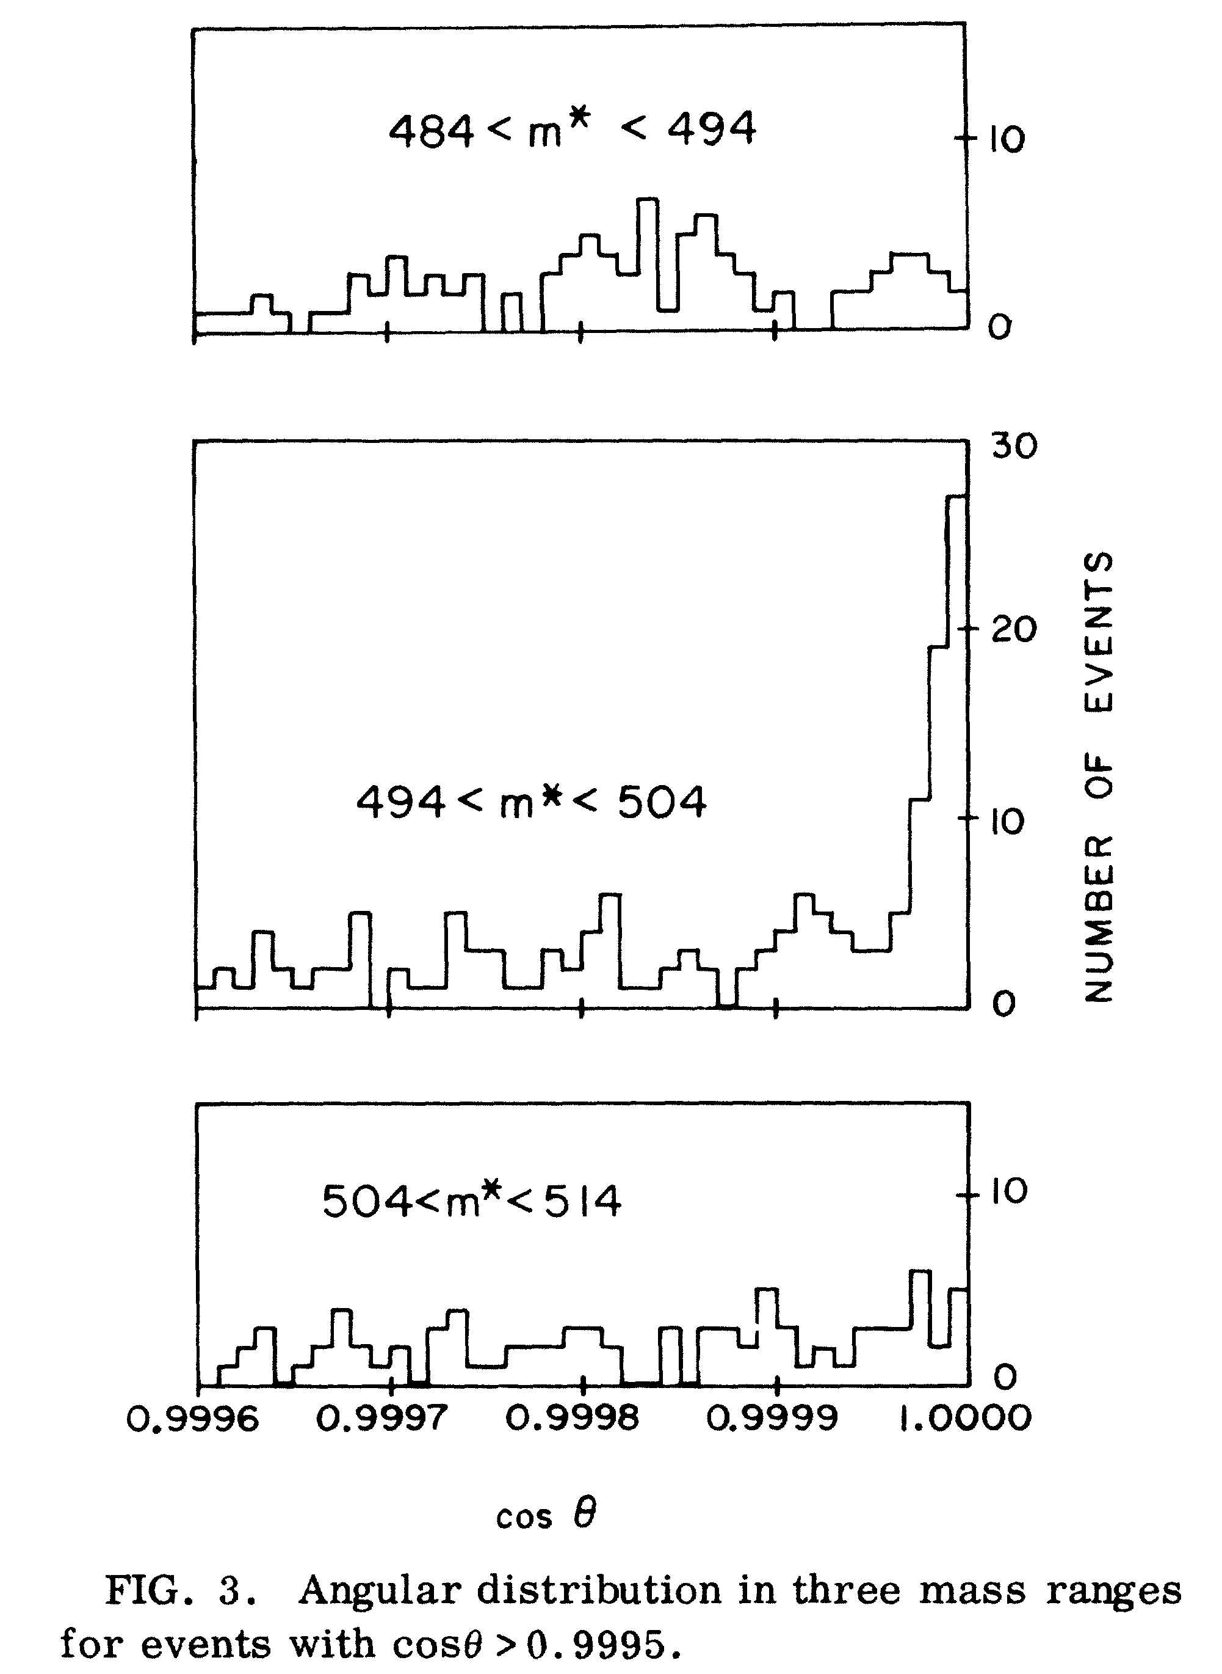
CP-Violation in the Standard Modell
+++++nobel
Cronin and Fitch
nobel price 1980
$K^{0}$ and ${\overline{K}}^{0}$
mix differently
Detection of $K_{L}^{0}→π^{+} π^{−}$

Slide 25
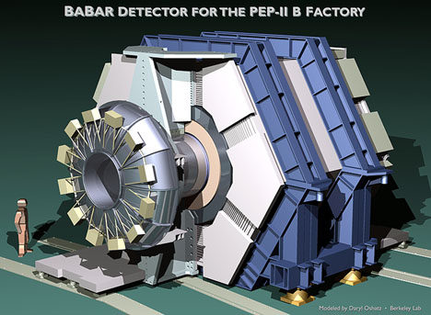
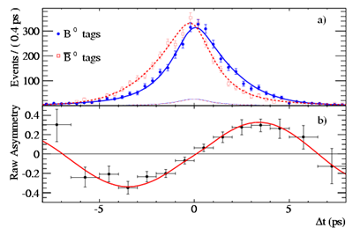
CP-Violation in the Standard Modell
verified with $B_{0}$/${\overline{B}}_{0}$ Mesons by KEK-b and BaBar

Slide 26
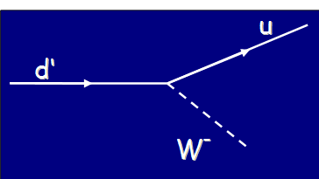
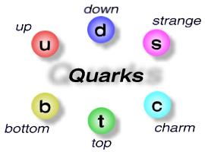
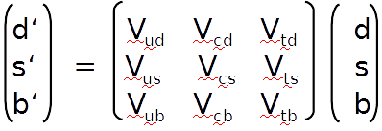
Theoretical Description
Flavour Eigenstates
Mass Eigenstates
CKM-Matrix: A complex phase introduces CP-Violation

Slide 27
Neutrino Oscillations
Flavour
Eigenstates
Mass
Eigenstates
$$\left|ν_{α}\right.〉=\sum_{i=1}^{3}{U_{α,i}\left|ν_{i}〉\right.}$$
$$e μ τ$$
1$2 3$
How neutrinos
interact
How neutrinos
propagate
$$\left(\begin{matrix}1 & 0 & 0 \\ 0 & \cos{θ_{23}} & \sin{θ_{23}} \\ 0 & −\sin{θ_{23}} & \cos{θ_{23}}\end{matrix}\right) \left(\begin{matrix}\cos{θ_{13}} & 0 & \sin{θ_{13}}e^{−iδ} \\ 0 & 1 & 0 \\ −\sin{θ_{13}}e^{iδ} & 0 & \cos{θ_{13}}\end{matrix}\right) \left(\begin{matrix}\cos{θ_{12}} & \sin{θ_{12}} & 0 \\ −\sin{θ_{12}} & \cos{θ_{12}} & 0 \\ 0 & 0 & 1\end{matrix}\right)$$
Pontecorvo Maki Nakagawa Sakata - matrix

Slide 28
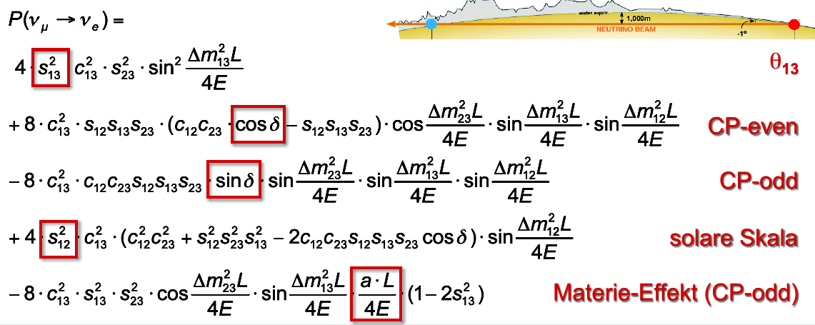
CP-Violation
$$\begin{matrix}P_{α→β}=δ_{αβ} −4 \sum_{i>j}{Re\left(U_{αi}^{∗}U_{βi}U_{αj}U_{βj}^{∗}\right)\sin^{2}{\frac{\left(m_{i}^{2}−m_{j}^{2}\right)L}{4E}}} \\ +2 \sum_{i>j}{Im\left(U_{αi}^{∗}U_{βi}U_{αj}U_{βj}^{∗}\right)\sin{\frac{\left(m_{i}^{2}−m_{j}^{2}\right)L}{2E}}} \end{matrix}$$
Example:
Neutrino Beams
Numerically relevant terms only
+
+
Jarlskog‘s Determinant for neutrinos: $0.28\sin{δ}$ (quarks: ${4⋅10}^{−5}$)

Slide 29
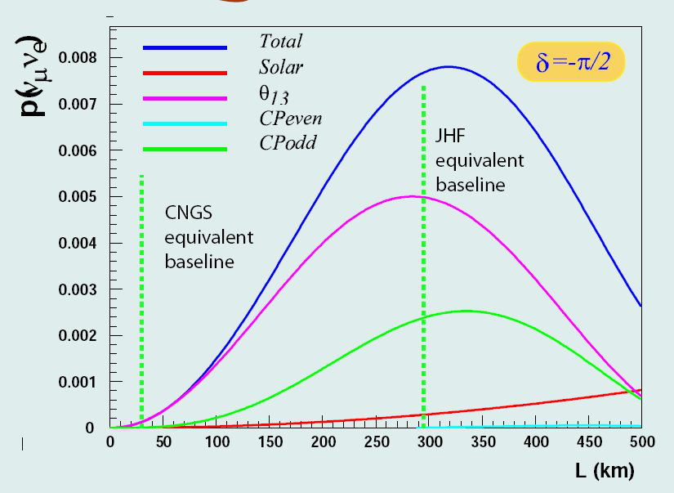
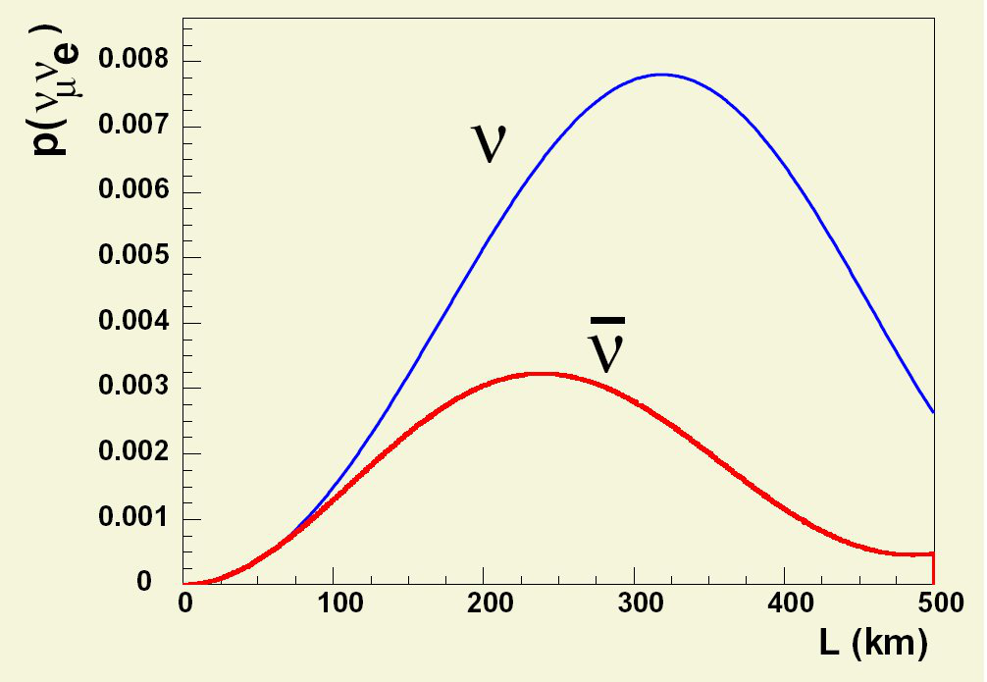
CP-Violation
+
+

Slide 30
T2K: Konosuke Iwamoto ICHEP 2016

Slide 31
T2K: Konosuke Iwamoto ICHEP 2016

Slide 32
Neutrino Oscillations
Flavour
Eigenstates
Mass
Eigenstates
$$\left(\begin{matrix}1 & 0 & 0 \\ 0 & \cos{θ_{23}} & \sin{θ_{23}} \\ 0 & −\sin{θ_{23}} & \cos{θ_{23}}\end{matrix}\right)$$
$$Δm^{2}≈2.4 {10}^{−3} eV^{2}$$
$$θ_{23}≈45°$$
Atmospheric Oscillations
$$e μ τ$$
1$2 3$
How neutrinos
interact
How neutrinos
propagate
$$\left(\begin{matrix}1 & 0 & 0 \\ 0 & \cos{θ_{23}} & \sin{θ_{23}} \\ 0 & −\sin{θ_{23}} & \cos{θ_{23}}\end{matrix}\right) \left(\begin{matrix}\cos{θ_{13}} & 0 & \sin{θ_{13}}e^{−iδ} \\ 0 & 1 & 0 \\ −\sin{θ_{13}}e^{iδ} & 0 & \cos{θ_{13}}\end{matrix}\right) \left(\begin{matrix}\cos{θ_{12}} & \sin{θ_{12}} & 0 \\ −\sin{θ_{12}} & \cos{θ_{12}} & 0 \\ 0 & 0 & 1\end{matrix}\right)$$
Pontecorvo Maki Nakagawa Sakata - matrix

Slide 33
Neutrino Oscillations
Flavour
Eigenstates
Mass
Eigenstates
$$\left(\begin{matrix}\cos{θ_{12}} & \sin{θ_{12}} & 0 \\ −\sin{θ_{12}} & \cos{θ_{12}} & 0 \\ 0 & 0 & 1\end{matrix}\right)$$
$$Δm^{2}≈7.6 {10}^{−5} eV^{2}$$
$$θ_{23}≈35°$$
Solar Oscillations
$$e μ τ$$
1$2 3$
How neutrinos
interact
How neutrinos
propagate
$$\left(\begin{matrix}1 & 0 & 0 \\ 0 & \cos{θ_{23}} & \sin{θ_{23}} \\ 0 & −\sin{θ_{23}} & \cos{θ_{23}}\end{matrix}\right) \left(\begin{matrix}\cos{θ_{13}} & 0 & \sin{θ_{13}}e^{−iδ} \\ 0 & 1 & 0 \\ −\sin{θ_{13}}e^{iδ} & 0 & \cos{θ_{13}}\end{matrix}\right) \left(\begin{matrix}\cos{θ_{12}} & \sin{θ_{12}} & 0 \\ −\sin{θ_{12}} & \cos{θ_{12}} & 0 \\ 0 & 0 & 1\end{matrix}\right)$$
Pontecorvo Maki Nakagawa Sakata - matrix

Slide 34
Neutrino Oscillations
Flavour
Eigenstates
Mass
Eigenstates
$$\left(\begin{matrix}\cos{θ_{13}} & 0 & \sin{θ_{13}}e^{−iδ} \\ 0 & 1 & 0 \\ −\sin{θ_{13}}e^{iδ} & 0 & \cos{θ_{13}}\end{matrix}\right)$$
$$Δm^{2}≈2.4 {10}^{−3} eV^{2}$$
$$θ_{13}≈9°$$
Reactor Oscillations
$$e μ τ$$
1$2 3$
How neutrinos
interact
How neutrinos
propagate
$$\left(\begin{matrix}1 & 0 & 0 \\ 0 & \cos{θ_{23}} & \sin{θ_{23}} \\ 0 & −\sin{θ_{23}} & \cos{θ_{23}}\end{matrix}\right) \left(\begin{matrix}\cos{θ_{13}} & 0 & \sin{θ_{13}}e^{−iδ} \\ 0 & 1 & 0 \\ −\sin{θ_{13}}e^{iδ} & 0 & \cos{θ_{13}}\end{matrix}\right) \left(\begin{matrix}\cos{θ_{12}} & \sin{θ_{12}} & 0 \\ −\sin{θ_{12}} & \cos{θ_{12}} & 0 \\ 0 & 0 & 1\end{matrix}\right)$$
Pontecorvo Maki Nakagawa Sakata - matrix

Slide 35
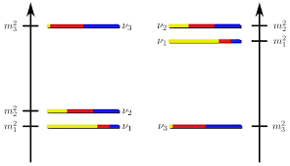
The Mass Hierarchy
normal
inverted

Slide 36
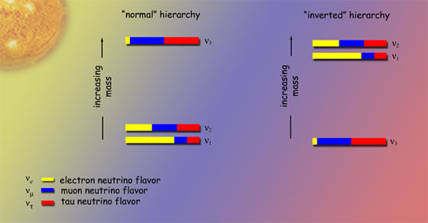
Normal or inverted hierarchy ?
Only 3 generations ?
Majorana or Dirac neutrinos ?
CP-violation ?
Absolute mass scale ?
Osc.: reactor, atmos., beam
Osc.: precision measurements
$2β0ν$-experiments
Osc.: beam
KATRIN, but beyond ?

Slide 37
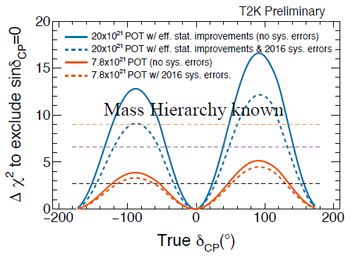
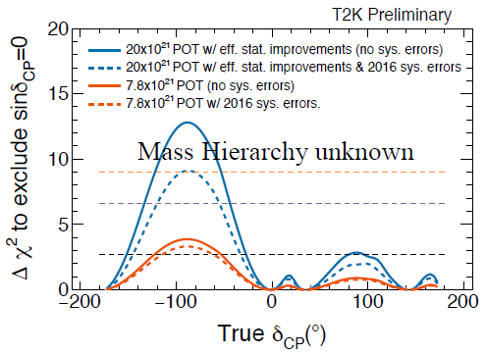
CP-Vioaltion / Mass Hierarchy
Sensitivity of T2K-II
mass hierarchy must be the next step

Slide 38
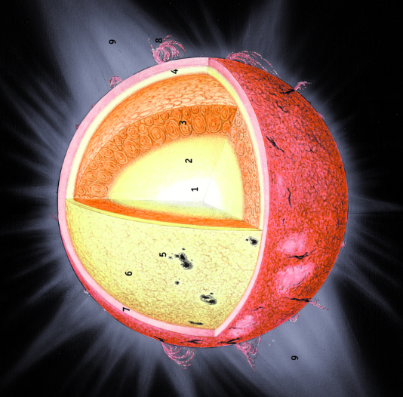
Method 1: Matter Effects
all neutrinos
ν_{e} only
ν
ν
ν_{e}
e⁻
$$\begin{matrix}\begin{aligned}\begin{matrix}P_{{\overline{ν}}_{μ}→{\overline{ν}}_{e}}= ……………… \\ \begin{aligned} \\ + ………………\end{aligned} \\ − …\frac{aL}{4 E}\cos{\frac{Δm_{23}^{2}L}{4 E}}\sin^{ }{\frac{Δm_{13}^{2}L}{4E}}\end{matrix} \\ \\ \end{aligned} \\ \end{matrix}$$
Z⁰
W
e⁻
e⁻
e⁻
ν_{e}
Hierarchy of ν₁ and ν₂
Determined from matter
effects in the sun.
ν
ν
ν_{e}
ν_{e}
W⁻
ν_{e}
Z⁰
e⁻
e⁻
e⁻
e⁻

Slide 39
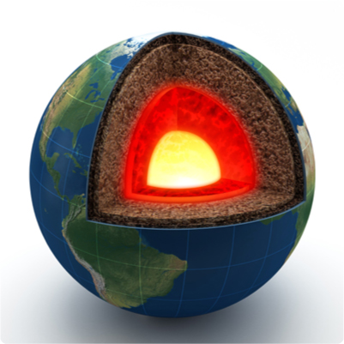
Method 1: Matter Effects
Matter Effect is proportional to L!
Long baseline Beams
T2K (295 km) too short
Noνa (810 km) 2σ
LBNE/DUNE (1300 km) excellent
neutrino beam

Slide 40
Method 1: Matter Effects
Resonant transition (MSW) near the core of the earth
atmospheric
neutrinos
ORCA good
PINGU good
INO some

Slide 41
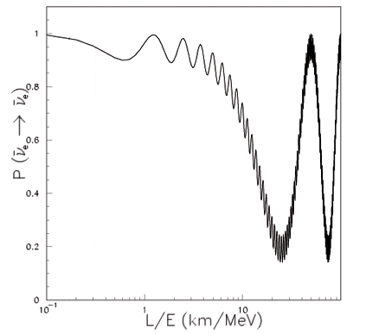
Reactor Experiments
leading terms:
$$\begin{matrix}P_{{\overline{ν}}_{e}→{\overline{ν}}_{e}}=1 −\sin^{2}{2θ_{13}}\sin^{2}{\frac{Δm_{ee}^{2}L}{4E}}−\cos^{4}{θ_{13}}\sin^{2}{2θ_{12}}\sin^{2}{\frac{Δm_{21}^{2}L}{4E}} \\ \end{matrix}$$
$\sin^{2}{\frac{Δm_{ee}^{2}L}{4E}}=\cos^{2}{θ_{12}}\sin^{2}{\frac{Δm_{31}^{2}L}{4E}}+\sin^{2}{θ_{12}}\sin^{2}{\frac{Δm_{32}^{2}L}{4E}}$, $Δm_{ij}^{2}=m_{i}^{2}−m_{j}^{2}$
Reactor Experiment
${\overline{ν}}_{e}$-disappearance
near
far
$$ν_{e}$$
current experiments
KamLAND
next generation
Notes:
Sources and oscillation lengths

Slide 42
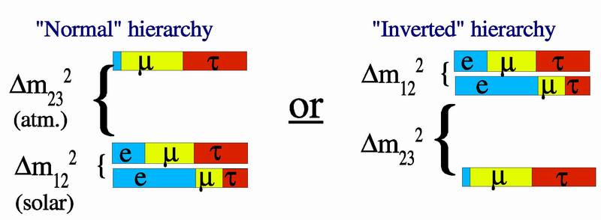
Mass Hierarchy
Reactor Electron-Anti-Neutrino Disappearance
$$P\left({\overline{ν}}_{e}→{\overline{ν}}_{e}\right)=1 −4\sum_{i,j}{{\left|U_{ei}\right|}^{2}{\left|U_{ej}\right|}^{2}\sin^{2}{Δ_{ij}}}$$
$$Δ_{ij}=\frac{Δm_{ij} L}{4E}$$
3-flavour scenario
$$\begin{matrix}P\left({\overline{ν}}_{e}→{\overline{ν}}_{e}\right)=1 \\ −\cos^{4}{θ_{13}}\sin^{2}{2θ_{12}}\sin^{2}{Δ_{21}} \\ \begin{aligned}−\cos^{2}{θ_{12}\sin^{2}{2θ_{13}}}\sin^{2}{Δ_{31}} \\ −\sin^{2}{θ_{12}}\sin^{2}{2θ_{13}\sin^{2}{Δ_{32}}}\end{aligned}\end{matrix}$$
$$Δm_{ij}=m_{i}^{2}−m_{j}^{2}$$
low frequency
high frequency
high frequency
Yu-Feng Li et al.,
Phys.Rev. D88 (2013) 013008
$$\left|Δm_{31}^{2}\right|=\left|Δm_{23}^{2}\right|+\left|Δm_{12}^{2}\right|$$
$$\left|Δm_{31}^{2}\right|=\left|Δm_{23}^{2}\right|−\left|Δm_{12}^{2}\right|$$

Slide 43
Mass Hierarchy
typ. ν-energy: 5 MeV
different frequencies
good L: 50 … 60 km

Slide 44
Mass Hierarchy
$$\cos{\frac{L}{E}}$$
Fourier analysis of signal
$$\sin{\frac{L}{E}}$$

Slide 45
Experimental Landscape
Matter-Effects:
atmospheric neutrinos
beam neutrinos
approval
status



PINGU
ORCA
INO
4 σ
4 σ
2 σ
Noνa
DUNE/LBNE


2 σ
>5 σ
3-Flavour Interference:
JUNO
RENO50


3-4 σ
?
Notes:
Approaches to mass hierarchy: Intereference (JUNO) / Matter effects: Beam or atmospheric

Slide 46
The JUNO Project
447 scientists, 73 institutions, 1/3 from Europe
Jiangmen
Underground
Neutrino
Observatory
See talks by
Stefan van Waasen: This afternoon
Livia Ludhova: Tuesday morning
supported by
Armenia, Austria, Belgium, Brazil, Chili, Chinese Republic, Czech Republic, Germany, Finland, France, Italy, Japan, Korea, Latvia, Russia, Taiwan, and the United States

Slide 47
Georgian-German School and Workshop in Basic Science
Summary

Slide 48
Georgian-German School and Workshop in Basic Science
Cosmology is a driving force of neutrino physics
… but there is more.
CP-violation is a major goal of neutrino physics
… but there is more.
Mass hierarchy is the main goal of JUNO
… but there is more.
Thanks

Slide 49
Georgian-German School and Workshop in Basic Science
Backup Slides

Slide 50
Physics of JUNO
Mass Hierarchy
Others
Super Nova
Direct observation
Diffuse Super Nova background
Solar Neutrinos
Oscillation parameters
Metallicity
Atmospheric Neutrinos
Oscillations
Mass hierarchy ?
Geo Neutrinos
Models of the earth‘s interior
Heat production → climate
Nucleon Decay
i.e. p → K⁺ ν
Dark Matter
χ → νν
Sterile Neutrinos
With radioactive sources
MC-studies:
>3 sigma in 4 years
(3% resolution @ 1 MeV)
ν-oscillations with reactor neutrinos:
Mass hierarchy
Precision Measurements
17

Slide 51
The CHALLENGE
Resolution
LENA: 7%/√E
KamLand: 5%/√E
JUNO: 3 %/√E

Slide 52
The CHALLENGE
Excellent Energy Resolution (3% @ 1 MeV)
Photonstatistics
high lightyield
good transparency
PMT-coverage
PMT-QE
Calibration
α/β/γ sources (in all positions)
light pulsers (in all positions)
UV-laser (in many positions)
e⁺ beam (along axis)
&
13

Slide 53
The MCP-PMT
Photo dection in the cathode
Hamamatsu R12860 (20“PMT)
Detection efficiency =
quantum efficiency
x collection efficiency
x area coverage
Typ. 27%
Spec. > 24%

Slide 54
The MCP-PMT
Multi Channel Plate
+HV
Detection efficiency =
quantum efficiency
x collection efficiency
x area coverage
Typ. 27%
Spec. > 24%
MCP-PMT 8“ prototype

Slide 55
The MCP-PMT
Multi Channel Plate
+HV
Detection efficiency =
quantum efficiency
x collection efficiency
x area coverage
Typ. 27%
Spec. > 24%
MCP-PMT 8“ prototype

