Slide 1
Diversified application of corrosion resistant materials
Georgian Technical University
Dr. Olga Tsurtsumia

Slide 2
Outlook
RCSR
The concept of corrosion
Materials and their application fields
Work already done
Work to be conducted

Slide 3
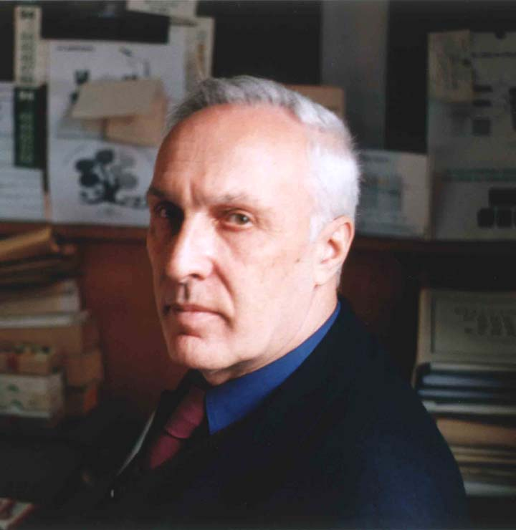
Republic center for structure research
Founded in 1987
RCSR is one of the major materials research and teaching centers in Georgia. The Republic Center for Structure Researches in the Georgian Technical University is serving several institutions in Georgia with the full range of methods for structural investigations of solid materials.
25 scientist, professionals in different fields of materials science and electron microscopy
Prof. Elguja Kutelia

Slide 4
RCSR of GTU
Materials science fields:
Nano powders
Liquid metals (Ga purification)
Crystallography of twinning in crystals
High temperature corrosion resistant alloys…
Structural analysis:
SEM
TEM
AES
Microscopy…

Slide 5
Projects in RCSR within the last 10 years
CRDF/GRDF
ISTC/UNTC
Rustaveli National Science Foundation
EU FP7
Joint and individual projects with German and US partners

Slide 6
HT corrosion resistant materials
Various ferritic alloys with different compositions:
Fe-Cr-Al-(RE)
DADI
P92 …

Slide 7
The principle
The developed oxide scale protects the underling bulk against environmental attack
Oxide layer
Metallic alloy

Slide 8
The environments:
Any aggressive ones:
High temperatures (dry)
High temperature steam
S rich (acid)
Cl rich
Ash (basic)
Others …
Or combination…
Thermal-chemical!!!

Slide 9
Possible materials:
Multy- or single component materials forming stable dioxides or other complex oxides or other scales on the top
Cr2O3
Al2O3
SiO2
…

Slide 10
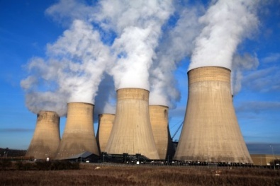
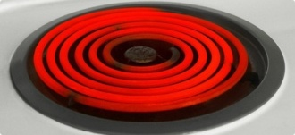
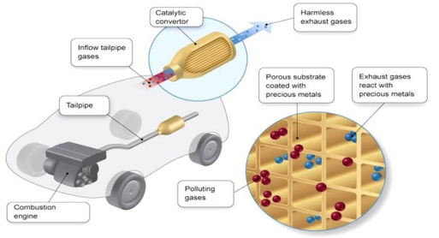
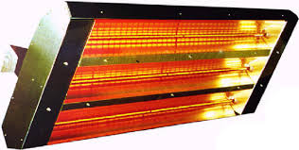
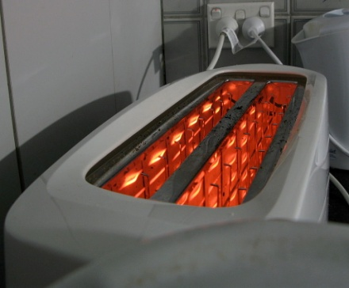
Application fields:
Since we deal with HT corrosion resistant materials:
Power generation
Automotive industry (catalytic converter )
Some electrical devices
Household techniques
And now medicine!

Slide 11
Examples of metallic implants used in medicine
Pins
Bone plates
Screws
Bars
Rods
Wires
Posts
Expandable rib cages
Spinal fusion cages
Finger and toe replacements
Maxillofacial prosthetics

Slide 12
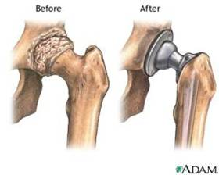
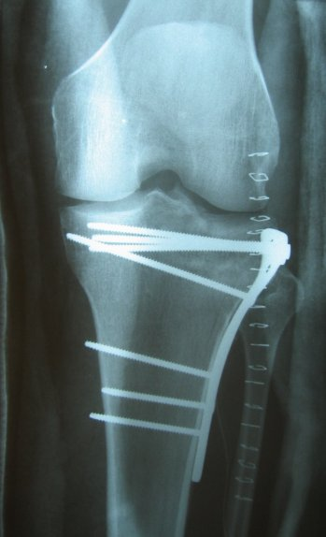
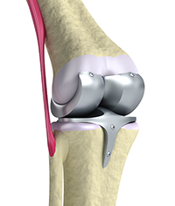
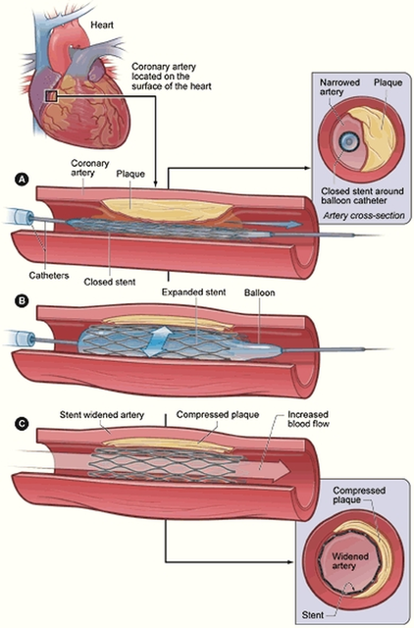
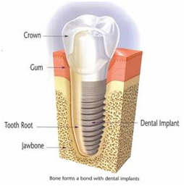
Examples :

Slide 13
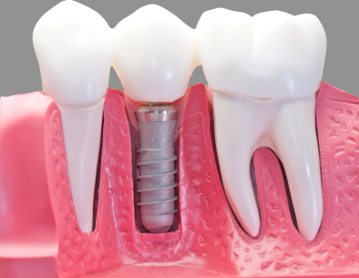
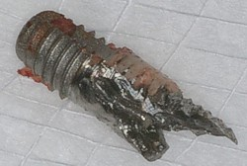
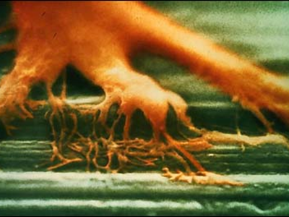
Dental implants (requirements)
Resistance against the corrosion attacks
Mechanical stability
Ability to be attached to the bone tissues in shortest time possible causing no or minimal inflammatory problems if possible
Price

Slide 14
Existing materials for osseointegration:
Special types of steels
austenitic 316 stainless steel
martensitic 440 stainless steel
martensitic 420 stainless steel
Ti and its alloys:
Ti-6Al-4V

Slide 15
Fe – Cr – Al alloy
It meets all of the requirements listed above
This drove us to the idea of trying our material in the radically different field, which is an osseo-implantology

Slide 16
What our alloy offers:
Since the alloy we investigate produces extremely stable alumina of alpha modification, the metal itself is got covered with it completely, it can provide us with all the requirements listed above

Slide 17
The self-organized ceramic layer
Which is Al₂O₃
Conditions for its forming is a high temperature above 1000^{O}C

Slide 18
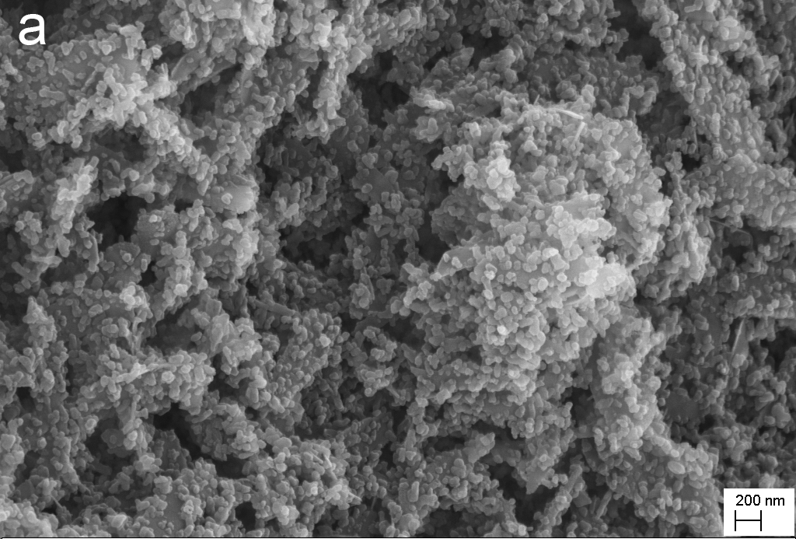
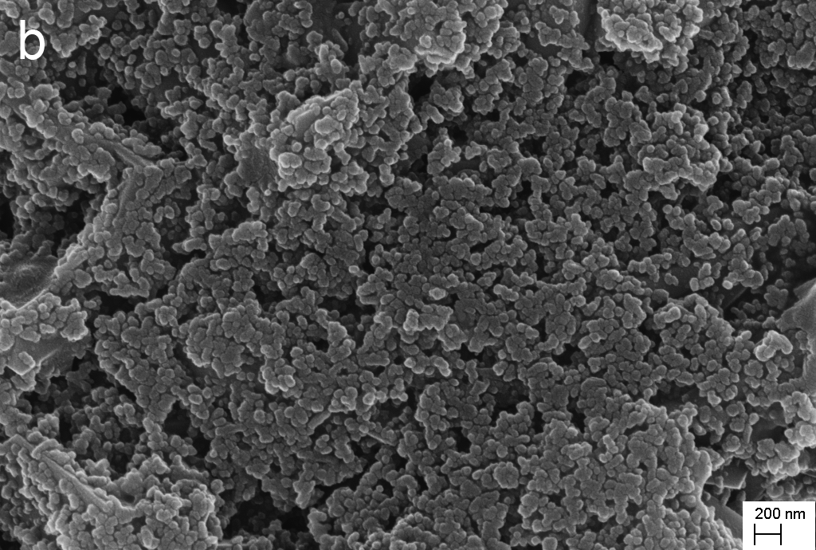
Procedure of MCC
HydroxyApatite (HA) [Ca₁₀(PO₄)₆(OH)₂] is known as a typical representative of the biologically active ceramics the coatings if which on the implant materials is considered as one of the ways of achieving the natural and accelerated bonding to the living tissues.
HA
Oxide layer
Hydroxyapatite powder (a) and thermally
pretreated Fe-Cr-Al-RE alloy (b) using
Electrophoretic deposition technique.
Metallic alloy

Slide 19
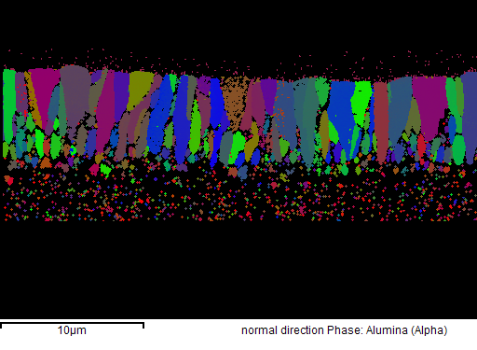
EBSD results
PM2000: Polished/
2000h/1100^{O}C/air
AluchromYHf: Polished/
2000h/1100^{O}C/air
Model alloy (with high Cr): 2000h/1100^{O}C/air
↑ Alloy
↑ Alloy
↑ Alloy
Columnar
Equiaxial
Columnar
Oxide ↓
Fine-grained equiaxial
Fine-grained equiaxial
Fine-grained equiaxial

Slide 20
Advantages of our material
There are several strong advantages of Fe-Cr-Al alloy to be attractive for its further investigation in the direction of the implantology:
Ability of the detail forming using any kinds of mechanical treatment: stamping, extrusion, cutting drilling …
The alumina coating can be received all over the detail
Non toxic (no contact of metal with human bones)
HA coating is got not on the ceramic layer (not metal)
Double protected (thus!)

Slide 21
Work to be done
Optimization of HA deposition technique and the parameters of deposition itself
Improving the adhesion between two ceramics
Conducting:
Mechanical tests
Bio-chemical tests in simulated saliva and growing osteoblast cells
Structural analysis
Application of the same technology on the porous metals
…

Slide 22
Thank you for the attention!

