Slide 1
Silicon Detectors in Particle Physics.
(An introduction to semiconductor detectors).
Paolo Lenisa
Università di Ferrara and INFN - Italy
Tbilisi, July 11th 2014

Slide 2
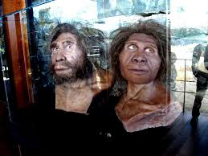
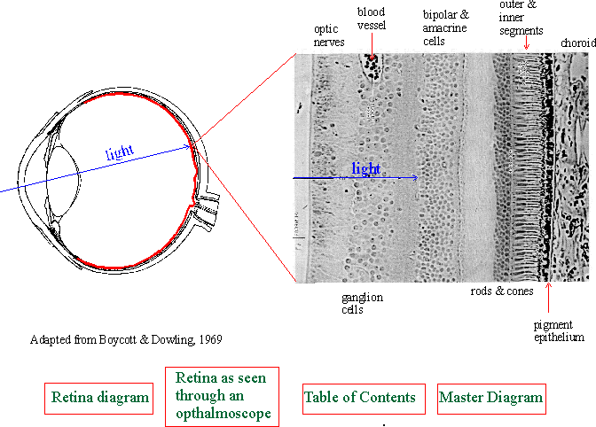
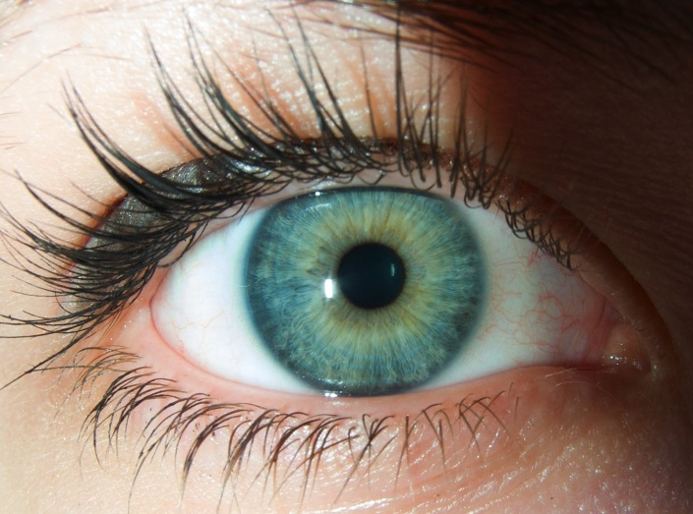
Particle detectors: history
The oldest particle detector …
retina
High sensitivity to photons
Good spatial resolution
Very large dynamic range (1:10¹⁴) + automatic threshold adaptation
Energy (wavelength) discrimination
Modest speed: Data taking rate ~ 10 Hz (incl. processing)

Slide 3
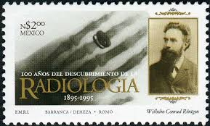
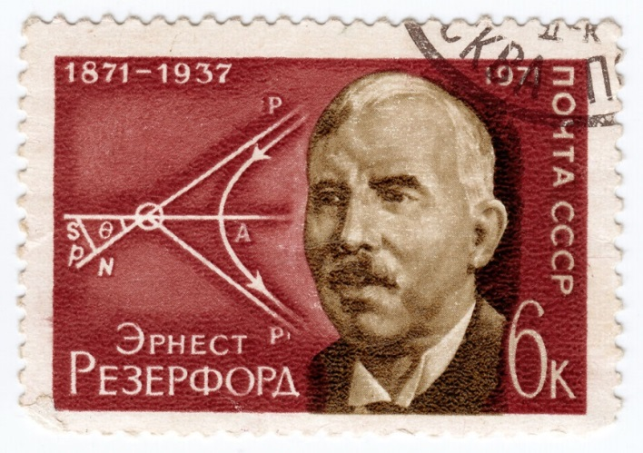
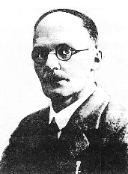
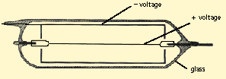
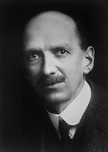
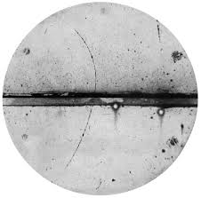
Particle detectors: history
1895 – Röntgen : Use of photographic paper as detector
Photographic paper/film
AgBr + ‘energy’ → metallic Ag (blackening)
Very good spatial resolution
Good dynamic range
No online recording
No time resolution
1909 - Geiger counter → first electrical signal
E. Rutherford
H. Geiger
pulse
1912:- Wilson: Cloud chamber → first tracking
Water evaporates to the point of saturation
Lower the pressure
Super-saturated volume of air
Passage of charged particle condense tvapor
Droplets indicate particle track

Slide 4
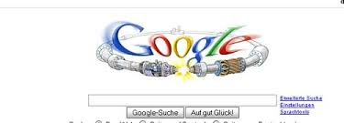
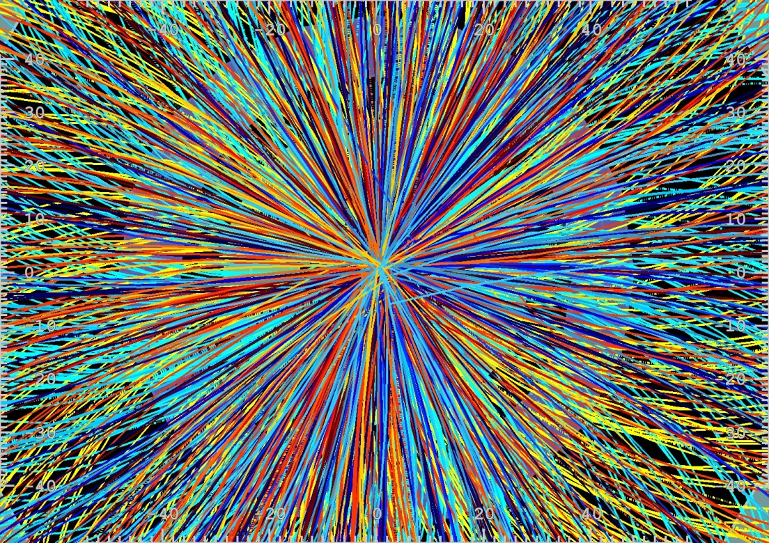
Nowdays …
LHC: 1 billion collisions/sec
How do we see the collisions?

Slide 5
A look at the details…
Example: measurement of B meson lifetime
L
E.g. B → J/Ψ K_{s}⁰
Secondary vertex
Primary vertex
L = p/m c τ
Look for B vertex and measure decay length – dist. between primary and secondary vert.
B mesons decay within 1-2 mm of interaction point (ct ~ 0.5 mm + relativistic time dilat.)
Need vertex detectors with excellent position resolution ~ 10 μm

Slide 6
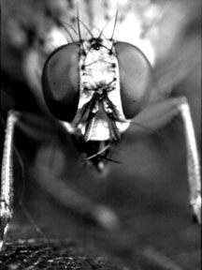
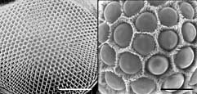
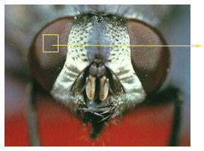
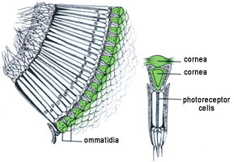
How do we see the collisions? The Eyes of an Insect:
1 billion collisions/s → 1,000 particles every 25 ns
We need highly granular detectors that take pictures quickly, and manipulate the resulting data onboard and store it before shipping to a farm of computers
Notes:
Scientists used to think a fly could see hundreds of separate pictures with its compound eye. Then they learned the pictures from all the separate units of a fly's eye are mixed together before they go to the fly's brain. Now scientists believe a fly sees just one picture of the world.
The fly's compound eye is made up of hundreds of separate identical units called ommatidia (o-ma-TI-di-a).
How does a fly's eye work?
* First, light enters each unit of the fly's eye.
* It hits a tube of light-sensitive cells.
* Each tube of cells sends a message about what it sees to the optic nerve.
* The optic nerve combines the messages and carries them to the fly's brain.
* Finally, the fly's brain puts a picture together and tells the fly what it's looking at.
Who else has compound eyes?
* all insects (including bees, butterflies, ants, moths, beetles and fleas)
* shrimp
* crabs
* lobsters
These are some of the animals that have compound eyes.
A Fly's Eyes
What's the BIG idea here?
A fly's eye is made up of lots of tiny identical shapes.
Look at the huge picture of a fly...
* Where are the fly's eyes?
* Do they look like your eyes?
* How are they different?
The fly's eyes are made up of many shapes that look like stop signs or hexagons.
Something to talk about...
* Why do you think it's so hard to sneak up on a fly?
* What do you imagine a fly sees?
Close up of eyes from
http://www.nbb.cornell.edu/neurobio/hoy/webpage/birgit/pages/strepsis.html
middle and right: comparison between the lens size of the fruit-fly
Drosophila melanogaster (middle) and the strepsipteran X. peckii (right).
The scale of both images is identical, the length of the scale bar 100 mm.

Slide 7
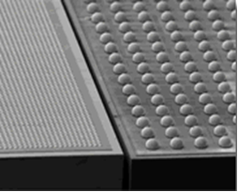
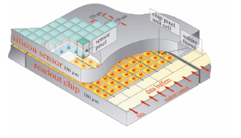
The Eyes of a Piece of Silicon:
The length of each side of the square is about the thickness of a piece of paper. Each eye is called a pixel

Slide 8
Particle detection: requests
High-energy physics detectors aim at:
Coverage of full solid angle
Measure momentum and energy (p, E)
Identify particles (mass, charge)
Fast response
Particles are detected via their interaction with matter:
Charged particles mainly excitation and ionization
Types of detectors:
Trackers (p) and vertex detectors
Thin (low-Z) material (gas, liquid or solid)
Calorimeter (E)
High-Z material (absorber)

Slide 9
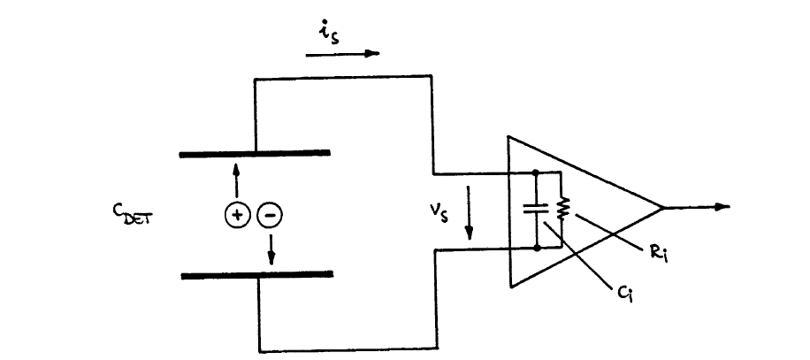
Principle of operation of a Silicon-eye: ionisation chamber
Particle deposits energy in detector medium → positive and negative charge pairs (amount of charge can vary wildly from ~100 – 100 M e, typical is 24,000 e = 4 fC)
Charges move in electrical field ⬄ electrical current in external circuit
Semiconductor detectors are solid-state ionization chambers

Slide 10
Principle of operation of a Silicon-detector: sequence
Charged particle crosses detector
Strips or Pixel - electrodes
charged particle
Positive voltage
Ground
+
~ 150V
Notes:
Need to show 3D picture of strip or pixel sensor
Need to have incident particle appear first
Need to show a realistic plot a la Fig 1.15 with better labelling on what is what
(n and p doped)
Need a plot to explain what electrons and holes are HS 2.7

Slide 11
Principle of operation of a Silicon-detector: sequence
Charged particle crosses detector
Creates electron hole pairs
Strips or Pixel - electrodes
+
-
+
-
~ 150V
+
+
-
-
+
-
+
+
-
Notes:
Need to show 3D picture of strip or pixel sensor
Need to have incident particle appear first
Need to show a realistic plot a la Fig 1.15 with better labelling on what is what
(n and p doped)
Need a plot to explain what electrons and holes are HS 2.7

Slide 12
Principle of operation of a Silicon-detector: sequence
Charged particle crosses detector
Creates electron hole pairs
These drift to nearest electrodes ⬄ position determination
Strips or Pixel - electrodes
+
-
+
-
~ 150V
+
+
-
-
+
-
+
+
-
Notes:
Need to show 3D picture of strip or pixel sensor
Need to have incident particle appear first
Need to show a realistic plot a la Fig 1.15 with better labelling on what is what
(n and p doped)
Need a plot to explain what electrons and holes are HS 2.7

Slide 13
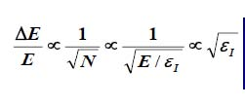
Solid state vs gas detectors
Ionization medium: gas, liquid or solid.
Gas: electron-ion pairs
Semiconductors: electron-holes pairs
Solid State Detector:
ADVANTAGES
Energy for e-h pair < 1/10 gas ionization
Increase charge → good E resolution
Greater density
Reduced range of secondary electron → excellent spatial resoluton
To minimize multiple scattering → short thickness
300 mm → 32000 e-ha pairs yealds good S/N
DISADVANTAGES
Cost ∝ Area covered
Most cost in readout channels
Material budget → Radiation length can be significant
Radiation damage → Replace often or design very well

Slide 14
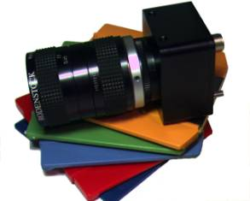
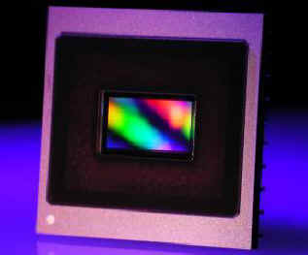
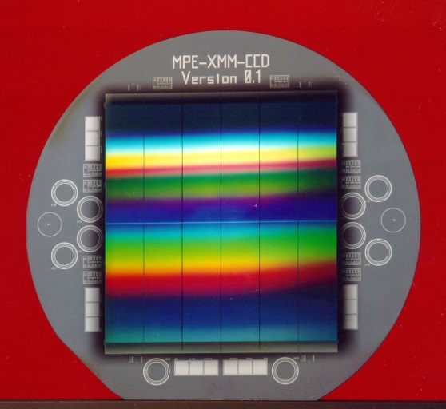
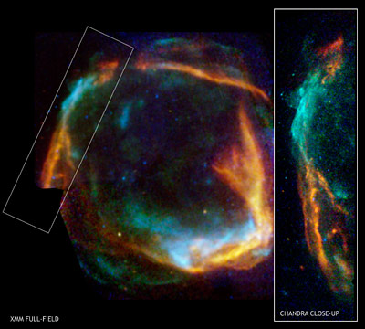
“Silicon-eyes” (detectors): many applications
in digital Cameras to detect visible light
in satellites to detect X-rays
synchrotrons: detection of X-ray and synchrotron radiation
nuclear physics measurement of γ-rays energy
heavy ion and particle physics: detection of charged particles
in medical imaging
in homeland security applications
What makes silicon detectors so popular and powerful?

Slide 15
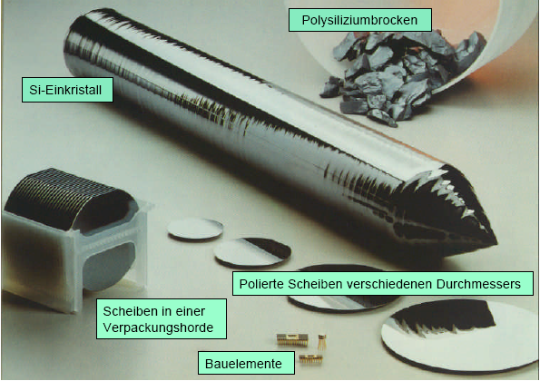
What’s silicon?

Slide 16
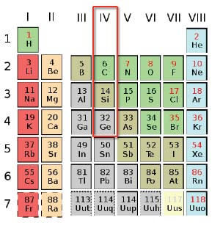
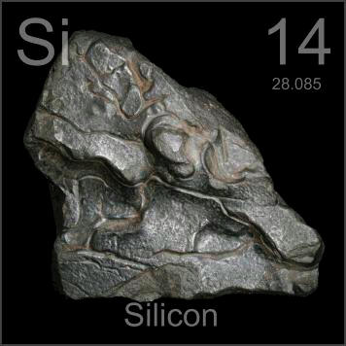
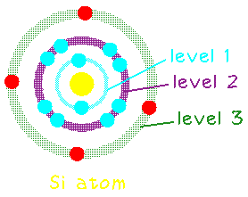
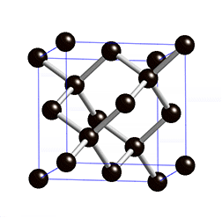
What’s silicon?
After Oxygen, Silicon is the 2nd most abundant element in Earth’s crust (>25% in mass)
The crystalline structure is diamond cubic (FCC), with lattice spacing of 5.43 A
Polysilicon consists of small Si crystals randomly oriented; in α-Si there is no long range order.

Slide 17
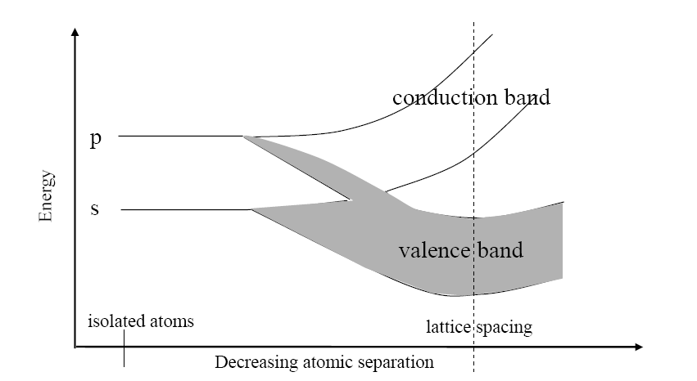
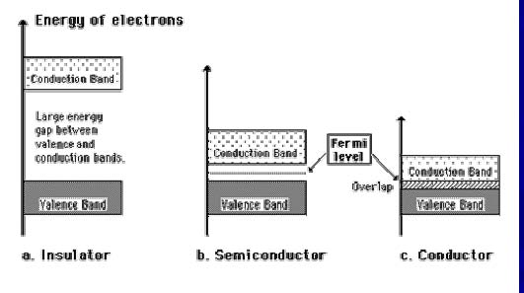
Semiconductor basics: band structure
Isolated atoms brought together and form lattice → wave functions overlap
Discrete atomic energy states shift and form energy bands
Properties of semiconductors depend on band gap

Slide 18
Semiconductor basics: intrinsic charge carriers
Intrinsic semiconductors have no (few) impurities
At 0 K all electrons in valence band
no current flow if electric field applied
At room temperature, electrons excited to the conduction band
 | Si | Ge | GaAs | Diamond
E_{g}[eV] | 1.12 | 0.67 | 1.35 | 5.5
n_{i} (300K) [cm⁻³] | 1.45 x 10¹⁰ | 2.4 x 10¹³ | 1.8 x 10⁶ | < 10³
Important parameter of a detector : signal to noise ratio (SNR).
Two contradictory requirements:!
Large signal → low ionisation energy → small band gap!
Low noise → very few intrinsic charge carriers → large band gap!
Optimal material: Eg ≈ 6 eV. !
Conduction band is almost empty at room temperature
Band gap small enough to create a large number of e⁻h⁺ pairs.
Such a material exist, it is Diamond. → too expensive for large detectors!.

Slide 19
E.g. calculation for silicon: Mean ionization energy I₀ = 3.62 eV mean energy loss per flight path: dE/dx = 3.87 MeV/cm intrinsic charge carrier density at T = 300 K n_{i} = 1.45 · 10¹⁰ cm⁻³ Assuming a detector with a thickness of d = 300 μm and an area of A = 1 cm²
Example: Estimate of SNR in an intrinsic Si-detector
Intrinsic charge carrier at 300 K:
→ Signal of a mip in such a detector:
→ Number of thermal created e⁺ h⁻ pairs four orders of magnitude higher than signal!
How to detect a drop of water in the ocean ?
Remove the charge carrier → Depletion zone in reverse biased p-n junctions (DIODE)!

Slide 20
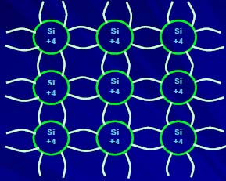
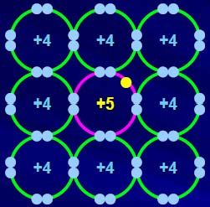
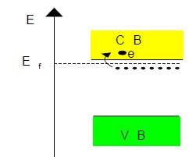
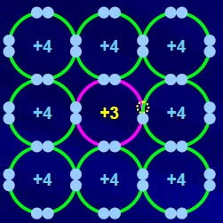
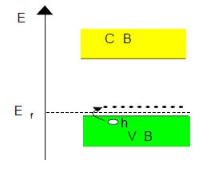
What are Si-diodes made of?
Silicon (group 4).
Each atom shares 4 valence electrons with its four neighbors.
The valence band has 8 electrons.•
At T=0K all electrons are in VB and CB is empty
As T increases some electrons jump the gap from VB to CB.
n -Type material
In an n-type semiconductor, e⁻ carriers obtained by adding an atom with 5 valence electrons: (As, Sb, P)
Electrons are the majority carriers
Donors introduce energy levels 0.01 eV below the CB
⇒ Fermi Level moves close to CB.
p -Type material
In a p-type semiconductor, holes carriers are obtained by adding impurities of acceptor ions (B)
Holes are the majority carriers.
Acceptors introduce energy levels close to VB that ‘absorb’ electrons from VB, creating holes
=> Fermi Level moves close to VB.

Slide 21
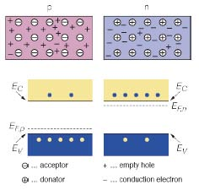
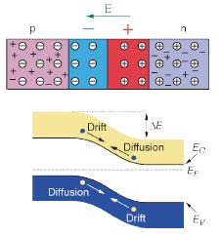
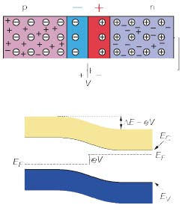
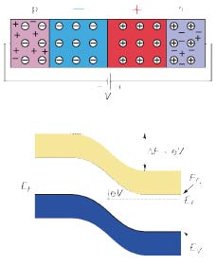
p-n junction
p-n junction
Difference in the Fermi levels cause diffusion of excessive carries to the other material until thermal equilibrium is reached.
At this point the Fermi level is equal. The remaining ions create a space charge region and an electric field stopping further diffusion.
The stable space charge region is free of charge carries and is called the depletion region.
Forward biasing.
Applying an external voltage V with the anode to p and the cathode to n, e⁻ and h⁺ are refilled to the depletion zone. The depletion zone becomes narrower.
Consequences:
• The potential barrier becomes smaller by eV
• Diffusion across the junction becomes easier
• The current across the junction increases significantly.
Reverse biasing.
Applying an external voltage V with the cathode to p and the anode to n, e⁻ and h⁺ are pulled out of the depletion zone. The depletion zone becomes larger.
Consequences:
• The potential barrier becomes higher by eV
• Diffusion across the junction is suppressed.
• The current across the junction is very small (“leakage current”)
(This is how we operate a semiconductor detector.)

Slide 22
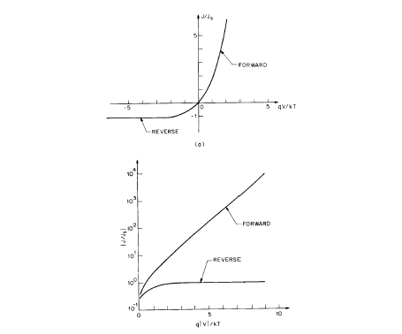
How to detect a drop of water in the ocean ? → remove ocean by blocking the DC current
Diodes reversely biased: very small leakage current flow

Slide 23
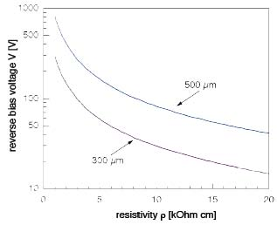
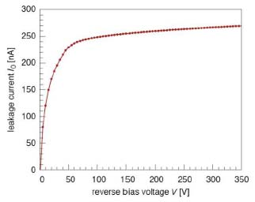
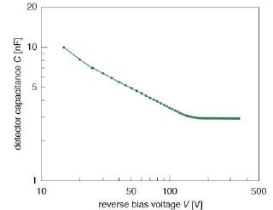
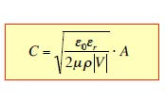
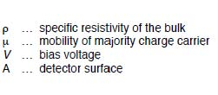
Detector characteristics
Depletion voltage
Minimum voltage at which the bulk of the sensor is fully depleted.
Operating voltage is usually chosen to be slightly higher (overdepletion).
High resistivity material (i.e. low doping) requires low depletion voltage
Leakage current
Detector operated with reverse bias,
Saturation current $$ leakage current
Drift of the e⁻ and h⁺ to the electrodes
Dominated by thermally generated e⁻h⁺ pairs.
Due to the applied electric field they cannot recombine and are separated.
Capacitance
Capacitance similar to parallel-plate capacitor
Fully depleted detector capacitance defined by geometric capacitance:

Slide 24
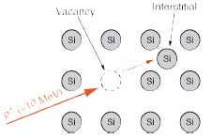
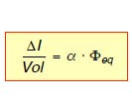
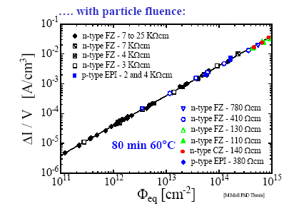
Operation: radiation damage
Particles (radiation) interact with:
a) electrons → used for particle detection (temporarily effects only)
b) atoms of the detector → permanent changes (defects) in the detector bulk.
A displaced silicon atom produces an empty space in the lattice (Vacancy, V) and in another place an atom in an inter lattice space (Interstitial, I).
Radiation induced leakage current
independent of impurities; every 7°C
of temperature reduction halves current
→ cool sensors to ≈ -25°C
type inversion” from n to p-bulk
→ increased depletion voltage
oxygenated silicon helps (for protons);
n+-in-n-bulk or n+-in-p-bulk helps
Charge trapping
the most dangerous effect at high fluences
→ collect electrons rather than holes
→ reduce drift distances
Notes:
Expand this into a few slides

Slide 25
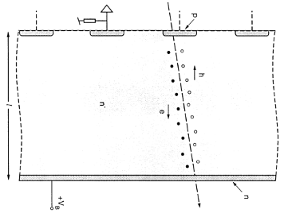
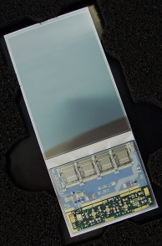
Example: strip detector
768 Strip Sensors
80μm
P⁺⁺
300μm
N⁺ (high res)
E
Wires
RO electronic
V_{bias} ~10’sV
Power supply
Charged particles create e⁻h⁺ pairs in the depletion zone (∼ 30.000 pairs in 300 μm).
Charges drift to the electrodes.
Drift (current) creates signal amplified by an amplifier connected to each strip.
From the signals on the individual strips the position of particle is deduced.
22

Slide 26
Example: strip detector
High events rate require fast signal collection:
Drift velocity of e⁻ and h⁺
For a detector thickness of 300 μm and over-depleted V_{b} = 50 V and 10 kΩ resistivity:
τ_{coll} (e⁻) ≈ 12ns
τ_{coll}(h⁺) ≈ 35ns
Fast collection time helps radiation hardness:
Radiation damage to the Si bulk increases recombination rate.
Signal has to be collected quickly, before recombination.
24

Slide 27
An application: Beam Polarization Measurement at PAX
Measurement of asymmetry in pd-elastic scattering
2 Silicon Tracking Telescopes left and right of the COSY beam
Deuterium Cluster Target (d_{t}=10¹⁴ atoms/cm²)

Slide 28
An application: Beam Polarization Measurement at PAX
Measurement of asymmetry in pd-elastic scattering
2 Silicon Tracking Telescopes left and right of the COSY beam
Deuterium Cluster Target (d_{t}=10¹⁴ atoms/cm²)
Top view
Detectors measure E, Θ, φ
Particle identification
Selection of elastic scattering
events
cluster target

Slide 29
An application: Beam Polarization Measurement at PAX
Energy loss in 1. vs 2. layer
Energy loss in 2. vs 3. layer
dE (STT1_2) vs dE (STT1_3)
dE (STT1_1) [MeV]
dE (STT1_2) [MeV]
deuterons
deuterons
protons
protons
dE (STT1_2) [MeV]
dE (STT1_3) [MeV]
Deuteron momentum vs. scattering angle
Proton momentum vs. scattering angle
P [GeV/c]
P [GeV/c]
Θ [deg]
Θ [deg]

Slide 30
An application: Beam Polarization Measurement at PAX
Events in left L↑↓ and right R↑↓ detector:
t = 0s
t = 12000s

Slide 31
Results.
Aim of the experiment.
polarization of a stored p-beam by interaction with a polarized H target (PAX session – Thu. 10.07)
P measured after 0 s, 1.2x10⁴ s and 1.6x10⁴ s:
Polarization build with time: dP/dt=(4.8±0.8)×10⁻⁷ s

Slide 32
The future PAX silicon-eye

Slide 33
The future PAX silicon-eye: a quadrant
READ-OUT LAYER 1
DISTRIBUTOR BOARDS ?
READ-OUT LAYER 3
SENSORS LAYER 3 : PAX
READ-OUT LAYER 2
SENSORS LAYER 2 : PAX
SENSORS LAYER 1 : HERMES

Slide 34
One of the largest eyes ever built: the ATLAS detector
ATLAS SCT
4 barrel layers, 2 x 9 forward disks
4088 double sided modules
Total Silicon surface 61.1m²
Total 6.3 M channels
Power consumption ~ 50kW
module

Slide 35
ATLAS detector: a sample picture

Slide 36
Summary

