Slide 1

The PAX experiment
Paolo Lenisa
Università di Ferrara and INFN - Italy
Tbilisi, July 10th 2014

Slide 2
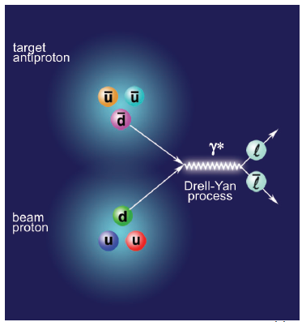



Motivation
The PAX collaboration proposed to investigate Drell Yan processes in scattering of polarized proton - antiproton beams at the HESR (FAIR).
Annihilation of valence quark with an
antivalence quark allows direct access
to: transversity, ….
Requirements:
Polarized proton beam
Polarized antiproton beam

Slide 3
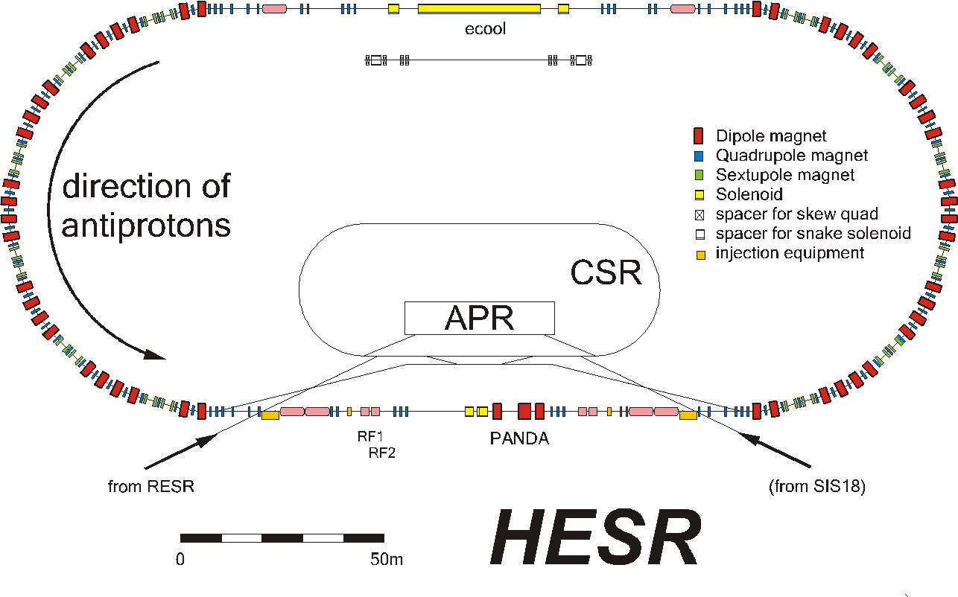
A polarized Proton-Antiproton Collider at FAIR
polarized antiprotons in HESR (p=15 GeV/c)
polarized protons in CSR (p=3.5 GeV/c)
direction of
protons
direction of
anti-protons

Slide 4
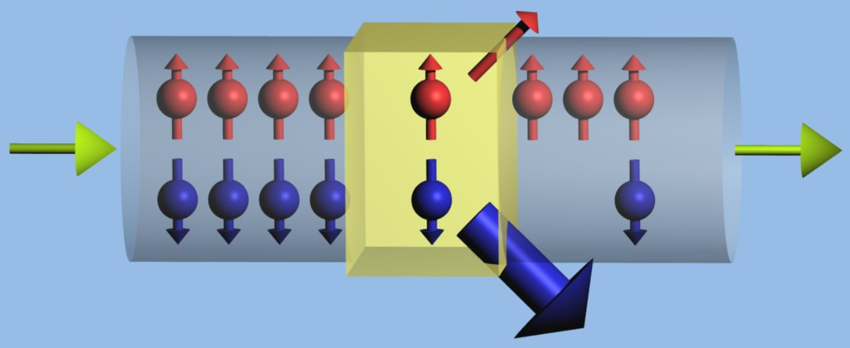
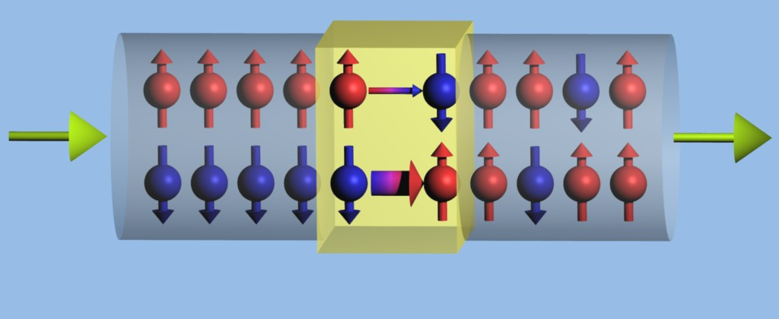
How to Polarize Antiprotons?
Spin-1/2 particles 2 states
selective removal
selective flip
unpolarized
polarized
unpolarized
polarized
Reduces beam intensity
Does not affect intensity

Slide 5
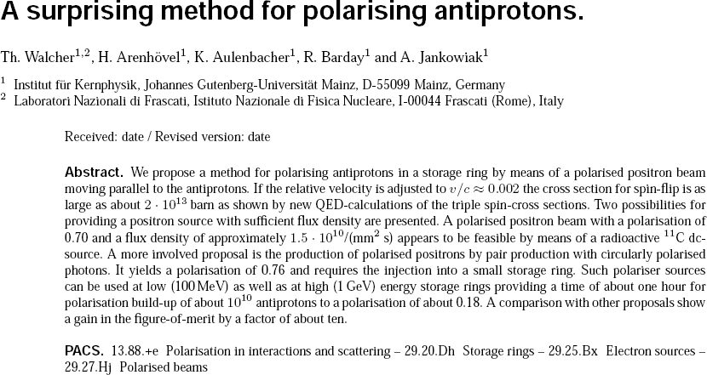
Selective-flip: a proposal
Eur. Phys. J. A 34, 447 (2007)

Slide 6
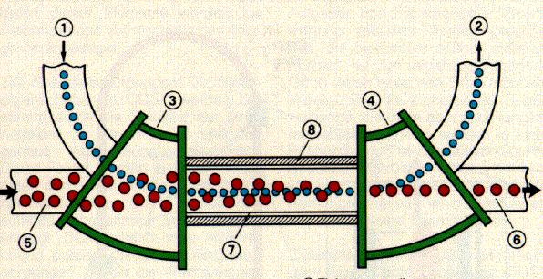
Spin-flip studies at COSY (in I3HP2)
Use proton beam and co-moving electrons
Turn experiment around: p e → p e into p e → p e
i.e. observe depolarization of a polarized proton beam
Velocity mismatch
COSY electron cooler (detuned)

Slide 7
Spin-flip: results
Nominal proton energy in electron rest frame (keV)
σ║ < 3.2 x 10⁷ b
σ┴ < 1.7 x 10⁷ b
0
1
2
3
4×10⁷
D.Oellers et al., Physics Letters B 674 (2009) 269
2×10⁷
σ_{depol} (barn)
0
-2×10⁷
-4×10⁷
0
1×10⁻³
2×10⁻³
3×10⁻³
|Relative velocity of electrons in proton rest frame| (c)
D.Oellers et al., Physics Letters B 674 (2009) 269
RESULT: Selective flip: e⁺ pbar spin-flip cross-section is too low
MILESTONE for the field!

Slide 8
How to Polarize Antiprotons?
Spin-1/2 particles 2 states
selective removal
selective flip
unpolarized
polarized
unpolarized
polarized
Reduces beam intensity
Does not affect intensity

Slide 9
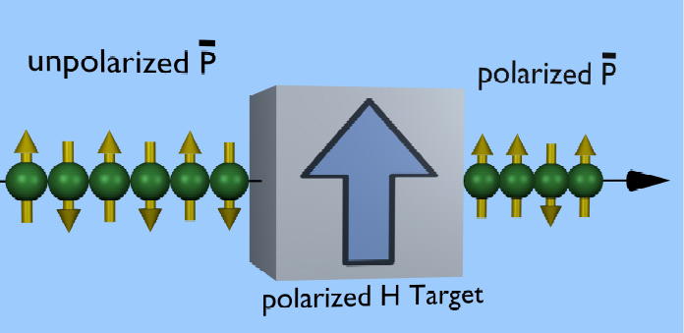
Spin-filtering
Polarization build-up of a circulating particle beam
by interaction with a polarized gas target

Slide 10
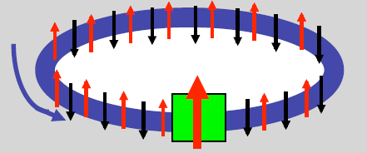
Spin-filtering
P…beam particle spin orientation
Q…target particle spin orientation
k || beam direction
unpolarized
p beam
polarized
target

Slide 11
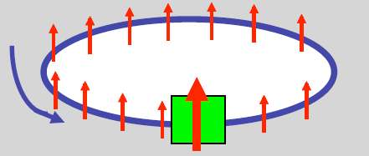
Spin-filtering
P…beam particle spin orientation
Q…target particle spin orientation
k || beam direction
polarized
p beam
polarized
target

Slide 12
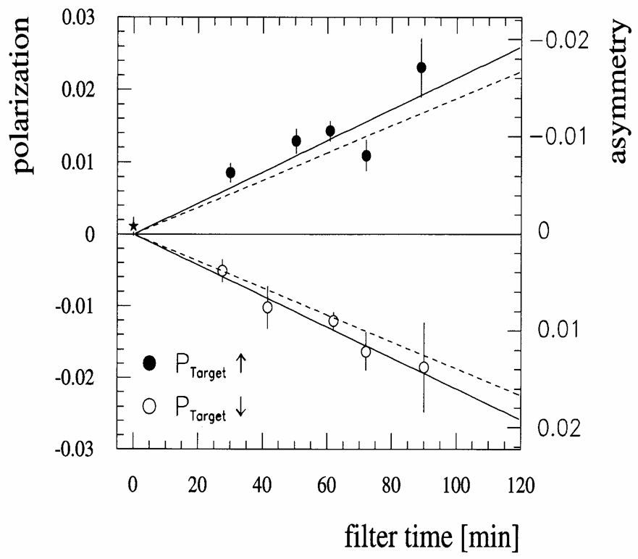
1992: Filter Test at TSR with protons
Spin filtering works for protons
F. Rathmann. et al.,
PRL 71, 1379 (1993)
PAX submitted new proposal to find out how well does spin filtering work for antiprotons Measurement of the Spin-Dependence of the pp Interaction at the AD Ring
(CERN-SPSC-2009-012 / SPSC-P-337)

Slide 13
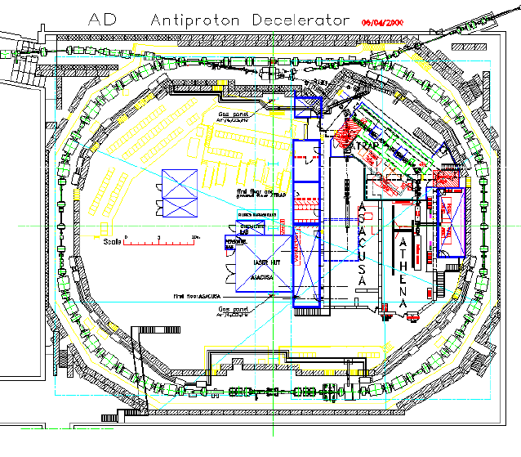
Measurements at AD (CERN)
Aim: 1st measurement of the spin-dependence of the pbar-p cross section
Method: measurement of polarization build-up by spin-filtering
PAX target section

Slide 14
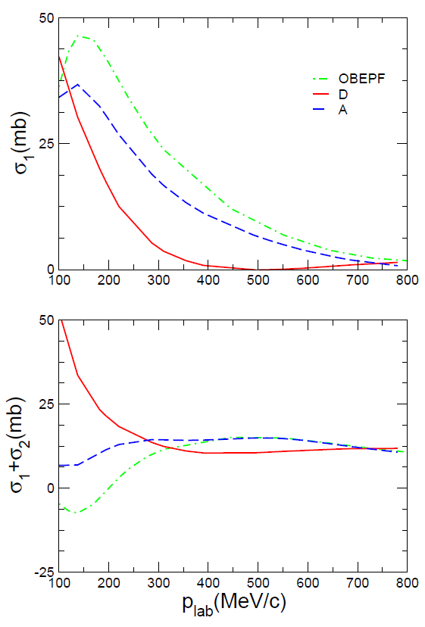
Spin-dependence of the pbar-p interaction
TRANSVERSE
Model A: T. Hippchen et al., Phys. Rev. C 44, 1323 (1991).
Model OBEPF: J. Haidenbauer, K. Holinde, A.W. Thomas, Phys. Rev. C 45, 952 (1992).
Model D: V. Mull, K. Holinde, Phys. Rev. C 51, 2360 (1995).
LONGITUDINAL
Oct. 2009 SPS Committee:
… Taking into account the timeline and constraints of the various projects concerned, the SPSC encourages the PAX Collaboration to first perform their spin filtering measurements at COSY…

Slide 15
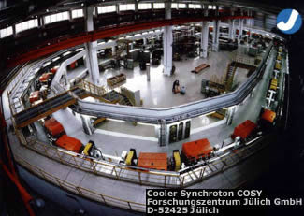
Spin Filtering Studies at COSY
Spin filtering with protons for better understanding of the underlying processes and commissioning of the experimental setup
Length: 183.4 m
Injection energy: 45 MeV
Electron cooling for long lifetimes
up to 600 MeV/c (p)

Slide 16
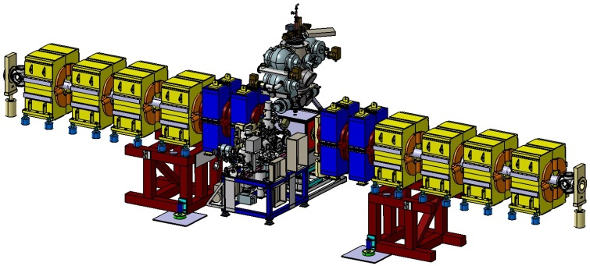
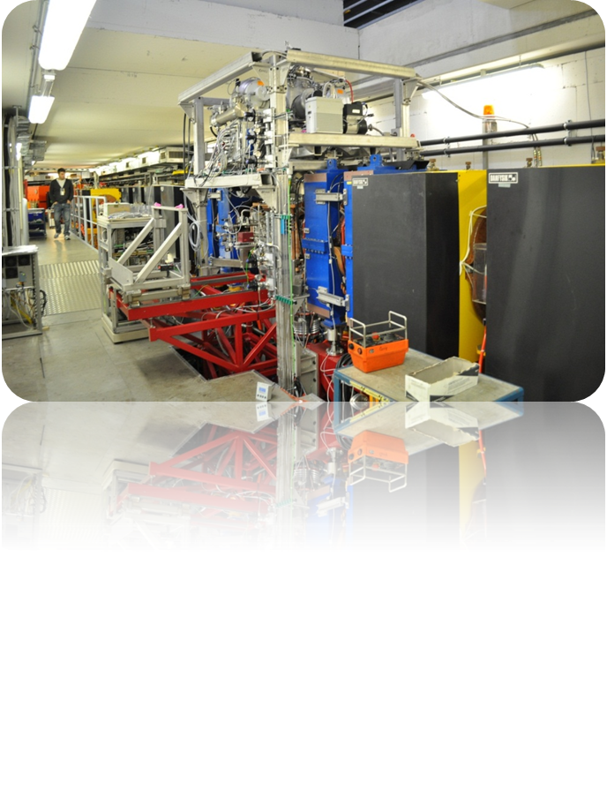
Experimental setup at PAX-IT
Low-β
Quadrupoles
ABS
Target
Chamber

Slide 17
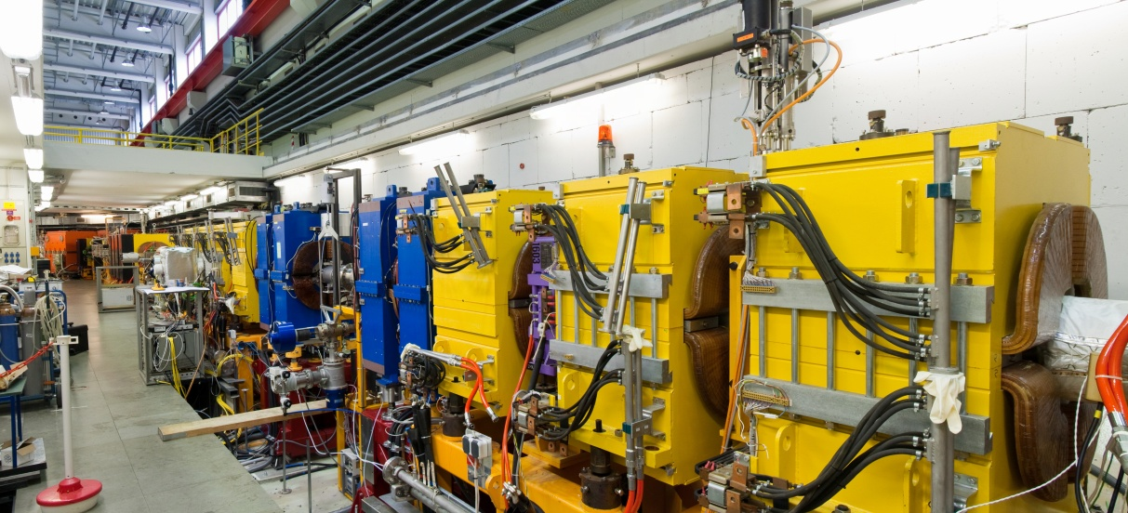
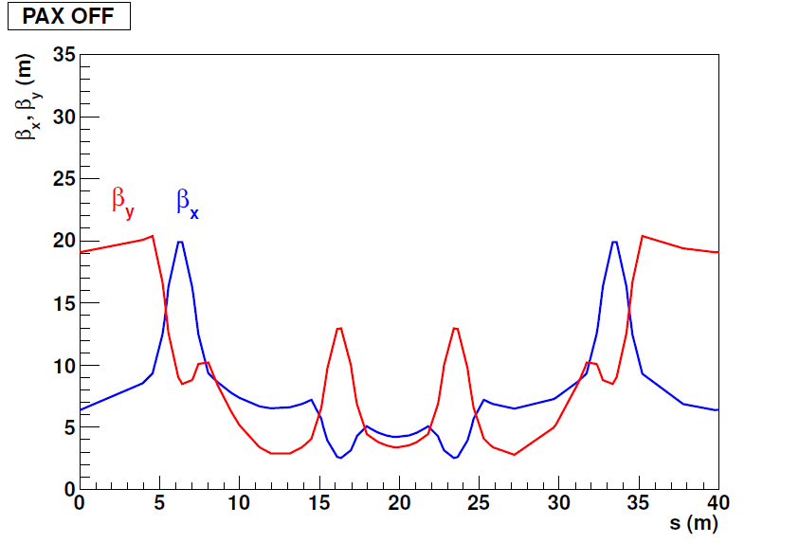
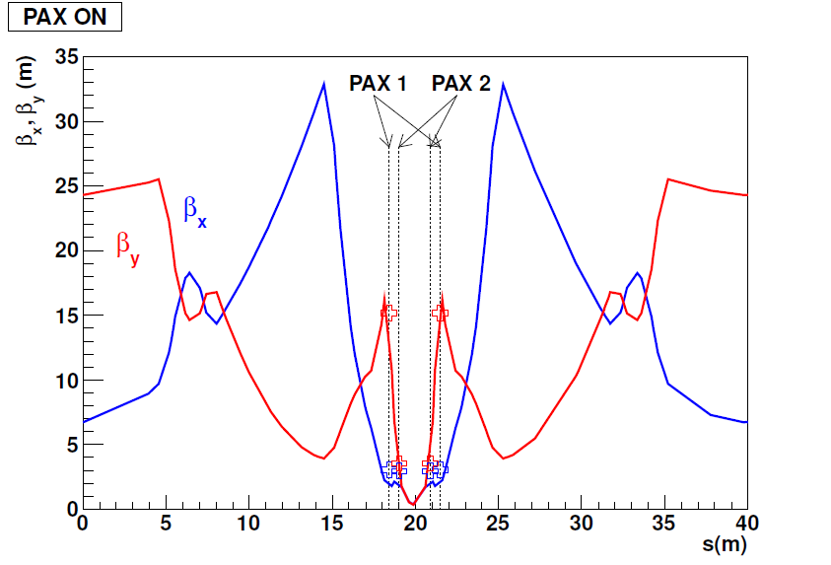

Low-β section
Beam lifetime $τ$:
Low-β section off
Low-β section on

Slide 18
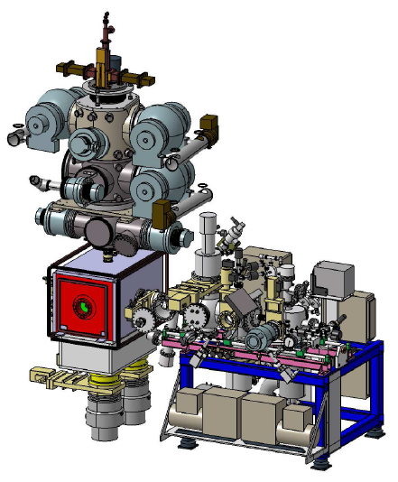
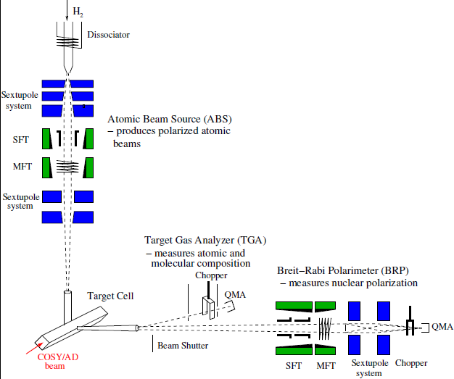
Atomic Beam Source

Slide 19
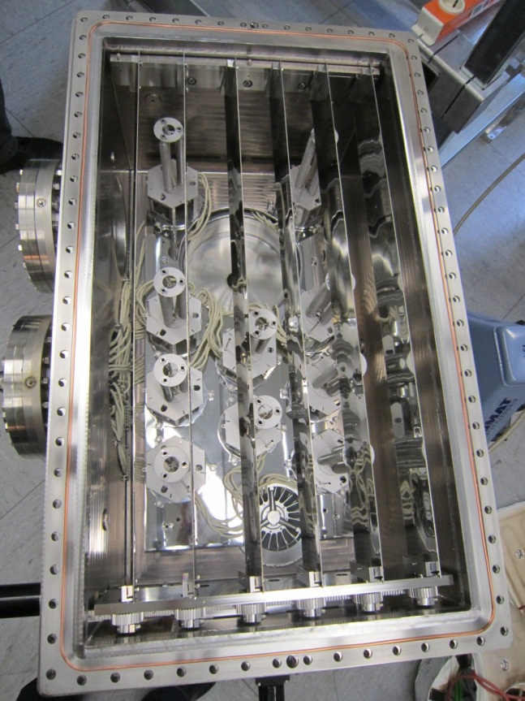
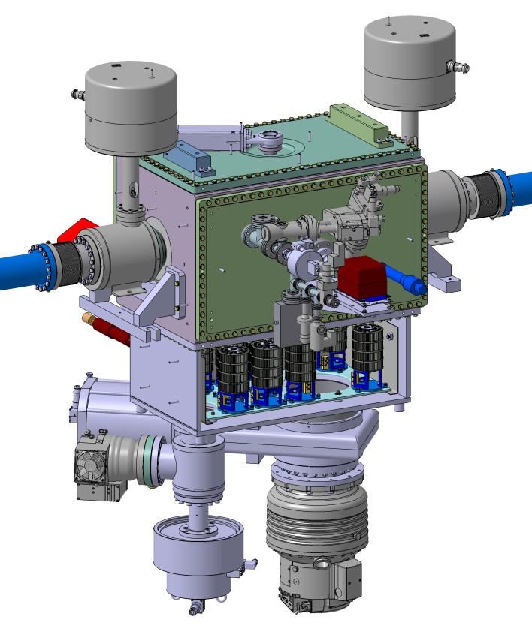
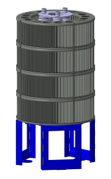
Target chamber
SAES getter pump
(each 1900 l/s)
HiPace 1800 turbo
(1200 l/s)

Slide 20
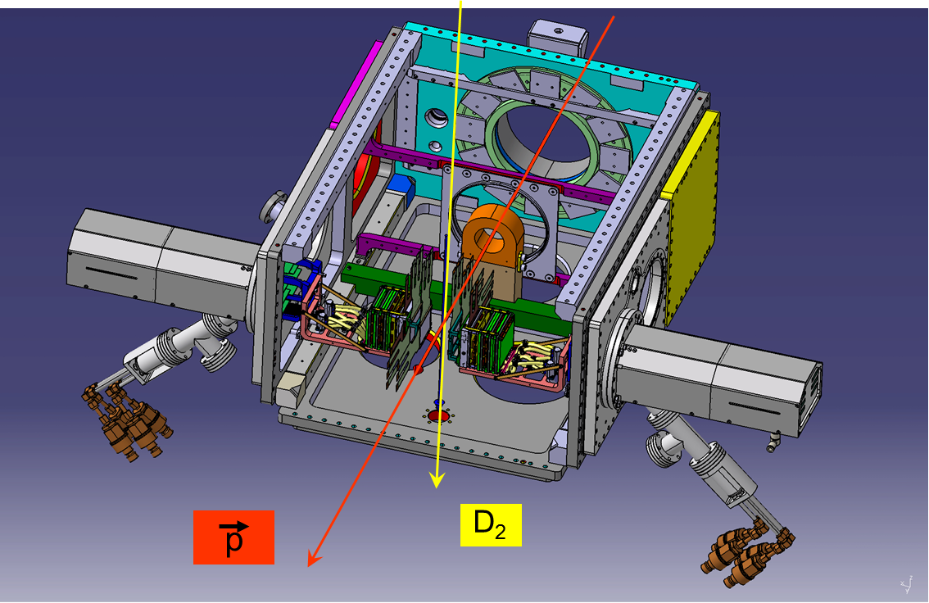
Beam polarimeter
Measurement of asymmetry in pd-elastic scattering
2 Silicon Tracking Telescopes left and right of the COSY beam
Deuterium Cluster Target (d_{t}=10¹⁴ atoms/cm²)

Slide 21
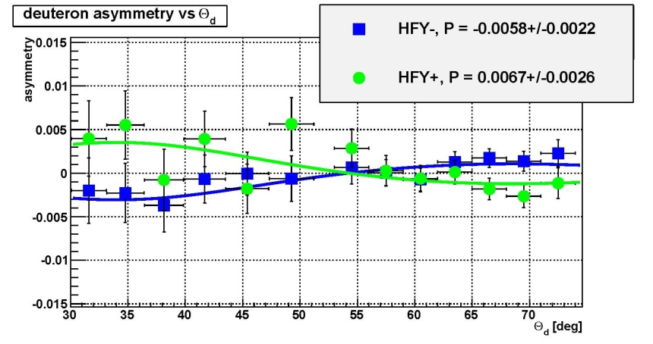
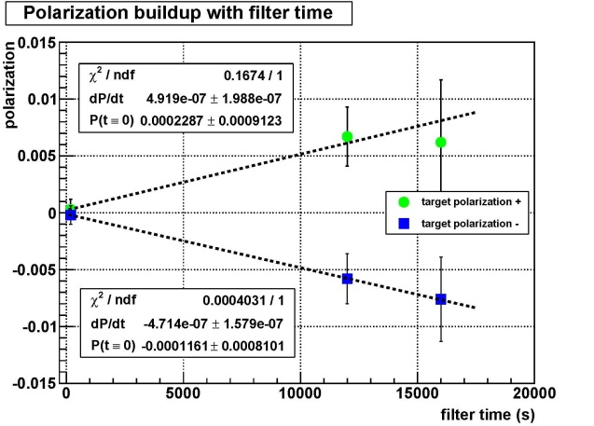
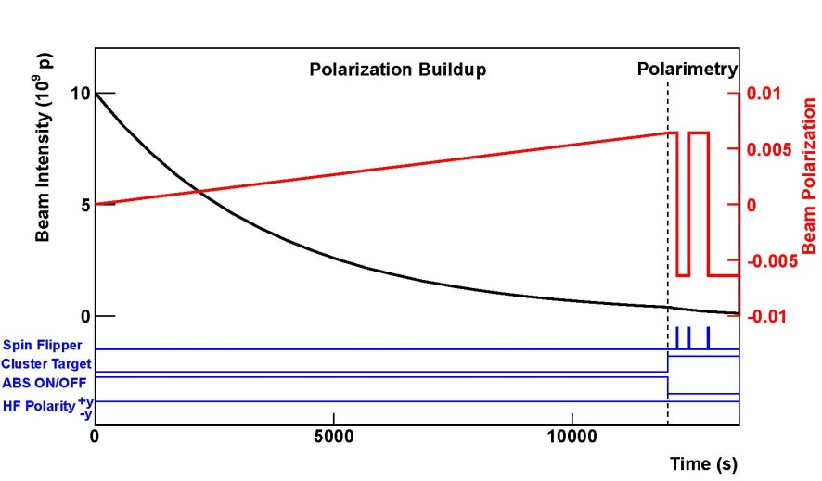
Spin-filtering cycle
Spin-flipper
cluster targ. + STT (beam polarimetry)
p
COSY ring
polarized target

Slide 22
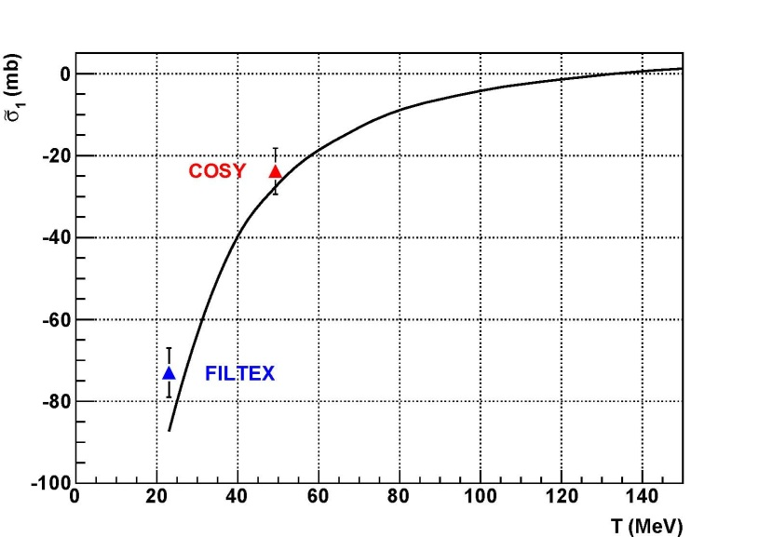
Spin-filtering: results
W. Augustyniak et al., Physi. Lett. B 712 (2012) 64
MILESTONE FOR THE FIELD!
  Confirms understanding of spin-filtering as a viable method to polarize a stored beam.
  Confirms complete control of the systematics of the experiment.
Mar. 2012 SPS Committee:
… many positive developments have occurred at the AD, leading to an updated program for the coming years ….We consider that PAX is now incompatible with this program.

Slide 23
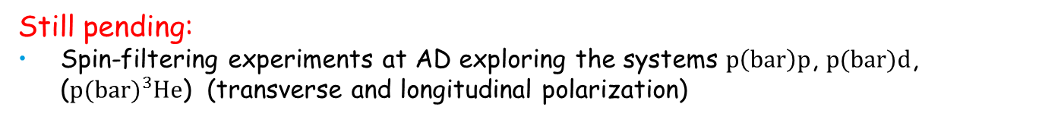
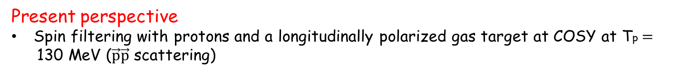
Polarized antiprotons: situation
Status:
Successfull (negative) spin-flip test at COSY
Successfull spin filtering measruement at COSY on transverse target.
  Excellent agreement with theoretical predictions for protons
  Successfull commissioning of experimental setup for experiments with antiproton
Present perspective
Spin filtering with protons and a longitudinally polarized gas target at COSY at Tp$=$130 MeV ($\vec{p}\vec{p}$ scattering)
Still pending:
    Spin-filtering experiments at AD exploring the systems $p\left(bar\right)p$, $p(bar)d$, ($p(bar){}_{}^{3}{He}$) (transverse and longitudinal polarization)

Slide 24
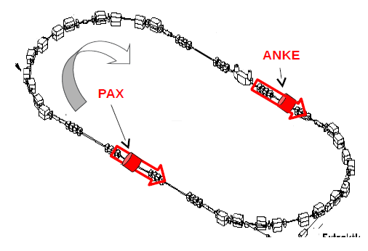
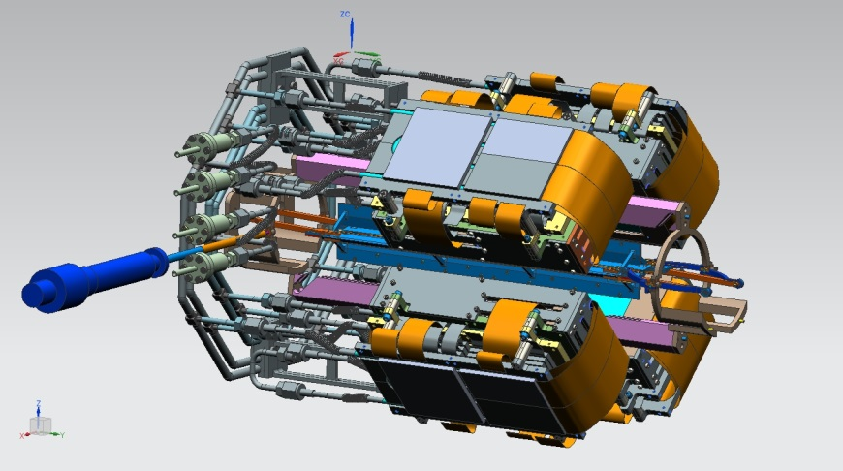
PAX next future plans
Waiting for approval at CERN (or construction of FAIR facility)
Longitudinal spin-filtering test at COSY
→ mandatory for determination of total spin-filtering cross-section
Superconducting 4.7 Tm solenoid ordered
Longitudinal beam polarimeter in pre‘aration:
-> next talk from V. Carassiti

Slide 26
Additional Slides

Slide 27
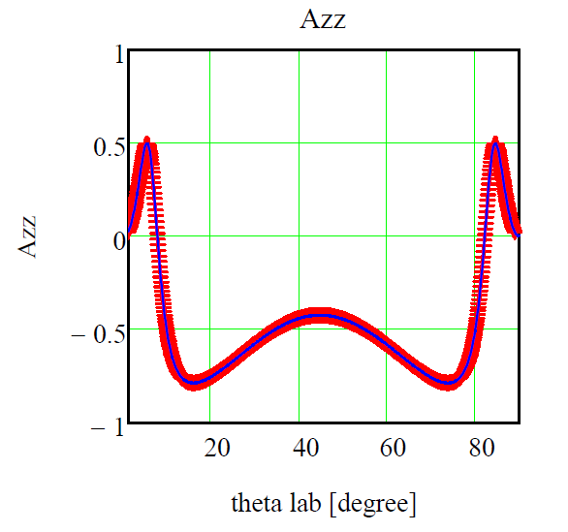
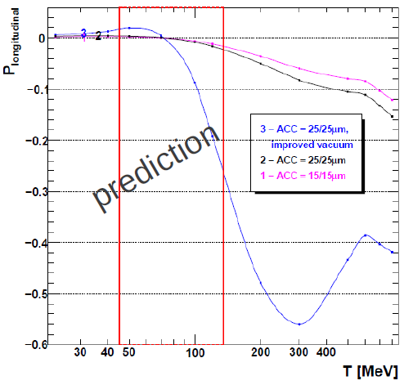
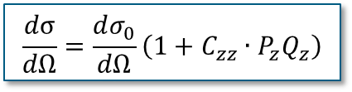

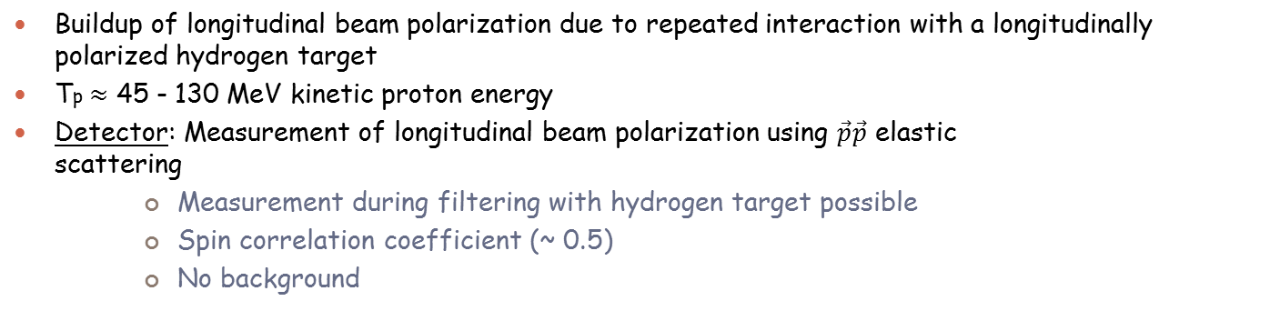
Spin Filtering with Longitudinal Polarization
Buildup of longitudinal beam polarization due to repeated interaction with a longitudinally polarized hydrogen target
Tp$≈$ 45 - 130 MeV kinetic proton energy
Detector: Measurement of longitudinal beam polarization using $\vec{p}\vec{p}$ elastic scattering
      Measurement during filtering with hydrogen target possible
      Spin correlation coefficient (~ 0.5)
      No background
$$\frac{dσ}{dΩ}=\frac{dσ_{0}}{dΩ}\left(1+C_{zz}∙P_{z}Q_{z}\right)$$
$$C_{zz}$$

Slide 28
Expected polarizations after filtering for two lifetimes
transverse
longitudinal
A
D

Slide 29
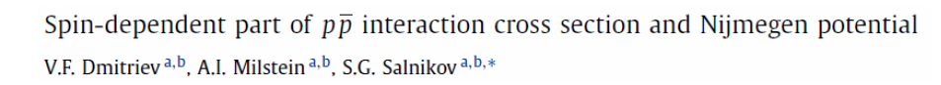
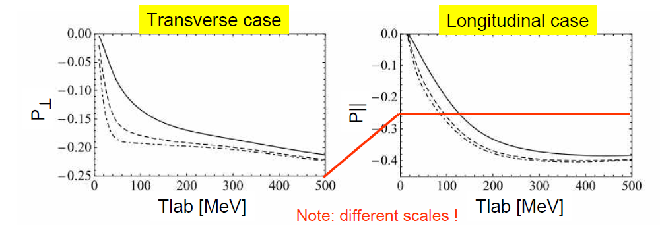
Additional calculations…
PLB 690 (2010)
Projected polarizations

Slide 30
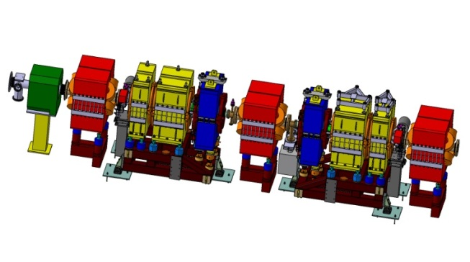
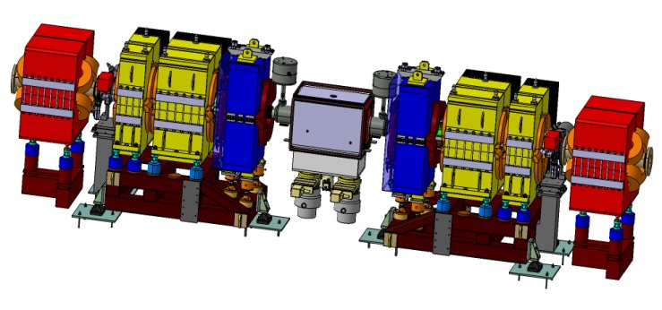
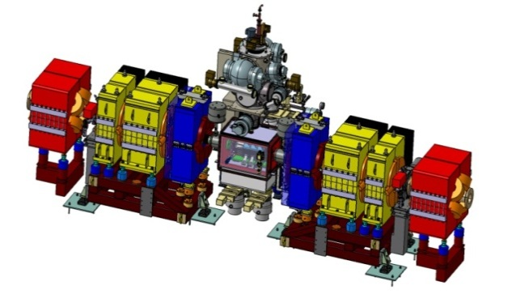
Stages of installation at AD
Installation of six magnets for the low-β insertion
Phase 1
Installation of the target chamber: Machine acceptance studies. Stacking studies
Phase 2
Spin-filtering measurements up to 70 MeV with transverse beam polarization
Phase 3

