Slide 1
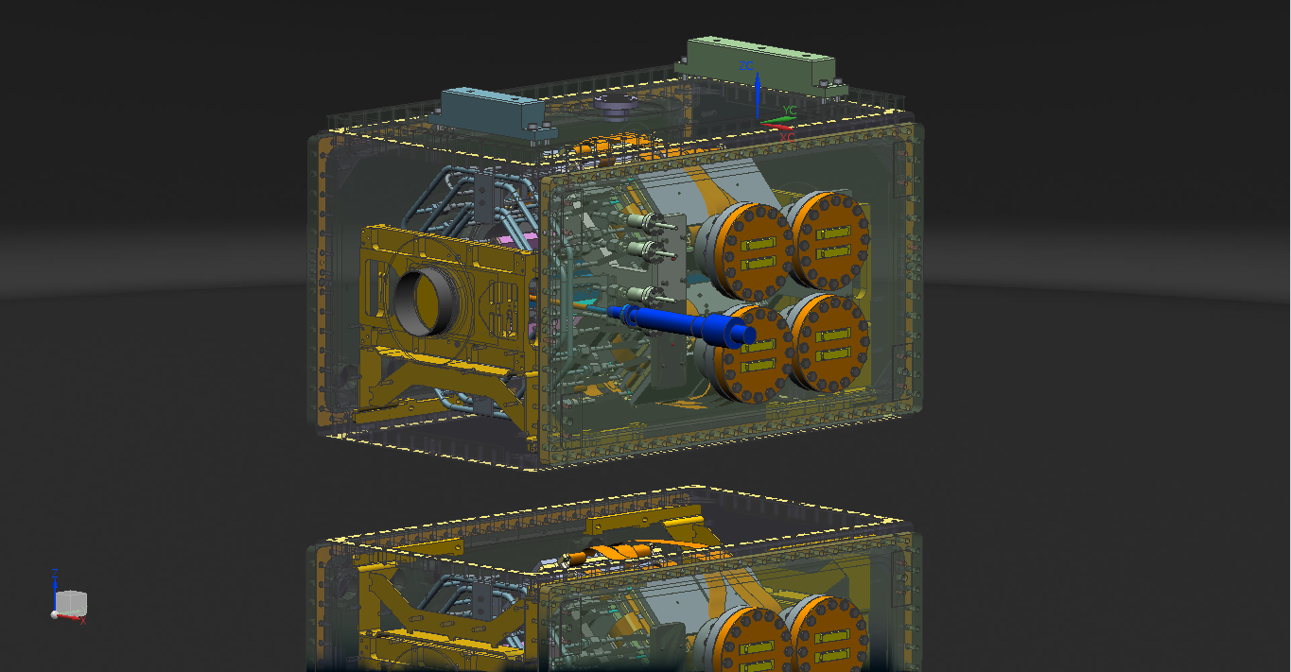
PAX DETECTOR

Slide 2
SUMMARY
DETECTOR LAYOUT
COOLING SYSTEM
SUPPORT
READ-OUT FEED THROUGH
OVERALL DIMENSIONS

Slide 3
DETECTOR LAYOUT

Slide 4
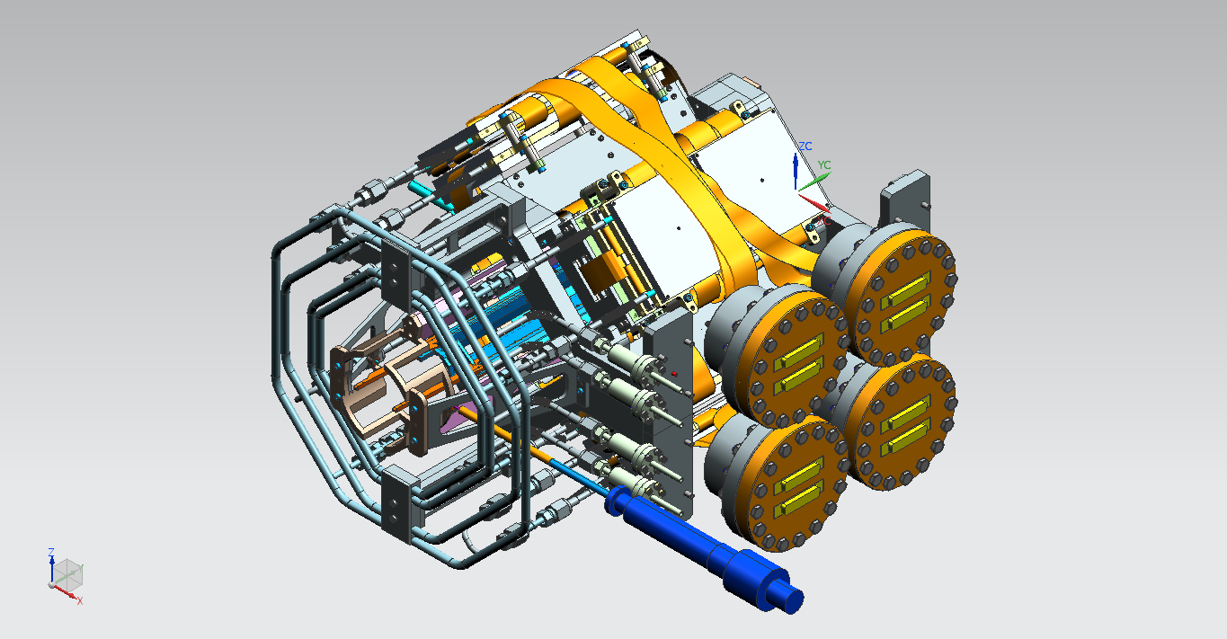
OVERALL VIEW
QUADRANT
TARGET CELL
SUPPORT
COOLING
FEED-THROUGH

Slide 5
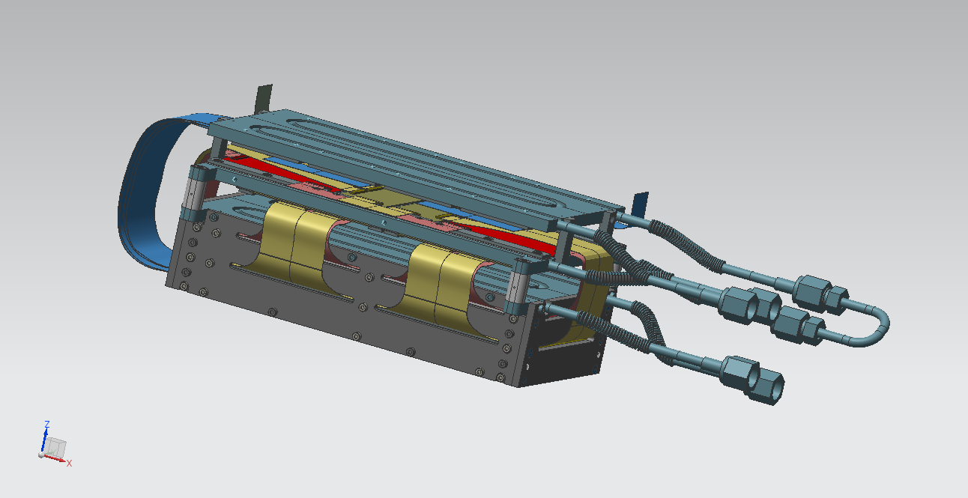
QUADRANT
READ-OUT ELECTRONICS
DETECTOR
COOLING BOX INCLUDING
3 LAYERS

Slide 6
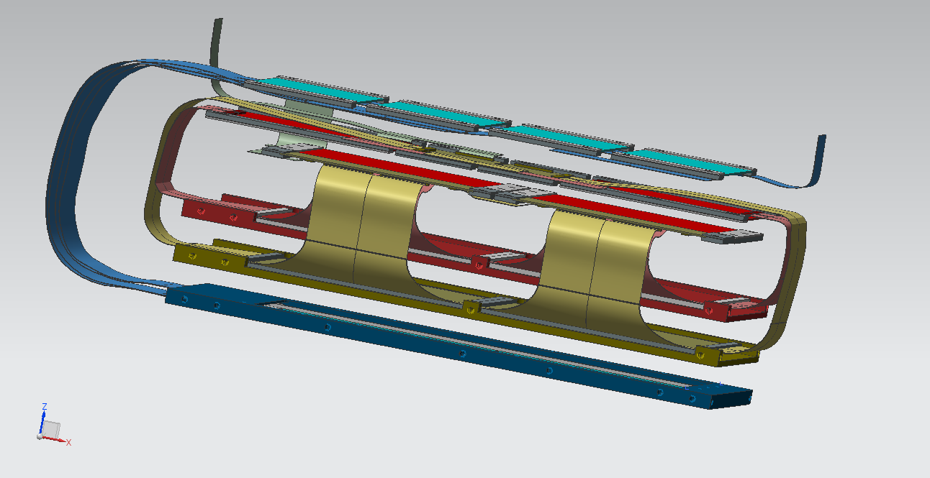
READ-OUT CONCEPT
READ-OUT LAYER 1
READ-OUT LAYER 2
READ-OUT LAYER 3
SENSORS LAYER 3 : PAX
SENSORS LAYER 2 : PAX
SENSORS LAYER 1 : HERMES

Slide 7
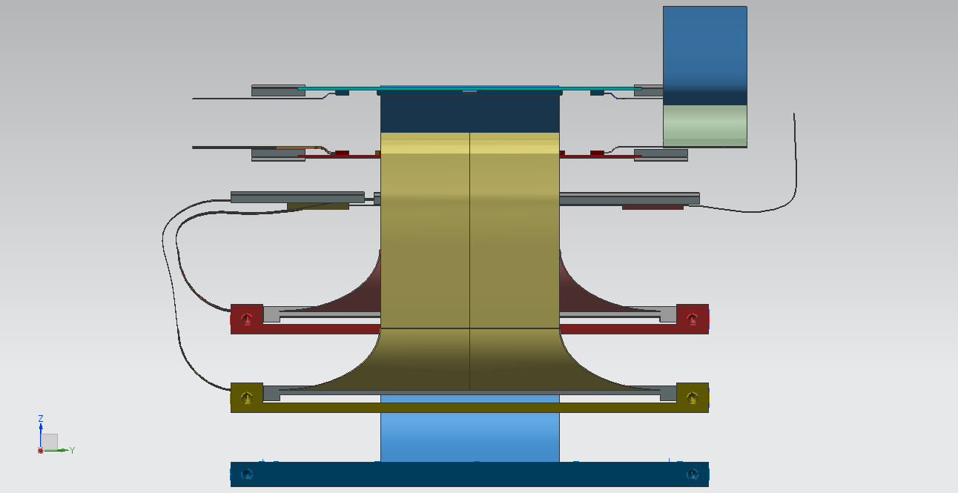
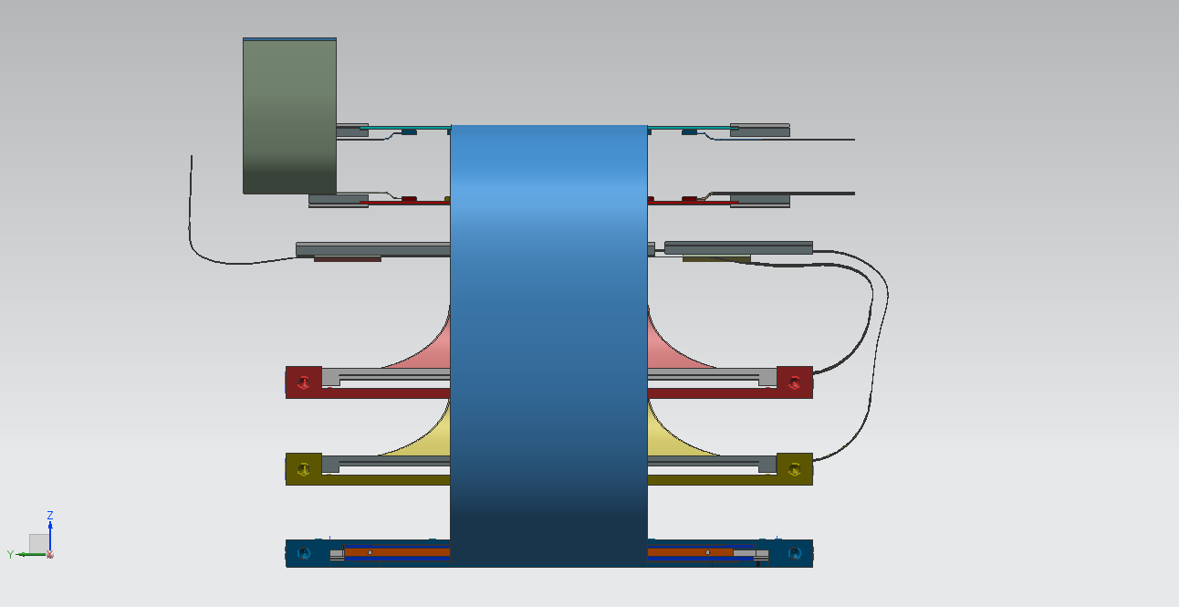
UPSTREAM/DOWNSTREAM VIEWS
UPSTREAM
DOWNSTREAM

Slide 8
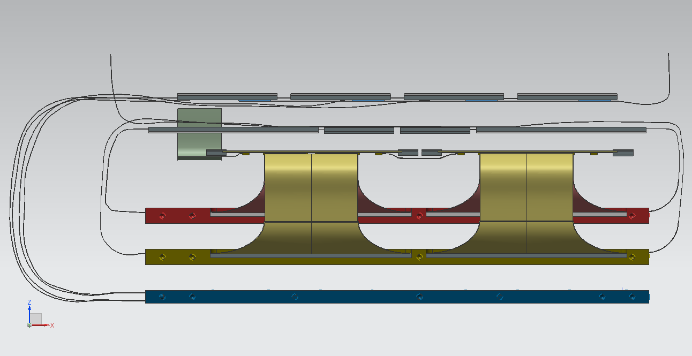
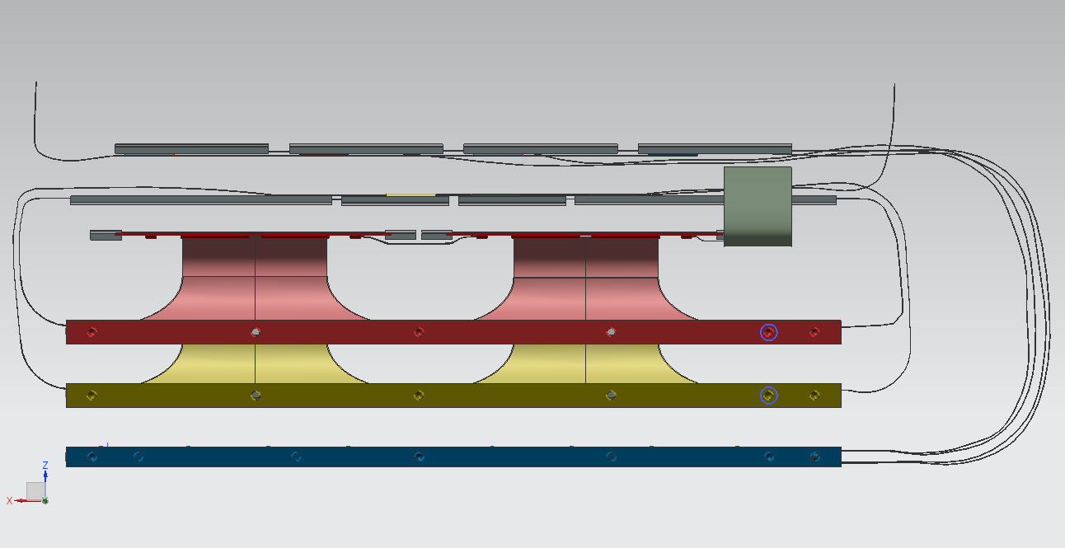
LEFT/RIGHT VIEWS
LEFT
RIGHT

Slide 9
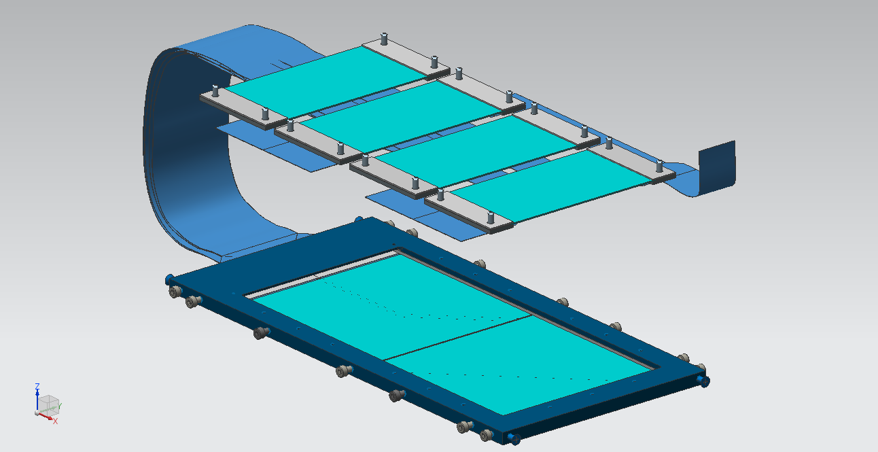
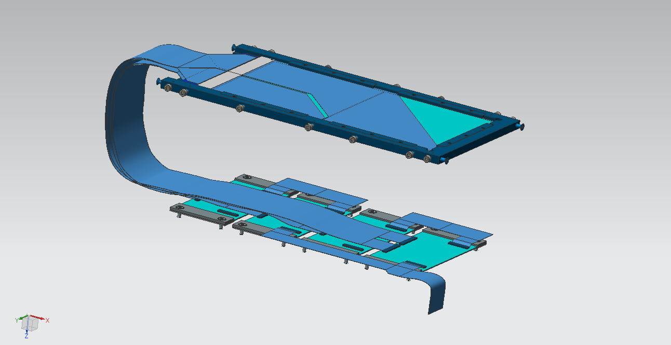
LAYER 1 + READ-OUT
READ-OUT PCB
HERMES SENSOR

Slide 10
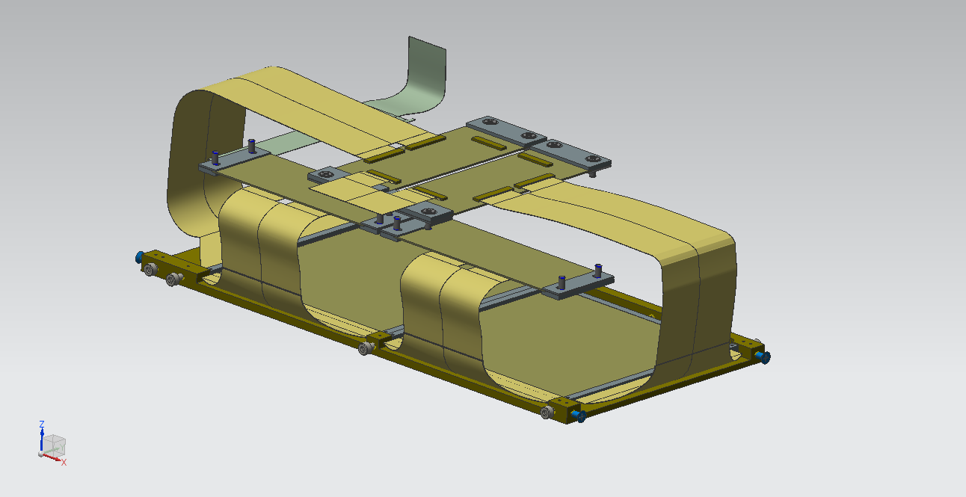
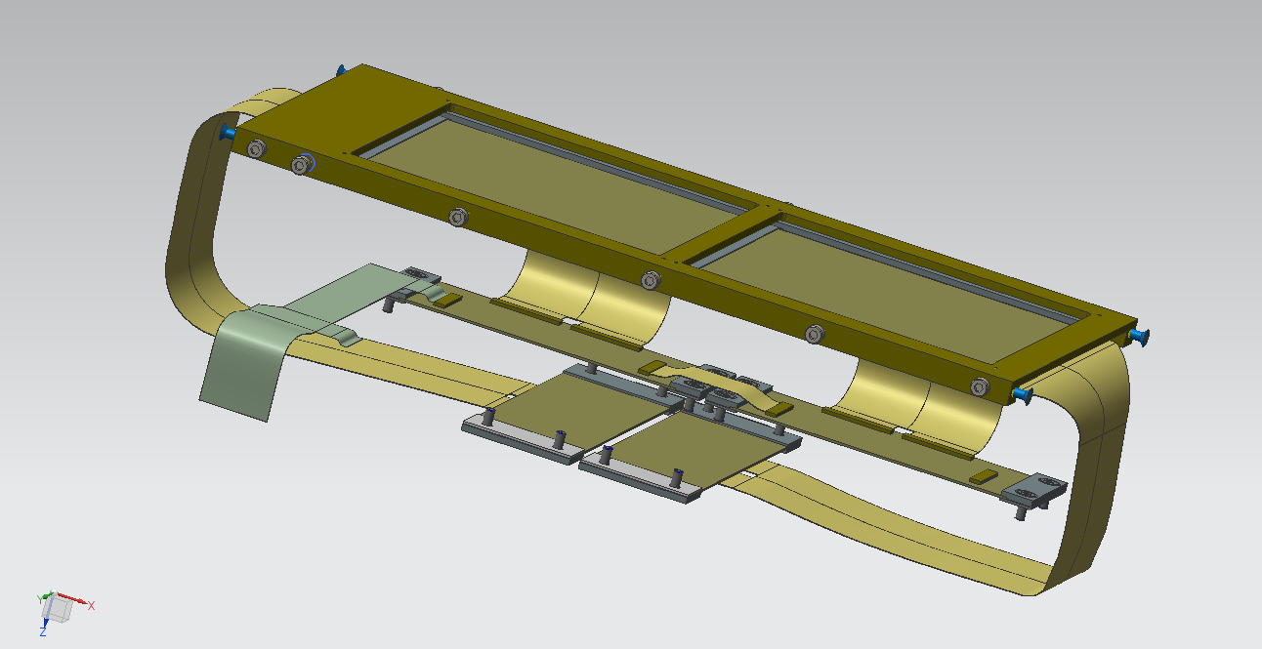
LAYER 2 + READ-OUT
READ-OUT PCB
PAX SENSOR

Slide 11
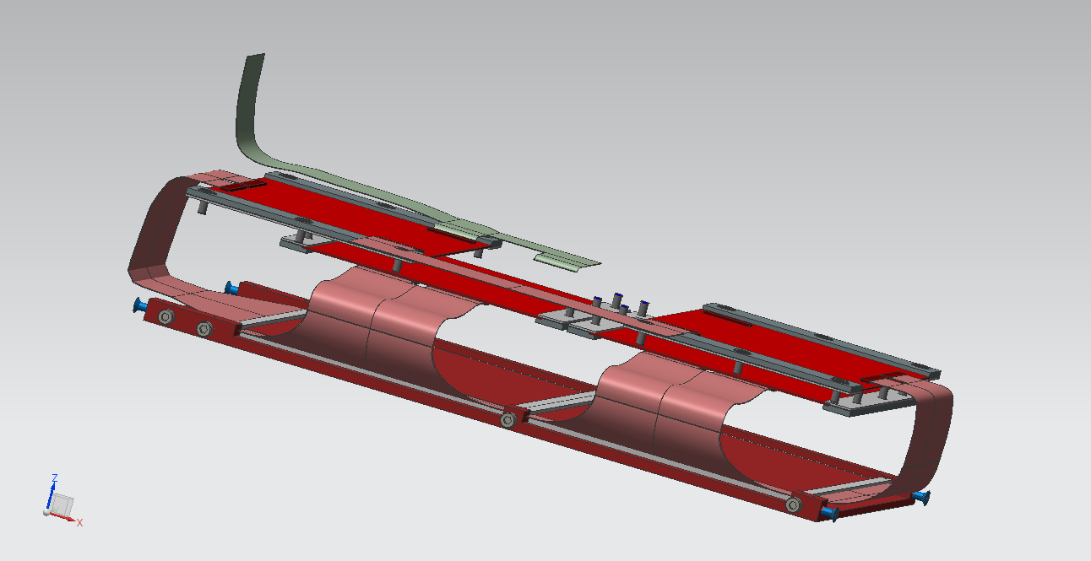
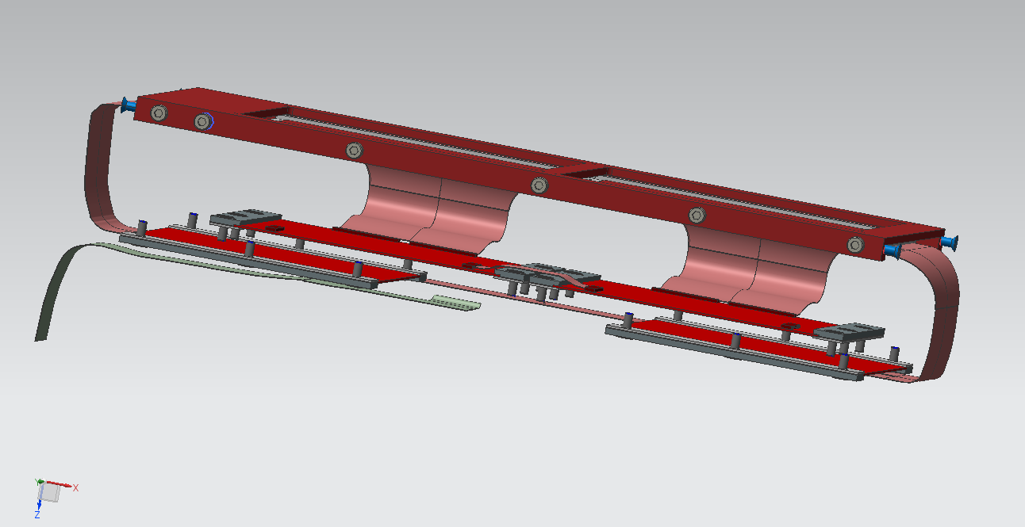
LAYER 3 + READ-OUT
READ-OUT PCB
PAX SENSOR

Slide 12
COOLING SYSTEM DESIGN
SENSORS COOLING SYSTEM
READ-OUT COOLING SYSTEM
FLOW RATE UNIFORMITY

Slide 13
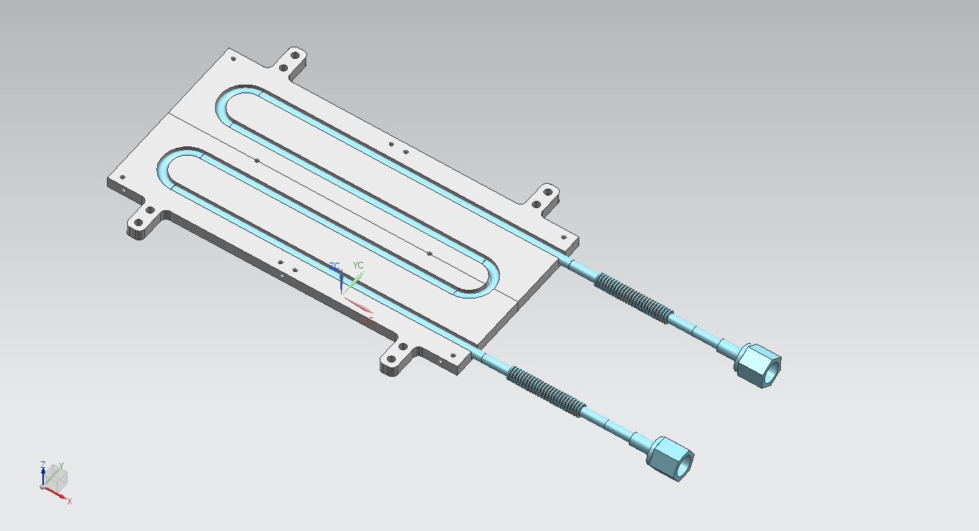
THE COLD PLATE
NOMINAL TUBE SIZE : ¼ in
MANUFACTURER:
THERMACORE EUROPE Ltd.
ASHINGTON (UK)
FLEXIBLE TUBE : ¼ in
Code : 321-4x2
TUBE AND PLATE WELDED BY DIFFUSION:
PROCESS UNDER VACUUM (10E-4 Bar) ; PRESSURE BETWEEN THE PARTS : 0,4-1,6 Bar ; WELDING TEMPERATURE : 50-70% OF THE MATERIAL MELTING POINT
COLD PLATE DIMENSIONS: 125 x 252,5 x 8 mm^3

Slide 14
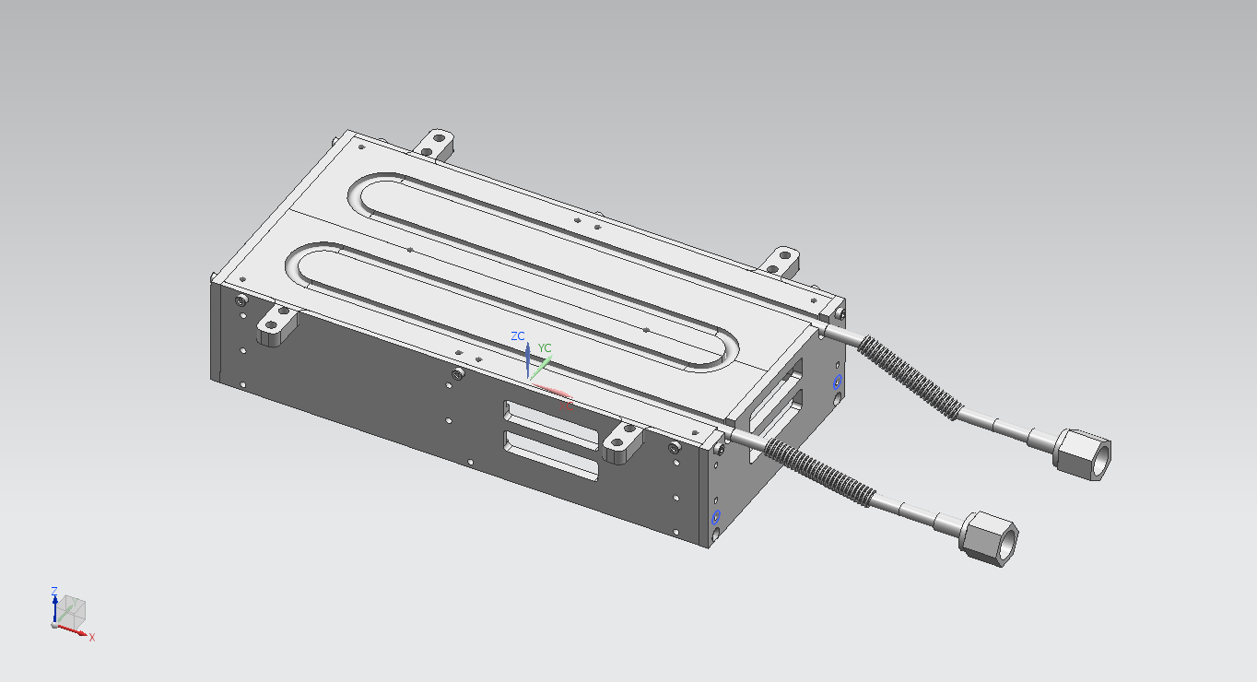
BOX COOLING POWER CALCULATION
ABSORBED RADIATION FROM ISOLATED BOX IN ROOM TEMPERATURE ENVIRONMENT
Box Aluminum Surface = Bas = 0,337 m^2
Box Silicon Surface = Bss = 0,033 m^2
Box Temperature = Tb = -10 °C
Room Temperature = Tr = 30 °C
Aluminum emissivity = Ae = 0,09
Silicon emissivity = Se = 0,9
COOLING POWER = Pc = 5,672E-8 x [Ae x Bas + Se x Bss] x (Tr^4 – Tb^4) = 12,5 W

Slide 15
COOLING FLUID PROPERTIES (SENSORS BOX)
COOLING FLUID TEMPERATURE VS CONVECTION COEFFICIENT
COOLING FLUID & CONVECTION COEFFICIENT SELECTION
COOLING FLUID : ETHANOL ALCOHOOL |  | °C | W/m^2C°
Boiling point |  | 78,5
Freezing point |  | -114
Convection coefficient | α |  | 250
Delivery temperature | Td | -19
Wall temperature | Tw | -10
Fluid temperature | Tf = (Td + Tw)/2 | -14
ETHANOL PROPERTIES @ Tf and atmospheric pressure
Density (Kg/m^3) | ρ | 818
Specific heat (J/KgK) | Cp | 2287
Thermal conductivity (W/mK) | λ | 0,13
Kinematic viscosity (m^2/s) | ν | 2,69E-06
Kinematic viscosity @ Tw (m^2/s) | νw | 2,54E-06

Slide 16
COOLING FLUID OPERATING CONDITIONS (SENSORS BOX)
FLOW SPEED, FLOW RATE AND FLOW RESISTANCE
α=250 W/m^2K

Slide 17
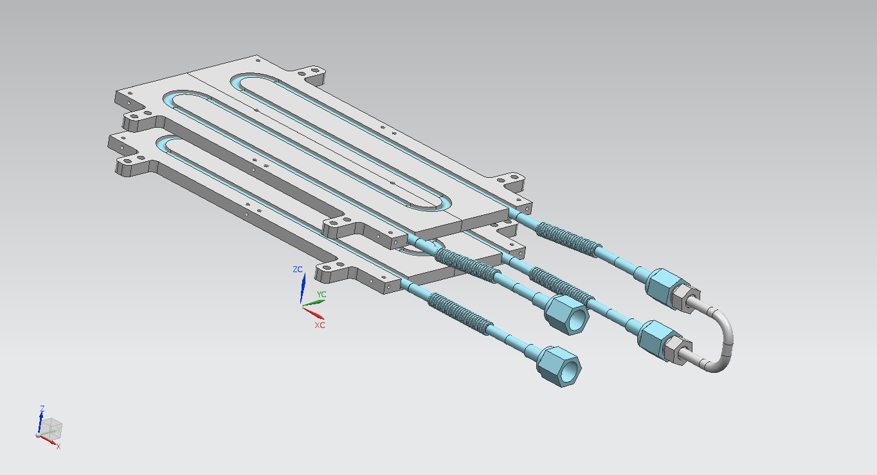
READ-OUT PCBs COOLING
Single PCB power = 1,25 W
PCB number/cooling plate = 4
Total power = 4 x 2 x 1,25 = 10 W
PCB Temperature = Tb = 30 °C
Room Temperature = Tr = 30 °C

Slide 18
COOLING FLUID PROPERTIES (READ-OUT PCB)
COOLING FLUID TEMPERATURE VS CONVECTION COEFFICIENT
COOLING FLUID & CONVECTION COEFFICIENT SELECTION
COOLING FLUID : ETHANOL ALCOHOOL |  | °C | W/m^2C°
Boiling point |  | 78,5
Freezing point |  | -114
Convection coefficient | α |  | 150
Delivery temperature | Td | 25
Wall temperature | Tw | 30
Fluid temperature | Tf = (Td + Tw)/2 | 28
ETHANOL PROPERTIES @ Tf and atmospheric pressure
Density (Kg/m^3) | ρ | 782
Specific heat (J/KgK) | Cp | 2476
Thermal conductivity (W/mK) | λ | 0,14
Kinematic viscosity (m^2/s) | ν | 1,25E-06
Kinematic viscosity @ Tw (m^2/s) | νw | 1,18E-06

Slide 19
COOLING FLUID OPERATING CONDITIONS (READ-OUT PCB)
FLOW SPEED, FLOW RATE AND FLOW RESISTANCE
α=150 W/m^2K

Slide 20
DETECTOR/PCBs COOLING SUMMARY TABLE ( Troom = 30 °C )
 | DETECTOR (1/4) | PCBs (1/4)
TEMPERATURE (°C) | -10 | 30
POWER (W) | 15 | 10
FLOW RATE (Kg/h) | 15,3 | 5,7
FLOW RESISTANCE (Pa) | 1917 | 756

Slide 21
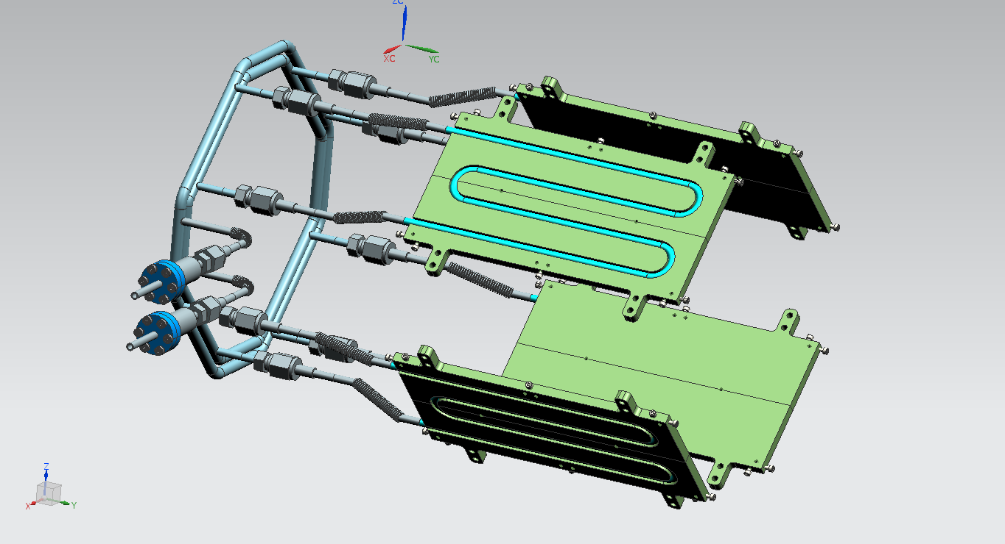
DETECTOR COOLING SYSTEM (SENSORS BOX)
SUPPLYING-COLLECTING RINGS
INPUT
OUTPUT
COLD PLATE
MANUFACTURER:
NORDIVAL Srl SWAGELOCK ITALIA
ROVATO (ITALY)

Slide 22
DETECTOR COOLING SYSTEM – HYDRAULIC CIRCUIT SCHEME
Collecting ring
Fr = box cooling flow rate = 18,7 (l/h)
Supplying ring
L = length of the branches (m)
Box circuit
4Fr = Qout
Lo1
2Fr
Lo2
Fr
Lo3
Fr
2Fr
Fr
D4
Fr
D3
Fr
D2
Fr
D1
Fr
2Fr
2Fr
Li2
Fr
Li3
4Fr = Qin
Li1

Slide 23
DETECTOR COOLING SYSTEM - FLOW RATE UNIFORMITY BETWEEN THE PLATES
CALCULATION PROCESS

Slide 24
DETECTOR COOLING SYSTEM - FLOW RATE UNIFORMITY BETWEEN THE PLATES
CALCULATION PROCESS
TOTAL FLOW RATE = 75 l/h
TOTAL PUMPING PRESSURE = 8250 Pa
FLOW RATE UNIFORMITY WITHIN 1%
Branch | Lo1 | Lo2 | Lo3 | D1 | Li3 | Li2 | Li1
Q (m^3/s) | 2,07E-05 | 1,04E-05 | 0,52E-05 | 0,52E-05 | 0,52E-05 | 1,04E-05 | 2,07E-05
L (m) | 0,523 | 0,344 | 0,642 | 2,442 | 0,642 | 0,344 | 0,523
d (m) | 4,55E-03 | 7,73E-03 | 7,73E-03 | 4,55E-03 | 7,73E-03 | 7,73E-03 | 4,55E-03
A (m^2) | 1,63E-05 | 4,7E-05 | 4,7E-05 | 1,62E-05 | 4,7E-05 | 4,7E-05 | 1,63E-05
c (m/s) | 1,27 | 0,22 | 0,11 | 0,32 | 0,11 | 0,22 | 1,27
Re | 2154 | 637 | 319 | 541 | 319 | 637 | 2154
λ | 0,03 | 0,1 | 0,2 | 0,12 | 0,2 | 0,1 | 0,03
ΔP_{T} (Pa) | 2598 | 100 | 86 | 2679 | 86 | 100 | 2598

Slide 25
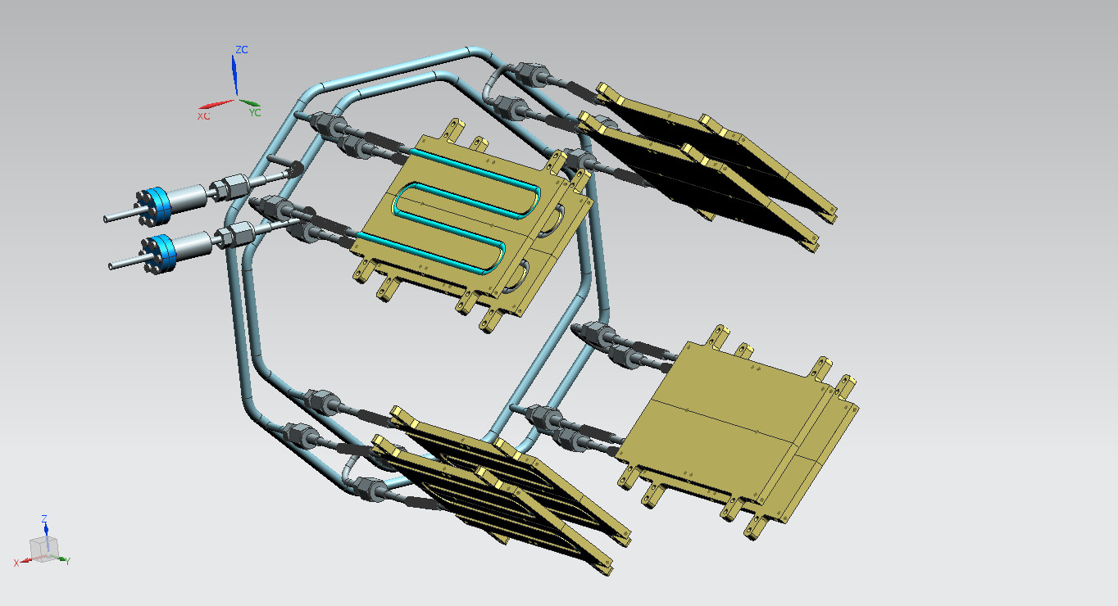
PCBs COOLING SYSTEM
SUPPLYING-COLLECTING RINGS
INPUT
OUTPUT
COLD PLATES

Slide 26
PCBs COOLING SYSTEM - FLOW RATE UNIFORMITY BETWEEN THE PLATES
CALCULATION PROCESS
TOTAL FLOW RATE = 30 l/h
TOTAL PUMPING PRESSURE = 1942 Pa
FLOW RATE UNIFORMITY WITHIN 1%
Branch | Lo1 | Lo2 | Lo3 | D1 | Li3 | Li2 | Li1
Q (m^3/s) | 8E-06 | 4E-06 | 2E-06 | 2E-06 | 2E-06 | 4E-06 | 8E-06
L (m) | 0,523 | 0,365 | 0,730 | 5,344 | 0,730 | 0,365 | 0,523
d (m) | 4,55E-03 | 7,73E-03 | 7,73E-03 | 4,55E-03 | 7,73E-03 | 7,73E-03 | 4,55E-03
A (m^2) | 1,63E-05 | 4,7E-05 | 4,7E-05 | 1,62E-05 | 4,7E-05 | 4,7E-05 | 1,63E-05
c (m/s) | 0,5 | 0,1 | 0,05 | 0,12 | 0,05 | 0,1 | 0,5
Re | 1792 | 527 | 264 | 448 | 264 | 527 | 1792
λ | 0,04 | 0,12 | 0,24 | 0,14 | 0,24 | 0,12 | 0,04
ΔP_{T} (Pa) | 436 | 18 | 17 | 1000 | 17 | 18 | 436

Slide 27
DETECTOR SUPPORT
SUPPORT GEOMETRY
CONSTRAINTS & STRUCTURAL COMPARISON

Slide 28
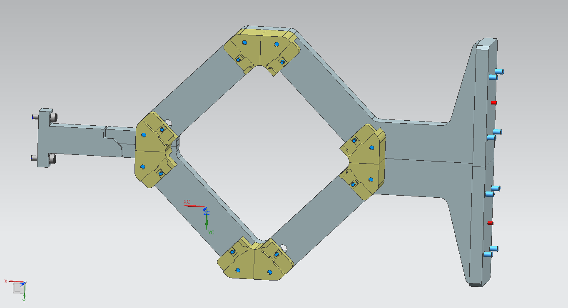
DETECTOR SUPPORT
QUADRANT ASSEMBLING SCREWS
QUADRANT SEATS
CS4
CS1
CS5
CHAMBER WALL
SUPPORT CROSS SECTIONS :
CS1 = 80 x 20 mm^2
CS2 = CS4 = 40 x 20 mm^2
CS3 = 33 x 20 mm^2
CS5 = 20 X 20 mm^2
CS2
CS3
CHAMBER MOUNTING WALL

Slide 29
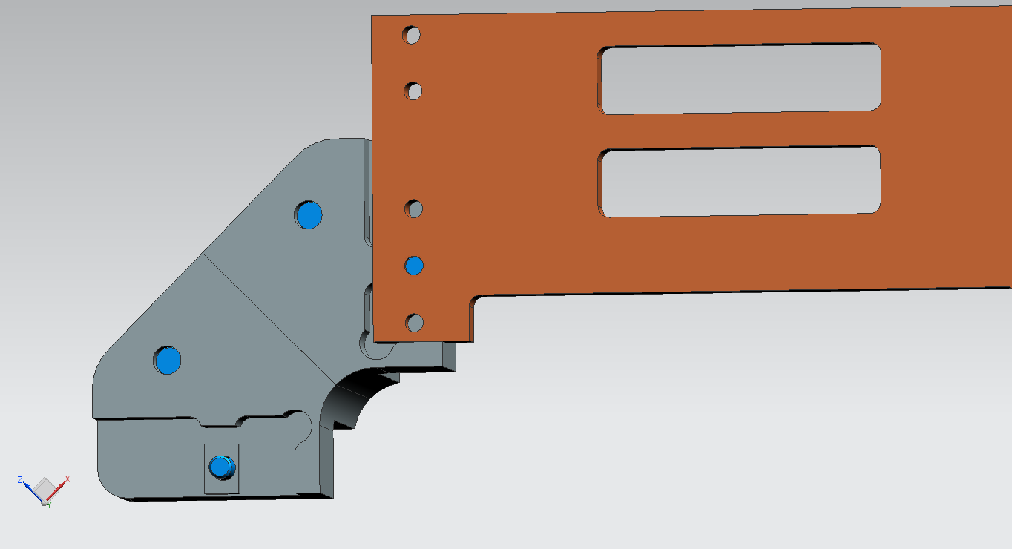
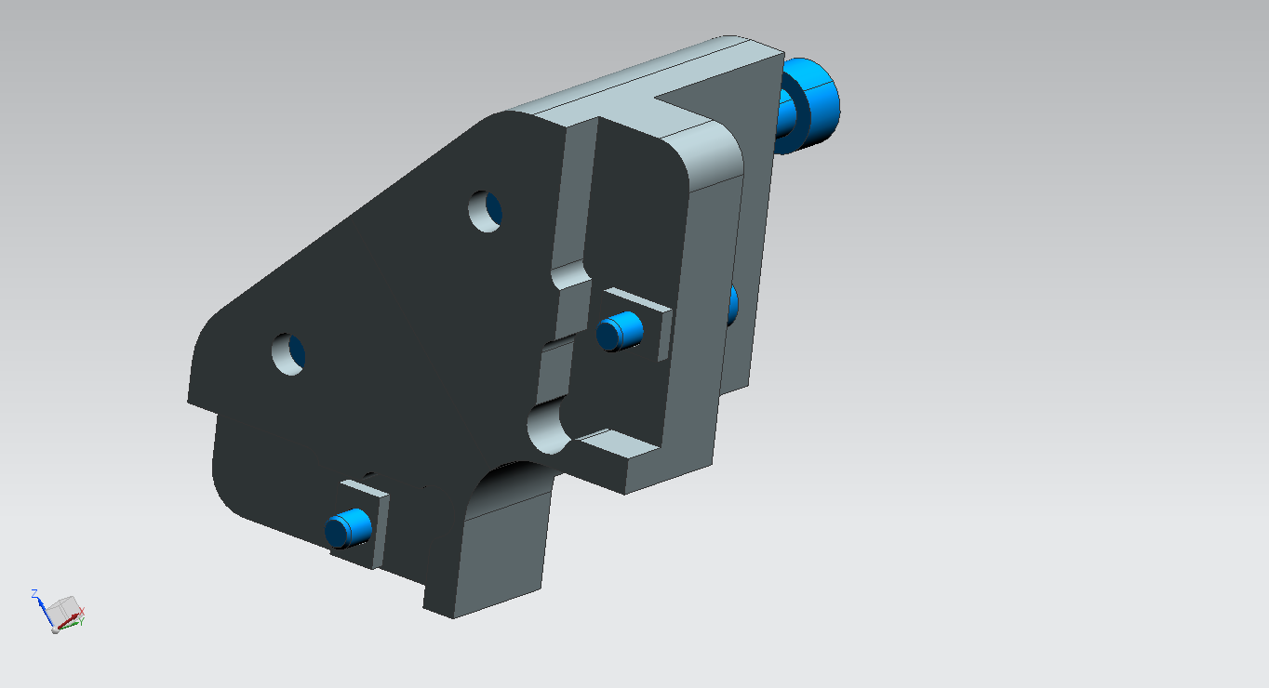
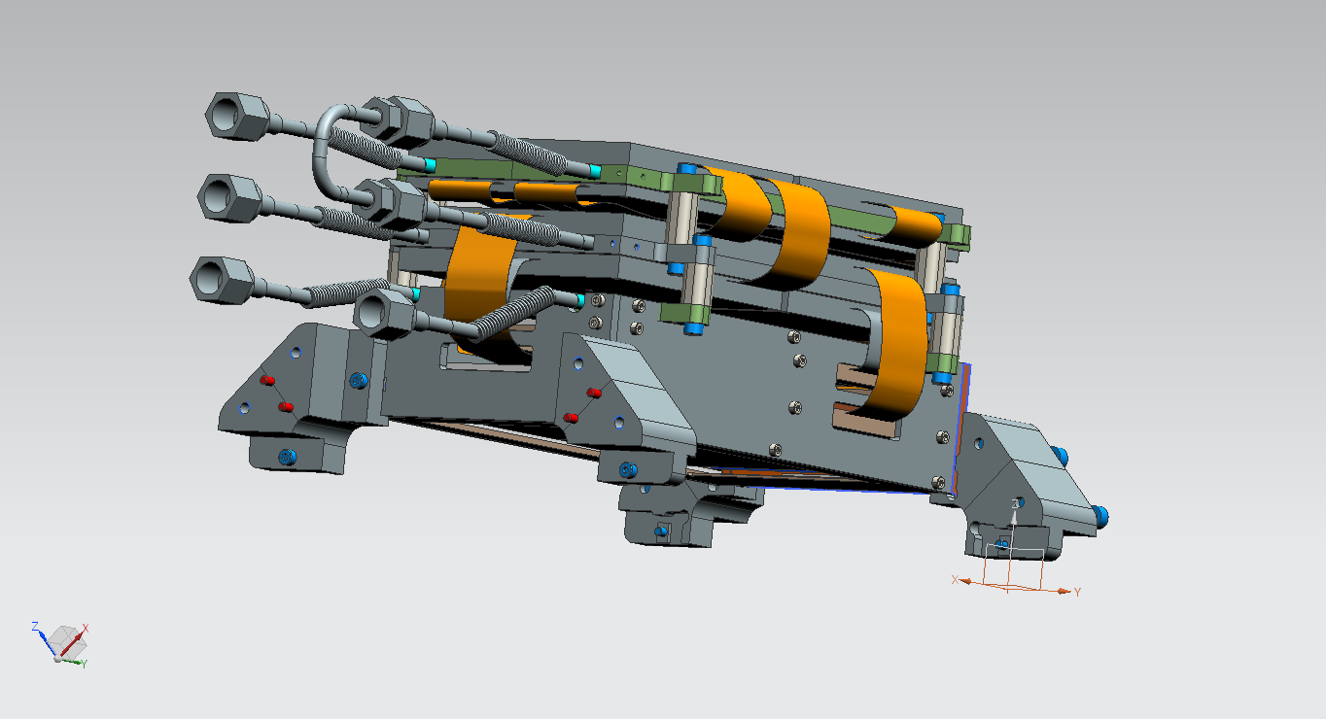
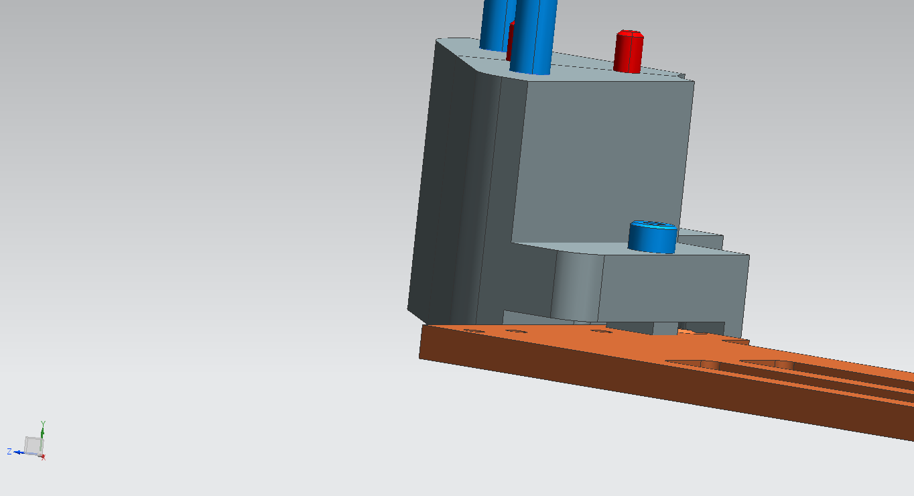
DETECTOR SUPPORT
QUADRANT SEAT
QUADRANT ASSEMBLED

Slide 30
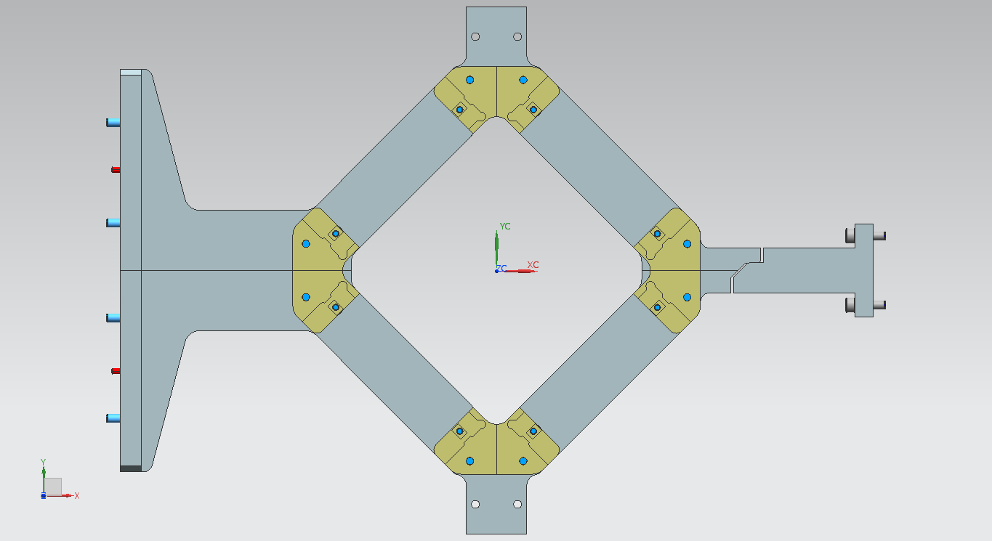
DETECTOR SUPPORT – STATIC SCHEME
APPLIED LOADS :
P1 = P4 = 104 N
P2 = P3 = 92 N
THE TOTAL LOAD
APPLIED TO ONLY
ONE SUPPORT
LOADS :
P support = 40 N
P detector quadrant = 72 N
P cooling system = 22 N
P target cell = 42 N
P target cell support = 3 N
P3
R2
R1
P1
BEARING
P4
FIXED END
P2
R1 , R2 = REACTIONS

Slide 31
DETECTOR SUPPORT STRUCTURAL COMPARISON
FIXED END
FIXED END
P4
CS2
P2+P3
CS3
P1
CS1
L1
L2
L3
MATERIAL : ALUMINUM 6061
σ_{R}=290 MPa
σ_{S}=240 Mpa
σ_{AMM}=240/1,6= 150 MPa
APPLIED LOADS :
P1 = P4 = 104 N
P2 + P3 = 184 N
LENGTHS:
L1 = 143 mm
L2 = 250 mm
L3 = 357 mm

Slide 32
DETECTOR SUPPORT STRUCTURAL COMPARISON
FIXED END + BEARING
FIXED END
P4
CS2
P2+P3
CS3
P1
CS4
CS1
L1
L2
BEARING
CS5
L3
L4
MATERIAL : ALUMINUM 6061
σ_{R}=290 MPa
σ_{S}=240 Mpa
σ_{AMM}=240/1,6= 150 MPa
LENGTHS:
L1 = 143 mm
L2 = 250 mm
L3 = 357 mm
L4 = 415 mm
APPLIED LOADS :
P1 = P4 = 104 N
P2 + P3 = 184 N

Slide 33
DETECTOR SUPPORT STRUCTURAL COMPARISON
 | FIXED END | FIXED END + BEARING
M_{CS1} (Nm) | 98 (max) | 9,4
M_{CS3} (Nm) | 11,1 | 12,5 (max)
T_{CS1} (N) | 392 | 258,6
T_{CS5} (N) | - | 133,4
98 Nm
9,4 Nm
VACUUM
CHAMBER
11,1 Nm
12,5 Nm
392 N
258,6 N
133,4 N

Slide 34
READ-OUT FEED THROUGH

Slide 35
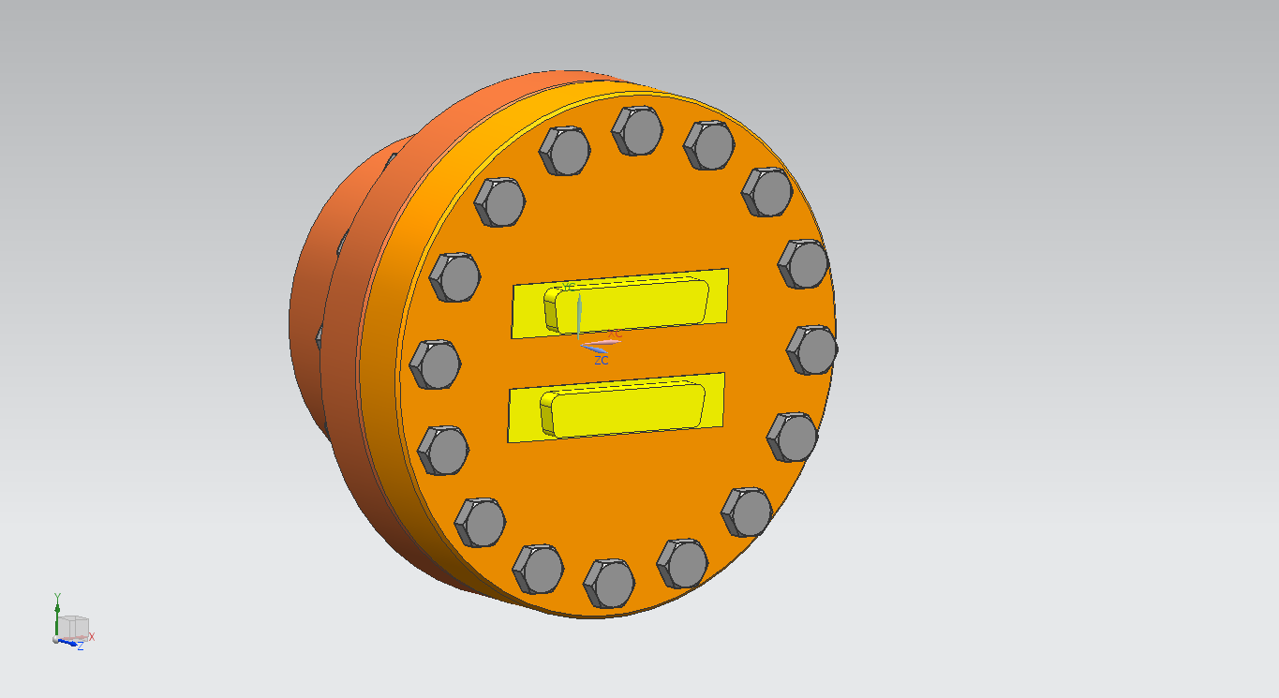
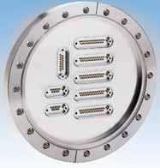
THE READ-OUT FEEDTHROUGH
50 PINS CONNECTOR
DNCF100 FLANGE

Slide 36
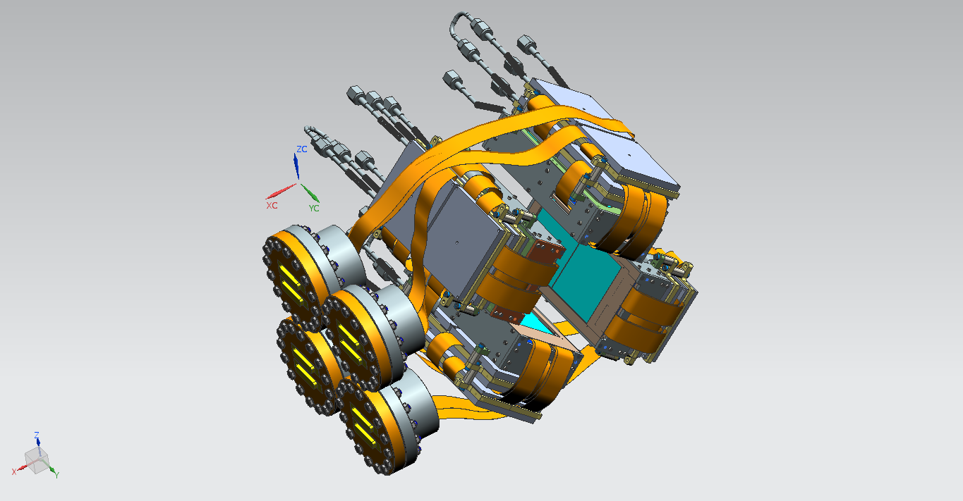
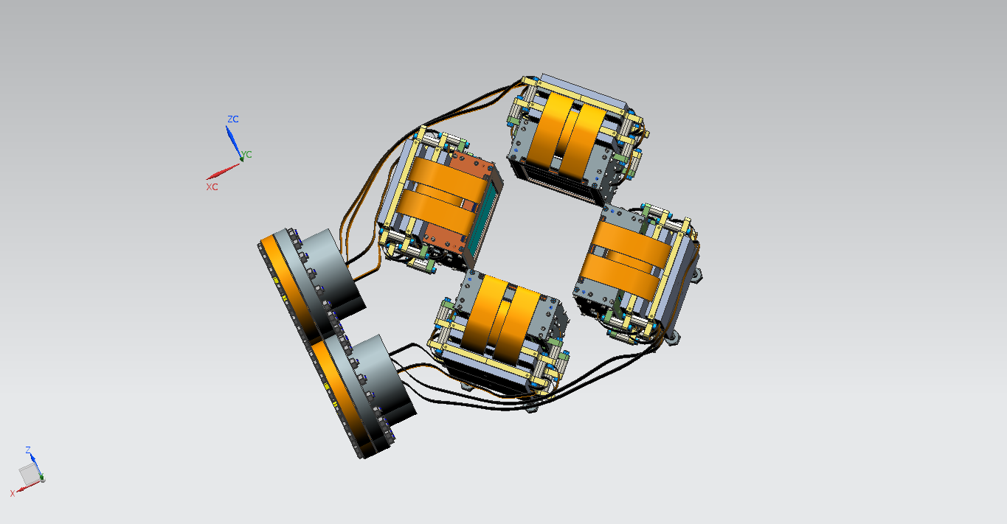
THE READ-OUT FEEDTHROUGH

Slide 37
DETECTOR OVERALL DIMENSIONS
ALLOWED ASSEMBLING SPACE
SKETCHES

Slide 38
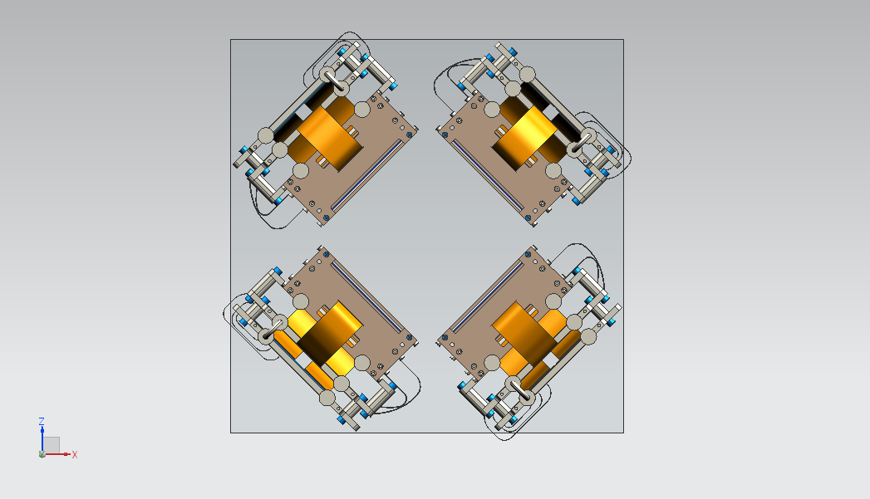
DETECTOR EXTRACTING/INSERTING ALLOWED SPACE
168 mm
397 mm
INSERTION/EXTRACTION
INSERTION WINDOW = 397 mm ; DETECTOR SIZE = 390 mm

Slide 39
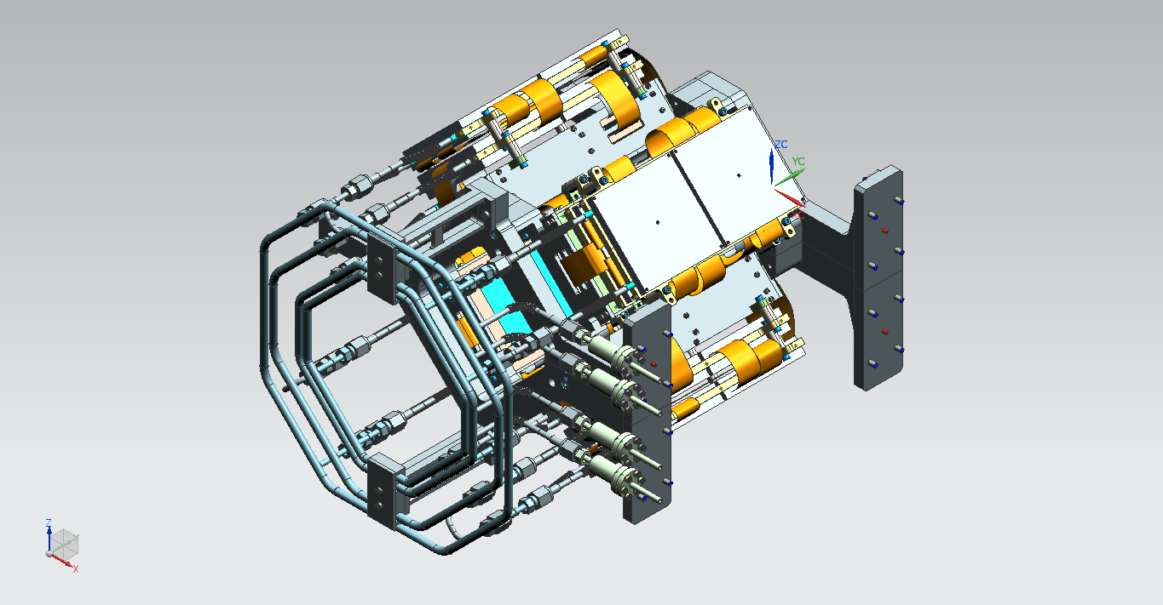
SCKETCH - 1

Slide 40
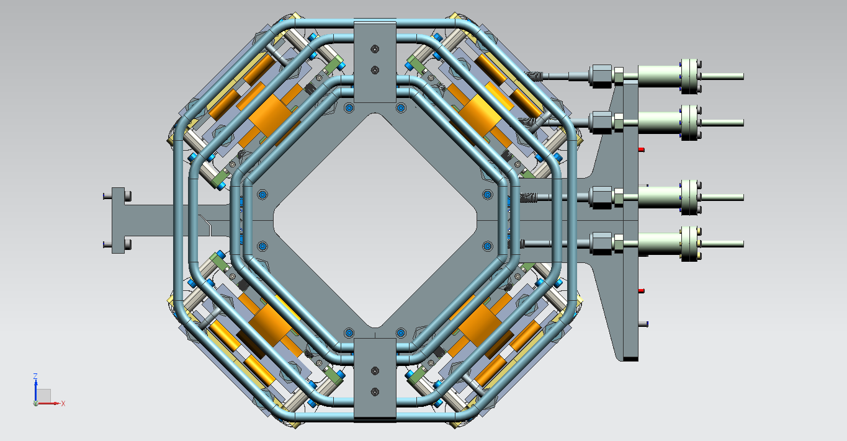
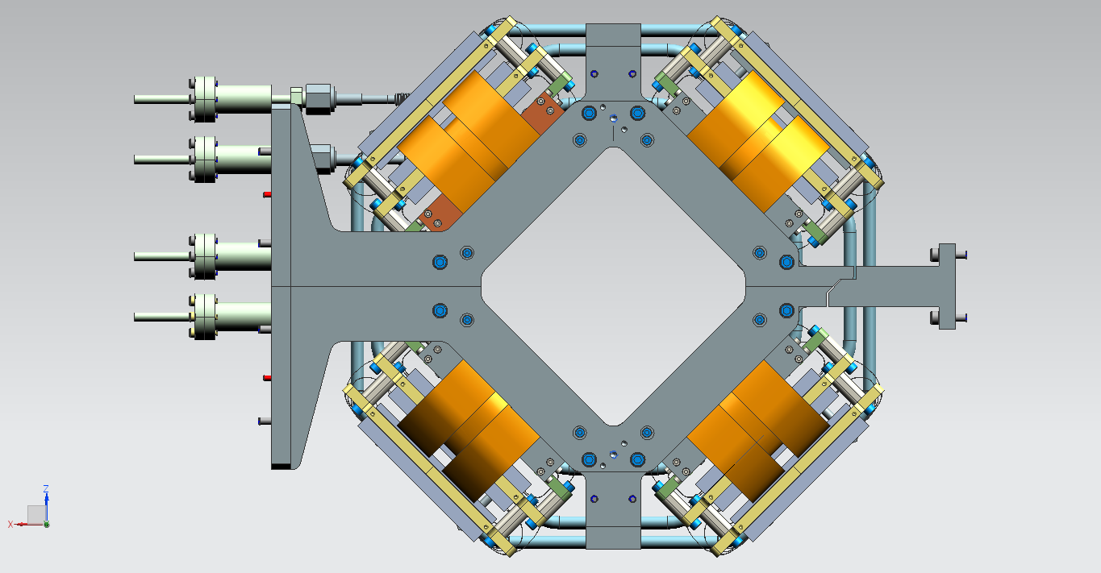
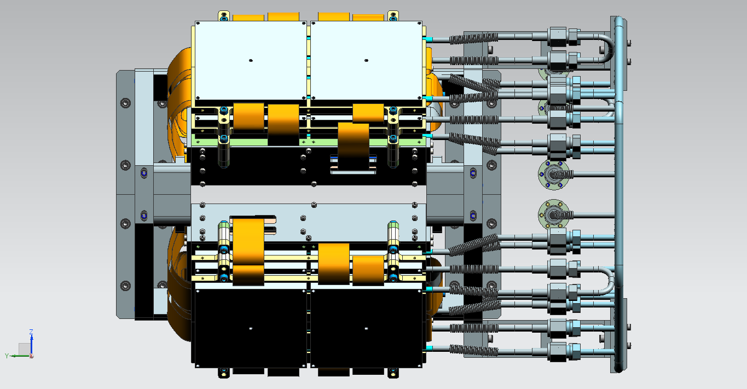
SCKETCH - 2

Slide 41
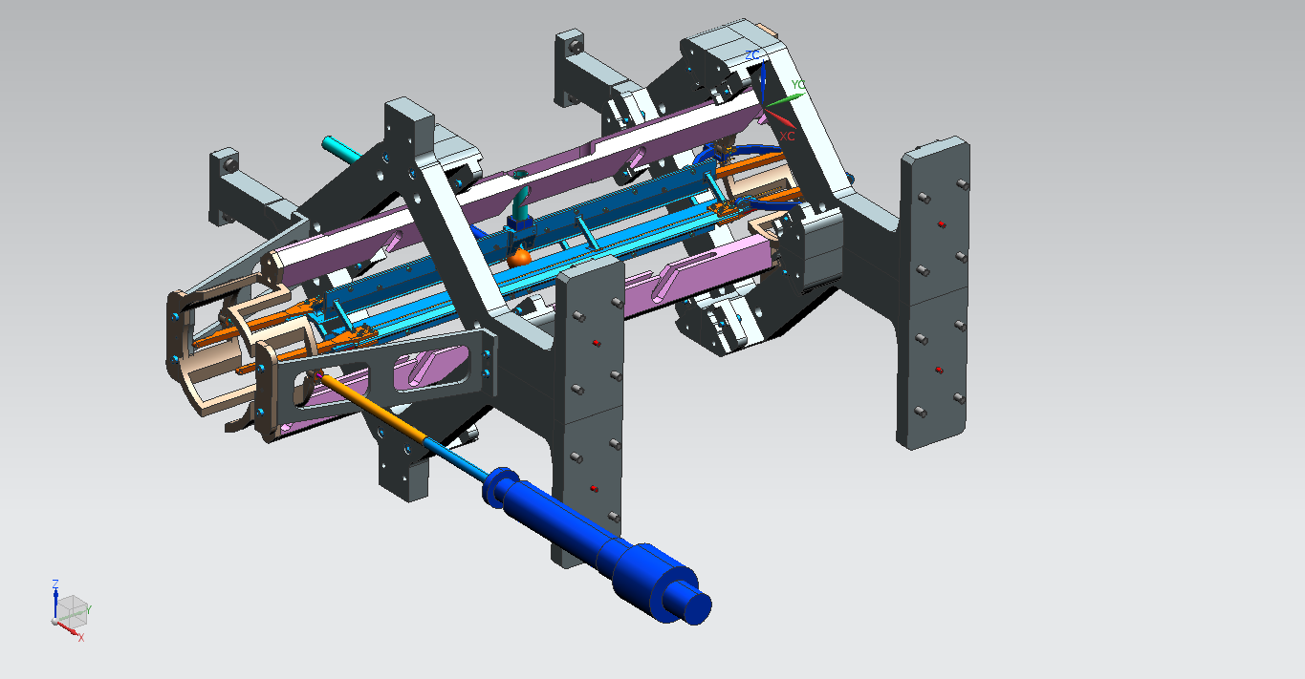
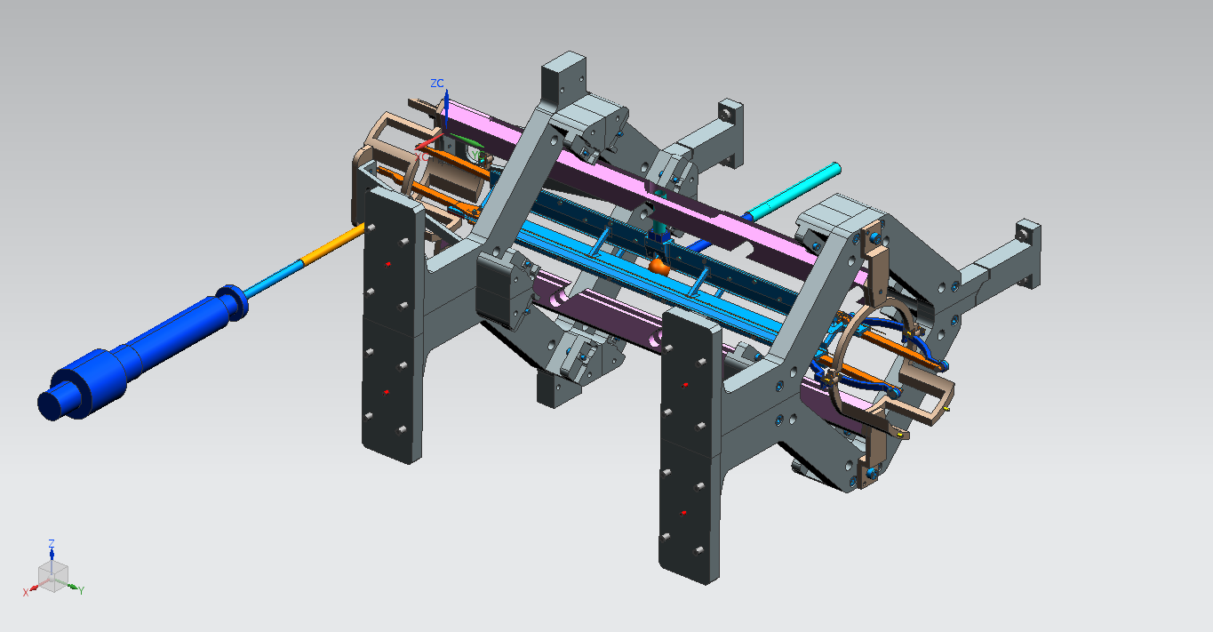
SCKETCH - 3

Slide 42
SCKETCH - 4

Slide 43
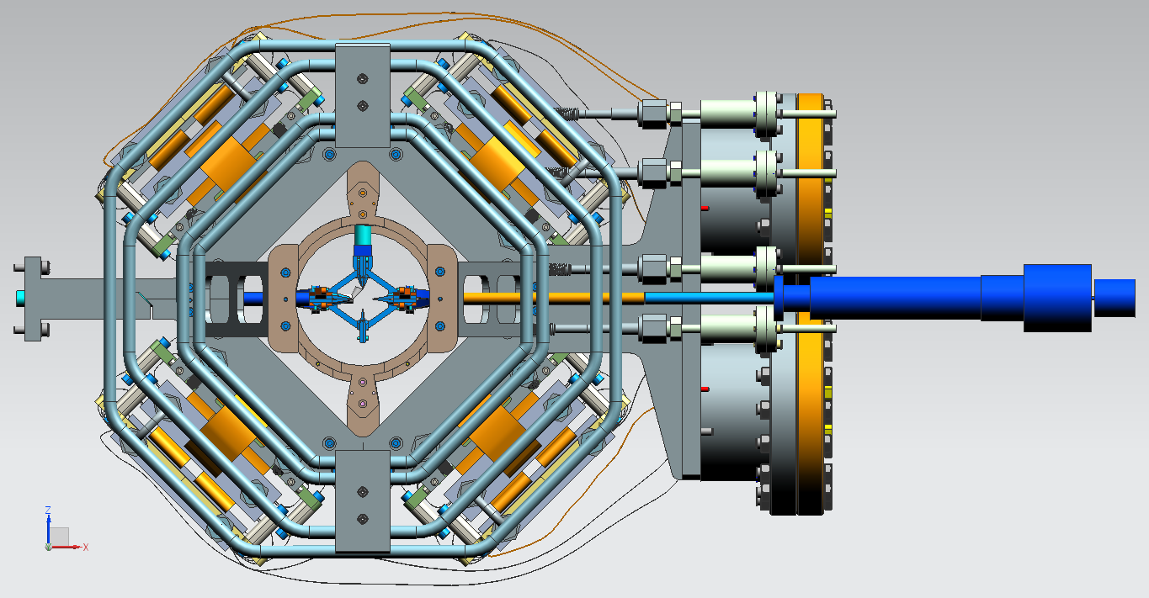
SCKETCH - 5

Slide 44
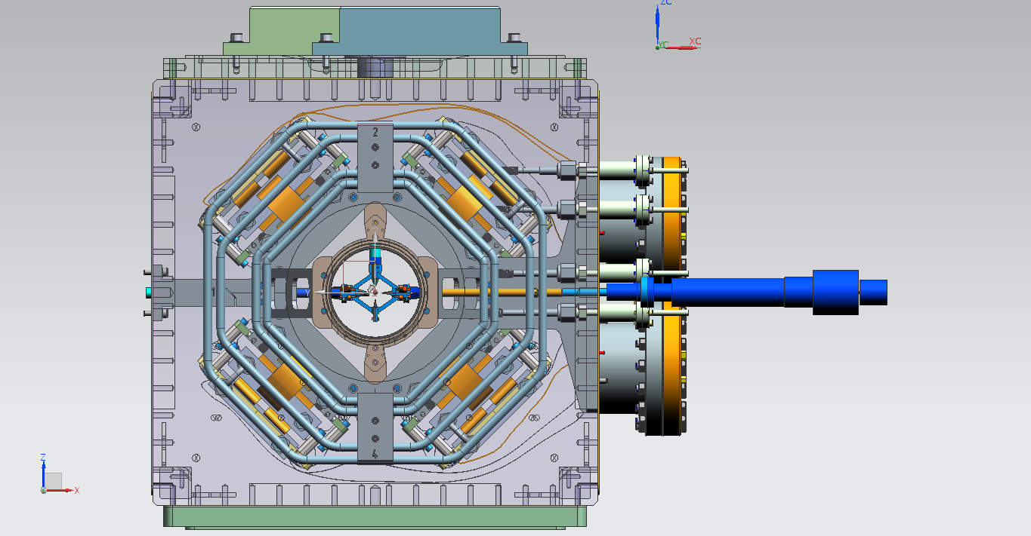
SCKETCH - 6

Slide 45
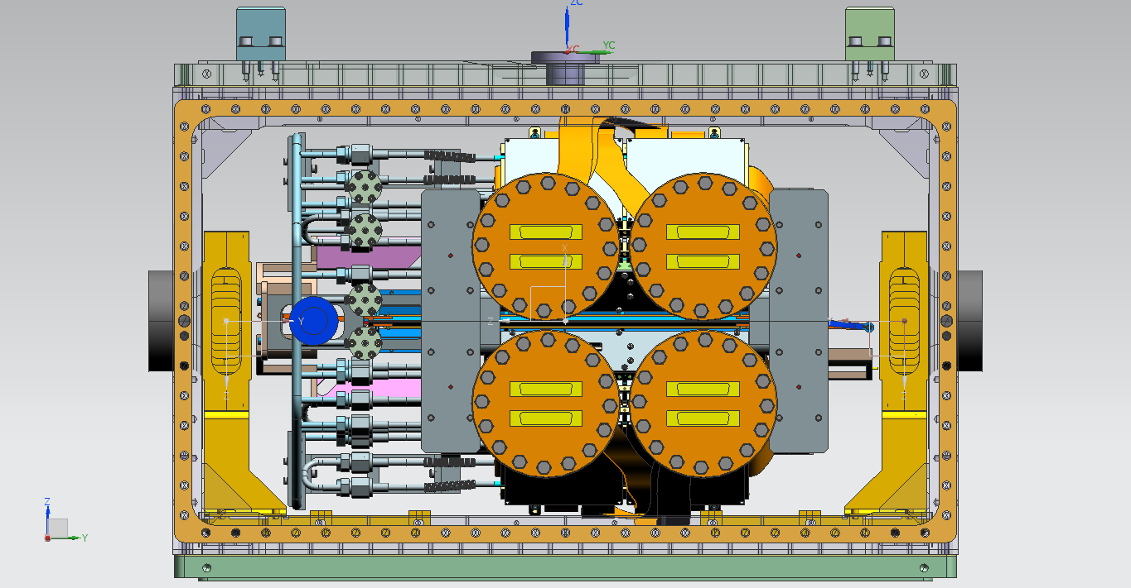
SCKETCH - 7

Slide 46
THANK YOU !!

