Slide 1
Looking Inside the Organic Solar Cell: Surfaces and Interfaces
S. Ismat Shah
Physics and Astronomy
Materials Science and Engineering
University of Delaware
Tbilisi State University, July 2014

Slide 2
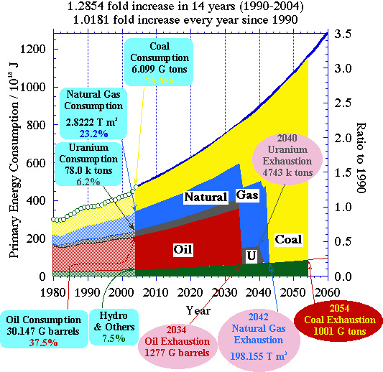
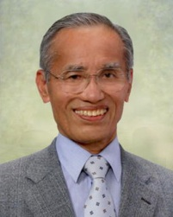
Hashimoto Predictions
Notes:
Kyoto University

Slide 3
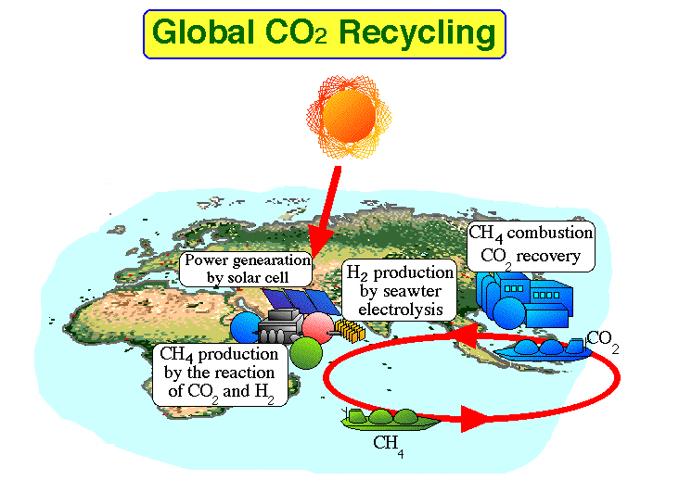

Hashimoto Solution

Slide 4
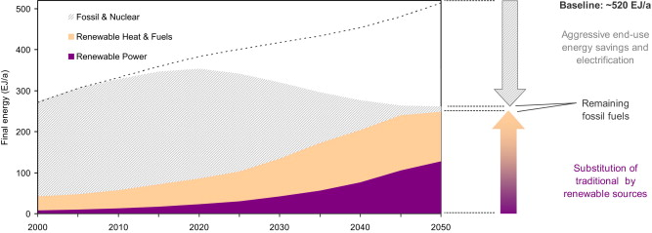
95% Renewable Energy World

Slide 5
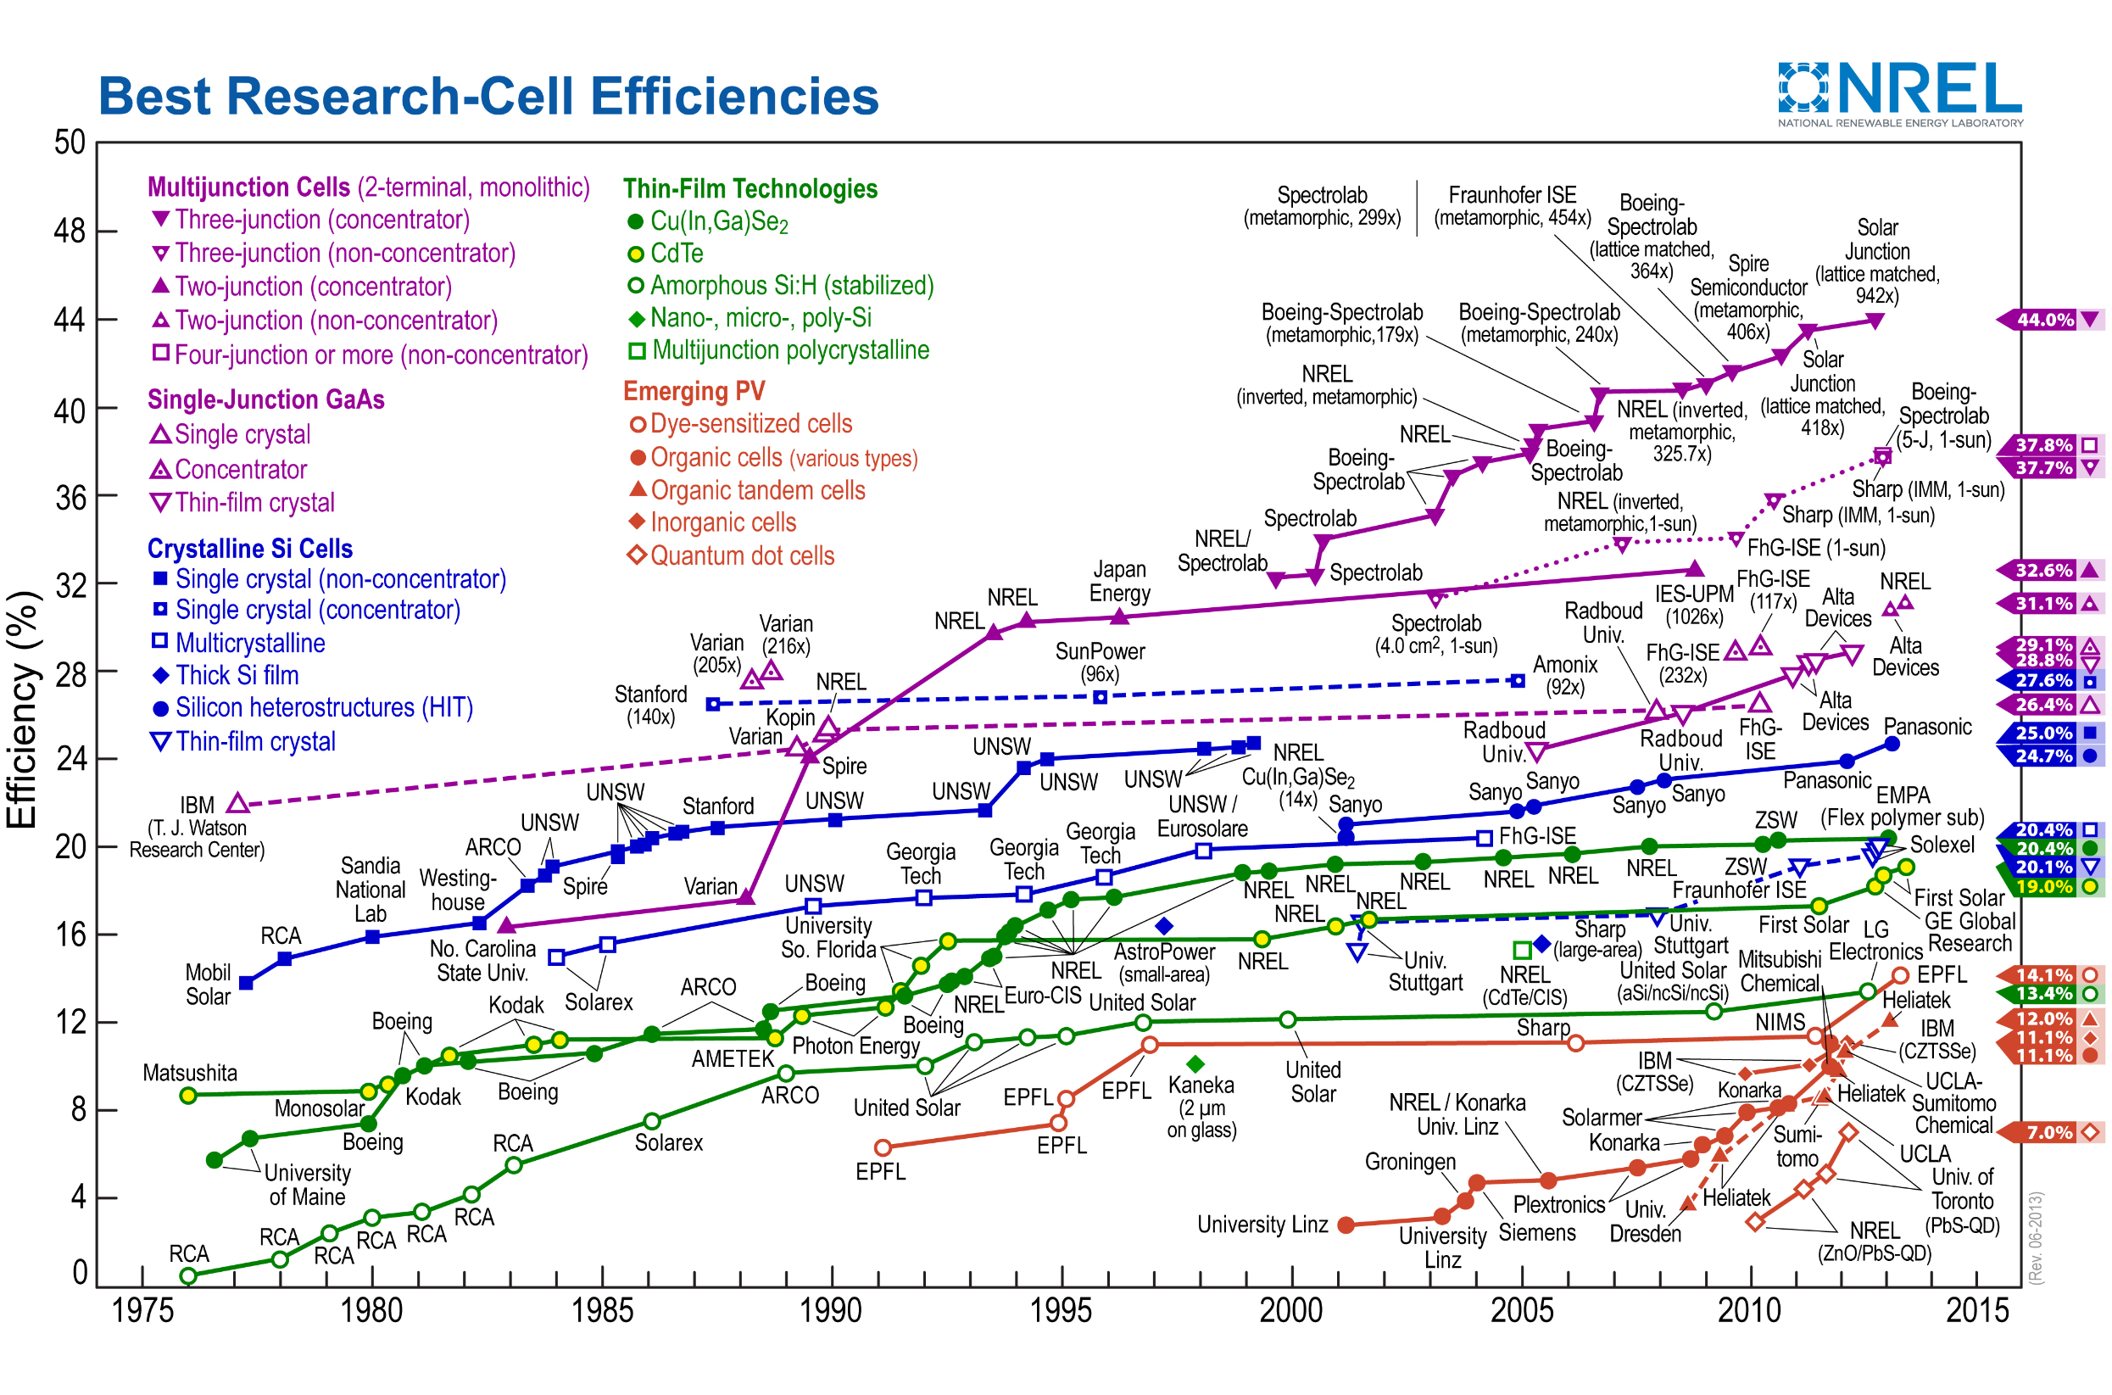
Notes:
Plextronics, Inc.
2180 William Pitt Way
Pittsburgh, PA 15238
Phone: (412) 423-2030
Fax: (412) 423-2039

Slide 6
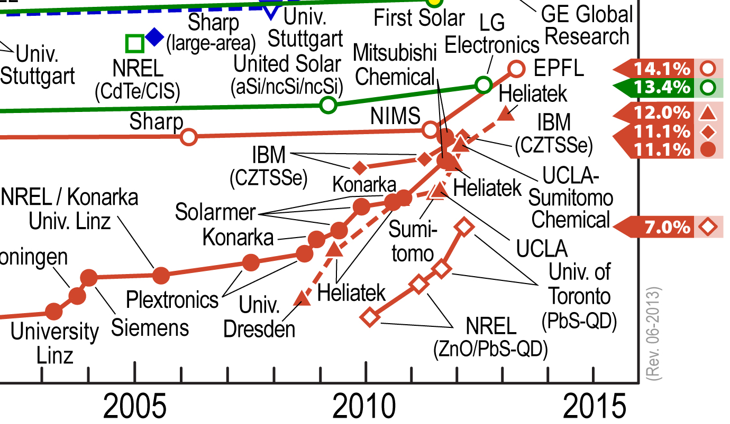
Provoskite
DSSC
OSC
QDSC
OTSC
Notes:
OTSC = Organic tendam cell

Slide 7

Conjugated Polymers: (Semi)conducting behavior
2s 2p³
x y z
x y z
sp³ hybrid
2p
π-bond
+
2s
2s
p_{z} unhybridized
σ-bond
2s 2p²
sp² hybrid
Double and single bond provide the semiconducting properties
Notes:
Q: what is the single double configuration i.e. is it pi sigm, pi sigma repetition?

Slide 8

Two conditions to become conductive:
Conducting Polymers
The first condition for this is that the polymer consists of alternating single and double bonds, called conjugated double bonds.
Every bond contains a localized “sigma” (σ) bond which forms a strong chemical bond. In addition, every double bond also contains a less strongly localized “pi” (π) bond which is weaker.

Slide 9
The second condition is that the polymer has to be altered - either by removing electrons from (oxidation), or inserting them into (reduction), the material.
1-Oxidation with halogen (or p-doping).
2- Reduction with alkali metal (n-doping).

Slide 10
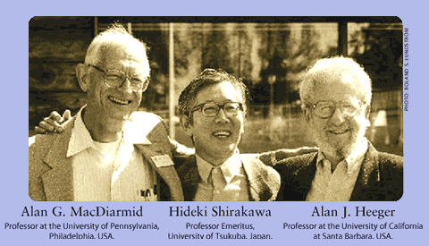
Conducting Polymer Inventors
Notes:
2000 Chemistry Nobel Prize

Slide 11
What is organic semiconductor?
Energy
LUMO
CB
CB
π*
LUMO
E_{G}
VB
HOMO
VB
HOMO
π
N = 1 2 4 …. Polymer Si,Ge… Metal
(Number of
molecules)
Organic semiconductor
LUMO: lowest unoccupied molecular orbital
HOMO: highest occupied molecular orbital
Inorganic semiconductor & metal
CB: conduction band VB: valance band
F. Gutmann, “Organic semiconductors”, Wiley, New York, 1967.
Notes:
Increase number of monomer unit.
Extend conjugation → lower Eg (HOMO higher, LUMO lower)
High conductivity in Metal → easily move

Slide 12
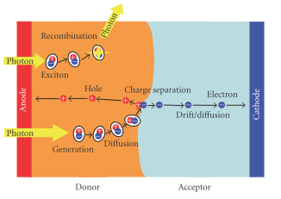
Difference in PV Mechanisms
Organic PV
Interface
Light
Input
e⁻ Donor
Inorganic PV
e ⁻
+
―
Exciton
Anode
―
Light
Input
+
Cathode
p-type
+
-
e⁻
hole
e-
Acceptor
+
-
Anode
+
-
-
Cathode
+
+
-
hole
n-type
Screening and Dielectric Constant
Angew. Chem. Int. Ed. 47, 58 (2008)
Notes:
p-n junction → depletion zone

Slide 13
Bulk-heterojunctions
Excitons binding energy in organic materials is 0.4~0.5eV
Bulk-heterojunction: Blend of two materials with different electron affinity and ionization potential (electron donor and acceptor)
hυ
D+A D*+A
D*+A [D*,A]
[D*,A] [D^{+*},A^{-*}]
[D+,A^{-*}] D⁺+A⁻
1- Photo-excitation
2-Excitons diffusion
3-Tranfer (geminate pair)
4- Charge separation
Bulk heterojunction
+
–
+
–
e⁻ Donor
e⁻ Acceptor
diffusion length ~10nm
Exciton dissociation at the interface by the local field
provide more interface
Angew. Chem. Int. Ed. 47, 58 (2008)
Notes:
Typically the exciton binding energy is of the order of 10±6 meV for common inorganic semiconductors. In organic materials it can be 1 eV.

Slide 14
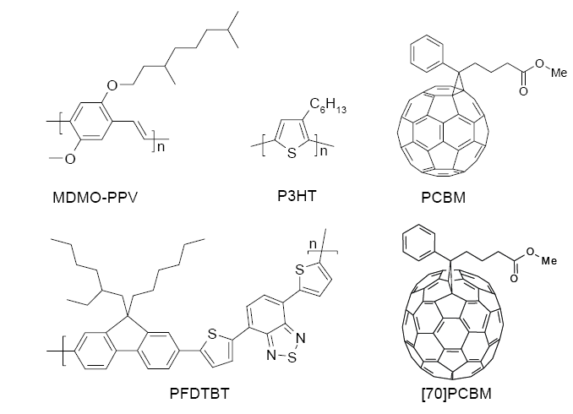
Selected materials for organic solar cells
(b)
Molecular structure and conjugated π-electron system
Ref. McMurry, J., Organic Chemistry. 3rd ed.; Brooks/Cole Publishing Company: 1992. and Angew. Chem. Int. Ed., 47, 58 (2008)

Slide 15
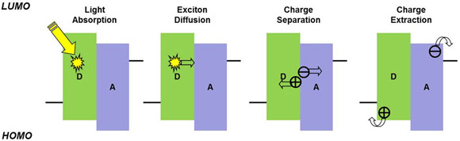
Enhancing OPV Performance
Light Absorption:
New Materials
Using Plasmon Effect
P3HT Crystallization
Exciton Diffusion:
Heterogeneous structure
A-D Interface
P3HT Crystallization
Charge Extraction:
Reduce parasitic resistance
New contact designs
ZnO Nanowires
Al-active layer interface
P3HT Crystallization
Charge Separation:
A-D selection
C-nanotubes
Addition of oxide nanoparticles
P3HT Crystallization

Slide 16
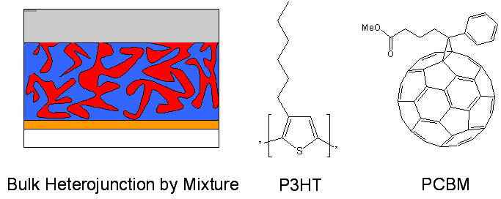
Bulk Heterojunction
Our research focuses on poly(3-hexylthiophene) and [6,6]-phenyl C61-butyric acid
Methylester blends

Slide 17
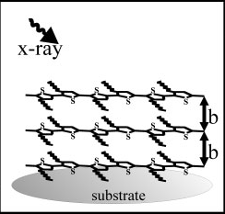
P3HT Crystallization
Annealing P3HT increases the crystallinity, which also increases the carrier mobility leading to overall increased device performance
b=0.38 nm
Adv. Funct. Mater. 2005, 15, 1193-1196
Bakhtyar, Murray and Shah, JAP 2012

Slide 18
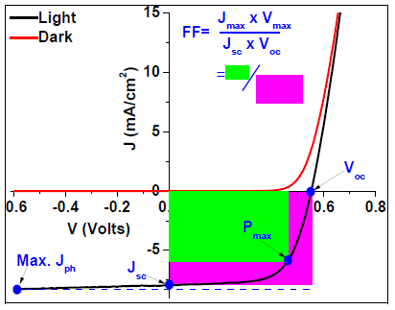
JV Analyses
As Cast:
After Annealing:
Voc, Jsc, FF, and PCE are all traditionally extracted from JV curves
Murray, Shah et al., J. Photon. Energy 3(1), 032098 (2013)

Slide 19
Annealing Effects
As Cast:
After Annealing:
Murray, Shah et al., J. Photon. Energy 3(1), 032098 (2013)

Slide 20
Photocarrier Physics
Simple model of a lumped circuit diagram conveniently and accurately describes most solar cells, including OPVs
$$J\left(V\right)= J_{0}\left\{\exp\left(q\frac{V−RJ}{nk_{B}T}−1\right)\right\}+GV− J_{L}(V)$$
Notes:
G is the generation rate

Slide 21
Differentiation of JV
$$\text{g}\text{(}\text{V}\text{)≡}\frac{\text{d}\text{J}}{\text{d}\text{V}}\text{=}\text{G}\text{+}\frac{\text{qJ}\text{o}}{\text{AkT}}\text{exp}\text{(}\text{qV}\text{/}\text{AkT}\text{)}$$
G = Shunt conductance
q = Electron charge
J₀ = Diode saturation current
A = Diode ideality factor
k = Boltzmann’s constant
T = Temperature
V = Voltage
If dJ/dV is relatively flat, the y-intercept = 1/Rshunt
Murray, Shah et al., J. Photon. Energy 3(1), 032098 (2013)

Slide 22
Differentiation of JV
$$\text{r}\text{(}\text{J}\text{)≡}\frac{\text{d}\text{V}}{\text{d}\text{J}}\text{=}\text{R}\text{+}\frac{\text{AkT}}{\text{q}}{(J+J_{L})}^{−1}$$
Slope = q/AkT, Intercept = Jo
Murray, Shah et al., J. Photon. Energy 3(1), 032098 (2013)

Slide 23
Device Resistances
Upon annealing, both series and shunt resistances respond favorably
Murray, Shah et al., J. Photon. Energy 3(1), 032098 (2013)

Slide 24
Circuit Parameters
The dark saturation current and the diode parameter, both measure of recombination, decreased
Murray, Shah et al., J. Photon. Energy 3(1), 032098 (2013)

Slide 25
R-Corrected JV Curves
Device | J_{o} (mA/cm²) | A | R (Ω-cm²) | J_{Lo} (mA/cm²) | V_{oc} (mV) | L_{c}/D | V_{fb} (mV) | J_{sc} (mA/cm²) | FF (%) | μτ (cm²/V) | PCE (%)
Raw Data | - | - | - | - | 560 | - | - | 10.4 | 46 | - | 2.7
R, η corrected | 7.8×10⁻⁷ | 1.4 | 14 | 11.8 | 577 | 5.5 | 590 | 10.8 | 83 | 1.7x10⁻¹³ | 6.0
Bakhtyar Ali, Shah, et. al., JAP, 112, 114514 (2012)

Slide 26
Finding the Limiting Carrier Mobility-Lifetime Product μτ
$$\frac{L_{c}}{D}= μτ\frac{V_{fb}}{D^{2}}$$
L_{c} =zero bias drift collection length
μτ = mobility-lifetime product
V_{fb} = flat band potential
D = active layer thickness
μτ has a weak dependence on T and a strong dependence on D
Murray, Shah et al., J. Photon. Energy 3(1), 032098 (2013)

Slide 27
P3HT-PCBM Interface

Slide 28
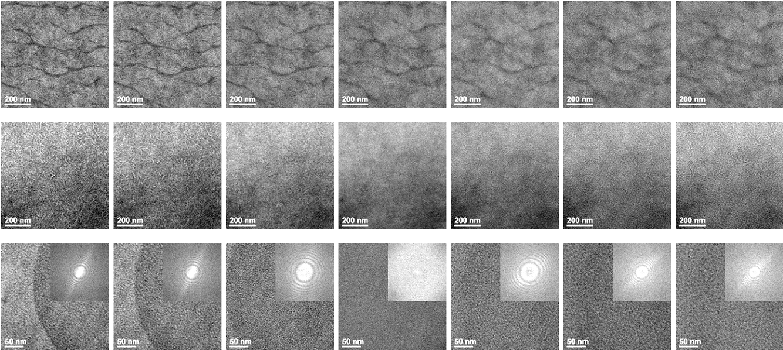
Transmission Electron Microscopy
Defocus (-ΔZ)
Focus
Over focus (+ ΔZ)
(a)
ΔZ=-25µm
ΔZ=-20µm
ΔZ=-10µm
ΔZ=0µm
ΔZ=-10µm
ΔZ=-20µm
ΔZ=-25µm
(b)
ΔZ=-25µm
ΔZ=-20µm
ΔZ=-10µm
ΔZ=0µm
ΔZ=-10µm
ΔZ=-20µm
ΔZ=-25µm
(c)
ΔZ=-25µm
ΔZ=-20µm
ΔZ=-10µm
ΔZ=0µm
ΔZ=-10µm
ΔZ=-20µm
ΔZ=-25µm
P3HT annealed at 160 C
P3HT:PCBM (1:1) annealed at 160 C
PCBM annealed at 160 C

Slide 29
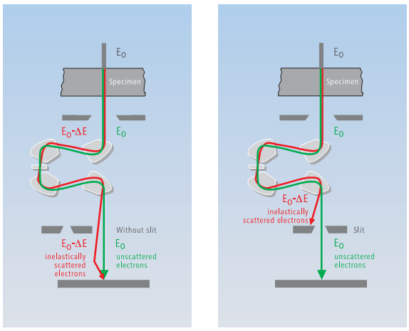
Electron Energy Loss Spectroscopy (EELS)
Incident high-kV beam
When electron penetrates a specimen, it can either be elastically or inelastically scattered ^{[1]}.
Secondary
Electron (SE)
Backscattered
Electron (BSE)
E_{o}
Characteristic
X-rays
There are two modes in EELS
The Electron Energy-Loss Spectrum (EELS)
The Energy-Filtered image (EFTEM)
Auger
electrons
Visible
Light
Absorbed
electrons
Specimen
Electron-hole
pairs
Bremsstrahlung
X-ray
Elastically
Scattered electrons
E_{o}
Inelastically
Scattered electrons (E₀ - ΔE)
Direct
Beam
Magnetic prism
The energy-loss events provide useful information about:
Chemistry—the bonding
Electronic structure—the nearest-neighbor atomic structure
In-Column Filters: Zeiss Libra® 120 Plus at DBI [2]
[1] Williams, D. B.; Carter, B. Transmission electron microscopy;Springer: New York, 1996
[2] www.zeiss.com

Slide 30
Electron energy loss spectroscopy (EELS) and EFTEM image
Incoming e ⁻ beam
E_{o}
An energy window
Specimen
Out going e – beam
Energy filter
unit
E_{o}
Image obtained by collecting electron with energy ΔE,
energy filtered TEM (EFTEM)
E_{o}-ΔE
EELS spectrum

Slide 31
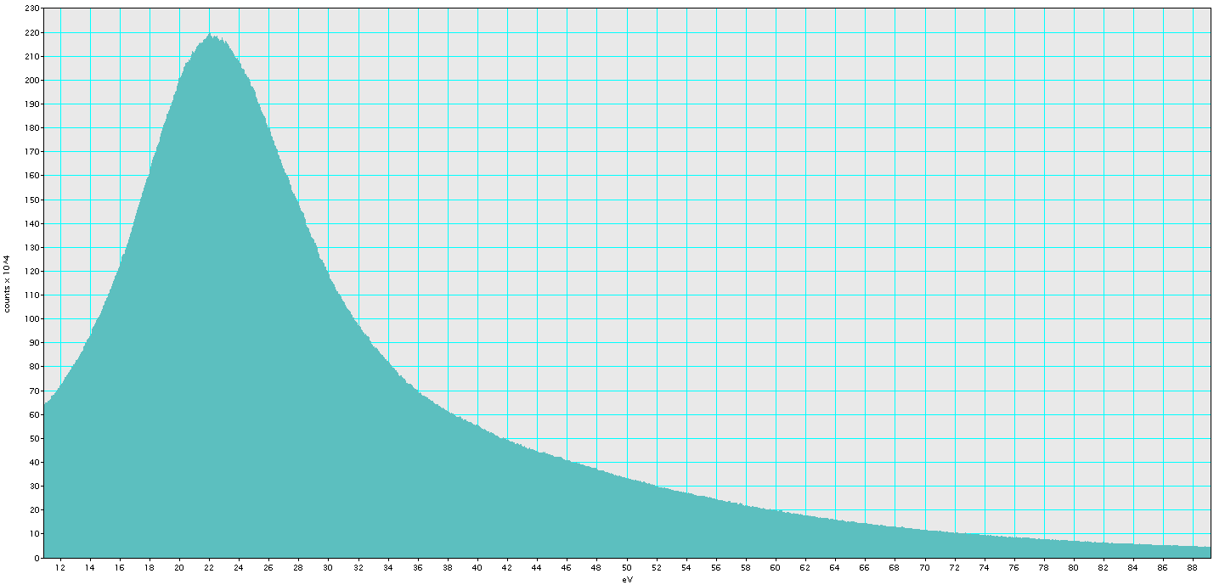
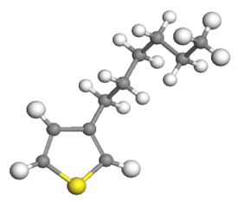
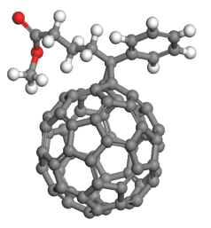
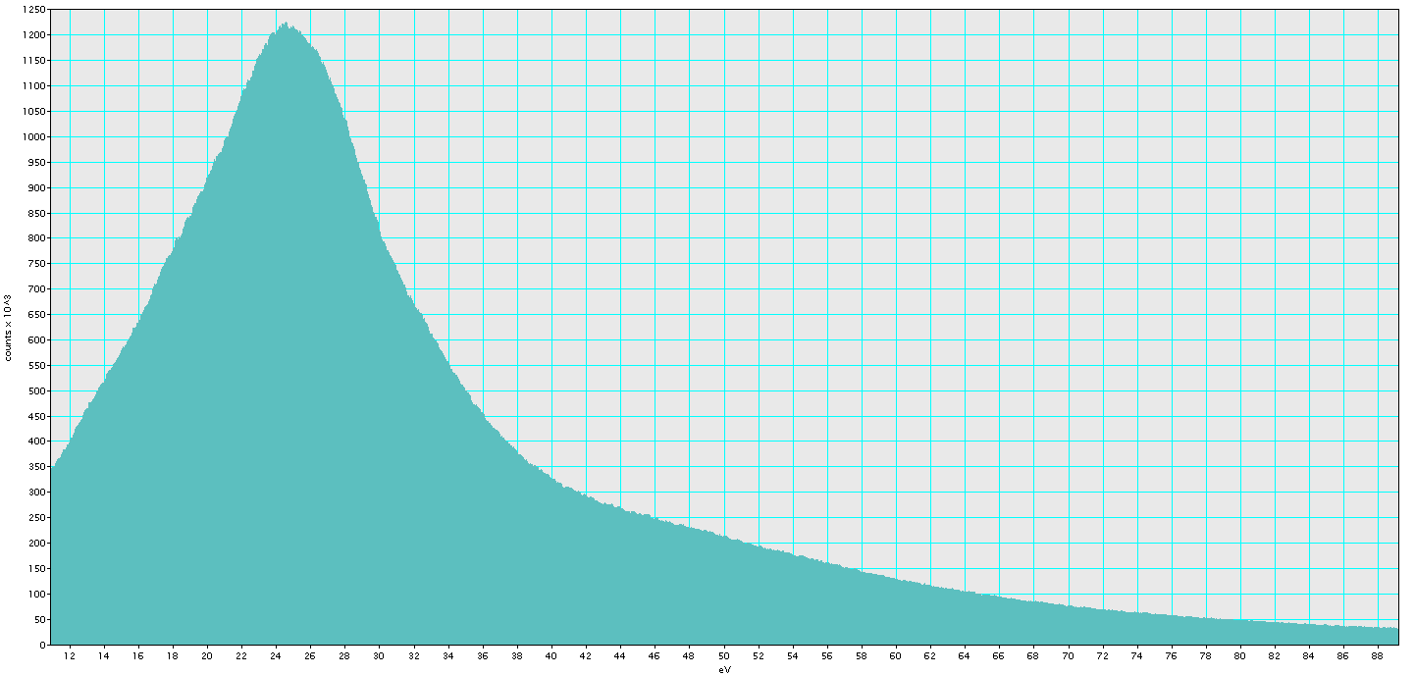
Electron Energy Loss Spectroscopy (EELS)
∼19 eV
Plasmon peak is a Fingerprint
Counts (arbitrary units)
window width ∼7 eV
P3HT
P3HT
PCBM
∼25 eV
∼30 eV
Plasmon peak positions
Counts (arbitrary units)
window width ∼7 eV
PCBM
PCBM
P3HT: ∼ 19 eV
PCBM: ∼ 25 eV
window width ∼7 eV
12
24
36
48
60
72
84
Energy (eV)

Slide 32
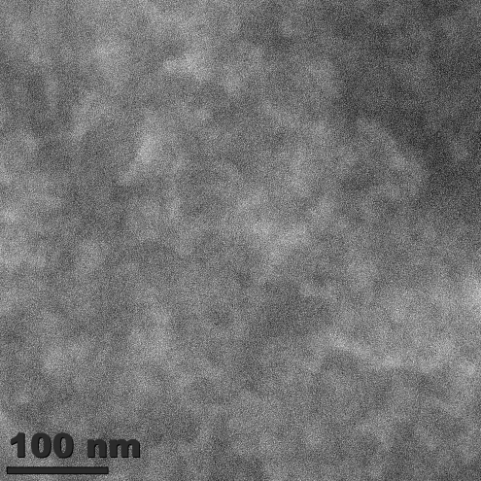
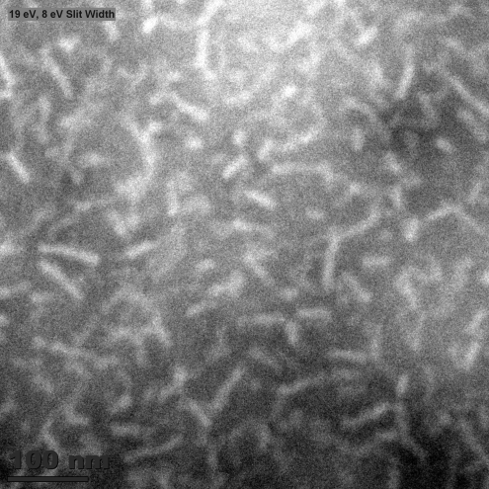
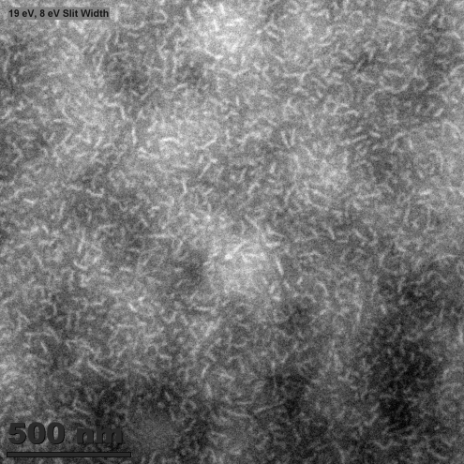
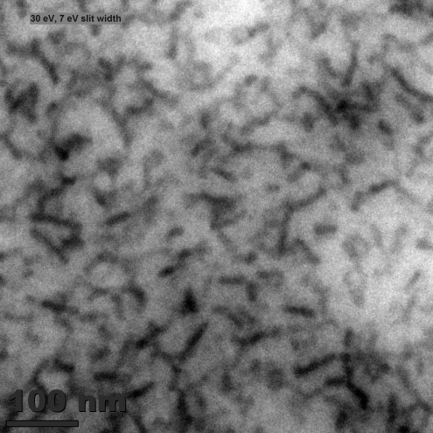
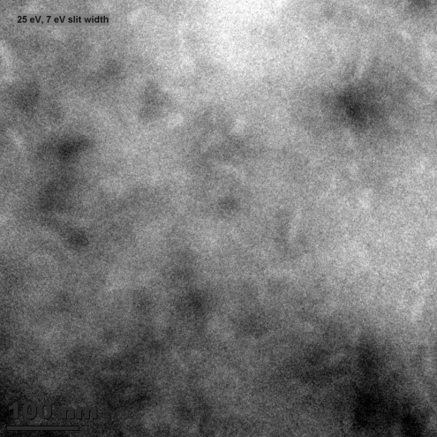
EFTEM imaging
Brighter regions correspond to P3HT rich domains
0 eV with 7 eV slit width
19 eV with 7 eV slit width
19 eV with 7 eV slit width
100 nm
100 nm
30 eV with 7 eV slit width
25 eV with 7 eV slit width
500 nm
Similar morphology, i.e. P3HT fibril structure, is observed on a sample annealed for 20 min
100 nm
100 nm
P3HT:PCBM (1:1) annealed at 160ºC for 60 min
[1] Rujisamphan N and Shah. et al. (ACS Surface and Interfaces, under review)

Slide 33
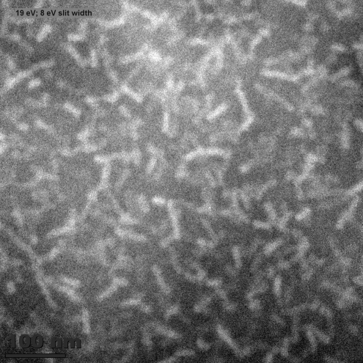
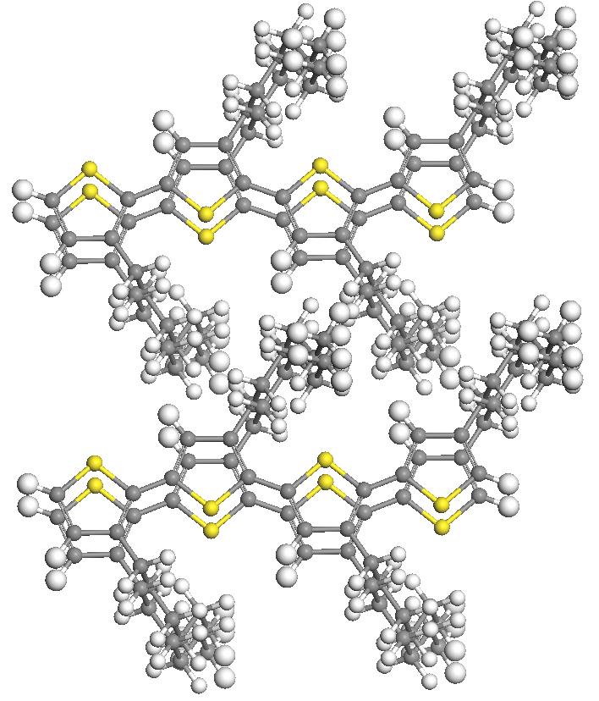
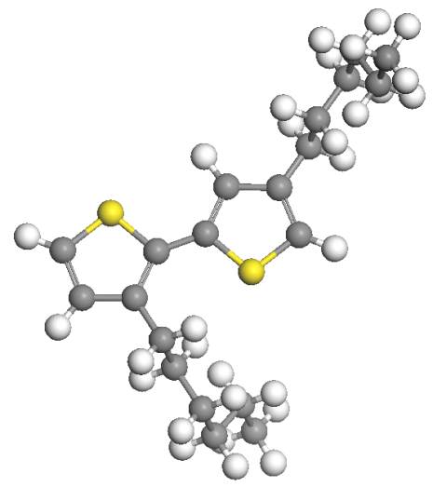
Electron Energy Loss Spectroscopy (EELS)/EFTEM
Annealed at 160 ºC for 20 min
Annealed at 160 ºC for 60 min
19 eV with 7 eV slit width
19 eV with 7 eV slit width
The average length of fibril is 70±5 nm
The average diameter of fibril is 15±2 nm
100 nm
100 nm
1 monomer of P3HT
∼8.0 Å
16.4 Å
3.8 Å
Substrate
Nopporn and Shah, Solar Energy Materials & Solar Cells 109 (2013) 56–62

Slide 34
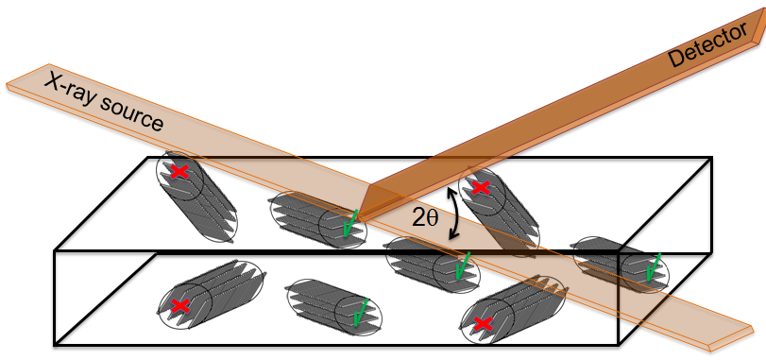
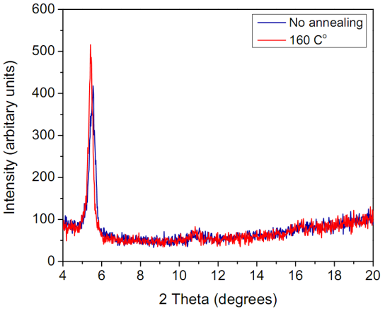
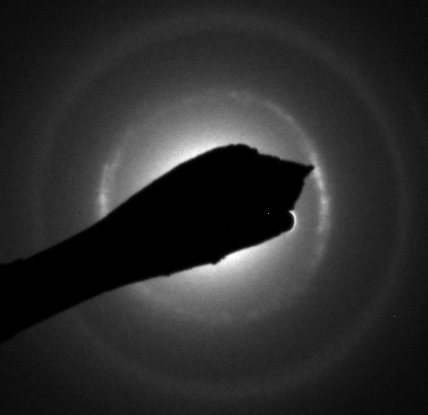
Other techniques to determine the structure
Out-of plane XRD
Out-of plane XRD results
SEAD results
(a)
d-spacing value perpendicular to a P3HTfibril (16.4 Angstrom )
(020)
pi-pi stacking distance (3.8 Angstrom)
along the P3HT fibril
(a) A spun cast P3HT sample

Slide 35
Chains orientation/packing in the P3HT fibril
Ordered chain
8.07Å
P3HT fibril
Shah I. et al. ACS, Appl. Mat. Int. under review, ACS (2014).

Slide 36
Al – Active layer Interface

Slide 37
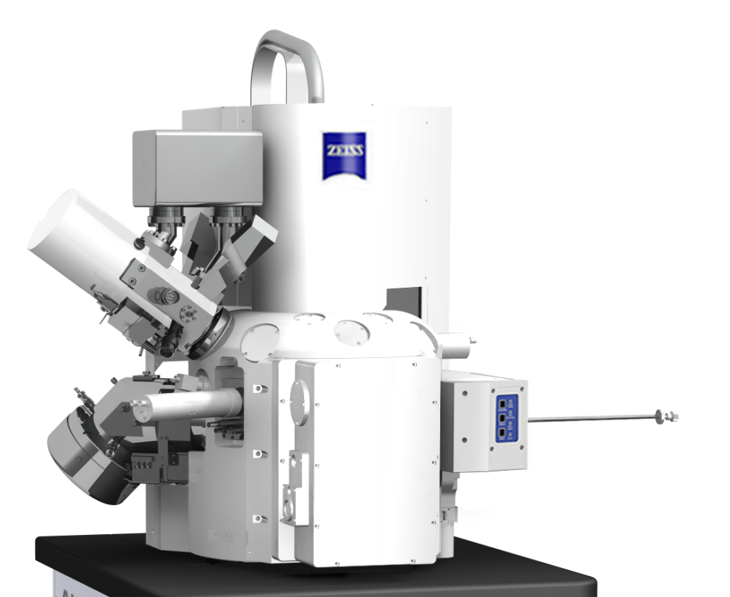
Focused Ion Beam (FIB) Machine
FIB column
SEM
FIB– Ga⁺ ion
CCD camera
& illumination
Inlens - Detector
sample
SE -Detector
Airlock
Gas Injection System (GIS)

Slide 38
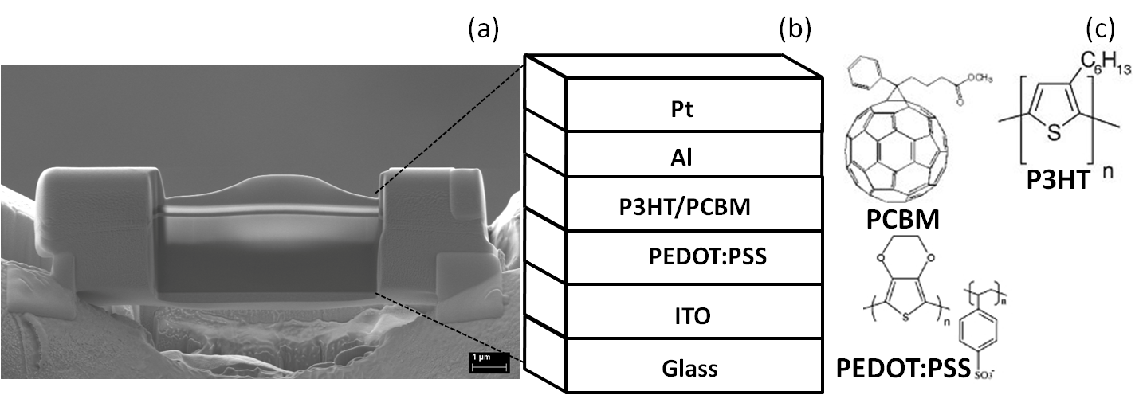
Organic Photovoltaic Device
Shah and Nopporn, Adv. Energy Mat. 2013

Slide 39
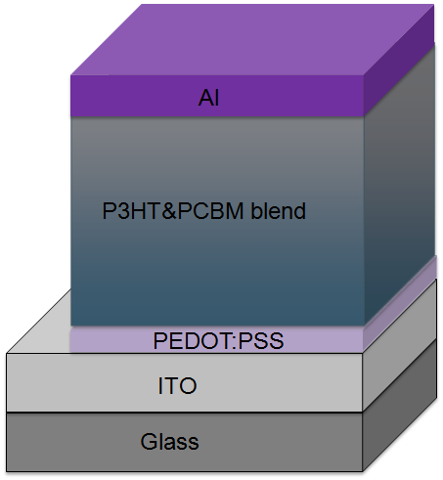
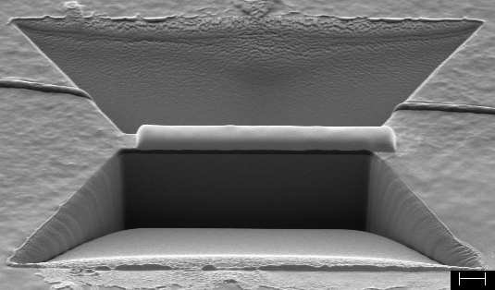
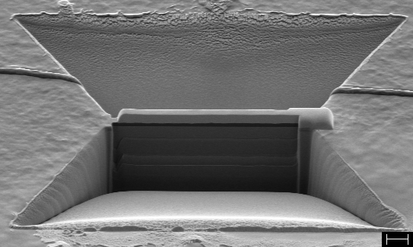
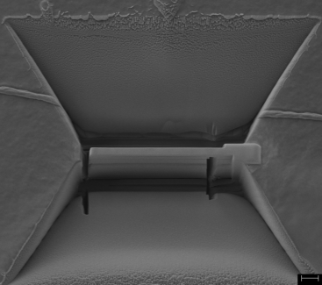
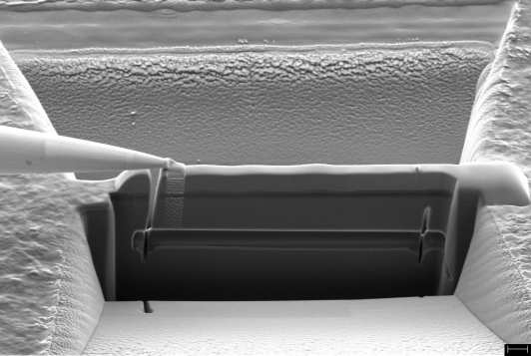
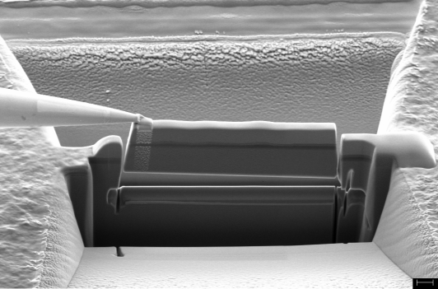
TEM Sample preparation with FIB
Ga⁺
Ga⁺ beam
Pt
Sample after thinning
(a)
(b)
Milling through the bottom
and side wall
(c)
Trench
Pt
3µm
Trench
2µm
2µm
2µm
In-situ picking up the sample
(d)
Lifting sample up
(e)
(f)
1µm
1µm
Detaching the lamella sample
A lamella TEM sample: 50 nm thick

Slide 40
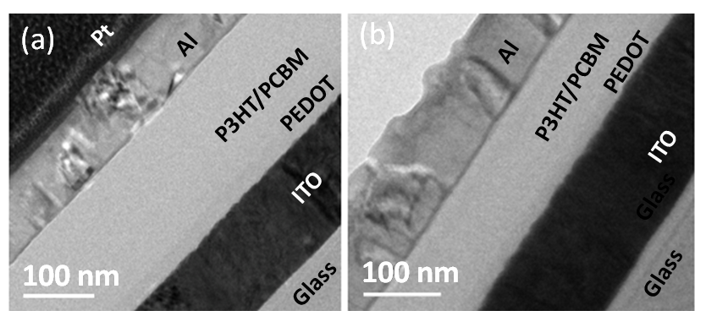
Crossection TEM of interfaces in OPV
Unannealed
Annealed
Shah and Nopporn, Adv. Energy Mat. 2013

Slide 41
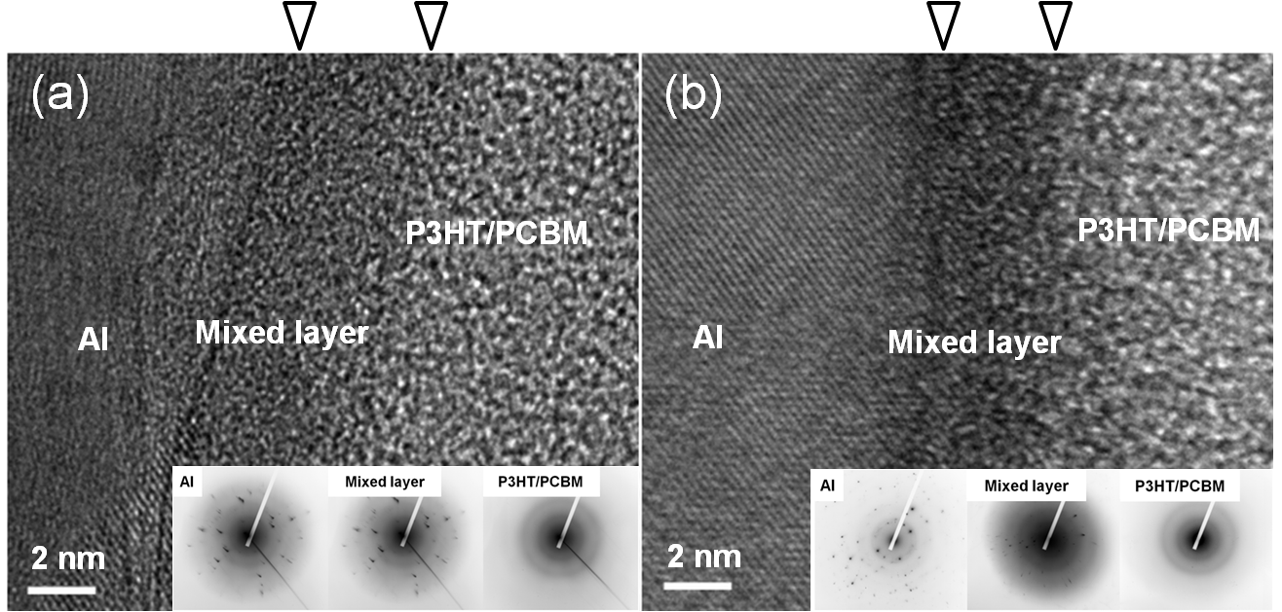
Crossection TEM of interfaces in OPV
Shah and Nopporn, Adv. Energy Mat. 2013

Slide 42
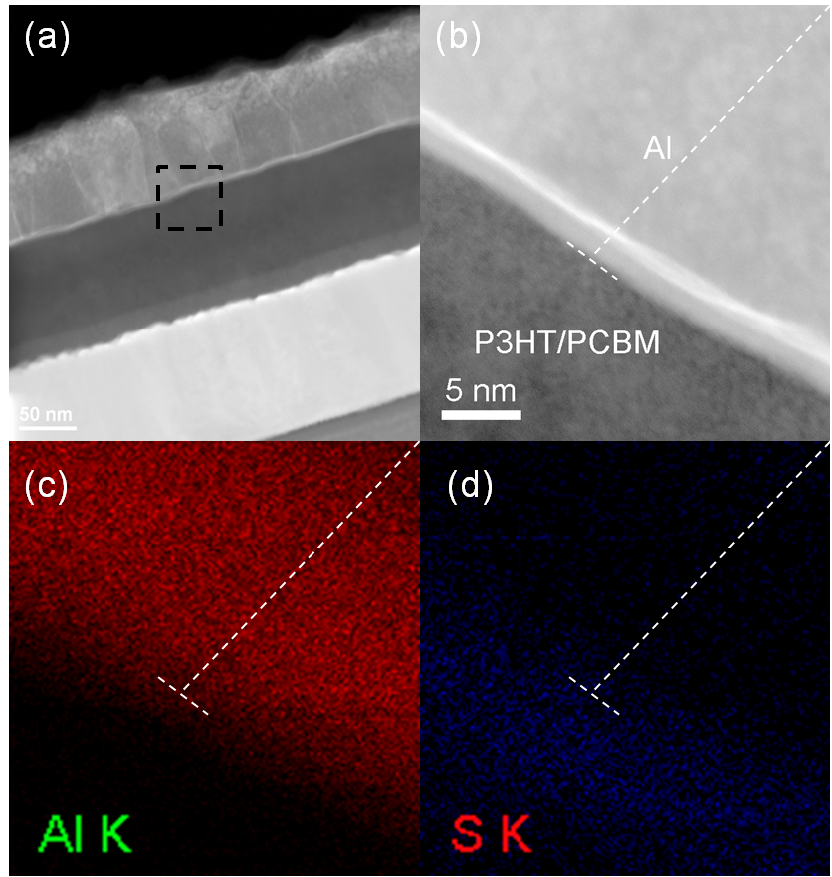
Elemental map of the interfaces in OPV
Shah and Nopporn, Adv. Energy Mat. 2013

Slide 43
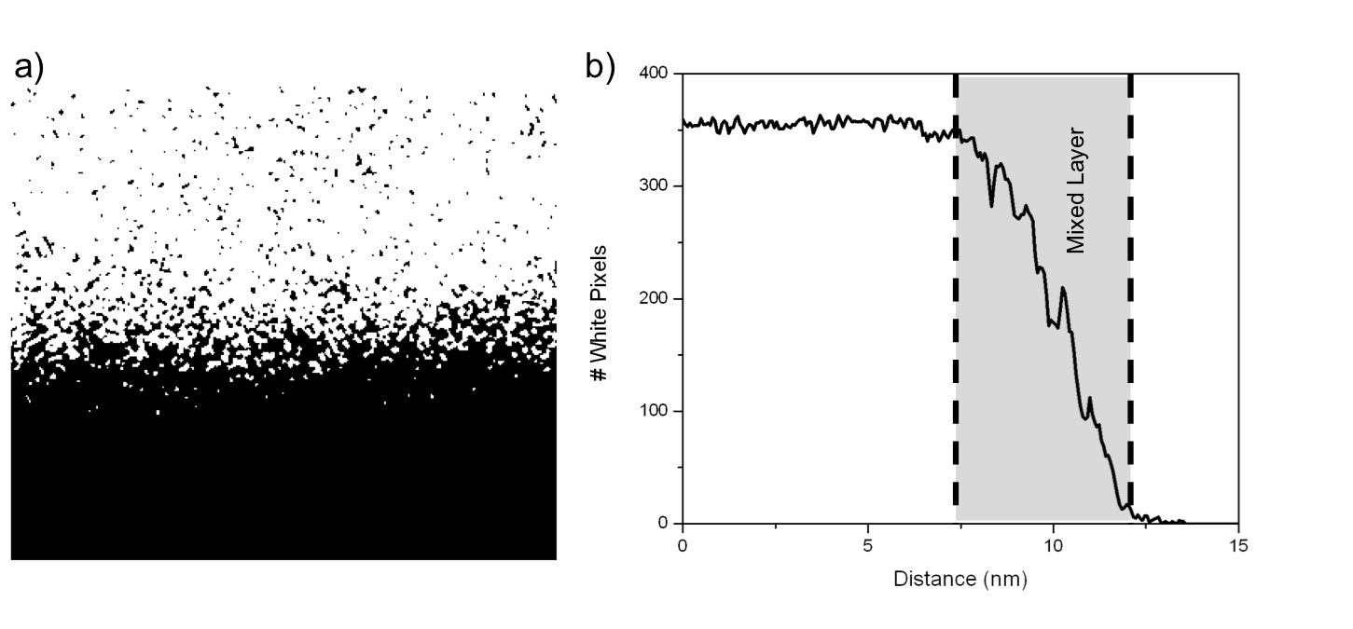
Al Elemental Map (pixelated) and Measured Depth profile
Cramer, Shah, et. al. ACS (2014)

Slide 44
Fick’s Second Law

Slide 45
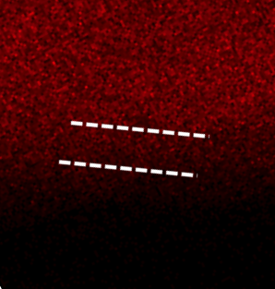
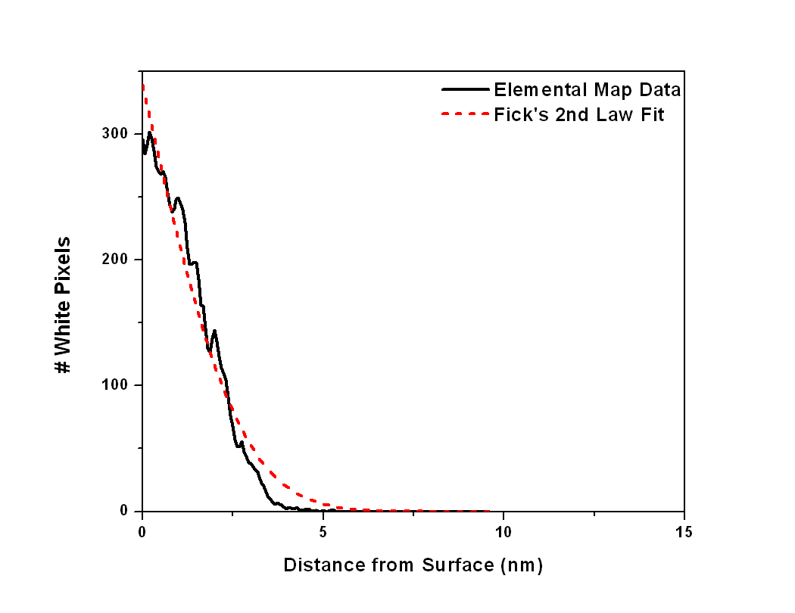
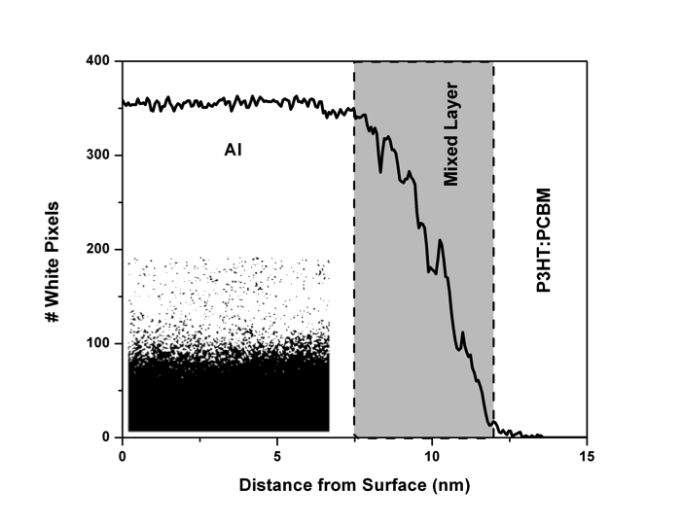

Al mapping
Aluminum diffusivity in the active layer
D = 1.8 x 10⁻¹⁷ ± 6 x 10⁻¹⁸ cm²/s
White pixels represent Al and black pixels represent P3HT.
This image has dimensions 22.53 x 19.57 nm.
D (diffusivity) of (1.8 x 10⁻¹⁷ ± 6 x10⁻¹⁸) cm²/s for Al in P3HT:PCBM was determined.
Work of Hailey Carmer, an undergraduate student in the group

Slide 46
Predicting J_{sc} from EFTEM Images
(TEM and EFTEM)

Slide 47

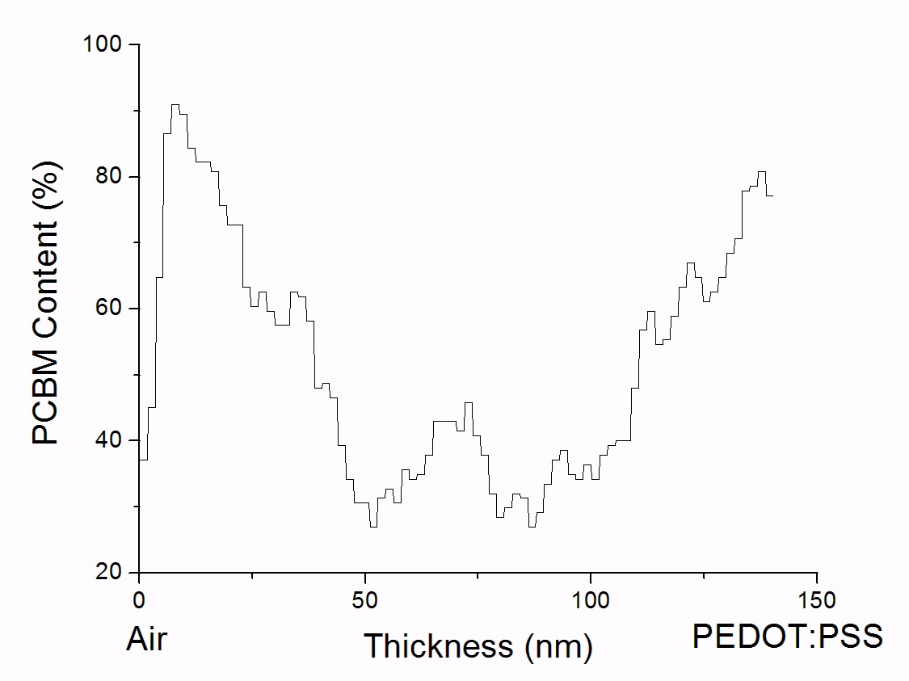
TEM and EFTEM Image Analysis

Slide 48
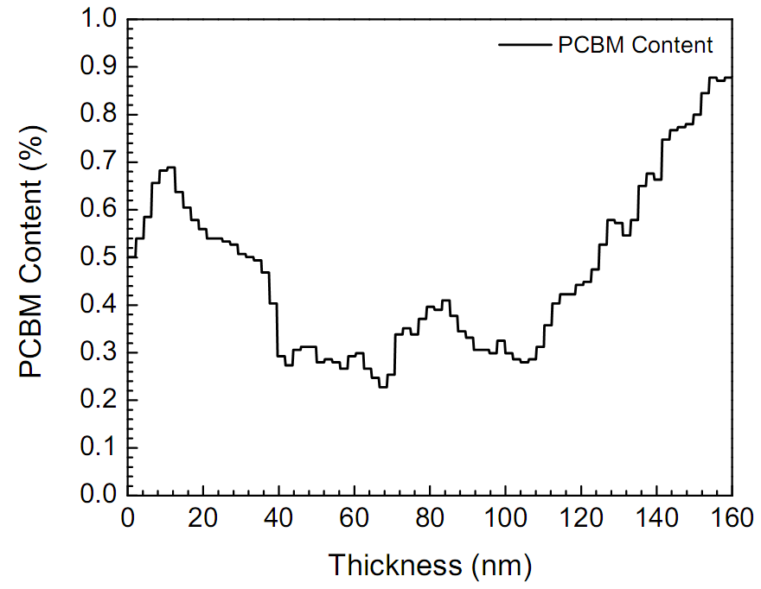
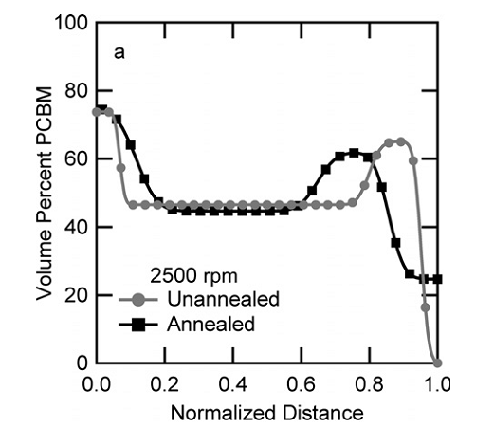
PCBM distribution analysis
Our results
Kiel et al., Soft matter (2012) ^{[1]}
100
80
P3HT:PCBM
Electrode
P3HT:PCBM
Electrode
substrate
substrate
60
40
20
Distance from the Al interface (nm)
electrode
Substrate
Substrate
electrode
[1] Mackay et al, Soft matter (2012)

Slide 49
Light Absorption in the active layer
Use Beer-Lambert law to calculate absorption: I = I₀ exp(-αx) (1)
We assumed a 90% reflection at the polymer-Al interface on the back layer, then repeated the absorption as the light reflected up the device.
White represents the areas of highest absorption, which correspond to P3HT sections.
P3HT has a much higher absorption in the visible range (1.7x10⁵ as compared to 2.7x10⁴ for PCBM).
Notes:
Use Beer-Lambert law to calculate absorption: I = I₀ exp(-αx) (1)
Where I is the transmitted light, I₀ is the incident light, α is the absorption coefficient and x is the thickness of the layer in cm.
By taking I₀-I, we find the amount of light absorbed by the layer, and thus the number of excitons generated in that area. We then pass I to the next layer down, where it becomes I₀ and the process is repeated.
We assumed a 90% reflection at the polymer-Al interface on the back layer, then repeated the absorption as the light reflected up the device.
This created the map of absorption shown in Figure 3.
White represents the areas of highest absorption, which correspond to P3HT sections. P3HT has a much higher absorption in the visible range (1.7x10⁵ as compared to 2.7x10⁴ for PCBM). Shading in the lower areas is observed as the P3HT above absorbs a significant amount of light.
How did you get this? Did you use the measured quantum efficiency?
How did you set layer thickness?
Any reference for this?

Slide 50
J_{sc} Prediction
Light Absorption
Current Generation

Slide 51
Conclusions:
OPV is promising but there are several issues related to stability, mobility, etc., that still need to be worked out.
Simple lumped circuit model is useful for modeling OPV devices.
EELS/EFTEM can provide the details needed to study the P3HT and PCBM interface.
Simple diffusion models can provide information pertinent to diffusion on Al in the devices
EFTEM in combination with other techniques gives you a peak into the inside of OPV device which is useful for understanding the device behavior.

Slide 52
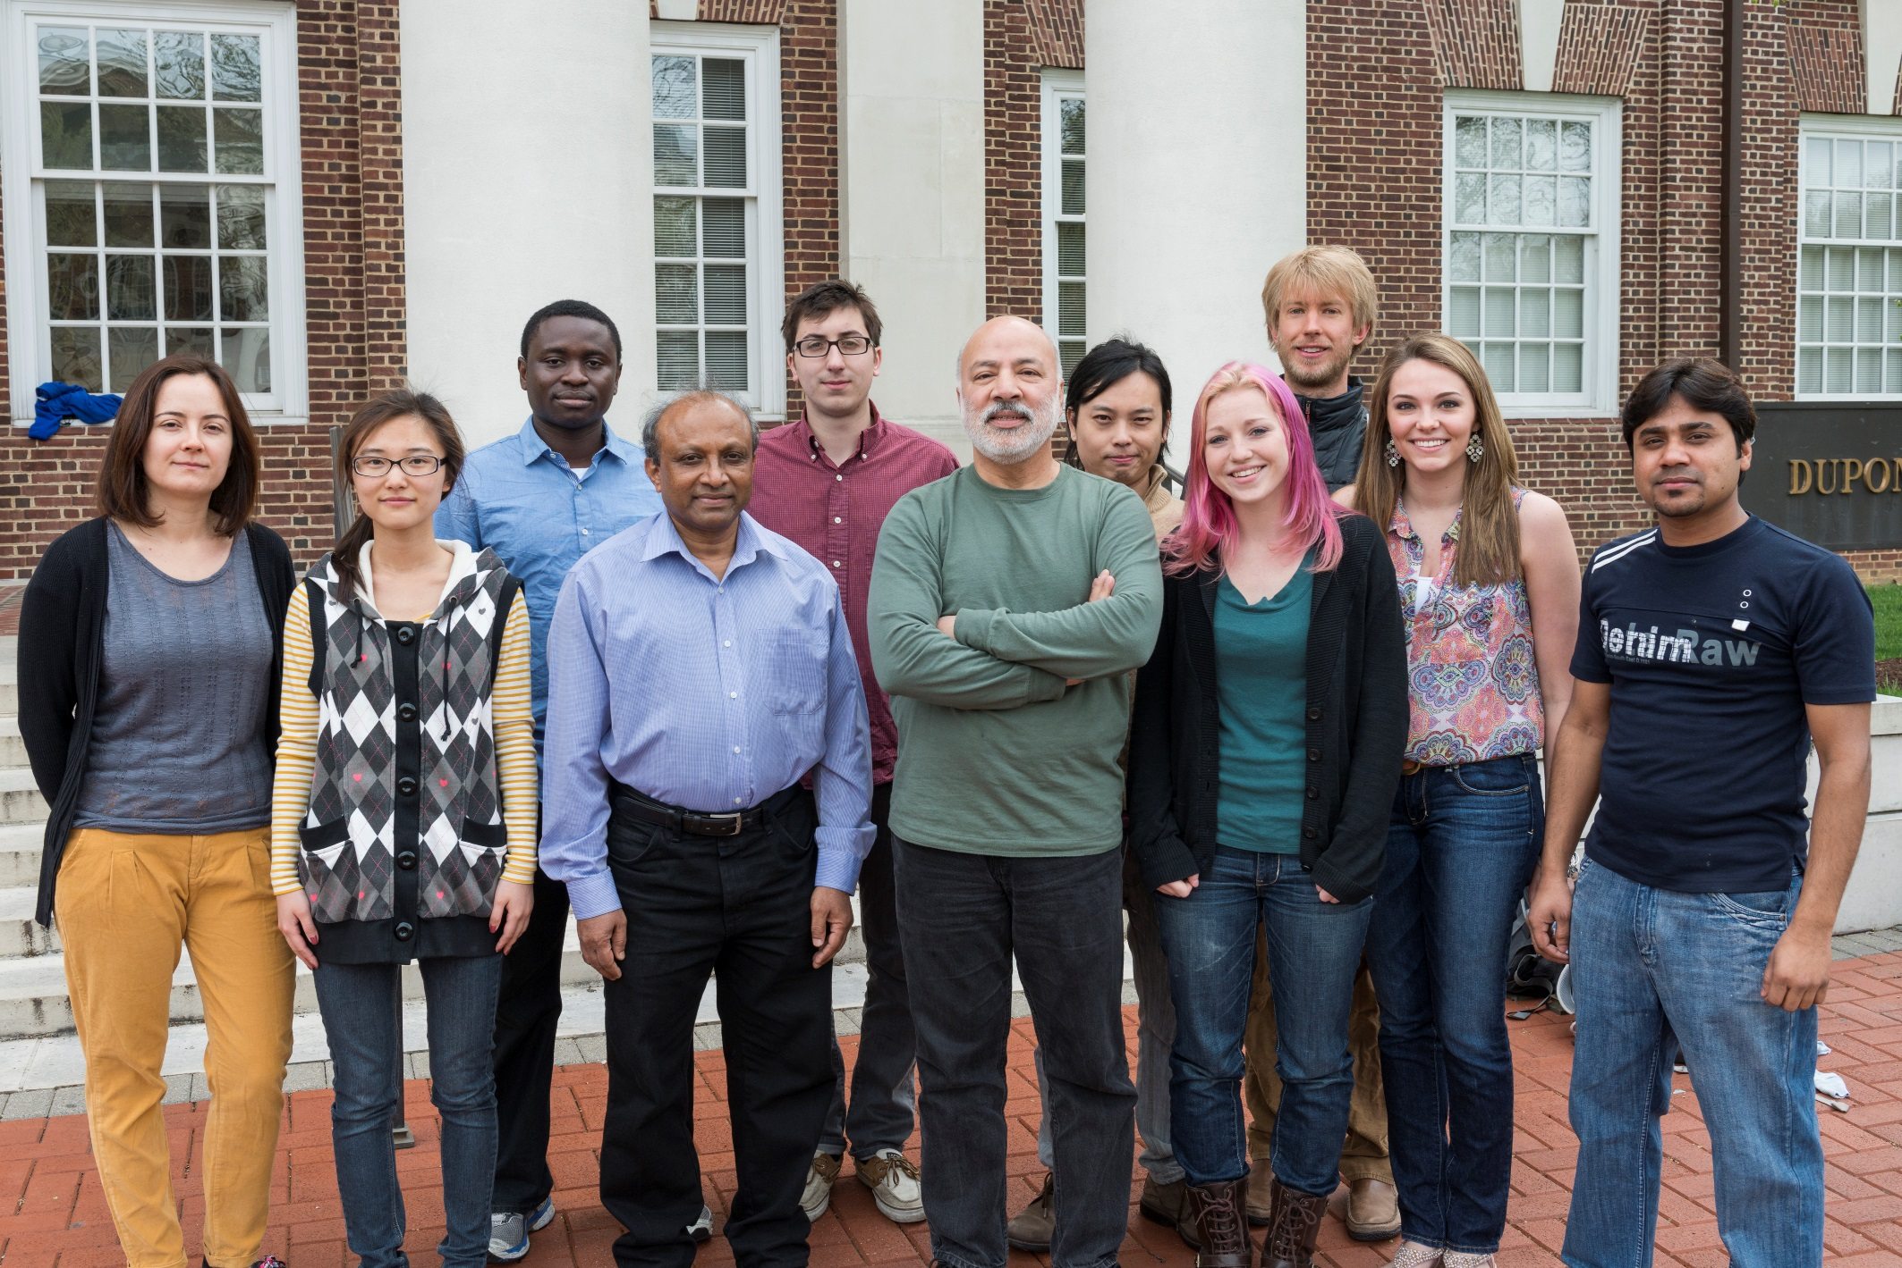
Thin Films and Nanostructures Group

Slide 55
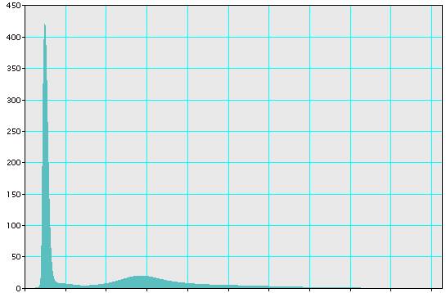
EELS and EFTEM
Incident high-kV beam
Secondary
Electron (SE)
Zero loss peak (ZLP)
Backscattered
Electron (BSE)
E_{o}
Characteristic
X-rays
Auger
electrons
Visible
Light
Low-loss region (<50eV)
High-loss region (>50 eV)
Counts (arbitrary units)
Absorbed
electrons
Specimen
Electron-hole
pairs
Bremsstrahlung
X-ray
Plasmon peak
E_{o}
Inelastically
Scattered electrons (E₀ - ΔE)
Direct
Beam
Energy (eV)
Elastically
Scattered electrons

Slide 56

Plasmon character for P3HT and PCBM

Slide 57

Plasmon characteristic peaks from a device

Slide 58

19 eV with 7 eV slit width
P3HT fibrils
500 nm
EFTEM images of P3HT:PCBM (1:1) annealed at 160 C for 60 min. (a) at 18 eV, (b) 20 eV, (c) 22 eV, (d) 24 eV, (e) 26 eV, (f) 28 eV, and (g) 30 eV, respectively

Slide 59



Comparison crosssectional TEM images obtained from BFTEM and EFTEM
BFTEM
EFTEM

Slide 60







J-V analysis: Background
(a) Diode equation
$$J\left(V\right)=J_{0}{\{e}^{\frac{qV_{j}}{AkT}}−1\} + GV−J_{L}$$
Where V_{j} ≡ V-RJ$and J_{o}\sim J_{oo}^{}exp⁡(−\frac{∅}{kT})$
(b) Taking the derivative of eqn. in part (a)
w. r. t. “V “: assuming J_{L} is constant
$$\frac{dJ}{dV}={\frac{qJ_{o}}{AkT}e}^{\frac{qV}{AkT}}+G$$
Which gives the value of G in the reverse bias when plotted as $\frac{dJ}{dV} vs V$
(c) Taking the derivative of eqn. (a)
w. r. t. “J “:
$\frac{dV}{dJ}=R+\frac{AkT}{q}$(J+J_{L})⁻¹ For RG<<1; J_{L}= J_{sc}
Ref. Steven S. Hegedus, Prog. Photovolt. Res. Appl. 12, 155 (2004)
(d) From eqn. (a) one can have;
$$\ln\left(J+JL−GV\right)=\ln\left(Jo\right)+\frac{q}{AkT}Vj$$
The intercept gives the value of J_{o} and the slope gives the diode factor A

Slide 61



J(V) analysis: J_{L}(V) losses
J_{L}(V)-losses
$$J\left(V\right)=J_{0}{\{e}^{\frac{q\left(V−RJ\right)}{nkT}}−1\}+GV−J_{L}$$
$$J\left(V\right)=J_{0}{\{e}^{\frac{q\left(V−RJ\right)}{nkT}}−1\}+GV−J_{L}(V)$$
J_{L}(V) loss: J at the maximum power point is ~39% less than J at far reverse bias. Similarly J at J_{sc} is 13% less than J_{Lo}
Principle of superposition is not applicable
$J\left(V\right)=Jd\left(V\right)−J_{L}$
Notes:
Voltage dependence introduces significant losses and the principle of suppers-position is not applicable

Slide 62
Outstanding Issues

Slide 63

Typical OPV Number

Slide 64
Two conditions to become conductive:
Conducting Polymers
The first condition for this is that the polymer consists of alternating single and double bonds, called conjugated double bonds.
Every bond contains a localized “sigma” (σ) bond which forms a strong chemical bond. In addition, every double bond also contains a less strongly localized “pi” (π) bond which is weaker.

Slide 65
The second condition is that the polymer has to be altered - either by removing electrons from (oxidation), or inserting them into (reduction), the material.
1-oxidation with halogen (or p-doping).
2- Reduction with alkali metal (n-doping).

Slide 66
Conducting Polymer Inventors
Notes:
2000 Chemistry Nobel Prize

Slide 67

OPV Material

Slide 68
Conjugated Polymers
The most important aspect of conjugated polymers from an electrochemical perspective is their ability to act as electronic conductors
Material which could combine the processibility, environmental stability, and weight advantages of a fully organic polymer with the useful electrical properties of a metal
All conjugated polymers have quasi-infinite system extending over a large number of recurring monomer units. This gives the materials a directional conductivity, strongest along the axis of the chain. The simplest possible form polyacetylene (CH)_{x}
While polyacetylene itself is too unstable to be of any practical value, its structure constitutes the core of all conjugated polymers.

Slide 69
Conjugated Polymers
a
b
c
Conjugated polymer structure: (a) trans- and (b) cis-polyacetylene, and (c) polythiophene
Notes:
Conjugated polymers are organic macromolecules which consist at least of one chain of alternating double- and single-bonds. Due to the fact the π-orbitals of the alternating double-and single-bonds mesomerize the single and double bonds becomes similar character. This means that the p_{z}-orbitals of the carbon atoms which forms the conjugated chain overlaps also over the single bonds. Thus π-electrons can be easier moved from one end of the polymer chain to the other. However, the remaining bond alteration (possibly by Peierl's instability) makes conjugated polymers to be only one-dimensional semiconductors. Like inorganic semiconductors they can be doped, to increase their conductivity extremely. For the discovery and development of such conductive polymers Alan J. Heeger, Alan G. MacDiarmid, Hideki Shirakawa received the Nobel prize in chemistry in 2000. The most simple conjugated polymer is polyacetylene, which consist only of a single chain of alternating single- and double-bonds.
Structure formula of Polyacetylene.
In principle one can construct any devices that are available from inorganic semiconductors, like diodes and transistors, also from conjugated polymers. The most advanced development in the last decade was that of light emitting devices from polymers like polyphenylvinylene (PPV), polyfluorenes (PF), and polythiophenes (PT), which are already on the market. Blended with Fullerene (C₆₀) or its derivates, the polythiophenes are also most promising materials for photovoltaic application.

Slide 70
Conclusions
OPVs have low carrier lifetime and short diffusion lengths
Crystallization of P3HT increases conductivity, but also increases domain size which leads to increased electron-hole recombination
Simple lumped circuit model accurately describes these issues and allows a glimpse into the internal workings of the devices
Model allows extraction of otherwise difficult to obtain data, such as barrier heights and the limiting carrier mobility lifetime product μτ

