Slide 1
Fullerene as Carbon allotropical alteration
Georgian Technical University
Student: Tamar Khechiashvili
Supervisor: Prof. Nodar Gafishvili
2012
tamo.xechiashvili@gmail.com

Slide 3
“Exercise will replace medicine, but medicine will not replace exercise”

Slide 4
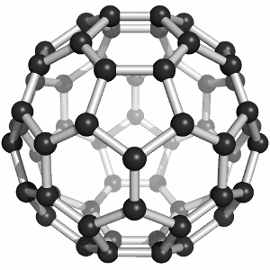
Fulleren

Slide 5
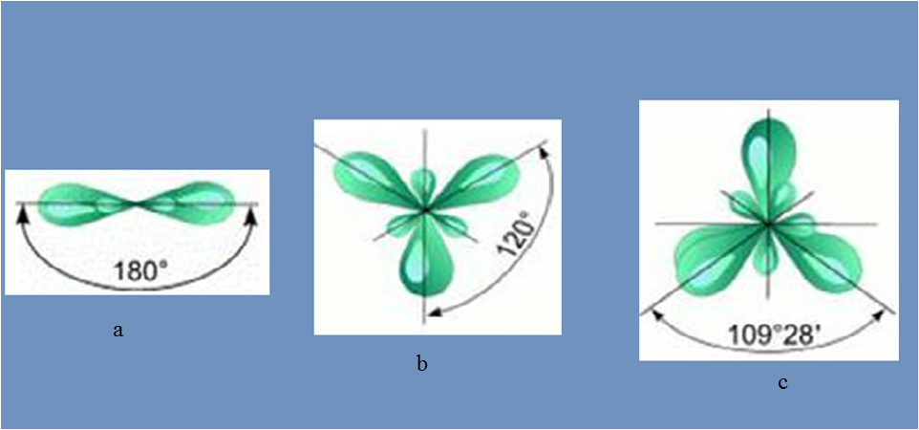
Electronic structure of
the carbon atom
Types of Chemical carbon linked: Karbini (a), Graffiti(b), Diamond(c)

Slide 6
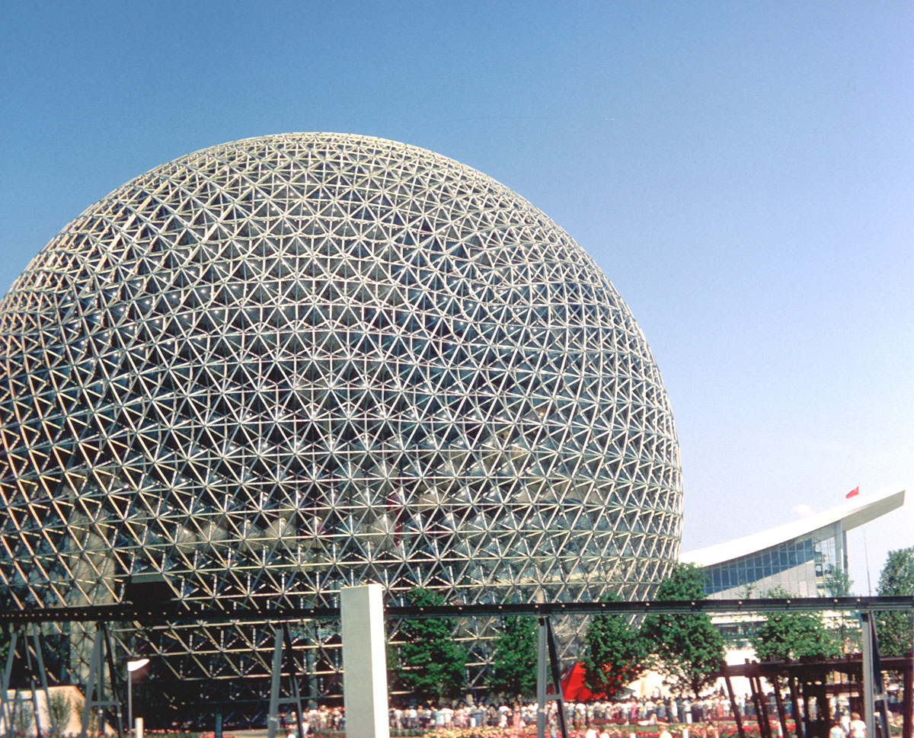
Fullerene Research Center

Slide 7
Vielen Dank !!!
Thenks for attention

