Slide 1
Georgian Technical
University
Speaker:
Faculty Of Information Science And Management Systems
Department of Physics
First year student
Mikheil Kelenjeridze
E-mail: inventing21@gmail.com

Slide 2
New direction of medicine
Quantum Therapy

Slide 3
Promotes healing wounds
Has analgesic effect
Anti allergy effect
Increases lymphocytes and macrophages activity 5–10 times
Stimulate on blood formation
Normalize immunity
Removes intoxication
Enlarges blood vessels
Has anti arrhythmia property

Slide 4
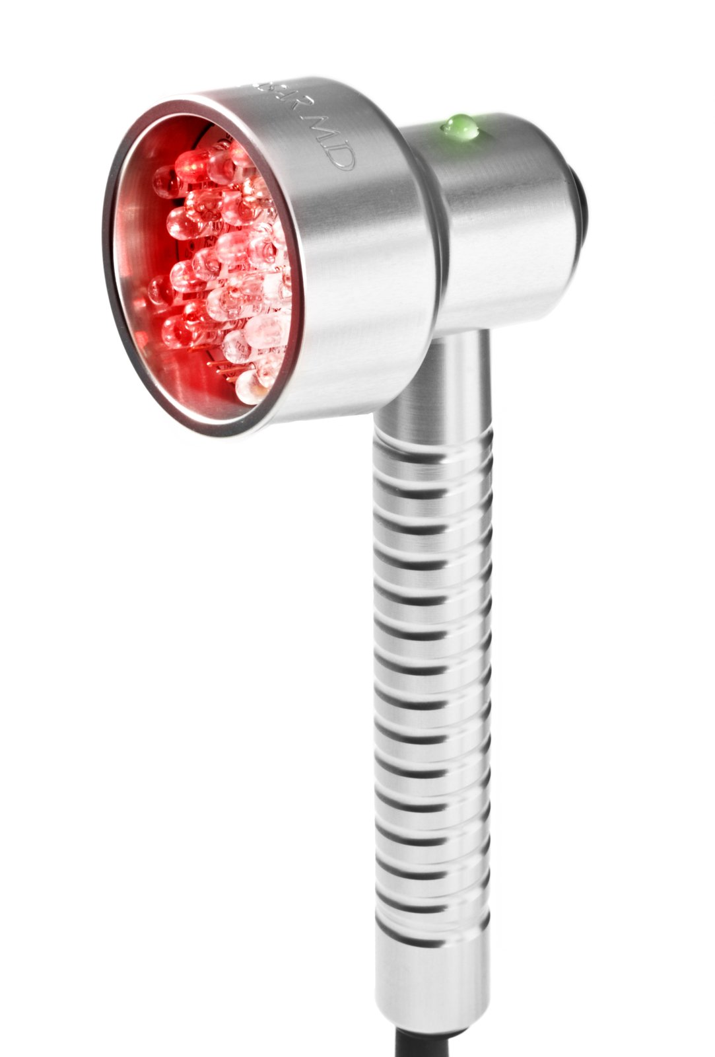
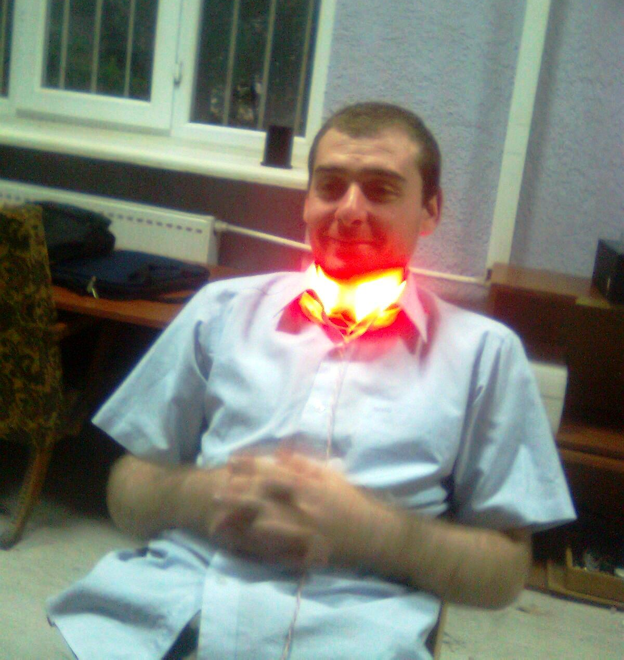
Using Quantum Therapy Device

Slide 5
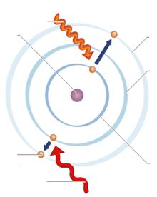
Quant absorption by atom and its excitement
Incoming photon is absorbed by the atom
Nucleus
Excited state
Lower energy level
Electron
Lowest energy level
Incoming photon is absorbed by the atom

Slide 6
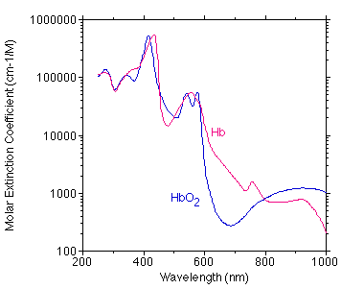
Observing blood absorption spectrum and choosing conformable light source
Blood absorption spectrum
Light spectrum
Light intensity (%)
Wavelength (nm)

Slide 7
Increasing body temperature from 37 ◦C to 40 ◦C, increases biochemical reactions' speed 10 times

Slide 8
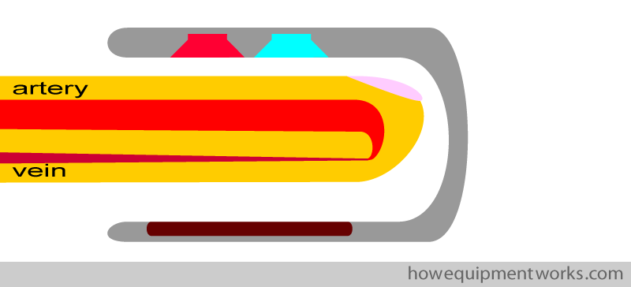
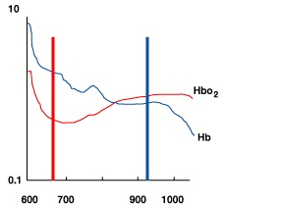
Pulseoxymeter as a dosage tool
Red light source
Infrared light source
Light detector
Red 660 nm
Infrared 910 nm
Wavelength (nm)

Slide 10
Quantum Therapy gives us opportunity to:
Decrease diseases between pupils 2.9 times
Decrease newborn’s diseases 2.8 times
Decrease ischemic diseases frequency 9 times
Decrease death incidents caused by infarct 2 times
Decrease wounds and fractures treatment time 1.9 times

Slide 11
Any
questions?

Slide 12
Thank you For Your
Attention
E-mail: inventing21@gmail.com

