Slide 1
Partial Differential Equations for Data Compression and Encryption
Ramaz Botchorishvili
Faculty of Exact and Natural Sciences
Tbilisi State University

Slide 2
Data Compression
Original file
Compressed file
Compression
Size = big
Size = small

Slide 3
Data Compression
Original file
Compressed file
Compression
Size = big
Size = small
Size = big
Decompression
Recovered file

Slide 4
Data Compression
Original file
Compressed file
Compression
Size = big
Size = small
Size = big
Decompression
Recovered file

Slide 5
Data Compression
Lossy or lossless ?
Original file
Compressed file
Compression
Size = big
Size = small
Size = big
Decompression
Recovered file

Slide 6
Data Compression
Lossless compression
Original file = Recovered file
Compression
Size = big
Size = big
Decompression
Compressed file

Slide 7
Data Compression
Lossless compression
Original file = Recovered file
Compression
Size = big
Size = big
Decompression
Original file is not Recovered file
Lossy compression

Slide 8
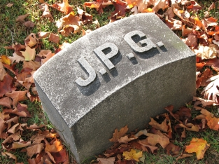
Lossy compression
JPEG
83261 bytes

Slide 9

Lossy compression
JPEG
83261 bytes
15138 bytes

Slide 10

Lossy compression
JPEG
4725 bytes
83261 bytes
15138 bytes

Slide 11
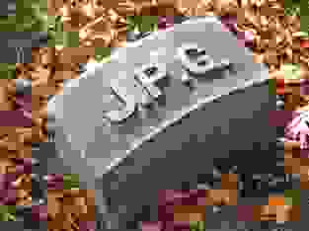
Lossy compression
JPEG, wikipedia
4725 bytes
83261 bytes
1523bytes
15138 bytes

Slide 12
Jpeg – cosine transform
Approach for data compression
  Data = function
  Algorithm =
    Expand function e.g. Fourier series
    Approximate function
      Set threshold
      Throw away Fourier coefficients smaller then threshold
    Store big coefficients only!

Slide 13
Jpeg – cosine transform
Approach for data compression
  Data = function
  Algorithm =
    Expand function e.g. Fourier series
    Approximate function
      Set threshold
      Throw away Fourier coefficients smaller then threshold
    Store big coefficients only!

Slide 14

Jpeg – cosine transform
Approach for data compression
  Data = function
  Algorithm =
    Expand function e.g. Fourier series
    Approximate function
      Set threshold
      Throw away Fourier coefficients smaller then threshold
    Store big coefficients only!

Slide 15
Jpeg – cosine transform
Approach for data compression
  Data = function
  Algorithm =
    Expand function e.g. Fourier series
    Approximate function
      Set threshold
      Throw away Fourier coefficients smaller then threshold
    Store big coefficients only!

Slide 16


Jpeg – cosine transform
Approach for data compression
  Data = function
  Algorithm =
    Expand function e.g. Fourier series
    Approximate function
      Set threshold
      Throw away Fourier coefficients smaller then threshold
    Store big coefficients only!

Slide 17

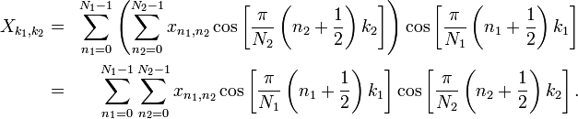
JPEG – Discrete cosine transform
Cosine basis functions

Slide 18
Cosine transform
Different interpretation
  Least square approach
  Interpolation

Slide 19
Cosine transform
Different interpretation
  Least square approach
  Interpolation
For accurate representation of smooth functions with small variation
less coefficients are needed
compared to
highly variable functions

Slide 20
New approach
preprocessing before compression
  Smooth out data
Compress smoothed data with existing methods

Slide 21
New approach
preprocessing before compression
  Smooth out data
Compress smoothed data with existing methods
How to smooth data?

Slide 22
New approach
preprocessing before compression
  Smooth out data
Compress smoothed data with existing methods
How to smooth data?
Apply Diffusion ?

Slide 23
New approach
preprocessing before compression
  Smooth out data
Compress smoothed data with existing methods
How to smooth data?
Apply Diffusion ?
No, time can not be inverted

Slide 24
Other models
Time can be inverted
Smoothing property by analogy of diffusion

Slide 25

Other models
Time can be inverted
Smoothing property by analogy of diffusion

Slide 26
Smoothing example

Slide 27
Smoothing example

Slide 28
Smoothing example

Slide 29



Other models
Parameters

Slide 30


Estimates

Slide 31
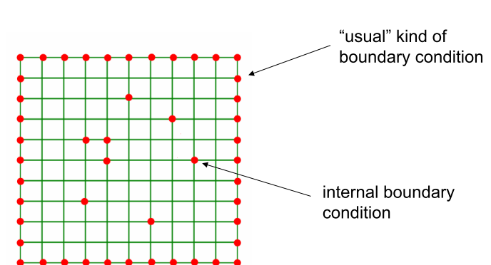

Laplace interpolation
Source, W.H.Press

Slide 32
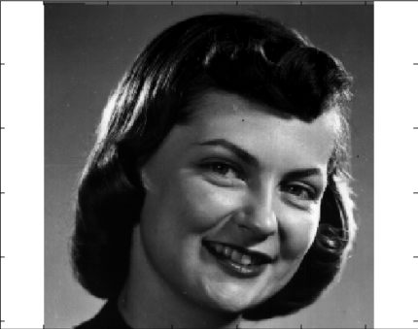
Laplace interpolation
original
Source, W.H.Press

Slide 33
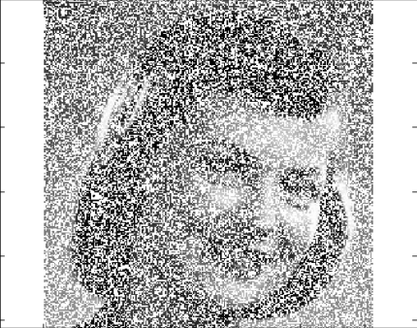
Laplace interpolation
50% of pixels deleted
original
Source, W.H.Press

Slide 34

Laplace interpolation
50% of pixels deleted
original
restored
Source, W.H.Press

Slide 35
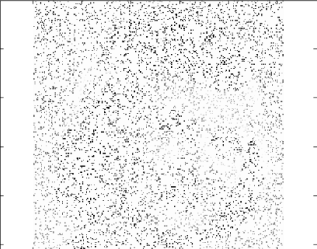
Laplace interpolation
90% of pixels deleted
Source, W.H.Press

Slide 36
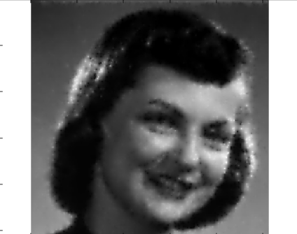
Laplace interpolation
90% of pixels deleted
restored
Source, W.H.Press

Slide 37

PDE inpainting and interpolation
Image
Confidence function
Differential operator, e.g. Laplacian
Unknown function
Source, J.Weickert et al

Slide 38



PDE interpolation and compression
Diffusion equations
  Homogenous diffusion
  Nonlinear diffusion
Source, J.Weickert et al

Slide 39
PDE compression
Select points/boundary conditions and let them diffuse
Some approaches can already beat JPEG, source Weickert et al

Slide 40
PDE compression
Select points/boundary conditions and let them diffuse
Some approaches can already beat JPEG, source Weickert et al
Smooth data, select points/boundary conditions and let them diffuse
Future projects for students

Slide 41
PDE compression
Select points/boundary conditions and let them diffuse
Some approaches can already beat JPEG, source Weickert et al
Smooth data, select points/boundary conditions and let them diffuse
Future projects for students
Which equations?
Bitsadze-Samarski problem?
Why not to start from refinement?

Slide 42
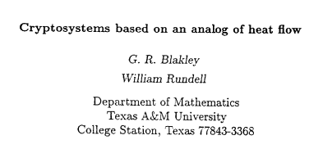
PDE based cryptosystem

Slide 43
Blakley-Rundell Cryptosystem main idea
Based on solution of hard problem
Initial function – data
Solution – encryption
Inverse problem – decryption
Key – coefficients of PDEs

Slide 44
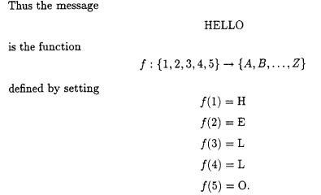
Connecting text to function

Slide 45

Connecting text to function

Slide 46
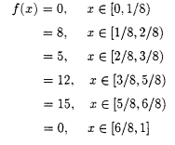
Connecting text to function
Piecewise constant
Encription block size

Slide 47


Encription
Key
Information to be encrypted
u(T,x) – encrypted message
Problem: decryption is not possible – heat equation can not be inverted in time
Solution: using pseudo parabolic equations

Slide 48
PDE based cryptosystem - principles
Based on really hard problems – what computational power is needed for few seconds of computations?

Slide 49
PDE based cryptosystem - principles
Based on really hard problems – what computational power is needed for few seconds of computations?
File for encryption – convert to real valued function on complex computational domain
No small block sizes for encryption but entire data

Slide 50
PDE based cryptosystem - principles
Based on really hard problems – what computational power is needed for few seconds of computations?
File for encryption – convert to real valued function on complex computational domain
No small block sizes for encryption but entire data
Computational domain – could be any figure in N dimensional space, N=2,3, 4, …
Different meshes could be used for the same data in the same domain

Slide 51
PDE based cryptosystem - principles
Based on really hard problems – what computational power is needed for few seconds of computations?
File for encryption – convert to real valued function on complex computational domain
No small block sizes for encryption but entire data
Computational domain – could be any figure in N dimensional space, N=2,3, 4, …
Different meshes could be used for the same data in the same domain
Different encryption for different time moment
Inventing different boundary conditions
Inventing different equations and problems, e.g. nonlocal in time
sensitive to numerical methods

Slide 52
PDE based cryptosystem - principles
Based on really hard problems – what computational power is needed for few seconds of computations?
File for encryption – convert to real valued function on complex computational domain
No small block sizes for encryption but entire data
Computational domain – could be any figure in N dimensional space, N=2,3, 4, …
Different meshes could be used for the same data in the same domain
Different encryption for different time moment
Inventing different boundary conditions
Inventing different equations and problems, e.g. nonlocal in time
sensitive to numerical methods
Key – combination of all the above

Slide 53
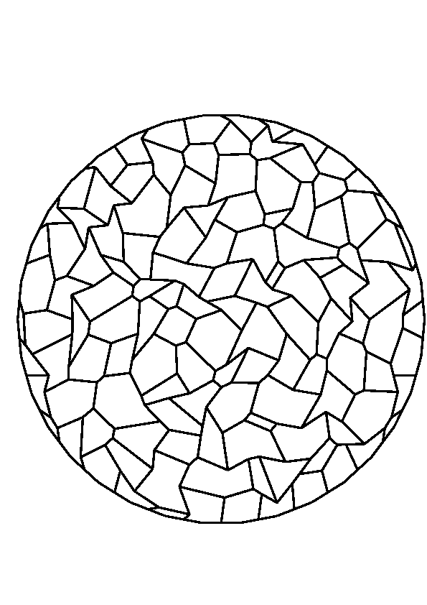
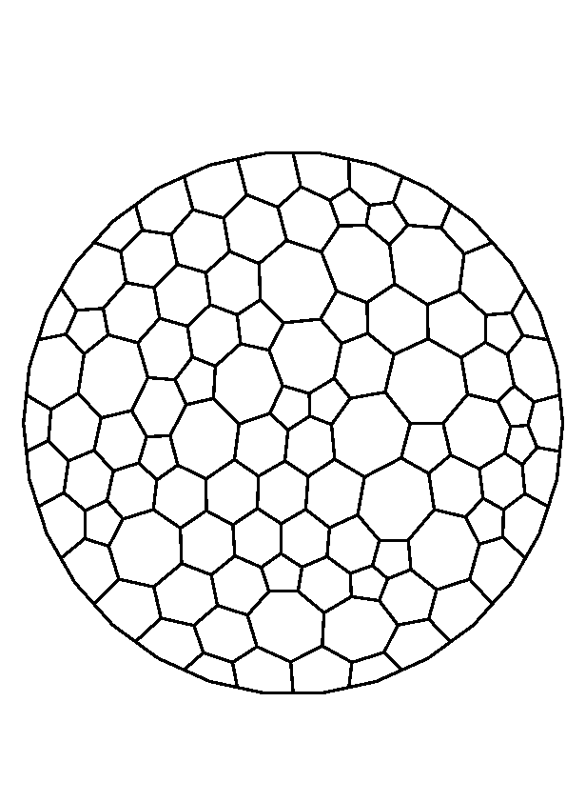
Importance of different meshes

Slide 54
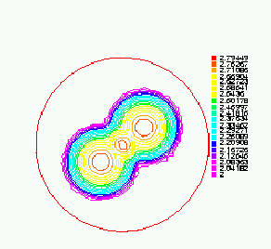
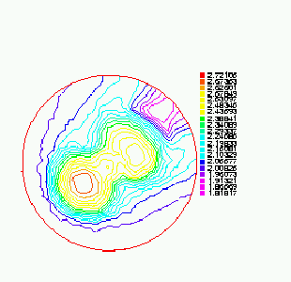
Sensitivity to numerical methods

Slide 55
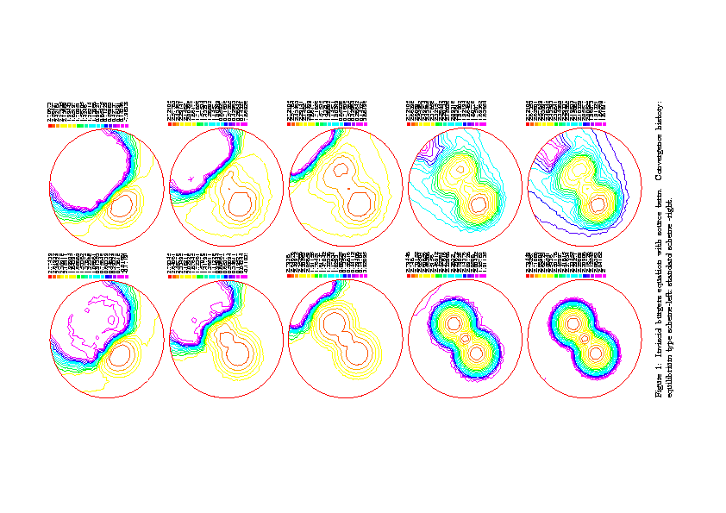
Different time = different encrypted file

Slide 56
Niche – where could be used
Seems not to be suitable for standard communication between two persons
Could be used for encrypting databases inside organization

Slide 57
Thank you for your attention

