Slide 1



Producing nanocrystalline composite materials via Spark Plasma Sintering Method
Lili Nadaraia, Nikoloz Jalabadze.
Georgian Technical University
Republic Center of Structural Research,
Tbilisi Georgia.

Slide 2
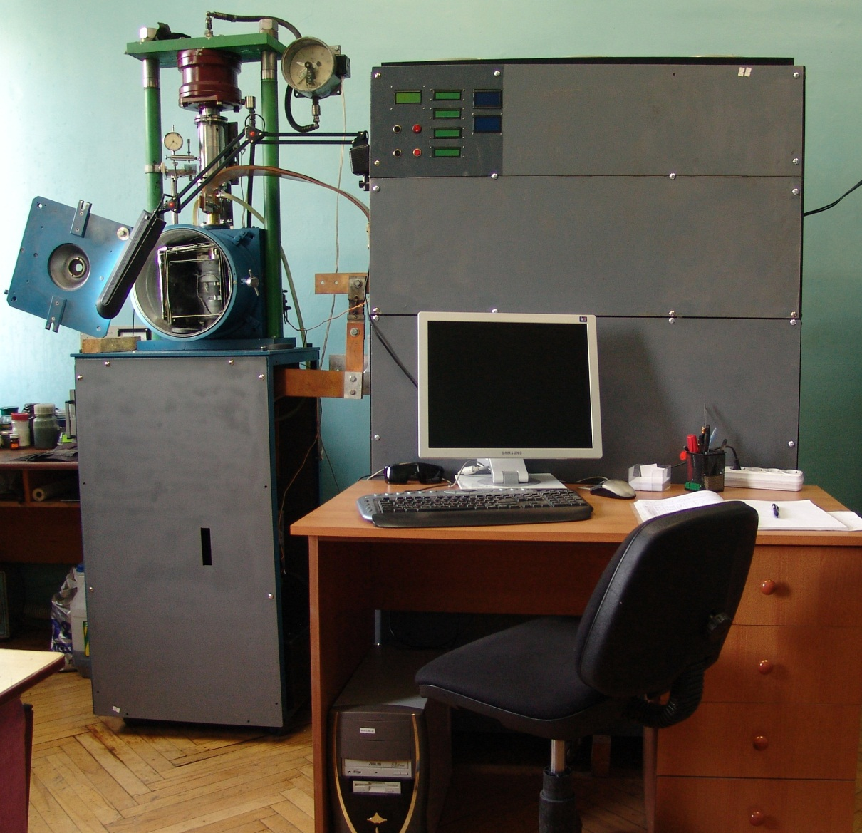
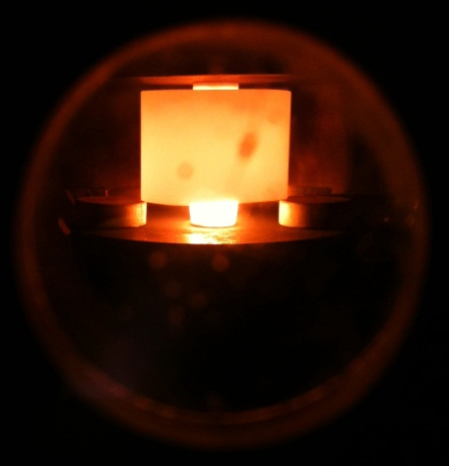
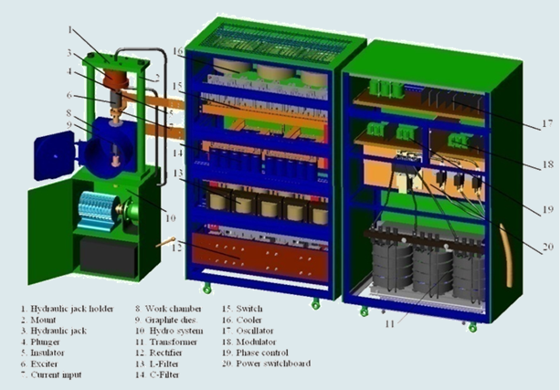
Spark Plasma Sintering Device
Sintering temperature (max 2500ºC)
Current (max 5000 A)
Applied pressure (max 100 MPa)

Slide 3
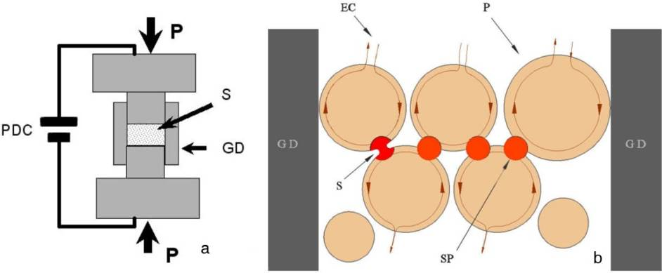
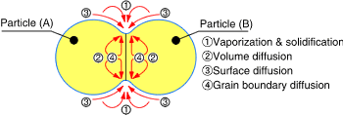
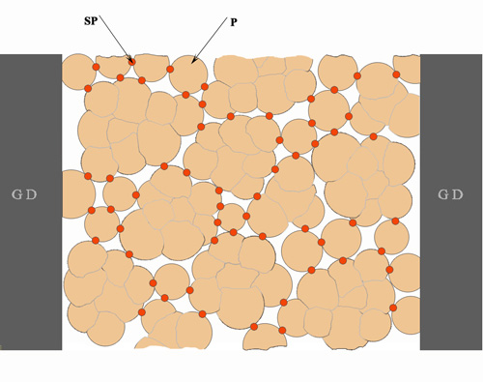
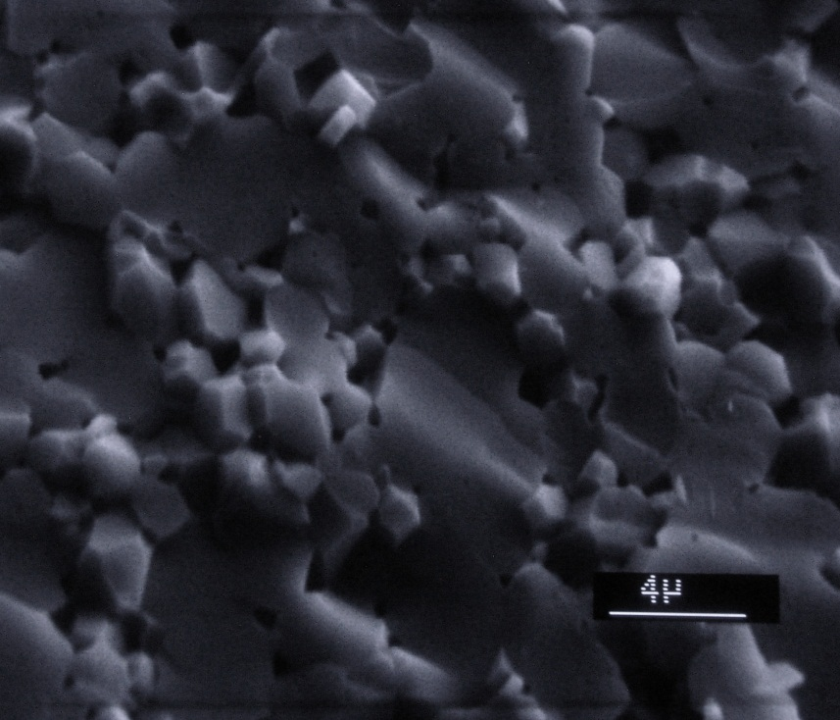

Spark plasma between powder particle

Slide 4
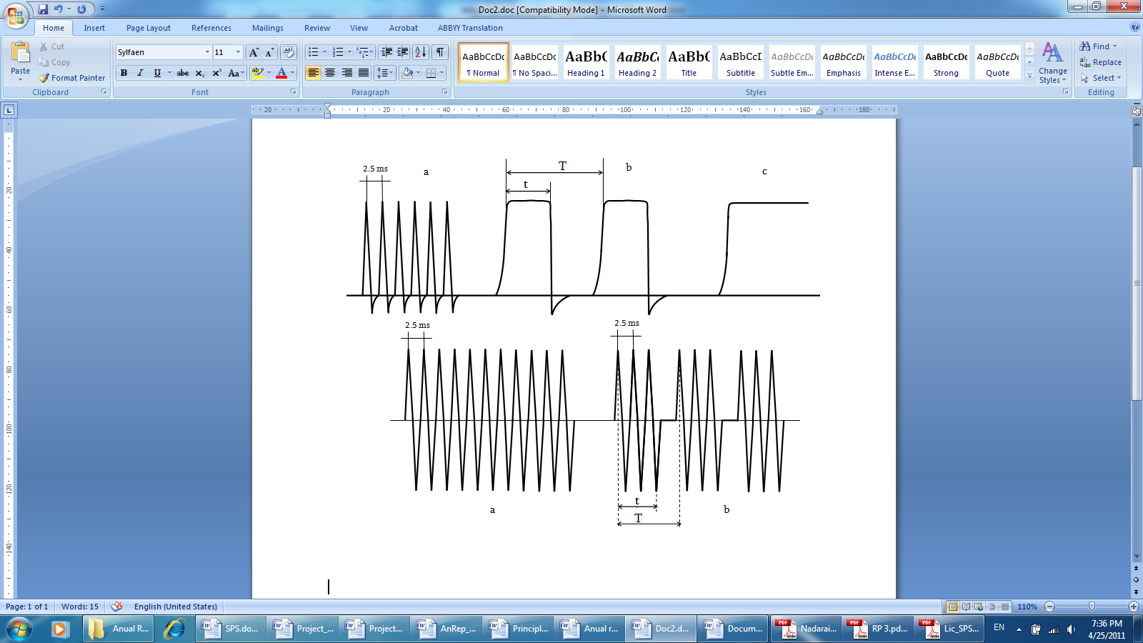
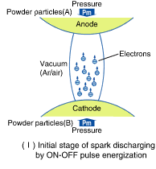
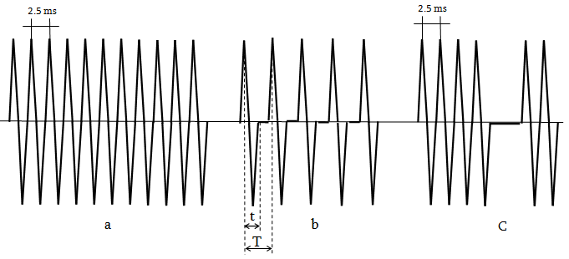
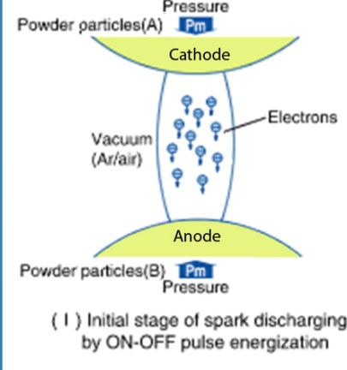
Current shapes
Pulse DC current Shape in the developed device: a- at the frequency of 400 Hz, b- during different frequencies (T), different duration impulses (t) and different duration pauses (T-t); c - during non-pulse DC current.
Pulse DC current Shape in Japanese SPS device.
I
AC (Alternating Current) Shapes : a- at frequency of 400 Hz, b- during different frequencies (T), different duration pulses (t) and different duration pauses (T-t); c – by using the design of the Japanese device while using pulse AC current instead of pulse DC current.
I

Slide 5
Dry Powder Compaction under Ultrasonic Action Tomsk Polytechnic University
O. L. Khasanov* and E. S. Dvilis “Net shaping nanopowders with powerful ultrasonic action and methods of density distribution control” Ultrasonic die for compacting powders.
Deformation model of layers of cylindrical powder compact under conditions of die wall friction
conventional uniaxial single action pressing;
collector pressing
a
b

Slide 6
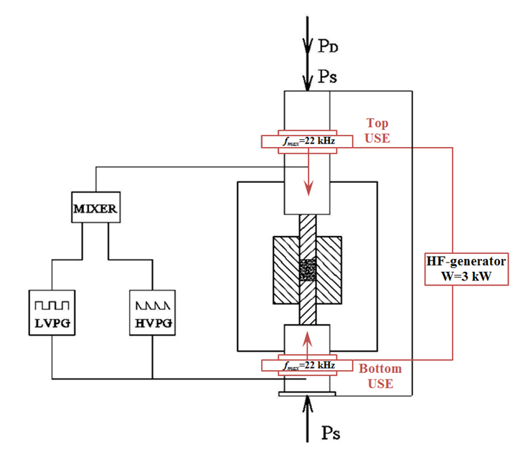
Schematic drawing of the modified SPS device that makes possible sintering non-conductive materials
HVPG- high voltage pulse generator. 1-2 KV
LVPG- Low voltage pulse generator 10-20V, current force : 3000-5000A.
USE- Ultrasonic excitation device F=22-25 kHz
HFG-High frecuency generator W=3KW
PD- Pulsed dynamic loading.

Slide 7
Schematic drawing of forming bulk sample
P
P
T₁≠T₂≠T₃
T₁=T₂=T₃
T₁ T₂ T₃
Ignition
T₁ T₂ T₃
Front Wave of SHS
I
Self-propagating High-temperature Synthesis
SHS
SPS produces Poly SHS

Slide 8
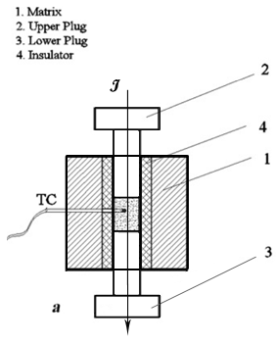
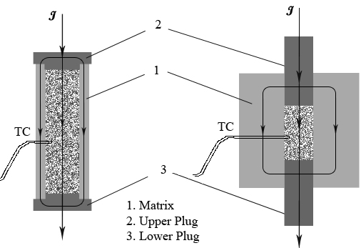
Press molds for a- synthesize nanopowder of boron carbide; b- sintering of isolator dens bodies and c- sintering of conductive dens bodies (with insulator layers)
Schematic drawing of Press forms
P
P
a
b
c

Slide 9
Schematic drawing of technology
Silicates, LSO, YSO,
Aluminates , LuAP, LuAG
Tungstats: PWO,CdWO_{4,} CaWO_{4,}
Ceramic Scintillators
Development of composition
Hard metals
WC-Co
TiC-Ni-Mo-W
TiC-Fe-Ni
Armor materials
B₄C
B₄C-Cu-Mn
TiC-Ni-Mo-W
TiB₂ - TiC
aerospace materials
B4C-TiB2, B4C-SiC, TiC-SiC, TiB2-TiN, TiB2-TiC, TiB2-TiN-TiC and TiC-Ni-Mo-W
Powder Metallurgy
Development of manufacturing process
Sol-Gel Method
Powder compaction
etc….
High Temp. Furnaces
Devices
Hot Press
SPS device
etc….

Slide 10
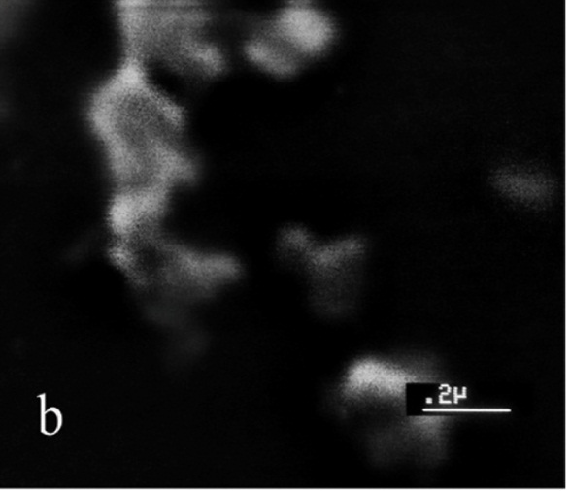
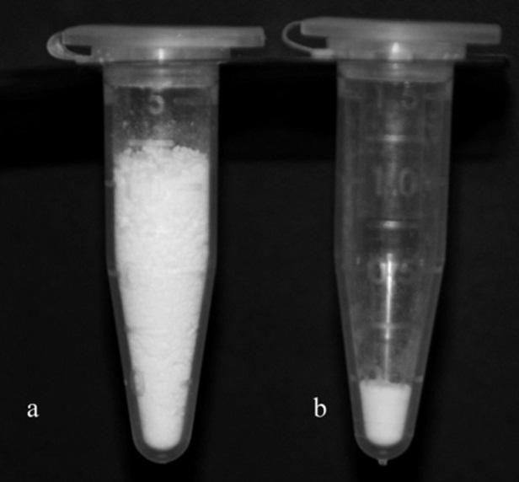
Ytrium Aluminate
SEM micrographs of nanocrystalline YAG powder.
Volume comparison of; a- nanopowder and b-coarse powder of YAG
YAG sintered at the SPS different mode obtained from: a-nanopowder at 1600⁰C:3min:20MPa;
b-nanopowder at 1100⁰C:2min:35MPa;
c,d- coarse powder at 1650⁰C:3min:40MPa

Slide 11
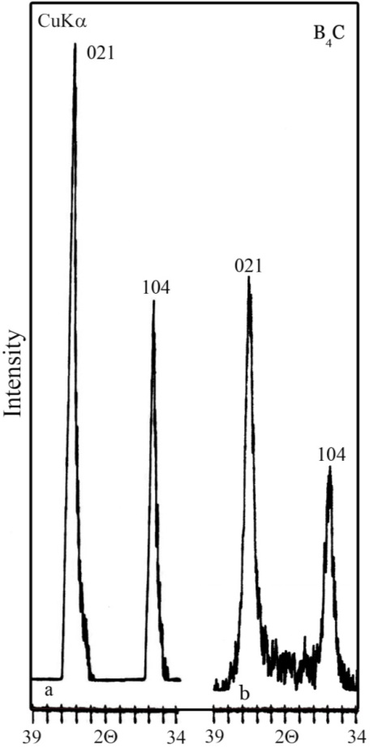
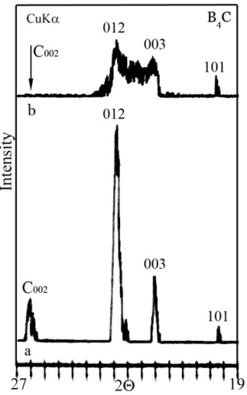
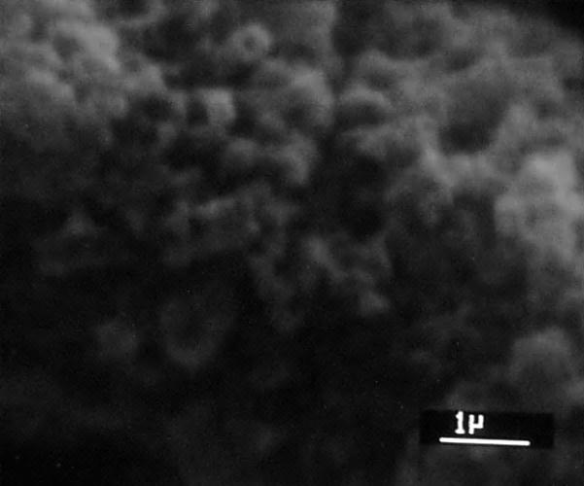
B - C
X-ray diffraction patterns of B₄C powder materials obtained by standard (a), SPS methods (b)
SEM image of B₄C synthesized via SPS technology
X-ray diffraction patterns of B₄C bulk materials obtained by standard (a) and SPS (b) methods of B₄C densified by SPS (1700⁰C-10min)

Slide 12
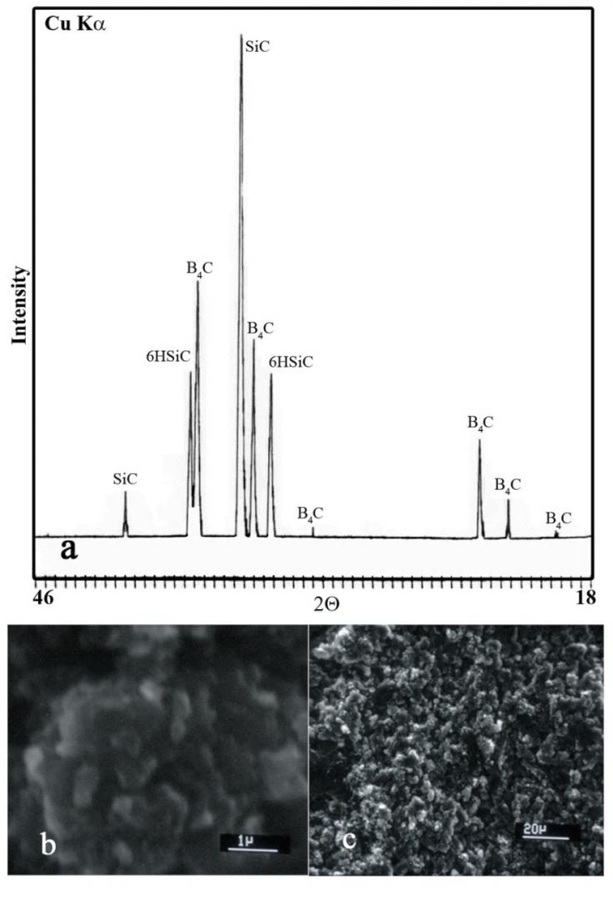
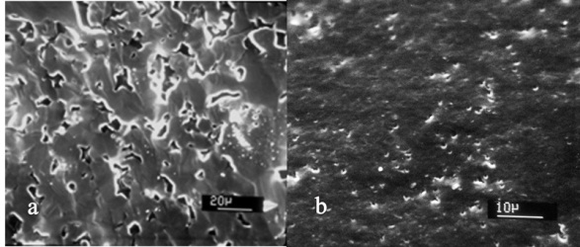
SEM images of B₄C armor materials obtained by standard (a) and SPS methods (b).
X-ray diffraction pattern (a) SEM images of B₄C – SiC (b,c)

Slide 13
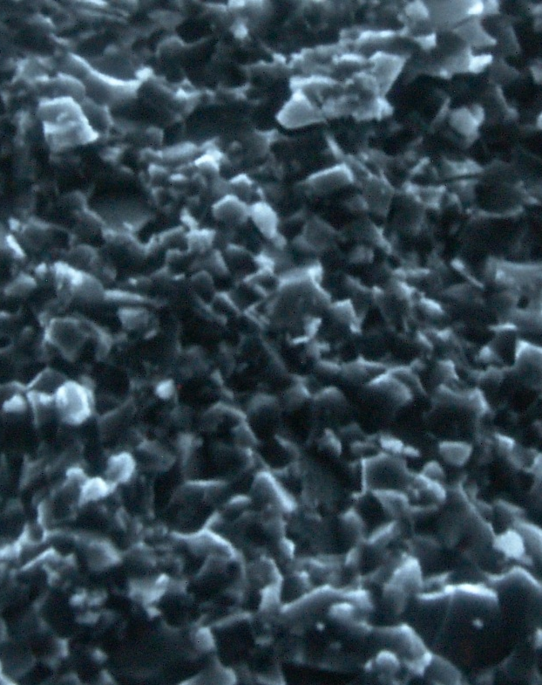
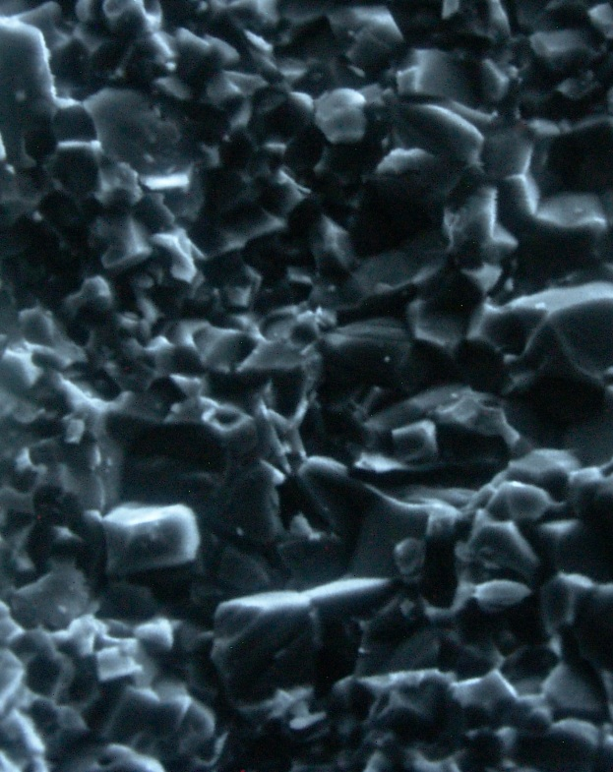
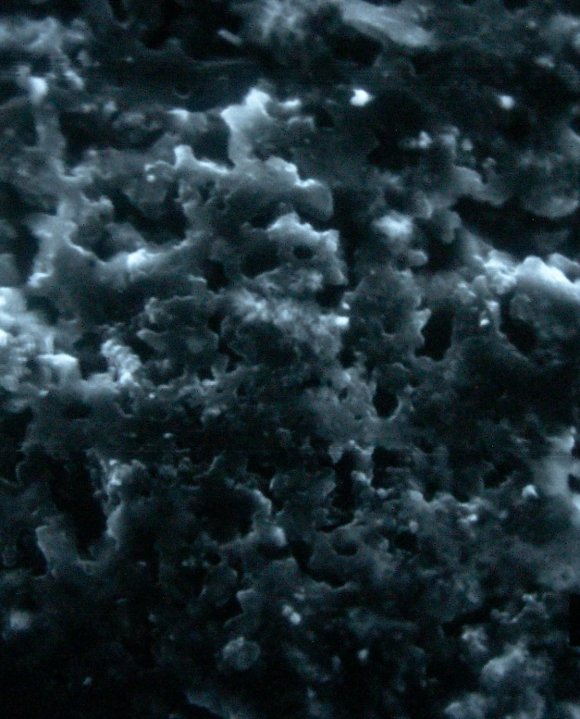
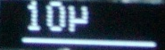
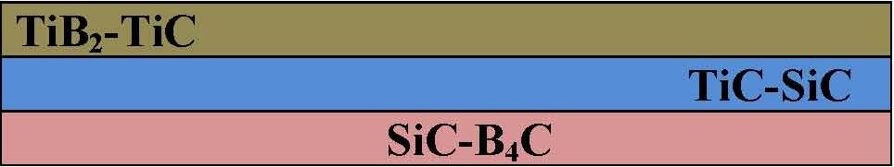
Ti-B-Si-C
Ti-B-C.
Ti-Si-C
B-Si-C
TiB2-TiC
TiC-SiC
SiC-B4C
SEM images of “sandwich” composite sintered via SPS.
“Sandwich”

Slide 14
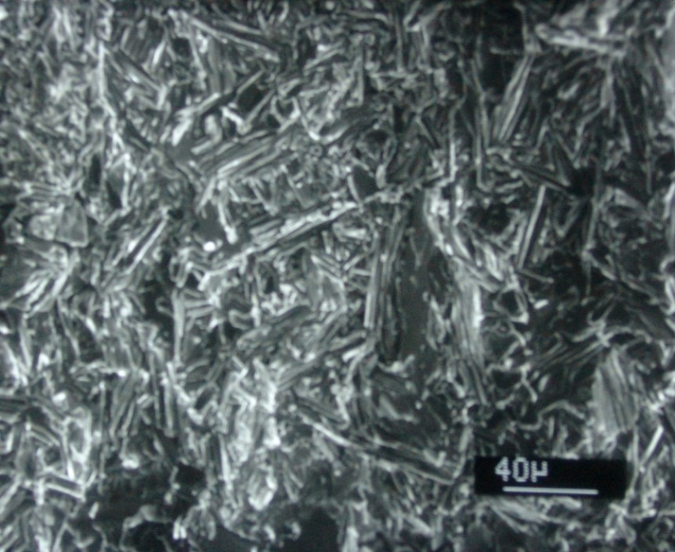
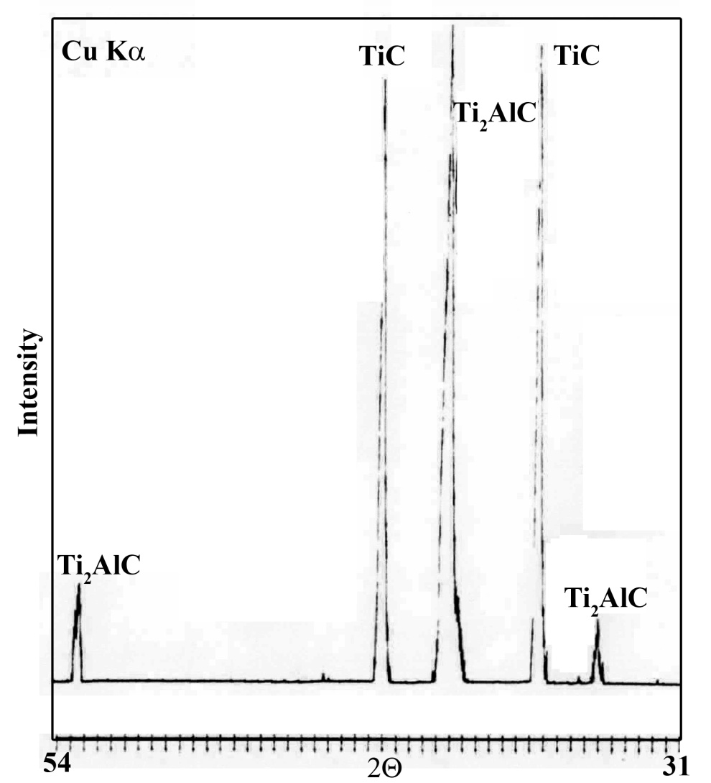
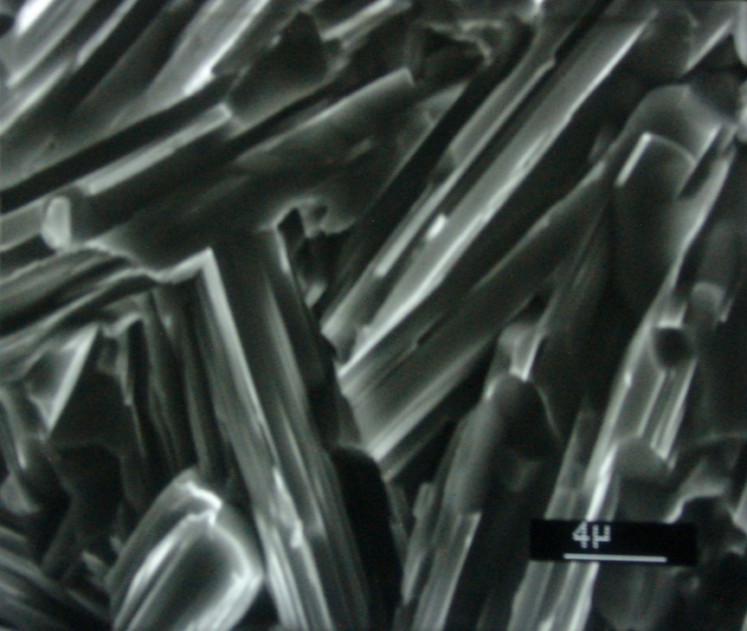
Ti-Al-C
SEM images and XRD pattern of Ti₂AlC-TiC composite sintered via SPS.

Slide 15
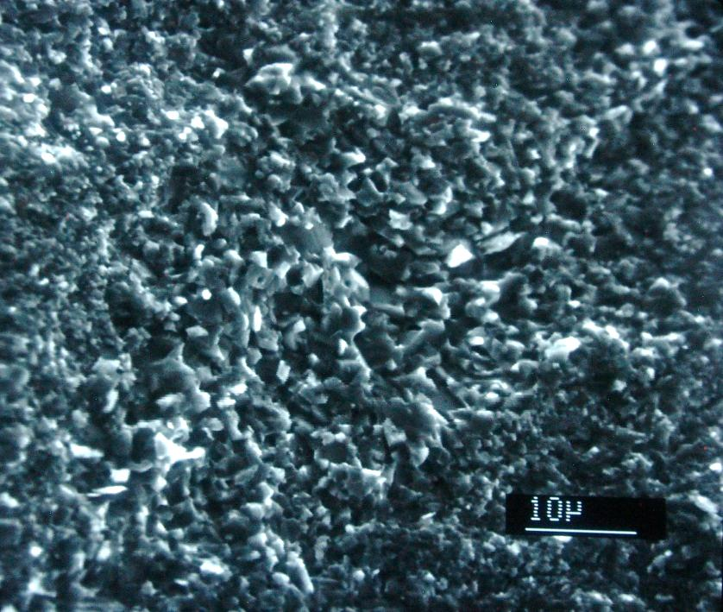
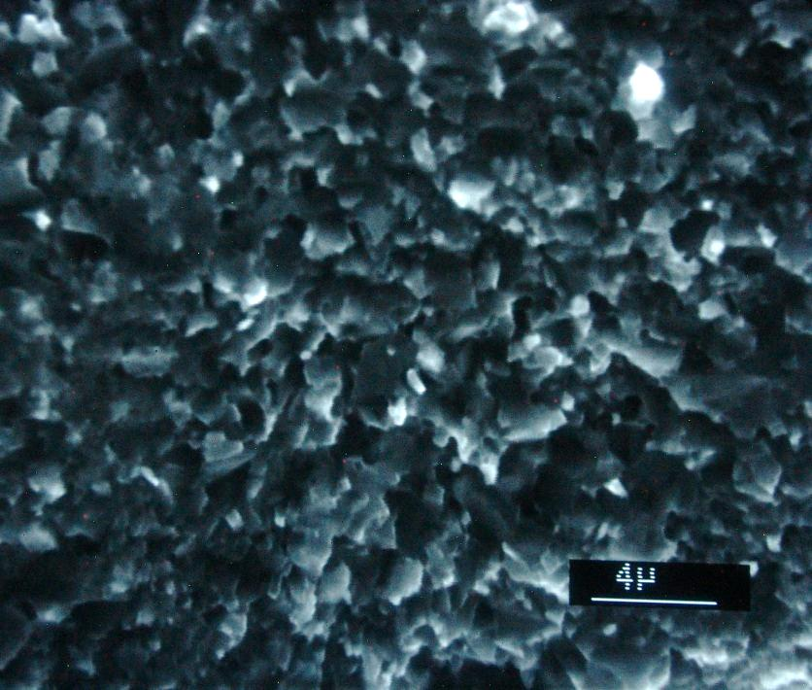
BN-Ti-Si-C
SEM images of TiB₂-TiN-SiC composite sintered via SPS

Slide 16
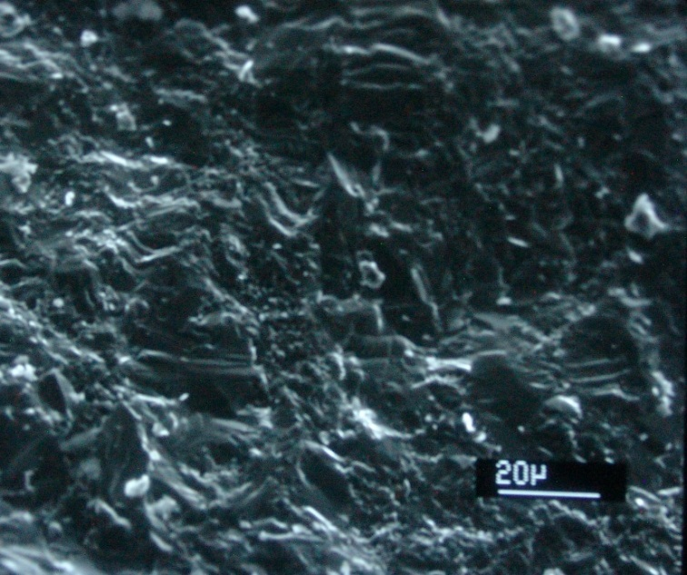
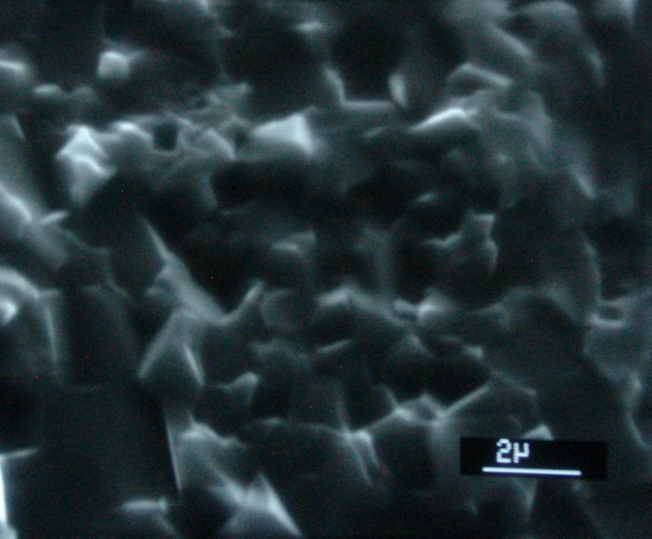
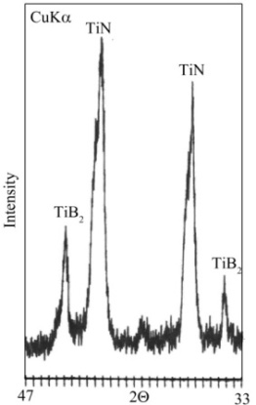
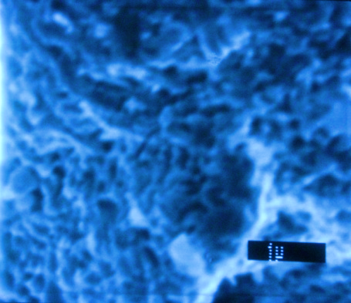
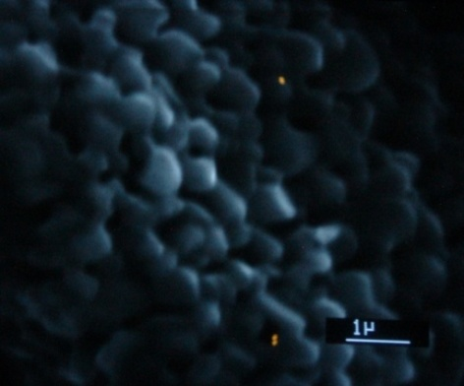
BN-Ti
SEM images of TiN-TiB2 composite sintered via SPS
Images of TiN-TiB2 a- XRD pattern, b- SPS sintering 3min, c- SPS sintering 5min

Slide 17
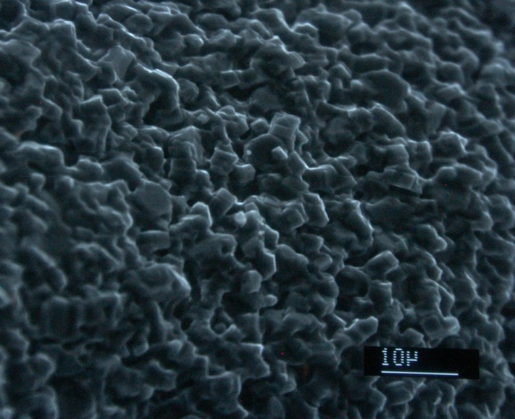
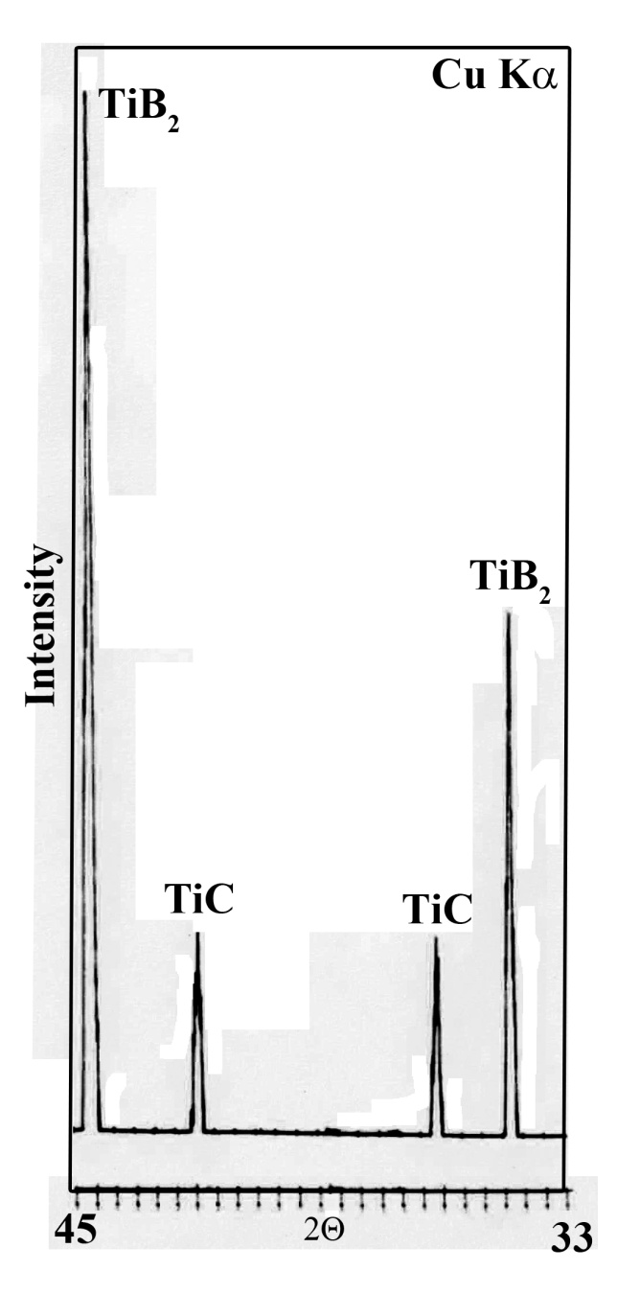
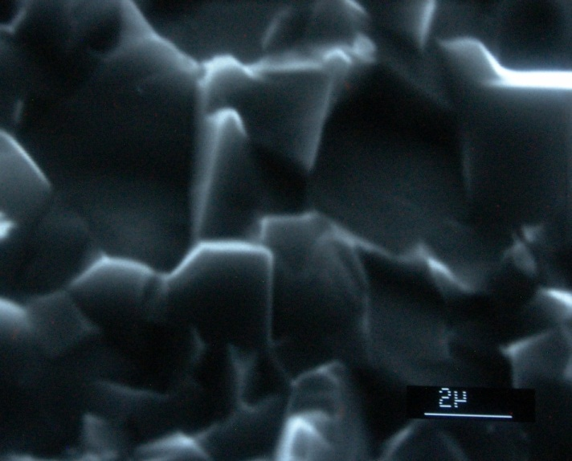
B4C-Ti-Zr
SEM images and XRD pattern of
(Ti,Zr)B2 – (Ti,Zr)C composite sintered
via SPS.

Slide 18
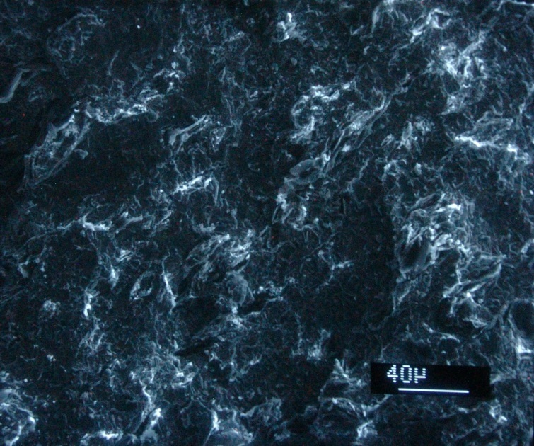
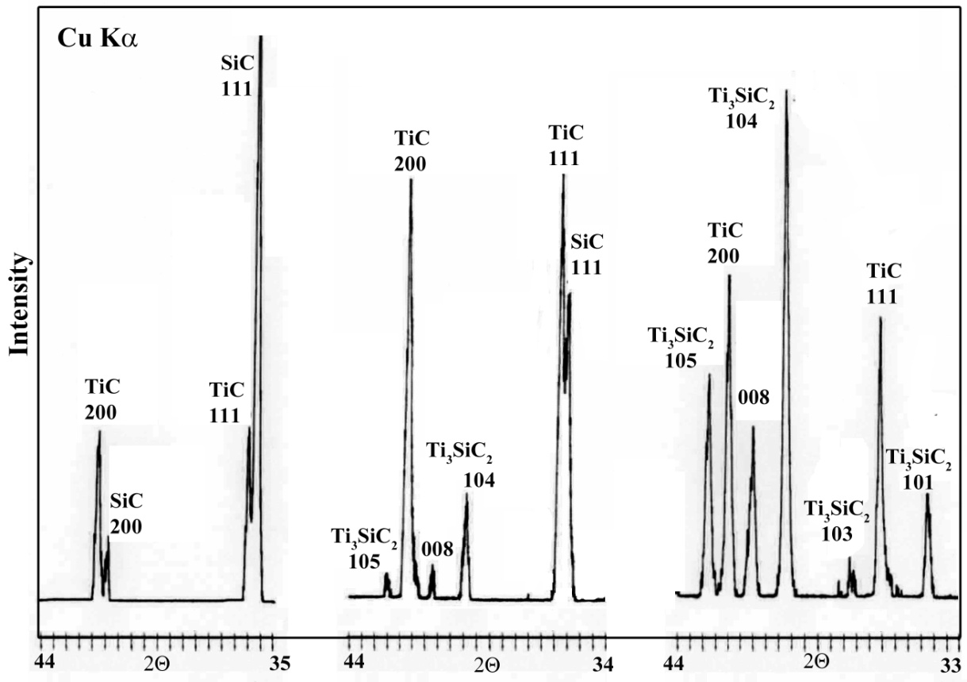
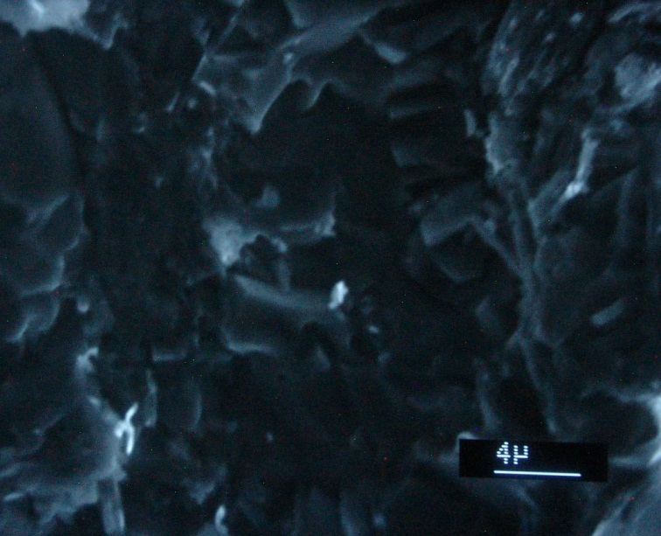
Ti-Si-C
SEM images and XRD patterns of
TiC-SiC, TiC-SiC-Ti3SiC2 and Ti3SiC2-TiC composites sintered via SPS.

Slide 19
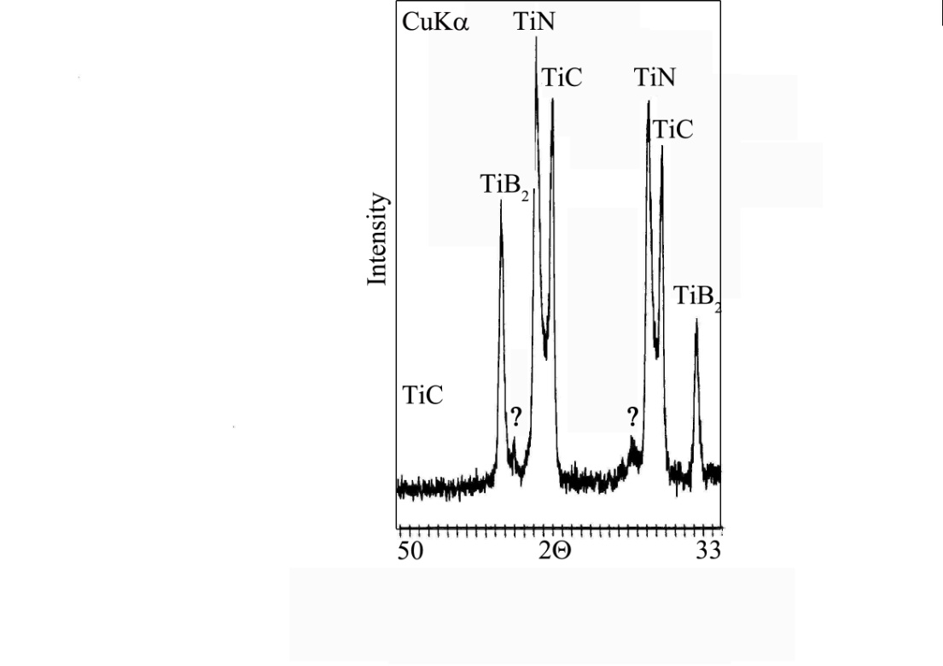
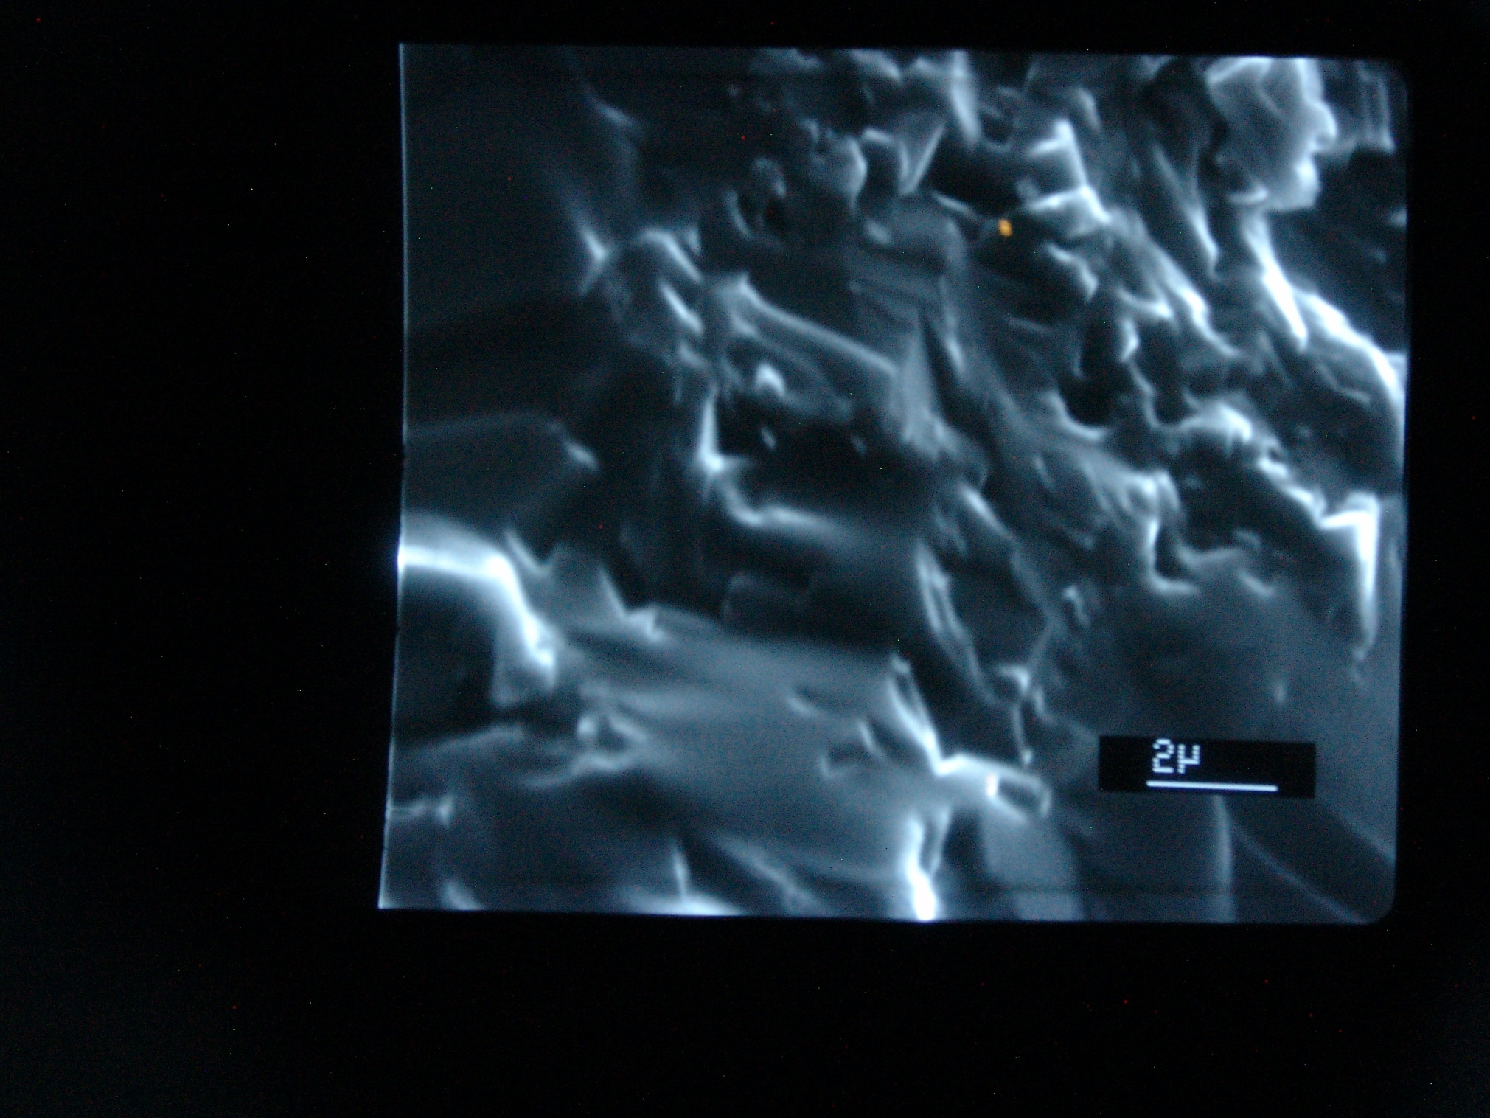
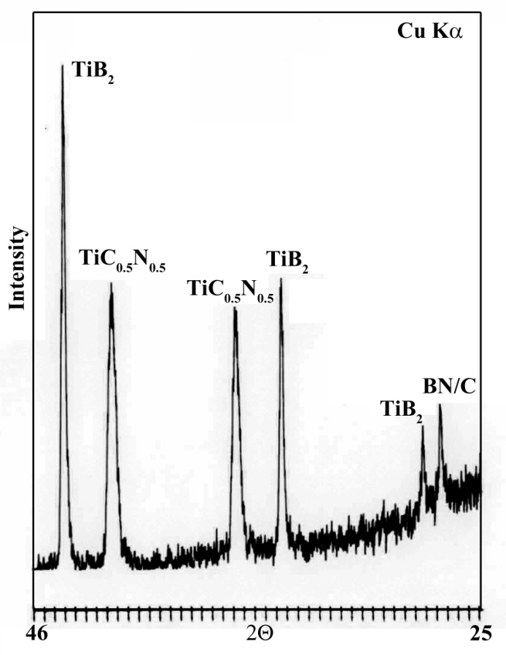
B₄C–BN-Ti
XRD patterns and SEM image of TiN-TiC-TiB2 and TiB2-TiC0.5N0.5 comosites sintered via SPS.

Slide 20
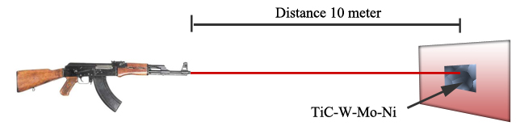
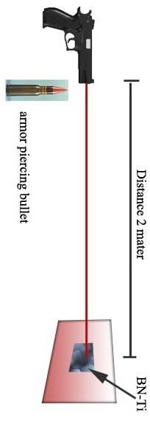
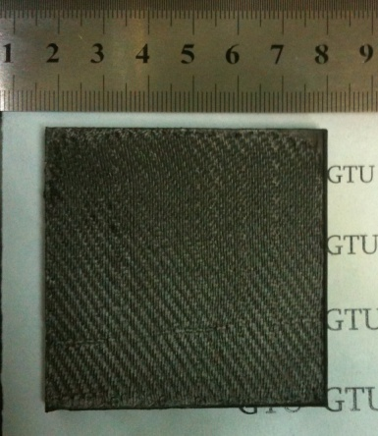
Preliminary ballistic testing
TiC-W-Mo-Ni plate is able to restrain armor piercing bullets from the 10 meter distance
Size of the plate -100x100mm;
Size of the plate fragments - 50x50mm; Weight - 50-100g.
The plate presented a package armored with ballistic textile (Kevlar, tvarin, denima); Weight of the package was 0,6 – 0,8 kg;
Fire tests were provided by shooting from the Kalashnikov automatic gun of AKM-type;
Bullets Б3-32 7,62х39 (armor-piercing incendiary)
Bullet Mass - 7,98±0,1;
Bullet speed - 730±10 m/sec.
Standard method shooting, distance - 10m towards a plasticine target.

Slide 21
Conclusion
There was developed new technology for manufacturing of nanocrystalline composite materials.
The Spark Plasma Sintering (SPS) device was modified.
  Modernization of SPS device was realized by replacing of pulse DC current unit with pulse AC current unit and ultrasonic unit for receiving the standing waves.
There were fabricated nanopowders of armor composite materials and bulk billets in nanocrystalline state.
There were produced translucent YAG ceramics
Effective aerospace materials in nanocrystalline structural state were developed.
Further works will be directed to :
  detect ultrasonic influence on sintering process.
  investigate physico-mechanical properties of composite materials with desirable structure.

Slide 22

Thank you
for attention

