Slide 1
Cubed Sphere Simulator
Natalia Nebulishvili Department of Mathematics
Giorgi Rukhaia Tbilisi State University
Mariam Doliashvili Department of Computer Science
Luka Tarielashvili Tbilisi State University
5th Georgian-German School and Workshop in Basic Science

Slide 2
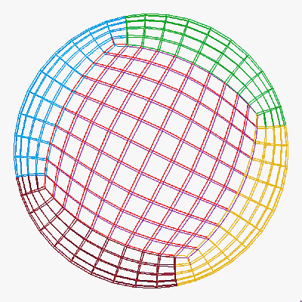
Main Goal
The environment for solving differential equations on the sphere

Slide 3
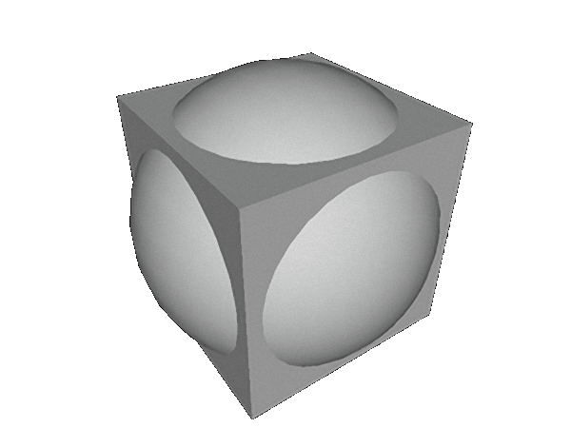
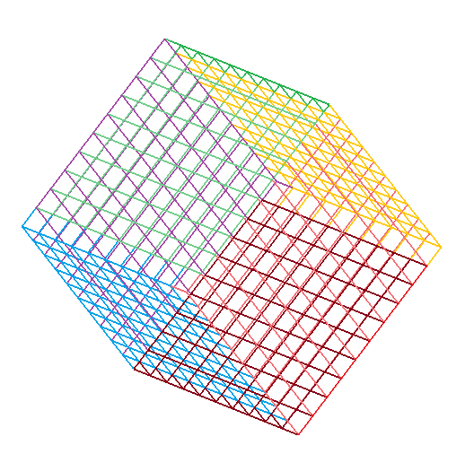
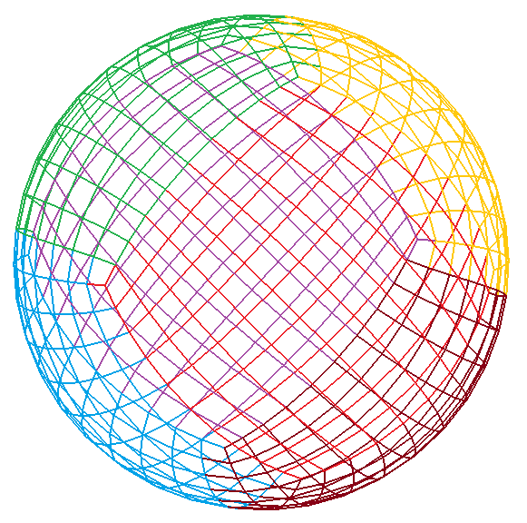
Creating a Grid

Slide 4
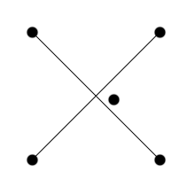
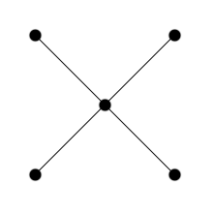
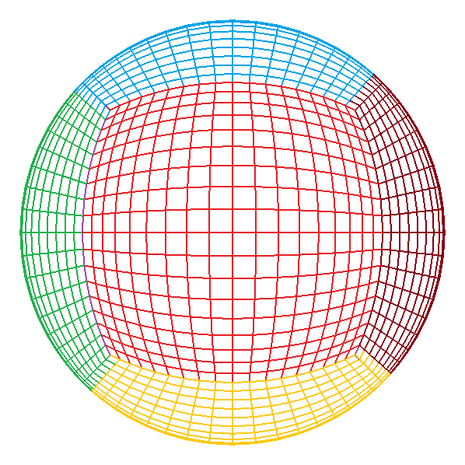
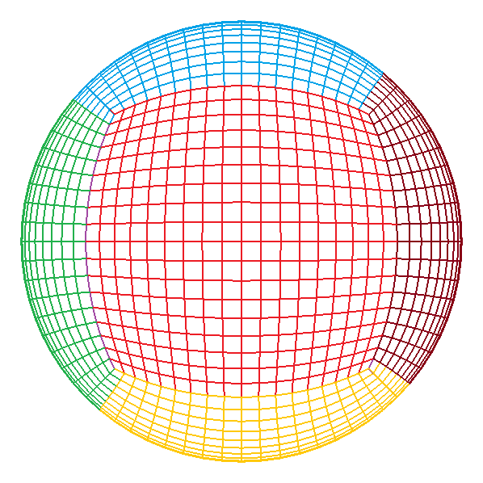
Smoothing the Grid
Non-uniform

Slide 5
Caushy Problem for
Differential Equations
-set of “neighbours” of ij point

Slide 6
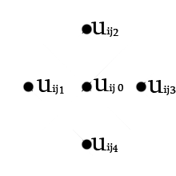
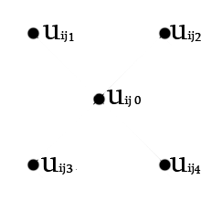
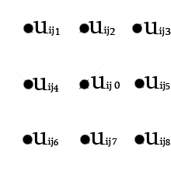
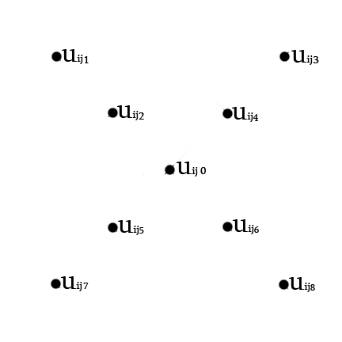
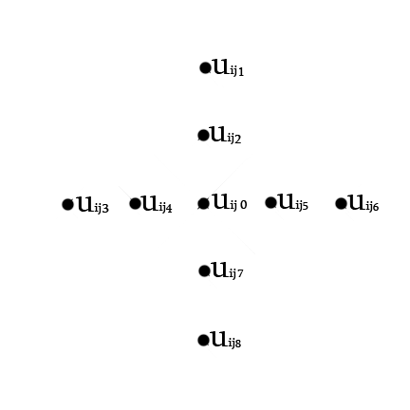
Stencils

Slide 7
Euler Explicit Scheme
- time step

Slide 8
Locally One Directional Decomposition

Slide 9
Euler Implicit Scheme
- time step

Slide 10
Classical Runge-Kutta Method
- time step

Slide 11
Fourth-Order SSP Schemes
- time step

Slide 12
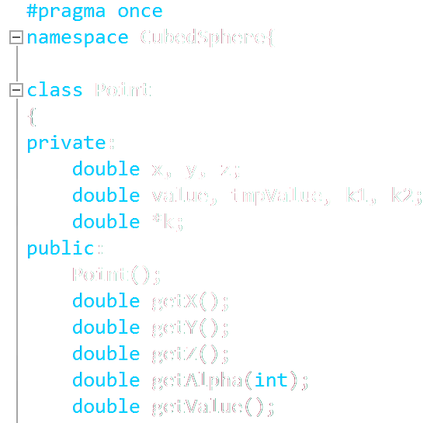
Programming language:
C++

Slide 13
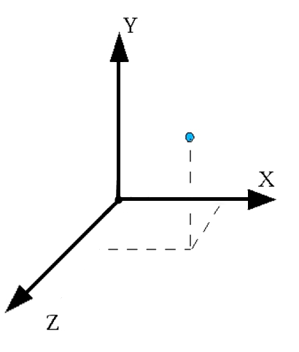
Func Value
*tmp values

Slide 14
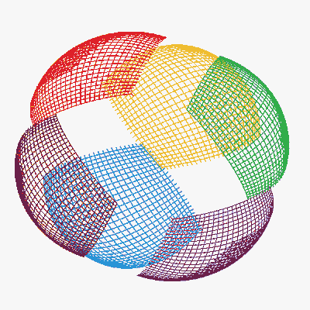
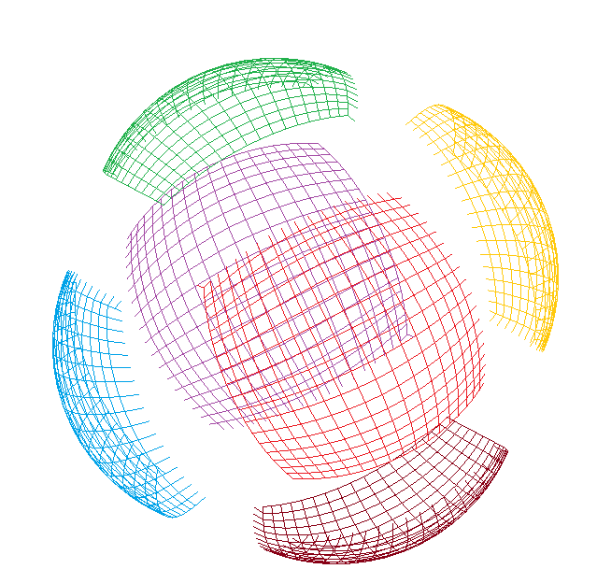
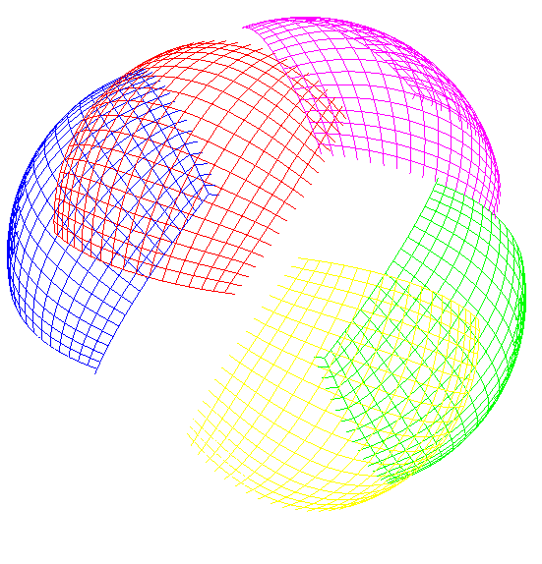
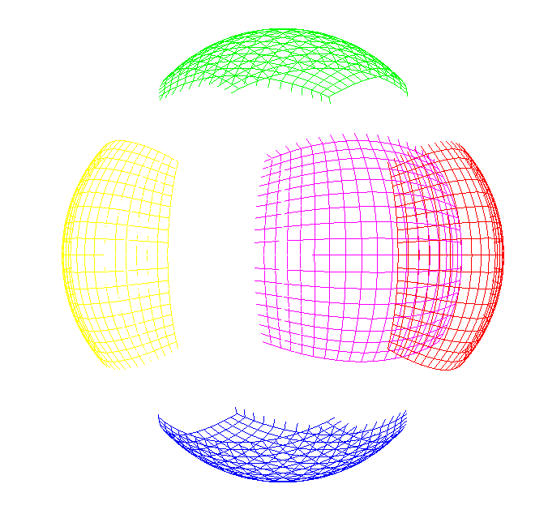
Splitting the Sphere

Slide 15
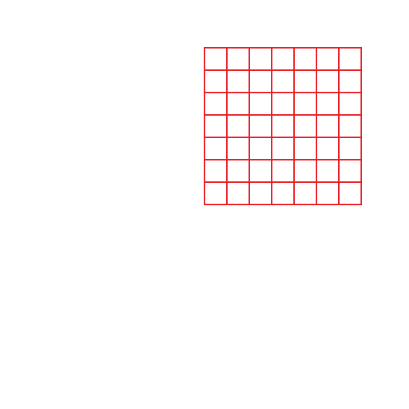
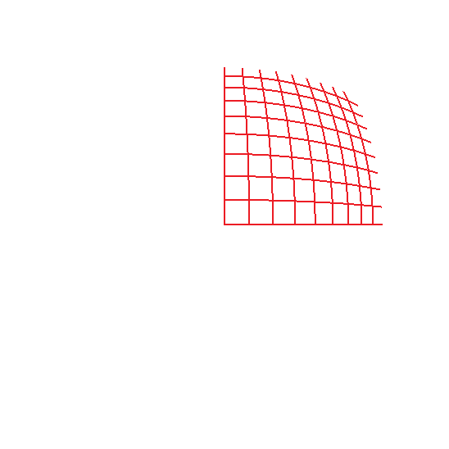
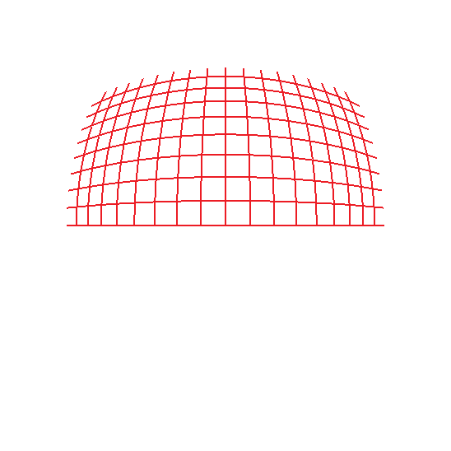
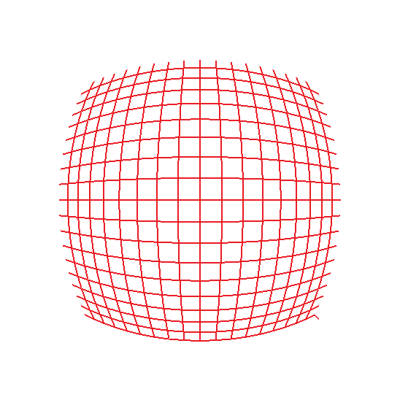
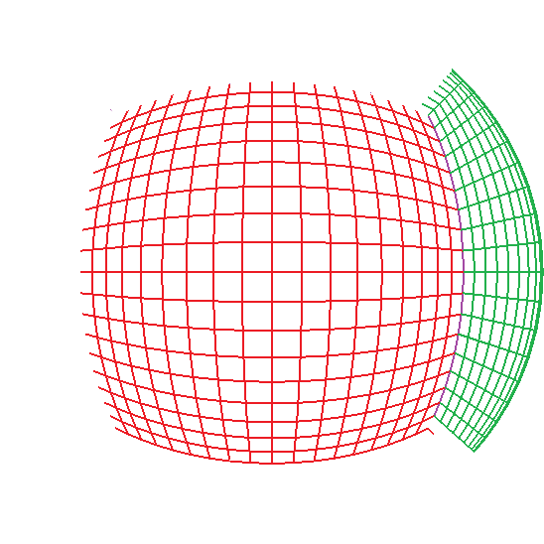
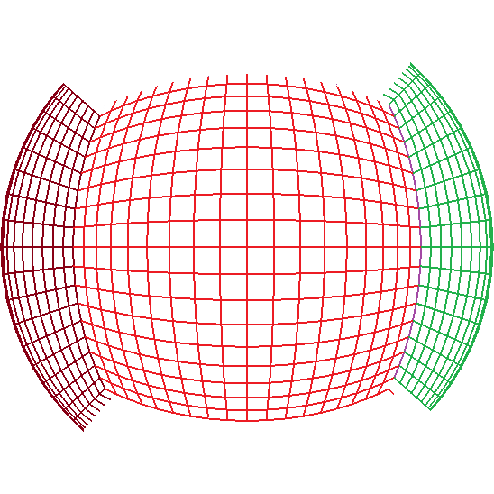
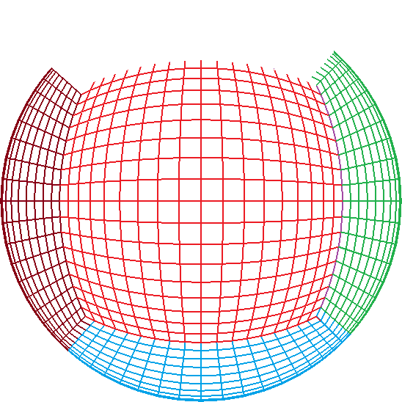
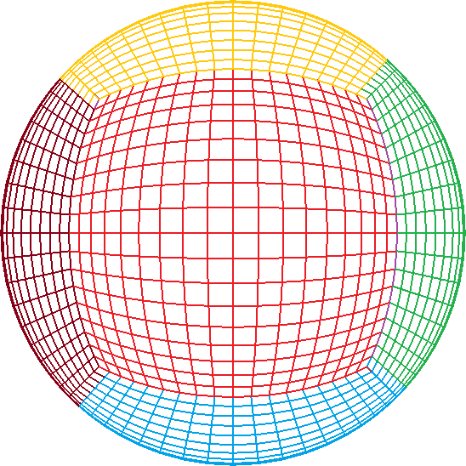
Optimised Algorithm for Grid Creation

Slide 16
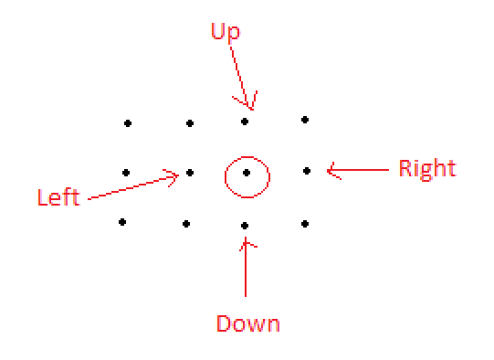
Sphere
“Neighbours”

Slide 17
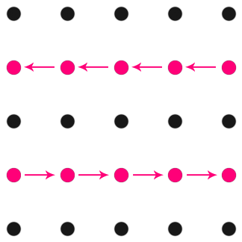
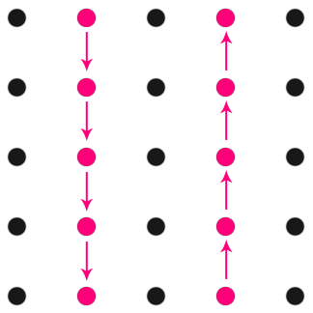
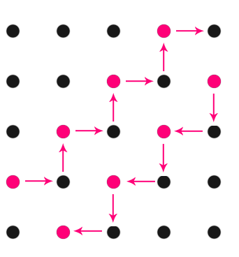
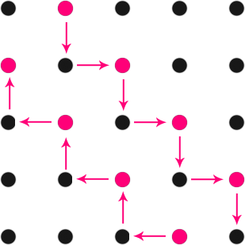
Moving around the Sphere

Slide 18
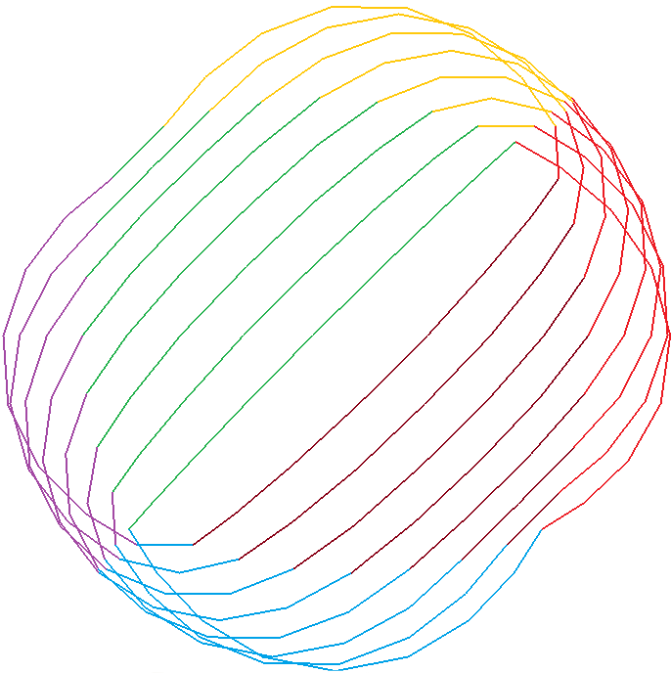
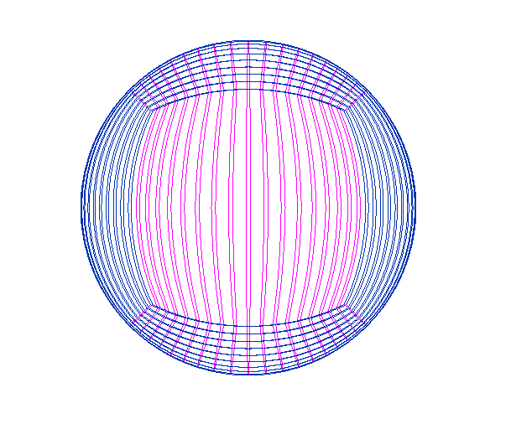
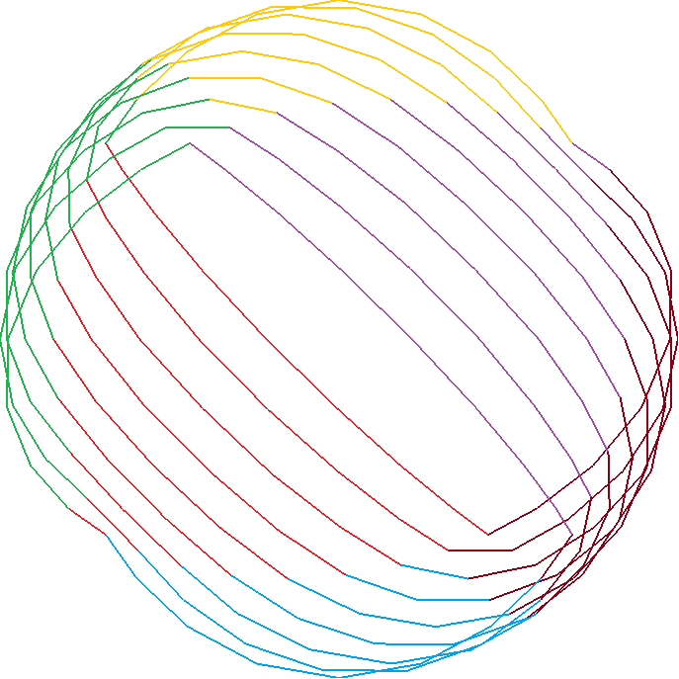
Moving around the Sphere
(using streams)

Slide 19
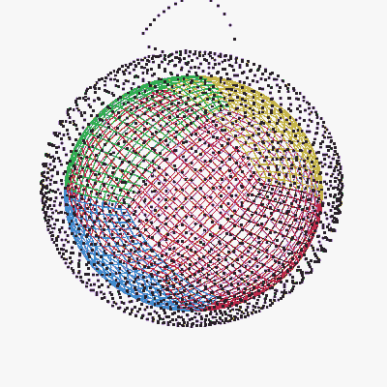
Visualization of Numerical Solution

Slide 20
Future Perspectives
Local mesh refinement
Expanding “neighbour “definitions
Changing structure from sphere to any surface
Solving real problems
Further development for testing new schemes

Slide 21
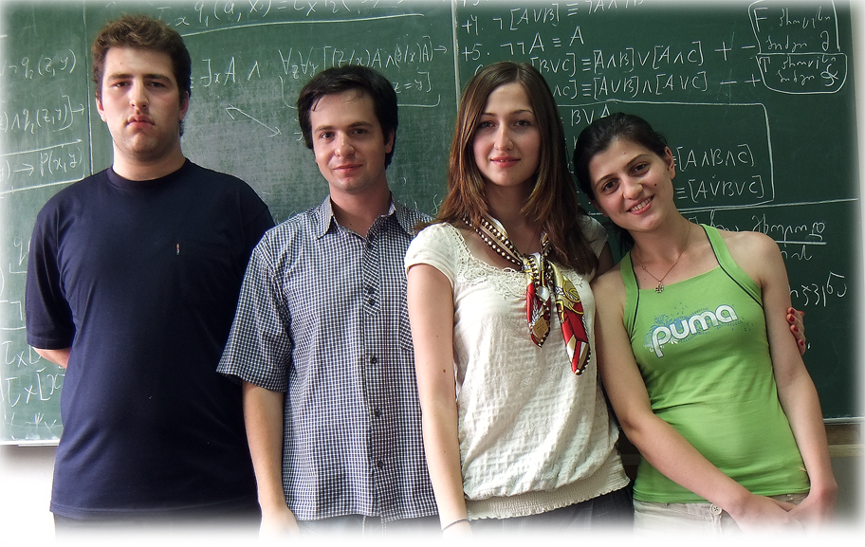
G. Rukhaia
L. Tarielashvili
M. Doliashvili
N. Nebulishvili
გმადლობთ ! Vielen Dank !

