Slide 1
Georgian - German School and Workshop in Basic Science
Electric Field-Induced Emission Enhancement and Modulation in CdSe Nanowires
Felix Vietmeyer¹, Tamar Tchelidze^{2,3},Veronica Tsou^{1,4}, Boldizsar Janko², Masaru Kuno¹
¹Department of Chemistry and Biochemistry, ²Department of Physics, University of Notre Dame, Notre Dame, Indiana 46556.
³Faculty of Exact and Natural Sciences, Iv. Javakhishvili Tbilisi State University, 0179 Tbilisi Georgia.
⁴Department of Chemistry, University of Waterloo, Waterloo, Ontario N2L 3G1, Canada

Slide 2
Georgian - German School and Workshop in Basic Science
Semiconductor nanowires, having advantages of tunable electronic structures using quantum confinement effects, are a class of materials with many powerful properties for future technologies.
High photoluminescence efficiency,
strongly linear polarized emission
significantly faster carrier relaxation

Slide 3
Georgian - German School and Workshop in Basic Science
In this work the model for explanation of phenomenon where the emission intensity NWs is enhanced and modulated by external electric field is presented.
Tangible and reversible QY enhancements of ~20% are observed in NWs emission intensities with an applied voltage ranging from -100 to 100 V.

Slide 4
Georgian - German School and Workshop in Basic Science
The effect is directly linked to field-induced changes of carrier detrapping rates from defect states responsible for non-radiative relaxation processes, namely a nanoscale Poole-Frenkel effect. Frenkel, J. Phys. Rev. 1938, 54, 647.
To more quantitatively rationalize the phenomenon, model that describes photogenerated carrier recombination dynamics (rate equation method) is applied. It is extended to account for field-enhanced carrier detrapping rates.
To define actual electric filed experienced by NW we performed traditional procedure with Poisson equation. Both external and internal (built-in) electric fields are considered in tandem to explain the observations.

Slide 5
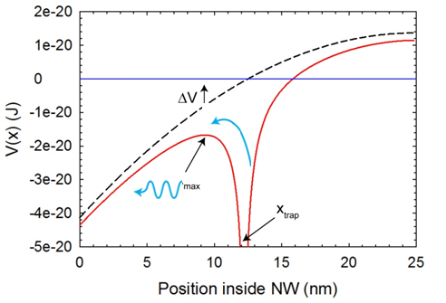
Georgian - German School and Workshop in Basic Science
Model
The key moment of the model in Pook-Frenkel effect, which connects the increase of emission intensity to increase of detrapping rate from the non-radiative relaxation centers.
R~np
An electric filed alters K_{d} detrapping coefficient by reducing barrier height. In an electric filed potential energy, which represent the superposition of the trap’s Coulomb potential with that of the NW, ϕ(x), acquires local maximum. If actual shape of ϕ(x) is known it is very easy to determine the position of this local maximum, barrier height and detrapping enhancement factor

Slide 6
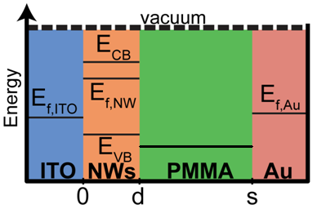
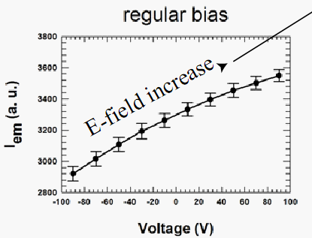
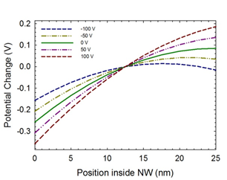
Georgian - German School and Workshop in Basic Science
Estimation of Electric field inside the CdSE NW for different applied voltage

Slide 7
Georgian - German School and Workshop in Basic Science
Conclusion
The emission sensitivity is rationalized by the field-induced modulation of carrier detrapping rates from defects sites responsible for nonradiative processes
The underlined physical mechanism is a nanoscale Pool-Frenkel effect, which lowers trap state barriers and enhances detrapping rate.
The good agreement between the theory and experiment suggests that the observed NW emission enhancement/modulation phenomenon offers insight into trapping dynamics, and can help clarify impact of defects in low dimensional materials

Slide 8
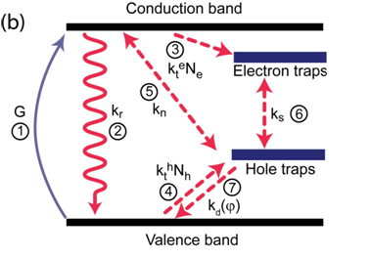
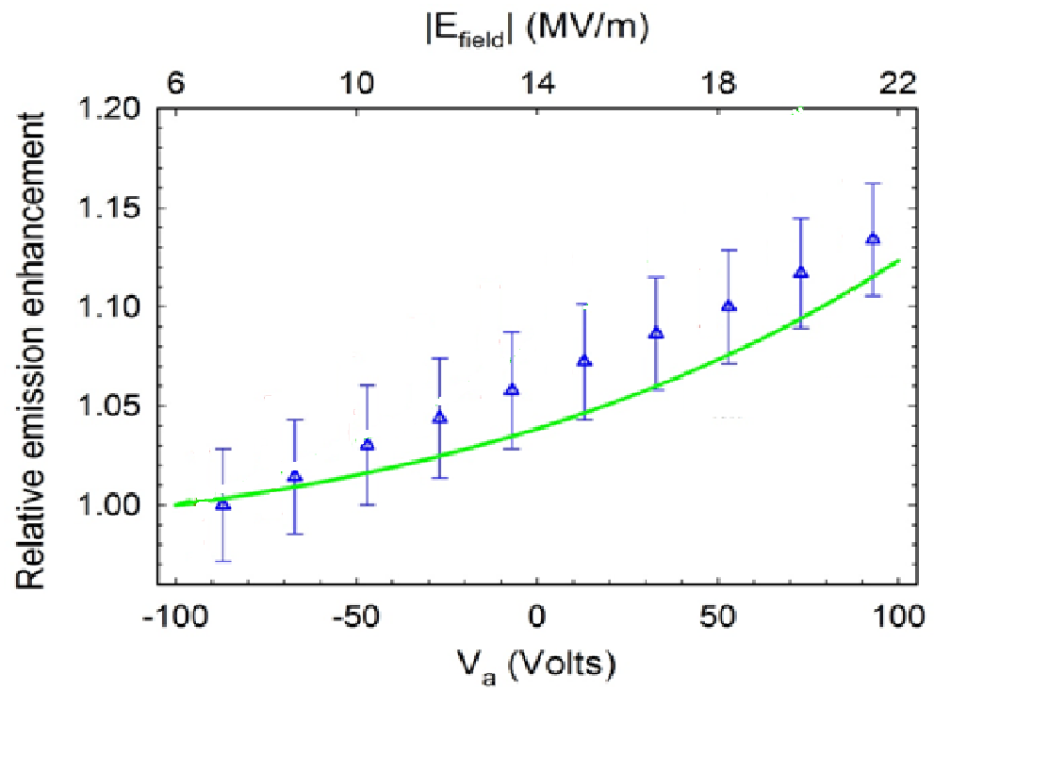
Georgian - German School and Workshop in Basic Science
Calculation of emission intensity by rate equations

Slide 9
Georgian - German School and Workshop in Basic Science
THANK YOU FOR ATTENTION !

