Slide 1

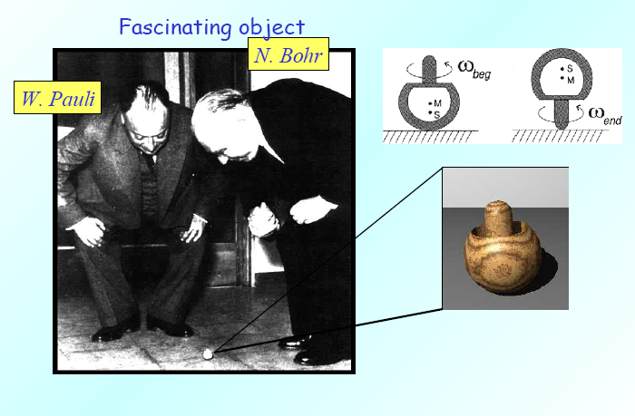
The PAX Project and HEPI TSU Contribution
Mirian Tabidze
High Energy Physic Institute of TSU
06 August, GGSWBS’12, Tbilisi.
Notes:
Why we need polarized antiproton beams and what new important information we can extract from polarized antiproton experiments?
Let me speak little about (because more details we will have in other talks) and
what contribution comes from Georgian participants, especially from HEPI TSU.

Slide 2
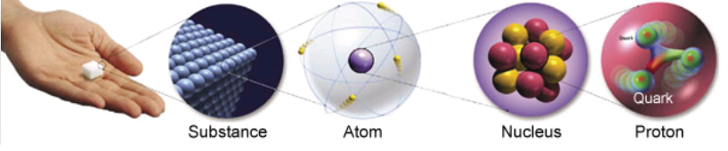
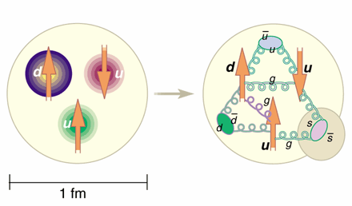
Hadron Physics
Understanding of all matter comprised of quarks and gluons
Notes:
According naïve quark model proton consist with 3 valence quark. It was expected that spin 1/2 of the proton is simply the sum of two
parallel and one antiparallel spin-1/2 quarks adding to s = 1/2. However, the real
picture of proton structure is much more complicated: the valence quarks swim in a "sea" of virtual quarks and antiquarks and
gluons, holding the quarks together. All of these contribute to the nucleon’s spin.

Slide 3
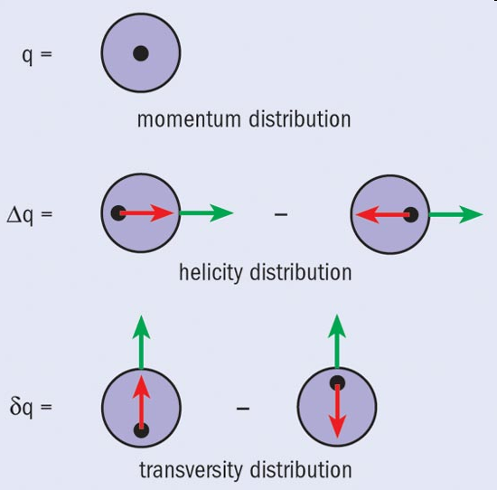
Introduction: Quark distributions
Very well known q(x) = q₊(x) + q-(x)
Well known
Δq(x) = q₊(x) - q-(x)
Largely unknown
Chirality Odd nature
Soffer inequality: q(x) + Δq(x) ≥ 2|δq(x)|
Mirian Tabidze HEPI TSU
Notes:
At leading level the quark structure of hadrons is described by three distribution functions: spin averaged q(x)=q₊(x)+q-(x), helisity ∆q(x)=q₊(x)-q-(x) and travsversity δq(x). Last two functions describe quark distribution in longitudinally and transversely polarized hadrons respectively.
q₊ /q- is the probability of finding quark with a fraction x of the longitudinal momentum and spin, parallel /antiparalel to the momentum.
If hadron is initially longitudinally polarized, quark remember hadron helisity.
In transversity basis δq(x) has similar meaning as Δq (x) but in transversely polarized hadron.
Because matrix element of δq is proportional to γ⁵ matrixes, it is chirality odd. So in order to measure δq the chirality must be flipped twice.
This three functions are related with the Soffer inequality: q(x)+ Δq(x) ≥ 2|δq(x)|.

Slide 4
Proton Spin
Mirian Tabidze HEPI TSU
Notes:
The quark transverse polarization does not mix with the gluon polarization because gluon carry out only longitudinal spin. It is reason, why it is impossible to measure δq in Deep Inelastic Scattering (DIS).
Direct measurement of transversity requires another chiral-odd partner. For example, lepton pair production when both scattered protons are transversely polarized.
//
Indirect measurement is possible in semi inclusive DIS if protons are transversely polarized, but here we have another problem – ftransversity is convoluted with unknown fragmentation function!

Slide 5
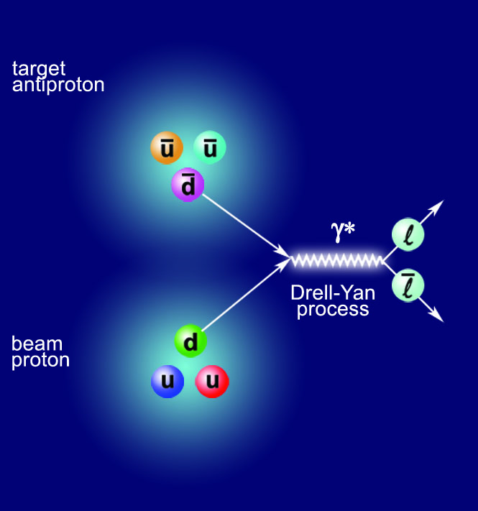
Introduction: Drell Yan
Interaction between
quark and antiquark
Direct access to “transversity“ in Drell Yan
Double transverse
spin asymmetry
Mirian Tabidze HEPI TSU
Notes:
Such a kind of process is Drell-Yan production of lepton pairs via measurement of the double transverse spin asymmetry A_{TT}.
Here a_{TT} is double spin asymmetry in elementary QED process which is well known, M ² – lepton pairs invariant mass. q – quark aroma (u, d, s ..)
For example at PAX energies (s~ 30-50 GeV, x₁x₂~ 0.2-0.3 ) A_{TT}/a_{TT}~0.2 and it is large enough to be measured.
So to measure transversity it is necessary to detect two opposite sign leptons (electron and positron) in pp-bar interaction.

Slide 6
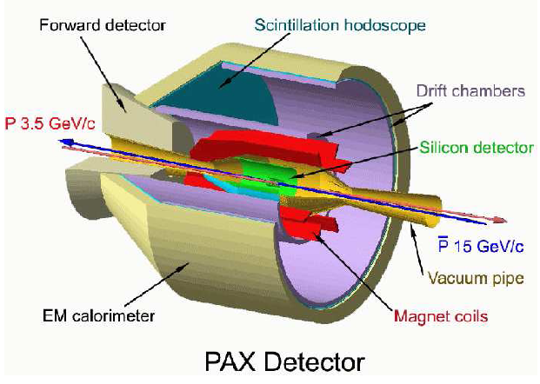
PAX DETECTOR: Artists view
Notes:
PAX experiment in collider mode looks like: GEANT4 figure of PAX detector from Gogi Macharashvili.

Slide 7
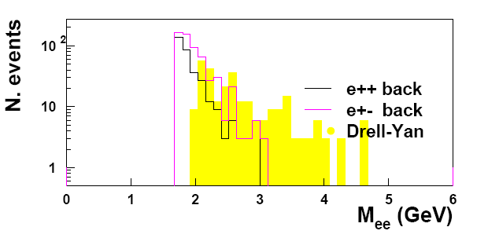
Drell-Yan signal and background
*
Notes:
Drell-Yan signal (yellow) and background; main background channel is pi0->gamma, e+e-
Whan only two lepton was detected from different pi0 decay (small energy, but large opening angle).
4 · 10^9 pp interactions generated according PITHYA event generator: by GM and myself.
The background below 1.5 GeV/c2 is not shown since it is vetoed by the trigger.
Problem: Polarized antiproton beam never produced yet.

Slide 8

Polarisation
For an ensemble of spin ½ particles with projections + (↑) and – (↓)
σ(↑↑) ≠ σ(↑↓)
Mirian Tabidze HEPI TSU
Notes:
But we are able to use unique possibility of storage rings: Any spin-dependent losses filters spin of the stored beam.
There are two processes:
Selective loss - discard one sub-state more than the other. Purely hadronic interaction, for example pp elastic scattering.
Selective flip - reverse one sub-state more than the other.
Both methods involve long beam lifetime and long polarization lifetimes!

Slide 9
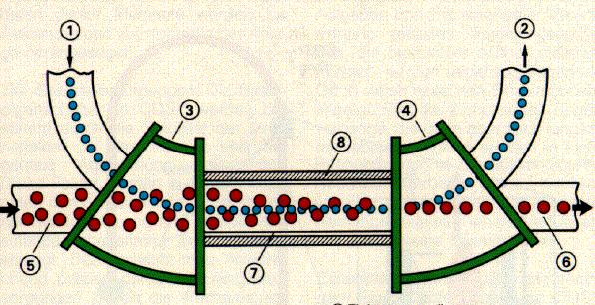
Spin Flip
Do polarised electrons (positrons) polarise a proton (anti-proton) beam ?
Polarised positron beam
Idea:
Velocity mismatch Δv/c ~ 0.002
Un-polarised anti-proton beam
Polarised anti-proton beam
Spin transfer
How to check this idea with the existing experimental facilities?
Mirian Tabidze HEPI TSU
Notes:
Do polarized electrons polarize a proton beam?
Idea is in following: lets we have unpolarized proton beam, circulating in storage ring and co-moving polarized electrons (for example from electron cooler ) with very small relative velocity.
In principle in this strict section spin transfers from electron to proton is possible and if cross section of this process is large enough at the and we will get polarized proton beam.
How to check this idea with the existing experimental facilities?

Slide 10
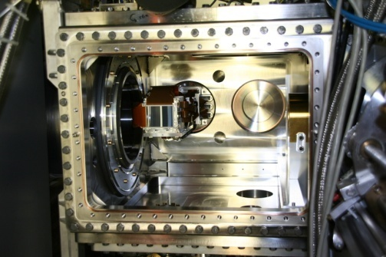
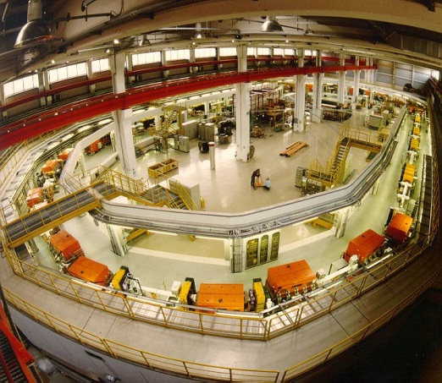
Spin Flip: Depolarisation study at COSY
Use (transversely) polarised proton beam circulating in COSY
Switch on electron cooler to depolarise proton beam
Analyze proton polarisation with internal D₂-cluster target of ANKE
ANKE cluster target & STT
e-cooler
p
T_{p} = 49 MeV
COSY
circumference 184 m
Mirian Tabidze HEPI TSU
Notes:
Experiment idea was in following:
use transversely polarized proton beam circulating in COSY ring;
Switch on electron cooler to depolarize proton beam;
Analyze proton polarisation with internal deuteron-cluster target of ANKE .
We used pd elastic scattering to measure proton polarization, because analyzing power of this reaction at 49 MeV is high (~.4).
For particle detection we used ANKE Silicon Tracking telescopes system (STT).

Slide 11
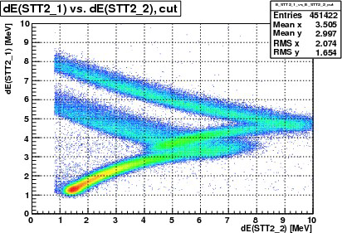
Spin Flip: Depolarisation study at COSY
pd elastic scattering:
detection in two (L-R) symmetric Silicon Tracking Telescopes
Deuteron identification
d
p
Mirian Tabidze HEPI TSU
Notes:
In left panel we can see ANKE vacuum chamber with STT system.
Each STT has three layer and was placed for both, Left and Right side of the cluster target.
Red horizontal line is proton beam; blue vertical line is deuteron cluster target.
All simulations for geometry optimizations and energy deposit calibration was done myself using GEANT framework.
At the right panel energy deposit in I layer versus energy deposit in second one is shown.
Top bands corresponds to stopped particles in second layer.
Above this red arrow, we can separate deuteron and proton with high accuracy.
L=2.5 10²⁸

Slide 12
Spin Flip: Depolarisation study at COSY
D.Oellers et al., Physics Letters B 674 (2009) 269
Ratio of beam polarisations with
and without electron beam during
interaction cycles:
Upper limit for
longitudinal and transverse
spin-flip cross section:
Cross section much too small to be a useful method !
10¹³ b
Mirian Tabidze HEPI TSU
Notes:
At the left panel ratio of beam polarisations with and without electron beam during interaction cycles was shown.
The R was measured for fife different values of relative velocity. The ratio within errors is close to unity.
Estimated spin-flip cross section (right panel) is fare from calculated one (10⁷ versus 10¹³) and much too small to be a useful method!
HEPI STU contributed in all stages of experiments:
preparation phase including simulations to optimize detector setup;
conducting experiments, data analyses;

Slide 13
Spin Filtering
P beam polarization
Q target polarization
k || beam direction
σ_{tot} = σ₀ + σ₁·P·Q + σ₂·(P·k)(Q·k)
For initially equally populated spin states: ↑ (m=+½) and ↓ (m=-½)
Transverse
case:
Longitudinal
case:
Unpolarised anti-p beam
Polarised target
Mirian Tabidze HEPI TSU
Notes:
In general total hadronic cross section consists of three terms: total spin independent hadronic cross section σ₀ and two spin dependent cross sections σ₁ (Transverse) and σ₂(Longitudinal).
For initially equally populated spin states this expression simplified : transverse case and longitudinal case.
Lets we have transversely polarized internal target and circulating proton beam.

Slide 14
Spin Filtering
P beam polarization
Q target polarization
k || beam direction
σ_{tot} = σ₀ + σ₁·P·Q + σ₂·(P·k)(Q·k)
For initially equally populated spin states: ↑ (m=+½) and ↓ (m=-½)
Transverse
case:
Longitudinal
case:
Unpolarised anti-p beam
Polarised target
Mirian Tabidze HEPI TSU
Notes:
Spin states with spin down kicked out often, then states with spin up.

Slide 15
Spin Filtering
P beam polarization
Q target polarization
k || beam direction
σ_{tot} = σ₀ + σ₁·P·Q + σ₂·(P·k)(Q·k)
For initially equally populated spin states: ↑ (m=+½) and ↓ (m=-½)
Transverse
case:
Longitudinal
case:
Polarised anti-p beam
Polarised target
Mirian Tabidze HEPI TSU
Notes:
At the end after multiple passage trough polarised internal target stored beam is polarising.

Slide 16
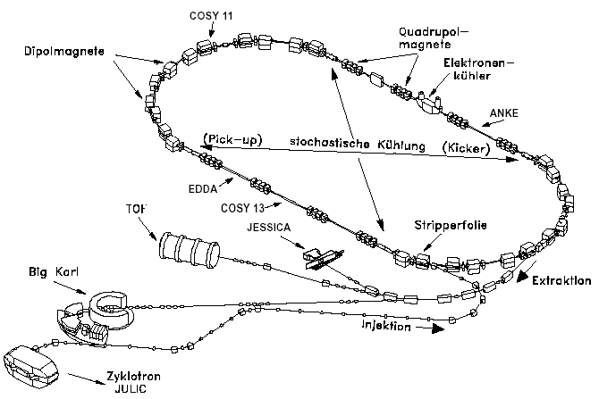
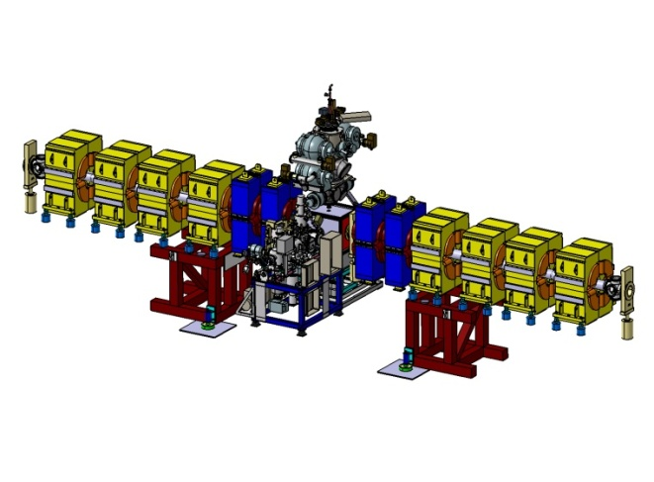
Spin Filtering: PAX at COSY
WASA
e-cooler
Low-ß section:
Quadrupoles
ABS (SC, BRP)
COSY
ANKE
PAX
TOF
Mirian Tabidze HEPI TSU
Notes:
Firs stage: spin filtering study at COSY using storage cell target.
The target density depends strongly on the transverse dimension of the storage cell. In order to minimize β-function at the storage cell, a special insertion has to be prepared, which includes additional 4 quadrupoles around storage cell.
In August 2011 Spin Filtering at COSY was successfully performed
(~11000 sec beam lifetime without pax target ~8000 sec with target, large polarization lifetime ~ 2.5x10^5 sec): principle works!
(more details by Christian Weideman).
HEPI STU contributed in all stages of experiments:
preparation phase including simulations to optimize detector setup;
conducting experiments, data analyses;
Geometrical COSY acceptance ~ 40 π mm mrad.

Slide 17
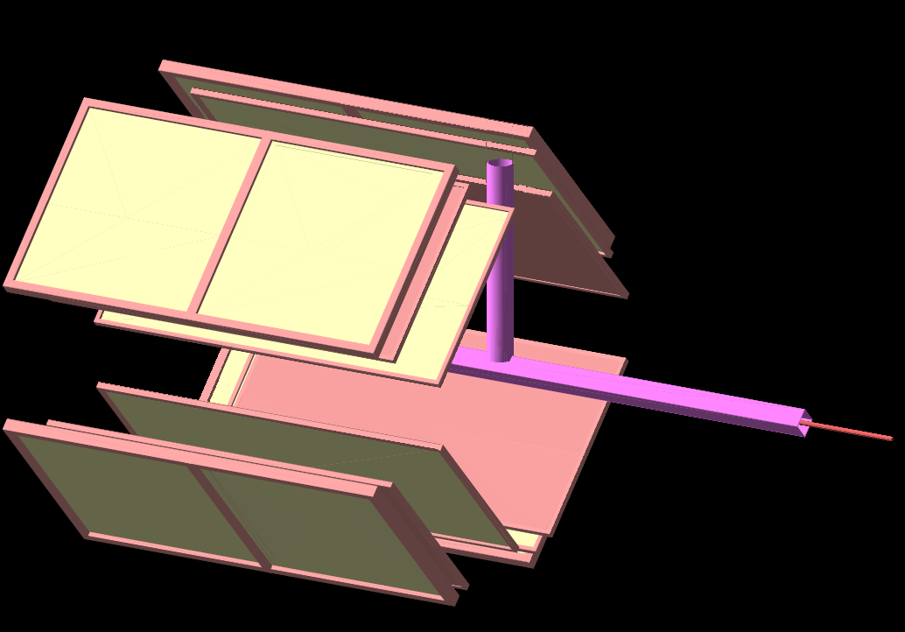
Skeleton view of new detector setup for SF
Notes:
Cell target with silicon strip detectors around: four quadrant with three layer silicon strip detectors in each quadrant.
All simulations to optimize detector positions, to estimate event rates, detector occupancy, ratio of detected signals etc.
was made myself in GEANT4 framework.
As a by product we can investigate deuteron break up reaction at low energy (45-60 MeV), which is important to test
predictions Chiral Perturbation Theory – Effective Field Theory of strong interaction and
also to estimate contribution of three nucleon forces.
In 2011 dedicated BUP proposal also was submitted to Juelich PAC. HEPI TSU also participates in this investigations.

Slide 18
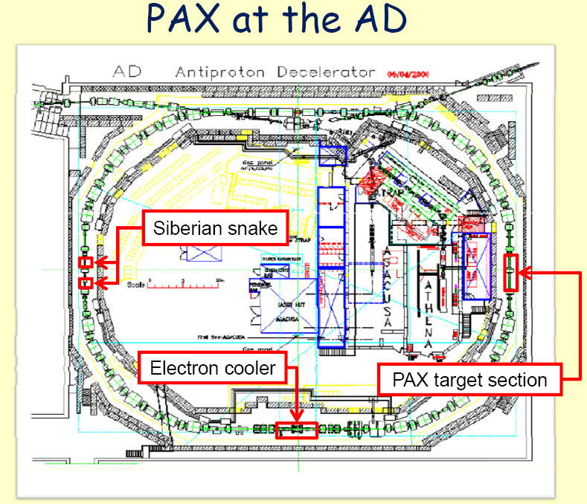
Notes:
On this slide skeleton wiev of CERN AD was shown.
Target section we can move from COSY after full testing and commisioning, but we need open-able storage cell because uncooled
beam size is bigger than storage cell dimensions.
At this moment - under construction.
The low β-section should be includes additional 6 quadruples.
It is necessary to upgrade existing electron cooler from 30 keV to 300 keV.
In order to determine σ₂, , in the straight section opposite the PIT, a solenoidal Seberian snake must be implemented.
Time table:
Unknow!

Slide 19
PAX Georgian Participants
HEPI TSU Bagdasarian Zara (PhD), Lomidze Nodar,
Mchedlishvili David (PhD), Nioradze Mikheil,
Tabidze Mirian.
IKP Jülich Kacharava Andro, Chiladze David (PosDoc).
JINR Dubna Macharashvili Gogi.
Mirian Tabidze HEPI TSU
Notes:
Eight Georgian Physicist from different European research centers participates in this experiments, five from HEPI TSU;
We have one Pos.Doc and two Ph.D students.

Slide 20
Summary
Outstanding physics potential of polarized antiprotons
Very small cross-section for Spin Flip
Spin Filtering seems to be the only way
Investigations on Spin Filtering at COSY with transversely polarized target was done successfully (August 2011).
Next step spin filtering at COSY with longitudinally polarized target (2014/2015).
Next: Design of Antiproton Polariser Ring (APR?).
Finally: asymmetric p-pbar collider (3.5-15 GeV/c) at FAIR.
Notes:
Successful end of spin filtering at any antiproton ring (AD?) will make a green light for the next steps:
Next: Design of Antiproton Polariser Ring (APR),
Finally: asymmetric p-pbar collider (3.5-15 GeV/c) at FAIR.

Slide 21
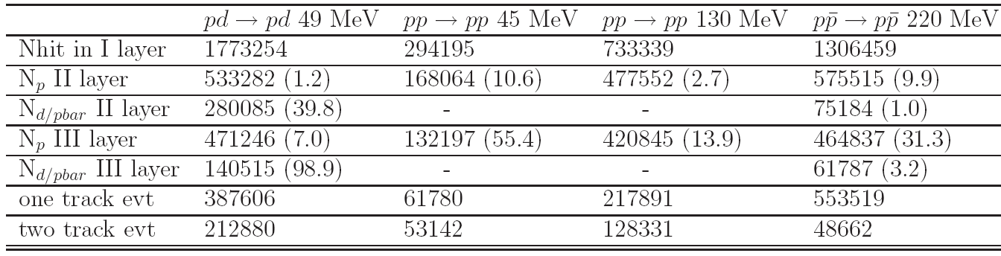
Simulation results of SF
Notes:
Simulation results: for each case two million events was generated according differential cross section shape.

