Slide 1
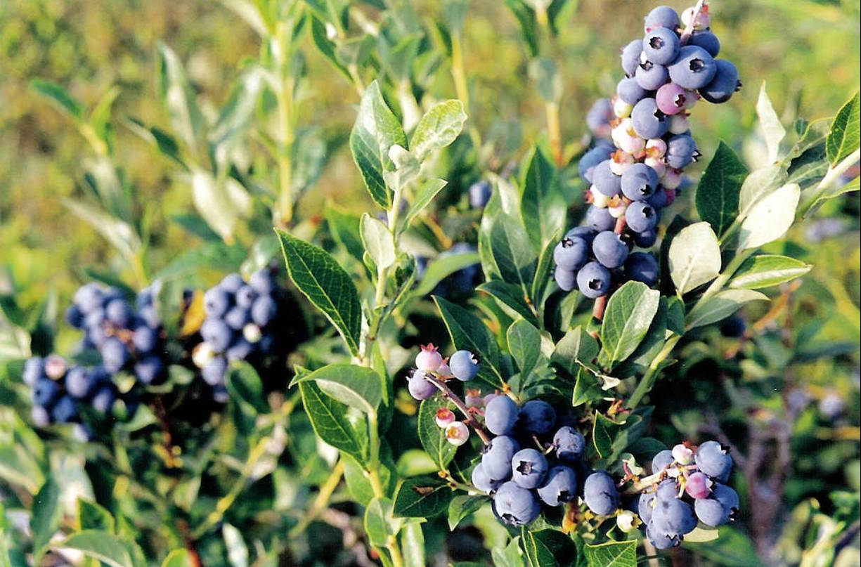
The Biodiversity of Genus- Vaccinium, Creation and Development of Its Genebank
Liana Koiava, PhD student
Email:liaka555@gmail.com
Mob: 593 32 00 11
Batumi, Georgia, August 13 – 17, 2012

Slide 2
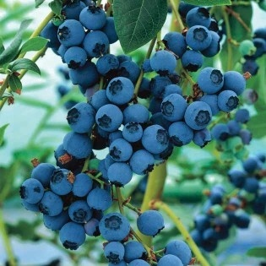
What is a Blueberry ?
Why are they significant plants
?

Slide 3
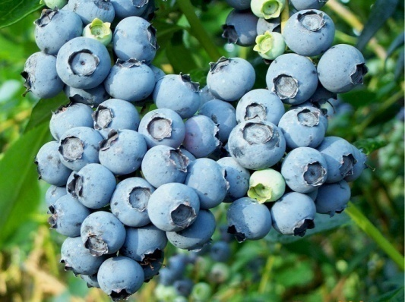
Scientific classification
Kingdom: Plantae
Division:Magnoliophyta
Class:Magnoliopsida
Order: Ericales
Family: Ericaceae
Genus: Vaccinium

Slide 4
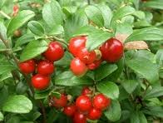
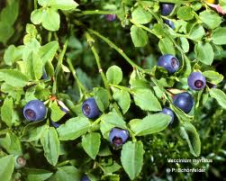
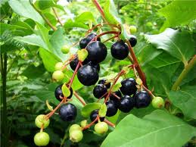
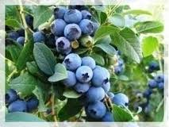
The following species of berry occur in the various ecosystems of Georgia
Deciduous berry – V. Myrtillus
High berry – V. Arctostaphylos
Red berry – V. Vitisidaea
Blue berry - V. Uliginosum

Slide 5
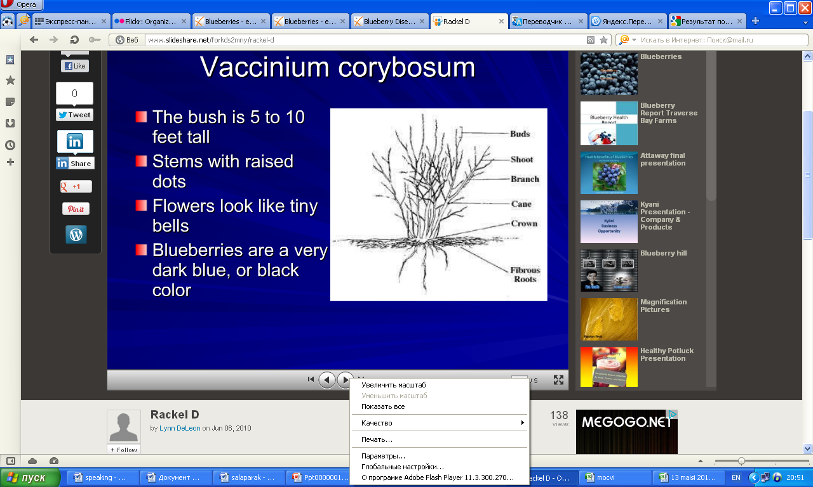
Morphology of Vacinium

Slide 6
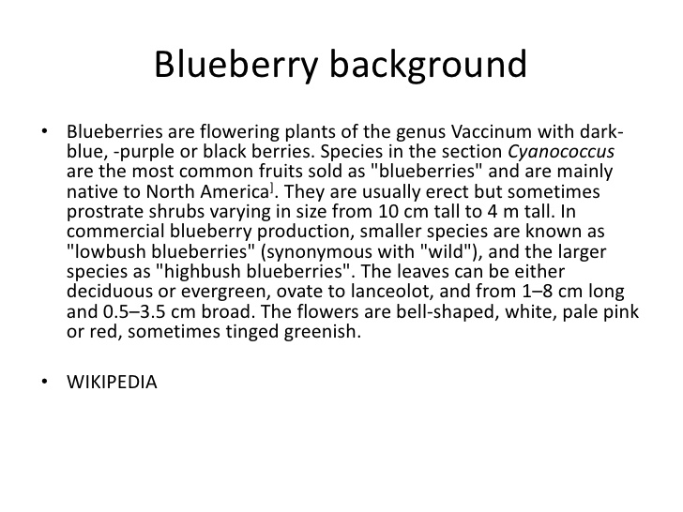
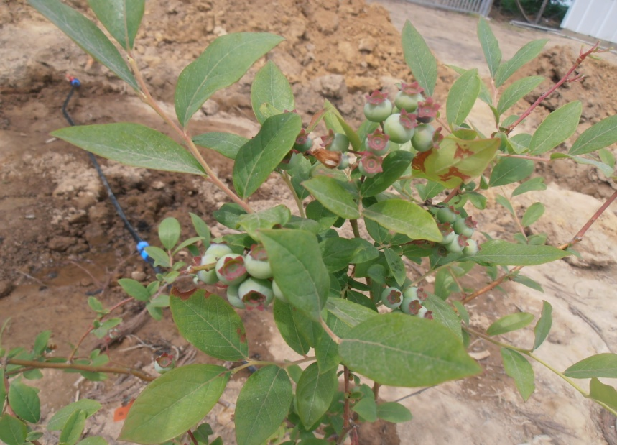
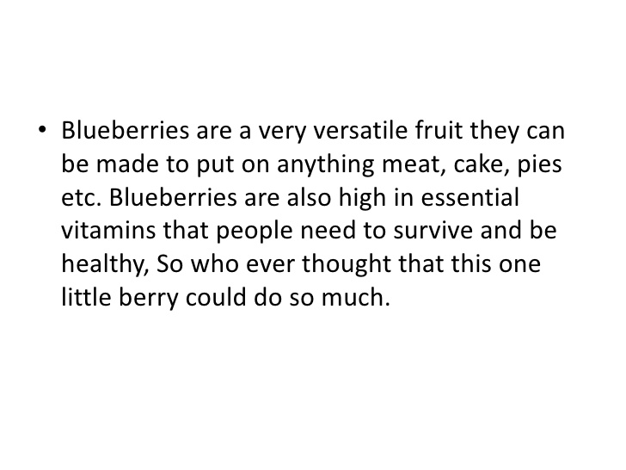
Blueberry background

Slide 7
Usage and popularity
Blueberries have gained increased attention because of beneficial components in them. The components are strong antioxidants that can delay components development of chronic disease and ageing.
the antioxidants compounds give blueberry their blue color
The consumption of blueberries has risen by about 1.6 time in the last ten years

Slide 8
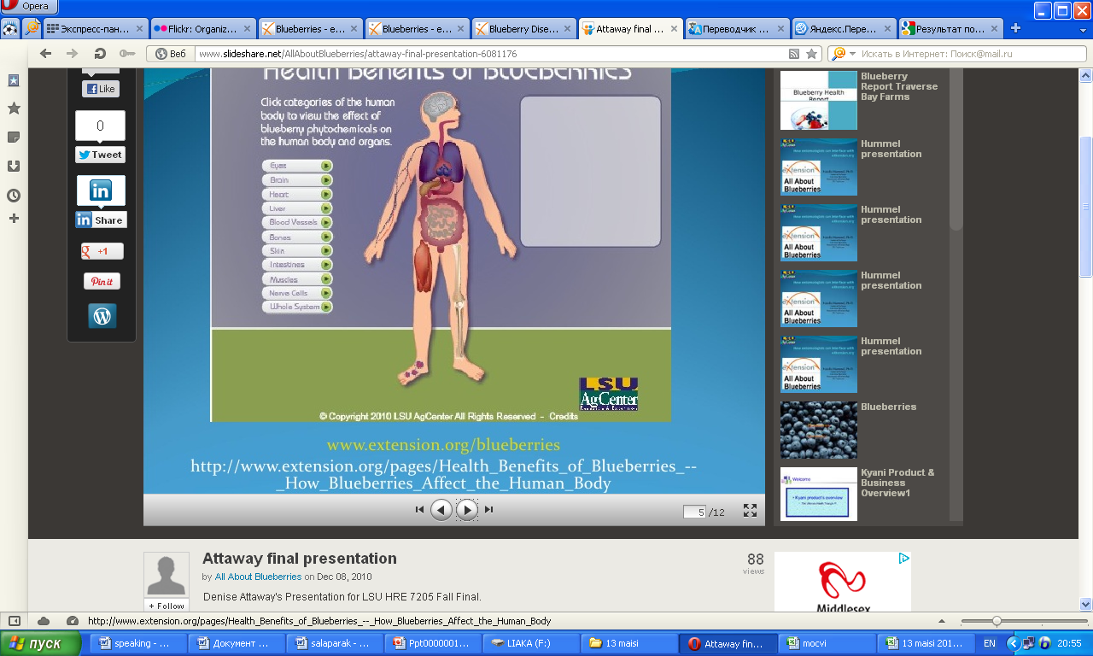
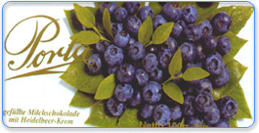
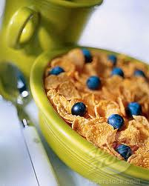
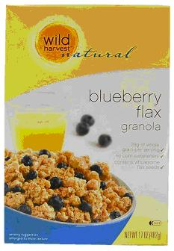
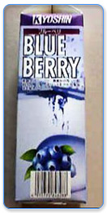
Why is blueberry important?
The medical importance
The economic importance
The importance of food

Slide 9
Health benefits of blueberries
Blueberries have many phytochemicals that have healthful properties. These compounds act as:
Antioxidants
Anticancer
Anti-neurodegerative
Anti-inflammatory
because of these properties recent researches have shown that blueberries have beneficial effects against chronic diseases. Blueberry antioxidants benefit many organs systems in the body.

Slide 10
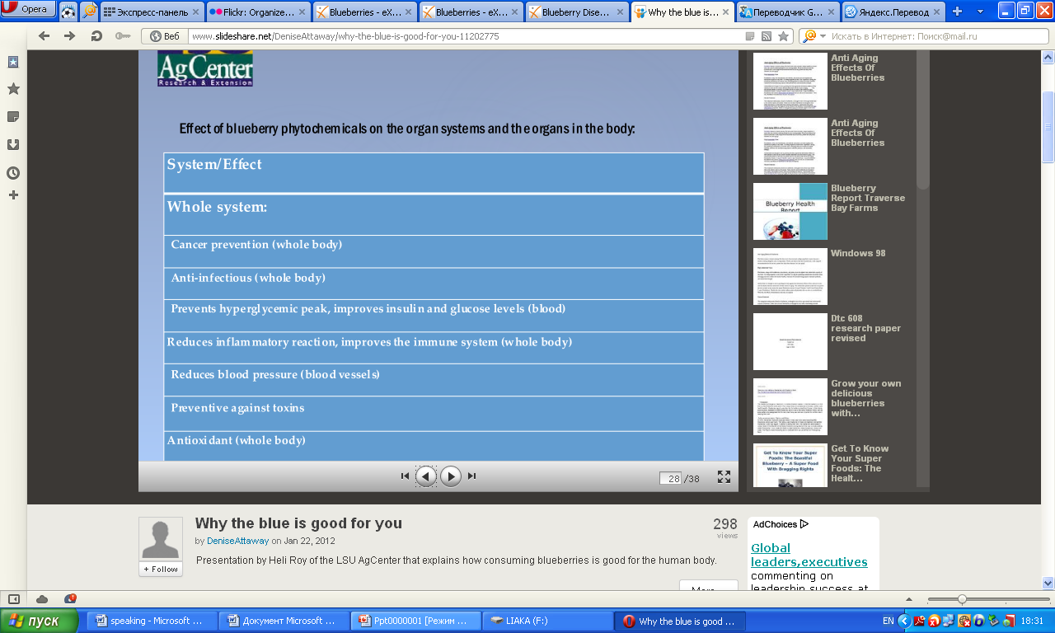

Slide 11
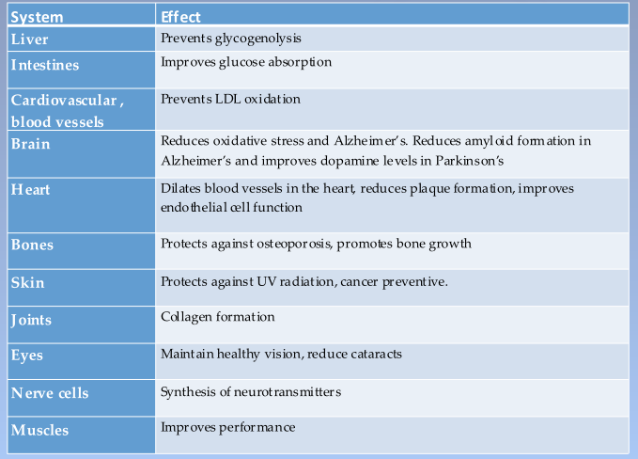

Slide 12
The demand for blueberry is increasing annually at the world market because of its consumption is much more than production. Hence, studies on the improvement of fruit processing technology and the care- growth of introduced berry have begun.
Production of blueberry in the world, 2004 FAO
Total area :65 000 ha
total production: 238 000 tones

Slide 13
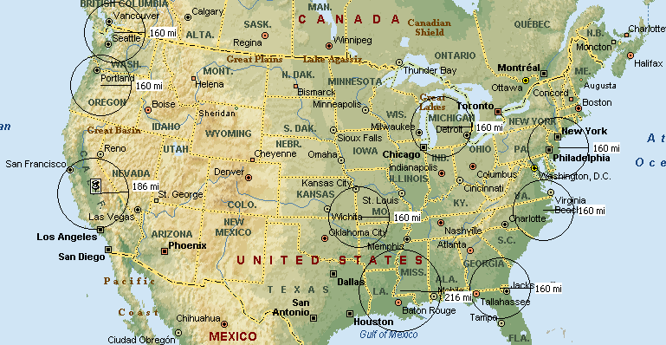
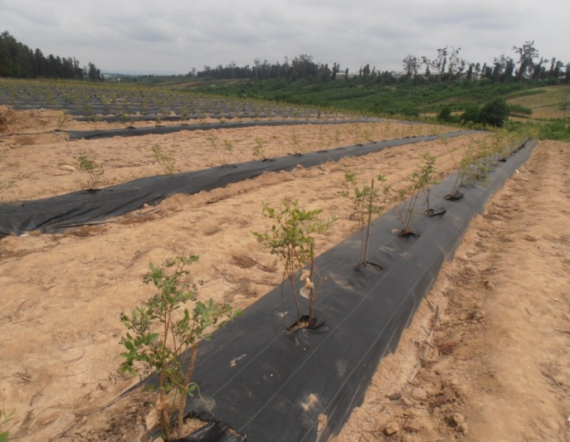
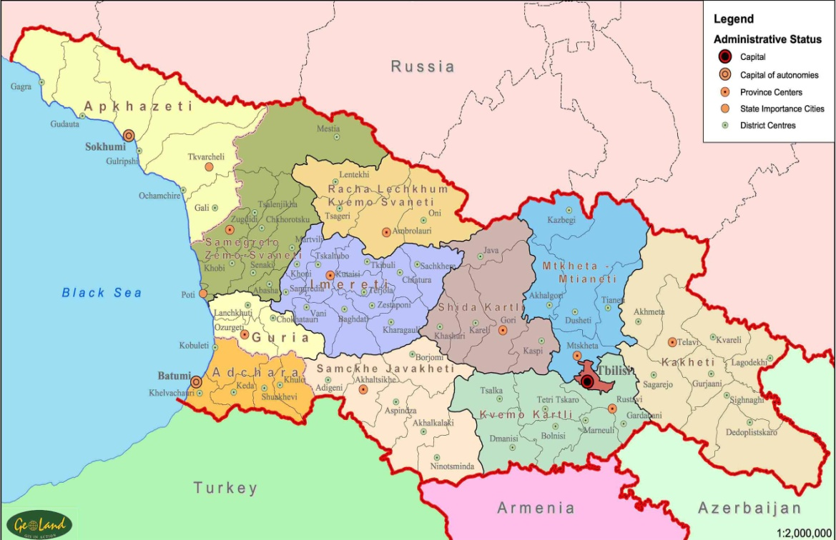
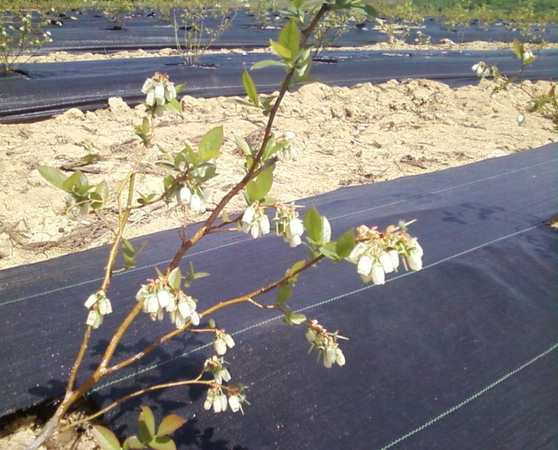
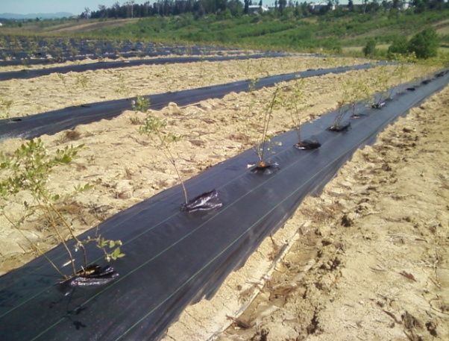
Zugdidi
Blueberry ‘s local area in Georgia
KobuleTi
OzurgeTi

Slide 14
Blueberry varieties
chandleri
oneal
earlyblu
Misty
Reka
Bluecrop
'Legacy
Bluaray
blugordi

Slide 15
Disease­causing “agents”
Fungi
Abiotic factors
Phytoplasmas
Viruses
Parasitic plants
Bacteria
Nematodes
Unknown

Slide 16
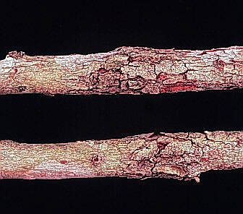
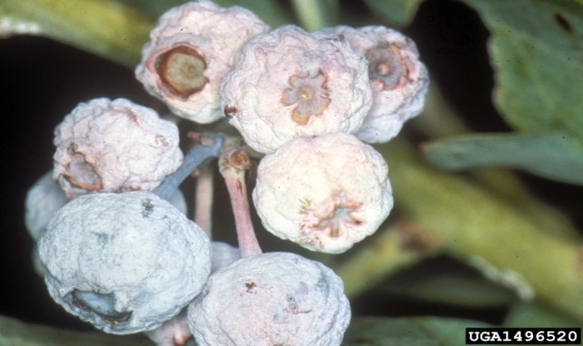
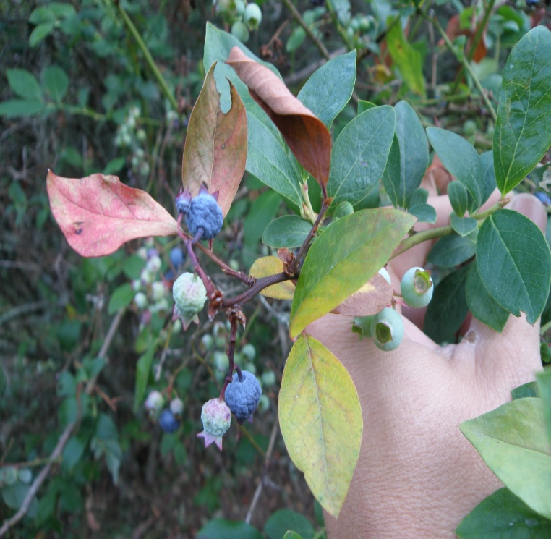
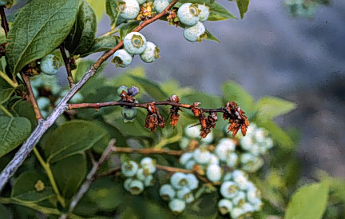
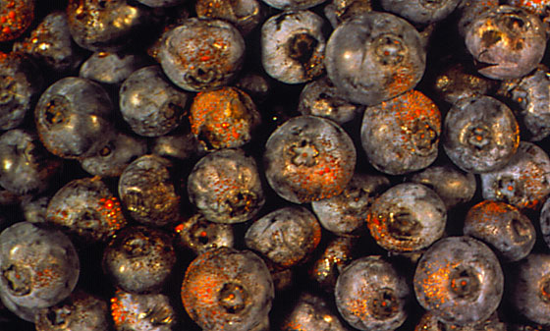
Some Important Fungal Diseases
Stem canker
Stem blight
Stem canker
Stem blight
Mummy berry
Twig blight
Fruit rots
Leaf spots
Root rots
Botrytis blight
Rust, Mildew
Others
Twig blight
Botrytis blight

Slide 17
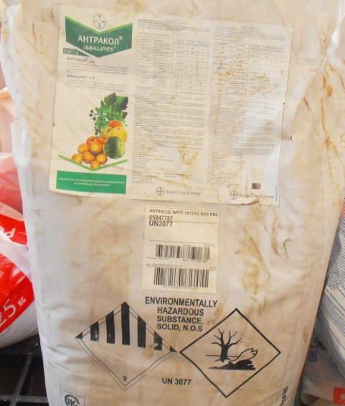
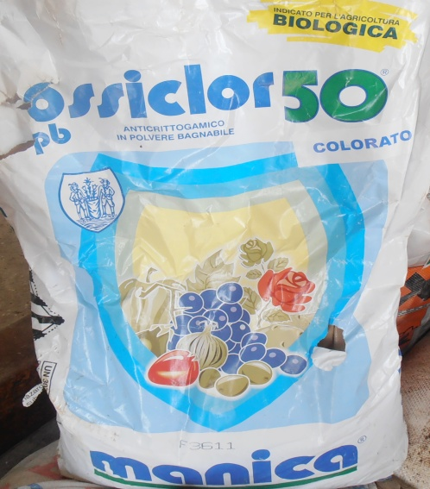
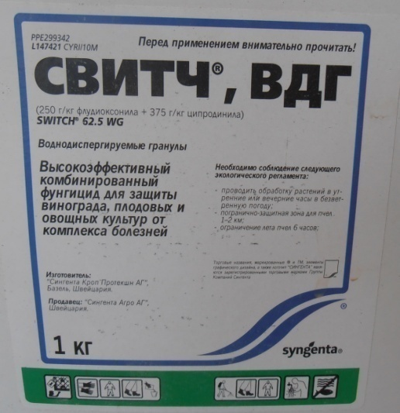
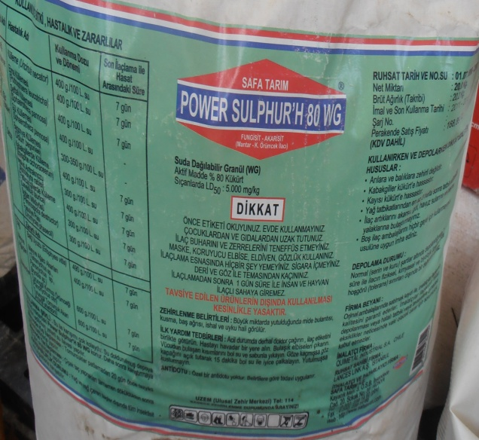
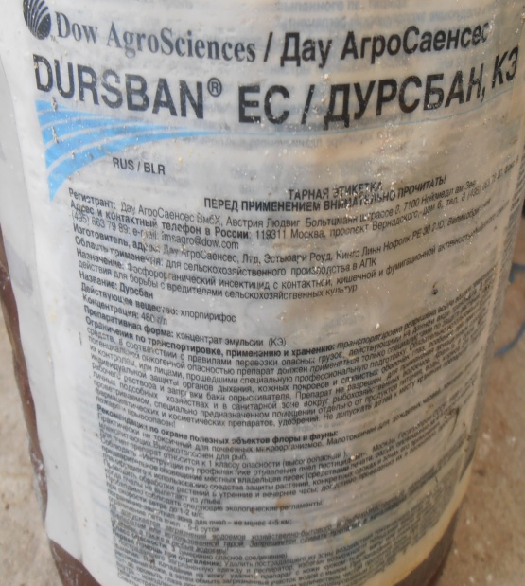
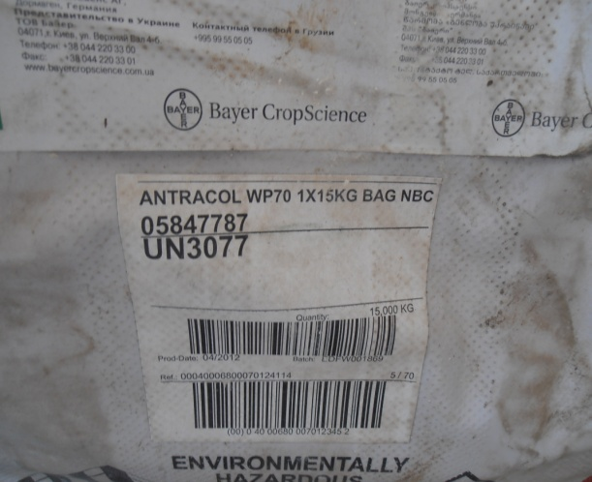
treating chemicals

Slide 18
The goals of research:
To search and catalogue the geneplasma of wild and cultural species of biodiversity;
The areal, state, bio-morphological research;
The creation of data bank of present ethno-pharmacological peculiarities

Slide 19
Main Steps:
The study of biological peculiarities of genus Vaccinium;
Phenological stages and physiological mechanisms of genus –Vaccinium;
Quality level of raw material of genus Vaccinium, its productivity, content of heavy metals in plant and soil;
Diseases and pests of genus –Vaccinium

Slide 20
Results:
I have studied the spreading of Blueberries to the different region of Georgia;
I have studied species of blueberry in Georgia;
I have done the phenological description

Slide 21
The heavy metal content in the leaves of Vaccinium arctostaphylos has been defined
N | Elements | Content kg/g ppm
1 | Nickel | 0,43
2 | Copper | 6,47
3 | Zinc | 36,17
4 | Selenium | 0,38
5 | Bromine | 2,68
6 | Cadmium | 0,21
7 | Strontium | 21,97
8 | Mercury | 0,01
9 | Bullet | 0,44
10 | Rubidium | 7,01

Slide 22
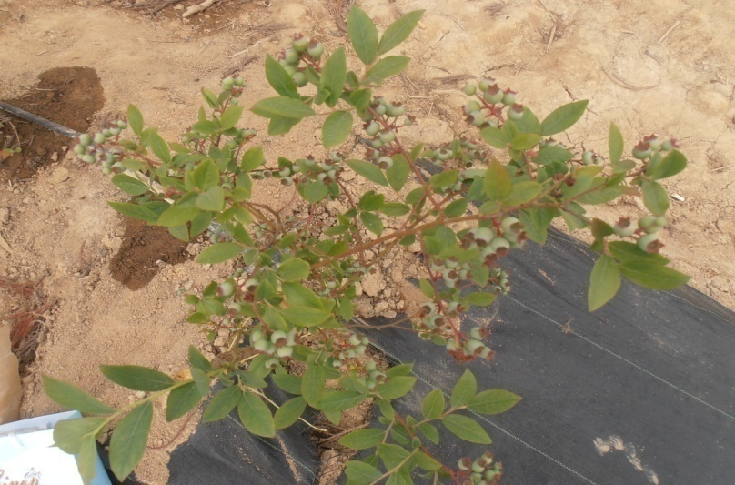

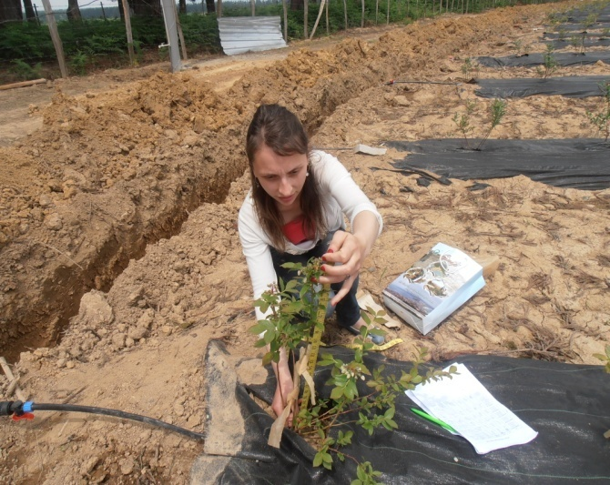
F
Description of the phenology
kobuleTi

Slide 23

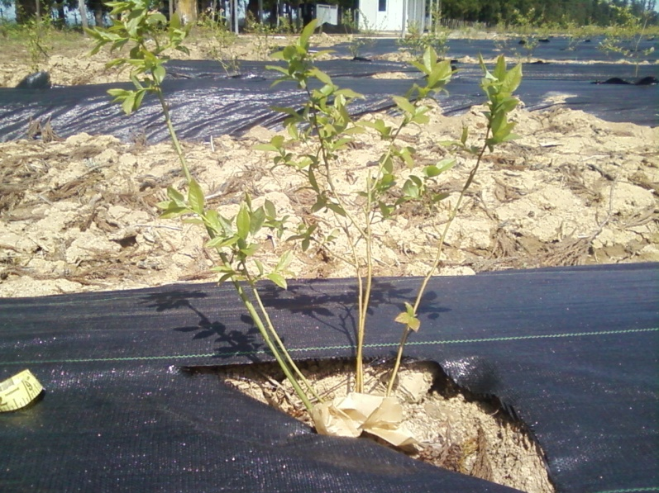
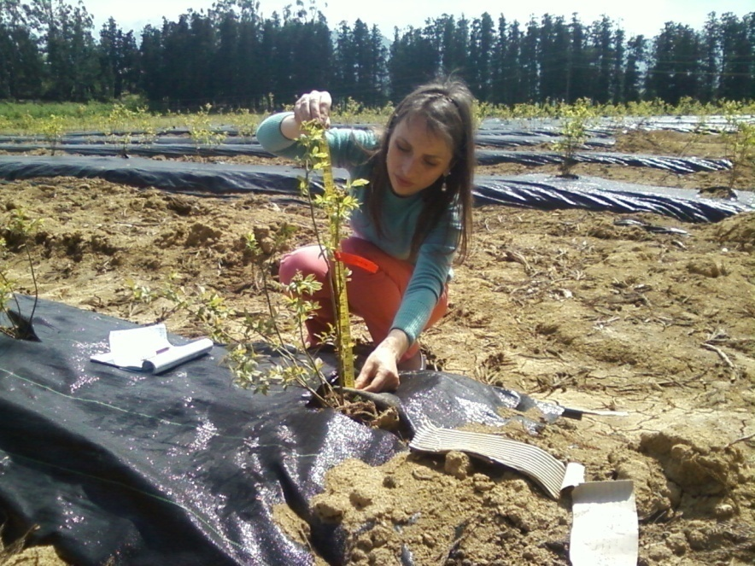
Ozurgeti

Slide 24
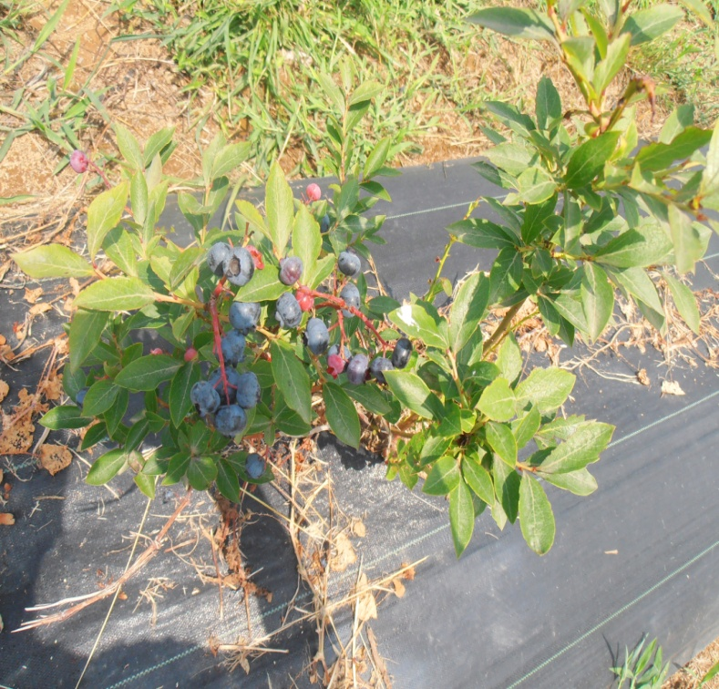
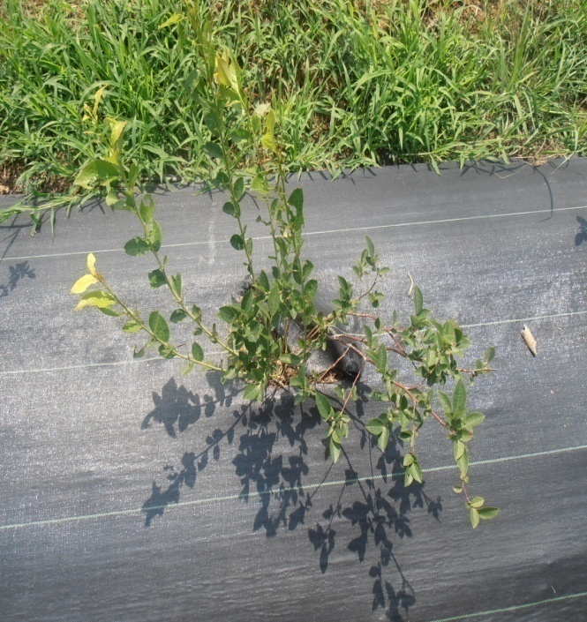
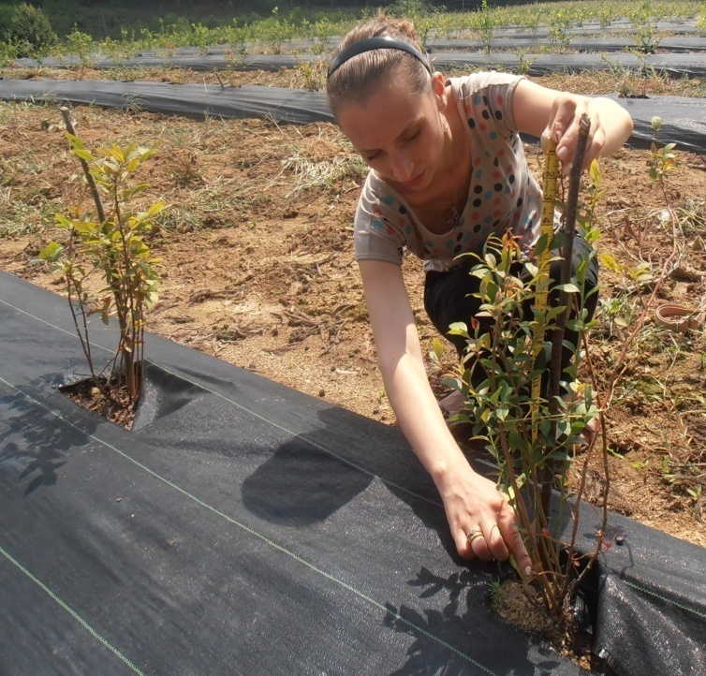
Zugdidi

Slide 25
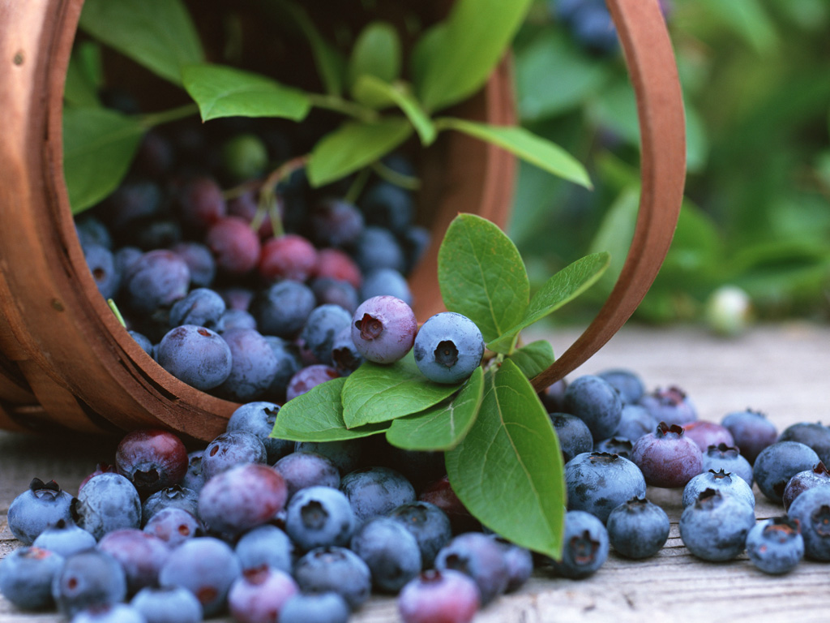
Thank you

