Slide 1
Topical lecture:
Quantum Size Effects in Nanostructures
A. Tavkhelidze
Ilia State University

Slide 2
Contents
Quantum mechanical tunneling and applications
Quantum wells and super lattices
Quantum wires and quantum dots (applications)
Carbon nanotubes
Graphene

Slide 3
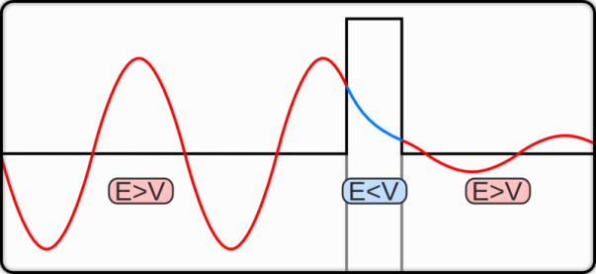
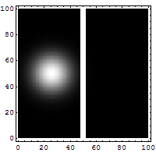
Quantum mechanical tunneling
Where hbar is the Plank’s constant, d is barrier width, m is the electron mass, and U is the height of the potential barrier.

Slide 4
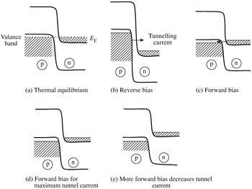
Tunnel diode

Slide 5
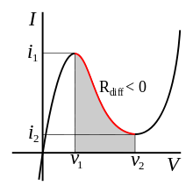
I-V characteristic of forward based tunnel diode
Applications for tunnel diodes included local oscillators for UHF television tuners, trigger circuits in oscilloscopes, high speed counter circuits, and very fast-rise time pulse generator circuits.

Slide 6
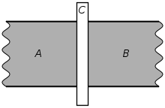
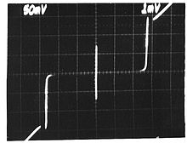
Josephson juction
Main applications:
SQUIDs
Millimeter wave detectors and mixers
Voltage standards

Slide 7
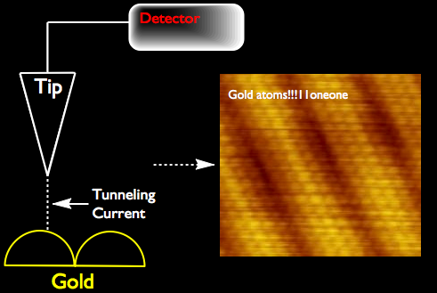
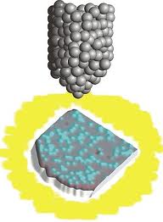
Scanning tunneling microscope (STM)

Slide 8
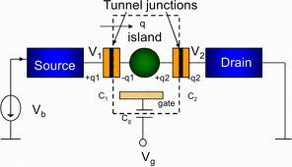
Coulomb blockade
T<1 K

Slide 9
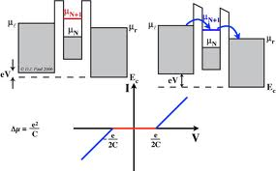
Single electron transistor

Slide 10
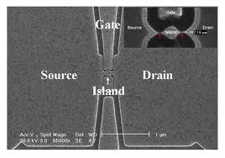
Single electron transistor

Slide 11
Problem 1
Why samples are cooled down in the scanning tunneling microscope?

Slide 12
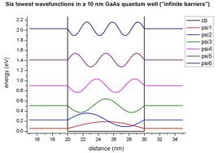
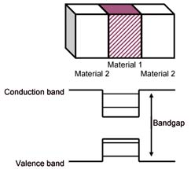
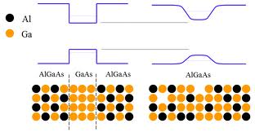
Quantum wells and super lattices

Slide 13
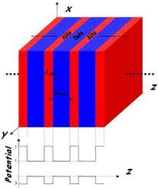
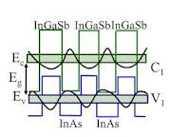
Super lattice

Slide 14
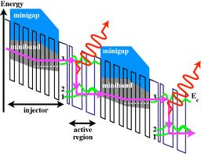
Quantum well applications

Slide 15
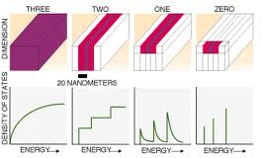
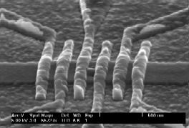
Quantum wires and dots

Slide 16
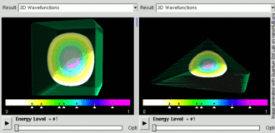
Electron inside the quantum dot

Slide 17
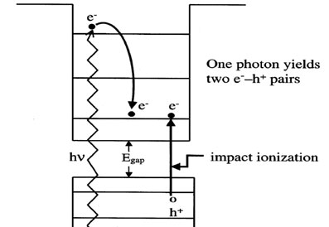
Quantum dot solar cell

Slide 18
Problem 2
Why electron wave function should equal to zero at the object boundary?

Slide 19
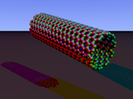
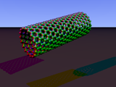
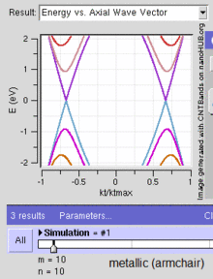
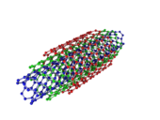
Carbon nanotubes
Armchar
Zigzag
Triple-walled armchair

Slide 20
Carbon nanotube propertyes
Carbon nanotubes are the strongest and stiffest materials yet discovered in terms of tensile strength and elastic modulus respectively
Standard single-walled carbon nanotubes can withstand a pressure up to 24GPa without deformation.
All nanotubes are expected to be very good thermal conductors along the tube, exhibiting a property known as "ballistic conduction", but good insulators laterally to the tube axis.

Slide 21
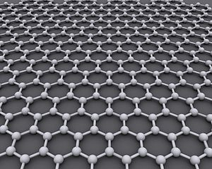
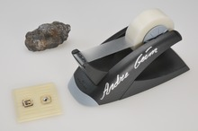
Graphene
Carbon carbon bond length 0.142 nm
Interplanar spacing 0335 nm
The Nobel Prize in Physics for 2010 was awarded to Andre Geim and Konstantin Novoselov at the University of Manchester "for groundbreaking experiments regarding the two-dimensional material graphene

Slide 22
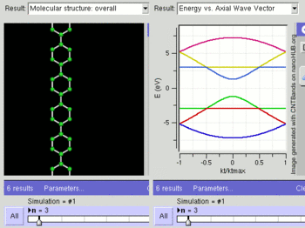
Band structure of for arm-chair orientation

Slide 23
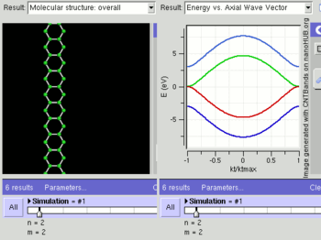
Band structure of for zig-zag orientation

Slide 24
Problem 3
Why such hard material as graphite in your pencil easily transfers to the paper when you write?

Slide 25
Thank you for attention!

